Slide 1
THREE-MODEL COMPARISON | AUGUST 2026
Current operational (v12.5.0) vs recommended (v12.9) vs OSM-ACD v2.26.1
An independent re-benchmark on MagPlot and recent Maine FIA, all metrics on FIA NSVB, comparing what is running in production today against the recommended forward version.
Aaron Weiskittel
Center for Research on Sustainable Forests, University of Maine
Prepared for C. Hennigar | after Hennigar and Weiskittel, ECANUSA 2018

Slide 2
WHAT IS BEING COMPARED
Three models, three roles, one question
v12.5.0 (current operational) What is actually running in production today. No ESI, no NSVB, no coupled self-thinning. The baseline everything else is measured against.
v12.9 (recommended) Built on the 2018 to-do list (Kuehne 2022 growth base, ESI v8 site driver, coupled self-thinning, FIA NSVB) plus a targeted fix for the one remaining structural gap. Not yet deployed; this is the case for moving to it.
OSM-ACD v2.26.1 The 2018 external benchmark, same Acadian equation family, independently calibrated (BGI, 2015 to 2018). Confirmed current release, checked against OSM-Contributors GitHub and the Forus Research download page.

Slide 3
DATA COMPILED
Independent, in-domain, all volume and biomass on FIA NSVB
MagPlot NB 355 remeasurement pairs, in-domain Canadian CFI, independent of the fitting data.
MagPlot QC (edge) 378 ESI-covered pairs at the domain edge; reported separately, as Hennigar 2018 handled Quebec.
Recent Maine FIA 788 pairs, measured 2010 or later, independent in time from the 1999 to 2005 fitting FIA.
FIA NSVB volume and biomass through an emulator (log(y) on log(DIA squared times HT) by species group, Duan smearing): R-squared 0.96 to 0.99 against FIA NSVB, applied identically to observed and predicted tree lists so every bias is internally consistent.

Slide 4
HOW WE GOT HERE
From v12.5.0 to v12.9, in one slide
Site driver: Legacy climate site index replaced with the validated Ecological Site Index (ESI v8), fitted dominant-height anchor.
Self-thinning: No working density-dependent mortality in v12.5.0 (basal area runs to 62+ m2/ha at age 120) replaced with a coupled two-segment relative-density form that plateaus at the true Acadian maximum.
Ingrowth: Fixed occurrence-gate recruitment replaced with expected-value, density-released ingrowth.
Volume currency: A single form-factor volume replaced with FIA NSVB (total, merch, sawlog, biomass, value) through a validated emulator.
v12.9 addition: A targeted SDImax correction for hardwood-dominated Quebec stands outside the Acadian-core ecoregion, the one structural gap v12.5 through v12.7.1 still had. Detailed on its own slides ahead.

Slide 5
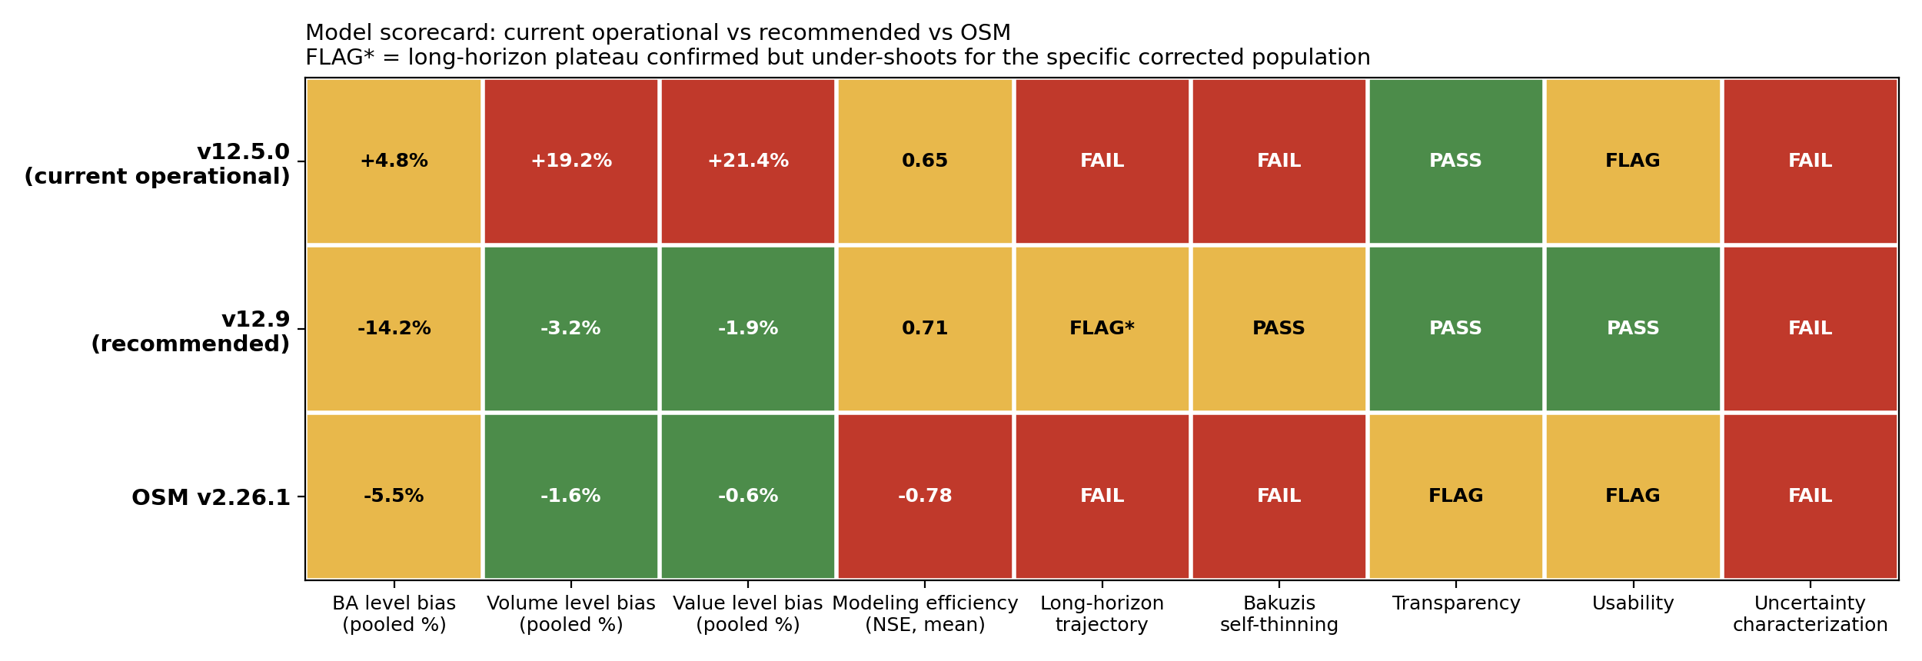
THE SCORECARD
Model by dimension: quantitative and qualitative, at a glance
v12.5.0 fails Bakuzis self-thinning outright and is red on every volume/value metric. v12.9 is the only model green on volume, value, transparency, and usability at once. OSM's bias looks competitive but its modeling efficiency is negative (next slide).

Slide 6
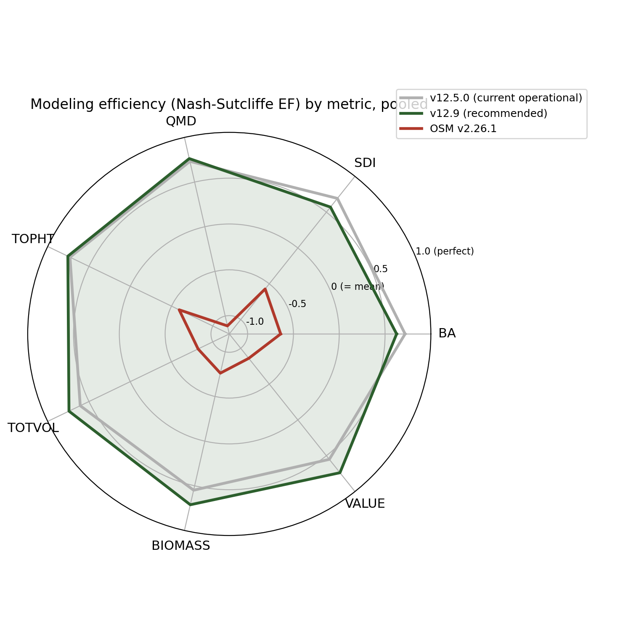
THE SCORECARD
Modeling efficiency (NSE) by metric, pooled NB and QC
OSM's aggregate bias looks best of the three models, but its modeling efficiency is negative on every metric, worse than predicting the observed mean: low bias from cancellation, not per-stand skill. v12.9 explains more out-of-sample variance than v12.5.0 on every metric and is the only model with a biologically correct long-horizon plateau.

Slide 7
V12.9: THE TARGETED FIX
A gate, not a global change: province x ecoregion x forest type
The diagnosis: Quebec's mature-stand over-prediction was never a Quebec problem. It is a hardwood-dominated-stand problem, concentrated outside the Acadian-core ecoregion. Softwood-dominated Quebec stands were already fine, same as New Brunswick.
The gate: corrects the maximum-density ceiling only where all three are true: province Quebec, ecoregion outside the Acadian core (CEC North American Level III), forest type hardwood-dominated. Everywhere else in the domain is untouched.
The result: the target cell's volume bias closes from +56.7 to +10.4 percent. New Brunswick is unchanged to the decimal. Independent recent Maine FIA reproduces the pre-fix baseline exactly, because no Maine plot can ever match the gate.
Why this matters: an earlier, broader version of this fix (ecoregion alone, no province) looked just as good on Quebec but silently damaged Maine's own growing stands, worsening the independent FIA check from -52 to -93 percent. The independent cross-check caught it before it shipped.

Slide 8
V12.9: THE TARGETED FIX
Scope: recommended now, with one open item
Recommended for: short-to-mid rotation inventory projection, replacing v12.5.0 as the operational version. Validated with a stand-level split-half robustness check (both random halves show the same correction, +54.9 and +62.2 percent baseline closing to +11.5 and +15.8 percent) and the independent recent Maine FIA cross-check.
Not yet recommended for: long-horizon carbon or old-growth work on the specific corrected population. A seeded 160-year trajectory shows the corrected hardwood plateau at about 21 m2/ha, below the realistic 28 to 32 target. The short-interval fix, run out to a full rotation, under-shoots.
Next step: a tapered version of the correction, strong at mid-rotation and relaxing as the stand approaches its true asymptote, is the fix for the long-horizon case. Queued, not yet built.

Slide 9
VERDICT
v12.9 is the recommended version. v12.5.0 remains operational until this is adopted.
What v12.9 delivers over v12.5.0
Before an official variant release
- Basal area plateaus at the true Acadian maximum, not a runaway climb past 62 m2/ha
- Tapered SDImax correction for long-horizon carbon and old-growth use
- Quebec hardwood volume bias closed from +56.7 to +10.4 percent
- Clean OSM volume re-derivation on the identical pairs, NFS access permitting
- All volume and biomass on FIA NSVB; Bakuzis self-thinning passes
- Finalize the variant GTR appendix parameter tables
- Positive modeling efficiency on every metric, unlike OSM
- Zenodo deposit at release: code, validation, figures, no coordinates
Aaron Weiskittel | CRSF, University of Maine | August 2026

