Slide 1


FVS-ACD vs OSM
An independent re-derivation, and a Chapter-11 lever to close the operational gap
Acadian Growth & Yield Meeting | 18 August 2026
Aaron Weiskittel | Center for Research on Sustainable Forests and Cooperative Forestry Research Unit, University of Maine
Honest read: on the operational domain OSM and FVS-ACD are close and OSM is strong. FVS-ACD's edge is biological realism, long horizon, QMD, and transparency.

Slide 2
CONTEXT
Why revisit the 2018 benchmark
2018 (Hennigar & Weiskittel, ECANUSA). OSM trailed only slightly behind FVS-ACD, and beat it on merchantable volume-increment bias and RMSE in ME, NB, and NS. That result set the FVS-ACD to-do list.
2026. Independent re-derivation on fresh data with a common FIA NSVB currency. If OSM's 2018 edge does not replicate, say so with evidence. It largely does not.
1
Site productivity ESI holds; height edge is extrapolation
2
Data harmonization MagPlot + FIA on one NSVB currency
3
New calibration approaches Multi-dimensional scorecard; Ch 11 modifiers
4
Integrating climate Current and 2030 ESI as a scenario
5
AI and productivity Accelerated the work, caught our own error
His five agenda topics, and what we bring to each

Slide 3
DATA HARMONIZATION
Data harmonized onto one currency
705
NSVB
ESI v8
5
ESI-covered in-domain stands, the
pooled NSVB scorecard sample
FIA volume and biomass as the
common currency for every model
30 m climate-and-terrain site
driver, cross-border coverage
models scored head to head
v12.5.0, v12.7.0, v12.9.x, v12.10.1, OSM
Also: recent post-2010 Maine FIA (independent in time from the 1999 to 2005 training FIA), and SILC Seven Islands for the long horizon. Coordinates stay on Cardinal; aggregates only.

Slide 4


BENCHMARK DATASET
One harmonized benchmark: 705 remeasured Acadian stands
705
remeasured stands
355 / 350
New Brunswick / Quebec
321 / 186 / 178
softwood / mixedwood / hardwood
4 to 14 yr
remeasurement interval
Coordinates never released: locations are aggregated to a 50 km equal-area hex grid; true plot coordinates stay on the analysis cluster.

Slide 5
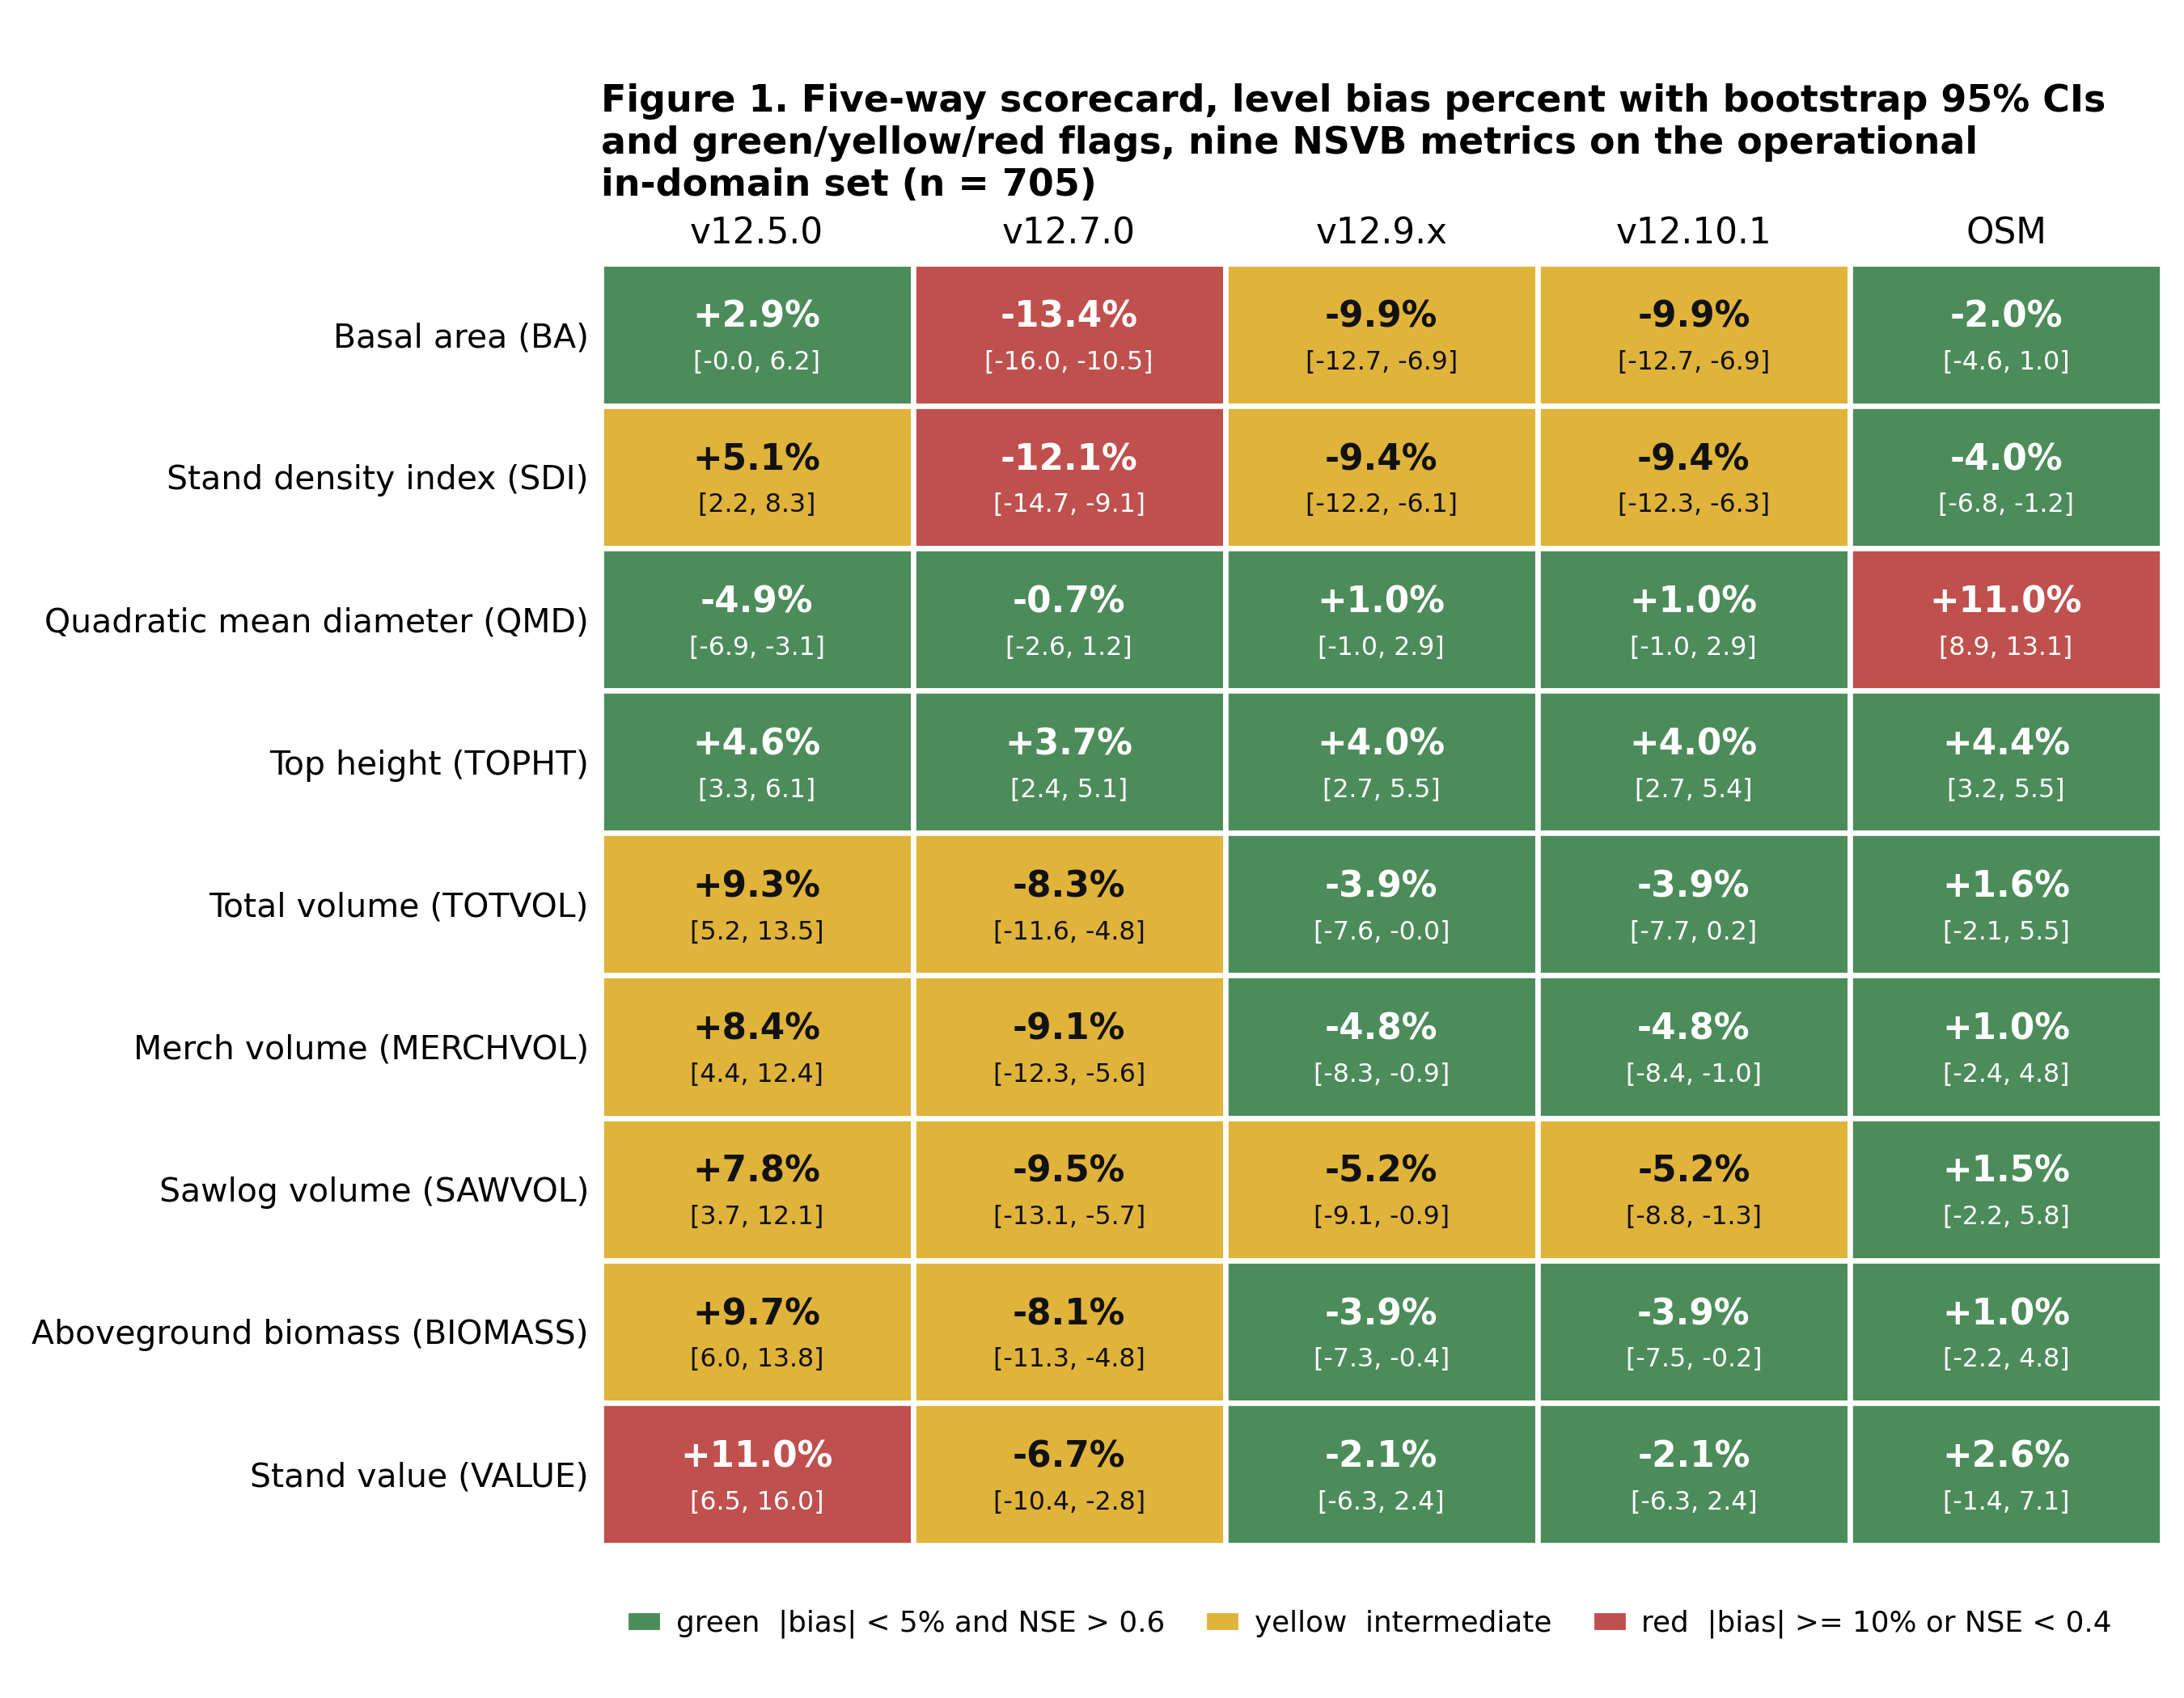
NEW CALIBRATION APPROACHES
OSM leads pooled, v12.9.x closes the gap
Corrected merge. An index-join artifact had made OSM look imprecise. With a single keyed merge OSM's modeling efficiency is positive (0.70 to 0.75) and it is the most accurate model on the pooled domain.
OSM and v12.9.x are close. v12.9.x roughly halves the incumbent v12.5.0 volume over-prediction; v12.7.0 over-corrects into a similar-sized under-prediction.
QMD is a durable FVS advantage (about +1 to +2 percent vs OSM +11).

Slide 6

NEW CALIBRATION APPROACHES
Hardwood is the shared frontier
Softwood is equivalent for every model. Hardwood is the shared frontier: all models over-predict, even OSM (+15). v12.9.x roughly halves the v12.5.0 hardwood bias.

Slide 7

ACCURACY AND PRECISION
Percent bias inflates on low means; %RMSE is the fairer read
Percent bias divides by the mean, so it balloons on low-mean metrics and can read a model as far worse than it is. Percent RMSE blends accuracy and precision and does not deflate. Hardwood is a high-variance frontier shared by every model: v12.10.1 hardwood total volume is +19 percent bias but about 76 percent %RMSE, and OSM is about 75 percent.

Slide 8
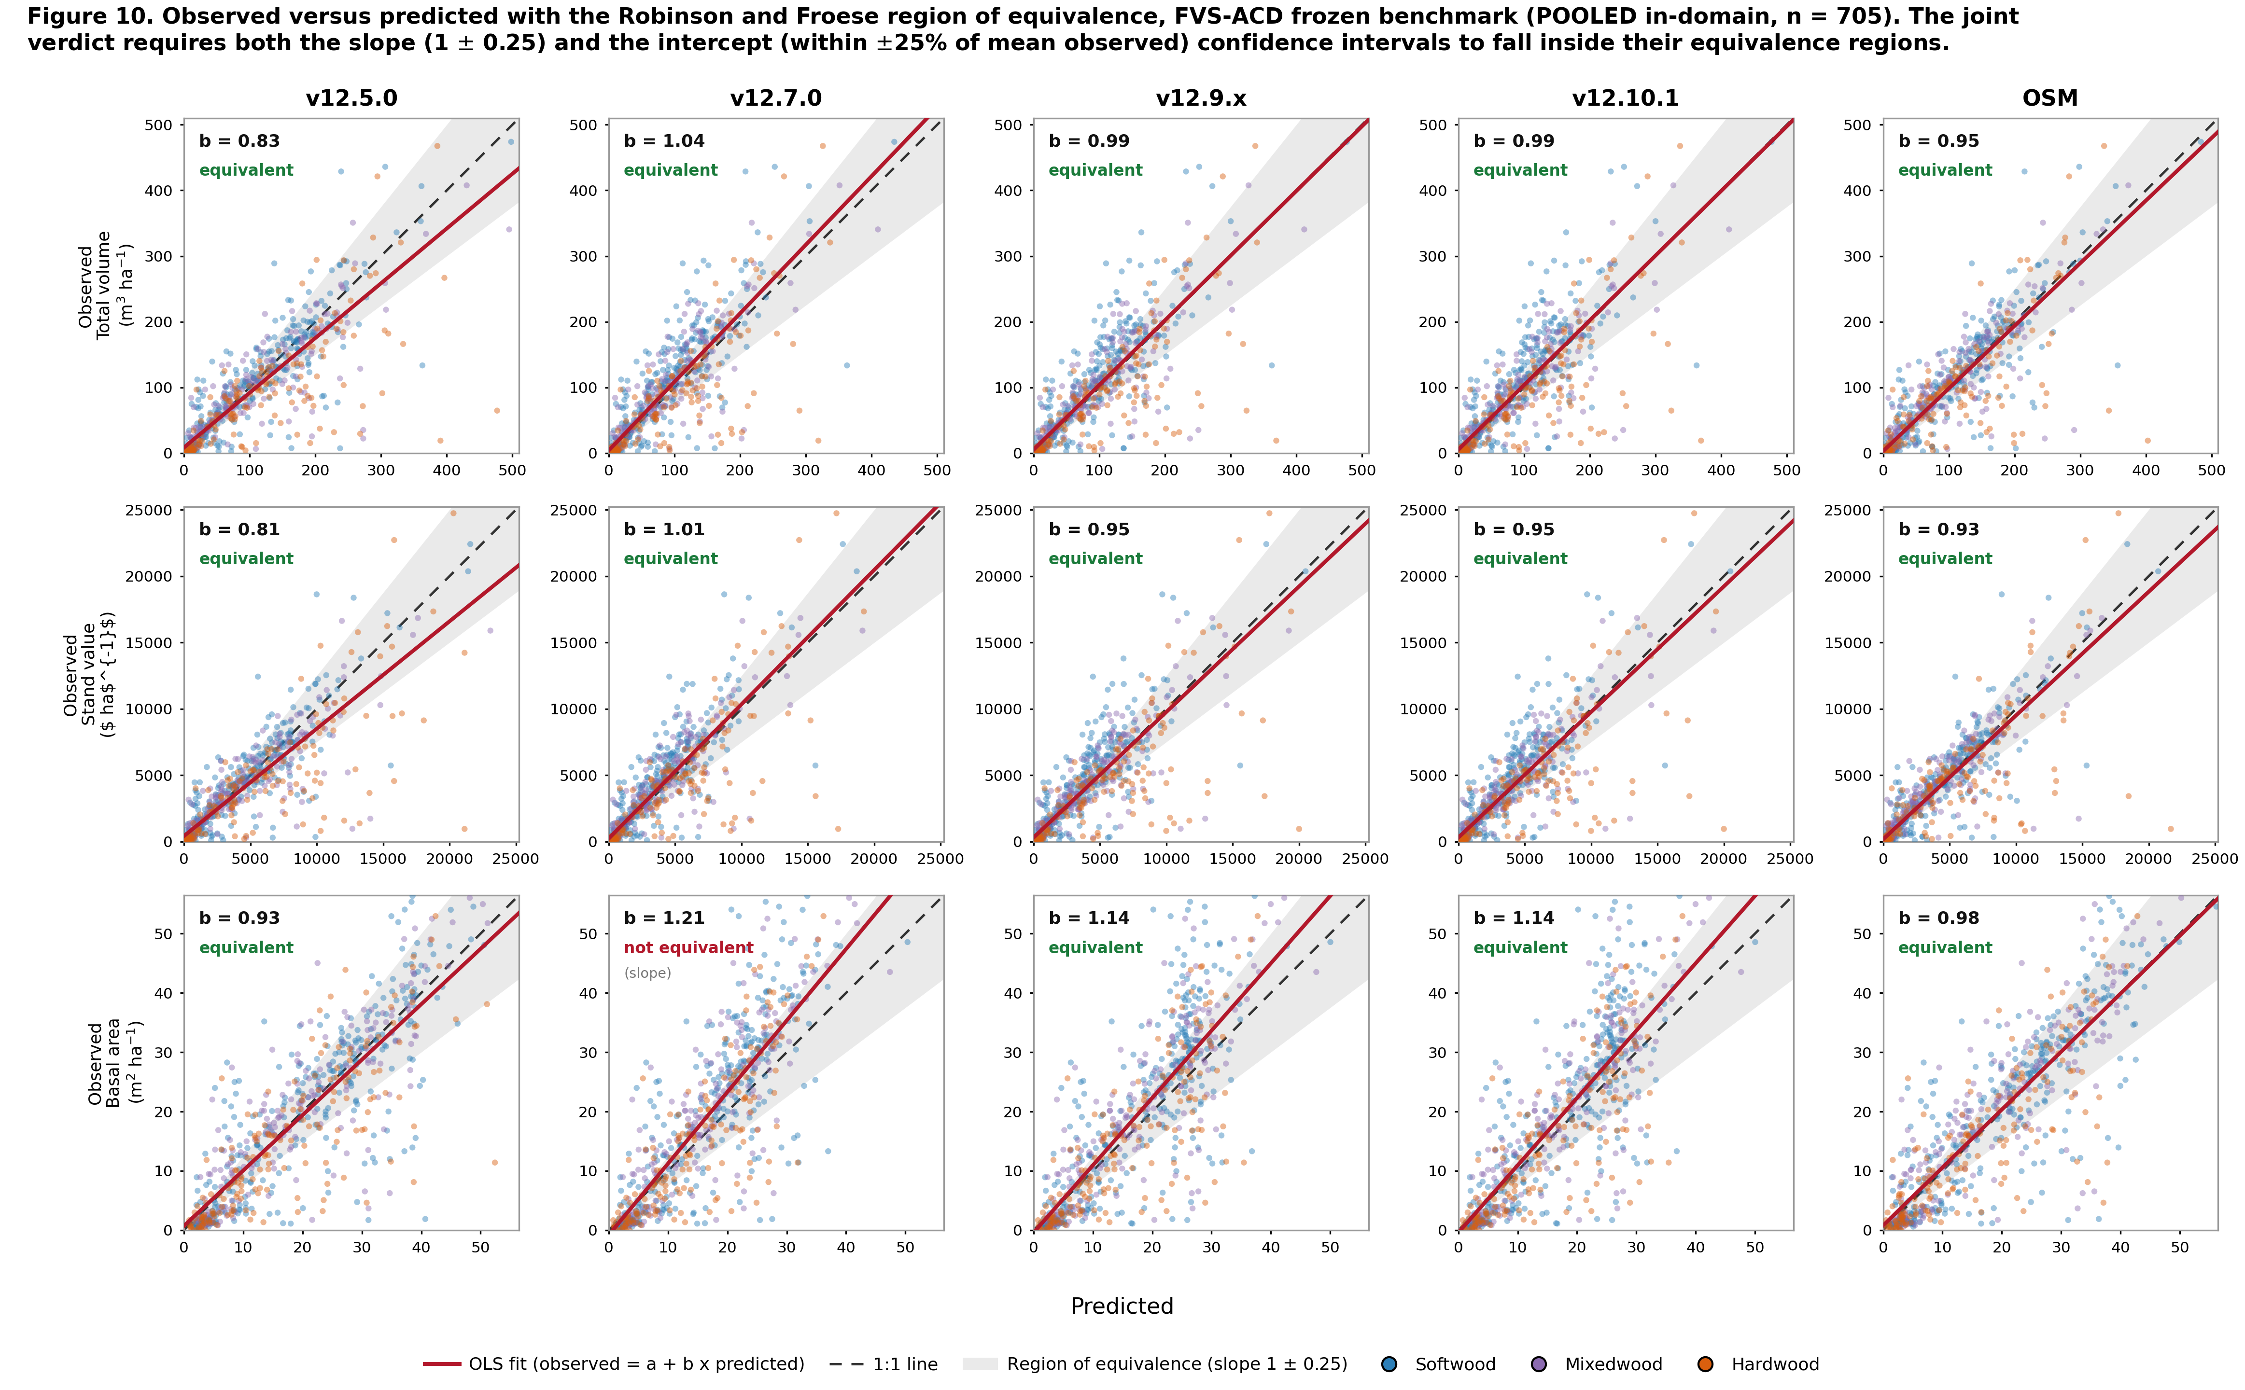
REGION OF EQUIVALENCE
Four of five models pass all nine equivalence metrics
Observed on predicted with the Robinson and Froese region of equivalence, joint on slope (1 ± 0.25) and intercept (within 25 percent of the mean observed). Four of five models pass all nine metrics. The one exception is v12.7.0 basal area, where the slope runs steep at 1.21. Every volume and value metric passes for every model.

Slide 9
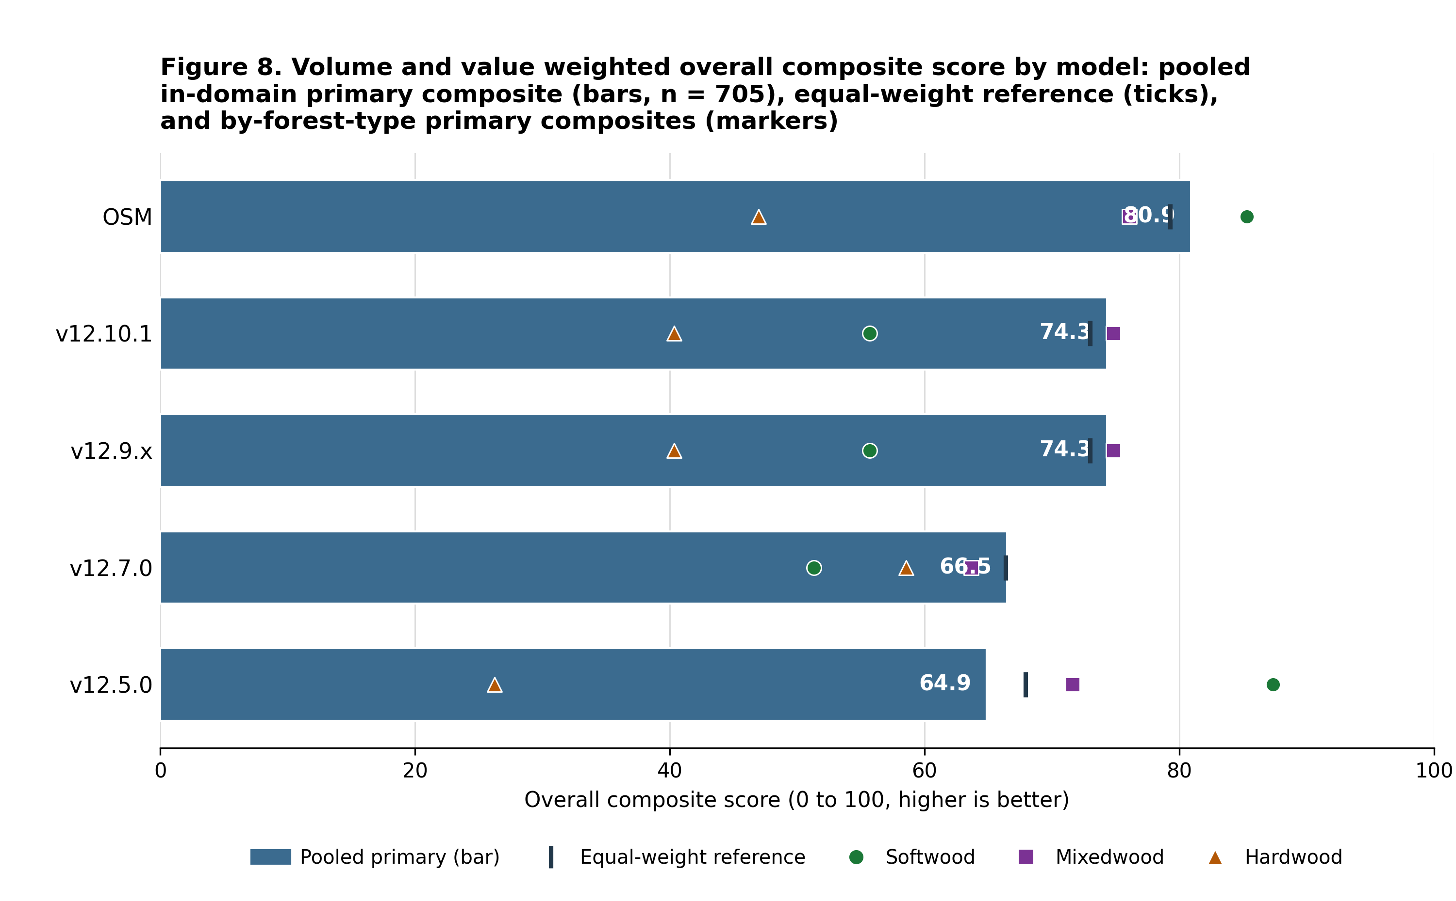
OVERALL COMPOSITE
OSM leads either composite; the FVS order flips by view
Volume and value carry the most weight. On the %RMSE-weighted composite, which blends accuracy and precision, the order is OSM 53.4, v12.7.0 52.1, v12.9.x and v12.10.1 tied at 49.8, v12.5.0 49.4. On the bias-weighted view shown above it is OSM 80.9, the shared v12.9.x and v12.10.1 build 74.3, v12.7.0 66.5, v12.5.0 64.9. v12.10.1 is the least biased; v12.7.0 has the tighter scatter.

Slide 10
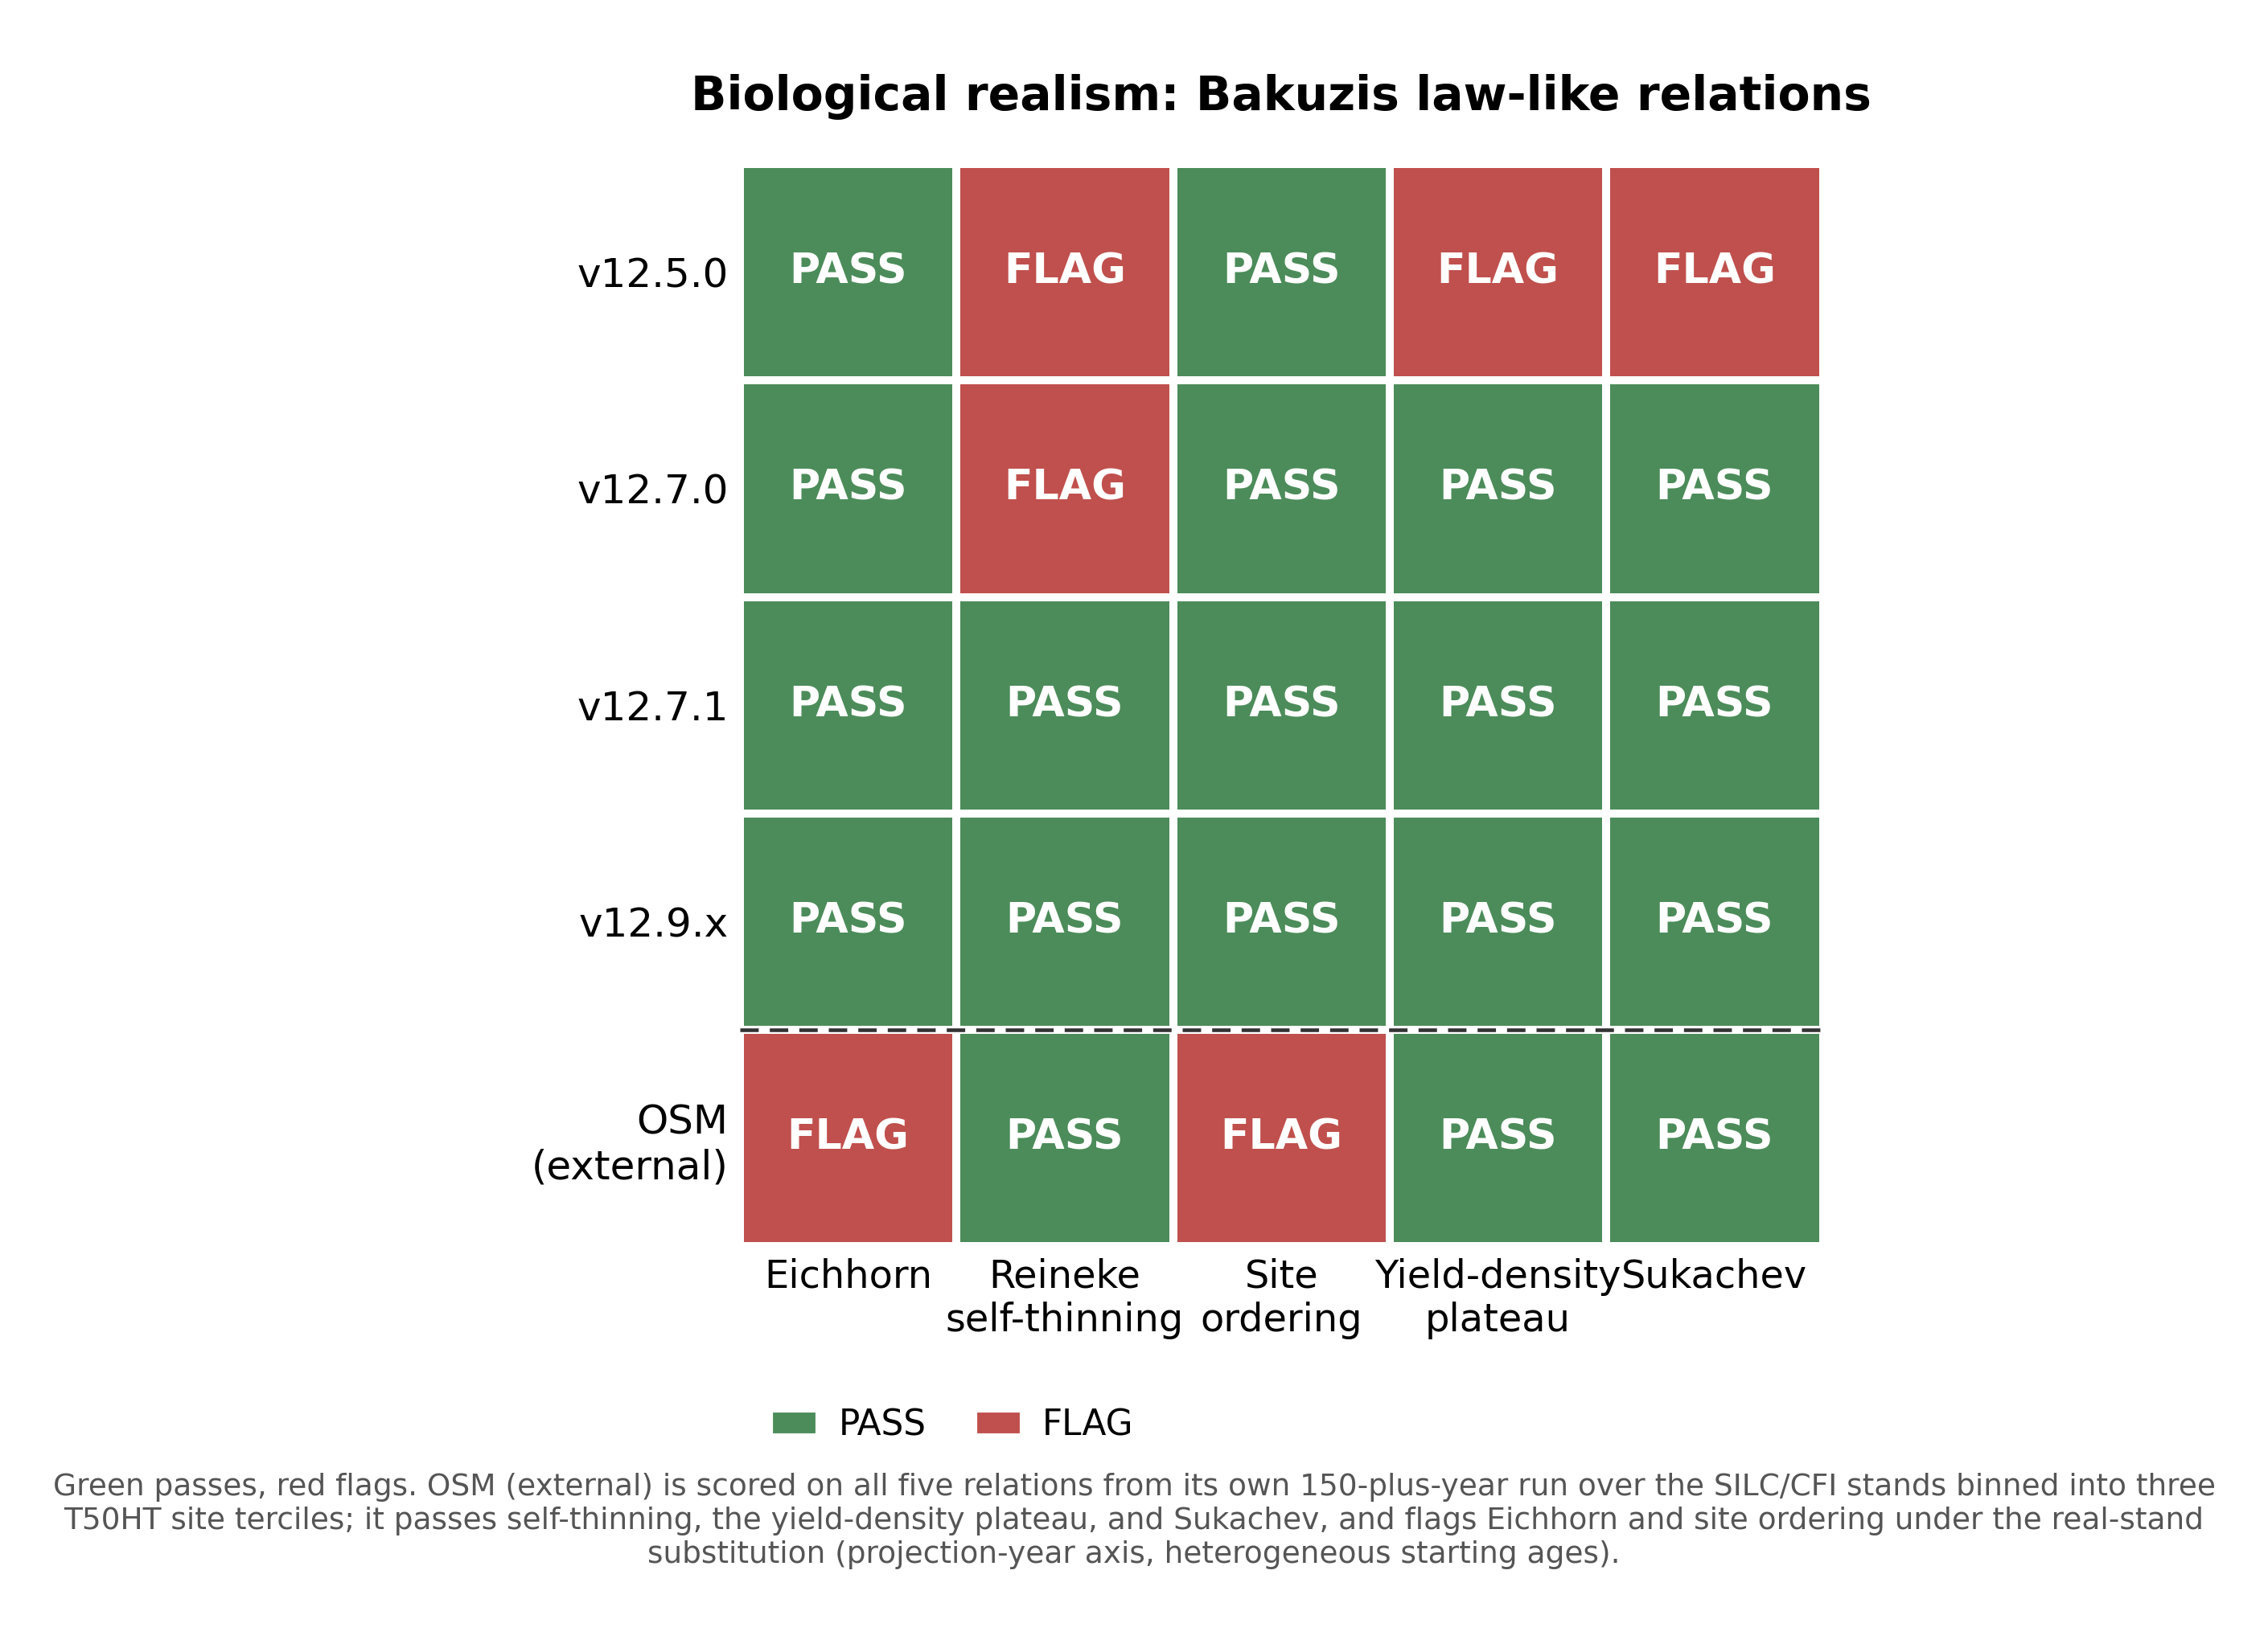
NEW CALIBRATION APPROACHES
Biological realism: only the self-thinning versions pass all five
The FVS-ACD self-thinning versions plateau at the realistic maximum and pass all five relations in the seeded-gradient battery. OSM, run 160 years, is now fully scored on all five: it passes Reineke self-thinning, the yield-density plateau, and Sukachev, and flags Eichhorn and site ordering.
v12.5.0 never self-thins (basal area runs to 65 with thousands of stems alive), failing yield-density, Reineke, and Sukachev. The age-60 read that showed OSM in runaway accumulation caught only the pre-plateau limb; over the full horizon OSM plateaus and self-thins.
Honest limit: ingrowth. Recruitment is under-predicted (NB 17.9 vs 39.8, QC 11.7 vs 19.7 stems ha⁻¹ yr⁻¹). Direction is correct, it responds to density and management; the level is low. A disclosed limit and a v13 target.

Slide 11

NEW CALIBRATION APPROACHES
Long horizon: FVS-ACD self-thins earlier, OSM plateaus later
The operational short-interval domain agreement hides a long-horizon divergence in the timing of self-thinning: FVS-ACD self-thins earlier, while OSM plateaus later over the full horizon. This is why FVS-ACD is the choice for carbon, old-growth, and climate work.

Slide 12

SITE PRODUCTIVITY
Site productivity: keep ESI
Bake-off settled. ESI vs BGI vs CPSI vs legacy CSI, out of sample with spatially blocked CV. ESI wins the dominant-height anchor and ties for diameter growth. BGI and CPSI carry no height signal and lack cross-border coverage.
Why pooled parity is deferred, not hand-waved. We tested a top-height anchor correction and did not ship it. In the shipped config a +4% top-height over-prediction offsets a −10% basal-area under-prediction, so correcting height alone drives volume further negative. True parity needs a joint height-and-basal-area re-anchor. That is v13.0.

Slide 13
NEW CALIBRATION APPROACHES
Only OSM carries a management term
Component | FVS-ACD v12 | OSM v2.26.1
Diameter growth | Parametric Kuehne 2022 | Random Forest table
Management term | None (verified) | IsManaged column (verified)
Site in DG | Continuous ESI | Binary IsGoodSite
Height calibration | None in base | Local-observation routine
Self-thinning | Composition-aware SDImax | Plateaus later, over full horizon
The verified difference
OSM's diameter-growth table literally carries an IsManaged column. FVS-ACD v12 has no management term anywhere.
That is the specific, source-level reason OSM is competitive on the heavily managed benchmark, and exactly what v12.10.1 targets.
OSM ships as a compiled binary; the exposed diameter-growth RF table verifies the management covariate. Mortality and ingrowth management terms are documented, not source-exposed.

Slide 14

NEW CALIBRATION APPROACHES
The Chapter-11 lever: a fitted release, not a clamp
Direct effect only (Ch 11).
The base equations already carry the indirect structural effect. The modifier isolates the direct effect by the multi-step method (Wang 1990).
Planted = Type 2, sustained.
PCT = Type 1, transient, decaying.
Result: robust re-fit. The direct effect is a fitted additive release (planted +3.8, PCT +2.4 m² ha⁻¹ BA), not a clamped ratio, so its fold coefficients move with the data. v12.10.1 clearly beats OSM on planted and edges OSM on managed out of sample. The effect is larger than the old 1.6 clamp allowed, which is why the capped version still under-predicted planted.

Slide 15

NEW CALIBRATION APPROACHES
The modifier closes the managed gap
Robust additive direct-effect release (planted +3.8, PCT +2.4 m² ha⁻¹ BA), clamp removed; engine carries a sustained (planted) or decaying (PCT) diameter-growth effect bounded by self-thinning. In-sample managed mean absolute bias across nine metrics: v12.9.x 10.2 to v12.10.1 1.3 (OSM 8.3). Cross-validated on the next slide. Gated, default off, so unmanaged stands are untouched.

Slide 16
NEW CALIBRATION APPROACHES
Does the lever hold out of sample?
Mean absolute level bias across nine metrics, lower is better. OSM reference is class-specific.
Cross-validation scheme | Planted | PCT | Managed
Leave-one-installation-out | 4.0 | 3.0 | 1.3
Leave-one-province-out | 5.6 | 4.1 | 1.5
Managed split-half (200 reps) | n/a | n/a | 5.6
OSM reference | 16.7 | 3.7 | 8.3
What survives the red team
Managed is a clean out-of-sample win: 1.3 leave-one-installation-out and 1.5 leave-one-province-out vs OSM 8.3.
Planted is a robust win over OSM in every scheme (4.0 vs 16.7) and transfers across the NB to QC border.
PCT now transfers NB to QC (4.1 vs OSM 3.7); the PCT basal-area residual closes. Quebec edge still reported as out of domain, conservatively.
The robust additive re-fit removed the 1.6 clamp; fold coefficients now move with the data (planted basal-area release 3.6 to 4.1 across folds) and the out-of-sample numbers hold. In-sample class bias is near zero by construction, so the cross-validated numbers are the evidence.

Slide 17
INTEGRATING CLIMATE
Climate enters as a scenario driver, not a benchmark
A validated base and a separate scenario driver.
ESI v8 gives current and 2030 climate site surfaces. The projected surface is a forward scenario driver, kept separate from the validated base and never benchmarked on.
For a credible forecast the future step uses a parametric climate-sensitive form (a GAM ratio on the dominant-height anchor), not a random-forest extrapolation. RCP4.5 gives a defensible cold-limited signal of +1.9 m (2030s) to +4.3 m (2090s).
Rule
Validate on observed climate.
Project with a parametric form.
Never benchmark on the projected surface.

Slide 18
AI AND PRODUCTIVITY
AI accelerated the work, humans kept it honest
Accelerated
Weeks of benchmarking, scorecards, and figures compressed into days of iteration.
Kept honest
A human check caught an index-join merge bug that had wrongly made OSM look imprecise; corrected to positive NSE.
Reproducible
Every number traces to a script and a keyed data file on Cardinal; coordinates never leave the cluster.

Slide 19
ROADMAP
v13 is the fall arc: what the data lets us commit to now
v13.0 Height and domain
Bound the calibrated domain: gate off predictions outside the ESI range so the anchor never extrapolates. The height re-anchor blend sweep is exhausted and parked: every blend traded a top-height gain for a volume loss, so none ships. The basal-area correction is retained and the domain gate stands. Mature Acadian data still identifies the asymptote for the New Brunswick to Quebec transfer.
1
v13.1 Hierarchical mortality and ingrowth
The full Bayesian hierarchical mortality and ingrowth refit is still running. A region random slope on management, standard deviation 1.21 on the log-hazard scale, far larger than the mean effect, so a single capped constant is the wrong object; leave-one-region-out transfer beats it in 5 of 5 held-out regions. This is also where the under-predicted ingrowth is refit (NB 45, QC 59 percent of observed today). Management then enters v13.2 as a growth-scale release, with prediction intervals and climate following.
2
The ask of the group
Provincial managed remeasurements and PSP treatment histories, with the provincial site surfaces. This is the data that unblocks the New Brunswick to Quebec management transfer, the one place the managed calibration still leans on thin planted and PCT samples. August is the moment to request a harmonized data-sharing arrangement so v13 is fit on the full Acadian record.
3

Slide 20
VERDICT & ROADMAP
Close on the operational domain, ahead on realism and transparency
On the operational inventory domain OSM and FVS-ACD are close and OSM is strong: OSM still leads pooled (mean absolute bias 3.2 vs 4.9, modeling efficiency 0.75 vs 0.71, TOST equivalence 8 of 9 vs 7 of 9). FVS-ACD does not claim pooled parity; its edge is biological realism and transparency.
It is the one model that plateaus at the realistic maximum, and it passes all five relations in the seeded-gradient battery, where OSM passes the two size-density relations and flags Eichhorn and site ordering; FVS-ACD self-thins earlier and more consistently across sites. Add a durable QMD advantage, a validated climate-ready ESI driver, and full transparency in R. The one honest limit on this slide is ingrowth, under-predicted but in the right direction and a v13 target.
August is a v12.10.1 conversation. Its Chapter-11 direct-effect management modifiers, re-fit as a robust additive release (planted +3.8, PCT +2.4 m² ha⁻¹ basal area, clamp-free), win the managed cell out of sample (managed 1.3 vs OSM 8.3, planted 4.0 vs 16.7) and transfer PCT NB to QC (4.1 vs 3.7). Gated, default off; unmanaged stands untouched.
v13 is the fall arc, and it is now moving: v13.0's height re-anchor blend sweep is parked as exhausted, with the basal-area correction retained; v13.1's hierarchical mortality and ingrowth refit is still running; management enters as a growth-scale release in v13.2, then prediction intervals and climate. The key ask stays the provincial managed remeasurement and PSP treatment data that unblocks the NB to Quebec management transfer.

Slide 21




Questions / Comments
Aaron Weiskittel | aaron.weiskittel@maine.edu | Center for Research on Sustainable Forests and Cooperative Forestry Research Unit, University of Maine
All results reproducible and openly archived; plot coordinates stay on the analysis cluster, aggregates only.
Support: CRSF and CFRU, University of Maine | Maine-FOREST (NSF EPSCoR OIA-1849227) | PERSEUS (USDA NIFA)

