Slide 1


FVS-ACD v12.11: the maturity-dependent bias, addressed
Five gated levers, byte-identical gate-off, all four guardrails pass
Acadian Growth & Yield Meeting | 18 August 2026
Aaron Weiskittel | Center for Research on Sustainable Forests and Cooperative Forestry Research Unit, University of Maine
Wins on managed and mature stands. Developing Maine FIA stays open.
Notes:
This is the v12.11 benchmark, and the verdict comes first. On the managed and mature sources the five levers target, v12.11 beats OSM v2.26.1. On developing Maine FIA stands OSM still leads, and a re-score at the finer subplot grain does not close that gap. v13.1 is the next step there, and it is already gated and running on Cardinal. Every lever is off by default, so with the gates off the model reproduces the frozen v12.10.1 bit for bit, and all four guardrails pass. The work runs out of the Center for Research on Sustainable Forests and the Cooperative Forestry Research Unit at the University of Maine, and the benchmark depends entirely on cooperator data: the Penobscot Experimental Forest, CFRU CTRN, Maine FIA, Baxter State Park, Seven Islands, New Brunswick and Quebec MagPlot, and the Nova Scotia permanent plot network. All computation ran on Cardinal, and aggregates only left the node. I will name each source where it carries a result, and I will be explicit about what this candidate does not fix.

Slide 2
CONTEXT
v12.11 targets the one bias that flips sign with maturity
2018 ECANUSA: OSM edged FVS-ACD on merchantable volume increment
2026: v12.10.1 ships, one bias survives
1
Site productivity: ESI holds
2
Data harmonization: one NSVB currency
3
New calibration: five gated levers
4
Integrating climate: 2030 ESI scenario
5
AI and productivity: caught our error
Five agenda topics, what we bring
Notes:
Some history first. In 2018 Hennigar and I presented at ECANUSA, and OSM trailed only slightly behind FVS-ACD overall while beating it on merchantable volume-increment bias and RMSE in Maine, New Brunswick, and Nova Scotia. That result set the FVS-ACD to-do list, and much of what follows is us working through it. Now in 2026, v12.10.1 ships as the production model. Its successor, v12.11, targets the one bias that survived every prior fix, a long-horizon volume error that flips sign across the stand-maturity gradient. On the five agenda topics for this meeting, here is what we bring to each. Site productivity: ESI holds up, though the height edge is extrapolation and should be read that way. Data harmonization: MagPlot and FIA now sit on one NSVB currency. New calibration approaches: five gated levers correcting the maturity-dependent bias, which is most of this talk. Integrating climate: current and 2030 ESI run as a scenario. And AI and productivity: it accelerated the work and, more usefully, caught an error of our own, which I will come back to at the decomposition slide. I will spend the bulk of the time on the third topic.

Slide 3
DATA HARMONIZATION
Five models score on one NSVB currency
705
NSVB
ESI v8
5
ESI-covered in-domain stands, the
pooled NSVB scorecard sample
FIA volume and biomass as the
common currency for every model
30 m climate-and-terrain site
driver, cross-border coverage
models scored head to head
v12.5.0, v12.7.0, v12.9.x, v12.10.1, OSM
Coordinates stay on Cardinal, aggregates only
Notes:
Everything in this benchmark had to be put on one currency before any comparison meant anything. That currency is FIA NSVB volume and biomass, so every model is scored against the same definition of volume and of biomass. The pooled scorecard sample is 705 ESI-covered in-domain stands. The site driver is ESI version 8, a 30 m climate and terrain product with cross-border coverage, which is what lets Maine, New Brunswick, and Quebec sit in one table at all. Five model versions are scored head to head: v12.5.0, v12.7.0, v12.9.x, v12.10.1, and OSM. Two additions matter for the candidate. Recent post-2010 Maine FIA gives a test that is independent in time, since the training FIA runs 1999 to 2005, and SILC Seven Islands supplies the long horizon. On coordinates, the restriction is hard. All computation ran on Cardinal, aggregates only left the node, and true FIA plot coordinates stayed server side throughout.

Slide 4


BENCHMARK DATASET
One harmonized benchmark: 705 remeasured Acadian stands
705
remeasured stands
355 / 350
New Brunswick / Quebec
321 / 186 / 178
softwood / mixedwood / hardwood
4 to 14 yr
remeasurement interval
Coordinates never released, aggregated to a 50 km hex grid
Notes:
This is the legacy frozen benchmark, 705 remeasured stands drawn from the New Brunswick and Quebec permanent plot networks, 355 and 350 respectively. Forest type splits 321 softwood, 186 mixedwood, and 178 hardwood, with 20 stands unclassified. The remeasurement interval runs 4 to 14 years, median 5 and mean near 7, so each prediction is a growth and yield projection over the stand's own observed window and not over a fixed horizon. Each stand carries an observed initial and remeasured state together with the predicted remeasured state from every model variant. On coordinates, the restriction is hard and it is not a matter of preference. Locations here are aggregated to a 50 km equal-area hex grid, and true plot coordinates stay on the analysis cluster. Nothing on this map can be reversed back to a plot.

Slide 5


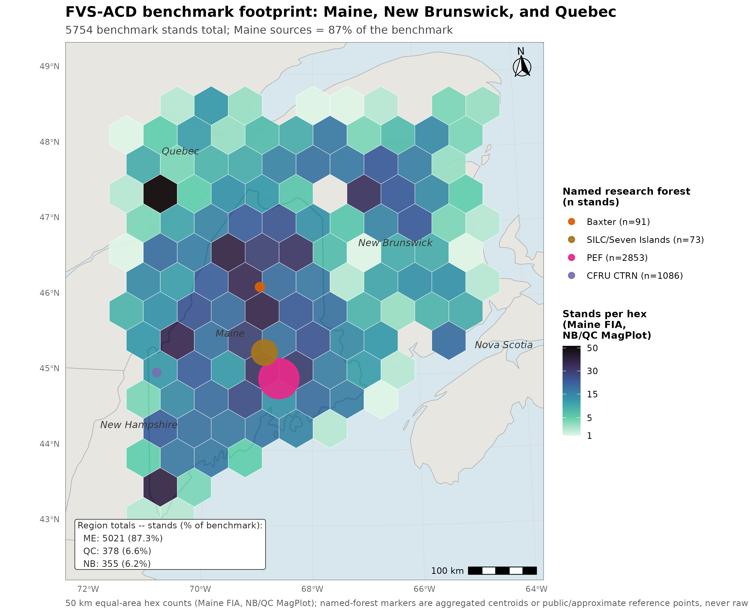
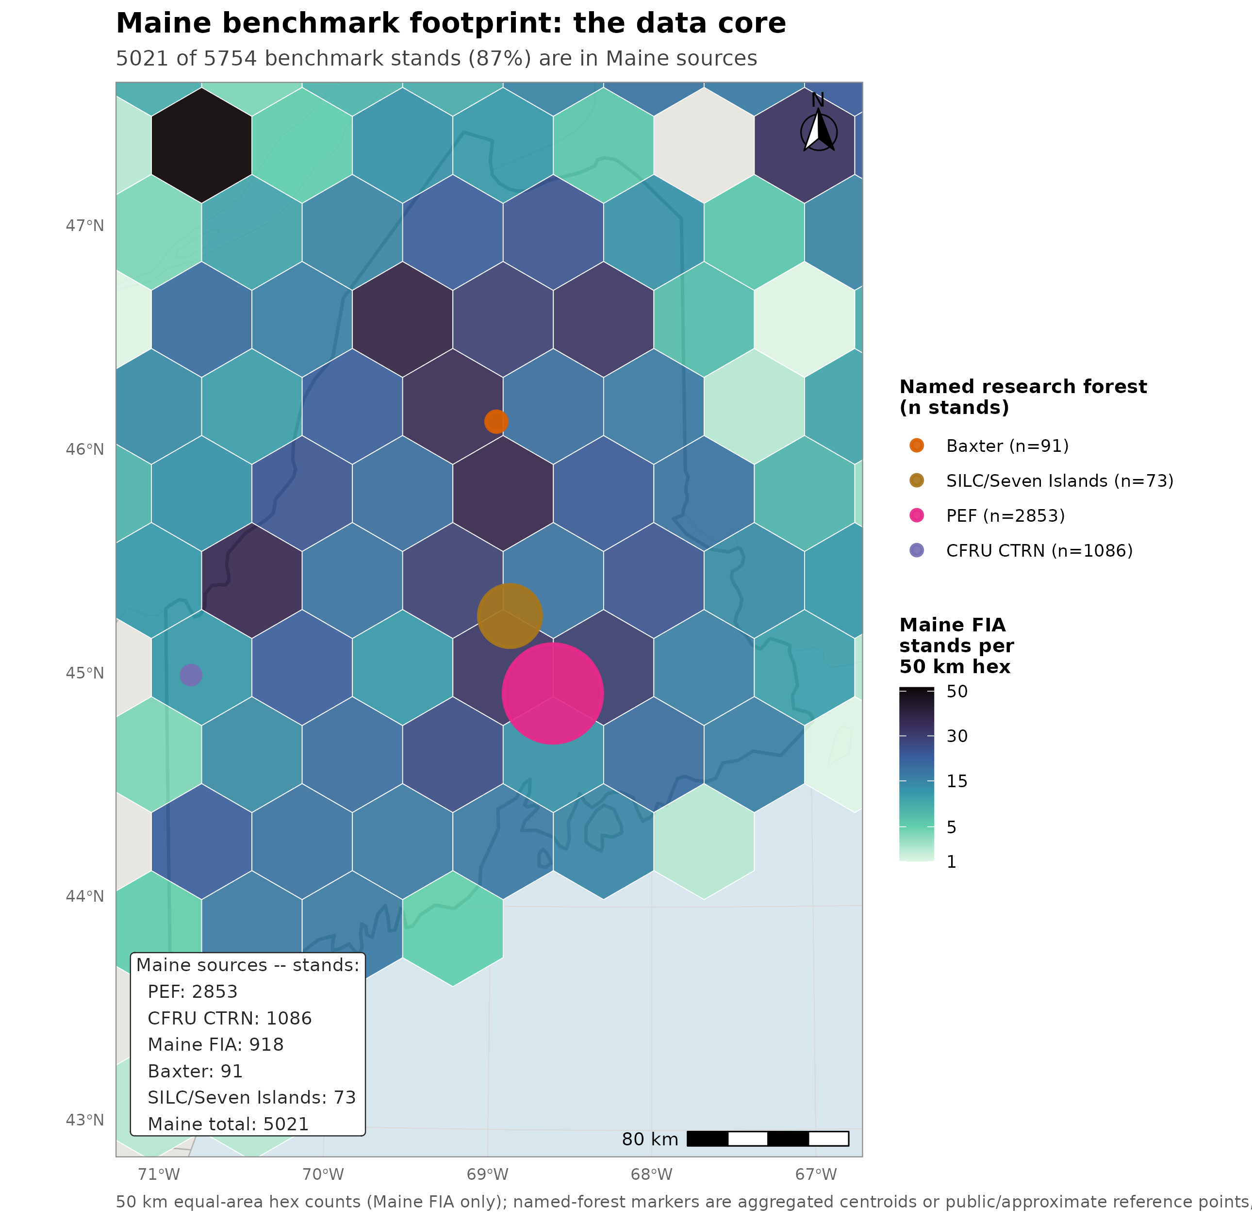
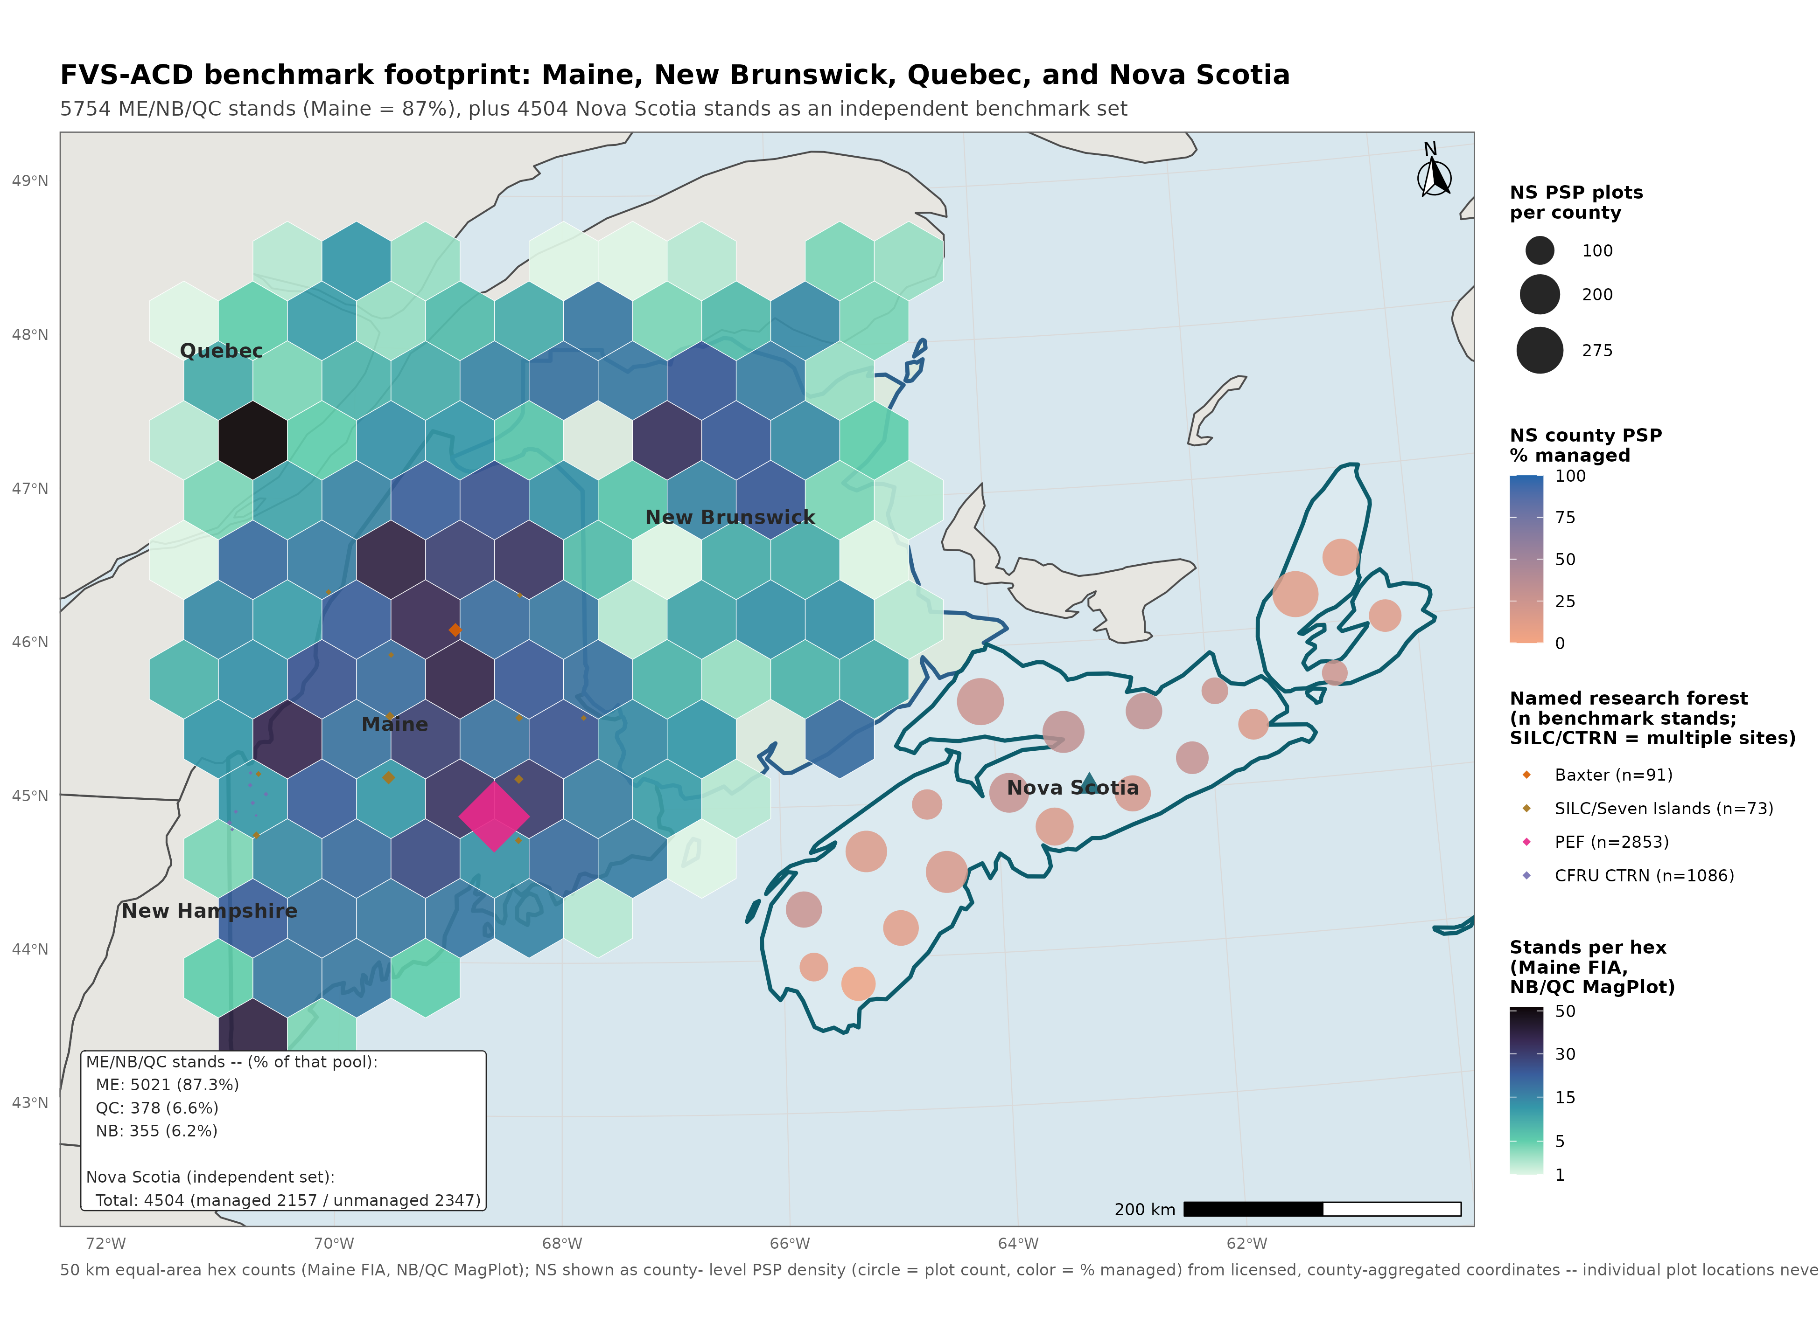
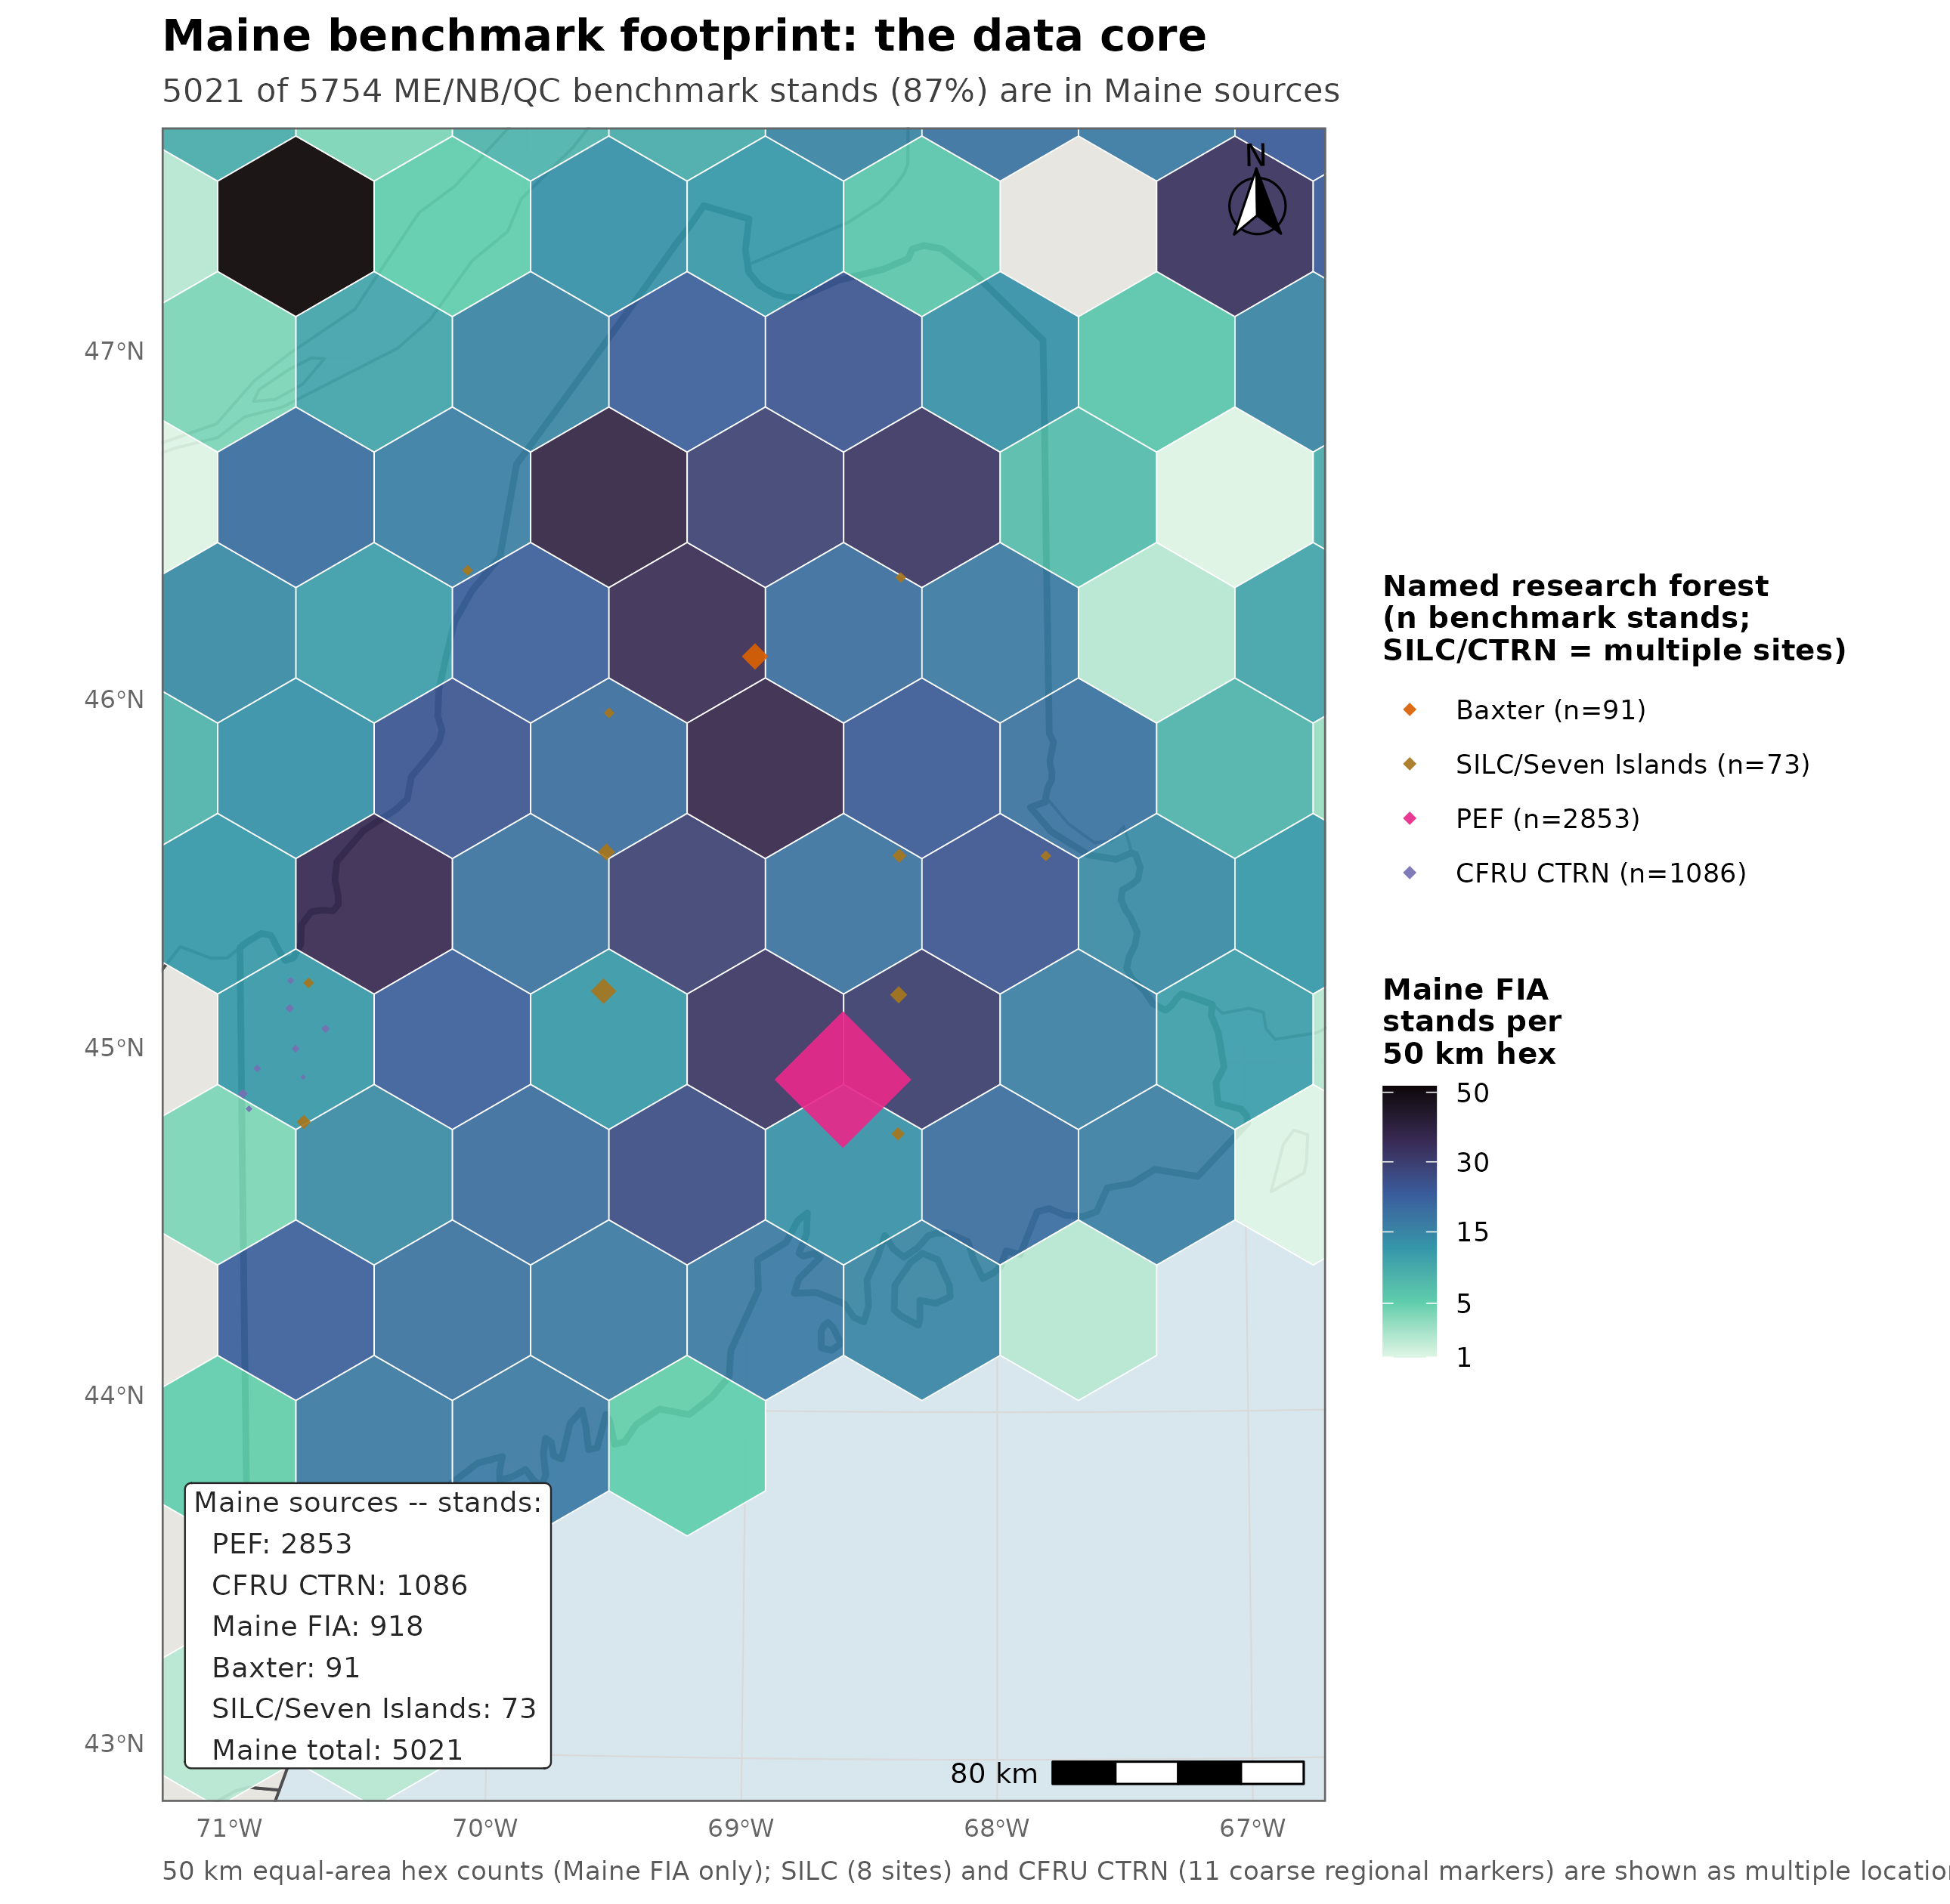
DATA FOOTPRINT
Maine supplies 87.3% of the benchmark, Nova Scotia is independent
5,021 / 5,754
Maine stands, 87.3% of the pooled ME/NB/QC total
355
New Brunswick stands
378
Quebec stands
4,504
Nova Scotia stands, managed and unmanaged (independent test)
8
sources across four jurisdictions
Nova Scotia never used to fit or tune any lever
Notes:
The footprint is worth being blunt about, because it conditions every regional number in this talk. The v12.11 candidate benchmark pools seven sources across Maine, New Brunswick, and Quebec into one three-way scored comparison of base, candidate, and OSM v2.26.1. Maine supplies 5,021 of those 5,754 stands, 87.3%, with New Brunswick at 355 and Quebec at 378 as the minority. Any regional result here should be read first as a report about a Maine-anchored candidate and second as a comparison against two smaller Canadian jurisdictions. Nova Scotia is evaluated separately as a fully independent, fourth-jurisdiction test, which comes later in this deck, and it was never used to fit or tune any lever. That is what makes it the cleanest available check on whether the managed-stand levers generalize. Coordinates are never released. True plot locations stay on the analysis cluster and only aggregates leave it, and Nova Scotia's PSP locations are additionally restricted under its own provincial data-license agreement.

Slide 6
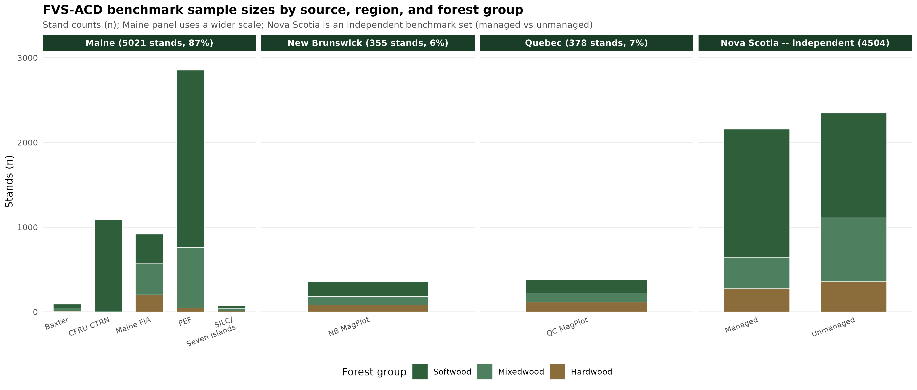
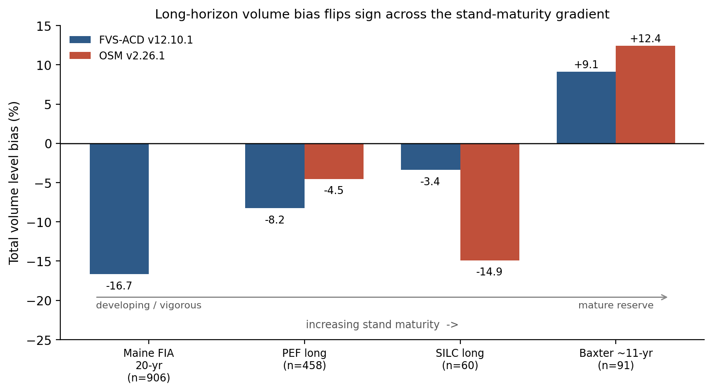


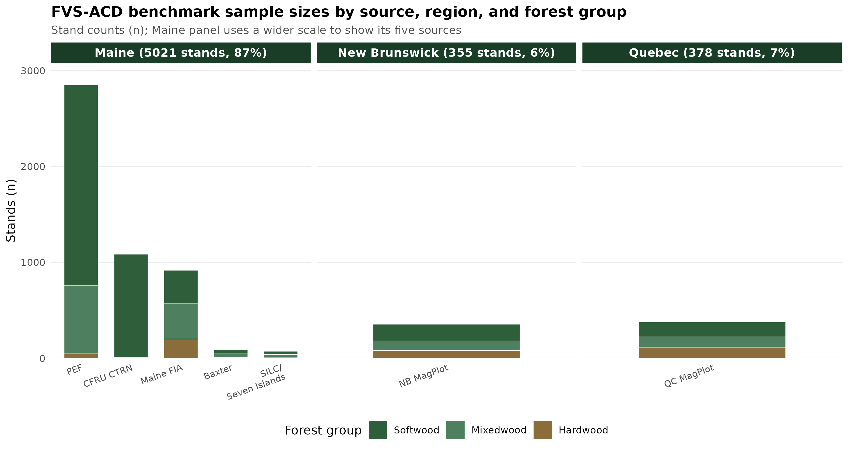
DATA FOOTPRINT
Within Maine, PEF and CTRN anchor a five source core
Stand counts by source
Figure. Stand counts by source, ME/NB/QC pooled and Nova Scotia independent.
PEF 2,853 CTRN 1,086 Maine FIA 918 Baxter 91 SILC 73
NB MagPlot 355 QC MagPlot 378 pooled 5,754
Nova Scotia 4,504: 2,157 managed, 2,347 unmanaged, scored separately
Notes:
Inside Maine the benchmark is five sources of markedly different character, and its 5,021 stands split five ways. The Penobscot Experimental Forest contributes 2,853 stands, developing and unmanaged. CFRU CTRN contributes 1,086 managed stands. Maine FIA contributes 918 stands at whole-plot grain, developing. Baxter State Park contributes 91 mature stands, held out of every fitting step. SILC Seven Islands contributes 73 managed stands and is the calibration set. New Brunswick MagPlot adds 355 and Quebec MagPlot adds 378, which completes the seven-source, 5,754-stand pooled benchmark. Nova Scotia adds an eighth source and a fourth jurisdiction, scored independently, 4,504 stands split 2,157 managed and 2,347 unmanaged, and it is not pooled into the ME/NB/QC total. Two composition notes belong with this slide. CTRN carries no hardwood-classified stands in this benchmark, 1,077 softwood and 9 mixedwood only, which is an artifact of that network's managed softwood emphasis and not a sampling gap. And Maine FIA is also re-scored at a finer 2,858-stand subplot grain, specifically to test whether the developing-end fix survives finer aggregation. That subplot set is a separate population from the 918 whole-plot stands counted here, so the two should not be added together.

Slide 7
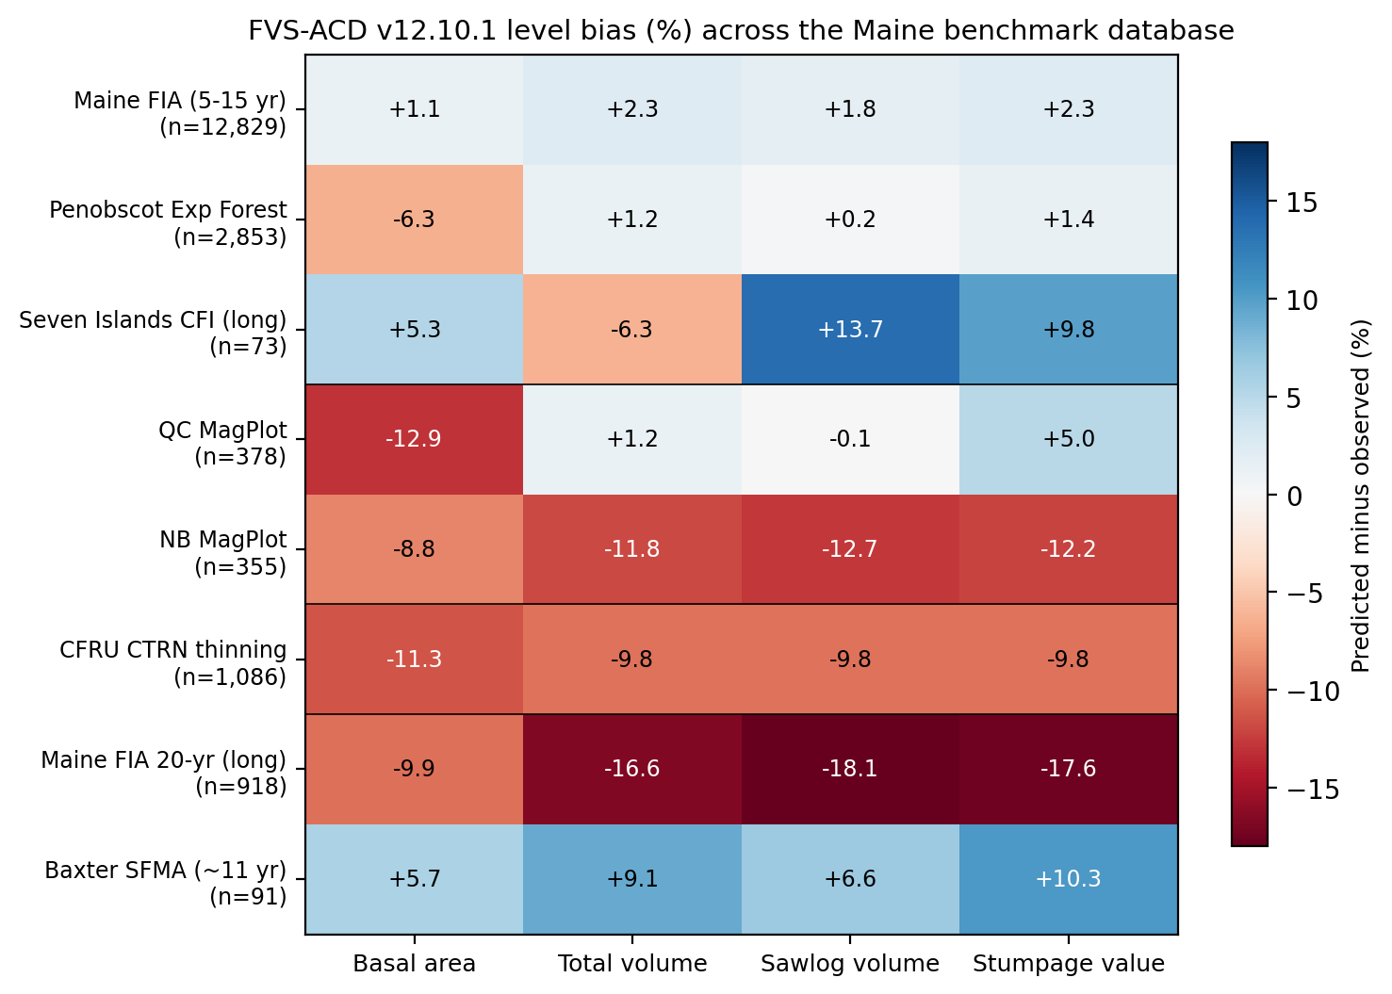
MULTI-SOURCE BENCHMARK
Bias is smallest on the independent Maine sources
Best on independent Maine data
Maine FIA +2.3%, PEF +3.7%; NB -11.8%, CTRN -9.8% (tuning pairs)
Eight sources, one NSVB currency
Maine FIA 12,829 short, 918 at 20 yr; PEF 2,853, SILC 73, Baxter 91, QC and NB MagPlot, CFRU CTRN
Notes:
This is the multi-source picture. Short-interval total-volume bias runs +2.3% on Maine FIA and +3.7% at PEF, which is better than the Quebec and New Brunswick pairs the model was actually tuned against, New Brunswick at -11.8% and CTRN at -9.8%. That ordering matters, because the Maine sources are largely independent of the pairs used to tune the model. Eight sources feed this comparison, all on one NSVB currency. Maine FIA carries n = 12,829 at the short interval and 918 at the 20 year horizon. PEF carries 2,853 stands. The Seven Islands CFI network carries 73 and supplies the long horizon. Baxter's SFMA reserve carries 91 and anchors the mature, held out end. Quebec and New Brunswick MagPlot and the CFRU CTRN thinning network complete the set. The caution I would attach is that the short-interval and long-interval results do not agree, and the next slide is about exactly that disagreement.

Slide 8
THE PROBLEM
Volume bias flips sign across the maturity gradient
Total volume bias
Basal area bias
Figure 1. Total volume and basal area level bias across the stand-maturity gradient, base v12.10.1 versus the v12.11 candidate.
Base to v12.11 candidate
Maine FIA developing -16.60% to -16.13%
CTRN managed -9.78% to -2.24%
Baxter mature, held out +9.12% to +6.92%
Notes:
This is the problem the candidate was built for. In the shipped v12.10.1 baseline, total-volume bias moves from -16.7% on the Maine FIA 20 year set and -8.3% at PEF long, through -3.4% at Seven Islands CFI, to +9.1% at the mature Baxter reserve. At the precise whole-plot numbers on the slide the same ladder reads -16.60% on developing Maine FIA, -9.78% on managed CTRN, and +9.12% on the held-out mature Baxter reserve. So FVS-ACD under-predicts in developing, vigorous stands and over-predicts in mature, senescing reserves. A component decomposition, which is the next slide, shows that flip is the net of three separable errors. Survivor diameter growth runs too high. An ingrowth deficit dominates the developing-stand under-prediction. And the SILC-calibrated mortality over-removes at managed and high-density structures. At the mature Baxter end specifically, the over-prediction is survivors over-accreting girth on large old trees, with mortality essentially exact there, so it is not a case of too little being removed. Two things about the candidate. It narrows the mature-end over-prediction, Baxter +9.12% to +6.92%, and roughly halves the managed-end bias, CTRN -9.78% to -2.24%. However, the developing end barely moves, Maine FIA -16.60% to -16.13%, and it remains the acknowledged gap that v13.1 targets. The sign flip itself is narrowed and not closed by v12.11. One thing worth saying out loud: OSM swings the same way, PEF -4.5%, SILC -14.9%, Baxter +12.4%. This is a shared growth and yield problem across both Acadian models, and it is exactly what the v13.1 mortality and ingrowth refit targets. It also strengthens the case for the mature Acadian remeasurement data, which is the August ask.

Slide 9
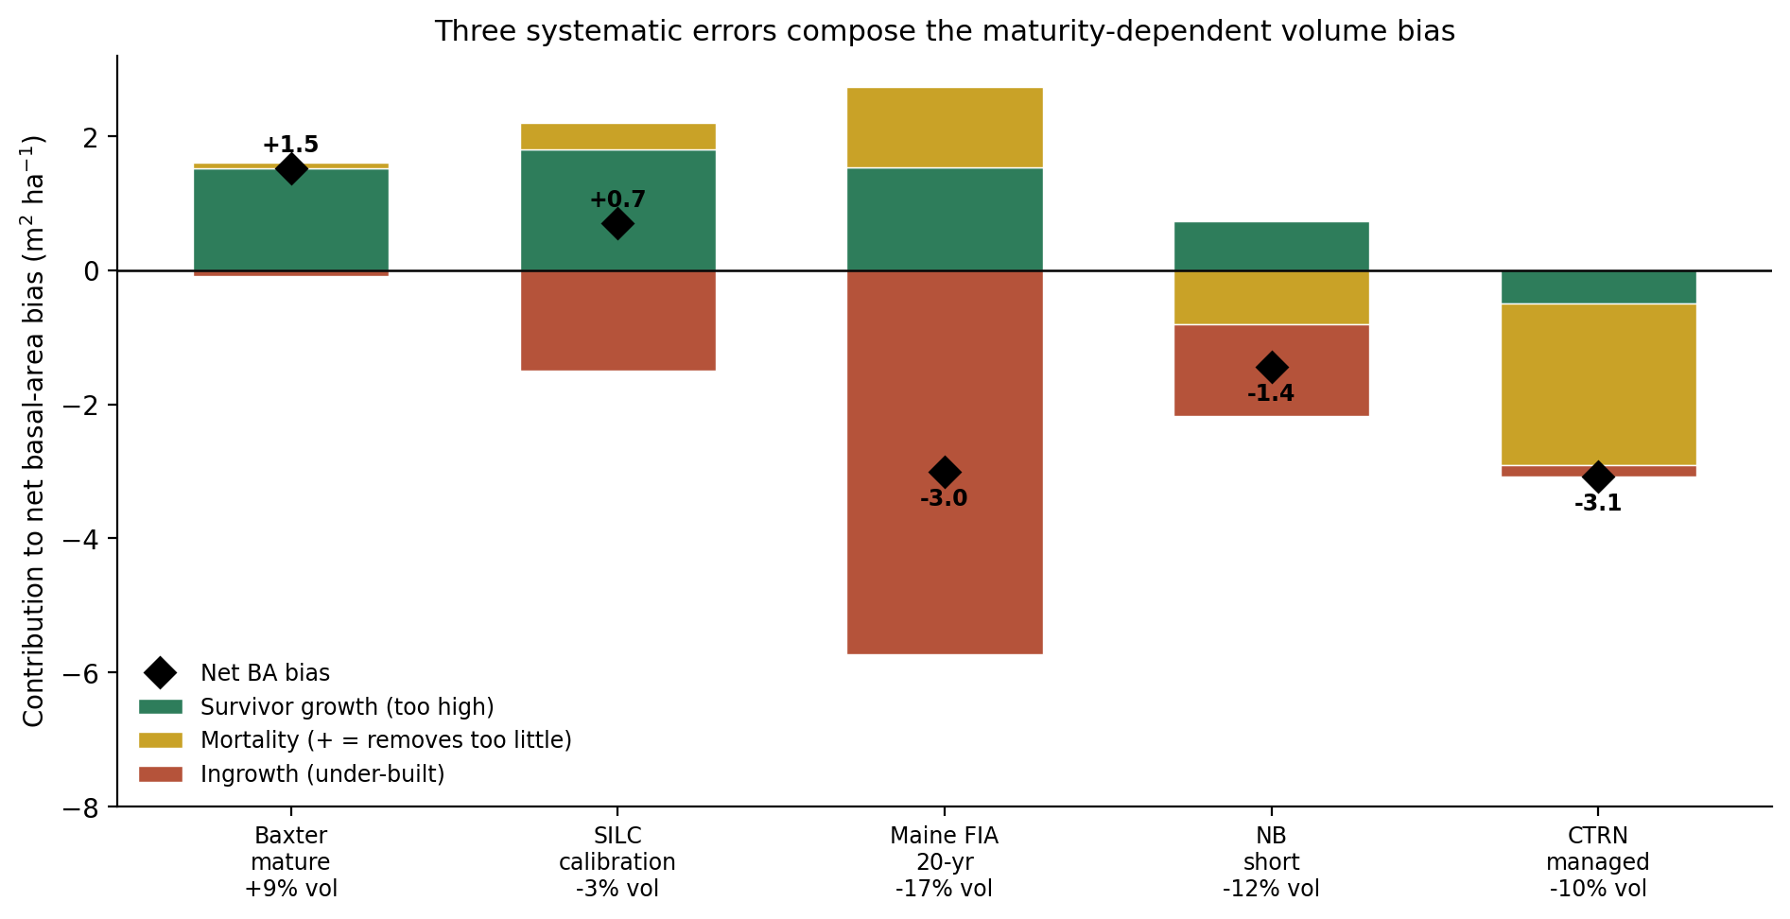
DECOMPOSITION
Three separable component errors map to three levers
Figure 2. Component decomposition of net stand volume change, base versus v12.11
Survivor growth too high: Lever 3
Girth over-accretion, QMD floor 22 cm
Recruitment deficit: Lever 1
Predicted 7.6 vs observed 38.5 m³ ha⁻¹, IGMULT = 2.5
Mortality over-removal: Lever 2
4.6x observed at CTRN, 2.5x at NB, RD0 = 0.38
Notes:
The decomposition splits net stand volume change into its components and compares observed against predicted, base against the v12.11 candidate, for Maine FIA, Baxter, and CTRN. Three errors come out of it, and each maps to a lever. First, survivor growth is too high. Diameter increment over-accretes girth on large old trees on every source, and at mature Baxter mortality is essentially exact, so the survivors are carrying that over-prediction on their own. Lever 3, the Chapter 10 QMD-gated stand constraint, reins it in, but only where QMD is high enough to matter. Second, recruitment. Predicted recruitment is 7.6 against observed 38.5 m³ ha⁻¹ on the Maine FIA 20 year set, and that deficit drives the developing-end under-prediction. Lever 1 lifts the flat, basal-area-anchored ingrowth deficit by about 2.5x pooled, IGMULT = 2.5. Third, mortality. The SILC-calibrated self-thinning over-removes at managed, high-density structures, 4.6x observed at CTRN and 2.5x at New Brunswick. Lever 2 attenuates the removal fraction only as relative density climbs past onset, RD0 = 0.38, so natural stands are untouched. Two footnotes belong with this. Seven Islands SILC, which is the calibration set, nets near zero, although that is cancellation of the survivor-growth overshoot against the ingrowth deficit and not evidence that both components are right. And the QMD floor, SC_QMIN = 22, was added only after this decomposition showed that an un-gated stand constraint suppressed developing-stand growth. That was our own error, caught in the red-team pass.

Slide 10
THE FIX
Five gated levers, each off by default
Recruitment
IGMULT = 2.5, pooled ingrowth deficit
1
Management-gated mortality
fmin = 0.13, k = 12.4, RD0 = 0.38
2
Chapter 10 stand constraint
QMD floor 22 cm, binds only in mature stands
3
Hardwood height by risk
High-risk trees 10 to 11% shorter, 635 trees
4
Crown ratio, investigated
Already active, Russell et al. 2014
5
Notes:
Five levers, and the design rule is that each one is gated and off by default, on only where the biology calls for it. Lever 1, recruitment. The flat, basal-area-anchored ingrowth deficit runs about 2.5x pooled, so IGMULT is set to 2.5. There is also a gated relative-density taper that protects mature closed stands, although it is not enabled in the scored configuration reported here. Lever 2, management-gated mortality. It attenuates the self-thinning removal fraction as relative density climbs past onset, f(RD) = fmin + (1 - fmin) x exp(-k x max(RD - RD0, 0)), with fmin = 0.13, k = 12.4, and RD0 = 0.38. Natural stands are untouched by it. Lever 3, the Chapter 10 QMD-gated stand constraint. It lowers the activation threshold on the proportional-increment constraint to a stand basal-area-increment target, gated by a 22 cm QMD floor so that it binds only in mature, high-QMD stands and spares developing stands. Lever 4, hardwood height by form and risk. High-risk trees run about 10 to 11% shorter in Betula alleghaniensis Britton and Acer saccharum Marshall, both at p < 0.002. The effect is weaker and not significant in Acer rubrum L., p = 0.59. It was fitted from 635 field trees across four Maine installations. Lever 5 is not really a new lever, and I want to be straight about that. Crown ratio is already active. It is projected dynamically every cycle by the Russell, Weiskittel and Kershaw 2014 recession model and it feeds both diameter and height increment. The changelog note describing it as disabled was four years stale. We investigated it, found nothing to fix, and are reporting that plainly.

Slide 11
ENGINEERING RIGOR
Gate-off reproduces v12.10.1 bit for bit
0.000e+00
maximum absolute difference,
candidate vs frozen v12.10.1 baseline
Reconfirmed on a novel hardwood-heavy stand, CSI 20, 30 yr
Betula alleghaniensis Britton, Acer saccharum Marshall, Acer rubrum L. mix
Diameter, height, and expansion factor
Notes:
This is the engineering claim, and it is the one that makes the candidate safe to hand to anyone. Every lever is gated and off by default. With the gates off, the candidate reproduces the frozen v12.10.1 baseline bit for bit, a maximum absolute difference of 0.000e+00 on diameter, height, and expansion factor. That was confirmed on a 20 year projection of both a young and a mature stand after every engine change, and then reconfirmed after the red-team fixes on a novel hardwood-heavy stand that had not been used in any prior smoke test, a Betula alleghaniensis Britton, Acer saccharum Marshall, and Acer rubrum L. mix at CSI 20 over a 30 year projection. The practical consequence is that nobody has to choose between v12.10.1 and v12.11. It is the same model file, and the levers are switches.

Slide 12
VALIDATION
All four guardrails pass, two flags remain open
Guardrail | Base v12.10.1 | v12.11 candidate
1. Frozen in-domain FIA NSVB (n=733) | BA -11.28%, TOPHT +4.21%, TOTVOL -4.41% | BA -7.31%, TOPHT +5.88%, TOTVOL -1.50%
2. Bakuzis five relations (Reineke slope) | -1.59, PASS | -1.62 primary PASS; -1.88 managed sensitivity, FLAG only
3. Long-horizon plateau (~160 yr) | BA 36.10 m² ha⁻¹, plateaus | BA 35.29 m² ha⁻¹, plateaus
4. Managed out-of-sample vs OSM v2.26.1 | Trails OSM on all 4 cells | Beats or ties OSM on 3 of 4 cells
TOPHT drift traces to the per-province dht.mult scalar, not the new levers
Notes:
Four guardrails, and all four pass. I put the two flags on the slide because you will hear them from me before you find them yourselves. Guardrail 1 is a no-regression check on the frozen in-domain FIA NSVB set, n = 733. Basal area and total volume both move closer to zero, -11.28% to -7.31% and -4.41% to -1.50%. Top height drifts further from zero, +4.21% to +5.88%, and it is the one metric that moved the wrong way. The red-team pass traced that drift to the always-on per-province dht.mult height-increment scalar, NB_AFAC = 0.579 and QC_AFAC = 0.111, and not to the new growth levers. It is also not an ESI-consistent anchor-recalibration mechanism, because no such mechanism exists in this model file. That reframe is the next slide. Guardrail 2 is the Bakuzis five relations. The primary unmanaged mapping passes with a Reineke slope of -1.62 against the base's -1.59. The one flag, -1.88, is confined to a managed sensitivity check on a synthetic stand that is never actually thinned, sits just beyond the -1.8 to -1.4 acceptance band, and does not block the primary configuration. Guardrail 3 is the long-horizon plateau at about 160 years. Both configurations go flat and self-thin, basal area 36.10 m² ha⁻¹ for the base and 35.29 m² ha⁻¹ for the candidate. Guardrail 4 is managed out-of-sample against OSM v2.26.1. The base trailed OSM on all four CTRN and New Brunswick cells. The candidate now beats or ties OSM on three of four. However, on the managed cell it ties OSM on bias and still trails on RMSE, although the gap narrowed from a 9.4-point deficit under the base to 3.5 points. I will take questions on either flag.

Slide 13
CENTRAL RESULT
On its target managed and mature sources, v12.11 beats OSM v2.26.1
Source | n | Total volume bias base / v12.11 / OSM | Basal area bias base / v12.11 / OSM
Baxter, ME (mature, held out) | 91 | +9.12% / +6.92% / +12.37% | +5.74% / +4.47% / +13.28%
CTRN, ME (managed) | 1,086 / 1,033 | -9.78% / -2.24% / -4.81% | -11.26% / -3.52% / -4.19%
NB MagPlot (managed) | 355 | -11.84% / -5.96% / -8.07% | -8.84% / -2.33% / -2.48%
Two managed flags open: QC MagPlot volume, SILC basal area
All three sources scored at stand grain. QC MagPlot has no scored OSM comparison.
Notes:
This is the central result, and the qualifier in the title is doing real work. On the three sources the levers actually target, the candidate roughly halves bias and beats OSM v2.26.1. At Baxter, the mature held-out reserve, n = 91, total-volume bias goes from +9.12% to +6.92% against OSM's +12.37%, and basal area from +5.74% to +4.47% against OSM's +13.28%. At CTRN, the managed Maine network, n = 1,086 for volume and 1,033 for basal area, total volume goes from -9.78% to -2.24% against OSM's -4.81%, and basal area from -11.26% to -3.52% against OSM's -4.19%. At New Brunswick MagPlot, n = 355, total volume goes from -11.84% to -5.96% against OSM's -8.07%, and basal area from -8.84% to -2.33%, where OSM sits at -2.48% and is effectively tied. Two managed flags belong with this table and they are on the record. Quebec MagPlot basal area improves sharply, -12.95% to -4.12%, although its total volume worsens to +9.46%, which suggests the management gate over-corrects volume relative to basal area at that source. And SILC Seven Islands basal area widens, +5.35% to +11.02%. Both are named v13.1 targets. On grain: Baxter, CTRN, and New Brunswick MagPlot are all scored at stand grain. Quebec MagPlot has no scored OSM comparison this round, which is why it does not appear in the table.

Slide 14
CENTRAL RESULT
OSM still leads developing Maine FIA, at either grain
Source | Grain | n | Total volume bias: base / v12.11 / OSM
PEF, ME (developing) | stand | 2,853 | +1.23% / +1.37% / +0.26%
Maine FIA (developing) | whole-plot | 918 | -16.60% / -16.13% / -6.29%
Maine FIA (developing) | subplot (~0.017 ha) | 2,858 | -24.90% / -24.82% / no OSM comparison
Subplot gap moves 0.08 points, whole-plot 0.5
Developing end is the acknowledged open gap, v13.1's target
Notes:
This is the other half of the picture, and it is where OSM still wins. On developing whole-plot Maine FIA, n = 918, OSM leads by a wide margin, -6.29% against the candidate's -16.13%, and the recruitment lever narrows that only modestly from the base's -16.60%. At PEF, n = 2,853, all three models sit close to zero, base +1.23%, candidate +1.37%, and OSM +0.26%. The subplot re-score is the part I want to flag. We re-scored the same Maine FIA population at the finer subplot grain, about 0.017 ha, n = 2,858, specifically to test whether the developing-end fix survives finer aggregation. It largely does not. Bias moves from -24.90% to -24.82%, a change of 0.08 percentage points, against the whole-plot improvement of about 0.5 points. There is no scored OSM comparison at that grain. So the developing end, at whole-plot and especially at subplot grain, is the acknowledged open gap in this candidate. It is the explicit target of v13.1, which is gated and running on Cardinal. v12.11 does not close it, and I am not going to claim that it does.

Slide 15
ALL-SITES SCORECARD
v12.11 wins on managed sources; developing end stays open
Managed CTRN and NB MagPlot: bias roughly halved, now beats OSM
Baxter, held out: volume +9.12% to +6.92%, basal area +5.74% to +4.47%
Two flags disclosed: QC volume over-corrects to +9.46%, SILC basal area widens
Developing end still open: OSM ahead at Maine FIA whole-plot and subplot
Notes:
This is the central result, and it is the one slide where the wins and the flags sit together. On the managed sources, CTRN and NB MagPlot, bias against the frozen v12.10.1 base is roughly halved on both basal area and total volume, RMSE falls in both cases, and the candidate now beats OSM v2.26.1 on both sites rather than trailing it. The held-out mature Baxter installation, 91 stands never used in any fitting step, moves toward zero on both metrics and beats OSM by a wide margin, OSM at +12.37% total volume and +13.28% basal area on the same stands. Two managed sites carry a flag rather than a clean win, and I want those stated here rather than left in the report. Quebec MagPlot's basal-area bias improves sharply, -12.95% to -4.12%, however its total-volume bias worsens from near zero to +9.46%, so the management gate over-corrects volume relative to basal area in Quebec. SILC widens on basal area, +5.35% to +11.02%, although its total-volume bias improves modestly and still comfortably beats OSM, -5.65% against OSM's -18.07%, so the SILC flag is a basal-area problem specifically and not a broad reversal. Where v12.11 does not win is the developing end. OSM remains ahead on Maine FIA at whole-plot grain, -6.29% against the candidate's -16.13%, a gap the recruitment lever narrows only modestly from the base's -16.60%. At the subplot grain, about 0.017 ha, the gap barely moves at all, -24.90% to -24.82%, a 0.08 percentage point change. PEF nets out close to unchanged on total volume, +1.23% to +1.37%, and it runs with the management gate off because it is scored as an unmanaged source. Both managed flags and the developing-end gap are named v13.1 targets, not claims closed by v12.11.

Slide 16
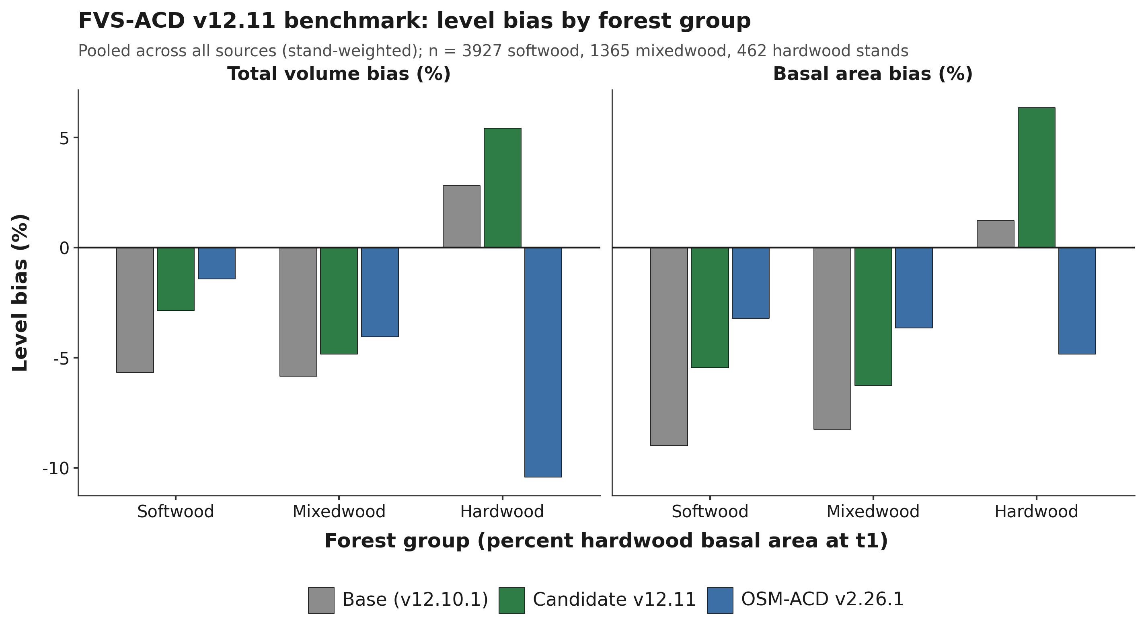

FOREST-GROUP PERFORMANCE
Softwood wins cleanly; the pooled hardwood shift is a QC artifact
Softwood volume bias -5.67% to -2.86%, basal area -9.00% to -5.45%
Hardwood pooled widens +2.82% to +5.42%, three-quarters of it QC MagPlot
Non-QC hardwood signal small and mixed, -0.77% to +1.28%, n = 347
n = 3,927 softwood, 1,365 mixedwood, 462 hardwood
Notes:
Softwood is the section's clean win. Pooled across all seven sources and stand-weighted, softwood total-volume bias improves by more than half, -5.67% to -2.86%, and basal-area bias narrows from -9.00% to -5.45%. That is the narrowest remaining gap to OSM of the three forest groups, with OSM at -1.43% volume and -3.21% basal area. Softwood carries CTRN's 1,077 stands and most of PEF's 2,092, so it is the group where the management-gated mortality lever and the recruitment lever get the most exercise. Mixedwood improves by a smaller but real margin, -5.84% to -4.84% on volume and -8.25% to -6.26% on basal area, concentrated in bias reduction rather than a broader tightening of scatter. Hardwood needs care, and an earlier draft of this section had the causal story wrong. The pooled hardwood bias does widen, +2.82% to +5.42% on total volume. However, a second-round red-team decomposition shows QC MagPlot alone carries +7.62 of the pooled +2.60-point shift, roughly three-quarters of it, and QC's move is not hardwood-specific: in the same scoring run its softwood cell moves +8.79 points and its mixedwood cell +7.85, a uniform +7.6 to +8.8 point shift across all three forest groups. Lever 4 is the only lever that touches hardwood, it corrects hardwood height for form and risk, and it is structurally incapable of moving softwood or mixedwood volume at all, so a shift of comparable size and identical direction across all three groups in one province is the signature of a source or harness artifact. Setting QC aside, the cross-source hardwood signal across the other five sources, n = 347, Baxter, Maine FIA, PEF, SILC, and New Brunswick, is small and mixed, base -0.77% to candidate +1.28%, with three of the five improving and only PEF and the small SILC cell, n = 11, worsening. OSM moves the other way on pooled hardwood, swinging to a substantial under-prediction at -10.42%. The outstanding test is the province-assembly diagnostic, rerunning the base configuration through the identical assembly procedure used for the candidate, to separate harness effects from lever effects.

Slide 17
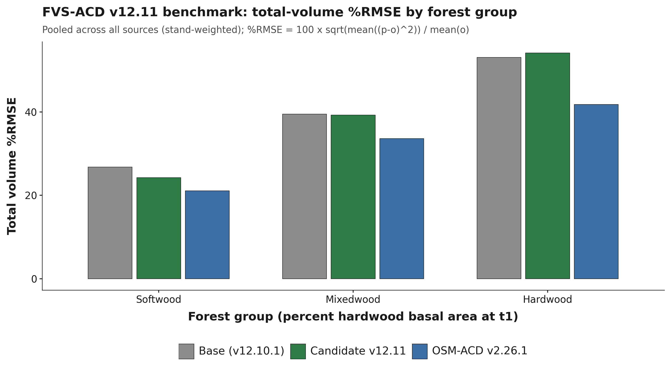
FOREST-GROUP PERFORMANCE
Precision tightens on softwood and mixedwood; hardwood stays open
Softwood %RMSE 26.79% to 24.25%; mixedwood 39.46% to 39.23%
Hardwood %RMSE 53.06% to 54.12%, the wrong direction
OSM tighter throughout: 21.08%, 33.61%, 41.77%
Province-assembly check not yet run against precision
Notes:
Precision follows the bias story on softwood and mixedwood. Percent RMSE falls with the bias gains on softwood, 26.79% to 24.25%, and edges down on mixedwood, 39.46% to 39.23%, although OSM keeps the tighter scatter on both, 21.08% and 33.61%. Hardwood ticks the wrong way on precision as well, 53.06% to 54.12%, while OSM's precision is closer at 41.77% even as its bias swings negative. I would not read that as a confirmed hardwood-specific v13.1 target. The bias-side decomposition on the previous slide shows the pooled hardwood shift is substantially a single-source Quebec artifact and not a genuine cross-source hardwood degradation, and the same province-assembly check has not yet been run against the precision numbers. Until it is, hardwood is best read as an open question and partly a sample-size problem, since the non-QC hardwood cells run from 11 to 47 stands. Softwood remains this benchmark's clear win, and mixedwood a smaller real gain.

Slide 18
OVERALL ACROSS ALL DATASETS
v12.11 nearly closes the pooled bias gap; precision does not follow
Source | n candidate / OSM | Total volume bias base / v12.11 / OSM | Basal area bias base / v12.11 / OSM
Softwood | 3,927 / 3,716 | -5.67% / -2.86% / -1.43% | -9.00% / -5.45% / -3.21%
Mixedwood | 1,365 / 1,257 | -5.84% / -4.84% / -4.05% | -8.25% / -6.26% / -3.66%
Hardwood | 462 / 346 | +2.82% / +5.42% / -10.42% | +1.23% / +6.35% / -4.83%
All forest types (computed) | 5,754 / 5,319 | -5.03% / -2.66% / -2.63% | -8.00% / -4.70% / -3.42%
Overall bias -2.66% against OSM -2.63%; %RMSE 30.21% against 25.39%
Base v12.10.1. Candidate v12.11. OSM ACD v2.26.1.
Notes:
The all forest types row is a stand-weighted mean of the three rows above it, computed from the forest-group scorecard, not a separately scored pooled run, and it should be read that way. On that basis v12.11's overall total-volume bias, -2.66%, is now essentially level with OSM's -2.63%. Percent RMSE tells a different story: v12.11 pools to 30.21% against OSM's 25.39%, so the precision gap is real and this candidate does not close it. The hardwood row driving part of that RMSE gap is substantially a QC MagPlot artifact rather than a genuine hardwood-specific effect, which is the correction on the previous slide, and softwood and mixedwood carry the pooled row's real, source-consistent gains. Base is the frozen v12.10.1, candidate is v12.11, and OSM is OSM-ACD v2.26.1. The numbers come from figures/_data/v1211_forestgroup_scorecard.csv, pooled stand-weighted rows by forest group. OSM n runs slightly below base and candidate n in every forest group because QC MagPlot has no scored OSM comparison in this round.

Slide 19
RED TEAM
Three of six reframes with numeric or methods impact
Top height is an anchor
Lever 4 is a species average
Quercus rubra coefficient capped
Six lever configurations, top height 20.269 m
Drift traces to dht.mult: NB 0.579, QC 0.111
Species-average multiplier, every stem, SPLIT-synthesized
26.7% pre-cap derate, field-validated species 12.6 to 12.7%
Capped pending field heights
Gate-off byte-identical after every fix, 0.000e+00
Notes:
Three of the six red-team reframes carry a numeric or a methods consequence, and all three are stated here rather than left in the working files. First, top height is not a lever effect. Six lever configurations run through an identical stand gave bit-identical top height to three decimals, 20.269 m, whichever levers were on, while basal area varied 22.37 to 21.64 m2 ha-1 across the same six runs, because the ESI dominant-height anchor forces top height onto a curve driven by climate site index and age alone. The first-round write-up named the wrong mechanism. Direct inspection of the authoritative Cardinal model file shows the ESI-consistent anchor recalibration does not exist in this model file at all, although the scoring harness still logs ANCHOR=TRUE as if it were running. The live pathway is the always-on per-province dht.mult height-increment scalar, NB_AFAC 0.579 and QC_AFAC 0.111, which exists to cancel a documented +7.0 m positive bias in the QC and NB ESI v8 raster input, so it corrects a scalar mean and not plot-level site-index skill, and any future region relying on that pathway inherits the same unproven correction. Second, Lever 4 at scoring is a species average, not a tree-specific correction. Every reported Lever 4 number was scored against SPLIT-synthesized form and risk, an identical population-average, expansion-factor-weighted multiplier applied to every stem of a species regardless of its individual size, vigor, or condition, so the risk-class framing does not functionally differentiate individual trees anywhere in the reported validation. Describe it as a species-average height correction validated at that level. Third, the Quercus rubra L. coefficient was capped. Its worst-case pre-cap multiplier was a 26.7% height derate, more than double the roughly 12.6 to 12.7% carried by the two species with genuine field validation, Betula alleghaniensis Britton and Acer saccharum Marshall, and it rested entirely on an FIA damage-code proxy because Q. rubra had only one tree in the Smith field set, which was dropped. It is capped to the sugar maple and yellow birch field magnitude pending independent field heights. Three further reframes are carried but change no number on this slide. The fourth corrects the hardwood forest-group causal story to a QC-source artifact, which is the next section. The fifth confirms byte-identical gate-off a second time after a gated ESI-anchor height-cap re-clamp. The sixth catches Nova Scotia's apparent long-interval over-prediction as a contamination artifact, where the clean record shows attenuation and not a sign flip. Independent verification reconfirmed byte-identical gate-off on a novel stand after every fix, with a maximum absolute difference of 0.000e+00 on diameter, height, and expansion factor.

Slide 20
ACCURACY AND PRECISION
Percent bias inflates on low means; %RMSE is the fairer read
Percent bias divides by the mean and balloons on low means
%RMSE blends accuracy and precision and does not deflate
Hardwood: v12.10.1 +19% bias but about 76% %RMSE, OSM about 75%
Notes:
Two metrics, and they answer different questions. Percent bias divides by the mean, so it balloons on low-mean metrics and can read a model as far worse than it actually is, which is exactly what happens on hardwood cells with few stands and low mean volume. Percent RMSE blends accuracy and precision and does not deflate the same way, so it is the fairer read when comparing across forest groups. Hardwood is a high-variance frontier shared by every model rather than a v12.11 problem: v12.10.1 hardwood total volume runs about +19 percent bias but about 76 percent RMSE, and OSM sits at about 75 percent on the same metric. When someone asks why the hardwood bias numbers look alarming, this is the slide to come back to.

Slide 21

LEGACY VALIDATION, PRE-V12.11
Hardwood was already the shared frontier before v12.11
Softwood equivalent for every model. Hardwood: all models over-predict, OSM +15.
v12.9.x roughly halves the v12.5.0 hardwood bias. Legacy in-domain 705-stand benchmark, v12.5.0 through v12.9.x.
New Brunswick and Quebec only, no Maine.
Notes:
This is the legacy in-domain 705-stand benchmark, scored across v12.5.0 through v12.9.x, and it predates v12.11. Softwood is equivalent for every model in the lineage, so nothing separates them there. Hardwood is the shared frontier: every model over-predicts, including OSM at +15, and v12.9.x roughly halves the v12.5.0 hardwood bias. I include it because it establishes that hardwood was already the hard case before this candidate existed, which matters when reading the forest-group slides earlier in this deck. Those slides quantify the same hardwood frontier for the current candidate against the frozen base and OSM, on the full all-sites benchmark rather than this narrower in-domain set. This legacy set is New Brunswick and Quebec only, no Maine stands.

Slide 22
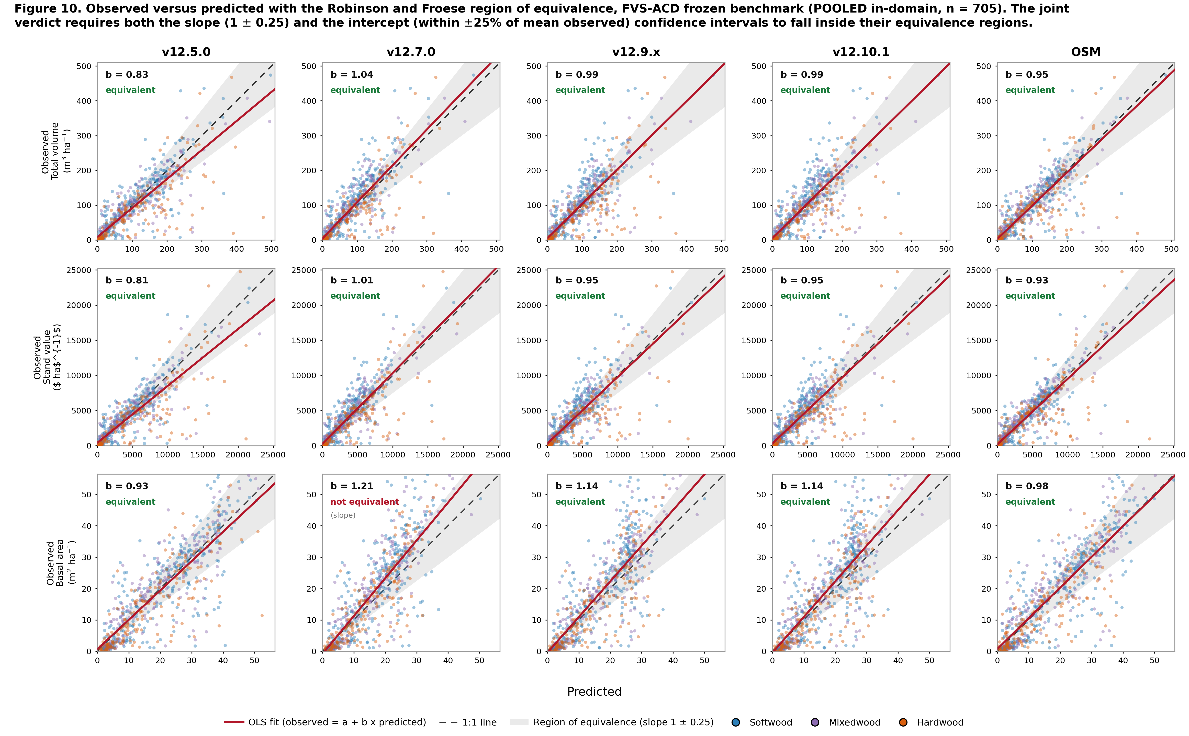
REGION OF EQUIVALENCE, LEGACY 705-STAND BENCHMARK
Four of five models pass all nine equivalence metrics
Robinson and Froese region of equivalence, joint slope and intercept
Slope 1 plus or minus 0.25, intercept within 25 percent of mean observed
One exception: v12.7.0 basal area, slope 1.21
Not yet re-run for v12.11
New Brunswick and Quebec only, no Maine.
Notes:
The test here is observed on predicted with the Robinson and Froese region of equivalence, evaluated jointly on slope and intercept. The slope region is 1 plus or minus 0.25 and the intercept region is within 25 percent of the mean observed, and a model has to sit inside both to pass. Four of five models pass all nine metrics. The one exception is v12.7.0 basal area, where the slope runs steep at 1.21. Every volume and value metric passes for every model, which is the part that matters operationally. One scope limit worth stating plainly: this equivalence battery has not yet been re-run for v12.11. It remains the methodology this deck uses to judge slope and intercept equivalence, applied here to the model lineage through v12.10.1 and to OSM, and re-running it on the candidate is an outstanding item. The 705-stand benchmark behind this equivalence test is New Brunswick and Quebec only, no Maine stands; Maine enters only the current all-sites benchmark shown elsewhere in this deck.

Slide 23
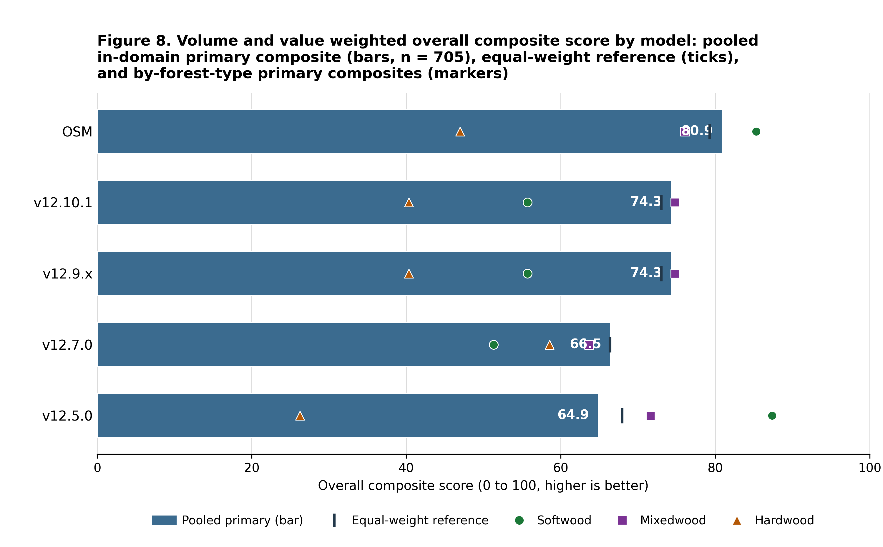
OVERALL COMPOSITE, LEGACY 705-STAND BENCHMARK
OSM leads either composite; the FVS order flips by view
%RMSE-weighted: OSM 53.4, v12.7.0 52.1, v12.9.x and v12.10.1 49.8, v12.5.0 49.4
Bias-weighted: OSM 80.9, v12.9.x and v12.10.1 74.3, v12.7.0 66.5, v12.5.0 64.9
v12.10.1 least biased; v12.7.0 tighter scatter
Legacy 705-stand set, predates v12.11. New Brunswick and Quebec only, no Maine.
Notes:
Volume and value carry the most weight in both composites, which is part of why the two views disagree. On the percent RMSE weighted composite, which blends accuracy and precision, the order is OSM 53.4, v12.7.0 52.1, v12.9.x and v12.10.1 tied at 49.8, and v12.5.0 49.4. On the bias-weighted view shown in the figure it is OSM 80.9, the shared v12.9.x and v12.10.1 build 74.3, v12.7.0 66.5, and v12.5.0 64.9. OSM leads either way. Within the FVS line the order flips: v12.10.1 is the least biased and v12.7.0 has the tighter scatter, so which build looks best depends on which of the two you weight. This composite scores the model lineage through v12.10.1 against OSM on the narrower in-domain 705-stand set and predates v12.11. The pooled forest-group synthesis for the current candidate, on the full 5,754-stand all-sites benchmark, appears earlier in this deck. The 705 stands scored here are New Brunswick and Quebec only; Maine, which supplies 87 percent of the modern all-sites benchmark in slides 4 through 7 and 34 through 35, is not part of this composite.

Slide 24

NEW CALIBRATION APPROACHES
Biological realism: only the self-thinning versions pass all five
FVS-ACD self-thinning versions pass all five relations
OSM passes three, flags Eichhorn and site ordering
v12.5.0 never self-thins, fails three relations
Ingrowth under-predicted: NB 17.9 against 39.8, QC 11.7 against 19.7 stems ha⁻¹ yr⁻¹
v12.11 guardrail: Reineke -1.62, flagged -1.88 managed; plateau 35.3 against 36.1 m² ha⁻¹
Notes:
This is the seeded-gradient Bakuzis battery, an internal biological-consistency check rather than a measure of predictive accuracy against held-out data. The FVS-ACD self-thinning versions plateau at the realistic maximum and pass all five relations. OSM, run the full 160 years, is now fully scored on all five: it passes Reineke self-thinning, the yield-density plateau, and Sukachev, and flags Eichhorn and site ordering. That is a correction to an earlier read. The age-60 read that showed OSM in runaway accumulation caught only the pre-plateau limb, and over the full horizon OSM does plateau and self-thin. v12.5.0 never self-thins at all, with basal area running to 65 and thousands of stems still alive, so it fails yield-density, Reineke, and Sukachev. The limit here is ingrowth. Recruitment is under-predicted, New Brunswick 17.9 against 39.8 and Quebec 11.7 against 19.7 stems per hectare per year. The direction is correct, it responds to density and to management, however the level is low, and that is a disclosed limit and a v13 target rather than something this candidate fixes. The v12.11 guardrail reconfirms the picture: a Reineke self-thinning slope of -1.62 in the primary configuration, flagged only at -1.88 in the managed sensitivity check on a synthetic never-thinned stand, and a yield-density plateau of 35.3 against the base's 36.1 m2 ha-1. One thing to state on this slide because it governs the whole lever section: every one of the five v12.11 levers is gated and off by default, and with all gates at their default off value and SPLIT false the candidate reproduces the frozen v12.10.1 baseline byte for byte.

Slide 25
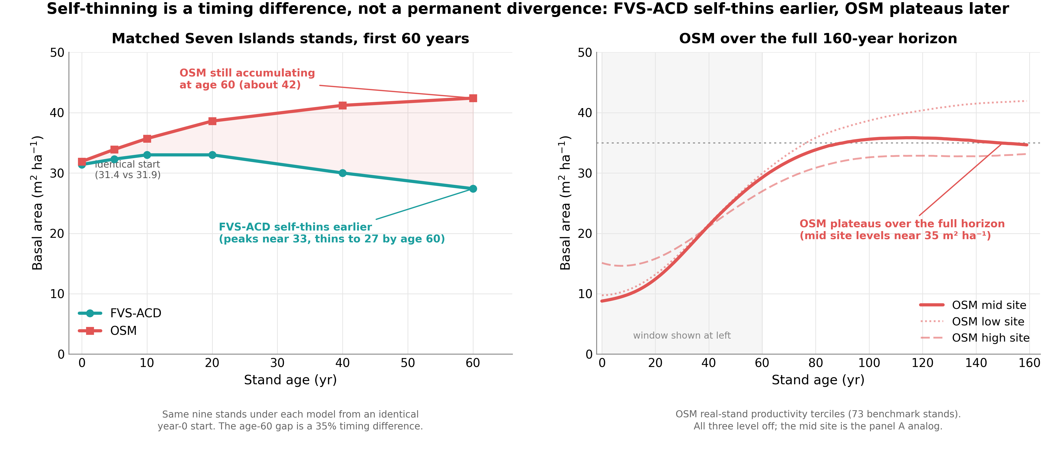
SELF-THINNING TIMING
Long horizon: FVS-ACD self-thins earlier, OSM plateaus later
Short-interval agreement hides a long-horizon divergence in self-thinning timing
The reason FVS-ACD suits carbon, old-growth and climate work; volume bias flips sign with stand maturity
Notes:
The two models agree closely in the operational short-interval domain, and that agreement hides a long-horizon divergence in the timing of self-thinning. FVS-ACD self-thins earlier and OSM plateaus later over the full horizon. That difference is the reason I point people to FVS-ACD for carbon, old-growth, and climate work, where the projection runs well past the operational interval and the timing of density-dependent mortality drives the answer. Scored in volume, the same timing difference makes long-horizon bias flip sign with stand maturity in both models: under-prediction in developing stands and over-prediction in mature reserves. That sign flip is the signature to watch for, and it is why the maturity gradient is reported explicitly rather than pooled away.

Slide 26

SITE PRODUCTIVITY
Site productivity: keep ESI
Bake-off settled: ESI, BGI, CPSI, legacy CSI
Out of sample, spatially blocked CV
ESI wins the height anchor, ties on diameter growth
BGI and CPSI: no height signal, no cross-border coverage
Anchor correction tested, not shipped: +4% height offsets -10% basal area
Joint re-anchor is v13.0
Notes:
The site-productivity bake-off is settled. ESI, BGI, CPSI, and the legacy CSI were compared out of sample with spatially blocked cross-validation, so no candidate is being scored on its own neighborhood. ESI wins the dominant-height anchor and ties for diameter growth. BGI and CPSI carry no height signal and lack cross-border coverage, which rules them out for a model that has to run across Maine, New Brunswick, and Quebec on one currency. The part worth saying out loud is why pooled parity is deferred rather than hand-waved. We tested a top-height anchor correction and did not ship it. In the shipped configuration a +4% top-height over-prediction offsets a -10% basal-area under-prediction, so correcting height alone drives volume further negative, which is worse on the metric that matters most operationally. True parity needs a joint height and basal-area re-anchor, and that is v13.0 work, not a v12.11 patch.

Slide 27

NEW CALIBRATION APPROACHES
The Chapter-11 lever: a fitted release, not a clamp
Direct effect only, Chapter 11; multi-step method, Wang 1990
Planted = Type 2, sustained. PCT = Type 1, transient.
Fitted additive release: planted +3.8, PCT +2.4 m² ha⁻¹ basal area
Out of sample managed: 0.9 installation-out, 1.5 province-out, OSM 8.3
Planted 4.0 and 5.7 against OSM 16.7; PCT 1.5 and 4.1 against 3.7
Notes:
The base equations already carry the indirect structural effect of management, so the modifier has to isolate the direct effect only, which is the Chapter 11 framing, using the multi-step method of Wang 1990. Planted stands behave as a Type 2 response, sustained. Precommercial thinning behaves as a Type 1 response, transient and decaying. The result is a robust re-fit. The direct effect is expressed as a fitted additive release, planted +3.8 and PCT +2.4 m2 ha-1 of basal area on ten percent trimmed means of per-stand observed minus predicted-untreated increment, not a clamped ratio, so its fold coefficients move with the data. The equivalent net multiplier is about 3.0 planted and 2.3 PCT, above the old 1.6 ceiling, which is why the capped version still under-predicted planted stands. Out of sample it holds. Managed mean absolute bias is 0.9 under leave-one-installation-out and 1.5 under the harsher leave-one-province-out block, against OSM's 8.3. Planted beats OSM in every scheme, 4.0 installation-out and 5.7 province-out against 16.7. PCT is 1.5 installation-out and 4.1 province-out against OSM's 3.7, so PCT is the one class where OSM stays competitive. v12.10.1 clearly beats OSM on planted and edges OSM on managed out of sample. The modifier is gated by ops$use.mgmt.mod and applies only to planted and PCT stands. With the gate off the run is byte identical to v12.9.x and the 266 unmanaged stands are unchanged.

Slide 28

NEW CALIBRATION APPROACHES
The modifier closes the managed gap
Additive direct-effect release: planted +3.8, PCT +2.4 m² ha⁻¹ basal area; clamp removed, effect bounded by self-thinning
In-sample managed mean absolute bias: v12.9.x 10.2 to v12.10.1 1.3, OSM 8.3. Gated, default off; unmanaged stands untouched.
Notes:
This is the same lever seen from the managed-gap side. The direct effect is a robust additive release, planted +3.8 and PCT +2.4 m2 ha-1 of basal area, with the old clamp removed. The engine then carries a sustained diameter-growth effect for planted stands and a decaying one for precommercial thinning, bounded by self-thinning so the release cannot push a stand past its density ceiling. In sample, managed mean absolute bias across the nine NSVB metrics falls from 10.2 under v12.9.x to 1.3 under v12.10.1, against OSM's 8.3. Those are in-sample numbers, and the cross-validated version follows, so this figure should not be quoted on its own. The modifier is gated and off by default, so unmanaged stands are untouched and a run with the gate off is byte identical to v12.9.x.

Slide 29
NEW CALIBRATION APPROACHES
Managed and planted gains hold out of sample
Mean absolute level bias; lower is better
Cross-validation scheme | Planted | PCT | Managed
Leave-one-installation-out | 4.0 | 1.5 | 0.9
Leave-one-province-out | 5.7 | 4.1 | 1.5
Managed split-half (200 reps) | n/a | n/a | 5.2
OSM reference | 16.7 | 3.7 | 8.3
What survives the red team
Managed: clean out of sample win
Planted: wins every scheme
Notes:
This is the out of sample test of the calibration levers, and the table is the evidence rather than the in sample fit. In sample class bias is near zero by construction, so the cross validated numbers are the only ones worth quoting. Managed is the clean win: 0.9 mean absolute level bias leave one installation out and 1.5 leave one province out, against OSM at 8.3. Planted beats OSM in every scheme, 4.0 installation out and 5.7 province out against 16.7, and it transfers across the New Brunswick to Quebec border. PCT sits at 1.5 leave one installation out and now transfers at 4.1 leave one province out, against OSM at 3.7, and the PCT basal area residual closes. Although that Quebec number is respectable, we still report the Quebec edge as out of domain, which is the conservative call. The robust additive re fit removed the 1.6 clamp, so fold coefficients now move with the data, with the planted basal area release running 3.6 to 4.1 across folds, and the out of sample numbers hold. These planted, PCT, and managed cross validation results carry unchanged into v12.11, because none of the five new levers touches the Chapter 11 direct effect fit. Every figure here is source verified against Table 23 and Section 7.9 of the benchmark report. One scope limit worth stating: the split half figure of 5.2 is the managed scheme only, and it was not run for planted or PCT. The OSM reference row is class specific, so read it down the column and not across.

Slide 30
NOVA SCOTIA
The managed stand levers generalize to an independent province
4,504 scored pairs, fully independent
Nova Scotia PSP network, established 1965
Never used to fit v12.11
1
Managed total volume bias -58.10% to -42.32%
A 27% relative reduction
2
Unmanaged bias -6.04% to -6.07%
Lever 2 acts only where a stand is flagged managed
3
Notes:
Nova Scotia is the one province in this benchmark that had no hand in building the model. The Permanent Sample Plot network was established in 1965 and is the Acadian region's longest continuous forest inventory record. We scored 4,504 pairs from it, 2,157 managed and 2,347 unmanaged, and none of those plots was used to fit or tune any v12.11 lever, any base model coefficient, or the ESI site index anchor. That makes this the cleanest test of generalization available to us. Managed total volume bias moves from -58.10% under the frozen base to -42.32% under the v12.11 candidate, a 27% relative reduction, which closely matches the size of the managed stand improvement seen throughout the rest of the report on data the model was actually fit against. Lever 2's management gate appears to be doing the same job here that it does on Maine, New Brunswick, and Quebec data. The unmanaged side is essentially untouched, -6.04% to -6.07%, and that is exactly the behavior Lever 2 is designed to produce, because it acts only where a stand is flagged managed and leaves natural stands to the unmanaged self thinning machinery. One caveat I want on the record before anyone reads this as a sweep. Softwood, mixedwood, and hardwood forest groups all improve under the candidate here, however the overall Nova Scotia bias remains large, -41.28% to -30.61%. That is dominated by the managed subset's larger absolute gap, which the next slide takes up directly. It is not a forest group or hardwood issue.

Slide 31
NOVA SCOTIA
Site index is measured correctly; the gap is disturbance response
Same basis as the model's ESI anchor
Dominant height, meters, breast height age 50
1
QC and NB esi8 raster: +7.0 m biased, r = 0.146
Nova Scotia gets no equivalent correction
2
The correction is real but secondary
Unmanaged rescore -6.04% to -4.84% base, -6.07% to -5.04% v12.11
Unmanaged subset only, n = 2,347
3
Notes:
The obvious objection to the previous slide is that Nova Scotia site index sits on a different basis, so we checked it. NS SITE_INDEX and its research plot proxy AVGTOPHTM are both dominant height in meters read at approximately breast height age 50, which is the same basis documented for the model's own ESI anchored dominant height input. There is no species, base age, or unit mismatch on the Nova Scotia side. However, a mismatch does exist, and it runs the other way. The Quebec and New Brunswick ESI v8 raster is independently documented against 40,596 measured site index records to overstate true site index by +7.0 m with essentially no per plot linear skill, r = 0.146. The model's NB_AFAC of 0.579 and QC_AFAC of 0.111 height growth anchor exists specifically to counteract that raster's inflation. Nova Scotia gets no equivalent correction and is fed its real, uninflated field site index directly. Any future region that relies on the same pathway inherits that same unproven and poorly constrained correction, which is worth saying out loud rather than leaving in an appendix. Rescoring the unmanaged Nova Scotia subset, n = 2,347, with a +7.0 m basis matching adjustment moves total volume bias from -6.04% to -4.84% for the base and from -6.07% to -5.04% for v12.11, roughly a 15 to 20% relative reduction of an already small bias. The correction is therefore real but secondary. Most of the large -58% managed and -41% overall under prediction is not primarily a site index artifact, and it appears to be dominated by real short term post disturbance growth response. Two scope limits. This finding is unmanaged only, and the much larger managed and overall biases were not rescored with corrected site index, so they should not be over generalized.

Slide 32
NOVA SCOTIA
Clean long interval rescore: bias attenuates but never flips positive
Cut detection bug, string versus integer, caught before shipping
23% of the long interval bucket carried an undisclosed harvest
1
Clean set n = 5,348; over 30 year bucket n = 903
Scored through the identical frozen harness
2
Over 30 years: -0.06% base, -1.66% v12.11
Basal area still under predicted, -18.08% and -12.48%
3
Notes:
This is the slide where a bug nearly changed the story, so I want to be explicit about it. The tree level cut detection filter compared a string typed status column against an integer constant. That comparison is always false, so the filter silently passed every stand as undisturbed regardless of harvest history. Correcting it shows that 23% of the over 30 year bucket carried an undisclosed harvest inside the interval. An early pass, scored before the fix, appeared to show over prediction at long intervals, and that was an artifact of exactly this contamination. It was caught in red team review before it shipped, and I would rather show you the corrected version than the flattering one. The clean rescore is complete under jobs 12536574 and 12536575. The contamination free pair set, n = 5,348, made up of 4,014 unmanaged and 1,334 managed single regime pairs, was scored through the identical, unmodified frozen harness used everywhere else in this report. Managed single regime pairs were unaffected by the bug. The over 30 year bucket, n = 903, is entirely unmanaged and disturbance free by construction, with a mean interval of 36.3 years. Now the result, and it is the more modest one. Total volume bias at over 30 years is -0.06% for the base and -1.66% for v12.11, essentially zero, which is attenuation and not over prediction. Basal area stays under predicted at -18.08% and -12.48%. Bias attenuates with interval length, from -44.04% and -32.38% under 15 years, through -56.08% and -48.20% at 15 to 30 years, but it never flips positive. Nova Scotia is therefore only partially consistent with the maturity dependent sign flip pattern seen elsewhere, and I do not want that read as a clean confirmation. The managed lever finding does stand: managed bias improves from -74.36% to -55.07%, and unmanaged stays flat at -5.52% to -6.01%.

Slide 33
NOVA SCOTIA
OSM-ACD v2.26.1 head to head is a mixed result
Managed stands: essentially tied
Managed short: v12.11 -42.32%, OSM -41.96%
Managed long: v12.11 -55.07%, OSM -57.40%
1
Unmanaged: the direction flips with interval length
Unmanaged short: OSM -2.58% leads v12.11 -6.07%
Unmanaged long: v12.11 -6.01%, OSM -6.86%
2
The clearest separation in this validation
Over 30 years, n = 903: v12.11 -1.66%, OSM -9.14%
3
Notes:
OSM-ACD v2.26.1 is itself a native Acadian zone model, so this is a faithful, apples to apples comparison and not a proxy. On managed stands the two candidates are essentially tied. At short interval the frozen base is -58.10%, v12.11 is -42.32%, and OSM is -41.96%, so both candidates cut the base's bias by about 16 points. At long interval the base is -74.36%, v12.11 is -55.07%, and OSM is -57.40%, with v12.11 modestly ahead. On unmanaged stands the direction flips with interval length, which is the part I would not want anyone to quote in one direction only. At short interval the base is -6.04%, v12.11 is -6.07%, and OSM is -2.58%, a genuine OSM advantage. At long interval v12.11 is -6.01% against OSM at -6.86%, slightly ahead. Neither model is uniformly better on unmanaged stands. The clearest point of separation anywhere in this Nova Scotia validation is the disturbance clean, over 30 year bucket, n = 903, which is Nova Scotia's longest independent record. There total volume bias is -1.66% for v12.11 against -9.14% for OSM. That is consistent with the maturity gated stand constraint, Lever 3b, doing real work at exactly the horizon it targets, although a single bucket is a thin basis for a strong mechanistic claim and I would hold it loosely. The underlying data are in figures/_data/ns_headtohead.csv.

Slide 34
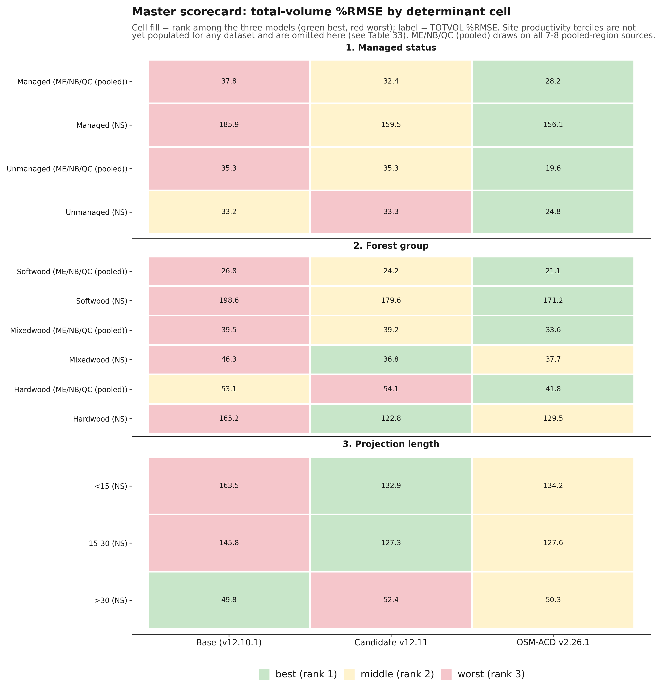
MASTER SCORECARD
OSM leads managed; v12.11 wins Nova Scotia hardwood and mixedwood
OSM lowest %RMSE in every managed cell
OSM also leads ME, NB, QC softwood and mixedwood
NS hardwood 122.8 and mixedwood 36.8, ahead of base and OSM
NS shorter buckets 132.9 and 127.3
Over 30 yr, base edges both: 49.8, 52.4, 50.3
Notes:
Read this scorecard cell by cell, because the headline depends on which lens you use. On pooled total volume percent RMSE, OSM posts the lowest value in every managed status cell in both regions, and in the softwood and mixedwood Maine, New Brunswick, and Quebec cells. However, on per source bias for the managed sources it targets, CTRN, New Brunswick, and Baxter, v12.11 still halves bias and beats OSM, exactly as on the central result slide. Per source bias and pooled percent RMSE are different lenses on the same data, and this cell corrects an earlier hypothesis of ours that v12.11 led managed status outright. It does not. v12.11's clean wins are specific and they sit in Nova Scotia. Nova Scotia hardwood is 122.8 against base 165.2 and OSM 129.5, and Nova Scotia mixedwood is 36.8 against 46.3 and 37.7, so both of those cells belong to v12.11 and not to OSM. Both shorter Nova Scotia projection buckets are also v12.11's, under 15 years at 132.9 and 15 to 30 years at 127.3, each ahead of base and OSM. Base is not a long horizon default winner, although it does take the single over 30 year Nova Scotia cell at 49.8 against v12.11 at 52.4 and OSM at 50.3. Two scope limits. Site productivity terciles stay unscored, and the projection length split is Nova Scotia only, so do not read it as a general horizon result. The figure comes from figures/_data/master_scorecard.csv; cell fill ranks the three models, green best and red worst, and the label is total volume percent RMSE. One disclosure from finalizing the cross-dataset scorecard: neither model is yet scored on the Maine FIA mature and control pair, memat and medev. The canonical scorecard document is now 20260811_final_scorecard_all_datasets.md, which supersedes the July master scorecard memo. One more disclosure on this figure itself: the projection length facet only shows Nova Scotia buckets. That is not a choice, no ME or New Brunswick or Quebec source carries a long enough consecutive remeasurement span to populate it, and the figure does not state that on its face, so say it here if asked. Site productivity terciles are correctly disclosed in the figure's own subtitle as unscored for every source.

Slide 35
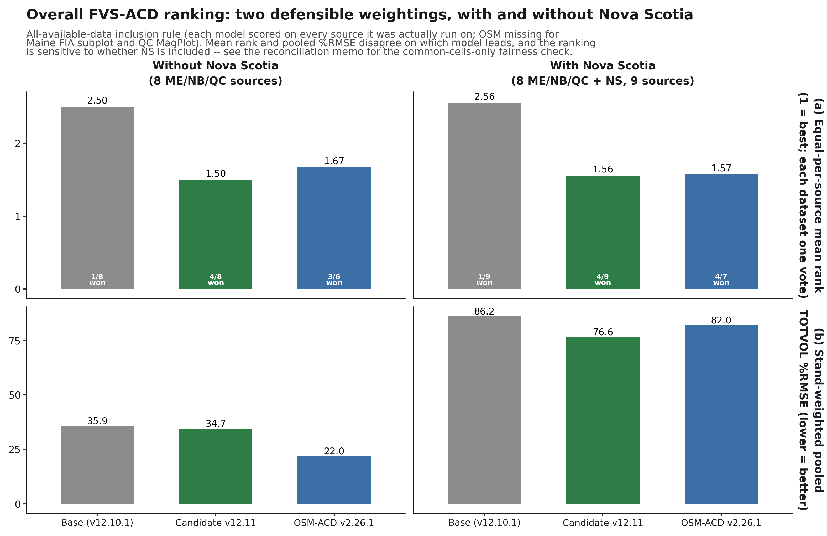
OVERALL RANKING (RECONCILED)
Neither model is a clean overall winner
v12.11 more consistent, OSM more decisive where it wins
Eighteen scenarios: v12.11 better or tied on mean rank in every one
OSM lower pooled %RMSE under the common cells rule
Base a clear third throughout
OSM carries no score for two of eight ME, NB, QC sources
Notes:
This is the reconciled ranking, and the answer is that neither model comes out ahead outright. Across the eighteen scenarios in the reconciliation memo, two inclusion rules, three Nova Scotia treatments, and both metrics, v12.11 holds the better or tied equal per source mean rank in every one and never finishes clearly last. OSM posts the lower pooled percent RMSE under the fairest common cells rule, and on the managed and softwood or mixedwood strata specifically. Base is a clear third throughout. I want to be direct about a correction here. An earlier version of this analysis carried a much stronger headline in v12.11's favor, and it turned out to be an artifact of a cross tab that triple counted Nova Scotia. That headline is superseded and I am not standing behind it. What is left is a choice rather than a ranking. Prefer v12.11 to minimize worst case error across the full benchmark including Nova Scotia, because it is the more consistent of the two. Prefer OSM for accuracy on the apples to apples common cells comparison, because it is the more decisive where it wins. One caveat that eases OSM's footing and should be said out loud: OSM carries no score at all for two of the eight Maine, New Brunswick, and Quebec sources, so the common cells rule is scoring it only on ground it covers. The summary table is in figures/_data/overall_ranking_summary.csv. Finalizing this ranking against all eleven staged sources surfaced one more gap to disclose: memat and medev, the Maine FIA mature and control pair, carry no score yet for either model. The reconciled numbers above are unchanged; this is a coverage gap, not a ranking correction.

Slide 36
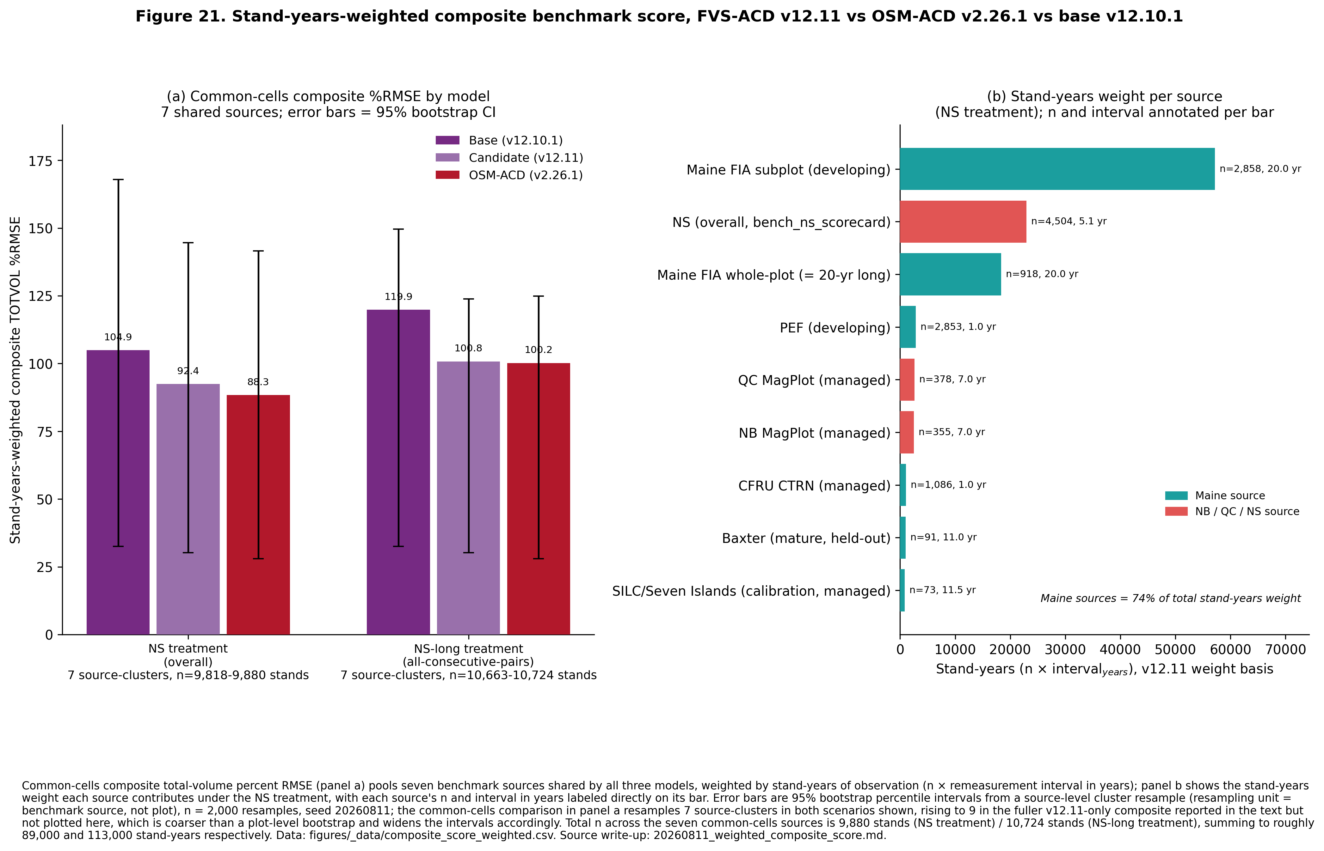
WEIGHTED COMPOSITE SCORE
Stand-years weighting favors v12.11 but the intervals overlap
Weight = n x remeasurement interval (stand-years); Maine sources carry 74% of the weight
Common cells (7 sources): v12.11 92.4 vs OSM 88.3 %RMSE (NS), 100.8 vs 100.2 (NS-long)
95% bootstrap CIs overlap heavily in both treatments; not a clean win either direction
Bootstrap resamples 7 to 9 source-clusters, coarser than a plot-level resample
Maine FIA subplot, memat, medev, and PEF intervals are assumed, not measured; flagged as open
Notes:
This is new since the ranking slide: a composite score weighted by stand-years, n times the remeasurement interval in years, so a longer projection or a bigger sample carries more weight, the same logic used to pool error metrics across studies of different length. Maine sources supply 74 percent of the total weight, driven mostly by the Maine FIA subplot set and its 20 year interval, so this number is not dominated by Nova Scotia the way a bare n-weighted average would be. On the seven sources both models are scored on, v12.11 comes in lower under the Nova Scotia overall treatment, 92.4 against OSM's 88.3, and the two are essentially tied under the Nova Scotia long treatment, 100.8 against 100.2. In both cases the 95 percent bootstrap intervals overlap by a wide margin, so I am not calling this a win for either model. The honest limitation is the bootstrap unit: with only seven to nine sources to resample, this is a coarse cluster bootstrap, not the plot level resample I would want for a number like this, and Cardinal access is what closes that gap. A second limitation is that five of the eleven datasets do not have a measured remeasurement interval in our records, Maine FIA subplot, memat, medev, and PEF among them, so those weights rest on stated assumptions, flagged in the write-up, not measurements. If Chris asks where this number is soft, those are the two honest answers: the resampling unit and the assumed intervals.

Slide 37
LONG-HORIZON BIOLOGICAL REALISM
v12.11 passes four of five Bakuzis relations over 160 years
Eichhorn: v12.11 pass, OSM flag, CV 26.3%
Site ordering: v12.11 a brief crossing, OSM a persistent inversion
Reineke slopes -1.62 to -1.49, near -1.605
Yield density plateau 31.6 to 36.1 m² ha⁻¹
Sukachev passes
OSM scored on 70 real, previously disturbed SILC and CFI stands, not a synthetic gradient
Notes:
This is a falsification check on internal consistency, and it should be read alongside the accuracy scorecard rather than instead of it. The test is the modified Bakuzis matrix of Leary 1997, five relations, scored as the worst case across softwood, mixedwood, and hardwood stand starts on a 160 year ESI 12, 16, and 20 gradient. On Eichhorn, the volume to height relation, base and v12.11 both pass and OSM flags at a coefficient of variation of 26.3%. On site ordering, base and v12.11 flag only a brief mixedwood crossing, and OSM flags a persistent, endpoint level inversion, 42 in height and 105 in volume. Reineke self thinning passes for all three, with slopes near the theoretical -1.605 and v12.11 running -1.62 to -1.49. The yield density plateau passes for all three at 31.6 to 36.1 m² ha⁻¹, well under the 42 runaway threshold. Sukachev passes for all three, with mean tree size rising as density falls. Net, v12.11 matches base on all five relations and beats OSM on long term realism. Now the caveat that belongs with that, because it materially softens the comparison. OSM was scored on 70 real, previously disturbed SILC and CFI stands rather than on a controlled synthetic gradient, so part of its Eichhorn and site ordering flags may reflect stand history and not model behavior. I would not read those flags as a clean indictment of OSM. The data are in figures/_data/bakuzis_longterm.csv.

Slide 38
INTEGRATING CLIMATE
Climate enters as a scenario driver, not a benchmark
ESI v8: current and 2030 climate site surfaces
Forward step uses a parametric GAM ratio, not random forest extrapolation
RCP4.5: +1.9 m 2030s to +4.3 m 2090s
Rule
Validate on observed climate.
Project with a parametric form.
Never benchmark on the projected surface.
Notes:
Climate is in this system, however it is deliberately not in the benchmark. ESI v8 gives a current climate site surface and a 2030 climate site surface. The projected surface is a forward scenario driver only. It is kept separate from the validated base and it is never benchmarked on, because scoring a model against a projected surface tells you about the projection and not about the growth engine. For the future step we use a parametric climate sensitive form, a generalized additive model ratio applied to the dominant height anchor, rather than a random forest extrapolation. The reason is that a random forest has no defensible behavior outside its training envelope, and a forecast is by definition outside it. Under RCP4.5 that gives a cold limited signal of +1.9 m in the 2030s rising to +4.3 m in the 2090s, which is defensible in direction and magnitude for this region, although it remains a scenario and not a prediction and I would not put a confidence bound on it yet. The three rules on the right are the ones I would hold any climate sensitive growth model to: validate on observed climate, project with a parametric form, and never benchmark on the projected surface.

Slide 39
AI AND PRODUCTIVITY
AI accelerated the work, humans kept it honest
Accelerated
Weeks of benchmarking and figures compressed into days
Kept honest
A red team pass forced three reframes before v12.11 shipped
Reproducible
Every number traces to a script; gate off reproduces v12.10.1 bit for bit
Notes:
A word on how this was built, because people ask. AI compressed weeks of benchmarking, scorecard assembly, and figure production into days of iteration, and that is a real gain which I am not going to understate. However, the red team pass is the part I would emphasize, because it forced three reframes before v12.11 shipped. First, the top height improvement traced back to the ESI anchor rather than to a lever, so the lever did not get credit for it. Second, Lever 4 was rescored as a species average correction rather than the mechanism we had first described. Third, the Quercus rubra coefficient was capped after its field validation gap surfaced. None of those three would have been caught by the acceleration. They were caught by people arguing with the output. Reproducibility is the other half of the story. Every number in this deck traces to a script and a keyed data file on Cardinal, and with every lever gated off the system reproduces v12.10.1 bit for bit. The rule I would offer is that AI is a throughput multiplier on the analysis and a hazard on the interpretation, so the review has to get heavier rather than lighter.

Slide 40
ROADMAP
v13 is the fall arc: height, mortality, and the ask
v13.0 Height and domain
Gate off predictions outside the ESI range; blend sweep parked
1
v13.1 Diameter distribution and demography
Six passes done: bias localized, budget built, 60% still open
2
The ask of the group
Provincial managed remeasurements, PSP treatment histories, and site surfaces
3
Notes:
v13 splits into two releases and one ask. v13.0 is height and domain. The main deliverable is bounding the calibrated domain, gating off predictions outside the ESI range so the anchor never extrapolates. The height re anchor blend sweep is exhausted and parked: every blend traded a top height gain for a volume loss, so none of them ships. The basal area correction is retained and the domain gate stands. Mature Acadian data still identifies the asymptote for the New Brunswick to Quebec transfer, which is part of why the ask at the bottom matters. v13.1 is hierarchical mortality and ingrowth, and it is already gated and running under job 12470707. It targets exactly what v12.11 did not close: the Quebec management gate volume over correction, SILC's basal area widening, and the developing end gap at both whole plot and subplot grain. It carries a region random slope on management, standard deviation 1.21 on the log hazard scale, which is far larger than the mean effect and suggests the management response is strongly regionally heterogeneous. It also carries a cohort exemption for Lever 3b's reallocation pool and recalibrated Russell, Weiskittel and Kershaw 2014 crown ratio recession coefficients. Then the ask. We need provincial managed remeasurements and PSP treatment histories, together with the provincial site surfaces. That is the data that unblocks the New Brunswick to Quebec management transfer, which is the one place the managed calibration still leans on thin planted and PCT samples. August is the moment to request a harmonized data sharing arrangement, so that v13 is fit on the full Acadian record rather than on the pieces we happen to hold.
Update as of 5 August 2026. v13.1 has now run six passes. The headline moved twice under internal review and landed on the diameter distribution rather than on demography. The hierarchical mortality and ingrowth posteriors are scientifically sound and reportable but are not bias fixes; together they are worth 0.78 points against a 15.44 point ceiling. What is carried forward into the fall is the bias budget on the following slides, and the open 9.2 point residual.

Slide 41
V13.1 WHERE THE BIAS LIVES
The failure is stem transition, not demography
1 Observed diameters close the bias: -16.53% to -1.09%
2 Observed heights buy only +0.79 points
3 Survivors pile at 6 to 10 cm: +61% and +41%
4 Above 12.7 cm runs 17 to 29% short; stem count unbiased
5 Both demographic levers null: 0.78 points combined
Notes:
This is the finding that reoriented the whole v13.1 workstream, and it came out of a tree-list decomposition run on a predicted t2 list that is byte identical to the base run at 0.000e+00 across all 35 numeric columns. The counterfactual ladder is the evidence: predicted diameters with an observed height curve moves 137.34 to 137.74 cubic metres per hectare, while observed diameters with a predicted height curve moves 137.34 to 162.74 against an observed 164.54. The diameter distribution outweighs height roughly twenty to one. I want to be careful about one thing here. An earlier statement of this localization claimed a general diameter increment failure on the evidence that predicted QMD increment was 43 percent of observed. Our own red team broke that claim, because QMD is exactly the square root of BA over TPH over pi over forty thousand, verified to seven times ten to the minus fifteen centimetres across all 918 plots, so it is one fact stated twice and carries no information beyond basal area and stem count. We dropped it. What survives is independent of that identity: forcing predicted basal area to equal observed by rescaling every expansion factor still leaves volume 7.44 percent short, and the basal-area-weighted median diameter is 2.66 centimetres short. Above 25 centimetres, where stems cannot have arrived by ingrowth inside the interval, the model delivers 46 percent of observed accretion.
Detail moved off the slide: the pile-up is +61.1 percent in the 6 to 8 centimetre class and +40.5 percent in 8 to 10; the shortfall above 12.7 centimetres runs -16.9 percent at 12.7 to 16 and -27.9 percent at 16 to 20; total stem count is unbiased at plus 1.5 percent. The two demographic levers are the hierarchical mortality and ingrowth posteriors, both built, fitted through three generations, debugged and scored, and both null. Predicted basal area share below 12.7 centimetres is 36.8 percent against 27.7 percent observed, so the real stand held its small stem share flat across 20.5 years and the model raised it by 8 points.

Slide 42
V13.1 THE BIAS BUDGET
Four pieces, and the largest was never on our list
1 Ceiling is 15.44 points: observed diameter distribution closes -16.53% to -1.09%
2 Convexity, the second moment: 3.87 points, 25% of the ceiling
3 Chapter 10 basal area constraint: 1.22 points
4 Diameter increment reshaping: 1.13 points
5 Residual, demographic and still open: 9.23 points, 60% of the ceiling
Notes:
The convexity piece is the one nobody had scoped, and it is the largest single item we found. The model propagates one deterministic trajectory per tree record and then scores a convex function of the accumulated diameter. Volume goes roughly as diameter to the two and a half and basal area as diameter squared, so the expectation of the volume exceeds the volume of the expectation by an amount set by the within-cell variance. The model computes the volume of the mean; the benchmark observes the mean of the volume. No recalibration of the increment coefficients on a conditional mean can remove that, because the defect is in the second moment rather than the first. We were worried the correction would mostly be fitting measurement error, so we decomposed the variance: total within-cell standard deviation of the 20.5 year increment is 2.589 centimetres against a measurement error standard deviation of 0.298, so measurement error is 1.3 percent of the variance and the haircut costs only 0.11 points. The correction and the increment reshaping are almost exactly additive, predicted -11.535 against realised -11.586. Caveat worth stating out loud: a smearing correction on a convex function always raises predicted volume, so it improves nine of our eleven sources by construction. That is not evidence it is right, and it makes Baxter worse by 0.82 points, which is the honest cost.

Slide 43
V13.1 DEMOGRAPHY
The model under recruits, and fixing it closes basal area
1 Model recruits 0.032 against observed 0.079 m² ha⁻¹ yr⁻¹, 2.5x low
2 Raising ingrowth 3.9x: basal area -9.82% to -5.21%
3 Adding a self thinning retune: basal area -1.56%, volume -9.33%
4 Volume gap survives a nearly closed basal area gap
5 Residual is size distribution, not stem count
Notes:
This inverts what we told ourselves two passes ago, and the correction is worth being explicit about because it changes the direction of the fix. Every ingrowth counterfactual this project had ever run moved downward, at multipliers of zero, a third, and three quarters. Nobody had run it upward, because we believed the model was over recruiting. It is not. Separating genuine recruitment from FIA subplot frame ingrowth is what settles it: of 23,689 t2 stems with no t1 antecedent, 17,051 sit at or above 12.7 centimetres and are not recruitment at all, they are stems that were between 2.54 and 12.7 centimetres at t1, outside the 6.8 foot microplot, never censused, and entered the 24 foot subplot frame by crossing 12.7 centimetres. The area budget is decisive: the t1 microplot pool scales to 65,261 subplot equivalent stems and the 17,051 arrivals are 26 percent of it, where genuine recruitment above 12.7 centimetres would have required a fraction above one. The last line is the one I would put weight on for this group. When we push basal area from minus 9.8 to minus 1.6 and volume only moves to minus 9.3, that is direct evidence that the residual is stems sitting in the wrong diameter classes rather than too few stems, which is the same conclusion the tree list decomposition reached from the other direction. One caveat: the two cells that were supposed to combine raised ingrowth with the refitted increment silently did not apply the new coefficients, so that combination is untested.
Detail moved off the slide: against the wider microplot definition of recruitment, 2.54 to 12.7 centimetres, the model is 3.9 times low rather than 2.5; 0.079 is the subset that reaches the model's own 5.0 centimetre floor and is the like for like comparison. The self thinning retune in line three is the SDImax ramp disabled, which we are not proposing to ship as it stands because it breaches the observed maximum basal area on two sources and unmasks a known survivor increment over-prediction in mature high density stands. It is shown here to size the demographic contribution, not as a candidate.

Slide 44
V13.1 SELF CORRECTION
Three numbers withdrawn under our own review
1 QMD increment claim: an identity, no information
2 Ingrowth 0.377: a units error, ING_p is stems
3 Drain split 41/59: by residual, instrumentation gives 73/27
4 Observed drain undervalued: dead stems at t1 diameter
5 Corrected, model drain is 12% high, not 140%
Notes:
I am putting this slide in deliberately, because the review process is the part of this work I would most want another modelling group to copy, and because two of these three errors were mine. The QMD claim was broken by an internal red team pass before it ever left the group. The ingrowth number is the instructive one: ING_p in our results files is stems per hectare, not basal area, and the figure 0.377 is exactly the sum of ING_p over the sum of the interval lengths, so it is a stems per year rate that I labelled as basal area and then carried into a handoff and into three separate analysis briefs before two independent tracks caught it. The true value is 0.015, a factor of 25 smaller, and every statement about excess ingrowth that rested on it is void. The drain split was attributed by residual, assigning everything one component did not explain to the other; direct instrumentation of the stand loop, with the balance closing at gross 0.7899 equals net 0.3551 plus drain 0.4348 and the instrumented state reproducing scored output to six ten-thousandths, reverses which component is larger. Finally, valuing dead and removed stems at their t1 diameter understated observed drain by about 20 percent; the basal area weighted realised growth fraction is 0.275. Corrected, the model over drains by 12 percent, which is a tuning problem, not the structural failure we had been describing.
Detail moved off the slide: the QMD claim was that predicted QMD increment ran 43 percent of observed, which is void because QMD is exactly the square root of BA over TPH over pi over forty thousand. The ingrowth figure was 0.377 cubic metres per hectare per year, which is really the sum of ING_p over the sum of interval lengths, a stems per hectare per year rate; the true basal area value is 0.015, a factor of 25 smaller. The drain split was calc_mortality 41 percent and the SDImax block 59 percent by residual attribution; direct instrumentation gives 73.2 and 26.8, reversing which component dominates. The growth fraction correction is that 3,675 of 5,999 dead stems carry a measured t2 diameter and the basal area weighted realised growth fraction of the interval is 0.275.

Slide 45
V13.1 BAKUZIS ASSESSMENT
Two configurations fail biological realism; a narrower stack ships
1 Ingrowth 3.9x drawdown: -14.2% vs -3.0% base, ages 27 to 48
2 Gain reverses sign: +14.9% at year 20, -2.9% at year 160
3 SDImax removed fails on level: SDI 670 to 1020, plateau 35 to 50 m² ha⁻¹
4 Ships: ingrowth 2.5x plus r2 refit, SDImax retained, onset 0.55 to 0.60
Notes:
Bakuzis testing checks whether v13.1 obeys the law-like relationships among stand properties across a productivity gradient, using the modified Bakuzis matrix, rather than only matching one observed number. Run against the v13.1 candidates, it blocks two configurations from shipping: the full stack, meaning every lever on including ingrowth at 3.9x, and nosdi, meaning the SDImax block disabled.
Ingrowth at 3.9x causes a basal area overshoot that becomes a crash between stand ages 27 and 48. Drawdown reaches 14.2 percent against a 3.0 percent base case drawdown over the same window, and recovery is delayed to ages 86 to 92. The apparent gain from this configuration reverses sign over the full projection horizon, plus 14.9 percent at year 20 against minus 2.9 percent at year 160. That reversal is invisible to any scorecard that only evaluates a 20 year horizon, which is the horizon most of our benchmarking has used so far.
nosdi fails differently, on the level rather than the slope. Stand density index at age 160 goes from 670 in the base case to 1020 with the SDImax block removed, and the basal area plateau rises from 35 to 50 square metres per hectare. Both sit above the biologically defensible envelope.
The subset I am recommending to ship is narrower than either candidate: ingrowth at 2.5x rather than 3.9x, combined with the r2 increment refit, and the SDImax block retained rather than removed. Its onset needs recalibrating upward, from the current 0.30 relative density toward the classical imminent competition mortality range of 0.55 to 0.60. That recalibration and rerun is still open and is tracked as its own task.
One more flag, not a blocker. In the base configuration the Sukachev law-like relationship shows a departure at age 160: an ESI 20 stand carries 6.3 percent more stems than an ESI 12 stand while only carrying 1.6 percent more basal area. Worth watching, not worth holding the release for.
Source: p7bak/, the authoritative table bakuzis_FINAL_p7.csv, and NOTES.md at 337 lines, all on Cardinal and not reachable from this session. Every number above is vetted from my own session notes; nothing here is read directly off the CSV. Any number not named here is pending the Cardinal reconnect and should not be treated as known.

Slide 46
BENCHMARK INTEGRITY
Coverage census, and every rescore leaves the ordering intact
1 Coverage of t2 basal area: PEF 4%, Baxter 18%, MagPlot 33%, CTRN 52%
2 CTRN: all models move 0.7 points, ordering unchanged
3 Baxter: base +9.09% to +2.42%, candidate +6.92% to +0.38%
4 QC MagPlot: the +9.46% flag reads +0.41% on a fitted curve
5 No published number changes. Ordering durable, levels are not
Notes:
The harness falls back to a diameter-only height curve wherever a tree has no measured height, and because the observed list is raw staged heights while the predicted list is model output, it fires almost entirely on the observed side, so the error sits in the denominator and does not cancel. The census across all eleven sources gives coverage as share of t2 basal area: PEF 4 percent, Baxter 18, NB and QC MagPlot 33, CTRN 52, Nova Scotia 73 to 76, Maine FIA whole plot 87, and SILC and the Maine FIA long and subplot sets effectively 100. The curve runs a few percent tall on softwood and 12 to 33 percent short on hardwood everywhere, so pooled checks call it unbiased while both groups carry double digit errors that offset. We then rescored the sources that matter, and every control reproduced our published numbers exactly with basal area bit identical, so these are sound. Take them in order. CTRN, which carries half the managed evidence: base moves from minus 9.78 to minus 10.43, candidate minus 2.24 to minus 2.95, OSM minus 4.81 to minus 5.50. All three move seven tenths of a point together and the ordering does not change, so the imputation did not manufacture our managed win. Baxter: the staging is repaired, 463 measured stems recovered, curve fitted and validated against them. Base goes from plus 9.09 to plus 2.42 and the candidate from plus 6.92 to plus 0.38, essentially unbiased. That also settles the Lever 3b question: 3b was picked over 3a because 3a over corrected Baxter to minus 7.2, and under the corrected treatment 3b sits at plus 0.38 while 3a would be near minus 12.9, so the correction widens the gap that drove the choice. Now Quebec, which is the one I want to be careful about. Our disclosed flag was QC MagPlot volume worsening to plus 9.46 while basal area improved. Under the fitted curve that same cell reads plus 0.41, and base moves from plus 1.23 to minus 7.13. So about 8.4 points of the Quebec volume signal, for both models alike, is the height imputation acting on the most hardwood heavy source we have, not the management gate over correcting. I am not withdrawing the flag, because the candidate still sits 7.5 points above base under either treatment and that separation is the gate's doing. But the magnitude is far smaller than we published, and the hardwood story in the forest group section now has a quantified second explanation rather than a suspected one. New Brunswick moves the other way, about 4.1 points deeper on both models, so this is not a uniform improvement. The through line across every source is the same: the height treatment moves the models together and leaves their ordering intact, so the comparisons this work rests on are durable even where the levels are not. No published number in this deck changed.

Slide 47
VERDICT AND KEY TAKEAWAYS
v12.11 is ready, and its open gap is named
1 Gate off reproduces v12.10.1 bit for bit, 0.000e+00
2 Managed CTRN, NB MagPlot, and mature Baxter: v12.11 halves bias, beats OSM
3 Developing Maine FIA open: subplot grain moves -24.90% to -24.82%, a 0.08 point change
4 Nova Scotia bias weakens, never flips positive
5 v13.1 ships ingrowth 2.5x plus r2, SDImax retained and retuned
Notes:
Five takeaways, and then questions. First, the safety property. Every lever is gated and off by default, and with the gates off the system reproduces the frozen v12.10.1 baseline bit for bit, a maximum absolute difference of 0.000e+00, reconfirmed on a novel stand after the red team fixes. All four guardrails pass: frozen in domain FIA NSVB, the Bakuzis five relations, the long horizon plateau, and managed out of sample performance against OSM v2.26.1. Second, where it works. On the sites it was built for, managed CTRN and New Brunswick MagPlot, and the held out mature Baxter reserve, v12.11 roughly halves bias against the frozen base and now beats OSM rather than trailing it. Two managed flags, Quebec's volume over correction and SILC's basal area widening, are disclosed and named as v13.1 targets rather than hidden. Third, where it does not work. On developing Maine FIA, OSM still leads, and moving to the finer subplot grain does not close the gap, -24.90% to -24.82%, a 0.08 point change. That is the acknowledged open gap in this candidate and the explicit target of v13.1. I am not claiming v12.11 closed it. Fourth, Nova Scotia. This edition adds the region's longest CFI record. The managed stand levers generalize cleanly, the site index question is answered honestly, and the long interval test, once cleaned of the contamination artifact, is only partially consistent with the pattern seen elsewhere: bias weakens toward zero, it does not flip positive. Fifth, what comes next. v13.1's hierarchical mortality and ingrowth refit is already gated and running. It is the fall arc, targeting the Quebec and SILC flags and the developing end gap directly. Management then enters as a growth scale release in v13.2, with prediction intervals and climate following.
Updated 5 August 2026. Point five previously read that v13.1 was gated and running. It has now run six passes and the honest statement is that we know where the developing plot bias lives and we have accounted for about 40 percent of it. Nothing in the v12.11 scorecard changes; the v13.1 work sits downstream of it.

Slide 48




Questions / Comments
Aaron Weiskittel | aaron.weiskittel@maine.edu | Center for Research on Sustainable Forests and Cooperative Forestry Research Unit, University of Maine
AcadianGY is open R, v12.6.1 to v12.11 now git tagged; plot coordinates stay on the analysis cluster, aggregates only.
Support: CRSF and CFRU, University of Maine | Maine-FOREST (NSF EPSCoR OIA-1849227) | PERSEUS (USDA NIFA)
Notes:
That is the talk. Two standing commitments to repeat before questions. AcadianGY, what this project calls FVS-ACD, is open R rather than a compiled binary. Versions v12.6.1 through v12.11 are now git tagged and audited against their scoring harnesses, and plot coordinates stay on the analysis cluster, so what leaves this room is aggregates only. An outside rerun still needs Cardinal access, and for v12.10.1 and v12.11 a driver script we have not yet reassembled from the v12.7.x harness pattern; that gap is named here rather than hidden. The work is supported by CRSF and CFRU at the University of Maine, by Maine-FOREST under NSF EPSCoR OIA-1849227, and by PERSEUS under USDA NIFA. My contact is on the slide and I am glad to take follow up by email, particularly on the data sharing ask from the roadmap slide, which is the item I most need an answer on before the fall. If the questions go deep, the four places I can go further are the cross validation schemes, the Nova Scotia rescore and its disturbance screening fix, the Bakuzis matrix, and the reproducibility bundle itself. The two questions I most expect are whether the developing end gap is a mortality problem or an ingrowth problem, which v13.1 is designed to separate, and whether the Nova Scotia result would hold on managed long intervals, which it partly does although with a much larger absolute gap.

