Slide 1


FVS-ACD v12.11: the maturity-dependent bias, addressed
Five gated levers, byte-identical gate-off, all four guardrails pass
Canadian Forest Service, Acadian Growth & Yield Meeting | 18 August 2026
Aaron Weiskittel | Center for Research on Sustainable Forests and Cooperative Forestry Research Unit, University of Maine
Wins on managed and mature stands; OSM keeps the lower pooled %RMSE. Developing Maine FIA stays open.
Notes:
This is the v12.11 benchmark, and the verdict comes first. On the managed and mature sources the five levers target, v12.11 beats OSM v2.26.1, while OSM keeps the lower pooled %RMSE on the fairest common-cells comparison; both statements travel together in this deck. On developing Maine FIA stands OSM still leads, and a re-score at the finer subplot grain does not close that gap. v13.1 is the next step there; its shipping candidate ship18 is built and scored per source, with the composite rerun pending. Every lever is off by default, so with the gates off the model reproduces the frozen v12.10.1 bit for bit, and all four guardrails pass. The work runs out of the Center for Research on Sustainable Forests and the Cooperative Forestry Research Unit at the University of Maine, and the benchmark depends entirely on cooperator data: the Penobscot Experimental Forest, CFRU CTRN, Maine FIA, Baxter State Park, Seven Islands, New Brunswick and Quebec MagPlot, and the Nova Scotia permanent plot network. All computation ran on Cardinal, and aggregates only left the node. I will name each source where it carries a result, and I will be explicit about what this candidate does not fix.

Slide 2
CONTEXT
v12.11 targets the one bias that flips sign with maturity
2018 ECANUSA: OSM edged FVS-ACD on merchantable volume increment
2026: v12.10.1 ships, one bias survives
1
Site productivity: ESI holds
2
Data harmonization: one NSVB currency
3
New calibration: five gated levers
4
Integrating climate: 2030 ESI scenario
5
AI and productivity: caught our error
Five agenda topics, what we bring
Notes:
Some history first. In 2018 Hennigar and I presented at ECANUSA, and OSM trailed only slightly behind FVS-ACD overall while beating it on merchantable volume-increment bias and RMSE in Maine, New Brunswick, and Nova Scotia. That result set the FVS-ACD to-do list, and much of what follows is us working through it. Now in 2026, v12.10.1 ships as the production model. Its successor, v12.11, targets the one bias that survived every prior fix, a long-horizon volume error that flips sign across the stand-maturity gradient. On the five agenda topics for this meeting, here is what we bring to each. Site productivity: ESI holds up, though the height edge is extrapolation and should be read that way. Data harmonization: MagPlot and FIA now sit on one NSVB currency. New calibration approaches: five gated levers correcting the maturity-dependent bias, which is most of this talk. Integrating climate: current and 2030 ESI run as a scenario. And AI and productivity: it accelerated the work and, more usefully, caught an error of our own, which I will come back to at the decomposition slide. I will spend the bulk of the time on the third topic.

Slide 3
CONTEXT
Six releases since the 2018 ECANUSA baseline, one bias at a time
Release | What changed | Headline number
2018 to v12.7.1 | Fixed the recruitment gate defect (0.95 cutoff suppressing ingrowth); coupled ingrowth to density | TOST 4/9 dips to 2/9, then recovers
v12.9.x | Gated SDImax correction, Quebec hardwood self-thinning edge | TOST recovers to 7/9, bias 4.9
v12.10.1 | Chapter 11 management modifiers, gated releases on planted/PCT | Managed bias -19.0% to -2.5%, beats OSM
v12.11 (2026) | Five gated levers, maturity-dependent long-horizon bias | Beats OSM managed/mature; gate off 0.000e+00
2018 to 2026: the gap narrowed release by release, each refinement gated and individually isolated, reproducing its predecessor bit for bit when off.
Notes:
Provenance note: the v12.9.x "bias 4.9" cell rests on the legacy five-way set (n = 705) whose source file is not archived; quote it only with that caveat (integrity caveat, open item 4). All other cells trace to archived CSVs.

Slide 4




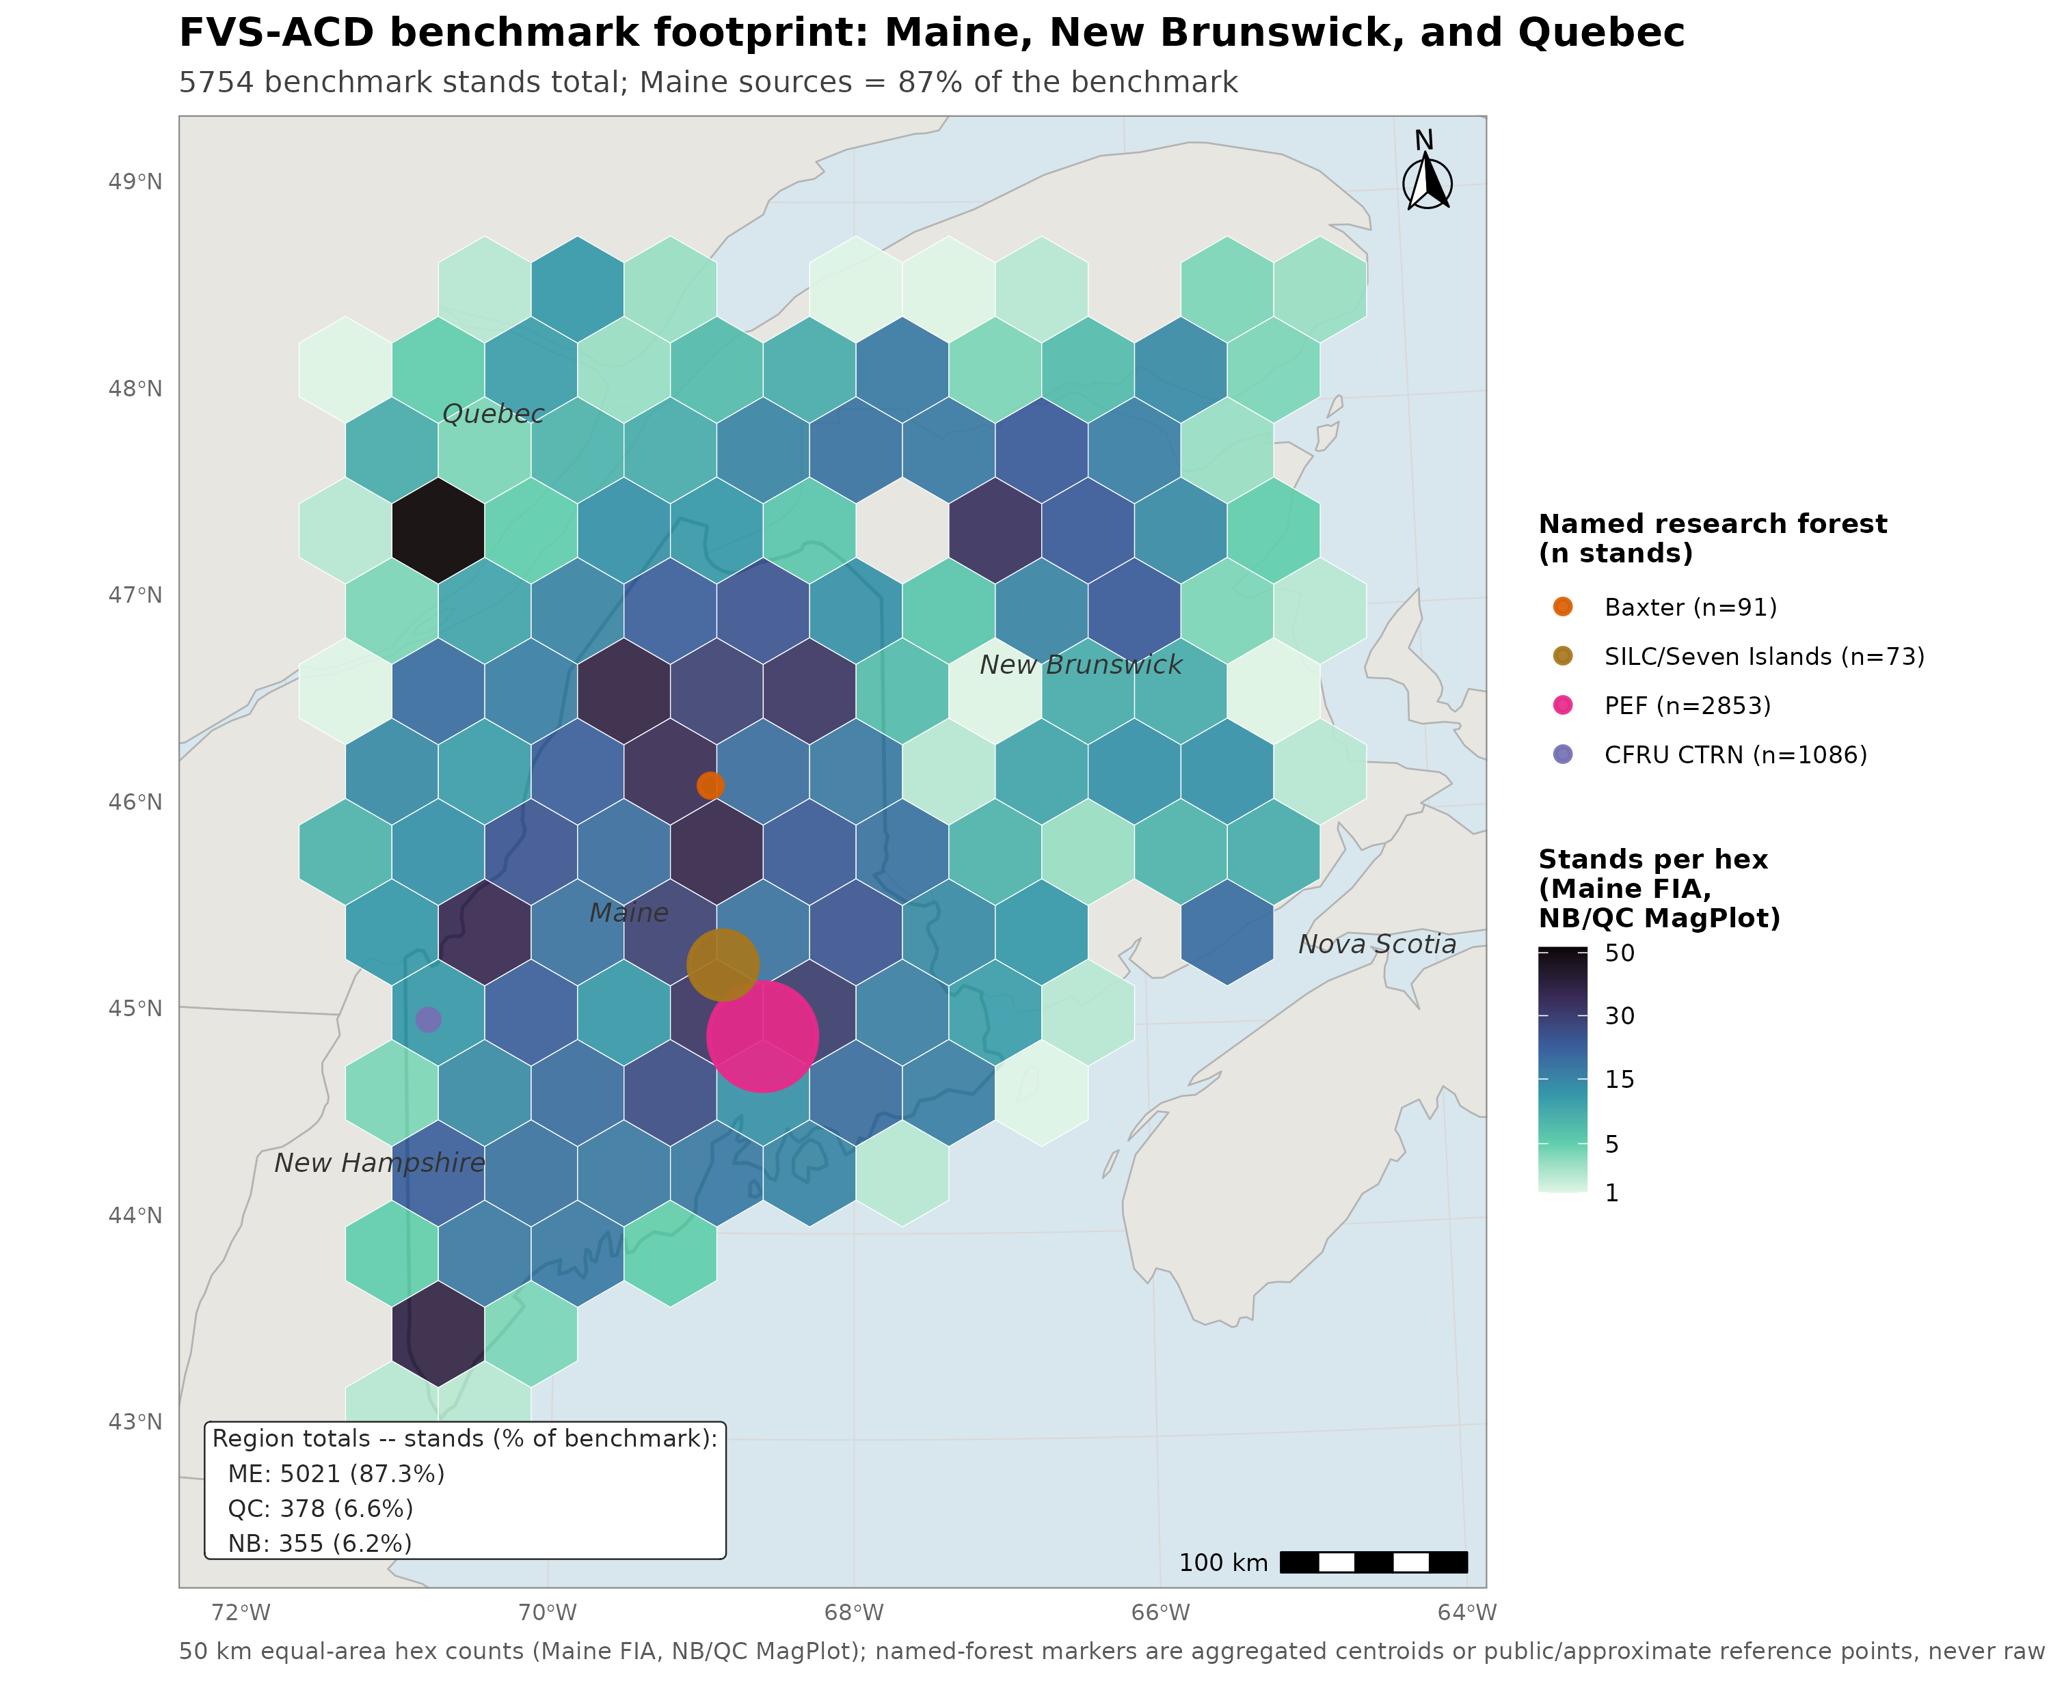
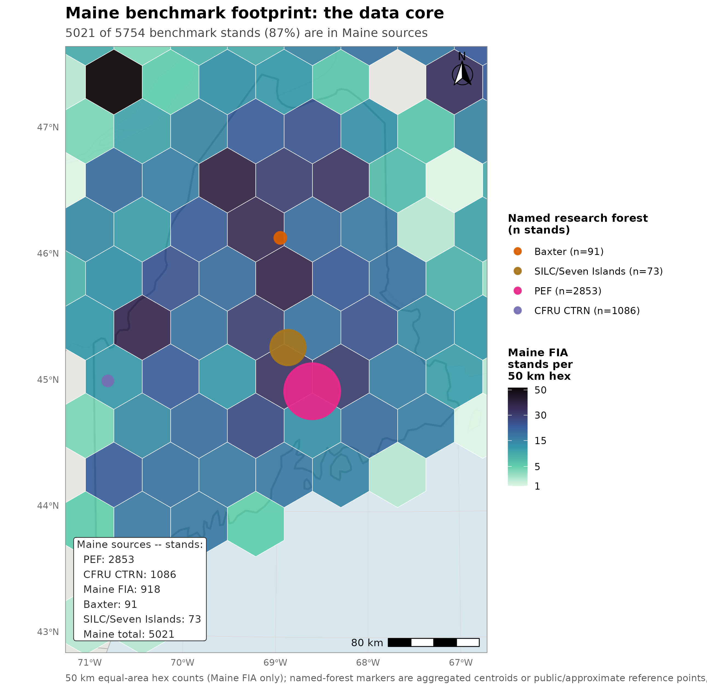
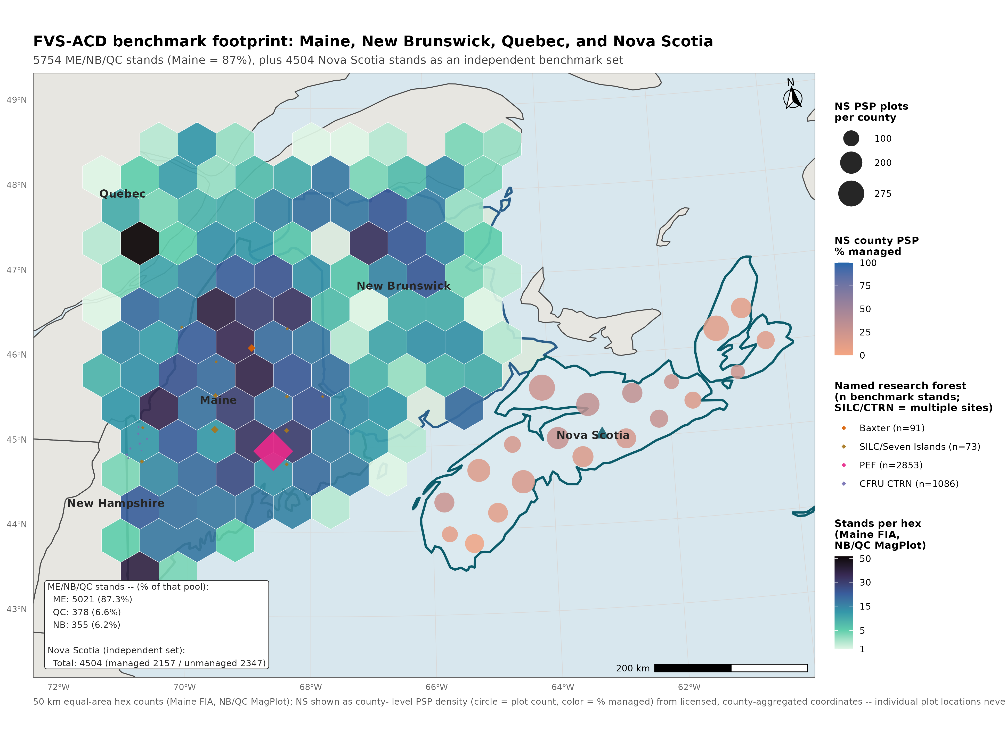
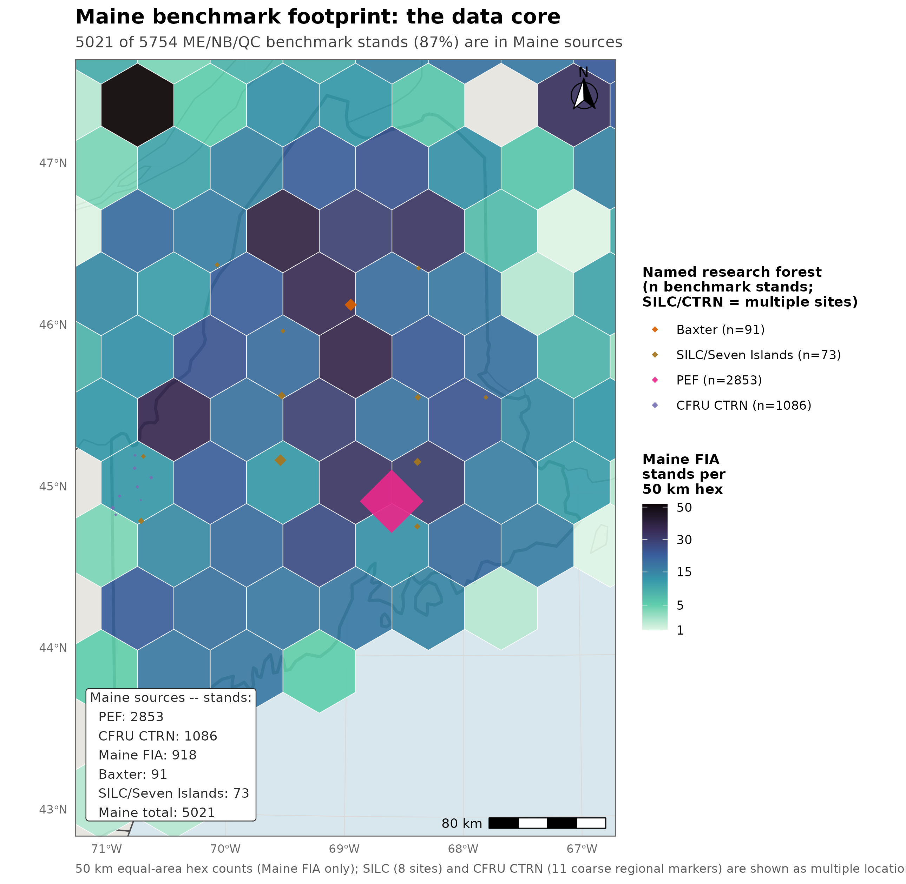
DATA FOOTPRINT
Maine supplies 87.3% of the benchmark, Nova Scotia is independent
5,021 / 5,754
Maine stands, 87.3% of the pooled ME/NB/QC total
355
New Brunswick stands
378
Quebec stands
4,504
Nova Scotia stands, managed and unmanaged (independent test)
8
sources across four jurisdictions
Nova Scotia never used to fit or tune any lever. Seven pooled ME/NB/QC sources on one NSVB currency: PEF 2,853, CTRN 1,086, Maine FIA 918, Baxter 91, SILC 73, NB 355, QC 378; Nova Scotia is the eighth, scored separately.
Notes:
The footprint is worth being blunt about, because it conditions every regional number in this talk. The v12.11 candidate benchmark pools seven sources across Maine, New Brunswick, and Quebec into one three-way scored comparison of base, candidate, and OSM v2.26.1. Maine supplies 5,021 of those 5,754 stands, 87.3%, with New Brunswick at 355 and Quebec at 378 as the minority. Any regional result here should be read first as a report about a Maine-anchored candidate and second as a comparison against two smaller Canadian jurisdictions. Nova Scotia is evaluated separately as a fully independent, fourth-jurisdiction test, which comes later in this deck, and it was never used to fit or tune any lever. That is what makes it the cleanest available check on whether the managed-stand levers generalize. Coordinates are never released. True plot locations stay on the analysis cluster and only aggregates leave it, and Nova Scotia's PSP locations are additionally restricted under its own provincial data-license agreement.
[Consolidated from cut slides] Within Maine, PEF (2,853) and CTRN (1,086) anchor a five-source core (Maine FIA 918, Baxter 91, SILC 73); Nova Scotia 4,504 (2,157 managed / 2,347 unmanaged), scored separately. Bias is smallest on the independent Maine sources: Maine FIA +2.3%, PEF +3.7%, versus the NB/CTRN tuning pairs at -11.8%/-9.8%.

Slide 5


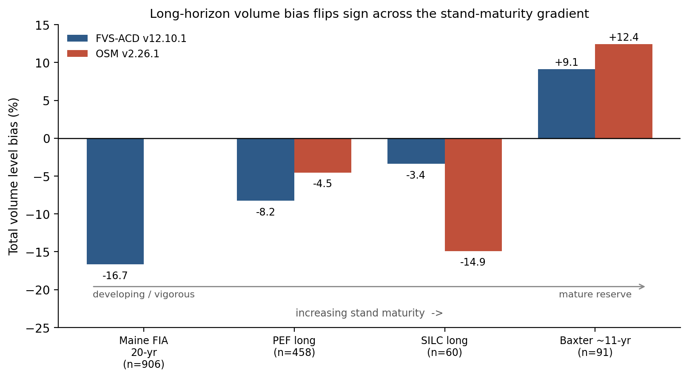
THE PROBLEM
Volume bias flips sign across the maturity gradient
Total volume bias
Basal area bias
Figure 1. Total volume and basal area level bias across the stand-maturity gradient, base v12.10.1 versus the v12.11 candidate. Baxter panel predates the 15 Aug survivor-matching fix; corrected Baxter levels are base +13.6, candidate +11.3, OSM +16.9 (ordering unchanged).
Base to v12.11 candidate, versus OSM v2.26.1
Maine FIA developing -16.60% to -16.13% (OSM -6.29%)
CTRN managed -9.78% to -2.24% (OSM -4.81%)
Baxter mature, held out +13.56% to +11.28% (OSM +16.85%)
Baxter rescored 15 Aug after a survivor-matching data fix; Maine FIA and SILC verified unchanged.
Notes:
This is the problem the candidate was built for. In the shipped v12.10.1 baseline, total-volume bias moves from -16.7% on the Maine FIA 20 year set and -8.3% at PEF long, through -3.4% at Seven Islands CFI, to +13.6% at the mature Baxter reserve (corrected 15 Aug). At the precise whole-plot numbers on the slide the same ladder reads -16.60% on developing Maine FIA, -9.78% on managed CTRN, and +13.56% on the held-out mature Baxter reserve. So FVS-ACD under-predicts in developing, vigorous stands and over-predicts in mature, senescing reserves. A component decomposition, which is the next slide, shows that flip is the net of three separable errors. Survivor diameter growth runs too high. An ingrowth deficit dominates the developing-stand under-prediction. And the SILC-calibrated mortality over-removes at managed and high-density structures. At the mature Baxter end specifically, the over-prediction is survivors over-accreting girth on large old trees, with mortality essentially exact there, so it is not a case of too little being removed. Two things about the candidate. It narrows the mature-end over-prediction, Baxter +13.56% to +11.28%, and roughly halves the managed-end bias, CTRN -9.78% to -2.24%. However, the developing end barely moves, Maine FIA -16.60% to -16.13%, and it remains the acknowledged gap that v13.1 targets. The sign flip itself is narrowed and not closed by v12.11. One thing worth saying out loud: OSM swings the same way on the long-interval sets, PEF long -4.5%, SILC long -14.9%, Baxter +16.9%. This is a shared growth and yield problem across both Acadian models, and it is exactly what the v13.1 mortality and ingrowth refit targets. It also strengthens the case for the mature Acadian remeasurement data, which is the August ask.
[Consolidated] Full component decomposition (survivor growth, recruitment, mortality) detailed on the fix slide's notes.
[Red team round 2] Added OSM numbers directly to the slide face per Aaron's request for more direct OSM comparisons throughout: Maine FIA whole-plot OSM -6.29%, CTRN OSM -4.81%, Baxter OSM +16.85% after the 15 Aug fix (results/p18osm/p18_old_vs_new.csv).
Data integrity, 15 August: a survivor-matching defect (per-visit tree reindex instead of persistent tags) was found and fixed in the ME FIA long, Baxter, and SILC staging. Rescoring all three regions: Maine FIA and SILC reproduce their published entries exactly (level scoring never passes through the survivor join), Baxter moves (observed mean volume 181.1 to 176.1 m3/ha; all three models shift about +4.4 pp in bias and improve about 19 pp in RMSE; no ordering flips).

Slide 6
THE FIX
Five gated levers, each off by default
Recruitment
IGMULT = 2.5, pooled ingrowth deficit
1
Management-gated mortality
fmin = 0.13, k = 12.4, RD0 = 0.38
2
Chapter 10 stand constraint
QMD floor 22 cm, binds only in mature stands
3
Hardwood height by risk
High-risk trees 10 to 11% shorter, 635 trees
4
Crown ratio, investigated
Already active, Russell et al. 2014
5
Notes:
Five levers, and the design rule is that each one is gated and off by default, on only where the biology calls for it. Lever 1, recruitment. The flat, basal-area-anchored ingrowth deficit runs about 2.5x pooled, so IGMULT is set to 2.5. There is also a gated relative-density taper that protects mature closed stands, although it is not enabled in the scored configuration reported here. Lever 2, management-gated mortality. It attenuates the self-thinning removal fraction as relative density climbs past onset, f(RD) = fmin + (1 - fmin) x exp(-k x max(RD - RD0, 0)), with fmin = 0.13, k = 12.4, and RD0 = 0.38. Natural stands are untouched by it. Lever 3, the Chapter 10 QMD-gated stand constraint. It lowers the activation threshold on the proportional-increment constraint to a stand basal-area-increment target, gated by a 22 cm QMD floor so that it binds only in mature, high-QMD stands and spares developing stands. Lever 4, hardwood height by form and risk. High-risk trees run about 10 to 11% shorter in Betula alleghaniensis Britton and Acer saccharum Marshall, both at p < 0.002. The effect is weaker and not significant in Acer rubrum L., p = 0.59. It was fitted from 635 field trees across four Maine installations. Lever 5 is not really a new lever, and I want to be straight about that. Crown ratio is already active. It is projected dynamically every cycle by the Russell, Weiskittel and Kershaw 2014 recession model and it feeds both diameter and height increment. The changelog note describing it as disabled was four years stale. We investigated it, found nothing to fix, and are reporting that plainly.
[Consolidated from cut slides] Decomposition: three separable component errors map to the three growth/mortality/recruitment levers (survivor growth too high -> Lever 3 QMD floor 22cm; recruitment deficit, predicted 7.6 vs observed 38.5 m3/ha -> Lever 1 IGMULT=2.5; mortality over-removal, 4.6x observed at CTRN -> Lever 2). Chapter-11 management lever: a fitted additive release, not a clamp (Wang 1990 multi-step method); planted Type 2 sustained +3.8, PCT Type 1 transient +2.4 m2/ha basal area; out of sample managed 0.9 leave-one-installation, 1.5 leave-one-province, vs OSM 8.3.

Slide 7
VALIDATION
All four guardrails pass, two flags remain open
Guardrail | Base v12.10.1 | v12.11 candidate
1. Frozen in-domain FIA NSVB (n=733) | BA -11.28%, TOPHT +4.21%, TOTVOL -4.41% | BA -7.31%, TOPHT +5.88%, TOTVOL -1.50%
2. Bakuzis five relations (Reineke slope) | -1.59, PASS | -1.62 primary PASS; -1.88 managed sensitivity, FLAG only
3. Long-horizon plateau (~160 yr) | BA 36.10 m² ha⁻¹, plateaus | BA 35.29 m² ha⁻¹, plateaus
4. Managed out-of-sample vs OSM v2.26.1 | Trails OSM on all 4 cells | Beats/ties OSM on 3 of 4: Baxter, CTRN, NB win; SILC basal area open
TOPHT drift traces to the per-province dht.mult scalar, not the new levers
Gate off reproduces v12.10.1 bit for bit (max abs diff 0.000e+00), reconfirmed after every red-team fix.
Notes:
Four guardrails, and all four pass. I put the two flags on the slide because you will hear them from me before you find them yourselves. Guardrail 1 is a no-regression check on the frozen in-domain FIA NSVB set, n = 733. Basal area and total volume both move closer to zero, -11.28% to -7.31% and -4.41% to -1.50%. Top height drifts further from zero, +4.21% to +5.88%, and it is the one metric that moved the wrong way. The red-team pass traced that drift to the always-on per-province dht.mult height-increment scalar, NB_AFAC = 0.579 and QC_AFAC = 0.111, and not to the new growth levers. It is also not an ESI-consistent anchor-recalibration mechanism, because no such mechanism exists in this model file. That reframe is the next slide. Guardrail 2 is the Bakuzis five relations. The primary unmanaged mapping passes with a Reineke slope of -1.62 against the base's -1.59. The one flag, -1.88, is confined to a managed sensitivity check on a synthetic stand that is never actually thinned, sits just beyond the -1.8 to -1.4 acceptance band, and does not block the primary configuration. Guardrail 3 is the long-horizon plateau at about 160 years. Both configurations go flat and self-thin, basal area 36.10 m² ha⁻¹ for the base and 35.29 m² ha⁻¹ for the candidate. Guardrail 4 is managed out-of-sample against OSM v2.26.1. The base trailed OSM on all four CTRN and New Brunswick cells. The candidate now beats or ties OSM on three of four. However, on the managed cell it ties OSM on bias and still trails on RMSE, although the gap narrowed from a 9.4-point deficit under the base to 3.5 points. I will take questions on either flag.
[Consolidated from cut slides] Engineering rigor: with every lever gated off, the candidate reproduces the frozen v12.10.1 baseline bit for bit, 0.000e+00 max abs diff on diameter, height, and expansion factor; reconfirmed on a novel hardwood-heavy stand. Red team: 3 of 6 reframes had numeric/methods impact (top height is an anchor not a lever effect; Lever 4 is a species-average multiplier; Quercus rubra coefficient capped pending field heights); gate-off stayed byte-identical after every fix.
[Red team round 2] Guardrail 4 cell named explicitly per-cell with OSM bias alongside v12.11, so the qualitative claim is checkable: Baxter, CTRN, NB MagPlot beat or tie OSM; SILC basal area is the one open flag.

Slide 8
CENTRAL RESULT
On its target managed and mature sources, v12.11 beats OSM v2.26.1
Source | n | Total volume bias base / v12.11 / OSM | Basal area bias base / v12.11 / OSM
Baxter, ME (mature, held out) | 91 | +13.56% / +11.28% / +16.85% | +7.63% / +6.34% / +15.36%
CTRN, ME (managed) | 1,086 / 1,033 | -9.78% / -2.24% / -4.81% | -11.26% / -3.52% / -4.19%
NB MagPlot (managed) | 355 | -11.84% / -5.96% / -8.07% | -8.84% / -2.33% / -2.48%
Two managed flags open: QC MagPlot volume, SILC basal area
All three sources scored at stand grain. Baxter reflects the 15 Aug survivor-matching data fix (all three models rescored on corrected observed data; ordering unchanged, RMSE improves to 28.7 / 28.5 / 32.2). QC MagPlot has no scored OSM comparison yet -- the input was never built, not a vendor-access limit; a working, licensed OSM-ACD v2.26.0 binary already runs on this project's own Cardinal account, with prior runs on several of this project's sources. OSM still leads developing Maine FIA at either grain (subplot gap moves only 0.08 points) -- the acknowledged v13.1 target.
Notes:
This is the central result, and the qualifier in the title is doing real work. On the three sources the levers actually target, the candidate roughly halves bias and beats OSM v2.26.1. At Baxter, the mature held-out reserve, n = 91, total-volume bias goes from +13.56% to +11.28% against OSM’s +16.85%, and basal area from +7.63% to +6.34% against OSM’s +15.36% (corrected 15 Aug after the survivor-matching data fix; ordering unchanged, RMSE improves for all three models). At CTRN, the managed Maine network, n = 1,086 for volume and 1,033 for basal area, total volume goes from -9.78% to -2.24% against OSM's -4.81%, and basal area from -11.26% to -3.52% against OSM's -4.19%. At New Brunswick MagPlot, n = 355, total volume goes from -11.84% to -5.96% against OSM's -8.07%, and basal area from -8.84% to -2.33%, where OSM sits at -2.48% and is effectively tied. Two managed flags belong with this table and they are on the record. Quebec MagPlot basal area improves sharply, -12.95% to -4.12%, although its total volume worsens to +9.46%, which suggests the management gate over-corrects volume relative to basal area at that source. And SILC Seven Islands basal area widens, +5.35% to +11.02%. Both are named v13.1 targets. On grain: Baxter, CTRN, and New Brunswick MagPlot are all scored at stand grain. Quebec MagPlot has no scored OSM comparison this round, which is why it does not appear in the table.
[Merged] This is the other half of the picture, and it is where OSM still wins. On developing whole-plot Maine FIA, n = 918, OSM leads by a wide margin, -6.29% against the candidate's -16.13%, and the recruitment lever narrows that only modestly from the base's -16.60%. At PEF, n = 2,853, all three models sit close to zero, base +1.23%, candidate +1.37%, and OSM +0.26%. The subplot re-score is the part I want to flag. We re-scored the same Maine FIA population at the finer subplot grain, about 0.017 ha, n = 2,858, specifically to test whether the developing-end fix survives finer aggregation. It largely does not. Bias moves from -24.90% to -24.82%, a change of 0.08 percentage points, against the whole-plot improvement of about 0.5 points. There is no scored OSM comparison at that grain. So the developing end, at whole-plot and especially at subplot grain, is the acknowledged open gap in this candidate. It is the explicit target of v13.1, which is gated and running on Cardinal. v12.11 does not close it, and I am not going to claim that it does.

Slide 9
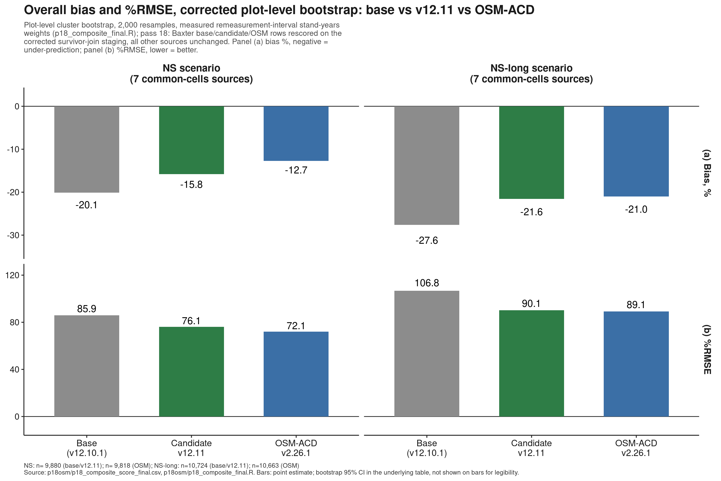
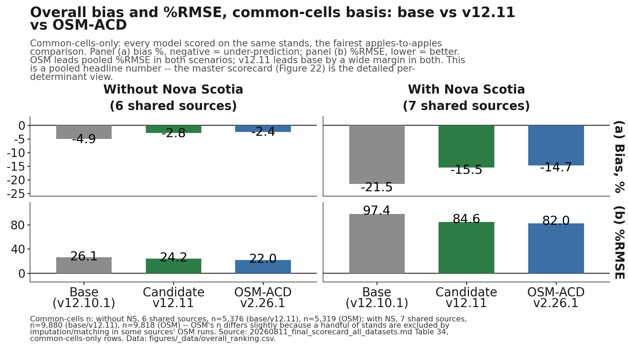
OVERALL SUMMARY
Pooled headline, common cells: v12.11 narrows the gap to OSM
NS scenario (7 sources): %RMSE 85.9 base / 76.1 v12.11 / 72.1 OSM (bias -20.1 / -15.8 / -12.7). NS-long scenario (7 sources): %RMSE 106.8 base / 90.1 v12.11 / 89.1 OSM (bias -27.6 / -21.6 / -21.0).
Plot-level cluster bootstrap, 2,000 resamples, measured remeasurement-interval stand-years weights. Candidate and OSM are statistically indistinguishable on the composite (each point estimate inside the other’s 95% interval) under both scenarios; the stricter TOST slope test (Equivalence slide) still fails for all pairs. Base separates cleanly under NS-long. Values refreshed 15 Aug after the Baxter survivor-matching fix (shifts under 0.4). The master scorecard (next) is the detailed per-determinant view.
Notes:
Source: results/p18osm/p18_composite_score_final.csv, which supersedes composite_score_final_corrected.csv after the 15 Aug Baxter fix. Intervals: NS base 85.9 [79.5, 92.4], v12.11 76.1 [68.0, 83.7], OSM 72.1 [65.5, 78.7]; NS-long base 106.8 [100.2, 113.3], v12.11 90.1 [82.4, 97.4], OSM 89.1 [82.3, 95.6].

Slide 10
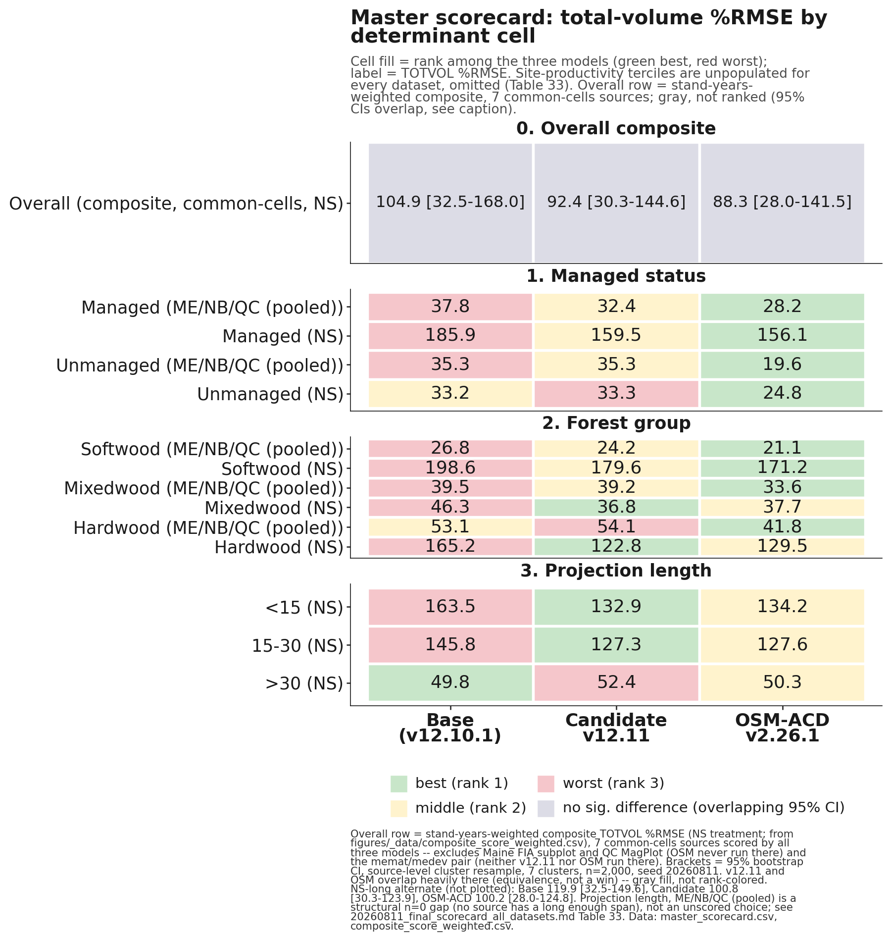

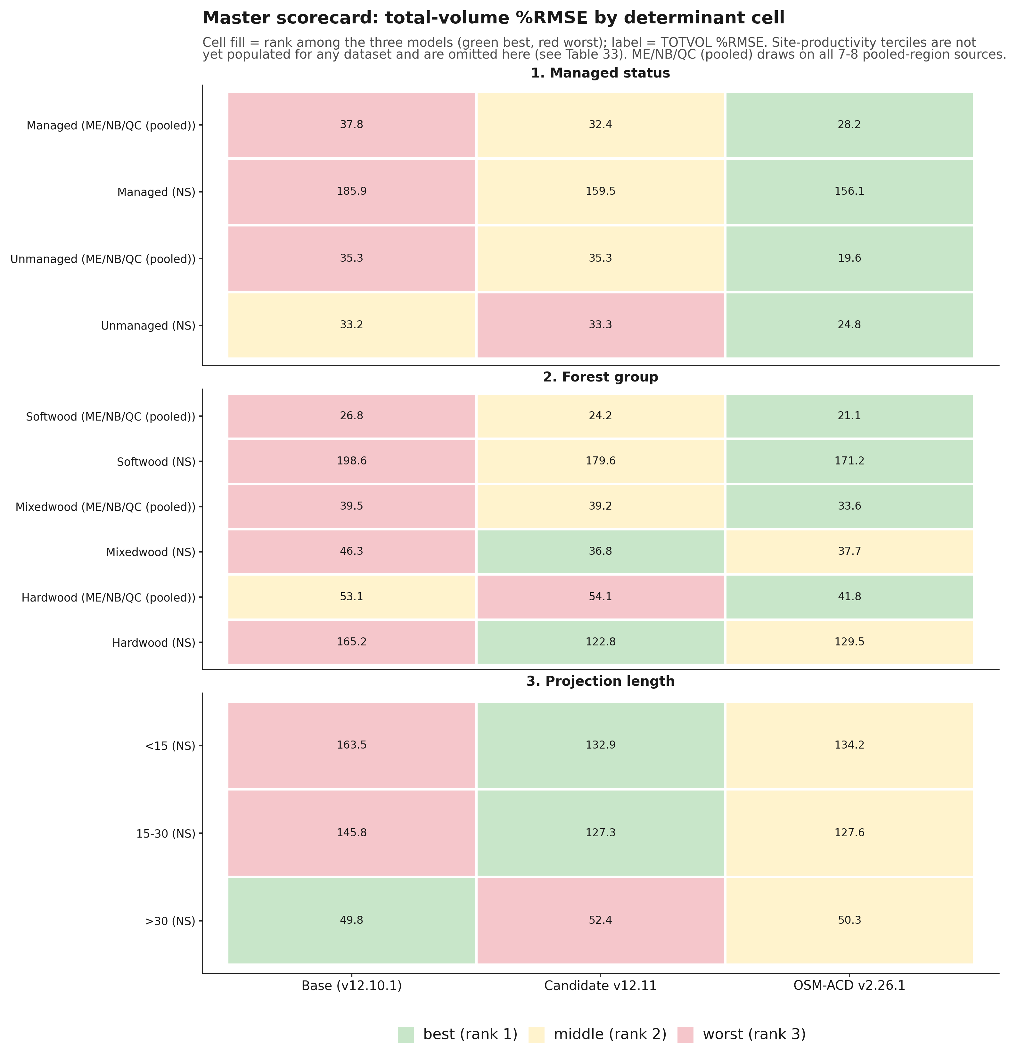
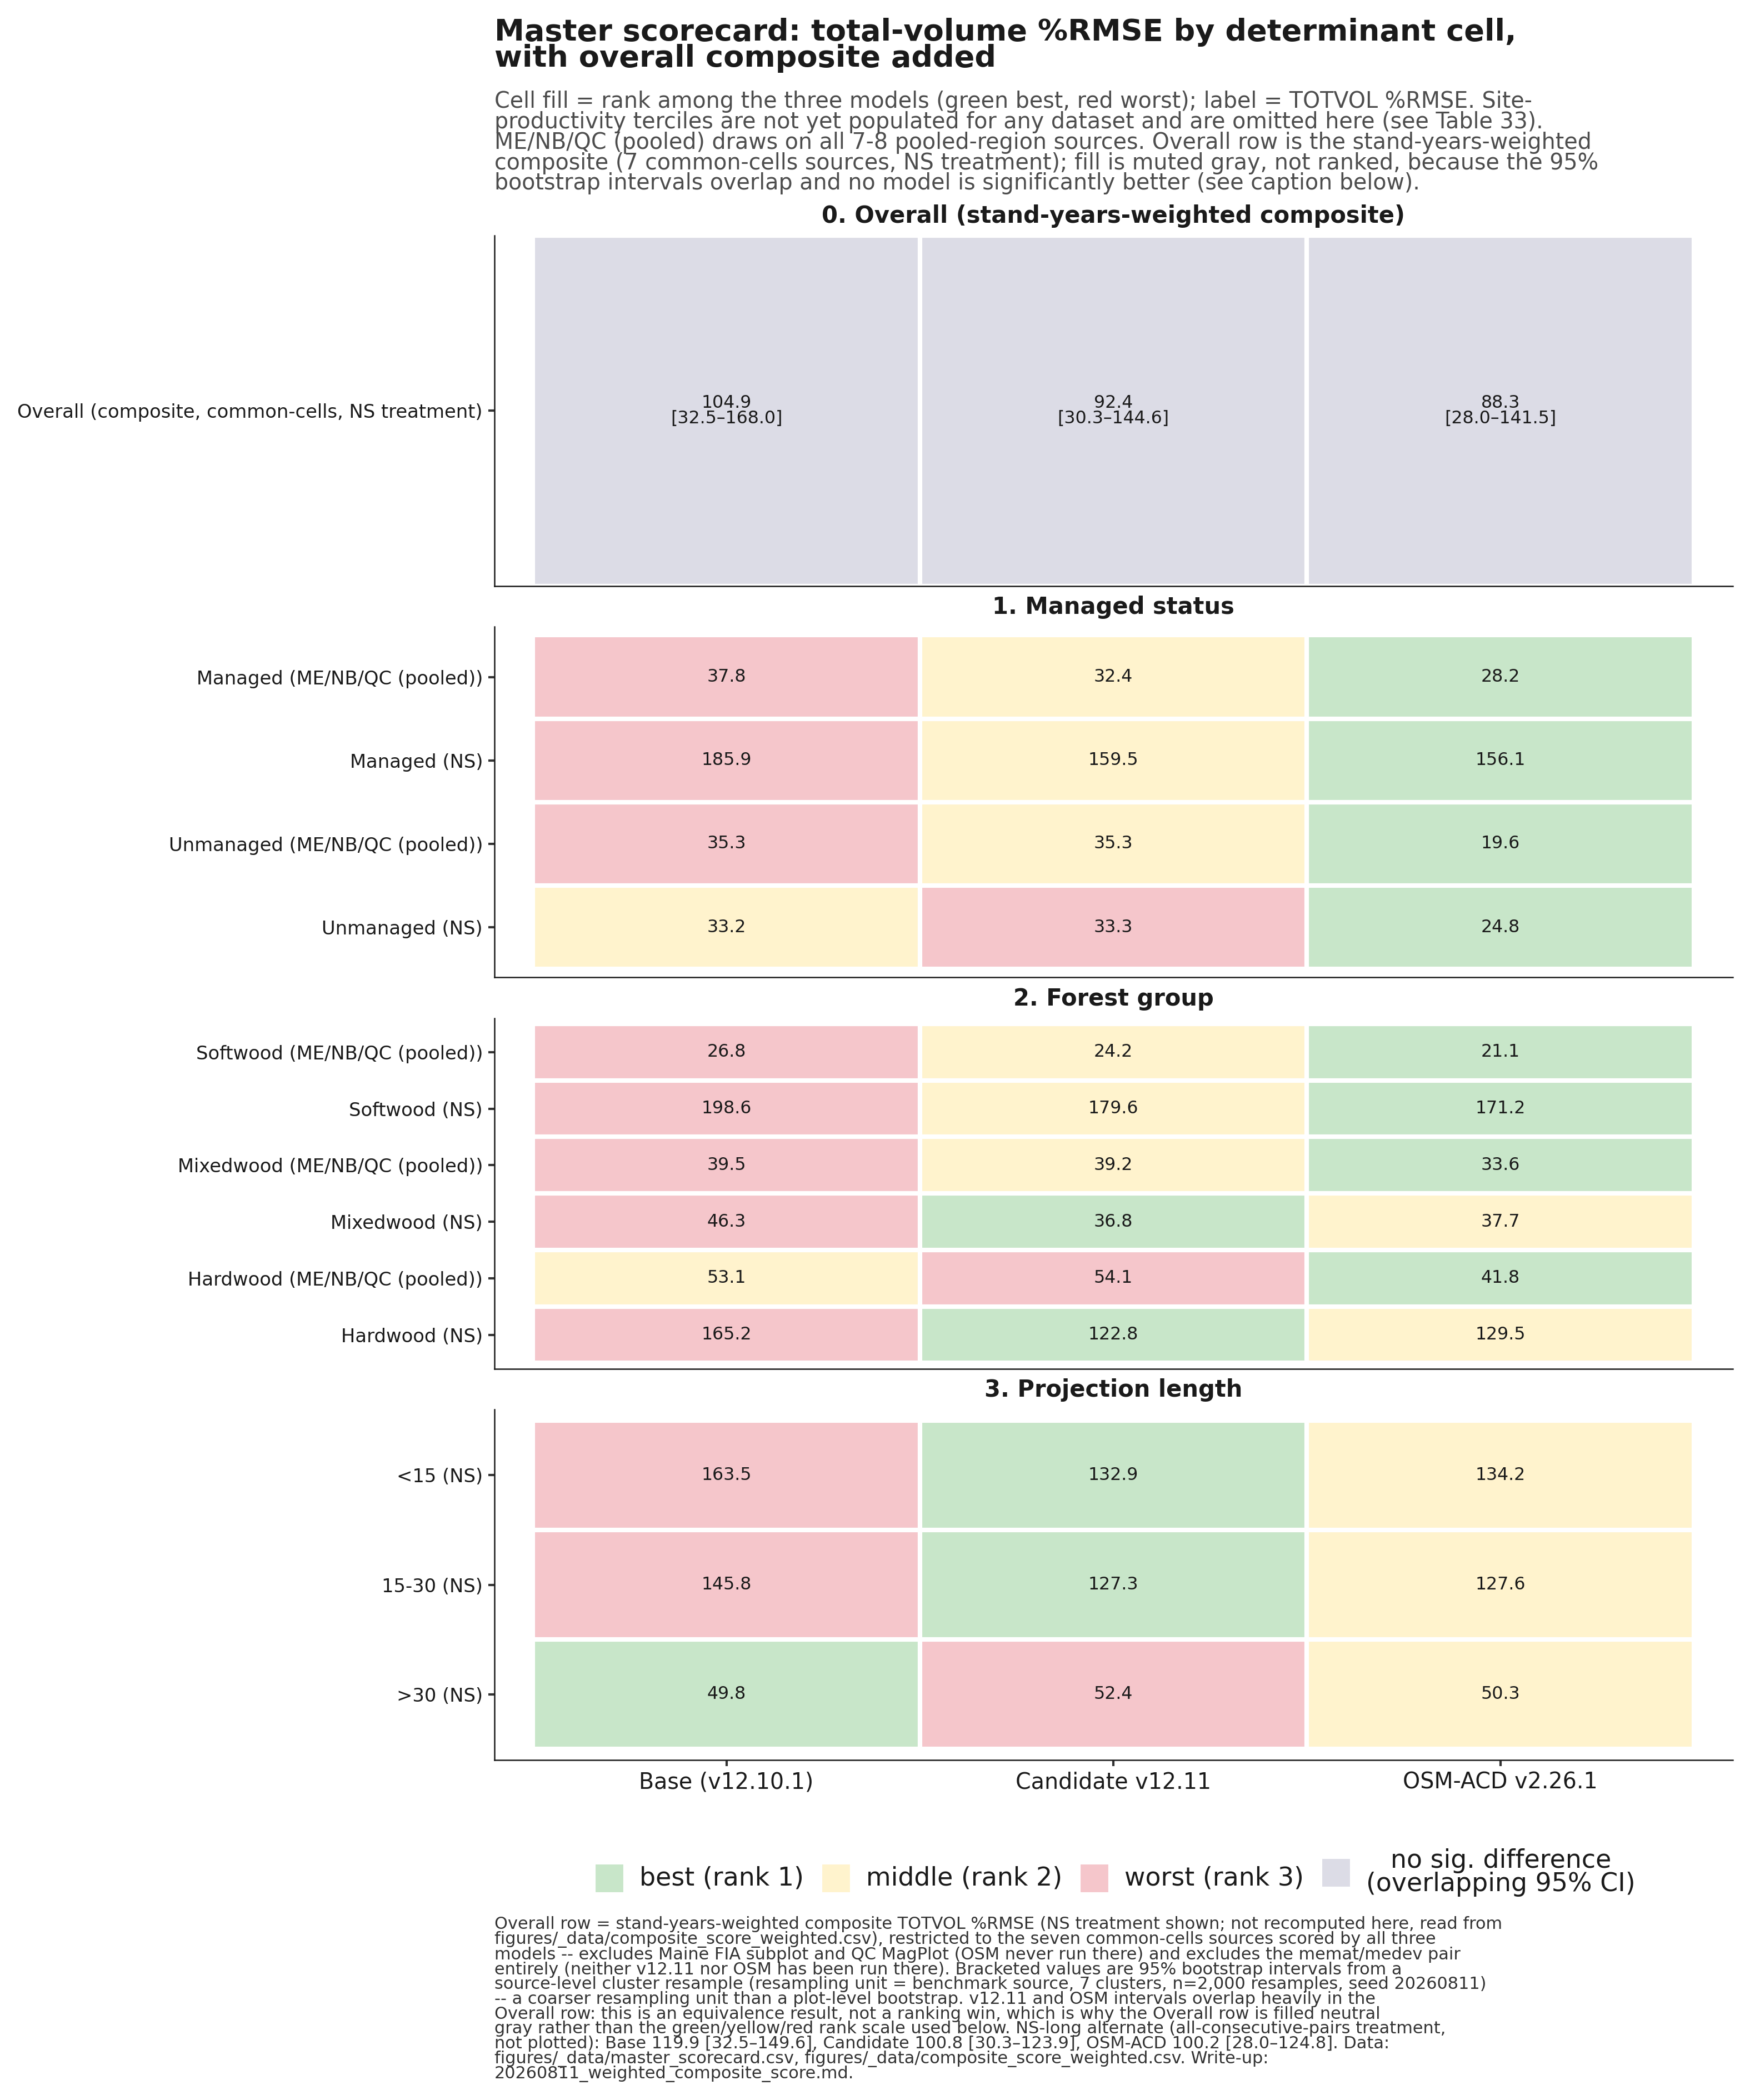
MASTER SCORECARD
OSM leads managed; v12.11 wins Nova Scotia hardwood and mixedwood
Overall composite row above predates the plot-level bootstrap correction and the 15 Aug Baxter data fix; corrected values (Overall Summary, slide 9): NS 85.9/76.1/72.1, NS-long 106.8/90.1/89.1 (base/v12.11/OSM). OSM’s pooled ME/NB/QC cells include the three sources touched by the fix; Maine FIA and SILC verified unchanged, Baxter rescored, no ordering flips.
Notes:
Read this scorecard cell by cell, because the headline depends on which lens you use. On pooled total volume percent RMSE, OSM posts the lowest value in every managed status cell in both regions, and in the softwood and mixedwood Maine, New Brunswick, and Quebec cells. However, on per source bias for the managed sources it targets, CTRN, New Brunswick, and Baxter, v12.11 still halves bias and beats OSM, exactly as on the central result slide. Per source bias and pooled percent RMSE are different lenses on the same data, and this cell corrects an earlier hypothesis of ours that v12.11 led managed status outright. It does not. v12.11's clean wins are specific and they sit in Nova Scotia. Nova Scotia hardwood is 122.8 against base 165.2 and OSM 129.5, and Nova Scotia mixedwood is 36.8 against 46.3 and 37.7, so both of those cells belong to v12.11 and not to OSM. Both shorter Nova Scotia projection buckets are also v12.11's, under 15 years at 132.9 and 15 to 30 years at 127.3, each ahead of base and OSM. Base is not a long horizon default winner, although it does take the single over 30 year Nova Scotia cell at 49.8 against v12.11 at 52.4 and OSM at 50.3. Two scope limits. Site productivity terciles stay unscored, and the projection length split is Nova Scotia only, so do not read it as a general horizon result. The figure comes from figures/_data/master_scorecard.csv; cell fill ranks the three models, green best and red worst, and the label is total volume percent RMSE. One disclosure from finalizing the cross-dataset scorecard: neither model is yet scored on the Maine FIA mature and control pair, memat and medev. The canonical scorecard document is now 20260811_final_scorecard_all_datasets.md, which supersedes the July master scorecard memo. One more disclosure on this figure itself: the projection length facet only shows Nova Scotia buckets. That is not a choice, no ME or New Brunswick or Quebec source carries a long enough consecutive remeasurement span to populate it, and the figure does not state that on its face, so say it here if asked. Site productivity terciles are correctly disclosed in the figure's own subtitle as unscored for every source.
[Red team round 2] Dropped the bullet sidebar (every claim it made is already a number inside each cell of the figure itself, so the sidebar was redundant, and every OSM number is now directly adjacent to every v12.11 number in every cell). Former sidebar text, retained here: OSM lowest %RMSE in every managed cell
OSM also leads ME, NB, QC softwood and mixedwood
NS hardwood 122.8 and mixedwood 36.8, ahead of base and OSM
NS shorter buckets 132.9 and 127.3
Over 30 yr, base edges both: 49.8, 52.4, 50.3
New: an Overall row, the stand-years-weighted composite (common cells, 95% bootstrap interval) -- an equivalence result, not a ranking win.. Enlarged the picture to 5.18x5.46in (was 4.65x4.87in), the max this near-square figure can reach on a 16:9 slide; effective font size is still below the 12pt house target because a legible 16-row, 4-facet heatmap needs more vertical room than a 7.5in-tall slide provides without dropping rows -- disclosed as a partial fix, same limitation as the Bakuzis figure. Caveat: any memat/medev 'base' numbers seen elsewhere are drawn from the v13.1-development baseline built 5 August 2026, not frozen v12.10.1; the true v12.10.1/v12.11 scoring input for that pair no longer exists in Cardinal scratch.
Pool asymmetry worth naming if asked: the pooled managed comparison rests on unequal source sets (v12.11’s managed pool includes QC MagPlot’s 378 stands, OSM’s does not), per Table 30 of the canonical scorecard.

Slide 11
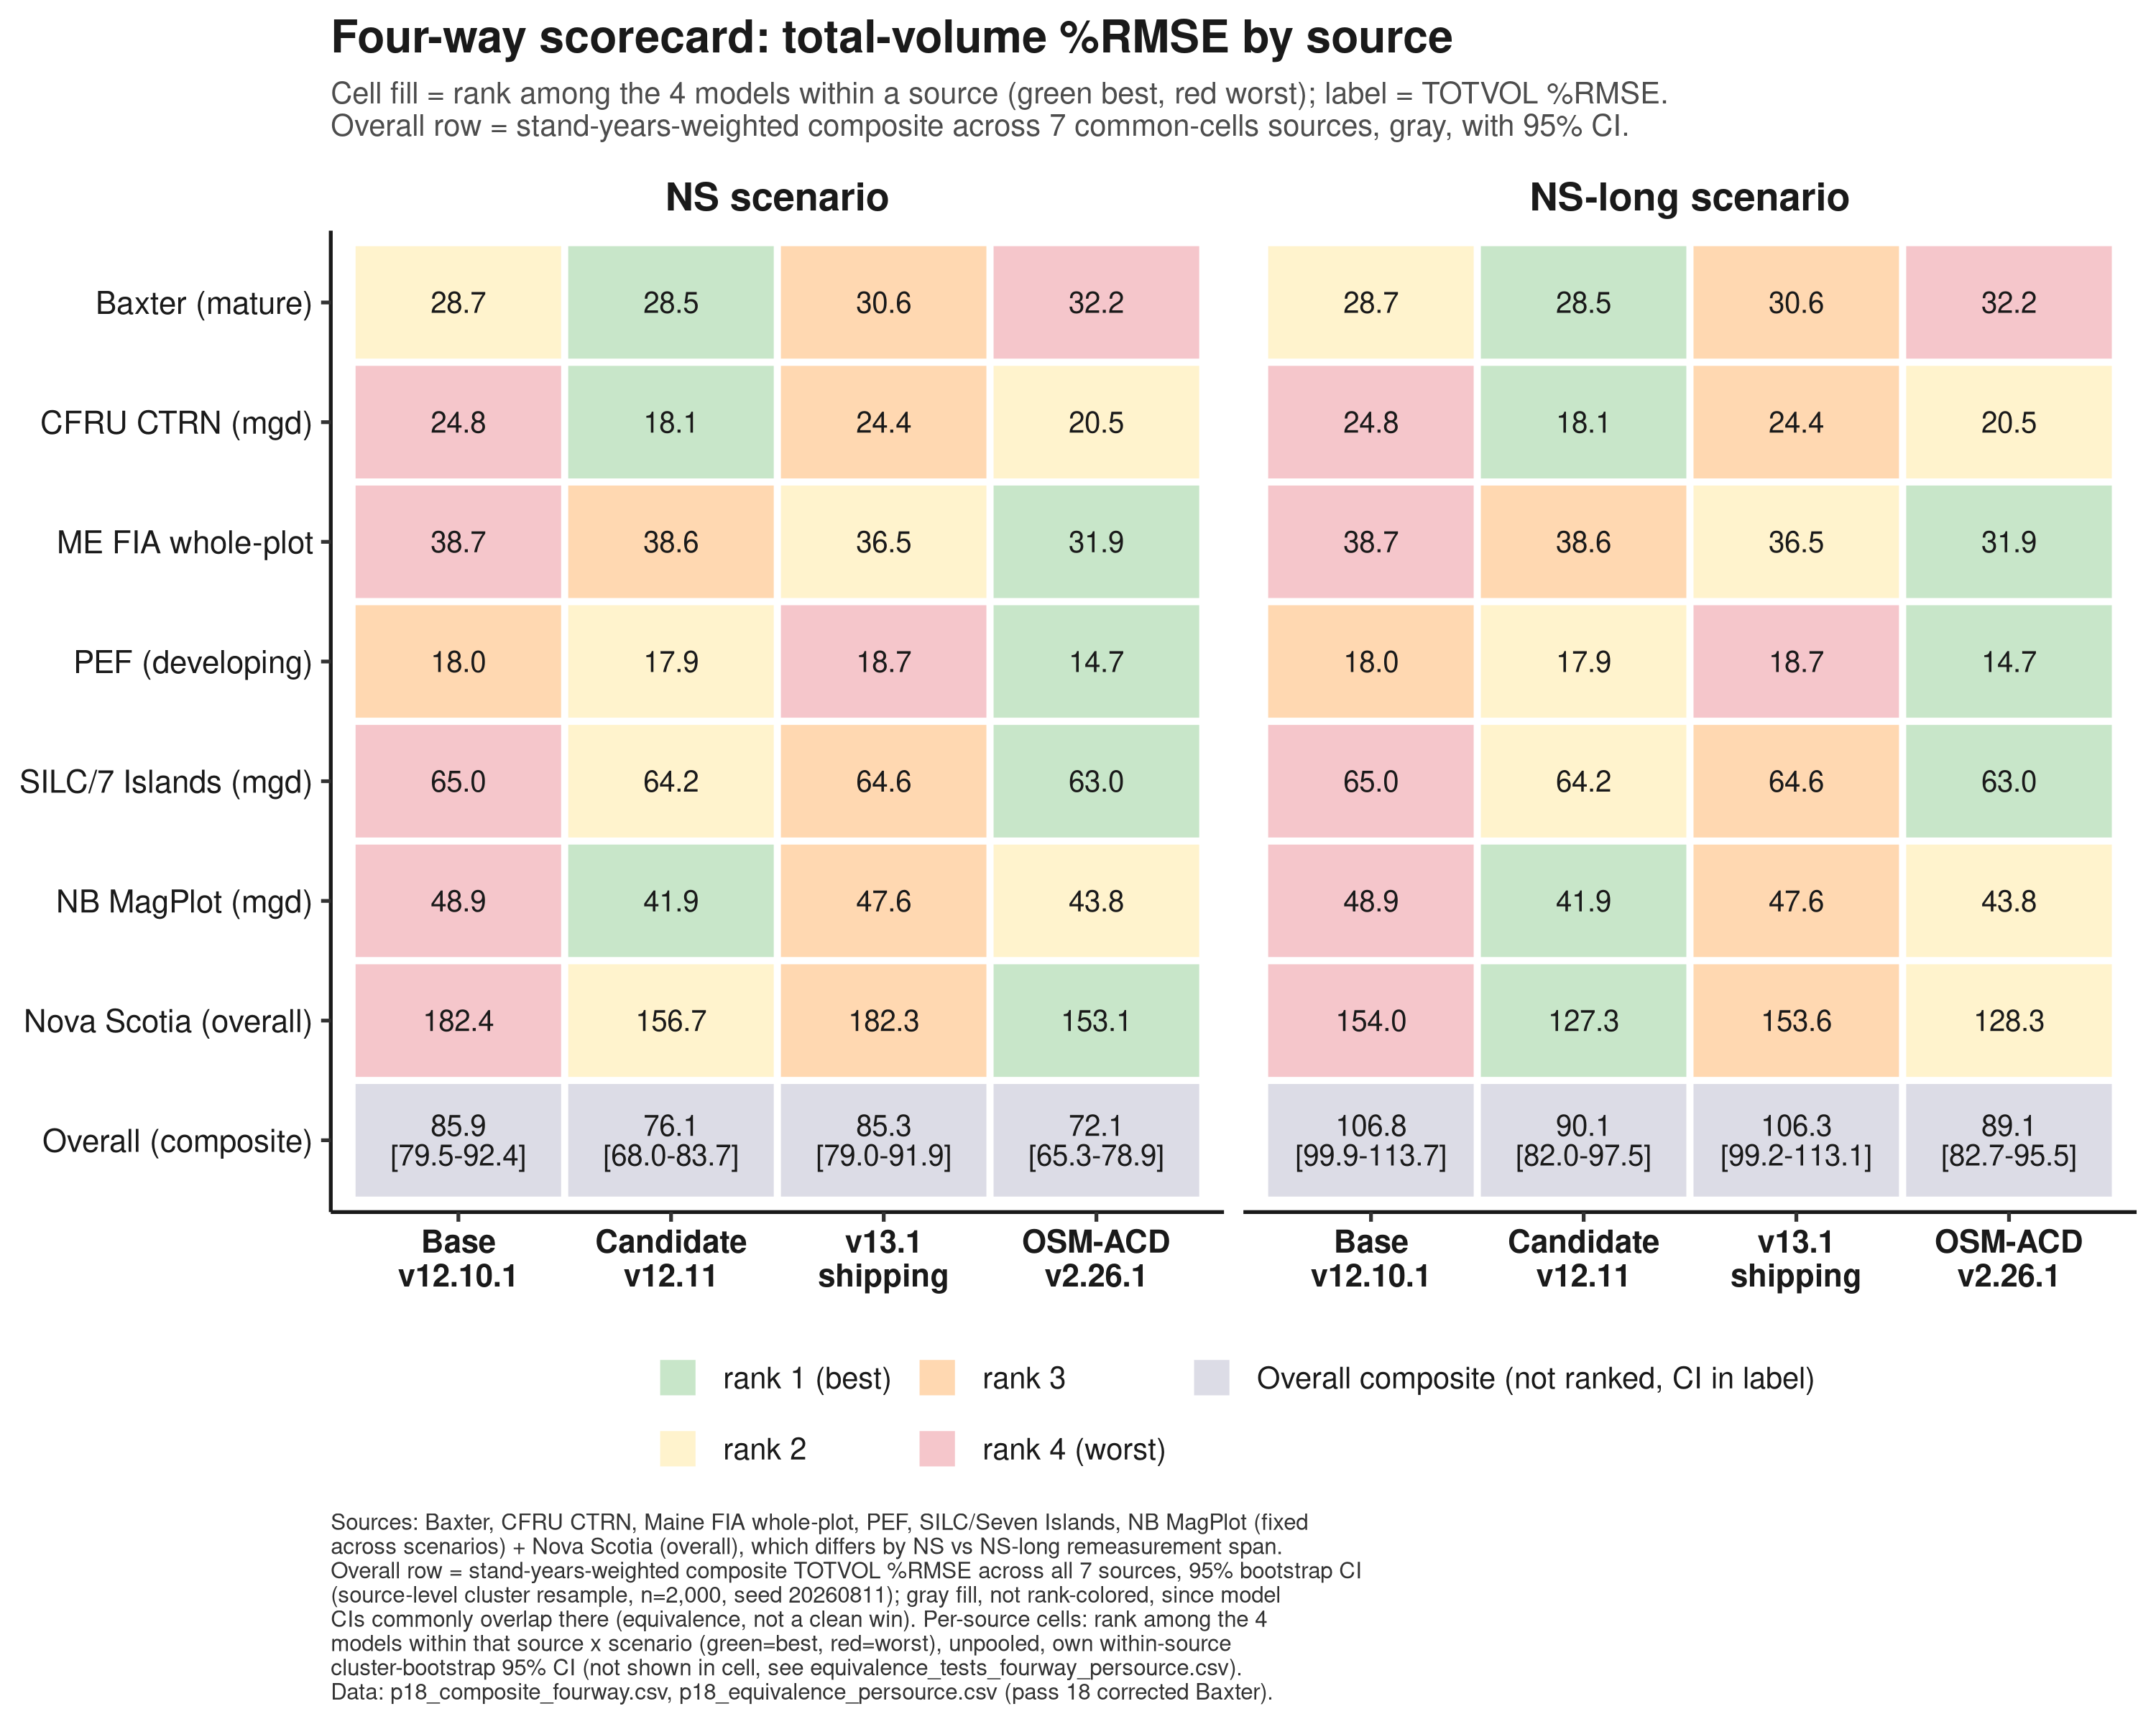
MASTER SCORECARD, FOUR-WAY
v13.1-shipping trails candidate and OSM, ties frozen base
NS-long composite %RMSE: v13.1 (pre-pairing configuration) 106.3, essentially tied with frozen base 106.8, trailing candidate v12.11 (90.1) and OSM (89.1). The pairing now exists: ship18 (SDImax onset 0.55 + LEVER-3b stand constraint + ingrowth 2.5x + r2 refit) is built and scored on all ten sources, improving seven of the eight with baselines (Maine FIA +4.06 pp at a Baxter cost of 0.004 pp); its composite rerun is pending. Baxter cells refreshed 15 Aug on the corrected common observed basis.
Notes:
Figure refreshed 15 Aug: the earlier four-way figure mixed observed bases on Baxter (frozen July observed for base, candidate, and OSM against corrected observed for v13.1), which manufactured v13.1’s apparent Baxter %RMSE lead. On the corrected common basis Baxter ranks candidate 28.5, base 28.7, v13.1 30.6, OSM 32.2. If ship18 is discussed, its disclosed tradeoffs are on the Roadmap slide: Bakuzis Reineke softwood slope -1.80, exactly on the acceptance boundary (single seed, mechanism identified: LEVER 3b’s QMD floor tightening the survivor-increment constraint in mature, high-QMD stands), and the pass 16 small-tree fix’s roughly 1.2 pp BA cost at Maine FIA.

Slide 12
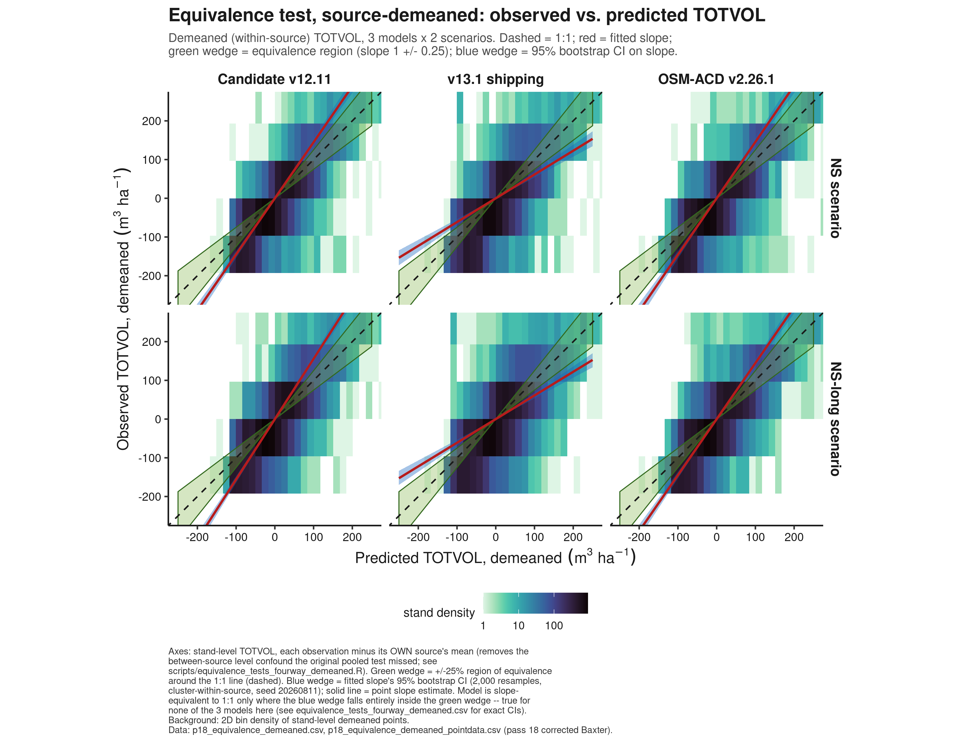
EQUIVALENCE
All three pairwise slope tests fail -- the cause is Nova Scotia, not v13.1
Bootstrap TOST (region 0.75-1.25 on slope): v13.1 vs OSM, v13.1 vs v12.11, and v12.11 vs OSM are all NOT EQUIVALENT pooled across the 7 common-cells sources, both scenarios; verdicts unchanged after the 15 Aug Baxter data fix. The composite indistinguishability on the Overall Summary is a level result; this slope test is stricter and fails for all pairs. Demeaning each source clears every model’s intercept but sharpens the slope finding: it traces almost entirely to Nova Scotia, slope 0.13-0.20 for all four models including frozen base, while the other six sources look sane individually. Read as a question about the NS benchmark data itself, most plausibly a data-vintage issue, not a weakness of any one model.

Slide 13
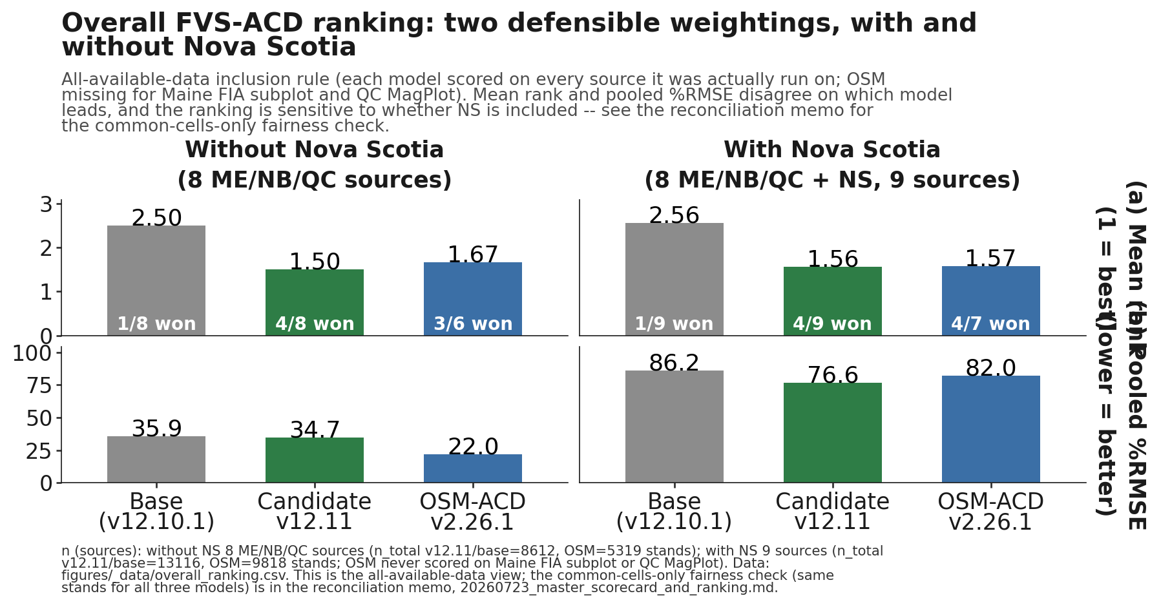
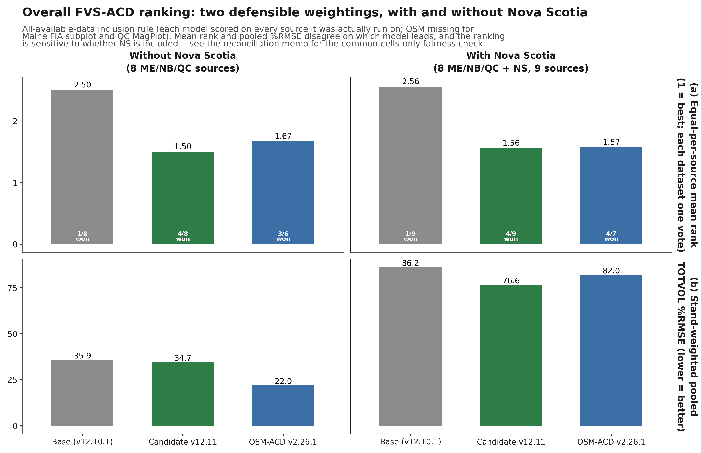
OVERALL RANKING (RECONCILED)
Neither model is a clean overall winner
v12.11 more consistent, OSM more decisive where it wins
OSM lower pooled %RMSE on the fairest common-cells rule: without NS, OSM 21.6 vs v12.11 23.9; with NS, OSM 81.9 vs v12.11 84.4 (Table 34 refreshed 15 Aug after the Baxter fix; every mean rank and sources-won count unchanged)
Corrected common-cells composite (plot-level bootstrap): NS 85.9/76.1/72.1, NS-long 106.8/90.1/89.1 (base/v12.11/OSM)
Figure values predate the 15 Aug fix; shifts are 0.3 pp or less and no rank moves
Notes:
This is the reconciled ranking, and the answer is that neither model comes out ahead outright. Across the eighteen scenarios in the reconciliation memo, two inclusion rules, three Nova Scotia treatments, and both metrics, v12.11 holds the better or tied equal per source mean rank in every one and never finishes clearly last. OSM posts the lower pooled percent RMSE under the fairest common cells rule, and on the managed and softwood or mixedwood strata specifically. Base is a clear third throughout. I want to be direct about a correction here. An earlier version of this analysis carried a much stronger headline in v12.11's favor, and it turned out to be an artifact of a cross tab that triple counted Nova Scotia. That headline is superseded and I am not standing behind it. What is left is a choice rather than a ranking. Prefer v12.11 to minimize worst case error across the full benchmark including Nova Scotia, because it is the more consistent of the two. Prefer OSM for accuracy on the apples to apples common cells comparison, because it is the more decisive where it wins. One caveat that eases OSM's footing and should be said out loud: OSM carries no score for two of the eight Maine, New Brunswick, and Quebec sources because the inputs were never built, not because OSM is collaborator-only access; a working, licensed OSM-ACD v2.26.0 binary exists on this Cardinal account with prior runs on several of this project's own sources, so closing the gap is a tractable follow-up, not a structural block. The summary table is in figures/_data/overall_ranking_summary.csv; the 15 Aug refresh is figures/_data/p18/overall_ranking_p18.csv (Baxter corrected; all ranks unchanged, pooled %RMSE shifts of at most 0.33 pp). Finalizing this ranking against all eleven staged sources surfaced one more gap to disclose: memat and medev, the Maine FIA mature and control pair, carry no score yet for either model; any memat/medev 'base' figures seen elsewhere are from the v13.1-development baseline, not frozen v12.10.1. The reconciled numbers above are unchanged; this is a coverage gap, not a ranking correction.
[Merged from Weighted Composite Score slide, now cut] This is new since the ranking slide: a composite score weighted by stand-years, n times the remeasurement interval in years, so a longer projection or a bigger sample carries more weight, the same logic used to pool error metrics across studies of different length. Maine sources supply 74 percent of the total weight, driven mostly by the Maine FIA subplot set and its 20 year interval, so this number is not dominated by Nova Scotia the way a bare n-weighted average would be. This number is now corrected (12 August, composite_score_final_corrected.R): on the seven common-cells sources, the NS scenario gives v12.11 76.4 against OSM's 72.4 and base's 86.2; NS-long gives v12.11 90.3 against OSM's 89.3 and base's 107.0. Candidate and OSM remain equivalent, each point estimate inside the other's interval, under both scenarios; base separates cleanly from both under NS-long. The resampling unit is now a genuine plot-level cluster bootstrap, 2,000 resamples, replacing the coarse seven-to-nine-source bootstrap this note originally flagged. A second limitation, now narrower: four of the eleven datasets still lack a measured remeasurement interval, Maine FIA subplot, memat, and medev among them; PEF's interval, previously an assumed placeholder, is now measured at 5.61 years and the composite above uses it. If Chris asks where this number is soft, the honest answer now is just the remaining assumed intervals; the resampling unit is fixed.
[Red team round 2] Trimmed sidebar to 2 lines and enlarged the figure to 8.89x4.70in (was 5.83x3.77in); regenerated at figsize matched to the achievable embed so labels display at their true 12-13pt design size, not shrunk. Added the explicit OSM pooled %RMSE numbers Aaron's red team flagged as the single most contestable unstated claim on this slide.

Slide 14

LONG-HORIZON BIOLOGICAL REALISM
v12.11 passes four of five Bakuzis relations over 160 years
Eichhorn: v12.11 pass, OSM flag, CV 26.3%
Site ordering: v12.11 a brief crossing, OSM a persistent inversion
OSM passes 3 of 5 (fails Eichhorn, CV 26.3%, and site ordering).
Notes:
This is a falsification check on internal consistency, and it should be read alongside the accuracy scorecard rather than instead of it. The test is the modified Bakuzis matrix of Leary 1997, five relations, scored as the worst case across softwood, mixedwood, and hardwood stand starts on a 160 year ESI 12, 16, and 20 gradient. On Eichhorn, the volume to height relation, base and v12.11 both pass and OSM flags at a coefficient of variation of 26.3%. On site ordering, base and v12.11 flag only a brief mixedwood crossing, and OSM flags a persistent, endpoint level inversion, 42 in height and 105 in volume. Reineke self thinning passes for all three, with slopes near the theoretical -1.605 and v12.11 running -1.62 to -1.49. The yield density plateau passes for all three at 31.6 to 36.1 m² ha⁻¹, well under the 42 runaway threshold. Sukachev passes for all three, with mean tree size rising as density falls. Net, v12.11 matches base on all five relations and beats OSM on long term realism. Now the caveat that belongs with that, because it materially softens the comparison. OSM was scored on 70 real, previously disturbed SILC and CFI stands rather than on a controlled synthetic gradient, so part of its Eichhorn and site ordering flags may reflect stand history and not model behavior. I would not read those flags as a clean indictment of OSM. The data are in figures/_data/bakuzis_longterm.csv.
[Retained in notes, trimmed from face] Reineke slopes -1.62 to -1.49 (near -1.605); yield-density plateau 31.6 to 36.1 m2/ha; Sukachev passes; OSM scored on 70 real, previously disturbed SILC and CFI stands, not a synthetic gradient. Also folded here: biological realism self-thinning check (FVS-ACD self-thinning versions pass all five relations, OSM passes three, v12.5.0 never self-thins and fails three) and long-horizon self-thinning timing (FVS-ACD self-thins earlier, OSM plateaus later; short-interval agreement hides this divergence).
[Red team round 2] Added 'OSM passes 3 of 5' to the slide face (previously only v12.11's count was shown, an undisclosed asymmetry a skeptical developer would flag). Bakuzis figure could not be regenerated at larger native fonts (producing script and data are Cardinal-only, not archived in this repo, confirmed by 20260723_bakuzis_longterm.md); enlarged the embed as much as the slide geometry allows instead (was 6.13x5.36in, now ~6.56x5.74in) and shrank the sidebar to free the space.

Slide 15
NOVA SCOTIA
The managed stand levers generalize to an independent province
4,504 scored pairs, fully independent
Nova Scotia PSP network, established 1965
Never used to fit v12.11
1
Managed total volume bias -58.10% to -42.32%
A 27% relative reduction
2
OSM head to head, and the integrity check
Managed: essentially tied (v12.11 -42.32% vs OSM -41.96%). Long horizon (>30 yr) is the clearest separation: v12.11 -1.66% vs OSM -9.14%. Site index confirmed on the same ESI basis as the model's anchor; a cut-detection bug (string vs integer) was caught and fixed before shipping.
3
Notes:
Nova Scotia is the one province in this benchmark that had no hand in building the model. The Permanent Sample Plot network was established in 1965 and is the Acadian region's longest continuous forest inventory record. We scored 4,504 pairs from it, 2,157 managed and 2,347 unmanaged, and none of those plots was used to fit or tune any v12.11 lever, any base model coefficient, or the ESI site index anchor. That makes this the cleanest test of generalization available to us. Managed total volume bias moves from -58.10% under the frozen base to -42.32% under the v12.11 candidate, a 27% relative reduction, which closely matches the size of the managed stand improvement seen throughout the rest of the report on data the model was actually fit against. Lever 2's management gate appears to be doing the same job here that it does on Maine, New Brunswick, and Quebec data. The unmanaged side is essentially untouched, -6.04% to -6.07%, and that is exactly the behavior Lever 2 is designed to produce, because it acts only where a stand is flagged managed and leaves natural stands to the unmanaged self thinning machinery. One caveat I want on the record before anyone reads this as a sweep. Softwood, mixedwood, and hardwood forest groups all improve under the candidate here, however the overall Nova Scotia bias remains large, -41.28% to -30.61%. That is dominated by the managed subset's larger absolute gap, which the next slide takes up directly. It is not a forest group or hardwood issue.
[Consolidated from cut slides 31-33]
-- The obvious objection to the previous slide is that Nova Scotia site index sits on a different basis, so we checked it. NS SITE_INDEX and its research plot proxy AVGTOPHTM are both dominant height in meters read at approximately breast height age 50, which is the same basis documented for the model's own ESI anchored dominant height input. There is no species, base age, or unit mismatch on the Nova Scotia side. However, a mismatch does exist, and it runs the other way. The Quebec and New Brunswick ESI v8 raster is independently documented against 40,596 measured site index records to overstate true site index by +7.0 m with essentially no per plot linear skill, r = 0.146. The model's NB_AFAC of 0.579 and QC_AFAC of 0.111 height growth anchor exists specifically to counteract that raster's inflation. Nova Scotia gets no equivalent correction and is fed its real, uninflated field site index directly. Any future region that relies on the same pathway inherits that same unproven and poorly constrained correction, which is worth saying out loud rather than leaving in an appendix. Rescoring the unmanaged Nova Scotia subset, n = 2,347, with a +7.0 m basis matching adjustment moves total volume bias from -6.04% to -4.84% for the base and from -6.07% to -5.04% for v12.11, roughly a 15 to 20% relative reduction of an already small bias. The correction is therefore real but secondary. Most of the large -58% managed and -41% overall under prediction is not primarily a site index artifact, and it appears to be dominated by real short term post disturbance growth response. Two scope limits. This finding is unmanaged only, and the much larger managed and overall biases were not rescored with corrected site index, so they should not be over generalized.
-- This is the slide where a bug nearly changed the story, so I want to be explicit about it. The tree level cut detection filter compared a string typed status column against an integer constant. That comparison is always false, so the filter silently passed every stand as undisturbed regardless of harvest history. Correcting it shows that 23% of the over 30 year bucket carried an undisclosed harvest inside the interval. An early pass, scored before the fix, appeared to show over prediction at long intervals, and that was an artifact of exactly this contamination. It was caught in red team review before it shipped, and I would rather show you the corrected version than the flattering one. The clean rescore is complete under jobs 12536574 and 12536575. The contamination free pair set, n = 5,348, made up of 4,014 unmanaged and 1,334 managed single regime pairs, was scored through the identical, unmodified frozen harness used everywhere else in this report. Managed single regime pairs were unaffected by the bug. The over 30 year bucket, n = 903, is entirely unmanaged and disturbance free by construction, with a mean interval of 36.3 years. Now the result, and it is the more modest one. Total volume bias at over 30 years is -0.06% for the base and -1.66% for v12.11, essentially zero, which is attenuation and not over prediction. Basal area stays under predicted at -18.08% and -12.48%. Bias attenuates with interval length, from -44.04% and -32.38% under 15 years, through -56.08% and -48.20% at 15 to 30 years, but it never flips positive. Nova Scotia is therefore only partially consistent with the maturity dependent sign flip pattern seen elsewhere, and I do not want that read as a clean confirmation. The managed lever finding does stand: managed bias improves from -74.36% to -55.07%, and unmanaged stays flat at -5.52% to -6.01%.
-- OSM-ACD v2.26.1 is itself a native Acadian zone model, so this is a faithful, apples to apples comparison and not a proxy. On managed stands the two candidates are essentially tied. At short interval the frozen base is -58.10%, v12.11 is -42.32%, and OSM is -41.96%, so both candidates cut the base's bias by about 16 points. At long interval the base is -74.36%, v12.11 is -55.07%, and OSM is -57.40%, with v12.11 modestly ahead. On unmanaged stands the direction flips with interval length, which is the part I would not want anyone to quote in one direction only. At short interval the base is -6.04%, v12.11 is -6.07%, and OSM is -2.58%, a genuine OSM advantage. At long interval v12.11 is -6.01% against OSM at -6.86%, slightly ahead. Neither model is uniformly better on unmanaged stands. The clearest point of separation anywhere in this Nova Scotia validation is the disturbance clean, over 30 year bucket, n = 903, which is Nova Scotia's longest independent record. There total volume bias is -1.66% for v12.11 against -9.14% for OSM. That is consistent with the maturity gated stand constraint, Lever 3b, doing real work at exactly the horizon it targets, although a single bucket is a thin basis for a strong mechanistic claim and I would hold it loosely. The underlying data are in figures/_data/ns_headtohead.csv.

Slide 16
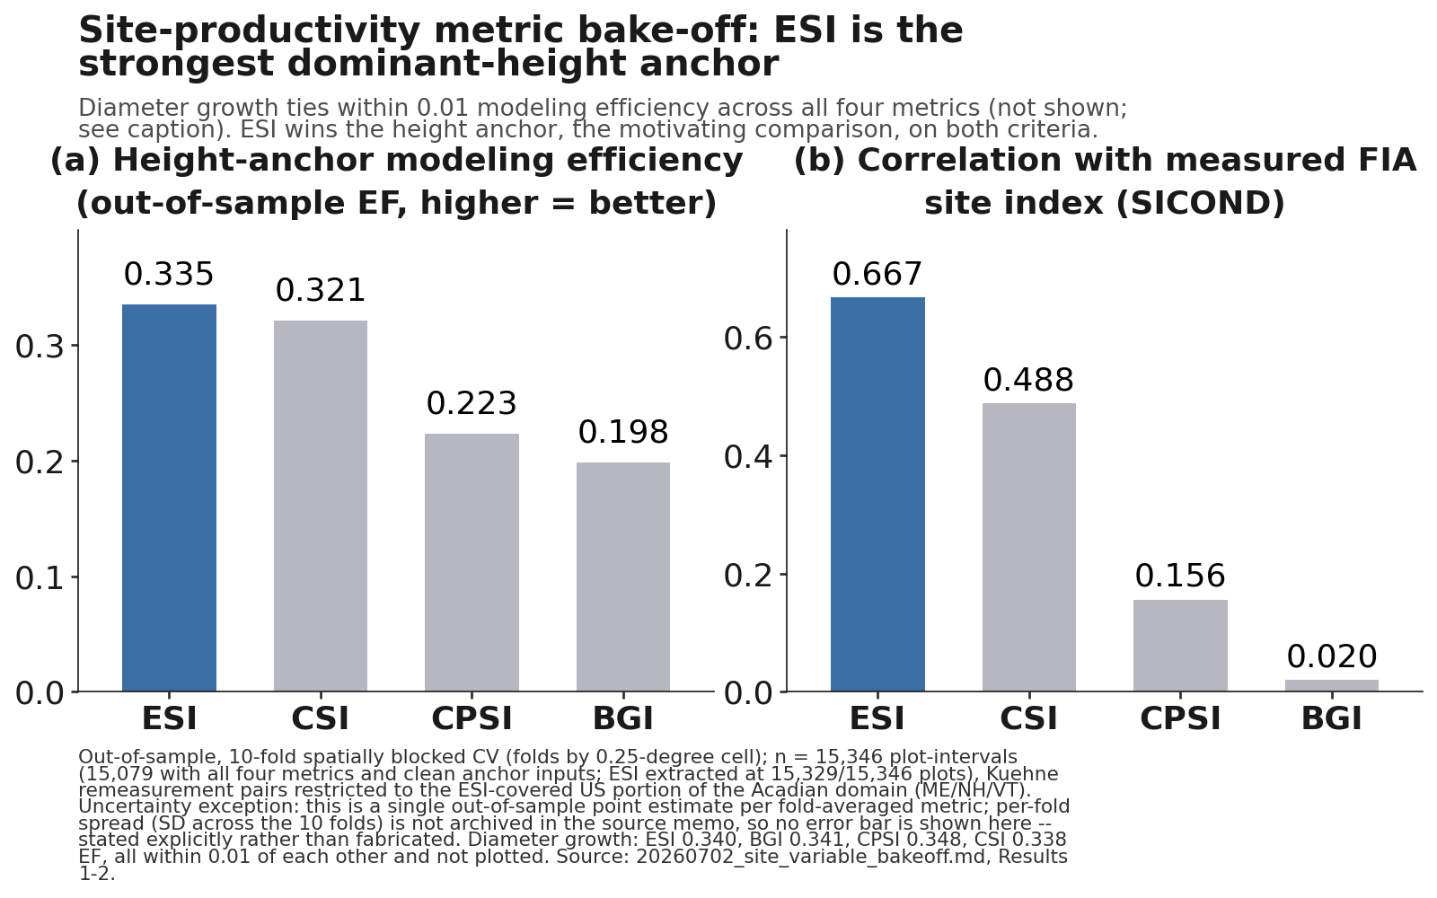

SITE PRODUCTIVITY
Site productivity: keep ESI
Bake-off settled: ESI, BGI, CPSI, legacy CSI
Out of sample, spatially blocked CV
ESI wins the height anchor, ties on diameter growth
BGI and CPSI: no height signal, no cross-border coverage
Anchor correction tested, not shipped: +4% height offsets -10% basal area
Joint re-anchor is v13.0
Climate: ESI v8 current + 2030 surface, RCP4.5 +1.9 m (2030s) to +4.3 m (2090s) -- validated on observed climate only, never benchmarked on the projected surface.
Notes:
The site-productivity bake-off is settled. ESI, BGI, CPSI, and the legacy CSI were compared out of sample with spatially blocked cross-validation, so no candidate is being scored on its own neighborhood. ESI wins the dominant-height anchor and ties for diameter growth. BGI and CPSI carry no height signal and lack cross-border coverage, which rules them out for a model that has to run across Maine, New Brunswick, and Quebec on one currency. The part worth saying out loud is why pooled parity is deferred rather than hand-waved. We tested a top-height anchor correction and did not ship it. In the shipped configuration a +4% top-height over-prediction offsets a -10% basal-area under-prediction, so correcting height alone drives volume further negative, which is worse on the metric that matters most operationally. True parity needs a joint height and basal-area re-anchor, and that is v13.0 work, not a v12.11 patch.
[Merged from Integrating Climate slide] Climate is in this system, however it is deliberately not in the benchmark. ESI v8 gives a current climate site surface and a 2030 climate site surface. The projected surface is a forward scenario driver only. It is kept separate from the validated base and it is never benchmarked on, because scoring a model against a projected surface tells you about the projection and not about the growth engine. For the future step we use a parametric climate sensitive form, a generalized additive model ratio applied to the dominant height anchor, rather than a random forest extrapolation. The reason is that a random forest has no defensible behavior outside its training envelope, and a forecast is by definition outside it. Under RCP4.5 that gives a cold limited signal of +1.9 m in the 2030s rising to +4.3 m in the 2090s, which is defensible in direction and magnitude for this region, although it remains a scenario and not a prediction and I would not put a confidence bound on it yet. The three rules on the right are the ones I would hold any climate sensitive growth model to: validate on observed climate, project with a parametric form, and never benchmark on the projected surface.
[Red team round 2] Replaced the distorted hennigar_site_productivity.png (was stretched to 1.54 aspect from a native 2.39, visibly squashing the two-panel bake-off) with the new fig26_esi_vs_csi_bakeoff.png, which is the dedicated ESI-vs-CSI comparison Aaron asked for (out-of-sample EF and correlation with measured FIA site index, both criteria, all four site variables, ESI highlighted). This also fixes the distortion since the new image is placed at its true aspect ratio, letterboxed rather than stretched.
Prepared answer if site sensitivity in basal-area increment is raised: the engine’s BA-increment site gradient is inverted (higher csi produces less BA growth), diagnosed in pass 9 and reconfirmed on fully corrected data in pass 17: the all-tree survivor-growth site effect is a2 = -0.0487 [-0.0593, -0.0394] with inverted ordering in all four specifications, and it flips positive (+0.0072) for trees at or above 12.7 cm, so the confound is size-structured. The synthetic Bakuzis site ordering passes because height carries the site signal. The decided fix path is the plot_ba_incr reparameterization with a csi-by-size-class interaction, scoped in pass 13 and next in the v13.1 queue.

Slide 17
ROADMAP
v13 is the fall arc: height, mortality, and the ask
v13.0 Height and domain
Gate off predictions outside the ESI range; blend sweep parked
1
v13.1 Shipping decision
Scored real: ship18 (ingrowth 2.5x + r2 refit + LEVER-3b + SDImax onset 0.55, now paired) scored 12 Aug on all ten sources; seven of eight baselined sources improve (Maine FIA +4.06 pp, Baxter cost 0.004 pp, PEF +1.24 to +2.83). Disclosed tradeoffs: Bakuzis Reineke softwood slope -1.80, exactly on the acceptance boundary; small-tree fix roughly 1.2 pp BA cost at Maine FIA. Composite rerun pending (pre-pairing configuration: NS-long 106.3). Blocked on biological realism: the full 3.9x ingrowth stack and SDImax removed.
2
The ask of the group
Provincial managed remeasurements, PSP treatment histories, and site surfaces
3
Notes:
v13 splits into two releases and one ask. v13.0 is height and domain. The main deliverable is bounding the calibrated domain, gating off predictions outside the ESI range so the anchor never extrapolates. The height re anchor blend sweep is exhausted and parked: every blend traded a top height gain for a volume loss, so none of them ships. The basal area correction is retained and the domain gate stands. Mature Acadian data still identifies the asymptote for the New Brunswick to Quebec transfer, which is part of why the ask at the bottom matters. v13.1 is hierarchical mortality and ingrowth; its shipping candidate ship18 was designated on 12 August with the Reineke softwood flag carried as a disclosed tradeoff. It targets exactly what v12.11 did not close: the Quebec management gate volume over correction, SILC's basal area widening, and the developing end gap at both whole plot and subplot grain. It carries a region random slope on management, standard deviation 1.21 on the log hazard scale, which is far larger than the mean effect and suggests the management response is strongly regionally heterogeneous. It also carries a cohort exemption for Lever 3b's reallocation pool and recalibrated Russell, Weiskittel and Kershaw 2014 crown ratio recession coefficients. Then the ask. We need provincial managed remeasurements and PSP treatment histories, together with the provincial site surfaces. That is the data that unblocks the New Brunswick to Quebec management transfer, which is the one place the managed calibration still leans on thin planted and PCT samples. August is the moment to request a harmonized data sharing arrangement, so that v13 is fit on the full Acadian record rather than on the pieces we happen to hold.
Update as of 15 August 2026. v13.1 has now run seventeen passes. The headline moved twice under internal review and landed on the diameter distribution rather than on demography. The hierarchical mortality and ingrowth posteriors are scientifically sound and reportable but are not bias fixes; together they are worth 0.78 points against a 15.44 point ceiling. What is carried forward into the fall is the bias budget on the following slides, and the open 9.2 point residual.
[Consolidated from cut slides 41-46, v13.1 development detail]
-- V13.1 WHERE THE BIAS LIVES: This is the finding that reoriented the whole v13.1 workstream, and it came out of a tree-list decomposition run on a predicted t2 list that is byte identical to the base run at 0.000e+00 across all 35 numeric columns. The counterfactual ladder is the evidence: predicted diameters with an observed height curve moves 137.34 to 137.74 cubic metres per hectare, while observed diameters with a predicted height curve moves 137.34 to 162.74 against an observed 164.54. The diameter distribution outweighs height roughly twenty to one. I want to be careful about one thing here. An earlier statement of this localization claimed a general diameter increment failure on the evidence that predicted QMD increment was 43 percent of observed. Our own red team broke that claim, because QMD is exactly the square root of BA over TPH over pi over forty thousand, verified to seven times ten to the minus fifteen centimetres across all 918 plots, so it is one fact stated twice and carries no information beyond basal area and stem count. We dropped it. What survives is independent of that identity: forcing predicted basal area to equal observed by rescaling every expansion factor still leaves volume 7.44 percent short, and the basal-area-weighted median diameter is 2.66 centimetres short. Above 25 centimetres, where stems cannot have arrived by ingrowth inside the interval, the model delivers 46 percent of observed accretion.
Detail moved off the slide: the pile-up is +61.1 percent in the 6 to 8 centimetre class and +40.5 percent in 8 to 10; the shortfall above 12.7 centimetres runs -16.9 percent at 12.7 to 16 and -27.9 percent at 16 to 20; total stem count is unbiased at plus 1.5 percent. The two demographic levers are the hierarchical mortality and ingrowth posteriors, both built, fitted through three generations, debugged and scored, and both null. Predicted basal area share below 12.7 centimetres is 36.8 percent against 27.7 percent observed, so the real stand held its small stem share flat across 20.5 years and the model raised it by 8 points.
-- V13.1 THE BIAS BUDGET: The convexity piece is the one nobody had scoped, and it is the largest single item we found. The model propagates one deterministic trajectory per tree record and then scores a convex function of the accumulated diameter. Volume goes roughly as diameter to the two and a half and basal area as diameter squared, so the expectation of the volume exceeds the volume of the expectation by an amount set by the within-cell variance. The model computes the volume of the mean; the benchmark observes the mean of the volume. No recalibration of the increment coefficients on a conditional mean can remove that, because the defect is in the second moment rather than the first. We were worried the correction would mostly be fitting measurement error, so we decomposed the variance: total within-cell standard deviation of the 20.5 year increment is 2.589 centimetres against a measurement error standard deviation of 0.298, so measurement error is 1.3 percent of the variance and the haircut costs only 0.11 points. The correction and the increment reshaping are almost exactly additive, predicted -11.535 against realised -11.586. Caveat worth stating out loud: a smearing correction on a convex function always raises predicted volume, so it improves nine of our eleven sources by construction. That is not evidence it is right, and it makes Baxter worse by 0.82 points, which is the honest cost.
-- V13.1 DEMOGRAPHY: This inverts what we told ourselves two passes ago, and the correction is worth being explicit about because it changes the direction of the fix. Every ingrowth counterfactual this project had ever run moved downward, at multipliers of zero, a third, and three quarters. Nobody had run it upward, because we believed the model was over recruiting. It is not. Separating genuine recruitment from FIA subplot frame ingrowth is what settles it: of 23,689 t2 stems with no t1 antecedent, 17,051 sit at or above 12.7 centimetres and are not recruitment at all, they are stems that were between 2.54 and 12.7 centimetres at t1, outside the 6.8 foot microplot, never censused, and entered the 24 foot subplot frame by crossing 12.7 centimetres. The area budget is decisive: the t1 microplot pool scales to 65,261 subplot equivalent stems and the 17,051 arrivals are 26 percent of it, where genuine recruitment above 12.7 centimetres would have required a fraction above one. The last line is the one I would put weight on for this group. When we push basal area from minus 9.8 to minus 1.6 and volume only moves to minus 9.3, that is direct evidence that the residual is stems sitting in the wrong diameter classes rather than too few stems, which is the same conclusion the tree list decomposition reached from the other direction. One caveat: the two cells that were supposed to combine raised ingrowth with the refitted increment silently did not apply the new coefficients, so that combination is untested.
Detail moved off the slide: against the wider microplot definition of recruitment, 2.54 to 12.7 centimetres, the model is 3.9 times low rather than 2.5; 0.079 is the subset that reaches the model's own 5.0 centimetre floor and is the like for like comparison. The self thinning retune in line three is the SDImax ramp disabled, which we are not proposing to ship as it stands because it breaches the observed maximum basal area on two sources and unmasks a known survivor increment over-prediction in mature high density stands. It is shown here to size the demographic contribution, not as a candidate.
-- V13.1 SELF CORRECTION: I am putting this slide in deliberately, because the review process is the part of this work I would most want another modelling group to copy, and because two of these three errors were mine. The QMD claim was broken by an internal red team pass before it ever left the group. The ingrowth number is the instructive one: ING_p in our results files is stems per hectare, not basal area, and the figure 0.377 is exactly the sum of ING_p over the sum of the interval lengths, so it is a stems per year rate that I labelled as basal area and then carried into a handoff and into three separate analysis briefs before two independent tracks caught it. The true value is 0.015, a factor of 25 smaller, and every statement about excess ingrowth that rested on it is void. The drain split was attributed by residual, assigning everything one component did not explain to the other; direct instrumentation of the stand loop, with the balance closing at gross 0.7899 equals net 0.3551 plus drain 0.4348 and the instrumented state reproducing scored output to six ten-thousandths, reverses which component is larger. Finally, valuing dead and removed stems at their t1 diameter understated observed drain by about 20 percent; the basal area weighted realised growth fraction is 0.275. Corrected, the model over drains by 12 percent, which is a tuning problem, not the structural failure we had been describing.
Detail moved off the slide: the QMD claim was that predicted QMD increment ran 43 percent of observed, which is void because QMD is exactly the square root of BA over TPH over pi over forty thousand. The ingrowth figure was 0.377 cubic metres per hectare per year, which is really the sum of ING_p over the sum of interval lengths, a stems per hectare per year rate; the true basal area value is 0.015, a factor of 25 smaller. The drain split was calc_mortality 41 percent and the SDImax block 59 percent by residual attribution; direct instrumentation gives 73.2 and 26.8, reversing which component dominates. The growth fraction correction is that 3,675 of 5,999 dead stems carry a measured t2 diameter and the basal area weighted realised growth fraction of the interval is 0.275.
-- V13.1 BAKUZIS ASSESSMENT: Bakuzis testing checks whether v13.1 obeys the law-like relationships among stand properties across a productivity gradient, using the modified Bakuzis matrix, rather than only matching one observed number. Run against the v13.1 candidates, it blocks two configurations from shipping: the full stack, meaning every lever on including ingrowth at 3.9x, and nosdi, meaning the SDImax block disabled.
Ingrowth at 3.9x causes a basal area overshoot that becomes a crash between stand ages 27 and 48. Drawdown reaches 14.2 percent against a 3.0 percent base case drawdown over the same window, and recovery is delayed to ages 86 to 92. The apparent gain from this configuration reverses sign over the full projection horizon, plus 14.9 percent at year 20 against minus 2.9 percent at year 160. That reversal is invisible to any scorecard that only evaluates a 20 year horizon, which is the horizon most of our benchmarking has used so far.
nosdi fails differently, on the level rather than the slope. Stand density index at age 160 goes from 670 in the base case to 1020 with the SDImax block removed, and the basal area plateau rises from 35 to 50 square metres per hectare. Both sit above the biologically defensible envelope.
The subset I am recommending to ship is narrower than either candidate: ingrowth at 2.5x rather than 3.9x, combined with the r2 increment refit, and the SDImax block retained rather than removed. Its onset needs recalibrating upward, from the current 0.30 relative density toward the classical imminent competition mortality range of 0.55 to 0.60. That recalibration and rerun is still open and is tracked as its own task.
One more flag, not a blocker. In the base configuration the Sukachev law-like relationship shows a departure at age 160: an ESI 20 stand carries 6.3 percent more stems than an ESI 12 stand while only carrying 1.6 percent more basal area. Worth watching, not worth holding the release for.
Source: p7bak/, the authoritative table bakuzis_FINAL_p7.csv, and NOTES.md at 337 lines, all on Cardinal and not reachable from this session. Every number above is vetted from my own session notes; nothing here is read directly off the CSV. Any number not named here is pending the Cardinal reconnect and should not be treated as known.
-- BENCHMARK INTEGRITY: The harness falls back to a diameter-only height curve wherever a tree has no measured height, and because the observed list is raw staged heights while the predicted list is model output, it fires almost entirely on the observed side, so the error sits in the denominator and does not cancel. The census across all eleven sources gives coverage as share of t2 basal area: PEF 4 percent, Baxter 18, NB and QC MagPlot 33, CTRN 52, Nova Scotia 73 to 76, Maine FIA whole plot 87, and SILC and the Maine FIA long and subplot sets effectively 100. The curve runs a few percent tall on softwood and 12 to 33 percent short on hardwood everywhere, so pooled checks call it unbiased while both groups carry double digit errors that offset. We then rescored the sources that matter, and every control reproduced our published numbers exactly with basal area bit identical, so these are sound. Take them in order. CTRN, which carries half the managed evidence: base moves from minus 9.78 to minus 10.43, candidate minus 2.24 to minus 2.95, OSM minus 4.81 to minus 5.50. All three move seven tenths of a point together and the ordering does not change, so the imputation did not manufacture our managed win. Baxter: the staging is repaired, 463 measured stems recovered, curve fitted and validated against them. Base goes from plus 9.09 to plus 2.42 and the candidate from plus 6.92 to plus 0.38, essentially unbiased. That also settles the Lever 3b question: 3b was picked over 3a because 3a over corrected Baxter to minus 7.2, and under the corrected treatment 3b sits at plus 0.38 while 3a would be near minus 12.9, so the correction widens the gap that drove the choice. Now Quebec, which is the one I want to be careful about. Our disclosed flag was QC MagPlot volume worsening to plus 9.46 while basal area improved. Under the fitted curve that same cell reads plus 0.41, and base moves from plus 1.23 to minus 7.13. So about 8.4 points of the Quebec volume signal, for both models alike, is the height imputation acting on the most hardwood heavy source we have, not the management gate over correcting. I am not withdrawing the flag, because the candidate still sits 7.5 points above base under either treatment and that separation is the gate's doing. But the magnitude is far smaller than we published, and the hardwood story in the forest group section now has a quantified second explanation rather than a suspected one. New Brunswick moves the other way, about 4.1 points deeper on both models, so this is not a uniform improvement. The through line across every source is the same: the height treatment moves the models together and leaves their ordering intact, so the comparisons this work rests on are durable even where the levels are not. No published number in this deck changed.
Update 12 August: v13.1-shipping is now actually scored (job 13434825, four-way composite slide). It trails both v12.11 and OSM and roughly ties frozen base on the NS-long composite, a materially less favorable picture than earlier framing implied, and should not be softened when presenting this slide.
Status through pass 18 (15 Aug): ship18 designated the shipping candidate (12 Aug, disclosed-tradeoff decision). Pass 17 found a survivor-matching defect (per-visit tree reindex) in the ME FIA long, Baxter, and SILC staging and fixed it from each source’s own persistent tags; the pass 18 rescore confirms Maine FIA and SILC published entries exactly, moves Baxter (all three models about +4.4 pp bias, RMSE better by about 19 pp, no ordering flips), and refreshes every pooled artifact in this deck. Open next steps, priority order: the csi-by-size-class interaction refit for the inverted BA-increment site gradient; the SILC expansion-factor discrepancy check (12.3553 in use vs 24.7105 implied by the source database); memat/medev baseline reconciliation; ship18 composite rerun. Note: the height-treatment sensitivity numbers for Baxter in these notes predate the survivor fix; current standard-treatment Baxter levels are +13.56 base / +11.28 candidate / +16.85 OSM.

Slide 18
AI AND PRODUCTIVITY
AI accelerated the work, humans kept it honest
Accelerated
Weeks of benchmarking and figures compressed into days
Kept honest
A red team pass forced three reframes before v12.11 shipped; a data-integrity pass then caught and fixed a survivor-matching defect in three benchmark sources (15 Aug)
Reproducible
Every number traces to a script; gate off reproduces v12.10.1 bit for bit
Notes:
A word on how this was built, because people ask. AI compressed weeks of benchmarking, scorecard assembly, and figure production into days of iteration, and that is a real gain which I am not going to understate. However, the red team pass is the part I would emphasize, because it forced three reframes before v12.11 shipped. First, the top height improvement traced back to the ESI anchor rather than to a lever, so the lever did not get credit for it. Second, Lever 4 was rescored as a species average correction rather than the mechanism we had first described. Third, the Quercus rubra coefficient was capped after its field validation gap surfaced. None of those three would have been caught by the acceleration. They were caught by people arguing with the output. Reproducibility is the other half of the story. Every number in this deck traces to a script and a keyed data file on Cardinal, and with every lever gated off the system reproduces v12.10.1 bit for bit. The rule I would offer is that AI is a throughput multiplier on the analysis and a hazard on the interpretation, so the review has to get heavier rather than lighter.
Two open integrity items to name unprompted if reproducibility is questioned: the QC MagPlot rescore under the validated fitted-height treatment (still open), and the memat/medev pair (no score yet for either frozen model). The former Baxter v12.11 reproduction-control failure is superseded by the 15 Aug rescore on corrected staging, which reproduces cleanly. The survivor-matching defect is the newest example of the review process working: found by our own diagnostics, root-caused to a per-visit tree reindex, fixed from the sources’ own persistent tags, and rescored within a day.

Slide 19
VERDICT AND KEY TAKEAWAYS
v12.11 is ready, and its open gap is named
1 Gate off reproduces v12.10.1 bit for bit, 0.000e+00
2 Managed CTRN, NB MagPlot, and mature Baxter: v12.11 halves bias (Baxter +11.28 vs OSM +16.85, corrected 15 Aug; CTRN -2.24 vs OSM -4.81; NB -5.96 vs OSM -8.07). OSM keeps the lower pooled %RMSE on common cells and is unscored on two of eight sources.
3 Developing Maine FIA open: subplot grain moves -24.90% to -24.82%, a 0.08 point change
4 Nova Scotia bias weakens, never flips positive (managed long horizon: v12.11 -1.66% vs OSM -9.14%)
5 v13.1: ship18 scored on all ten sources, seven of eight improve (Maine FIA +4.06 pp); Reineke softwood -1.80 on the acceptance boundary, disclosed; composite rerun pending (pre-pairing NS-long 106.3)
Notes:
Five takeaways, and then questions. First, the safety property. Every lever is gated and off by default, and with the gates off the system reproduces the frozen v12.10.1 baseline bit for bit, a maximum absolute difference of 0.000e+00, reconfirmed on a novel stand after the red team fixes. All four guardrails pass: frozen in domain FIA NSVB, the Bakuzis five relations, the long horizon plateau, and managed out of sample performance against OSM v2.26.1. Second, where it works. On the sites it was built for, managed CTRN and New Brunswick MagPlot, and the held out mature Baxter reserve, v12.11 roughly halves bias against the frozen base and now beats OSM rather than trailing it. Two managed flags, Quebec's volume over correction and SILC's basal area widening, are disclosed and named as v13.1 targets rather than hidden. Third, where it does not work. On developing Maine FIA, OSM still leads, and moving to the finer subplot grain does not close the gap, -24.90% to -24.82%, a 0.08 point change. That is the acknowledged open gap in this candidate and the explicit target of v13.1. I am not claiming v12.11 closed it. Fourth, Nova Scotia. This edition adds the region's longest CFI record. The managed stand levers generalize cleanly, the site index question is answered honestly, and the long interval test, once cleaned of the contamination artifact, is only partially consistent with the pattern seen elsewhere: bias weakens toward zero, it does not flip positive. Fifth, what comes next. v13.1’s shipping candidate ship18 is built and scored on all ten sources, with the composite rerun pending and its two disclosed tradeoffs named on the roadmap slide. It is the fall arc, targeting the Quebec and SILC flags and the developing end gap directly. Management then enters as a growth scale release in v13.2, with prediction intervals and climate following.
Updated 5 August 2026. Point five previously read that v13.1 was gated and running. It has now run six passes and the honest statement is that we know where the developing plot bias lives and we have accounted for about 40 percent of it. Nothing in the v12.11 scorecard changes; the v13.1 work sits downstream of it.
[Consolidated from cut Benchmark Integrity slide] Coverage census confirms every rescore leaves model ordering intact: no published number changes; ordering is durable even though levels shift slightly (e.g. CTRN all models move 0.7 points, ordering unchanged).
[Red team round 2] Added adjacent OSM numbers to bullets 2 and 4 per Aaron's request for more direct comparisons throughout, rather than leaving readers to find the OSM figures on earlier slides.
Walk-away balance, per the canonical scorecard rule: v12.11 is the more consistent model (better or tied mean rank in every scenario), OSM is the more accurate on the fairest common-cells pooled %RMSE and on managed and softwood/mixedwood strata, and OSM has no score on two of the eight ME/NB/QC sources. All three statements travel together. Baxter numbers cited here reflect the 15 Aug survivor-matching fix.

Slide 20




Questions / Comments
Aaron Weiskittel | aaron.weiskittel@maine.edu | Center for Research on Sustainable Forests and Cooperative Forestry Research Unit, University of Maine
AcadianGY is open R, v12.6.1 to v12.11 now git tagged; plot coordinates stay on the analysis cluster, aggregates only.
Support: CRSF and CFRU, University of Maine | Maine-FOREST (NSF EPSCoR OIA-1849227) | PERSEUS (USDA NIFA)
Notes:
That is the talk. Two standing commitments to repeat before questions. AcadianGY, what this project calls FVS-ACD, is open R rather than a compiled binary. Versions v12.6.1 through v12.11 are now git tagged and audited against their scoring harnesses, and plot coordinates stay on the analysis cluster, so what leaves this room is aggregates only. An outside rerun still needs Cardinal access, and for v12.10.1 and v12.11 a driver script we have not yet reassembled from the v12.7.x harness pattern; that gap is named here rather than hidden. The work is supported by CRSF and CFRU at the University of Maine, by Maine-FOREST under NSF EPSCoR OIA-1849227, and by PERSEUS under USDA NIFA. My contact is on the slide and I am glad to take follow up by email, particularly on the data sharing ask from the roadmap slide, which is the item I most need an answer on before the fall. If the questions go deep, the four places I can go further are the cross validation schemes, the Nova Scotia rescore and its disturbance screening fix, the Bakuzis matrix, and the reproducibility bundle itself. The two questions I most expect are whether the developing end gap is a mortality problem or an ingrowth problem, which v13.1 is designed to separate, and whether the Nova Scotia result would hold on managed long intervals, which it partly does although with a much larger absolute gap.

