Slide 1
FVS-Modern
Bayesian Calibration of the Forest Vegetation Simulator Across CONUS
Greg Johnson | David Marshall | Aaron Weiskittel
GMUG Meeting | April 2026

Slide 2
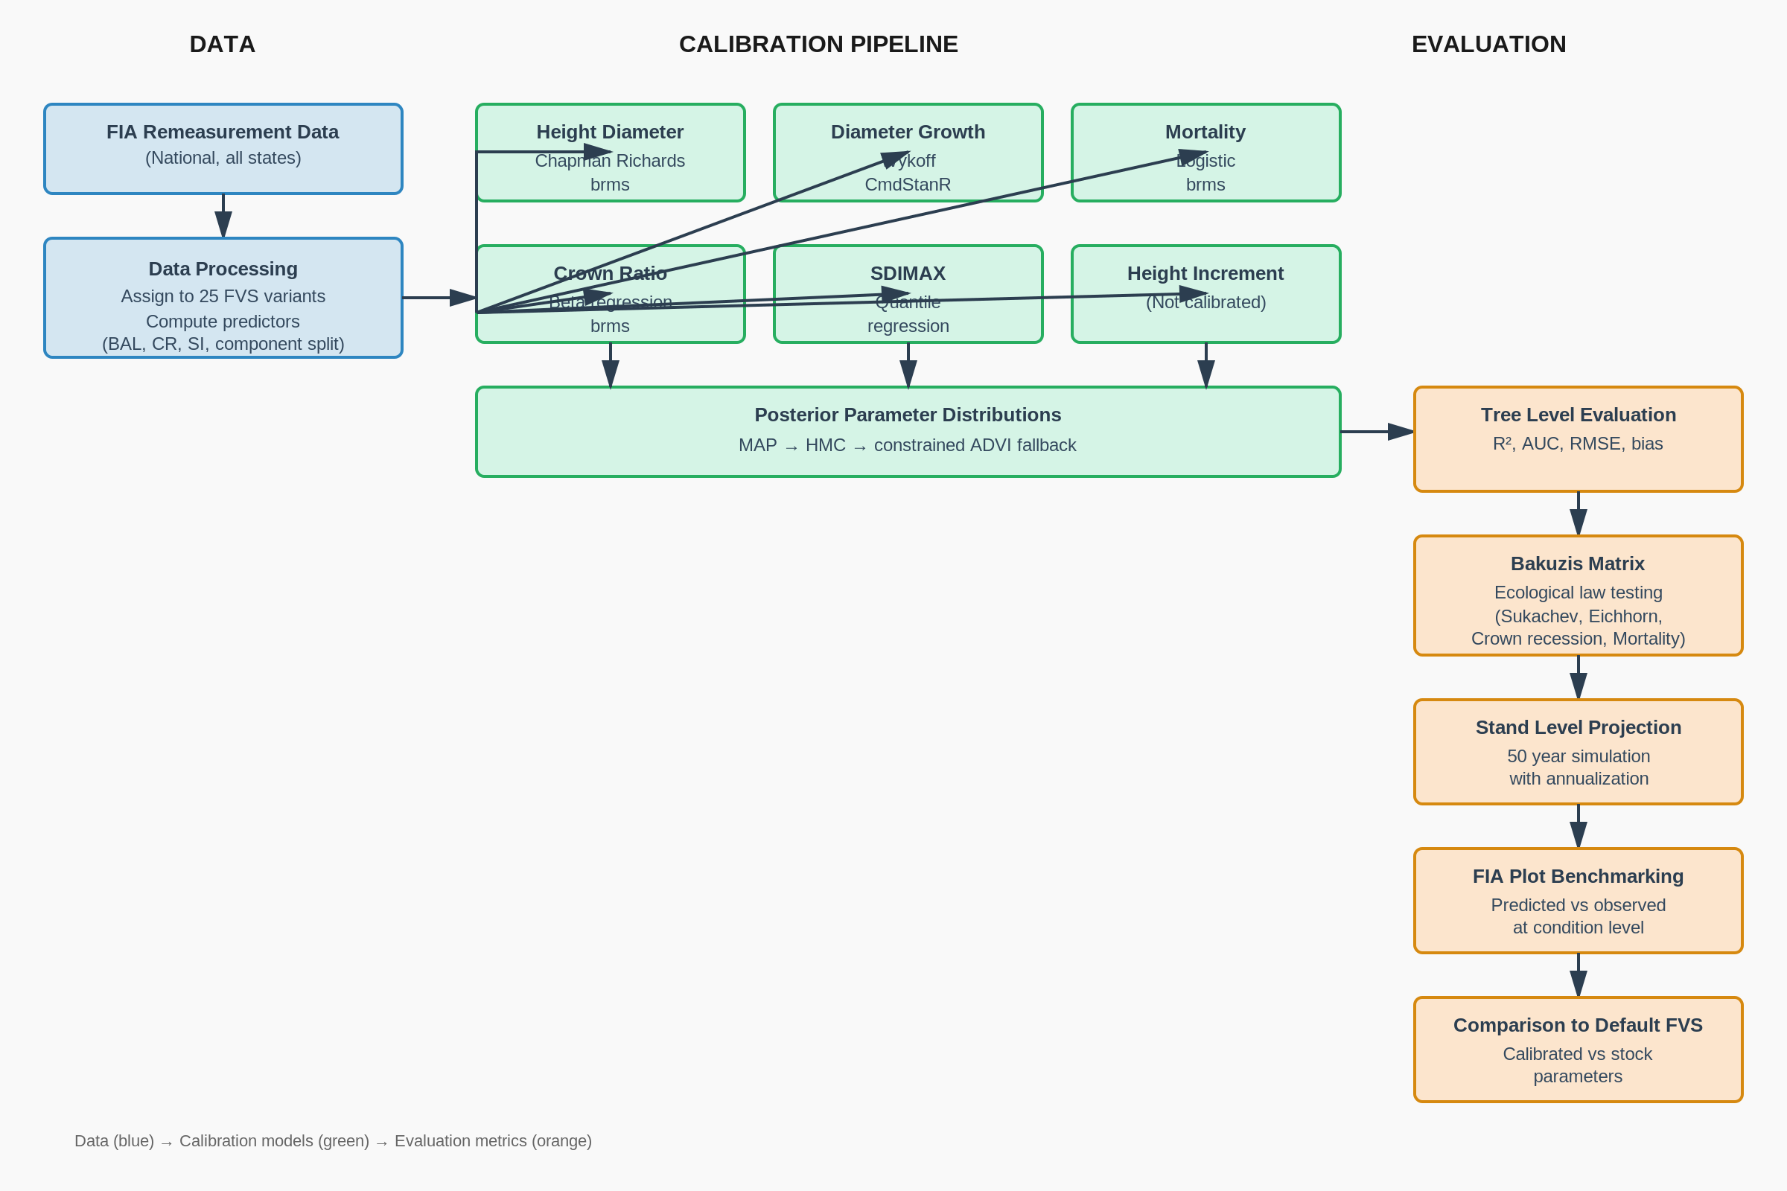
Calibration Workflow
16.2M FIA trees | 435K condition pairs | 25 FVS variants | Bayesian posteriors via Stan/ADVI

Slide 3
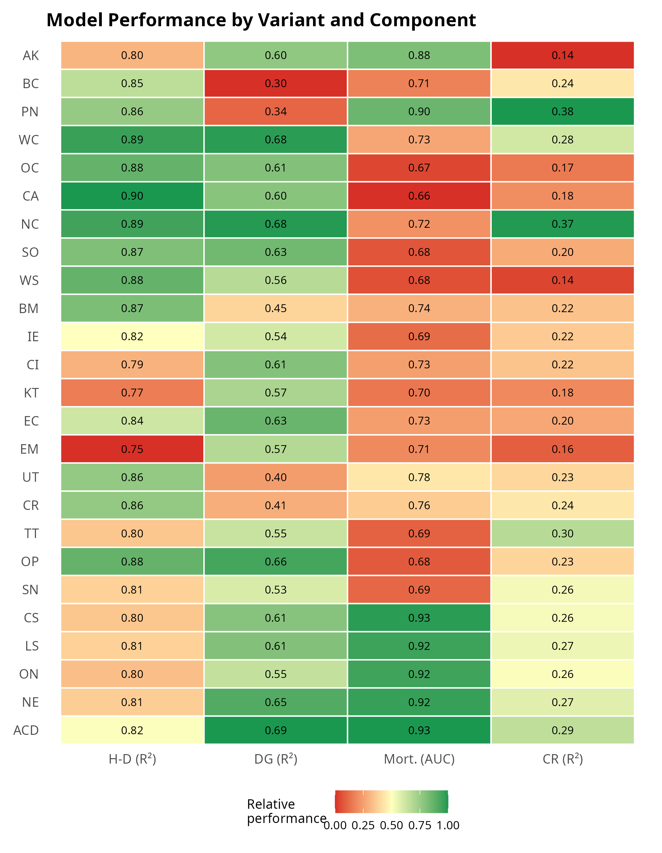
Model Performance by Variant and Component
25 variants calibrated
H-D strongest component (R² = 0.75–0.90)
Mortality AUC 0.66–0.93
Large-tree U-shaped mortality now captured in most variants
Crown ratio weakest (R² = 0.14–0.38)
Observed CR used at initialization; only change modeled
DG R² = 0.30–0.69
Shared 13-covariate Wykoff ln(DDS) equation with species random effects

Slide 4
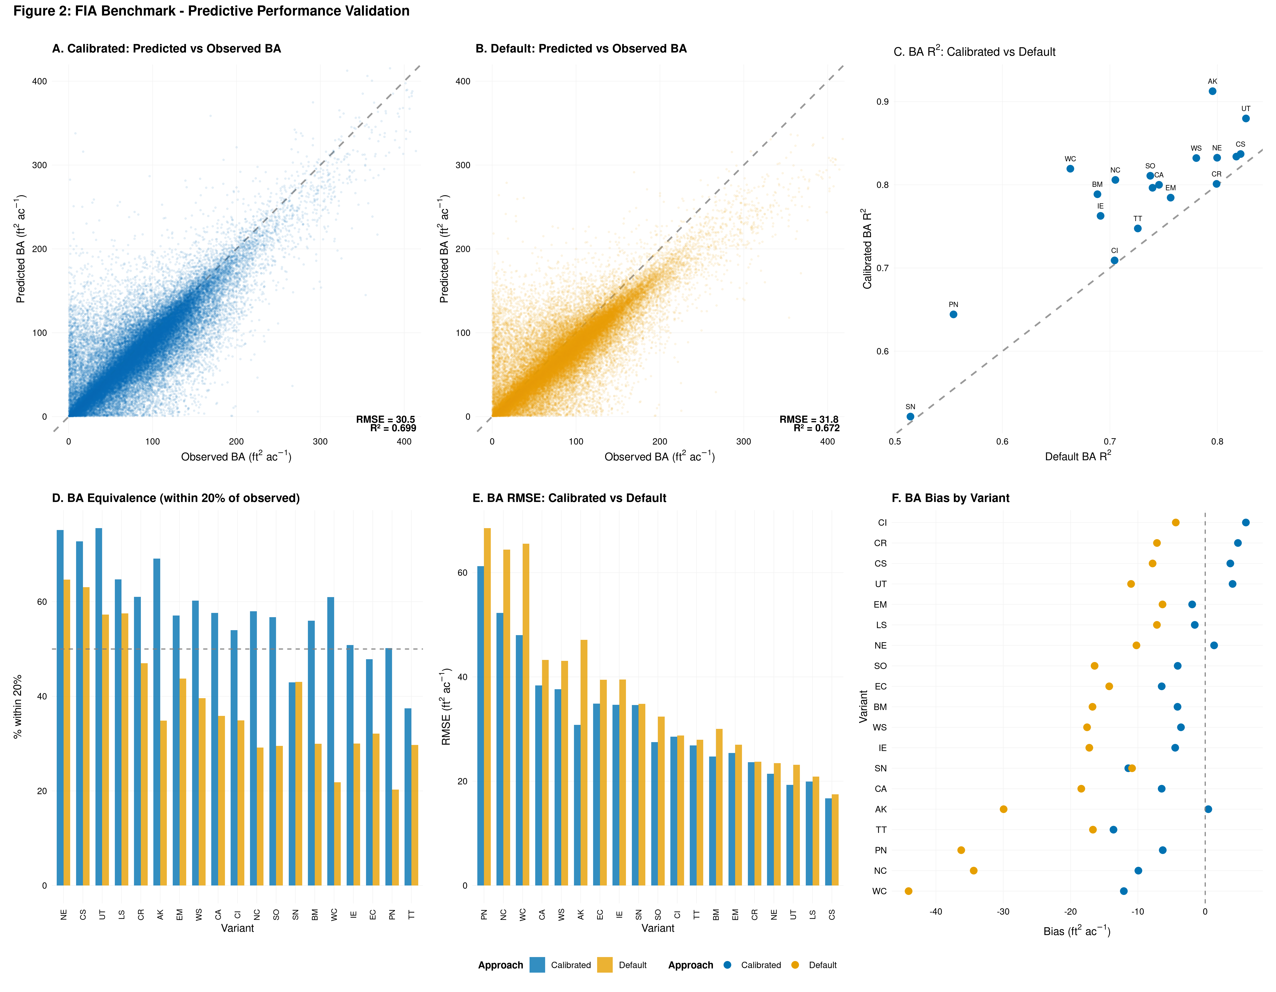
Stand-Level Validation: FIA Benchmark
Predicted vs. observed BA for 435K FIA condition pairs. Calibrated (blue) outperforms default (gold) in RMSE, R², and equivalence across all 19 tested variants.

Slide 5
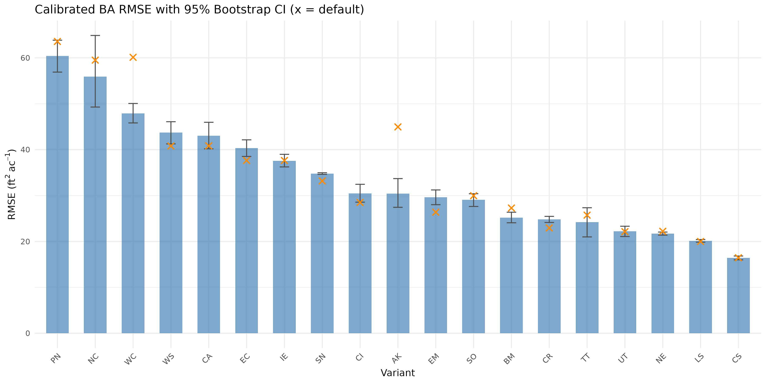
BA RMSE with Bootstrap Confidence Intervals
Calibrated RMSE: 15–60 ft²/ac with narrow CIs
Default (orange ×) often outside calibrated 95% CI

Slide 6
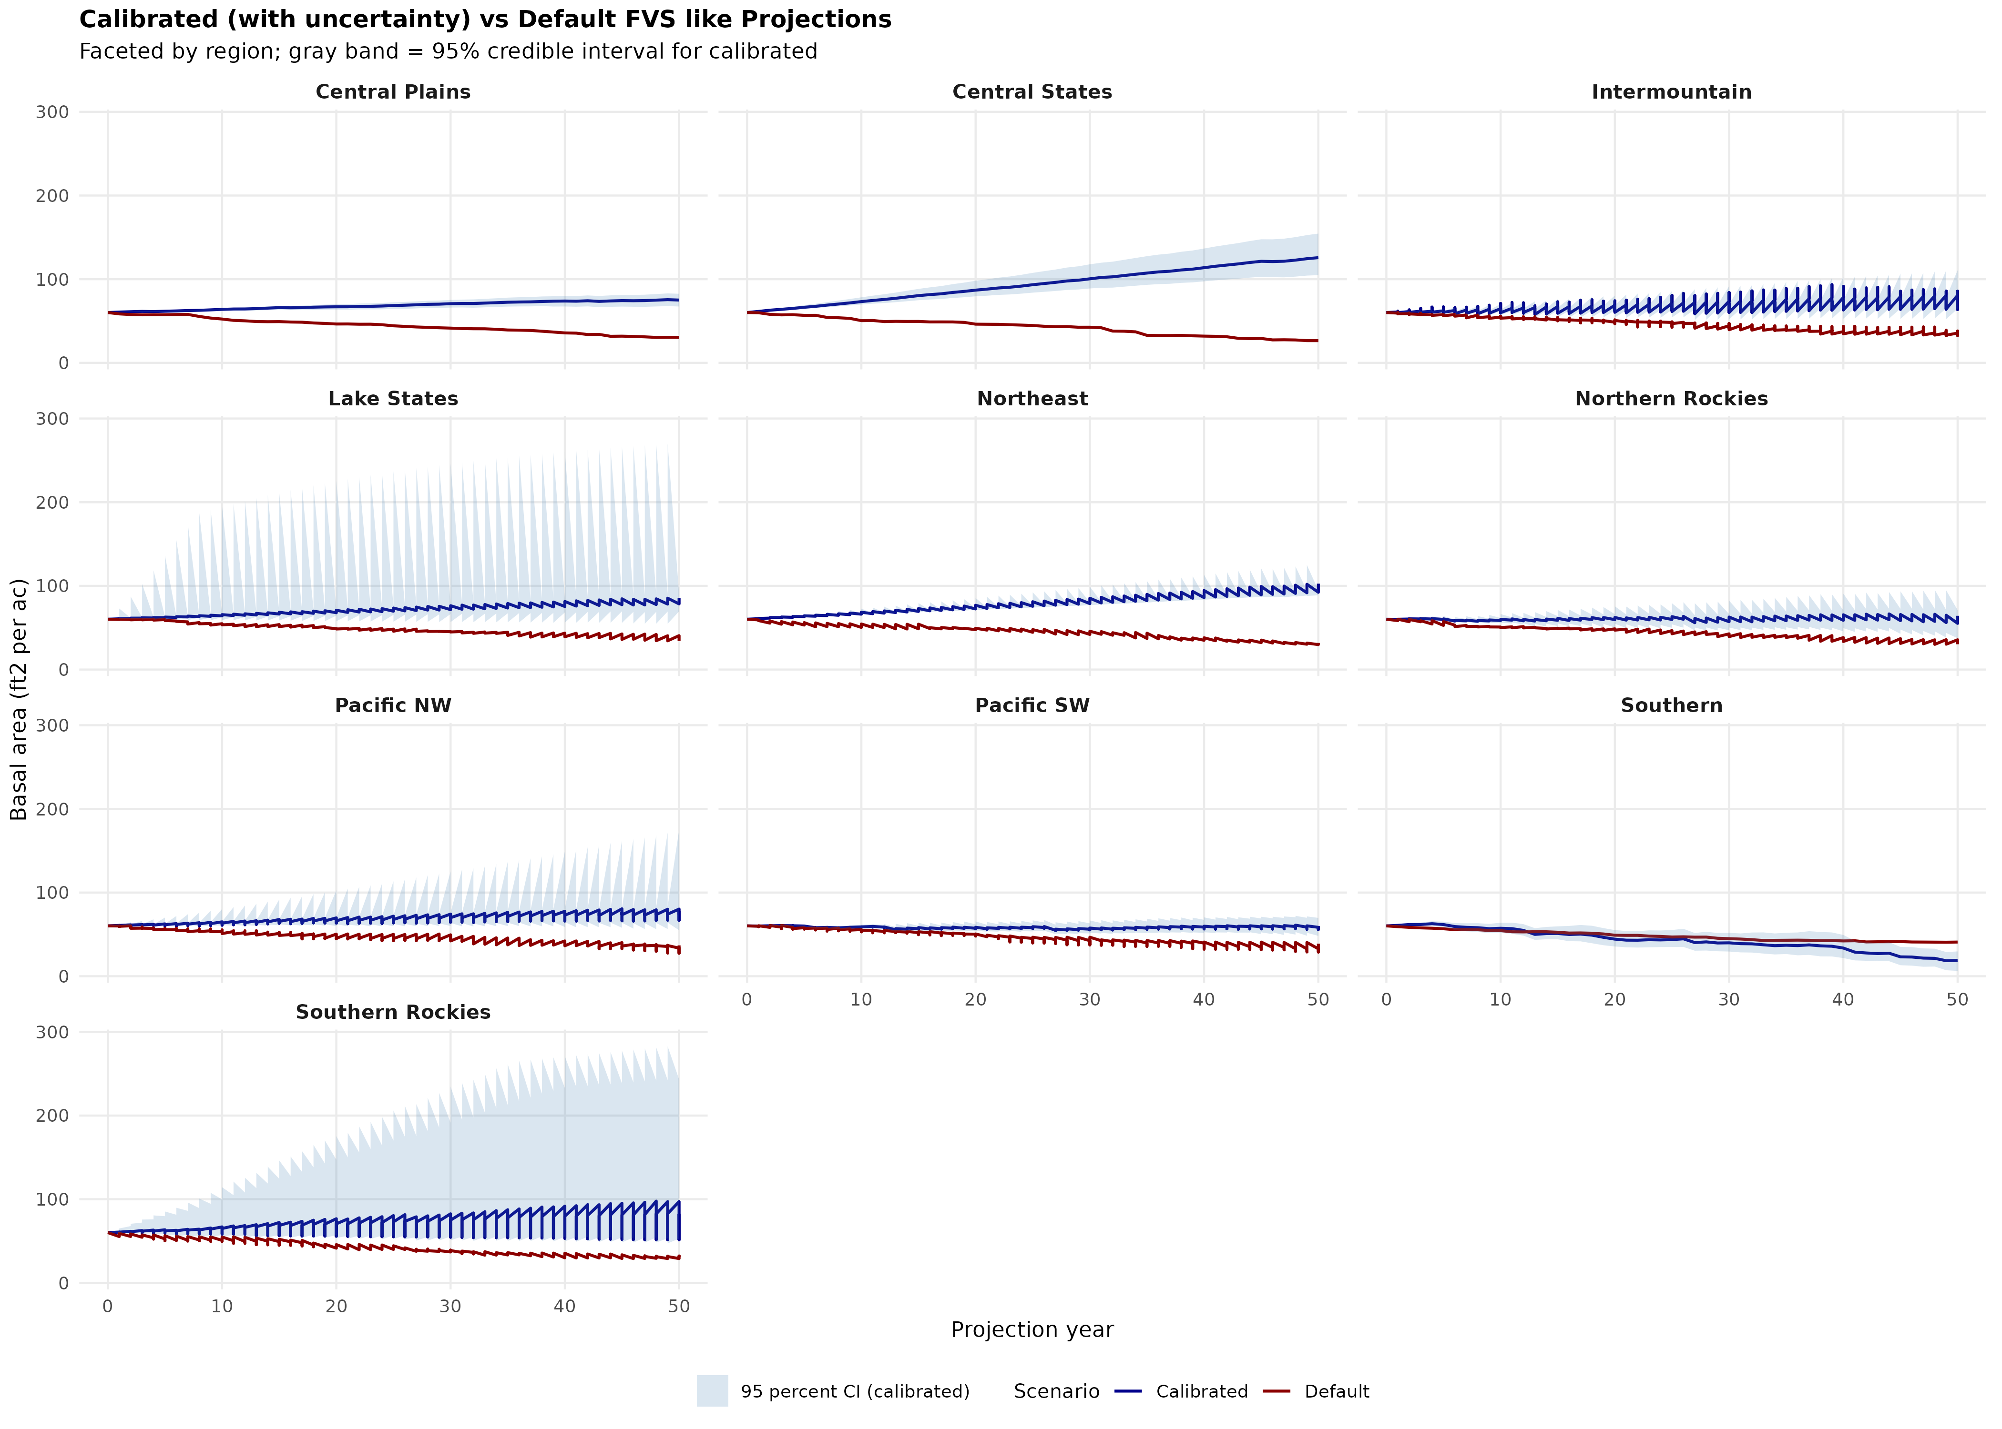
50-Year Projections: Uncertainty Quantification
Blue bands = 95% credible interval from Bayesian posteriors. Default FVS (red) frequently falls outside the calibrated CI, particularly in western variants.

Slide 7
Remaining Gaps and the Path Forward
What Needs Work
Roadmap
PAI predictions poor without ingrowth model
→ Now addressed with empirical FIA ingrowth
SN variant remains weakest (R² = 0.52)
Crown ratio modeling limited
Site index inconsistencies across FIA
Ingrowth model from FIA PREV_TRE_CN ✓
Large-tree mortality via DBH quadratic ✓
Alternative productivity variables (ClimateSI, RS)
SN sub-region analysis
Open collaboration via GitHub
A single growth module capable of projecting any species anywhere in CONUS.

