Slide 1
FVS–Modern
Bayesian Calibration of CONUS–Wide Growth Equations
from 16.2 Million FIA Tree Records
Greg Johnson · David Marshall · Aaron Weiskittel
GMUG Keynote | April 2026
25 Variants 435K Conditions 6.5 yr

Slide 2
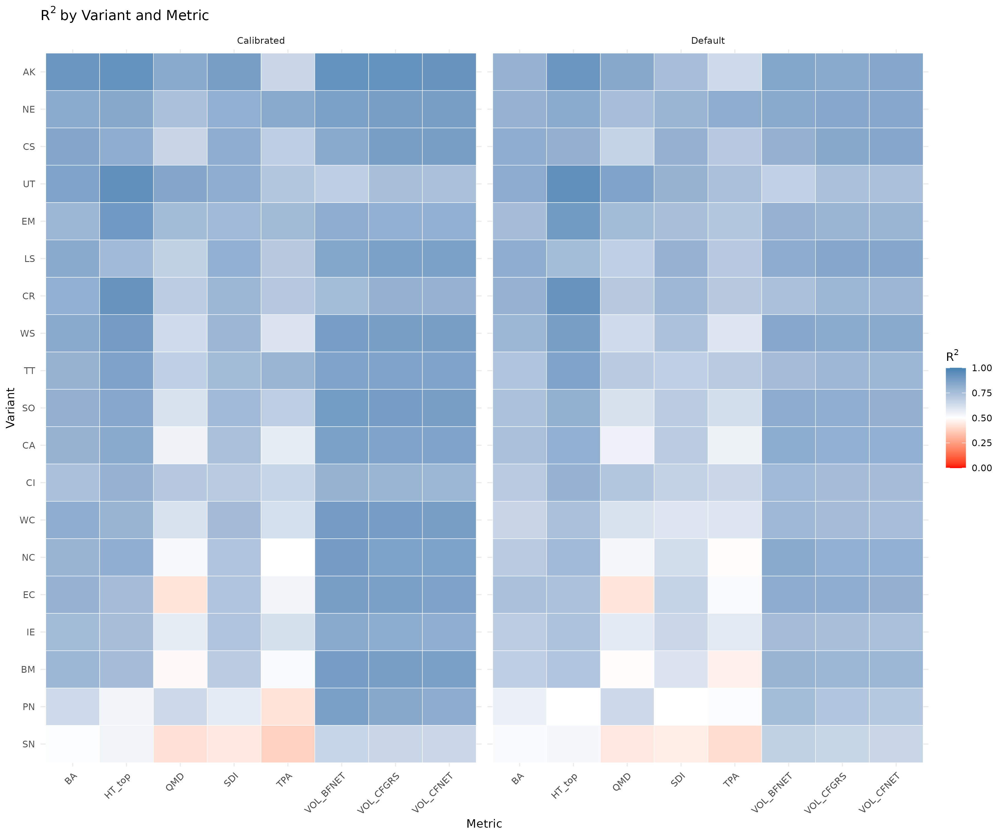
Stand–Level Validation: Calibrated vs Default FVS
Overall Performance (19 Variants)
Metric | Default | Calibrated
BA R² | 0.672 | 0.699
BA RMSE (ft²/ac) | 31.8 | 30.2
BA Equivalence (%) | 48.2 | 53.7
VOL (CFGRS) R² | 0.783 | 0.818
VOL (BFNET) R² | 0.819 | 0.858
Calibrated model improves BA prediction in all 19 variants tested
R² across variants and metrics: Calibrated (left) vs Default (right)
Johnson, Marshall & Weiskittel | GMUG 2026
2 / 3

Slide 3
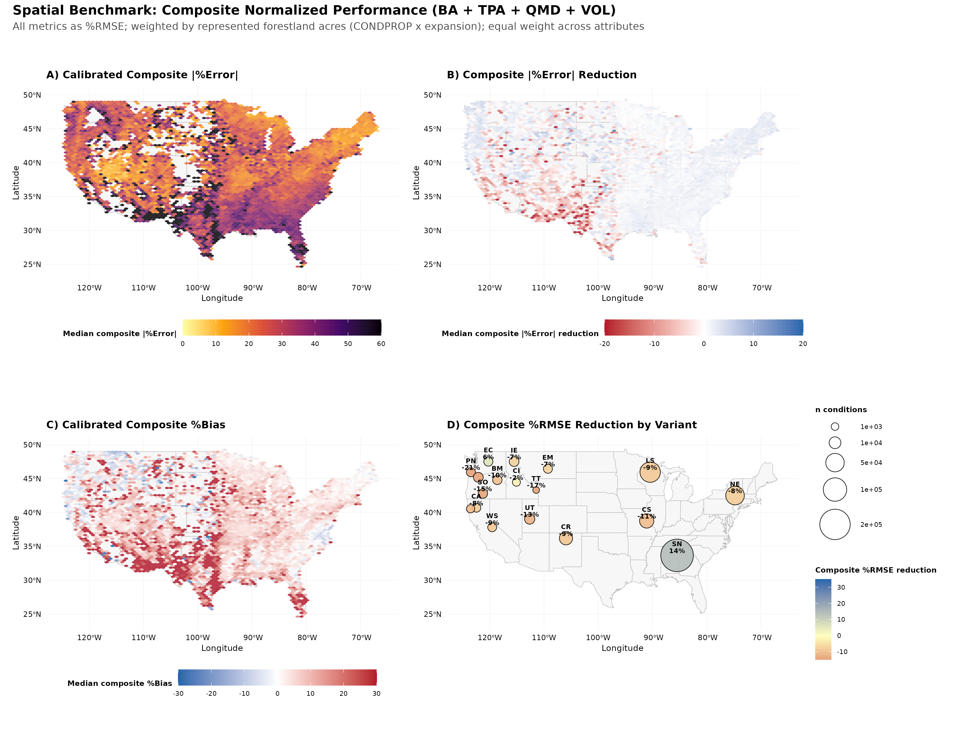
Spatial Benchmark: Where Does Calibration Help Most?
Key Findings & Next Steps
Strongest gains in South (SN), Northeast, and Lake States
Volume improvements exceed BA due to combined DG + HD calibration
SDImax Bayesian estimates average 23% lower than FVS defaults
Site index inconsistency is the dominant remaining challenge
Roadmap
Replace SI with universal productivity metric (ClimateSI, RS)
Refine SN sub–region analysis
Open collaboration via GitHub
Johnson, Marshall & Weiskittel | GMUG 2026
3 / 3

