Slide 1
Reproducing and stress-testing the Hagan 2026 LSOG map
A full unorganized-townships cross-validation of the FIA-based v5.1 classifier
Aaron Weiskittel
Center for Research on Sustainable Forests | University of Maine | June 2026

Slide 2
What the new data unblocked
Training data
RF recipe
Wall-to-wall grid
463 plots with the 8 LiDAR canopy metrics and full ground vegetation
The exact random forest code (Ecosphere_code.Rmd)
8 metrics for every hectare in the 4.2 M ha AOI
Phase 6 was blocked on Hagan's raster; Phase 9 had only the Pingree subset (n=125).
Hagan et al. (2026). Zenodo 10.5281/zenodo.19696494.
The Zenodo deposit removed the exact barrier our project had been stuck on

Slide 3
The published model reproduces faithfully
94.2%
cano_cover_15
86.6%
binary accuracy (published 94.1%)
top predictor (matches paper)
four-class OOB accuracy
Refit on the 463 training hectares, fixed seed.
We can reproduce Hagan's published classifier from the public deposit

Slide 4
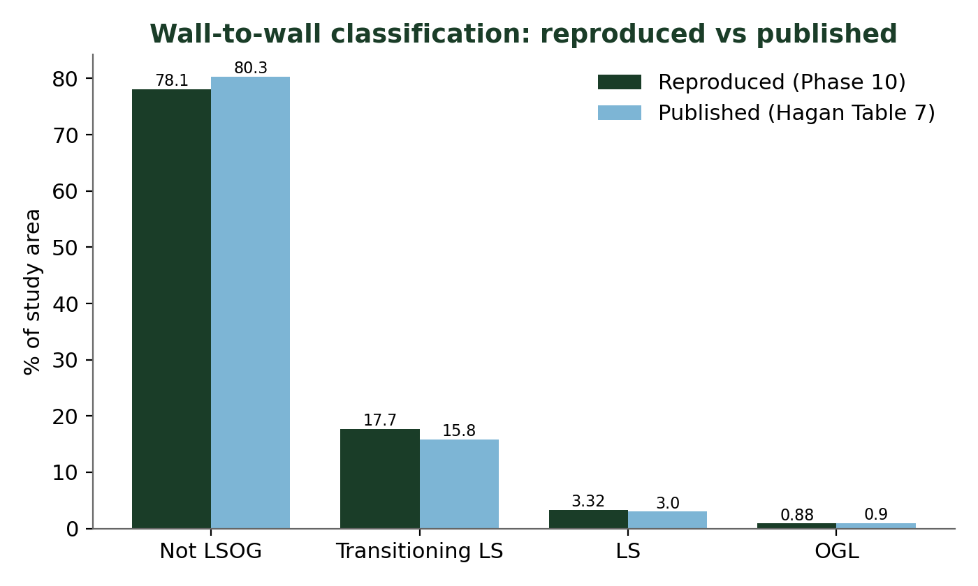
Wall-to-wall areas match the published map
180,000 ha
reproduced LS + OGL
161,881 ha
published
Hagan et al. (2026). Ecosphere 17:e70670, Table 7.
OGL reproduces almost exactly; the small LS+OGL gap is the study-area denominator

Slide 5
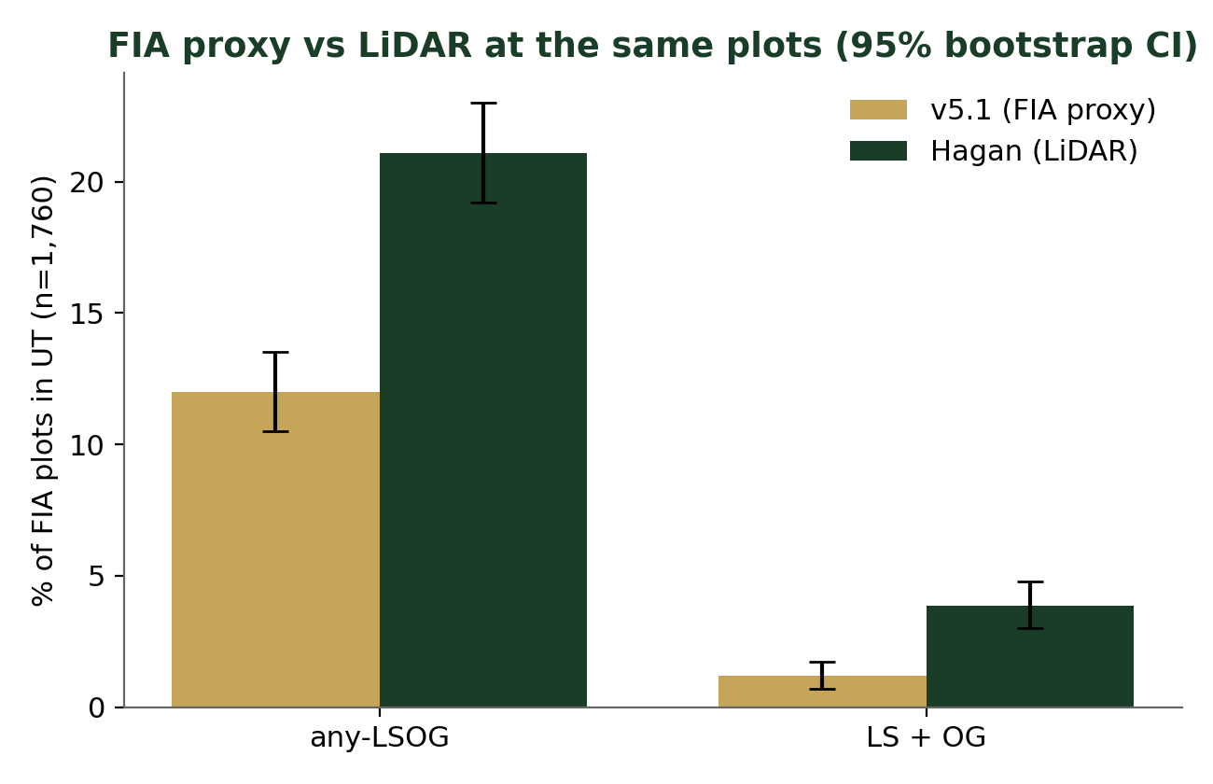
Full-UT cross-validation: 1,760 plots, not 125
n = 1,760
FIA plots in the UT
(14x the Pingree sample)
kappa = 0.12
weak plot-by-plot
agreement
Same landscape total, but the FIA proxy and LiDAR disagree plot by plot

Slide 6
Why the two methods diverge
Hagan (LiDAR canopy)
v5.1 (FIA tree-level)
Reads canopy gaps from skid trails and selective harvest that FIA tree records miss
Weights large-tree basal area, snags, structure, and stand age, which change after partial harvest
Sees disturbance to canopy structure
Sees disturbance to tree attributes
Only the combined LS+OG category is policy-stable across methods

Slide 7
The findings are robust
20-seed ensemble
LS+OGL 4.23% (SD 0.06); kappa 0.128 (SD 0.004)
Coordinate-fuzz (1 km)
kappa 0.12 to 0.21; still fair-to-weak
Bootstrap (B=2,000)
shares in non-overlapping 95% intervals
Reproduction and weak agreement both hold under noise, fuzzing, and resampling

Slide 8
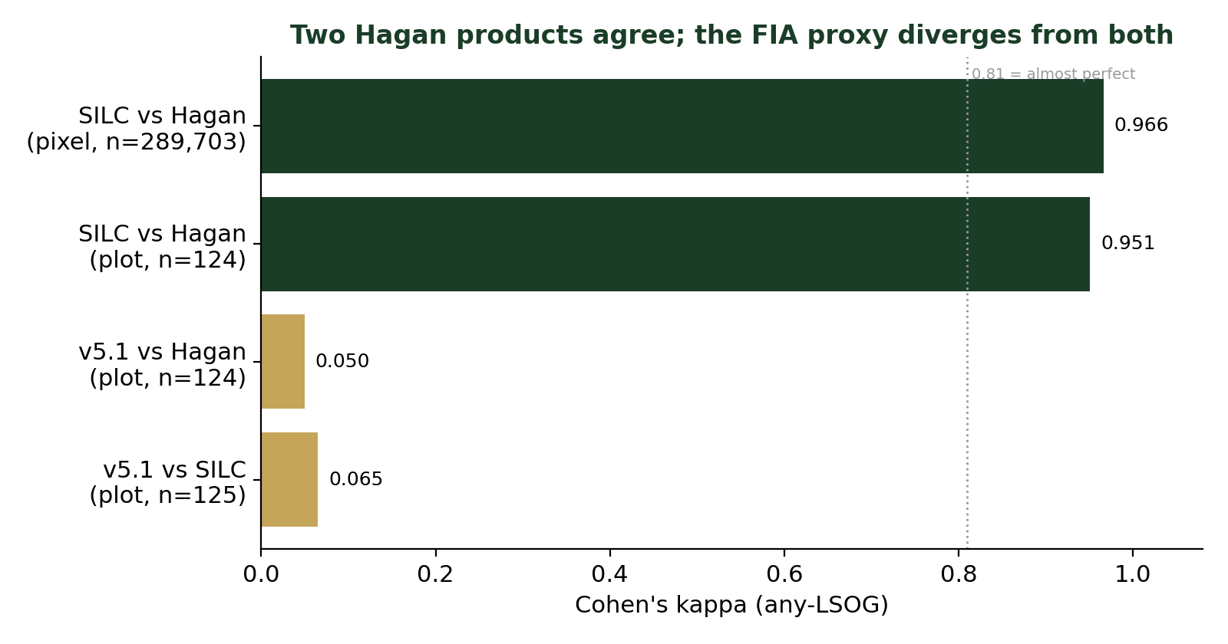
SILC equals the published model
kappa 0.97
SILC vs published model
(289,703 pixels)
Validates the
Phase 9 work
The privately shared Seven Islands raster is the same product as the published model

Slide 9
What this means
Hagan's published numbers are reproducible and can be cited as the authoritative LiDAR benchmark
Always state the classification method; FIA-proxy and LiDAR products are not interchangeable plot by plot
Manuscript cross-validation and Limitations updated to the full-UT result and SILC equivalence
Reproduced 100 m classification raster saved for ownership and size-class analysis
A reproducible benchmark, a robust cross-validation, and a clear methods caveat

Slide 10
Questions / comments?
aaron.weiskittel@maine.edu

