Slide 1
How hard is it to map old forest in Maine?
A multi-method uncertainty assessment, and a caution for conservation prioritization
Aaron Weiskittel
Center for Research on Sustainable Forests | University of Maine | June 2026

Slide 2
Why this matters now
$200–300 million
estimated cost to protect the “top 50%” of LSOG patches
from a single LiDAR map (Thompson et al. 2026, informing LD 1529)
LD 1529 requires a statewide LSOG conservation strategy by November 2026. When one map becomes the basis for patch-level spending at this scale, the map’s uncertainty is a first-order question.
A single map is being turned into hundreds of millions in conservation priorities

Slide 3
Three credible ways to map LSOG
M1 Hagan
M2 v5.1-GEDI
M3 Potapov-direct
Random forest on 8 airborne-LiDAR canopy metrics
FIA field-structure class, calibrated to GEDI canopy height
GEDI canopy height ≥ 18 m
Measures canopy shape
Measures field structure, mapped
Measures tall canopy
v5.1 field class: OG matches independent national estimate (0.128% vs 0.130%); OG carbon 2.6–3.6× non-LSOG.
The defensible target is FIA field structure; GEDI height is the best wall-to-wall predictor

Slide 4
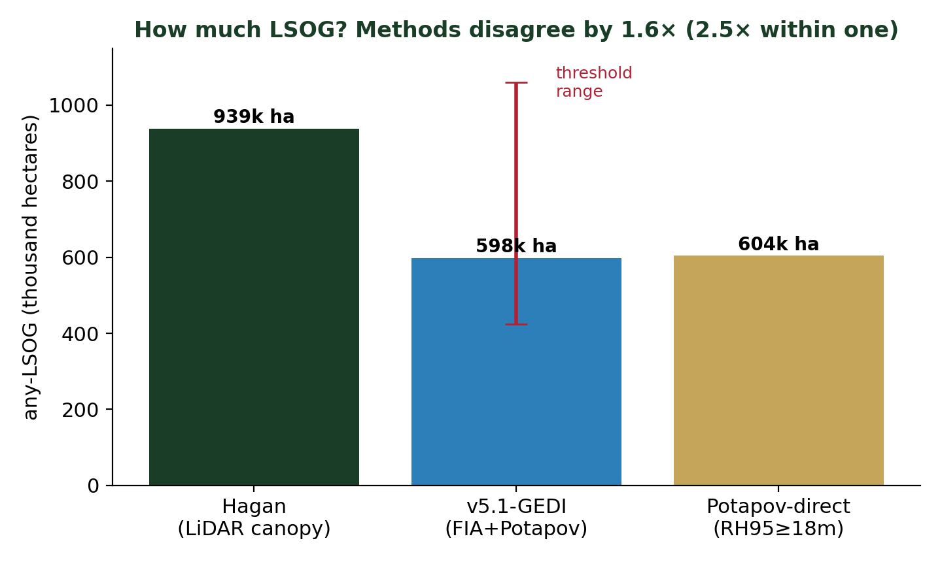
They disagree on how much
1.6×
Hagan vs the
GEDI methods
2.5×
swing within
one method
“How much LSOG is there?” has no single answer

Slide 5
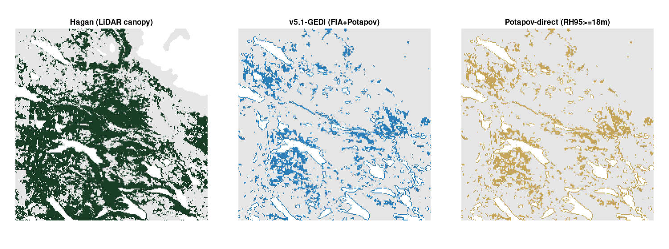
They disagree on where, much more
Same 24 km window. Hagan (green) flags far more forest, in different places, than the GEDI-based maps (blue, gold).
About 4 of every 5 LSOG hectares are flagged by one method but not the other

Slide 6
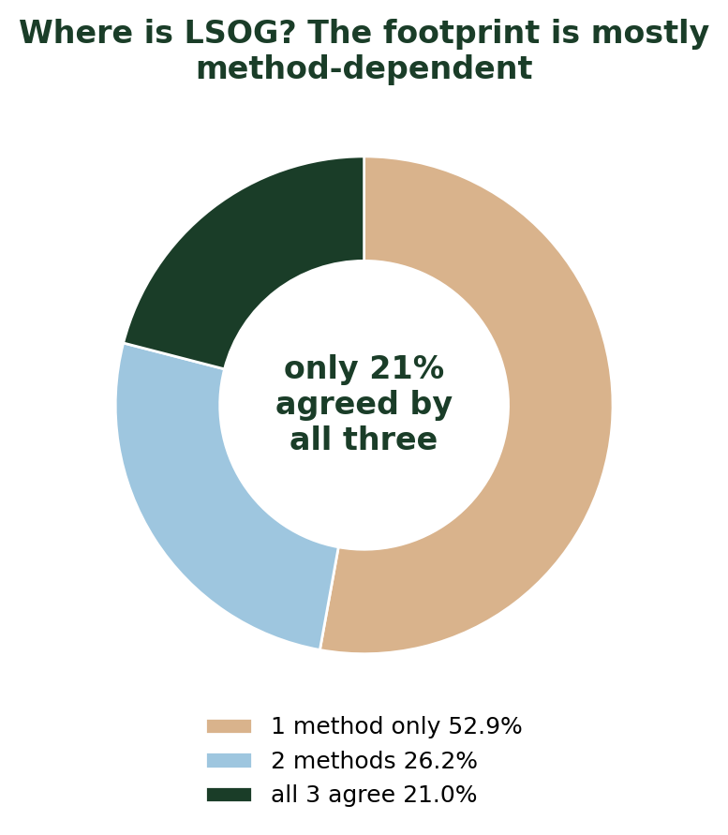
The LSOG footprint is mostly method-dependent
only 21%
of the flagged footprint is
agreed by all three methods
53%
is flagged by a single
method alone
Most of the mapped LSOG depends on which method you choose

Slide 7
No method matches the field plots well
kappa 0.06 – 0.21
agreement of every method with the FIA field-structure
class at 1,760 plots (plot-level to wall-to-wall)
Even the FIA-calibrated GEDI product reaches only 0.063 plot-by-plot. Canopy height alone cannot resolve the tree-level structure that defines LSOG. The field class is itself a proxy for a continuous, fuzzy property — there is no clean ground truth.
LSOG is inherently continuous and fuzzy; every product is an uncertain estimate

Slide 8
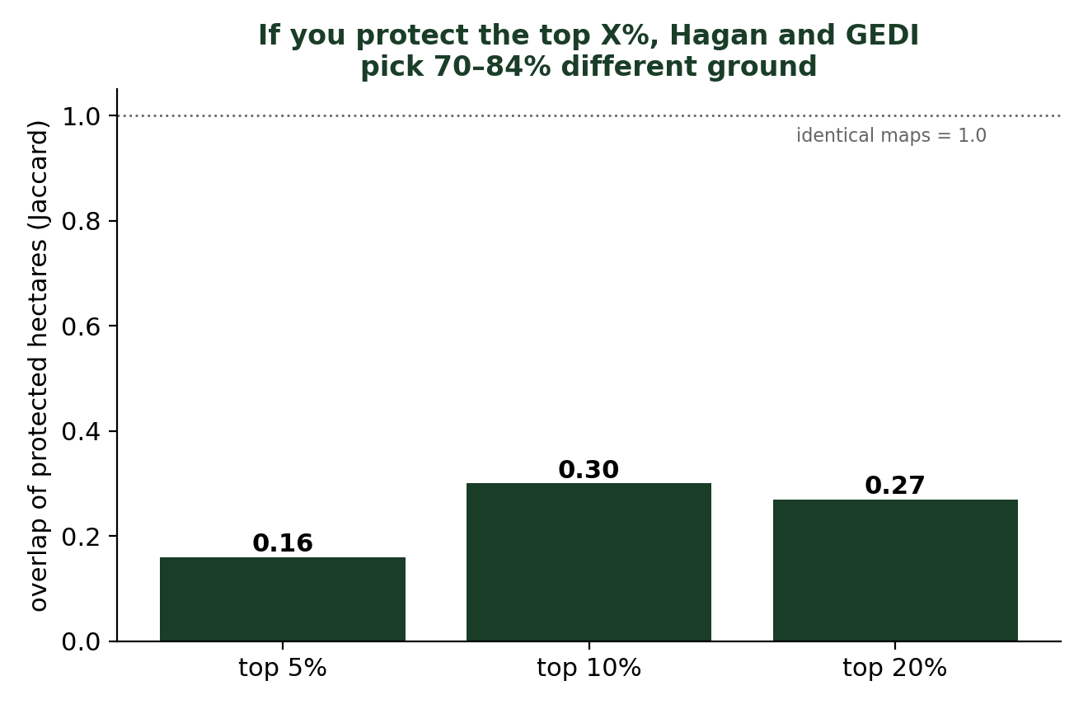
Why this matters for conservation spending
70–84%
of the prioritized hectares
differ depending on which
map you trust
A $200–300M program would
buy largely different forest.
Spatial uncertainty, not just the headline total, is the operative risk

Slide 9
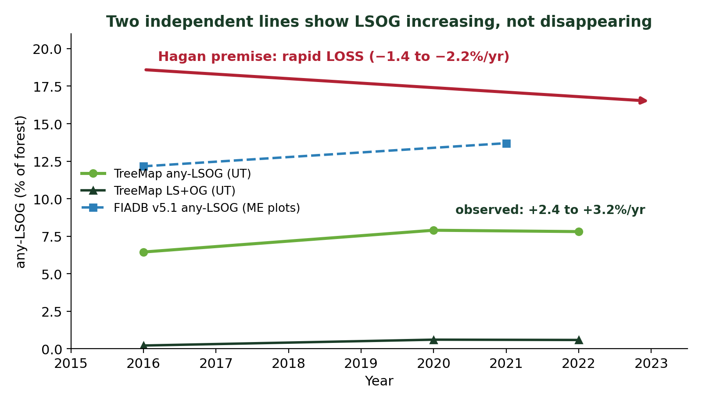
Is LSOG really “rapidly disappearing”?
No.
TreeMap and FIA both show
the LSOG stock rising
(+2.4 to +3.2%/yr)
Hagan’s “loss” is harvest
flux, not net stock.
Stands are harvested at ~2%/yr, but total LSOG is not declining — different questions

Slide 10
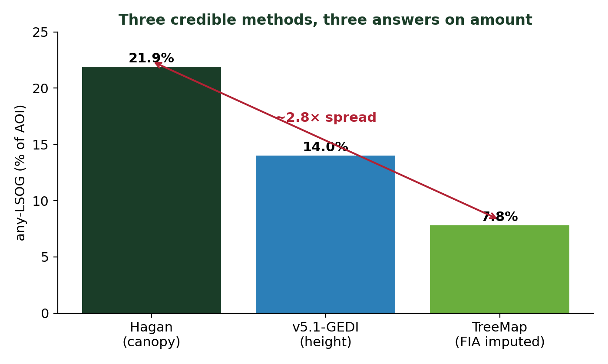
A third method widens the disagreement
2.8×
spread in “how much
LSOG” across three
credible methods
(7.8% to 21.9%)
The more methods we add, the wider the uncertainty, not the narrower

Slide 11
This is real disagreement, not a reproduction error
94.2% vs 94.1%
kappa 0.97
robust
we reproduced Hagan’s model exactly
Seven Islands raster equals the published model
20-seed, fuzz, and bootstrap checks all hold
The divergence reflects genuine methodological differences in defining LSOG

Slide 12
What to do
Report LSOG extent as a range across methods with explicit uncertainty, not one number
Treat single-map patch-level prioritization for large spending with caution; field-verify before acquisition
Anchor the mappable definition in FIA field structure (v5.1) with GEDI height as predictor — most defensible, still one estimate
Reports informing LD 1529 should carry the mapping uncertainty in the headline, not the appendix
Use the maps as uncertain guidance, not as precise spending blueprints

Slide 13
Questions / comments?
aaron.weiskittel@maine.edu

