Slide 1
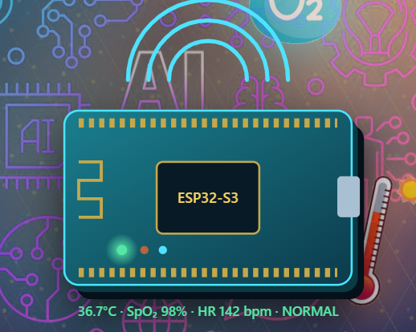
NeoGuard
Offline neonatal
monitoring
Local alerts. Preserved readings.
Advisory risk analysis.
Embedded systems research prototype
NEOGUARD / GROUP D
01 / 17
Notes:
Source: NeoGuard_final_report_reviewed.docx, chapters 3–7; EMBEDDED SYSTEMS PROJECT PROPOSAL.pdf, §§1.2–1.3. Research prototype; no clinical validation established.

Slide 2
Main objective
A low-cost, offline-capable neonatal monitoring prototype
Design, develop, test and evaluate local warnings for hypothermia and hypoxia.
01 Design the hardware
02 Develop the software
Add backend AI risk scoring and trend analysis when a connection is available.
03 Test the integrated system
04 Evaluate against a baseline
Proposal §1.3. Hardware spending is detailed on slide 15. Battery endurance remains unqualified.
NEOGUARD / GROUP D
02 / 17
Notes:
Source: NeoGuard_final_report_reviewed.docx, chapters 3–7; EMBEDDED SYSTEMS PROJECT PROPOSAL.pdf, §§1.2–1.3. Research prototype; no clinical validation established.

Slide 3
The monitoring gap
Between
observation rounds
The proposal identifies a need for continuous, multi-parameter monitoring in rural Ugandan clinics with unreliable network and power infrastructure.
Local warnings and retained data address this design need.
NEOGUARD / GROUP D
03 / 17
Notes:
Source: NeoGuard_final_report_reviewed.docx, chapters 3–7; EMBEDDED SYSTEMS PROJECT PROPOSAL.pdf, §§1.2–1.3. Research prototype; no clinical validation established.

Slide 4
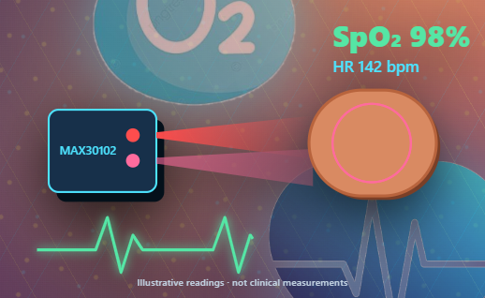
Pulse and oxygen sensing
MAX30102 optical sensor
Red and infrared light provide the signals used to estimate pulse and oxygen saturation.
I²C address 0x57 responded on the shared GPIO4 / GPIO5 bus.
Finger removal cleared HR and SpO₂ to unavailable.
Illustration values are examples. Reference-instrument accuracy remains unverified.
NEOGUARD / GROUP D
04 / 17
Notes:
Source: NeoGuard_final_report_reviewed.docx, chapters 3–7; EMBEDDED SYSTEMS PROJECT PROPOSAL.pdf, §§1.2–1.3. Research prototype; no clinical validation established.

Slide 5
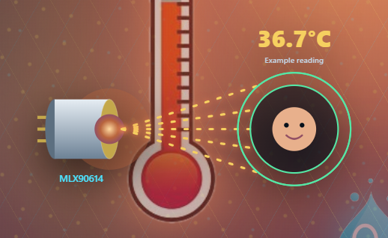
Non-contact temperature
MLX90614 infrared sensor
The sensor estimates surface temperature from infrared energy.
Address 0x5A responded. Observed surface readings ranged from 25.97 to 30.73 °C.
Clinical interpretation needs controlled distance, calibration and reference comparison.
These diagnostic readings are not neonatal core-temperature measurements.
NEOGUARD / GROUP D
05 / 17
Notes:
Source: NeoGuard_final_report_reviewed.docx, chapters 3–7; EMBEDDED SYSTEMS PROJECT PROPOSAL.pdf, §§1.2–1.3. Research prototype; no clinical validation established.

Slide 6
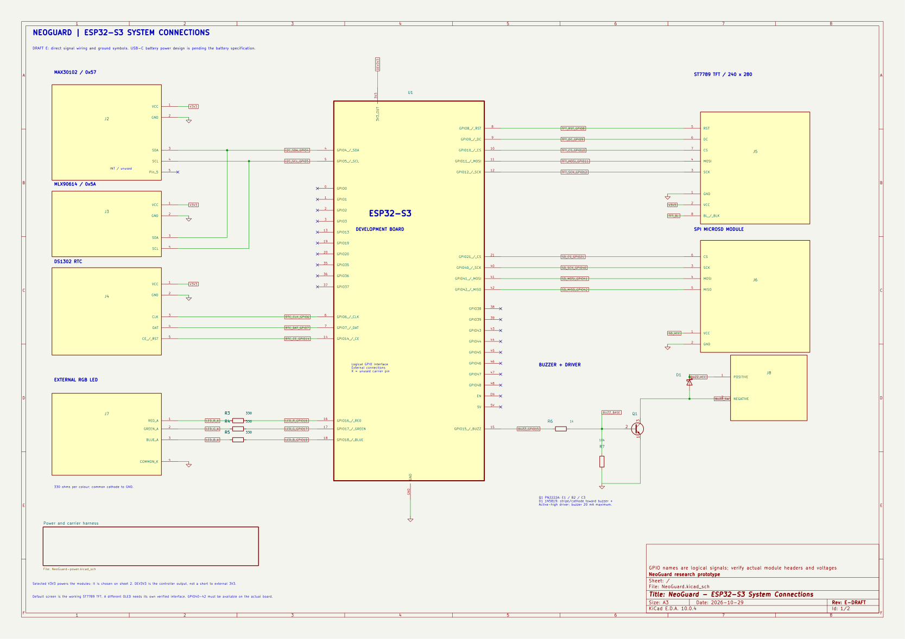
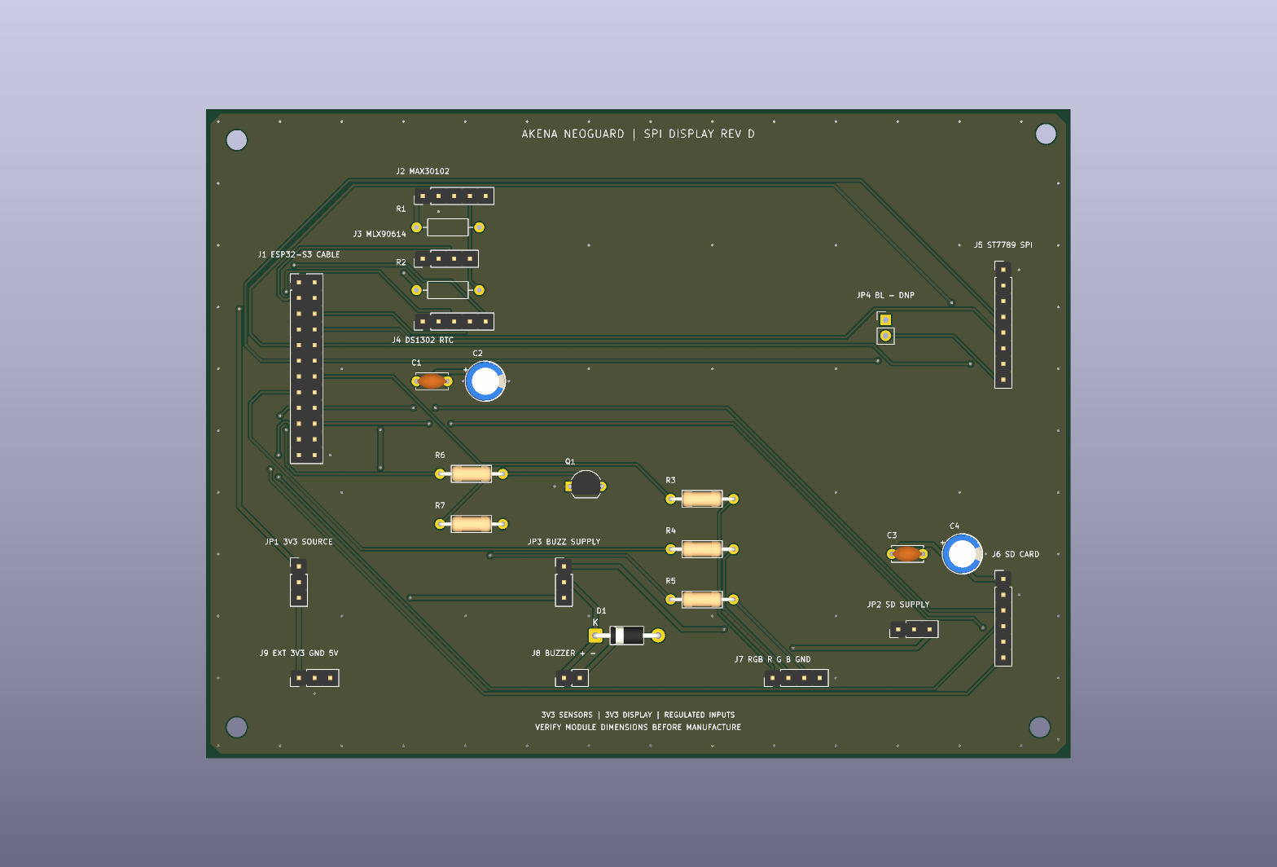
Schematic and PCB
Actual NeoGuard design visuals from the reviewed report
Figure 3.4 shows wired ESP32-S3 connections. Power design and mechanical fit require qualification.
NEOGUARD / GROUP D
06 / 17
Notes:
Source: NeoGuard_final_report_reviewed.docx, chapters 3–7; EMBEDDED SYSTEMS PROJECT PROPOSAL.pdf, §§1.2–1.3. Research prototype; no clinical validation established.

Slide 7
Objective 1: Hardware integration
IMPLEMENTATION
RECORDED EVIDENCE
Wired both sensors to I²C; added the RTC, ST7789 display, microSD, RGB and buzzer.
2 sensors
0x57 and 0x5A responded; zero bus errors
Confirmed sensor responses, display output and command-driven buzzer beeps.
91,561–105,770
Infrared counts with finger; about 700 uncovered
Produced and checked the schematic and two-layer SPI carrier.
4 / 4
SD diagnostic attempts passed
Achieved at prototype integration level. Sensor accuracy and power endurance remain unverified.
NEOGUARD / GROUP D
07 / 17
Notes:
Report §§7.3.2–7.3.6. GPIO4/5 I2C; DS1302 GPIO6/7/14; ST7789 GPIO8–12; SD GPIO21/40/41/42; RGB GPIO16/17/18; buzzer GPIO15. Recorded carrier ERC, DRC, unrouted and parity violations: zero. HR estimates ranged 42–187 bpm without a reference instrument. Maximum surface-to-ambient difference 0.84°C did not meet 1.5°C warm-target rule. Proposed LCD/DS3231 changed to ST7789/DS1302.

Slide 8
Firmware and offline operation
Acquire and validate readings; attach session and time information.
588 / 230
Apply threshold rules locally. Display and alarms do not wait for AI or the network.
rows saved in two analysed runs
0 resets
0 packet errors
Buffer readings on microSD, then synchronise queued records after reconnection.
Report §7.4.3. Diagnostic runs do not establish an outage-duration or delivery guarantee.
NEOGUARD / GROUP D
08 / 17
Notes:
Source: NeoGuard_final_report_reviewed.docx, chapters 3–7; EMBEDDED SYSTEMS PROJECT PROPOSAL.pdf, §§1.2–1.3. Research prototype; no clinical validation established.

Slide 9
The data journey
One illustrative reading, from acquisition to nursing review
Measure
→
ESP32
→
Backend
→
Dashboard
→
Nurse
36.7 °C
SpO₂ 98%
HR 142 bpm
Validate
Timestamp
Local rules
Save to SD
Flask API
PostgreSQL
Risk / trends
Current values
History
Alerts
Quality / time
Review data
Assess patient
Decide care
When offline
ESP32 keeps monitoring and buffering. New samples cannot reach the backend or dashboard until connectivity returns.
Illustrative values, not live patient data. The nurse retains clinical judgement.
NEOGUARD / GROUP D
09 / 17
Notes:
Source: NeoGuard_final_report_reviewed.docx, chapters 3–7; EMBEDDED SYSTEMS PROJECT PROPOSAL.pdf, §§1.2–1.3. Research prototype; no clinical validation established.

Slide 10
Objective 2: Software development
IMPLEMENTATION
RECORDED EVIDENCE
Built firmware, Flask API, PostgreSQL persistence and the React dashboard.
HTTP 200
Runtime, heartbeat and sync in both recorded runs
Stored readings locally and synchronised JSON records when connected.
588 / 230
Saved records in two diagnostic runs
Added advisory AI using a 120-second causal history and 12 features.
120 s / 12
History window / explainable time-series features
Achieved as a working prototype. Dashboard delay and controlled offline recovery remain unquantified.
NEOGUARD / GROUP D
10 / 17
Notes:
Report §§7.4.1–7.4.6. Local alerts independent of network and AI. Last, mean, slope and variation for three vital signs produce 12 features. Record counts do not establish loss rate. Backend controls include authentication, clinic scoping, clock validation and retry handling.

Slide 11
Advisory AI risk analysis
Logistic regression analyses temperature, SpO₂ and heart-rate history.
0.75
The 12 features describe the last value, mean, slope and variation for each signal.
decision threshold
selected on validation data
The output supports trend review. Local threshold alerts remain independent.
Synthetic evaluation does not establish calibrated patient risk or clinical accuracy.
NEOGUARD / GROUP D
11 / 17
Notes:
Source: NeoGuard_final_report_reviewed.docx, chapters 3–7; EMBEDDED SYSTEMS PROJECT PROPOSAL.pdf, §§1.2–1.3. Research prototype; no clinical validation established.

Slide 12
Objective 3: System testing
IMPLEMENTATION
RECORDED EVIDENCE
Compiled, uploaded and verified firmware; exercised sensors, display, RGB and buzzer.
21 / 21
Backend tests passed at the recorded checkpoint
Tested SD write, read, append, compare and delete, including RGB activity.
4 migrations
Applied to a fresh database
Checked API authentication, access control, reading round-trip, retries and clock validation.
0 differences
Reported between migrated schema and models
Partly achieved. Reference accuracy, timing, controlled outages and clinical testing remain incomplete.
NEOGUARD / GROUP D
12 / 17
Notes:
Report §§7.3.4 and 7.5. Display/sensor diagnostic: 345,966 B flash; 24,912 B static RAM. SD/RGB build: 391,730 B flash; 24,240 B static RAM. Four SD attempts passed. No verified jitter/latency dataset, full 5/15/30-minute offline trials, 20 Wi-Fi cycles, dashboard delay or neonatal clinical study.

Slide 13
Synthetic evaluation results
AI detected more simulated events, with a greater warning burden
Metric | AI | Threshold only
Events detected at onset | 44 / 49 | 25 / 49
Event sensitivity | 89.8% | 51.0%
Median lead time | 107.5 s | 0 s
False-warning episodes/hour | 1.4197 | 0.7472
Report §7.6. 49 synthetic events. False-warning episodes differ from row-level false positives.
NEOGUARD / GROUP D
13 / 17
Notes:
Source: NeoGuard_final_report_reviewed.docx, chapters 3–7; EMBEDDED SYSTEMS PROJECT PROPOSAL.pdf, §§1.2–1.3. Research prototype; no clinical validation established.

Slide 14
Objective 4: Performance evaluation
IMPLEMENTATION
RECORDED EVIDENCE
Split 480 synthetic sessions into 288 training, 96 validation and 96 test sessions.
93.77% precision
4,395 / (4,395 + 292)
Evaluated 19,272 held-out rows using a validation-selected threshold.
81.77% recall
4,395 / (4,395 + 980)
Compared event detection, lead time and warning burden with threshold-only detection.
0.9748 ROC-AUC
Ranking performance, not 97.48% accuracy
Partly achieved. Clinical accuracy, real-world alert timing and patient outcomes remain unestablished.
NEOGUARD / GROUP D
14 / 17
Notes:
Report §7.6. Confusion matrix: TP 4395, TN 13605, FP 292, FN 980. 19 more events detected at onset. 89.8% versus 51.0% event sensitivity, 38.8 percentage point difference. Synthetic scenario labels are not verified neonatal outcomes. Median lead 107.5 seconds; warning episodes/hour 1.4197 versus 0.7472.

Slide 15
Project cost
Actual component purchases recorded in the budget
Purchased item | Actual UGX
ESP32 DevKit | 75,000
MAX30102 | 30,000
MLX90614 | 50,000
RTC module* | 12,000
Display* | 30,000
Active buzzer | 3,000
LED | 15,000
Breadboard + wires | 20,000
USB + 5V source | 20,000
microSD | 10,000
TOTAL | 265,000
UGX 265,000
Hardware total including microSD
UGX 147,000 to 212,000 proposed
UGX 53,000 above maximum
25% over the upper estimate
Listed hardware only. Other project expenses are not itemised. *Budget labels RTC/display as DS3231/OLED; report uses DS1302/ST7789.
NEOGUARD / GROUP D
15 / 17
Notes:
Source: NeoGuard_Budget_and_Cost_Analysis.docx, �3.8 and Table 3.2. Ten actual purchase lines sum to UGX 265,000. Essential items: 255,000 versus proposed 137,000�197,000, an overrun of 58,000 or 29.44% above maximum. Including microSD: proposed 147,000 to 212,000; 53,000/212,000 = 25%. ESP32 largest overrun: 75,000 versus 40,000 upper estimate. Transport, PCB fabrication, enclosure, hosting, labour and other costs are not itemised; this is not a verified all-in project expenditure total. Preserve procurement labels and flag discrepancy with implemented DS1302/ST7789.

Slide 16
Next validation steps
Compare sensor readings with calibrated reference instruments.
Measure sampling jitter, alert latency, offline recovery and dashboard delay.
Qualify power, battery endurance and mechanical fit.
Conduct ethical clinical evaluation before clinical deployment.
The project currently supports a research-prototype claim.
NEOGUARD / GROUP D
16 / 17
Notes:
Source: NeoGuard_final_report_reviewed.docx, chapters 3–7; EMBEDDED SYSTEMS PROJECT PROPOSAL.pdf, §§1.2–1.3. Research prototype; no clinical validation established.

Slide 17
Conclusion
A working
research prototype
Hardware and software integration achieved.
Testing and evaluation partly achieved.
Questions
Local monitoring, preserved data and advisory analysis; clinical performance remains unverified.
NEOGUARD / GROUP D
17 / 17
Notes:
Source: NeoGuard_final_report_reviewed.docx, chapters 3–7; EMBEDDED SYSTEMS PROJECT PROPOSAL.pdf, §§1.2–1.3. Research prototype; no clinical validation established.

