Slide 1
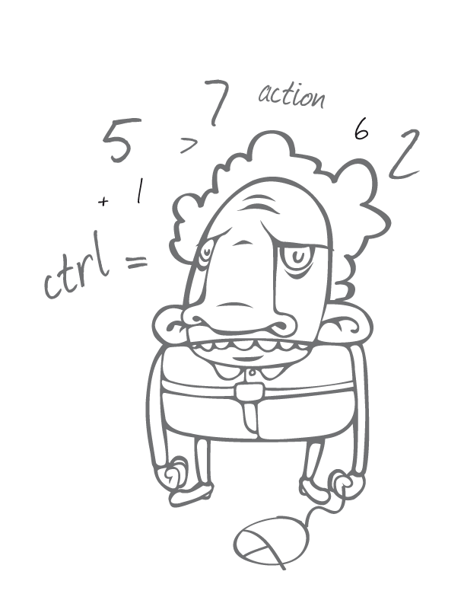

Entity Framework (EF) Core
Michael Denny
Microsoft MVP for Visual Studio and Development Technologies
@dennymic

Slide 2
Agenda
Introducing EF Core
EF Core & EF6.x
Demos
EF Core 1.1
More Demos
Next steps

Slide 3
Introducing EF Core

Slide 4
Naming history
Entity Framework Everywhere
Entity Framework 7 (EF7)
Entity Framework Core 1.0 (EF Core)

Slide 5
Entity Framework project status
Entity Framework 6.2
Entity Framework Core 1.1
Entity Framework 6.x
Runtime on NuGet
Tooling on Microsoft Download Center
Latest version included in Visual Studio
Entity Framework Core 1.0
Entity Framework 5
New runtime components on NuGet
Existing runtime components in .NET
Tooling in Visual Studio
Entity Framework 4.x
Entity Framework 4
Runtime in .NET Framework
Tooling in Visual Studio
Entity Framework 3.5 SP1

Slide 6

New platforms

Slide 7


Unified platform
.NET FRAMEWORK
XAMARIN
TOOLS
WINDOWS APPLICATIONS
CROSS-PLATFORM SERVICES
MOBILE APPLICATIONS
.NET CORE
Visual Studio
.NET STANDARD LIBRARY
Visual Studio Code
COMMON INFRASTRUCTURE
Compilers
Languages
Runtime components
Xamarin Studio
EF6.x
EF Core

Slide 8

New data stores

Slide 9
New data stores
Relational & non-relational
Not a magic abstraction
High level services that are useful on all/most stores
Non-common concerns handled by provider extensions
Example providers
Relational (SQL Server, SQLite, Postgres, MySQL, SQL Compact, Oracle soon, etc.)
In Memory (for testing)
Azure Table Storage (prototype)
Redis (prototype)
Just relational providers for v1.0

Slide 10

New features

Slide 11
New features
Batching during SaveChanges
Client eval in LINQ queries
Shadow state properties
SQL Server sequences
Alternate keys

Slide 12

Lightweight & extensible

Slide 13
Lightweight & extensible
Top level API built over a modular services
Services = SQL generation, change tracking, value generation, etc.
Follows dependency injection principles
Easy to use/replace/extend individual services
Optimized for memory and CPU usage
Pay-per-play components

Slide 14
Built over services
Top Level API DbContext, DbSet, ChangeTracker, Database, etc.
Common Services StateManager, CompiledQueryCache, etc.
Provider Specific Services SqlServerTypeMapper, SqlServerSqlGenerationHelper, etc.

Slide 15
EF Core & EF6.x

Slide 16
EF Core
Mindful of our past…
Same top level experience as EF6.x
Not changing things just for the sake of it
…but not constrained by it
New code base
Completely different low level services
Not all features from EF6.x will be implemented

Slide 17
EF Core & EF6.x
EF6.x is the mature data stack
8 years of RTM releases = features and stability
Rich ecosystem of database providers
Patch and minor releases will continue
EF Core is a true v1
Basic feature set shipping in v1
Limited set of early adopter database providers

Slide 18
EF Core & EF6.x
EF6.x will be the right choice for many applications
Carefully evaluate requirements if considering EF Core
Many features not implemented in 1.0.0 (e.g. lazy loading, stored procedure mapping, etc.)
Less mature code base (e.g. LINQ translator has limitations)
EF6.x to EF Core is “port” not “upgrade”
Very basic code will port easily
Many APIs have changed drastically
Beware of behavior differences in similarly named APIs
Detailed guidance at docs.efproject.net
See “EF Core vs. EF6.x” section

Slide 19
Demos

Slide 20

Demo EF Core 101

Slide 21

Demo Performance improvements

Slide 22
EF6.x model building pipeline
Entity Classes
Conventions
Context
DbSet properties
DbSet Discovery
Model
OnModelCreating
Configuration

Slide 23
EF Core model building pipeline
Entity Classes
Conventions
Context
DbSet properties
DbSet Discovery
Model
OnModelCreating

Slide 24
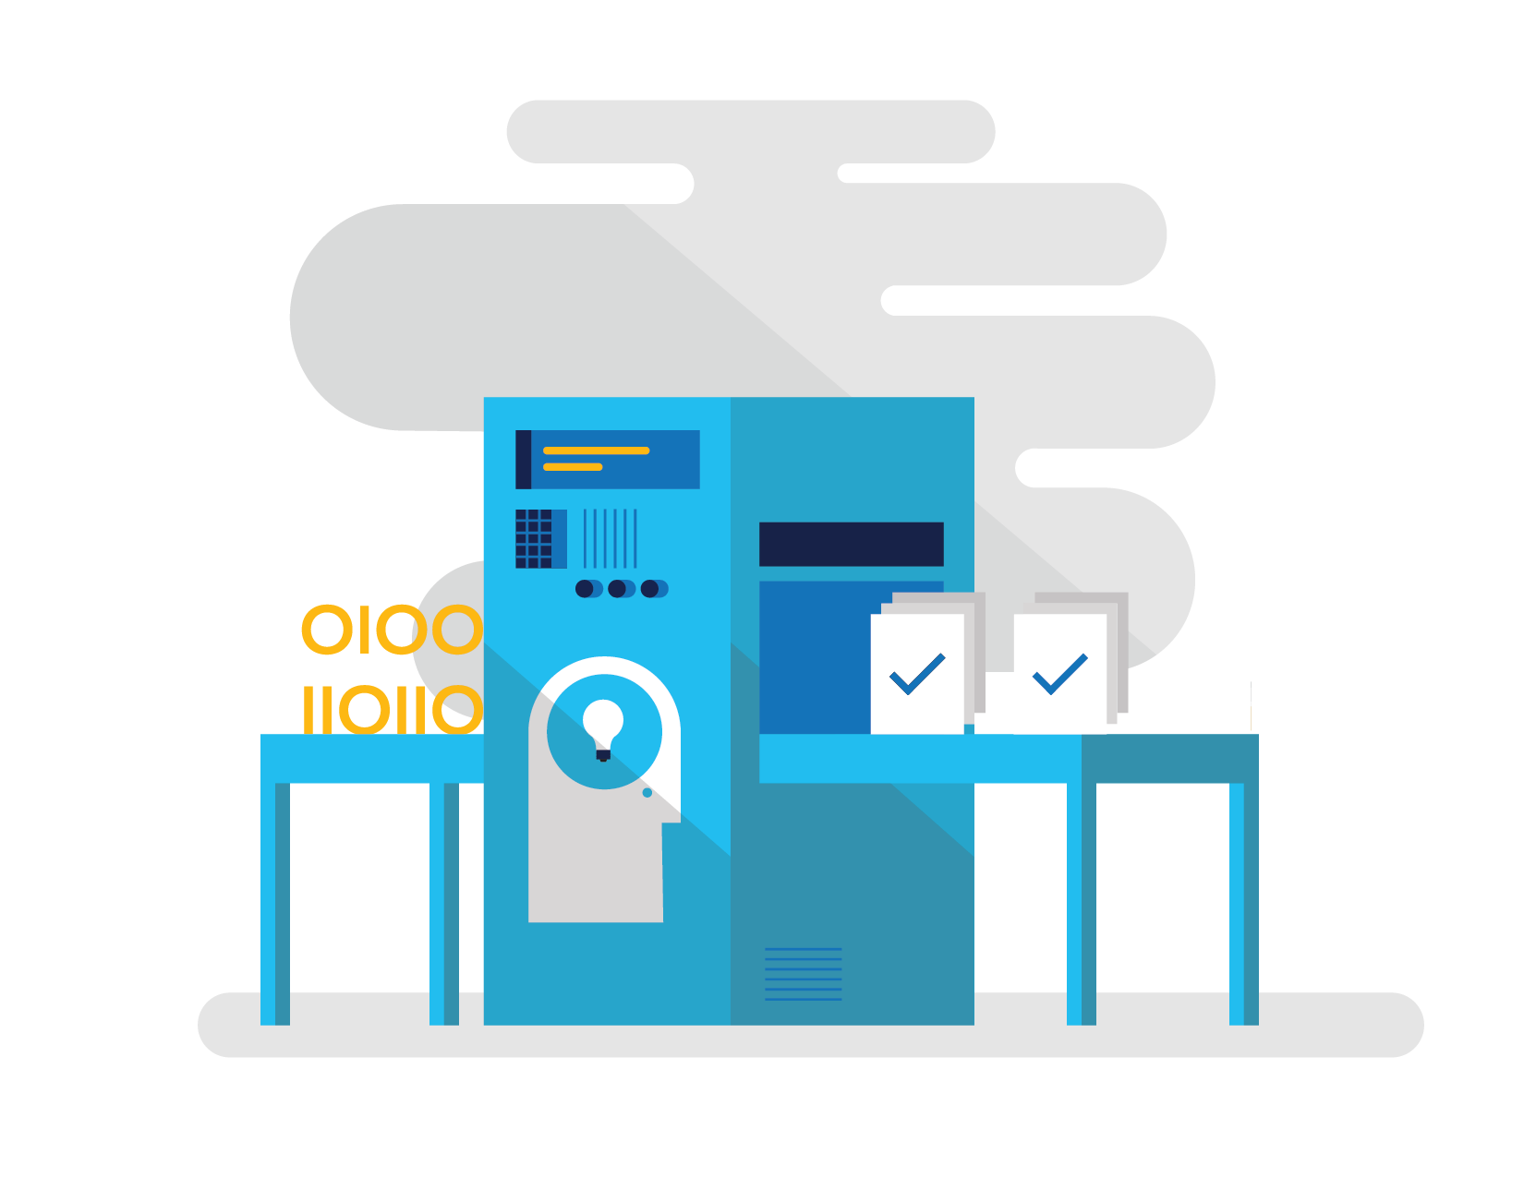
Demo Model building pipeline

Slide 25

Demo Simplified metadata API

Slide 26

Demo Same model, multiple platforms

Slide 27
Demo Same model, multiple databases

Slide 28

Demo Consuming low level services

Slide 29
EF Core 1.1

Slide 30
EF Core 1.1
Scheduled for late Q4 2016
Focused on removing adoption blockers
Bug fixing to improve stability
Critical O/RM features

Slide 31
EF Core 1.1
Improved LINQ translation
DbSet.Find
Mapping to fields
Explicit Loading
Additional EntityEntry APIs from EF6.x
Reload, GetModifiedProperties, GetDatabaseValues etc.
Connection resiliency
SQL Server memory-optimized table support
Simplified service replacement

Slide 32
Beginning work on (but not shipping in 1.1)
Complex/value types
Simple type conversions (json object <-> string)
Visual Studio wizard for reverse engineering

Slide 33
Demo Replacing low level services

Slide 34
Demo Mapping to fields

Slide 35
Demo SQL Server memory-optimized tables

Slide 36
Next steps

Slide 37
Next steps
docs.efproject.net
github.com/aspnet/EntityFramework
github.com/micdenny/Demo-EFCore

Slide 38
Thanks!
Any questions?
You can find me on:
Twitter: @dennymic
GitHub: micdenny
Blog: http://dennymichael.net

