Slide 1
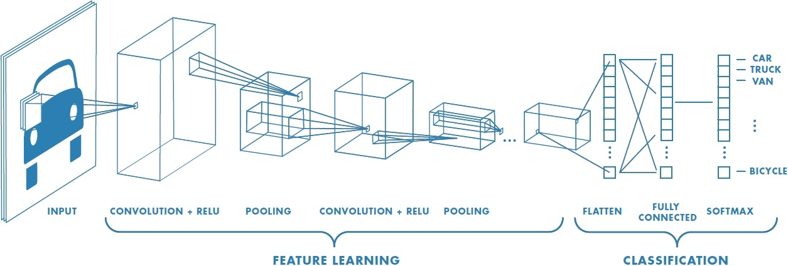
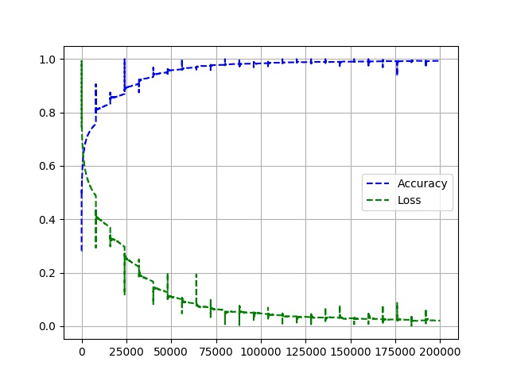
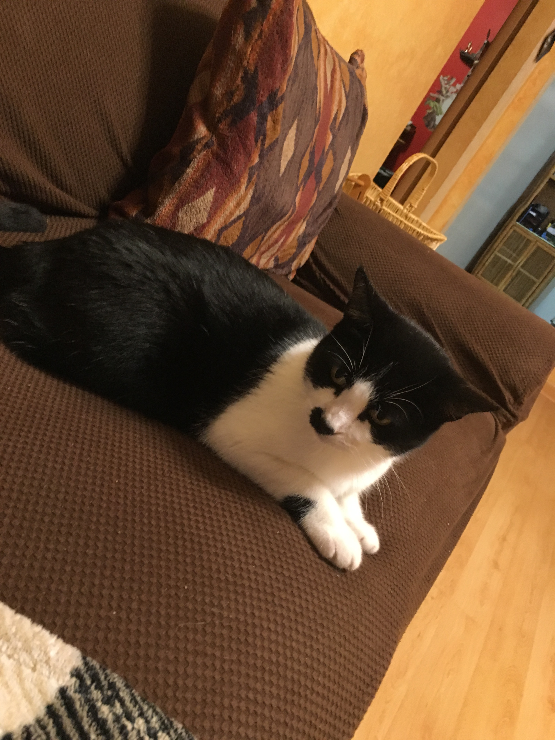
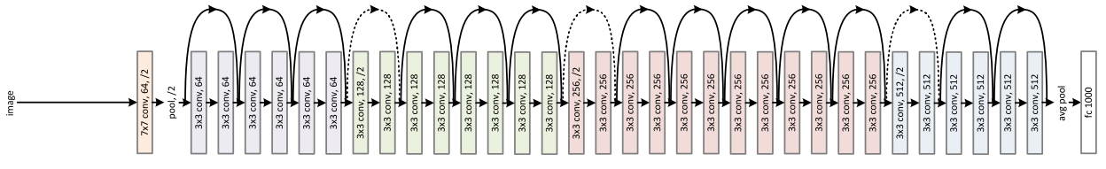
A Comparison of CNNs for Image Classification
Holt Skinner
University of Missouri – Computer Science 8780
Summary
There are a multitude of different Neural Network options for image classification
For a simple problem, (Cats vs. Dogs) how does each method perform?
Dataset: Kaggle -Dogs & Cats: Training - 8000 Images, Testing – 1000 Images
Methodology
Built and trained a Sequential Convolutional Neural Network in Keras & TensorFlow (Binary Classifier)
Train with Kaggle Dataset (18 Hours)
Loss: 2.07% Accuracy: 99.32%
Worked well on Dogs, didn’t work on Cats in Practice
Pretrained ResNet50 and MobileNet Models
ImageNet Dataset (Similar Classes)
Google Cloud Vision API
Correctly Classified 100% of testing data (Before API limit was reached)
 | Homemade |  | ResNet50 | MobileNet | Google
Class |  | Cat | Siberian Husky: 40% Seat Belt: 7.96% Siamese Cat: 7.82% | Weasel: 12.55% Siberian Husky: 10.84% Siamese Cat: 8.74% | Cat: 98.99%, Whiskers: 88.04% Flooring: 65.02%

