Slide 1
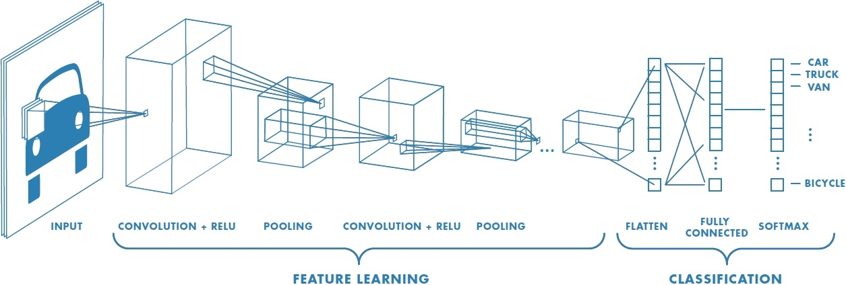
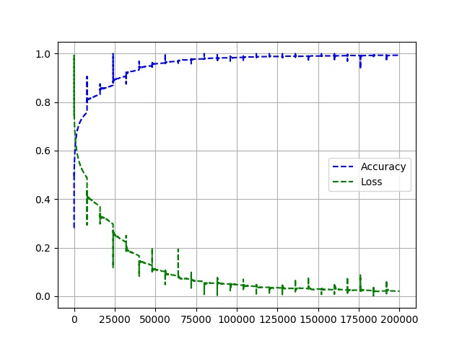
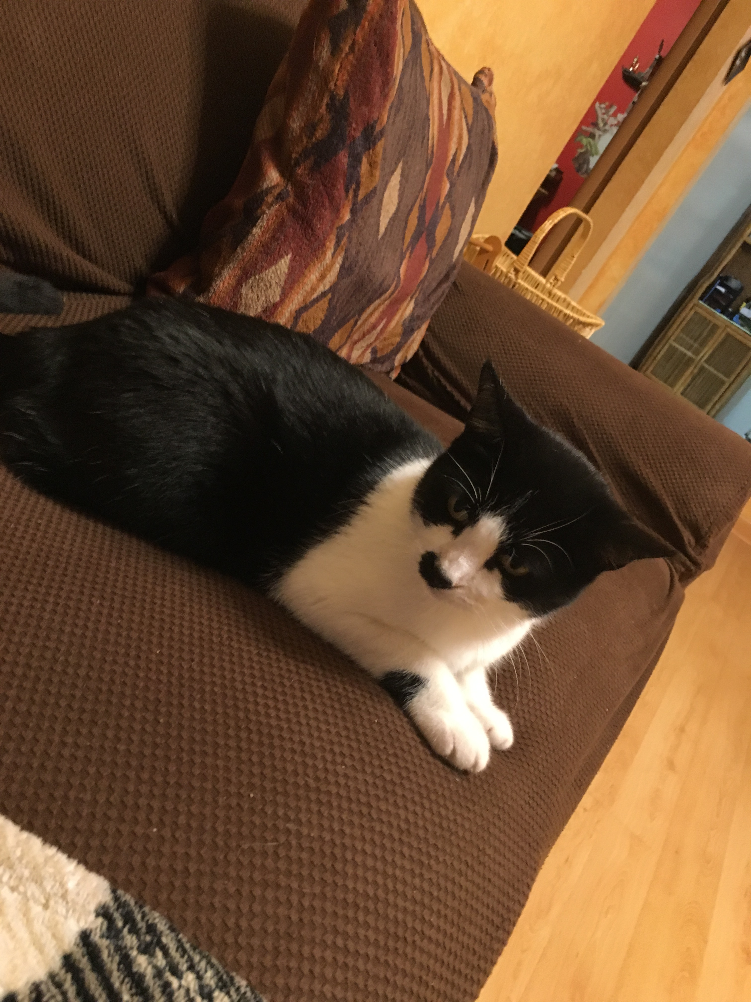
A Comparison of CNNs for Image Classification
Holt Skinner
University of Missouri – Computer Science 8780
Summary
There are a multitude of different Neural Network options for image classification
For a simple problem, (Cats vs. Dogs) how does each method perform?
Dataset: Kaggle -Dogs & Cats: Training - 8000 Images, Testing – 1000 Images
Methodology
Built and trained a Sequential Convolutional Neural Network in Keras & TensorFlow (Binary Classifier)
Train with Kaggle Dataset (18 Hours)
Loss: 2.07% Accuracy: 99.32%
Pretrained ResNet50 and MobileNet Models
ImageNet Dataset (Similar Classes)
Google Cloud Vision API
Amazon Rekognition
Homemade: Cat
ResNet50: Siberian Husky 40%, Seat Belt 7.96%, Siamese Cat 7.82%
MobileNet:

