Slide 1
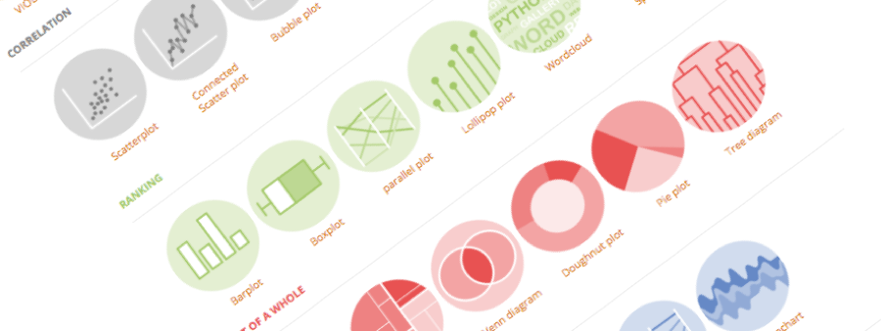
A tutorial by Yan Holtz, Florian Rohart & Baptiste Couvy-Duchesne
Introduction to R Markdown
Or how to boost reproducibility in your research
bit.ly/2SxJFlV
Brisbane, Australia, December 2018

Slide 2
What
“ An R Markdown (.Rmd) file is a record of your research. It contains the code that a scientist needs to reproduce your work along with the narration that a reader needs to understand your work. “
Why
Efficiency
Reproducibility
Interactivity
Automation
Notebook
And much more..

Slide 3
Most Basic Document

Slide 4
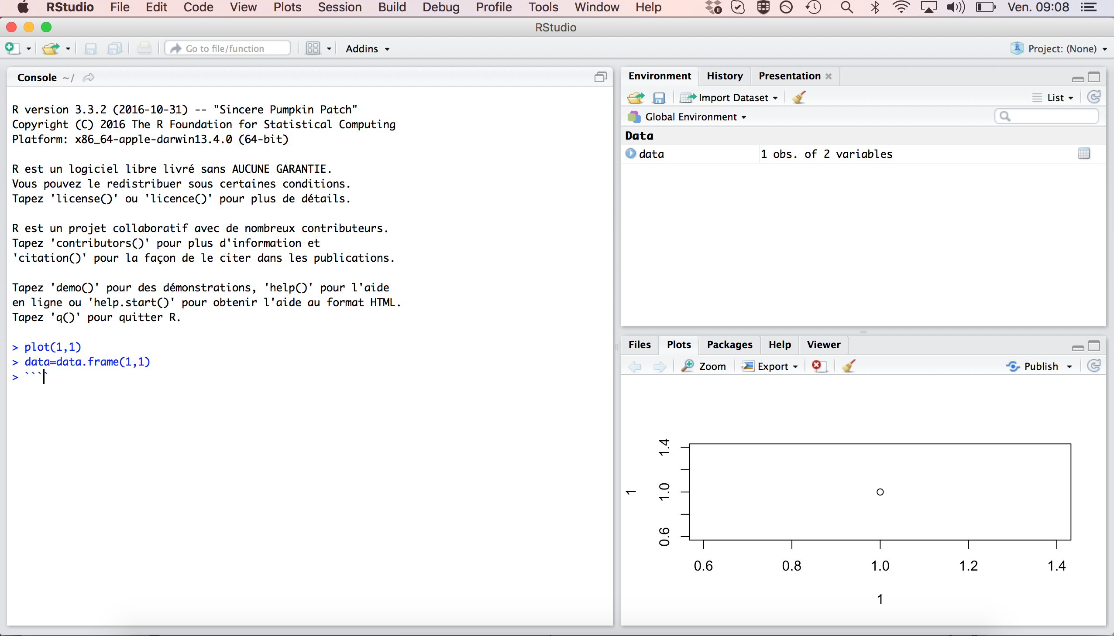
1 - Open R studio:
User Friendly environment
Auto completion
Run a line of code with Cmd + Enter

Slide 5
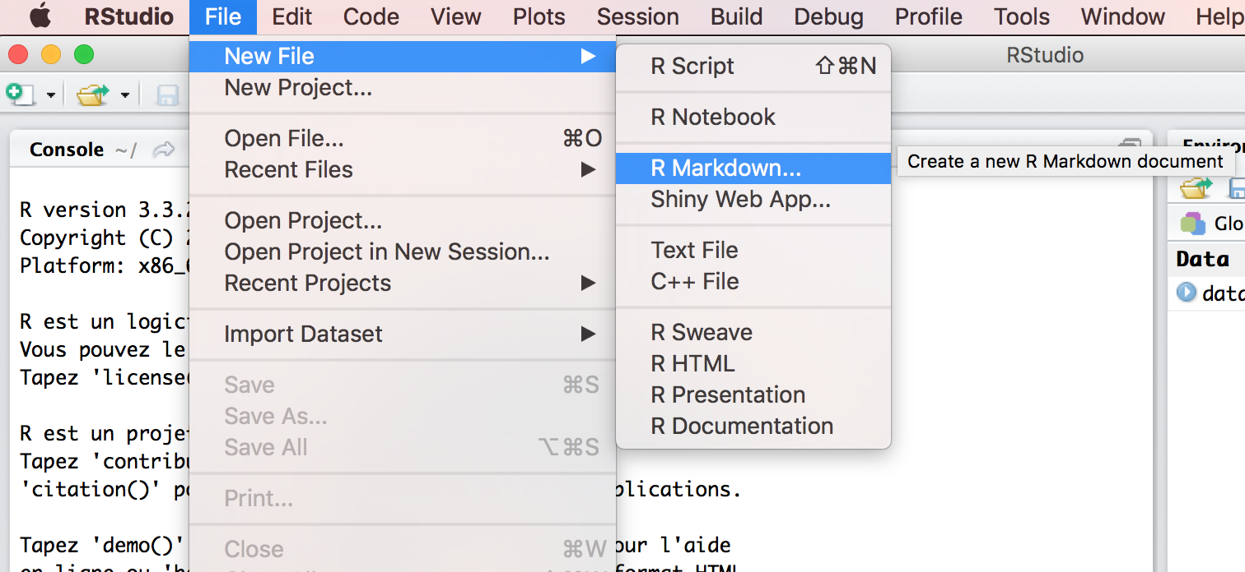
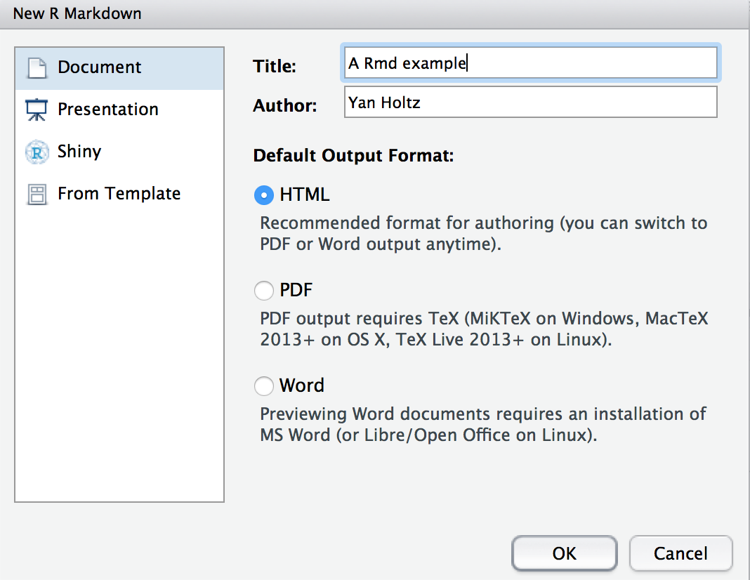
2 - Open a .Rmd file:

Slide 6
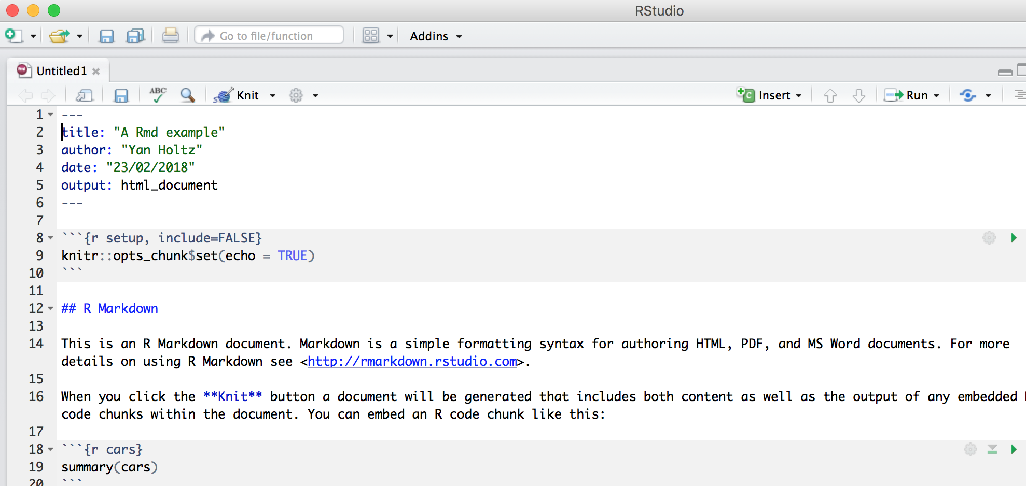
Anatomy of a .Rmd file:
Header
Title
Text
Code chunk

Slide 7
3 - Knit the .Rmd file:

Slide 8
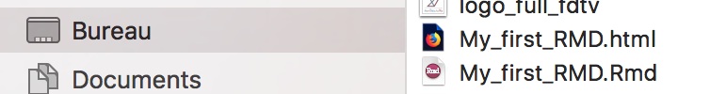
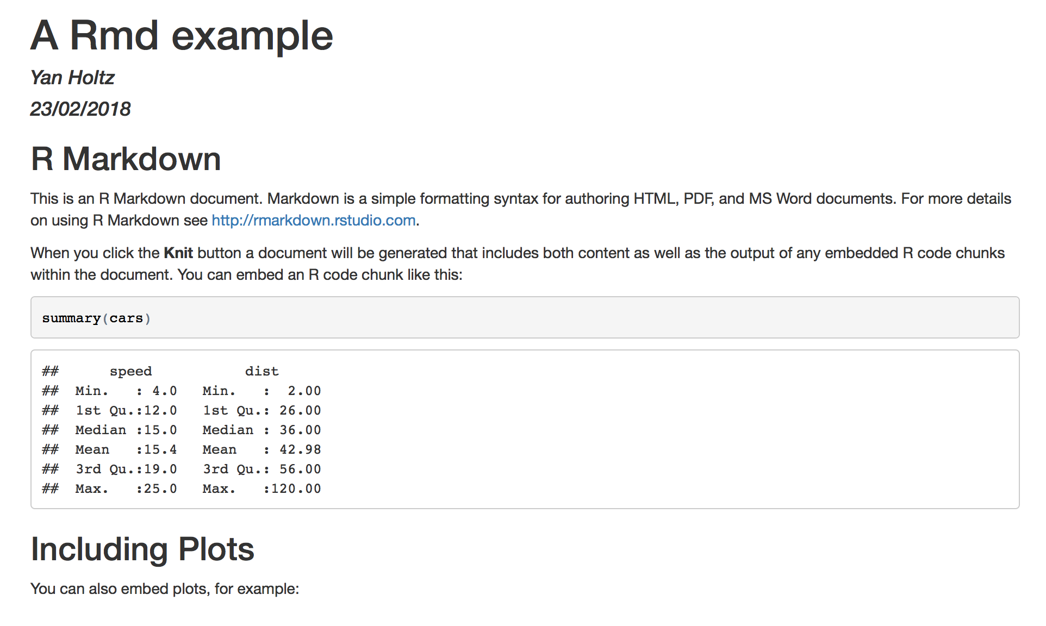
.html
4 - .HTML output is ready
Have a look to your current directory
Open the .html in a browser
.rmd
header
Title
Text
Code
Code result

Slide 9
Customize text

Slide 10
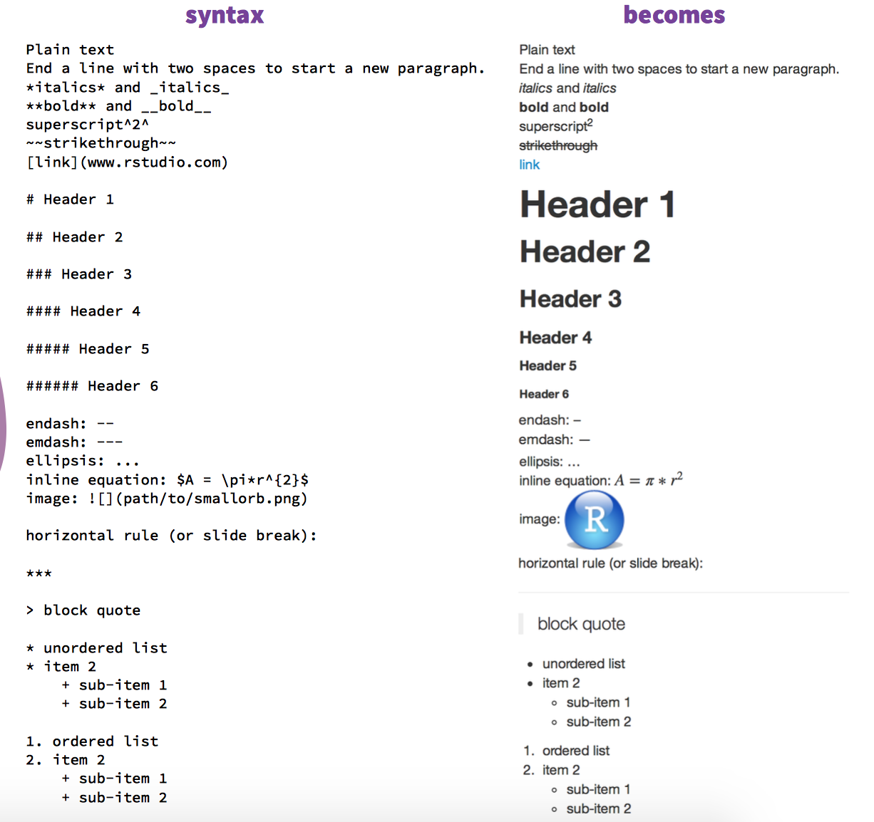
Customize the text
R Markdown cheat sheet
bit.ly/1SuNTo9

Slide 11
Code chunk options

Slide 12
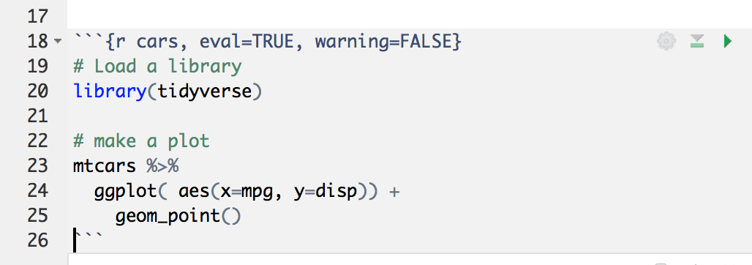
Anatomy of a Code chunk:
Run all previous chunks
Run this chunk
Optional: chunk name
Chunk options
R, bash, python?
Comment your code

Slide 13
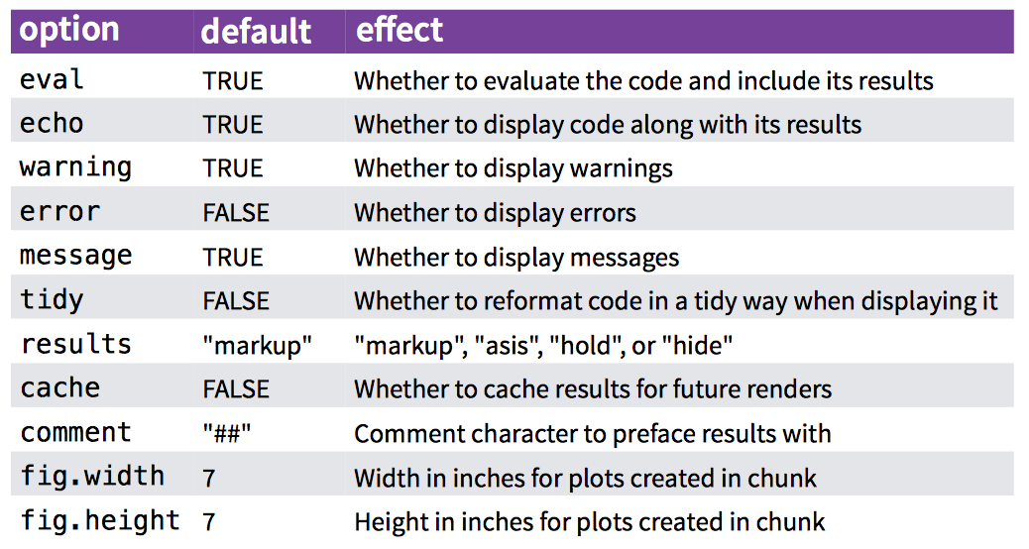
Code chunk options:

Slide 14
Do not always run the whole document
→ R Markdown document is a Notebook !!

Slide 15
Header

Slide 16
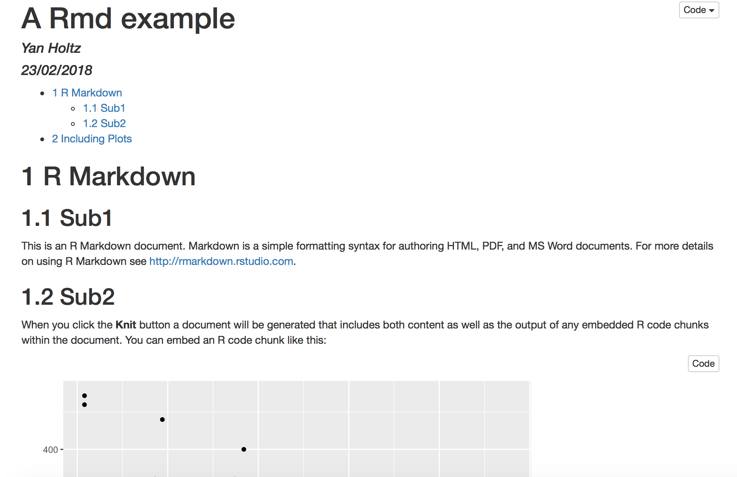
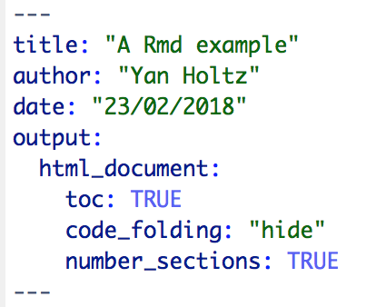
Anatomy of the header:

Slide 17
Going further

Slide 18
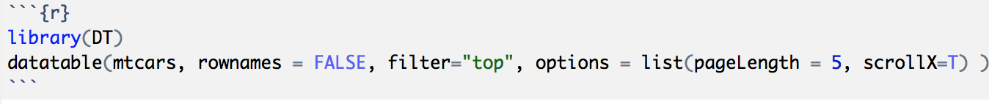
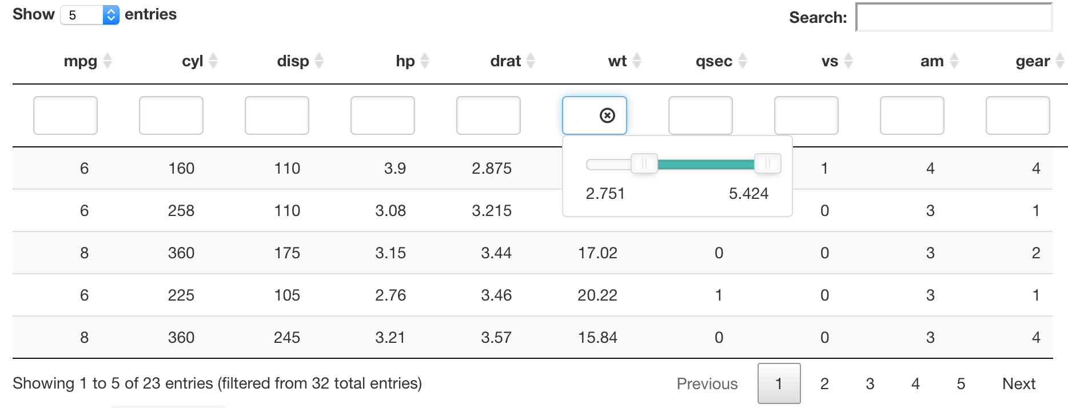
Insert a table: the DT library
Data frame

Slide 19
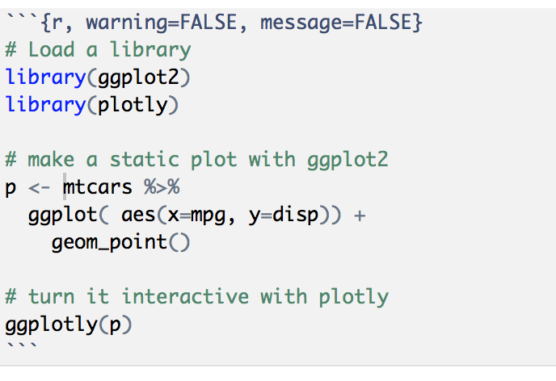
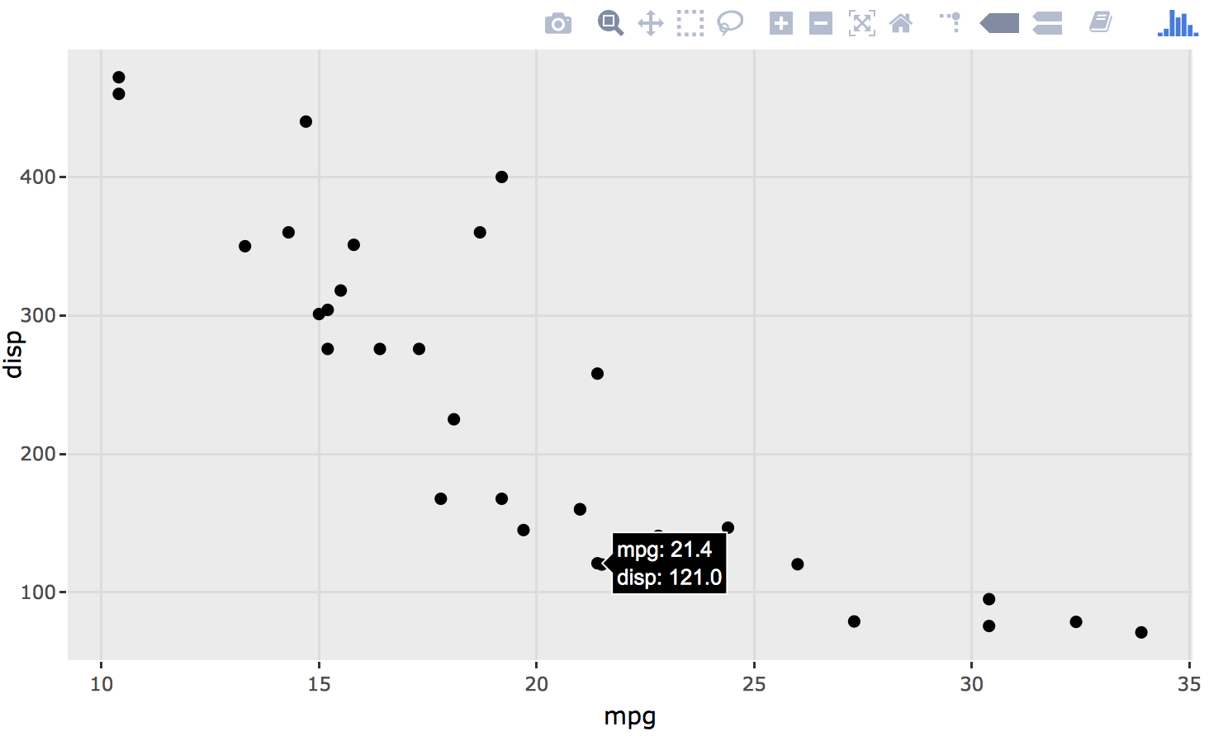
Use Interactive charts
Result: zoom / hover / export .. And more
Plotly library
Basic ggplot2 graphic
Ggplotly turn the plot interactive
http://www.htmlwidgets.org

Slide 20
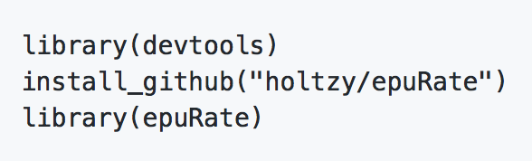

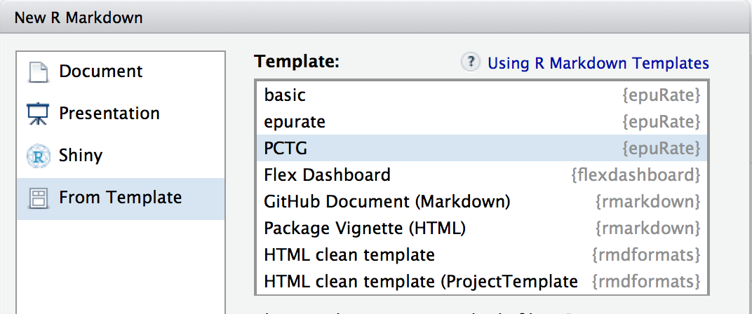
Use a template
The PCTG template: www.github.com/holtzy/epuRate

Slide 21
Pimp my .Rmd
holtzy.github.io/Pimp-my-rmd/
Everything is possible
Use CSS and HTML code
Add header and footer
More

Slide 22
Sharing

Slide 23
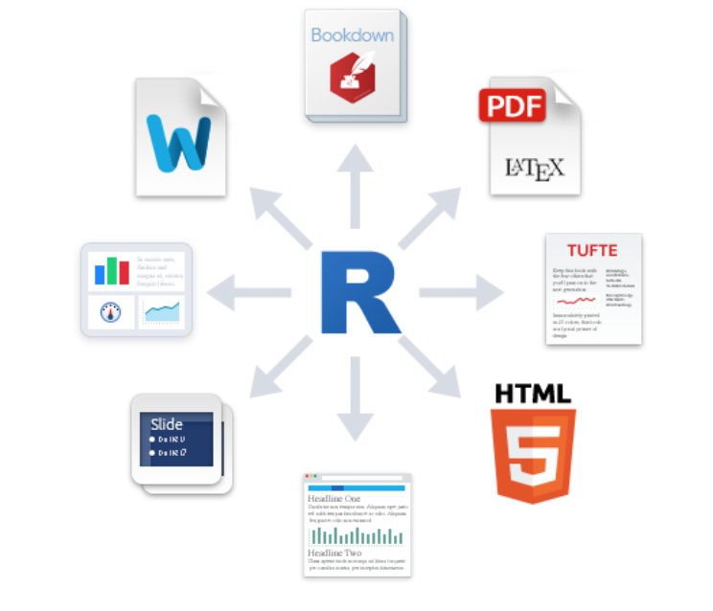
Output format?
Book
.pdf
Word .doc
Dashboard
Template
Slides
Blog

Slide 24

Share your analysis
Mail with colleagues, supervisor
Publication as a supplementary material
Github: www.github.com
Website

Slide 25
Example

Slide 26
An example: my bioinfo pipeline:
Interaction with clusters
One unique folder
Several .rmd wrapped in a website
Shared online

Slide 27




Thanks
Yan.holtz.data@gmail.com
www.yan-holtz.com
Slides:
bit.ly/2SxJFlV
Cheat Sheet:
bit.ly/2AZySd9
@R_Graph_Gallery
github.com/holtzy
Pimp my rmd:
bit.ly/2QDX7Hz

