Slide 1
Efficient and reproducible research with R Markdown
Yan Holtz: yan.holtz.data@gmail.com
Florian Rohart: f.rohart@imb.uq.edu.au
Brisbane, Australia, March 2018

Slide 2
A few resources:
The R Markdown website
The R Markdown cheat sheet
This presentation
The PCTG template

Slide 3
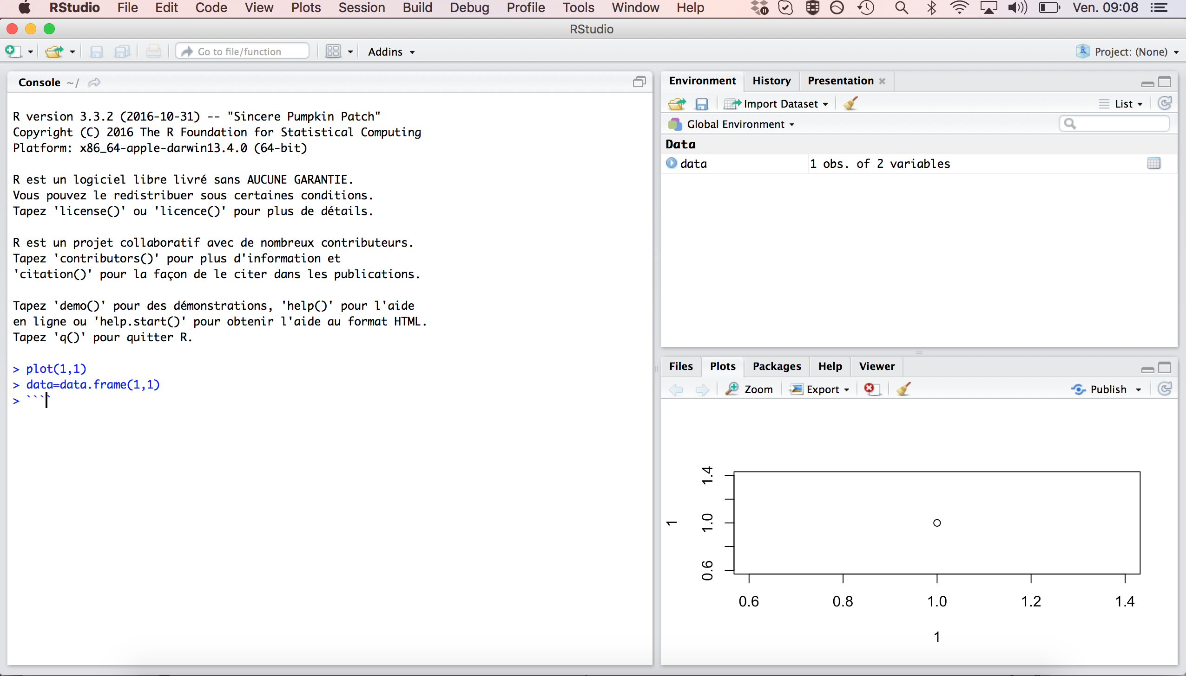
Open R studio:
User Friendly environment
Auto completion
Run a line of code with Cmd + Enter

Slide 4
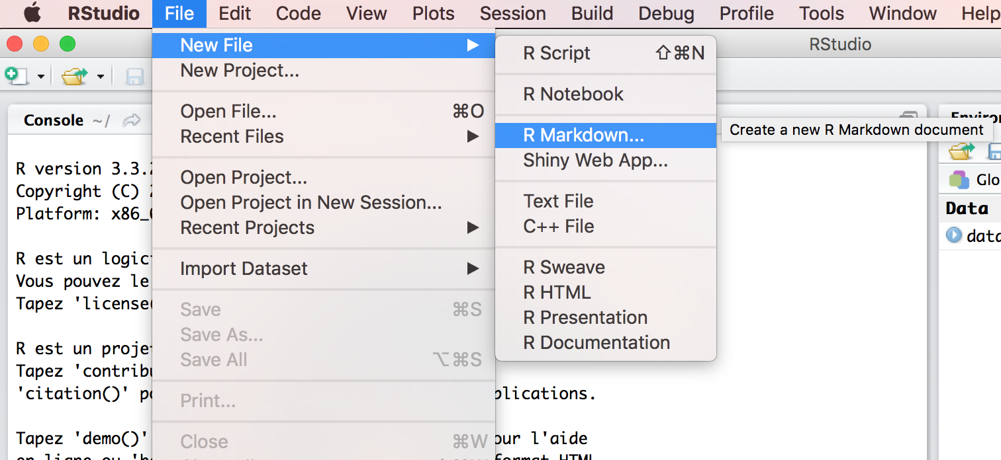
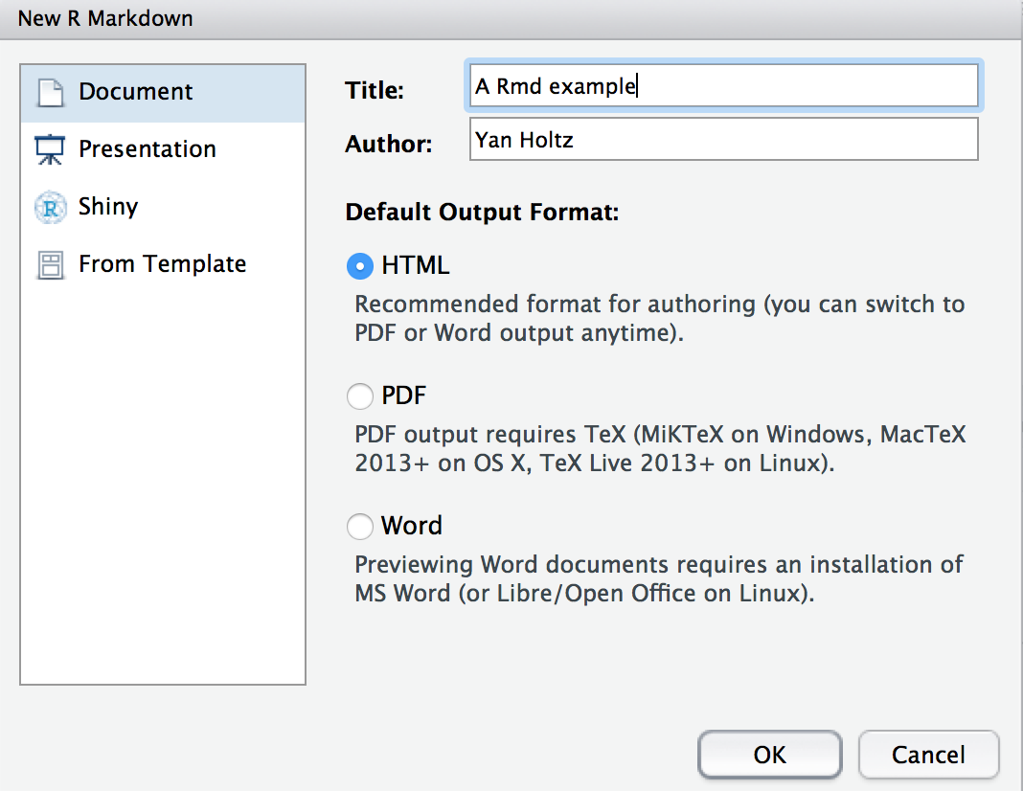
Open a .Rmd file:

Slide 5
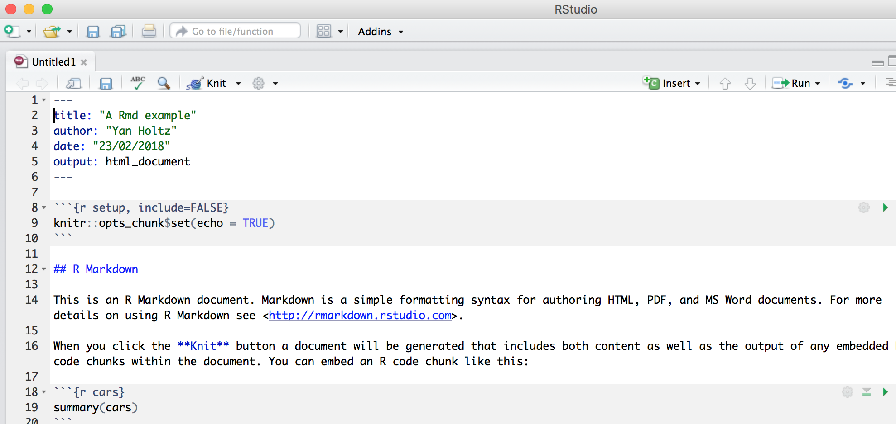
Anatomy of a .Rmd file:
Header
Title
Text
Code chunk

Slide 6
Knit the .Rmd file:

Slide 7
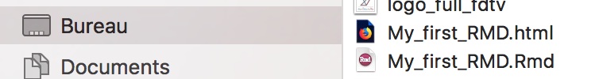
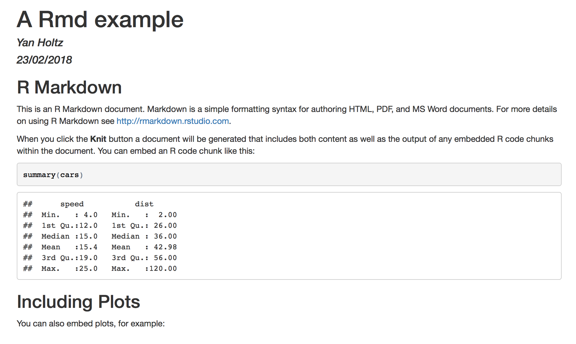
.html
.HTML output is ready !
Have a look to your current director
Open the .html in a browser
.rmd
header
Title
Text
Code
Code result

Slide 8
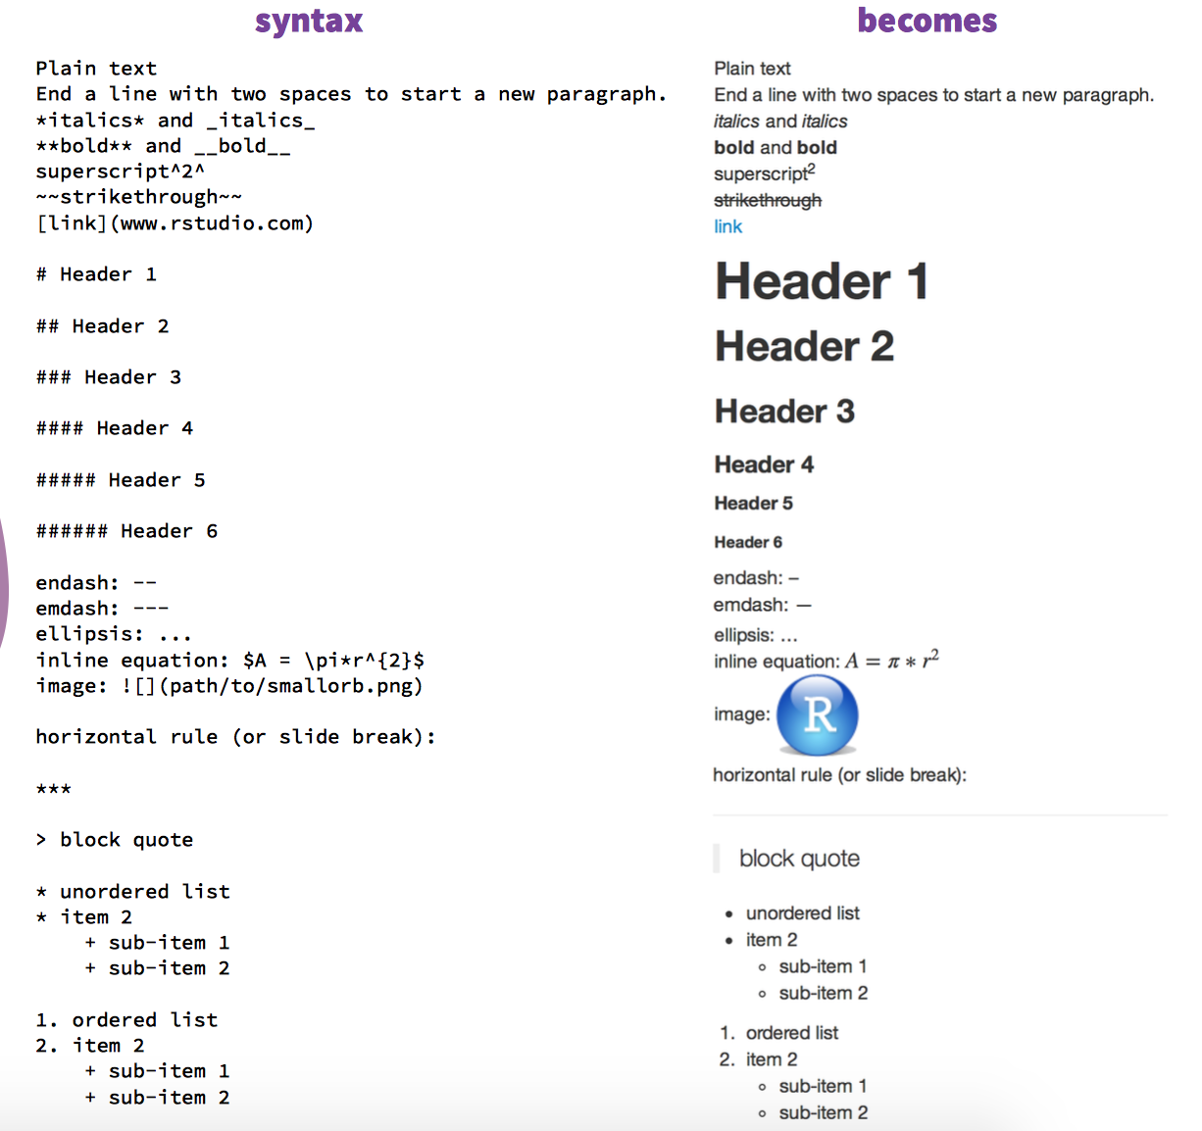
Customize the text
R Markdown cheat sheet

Slide 9
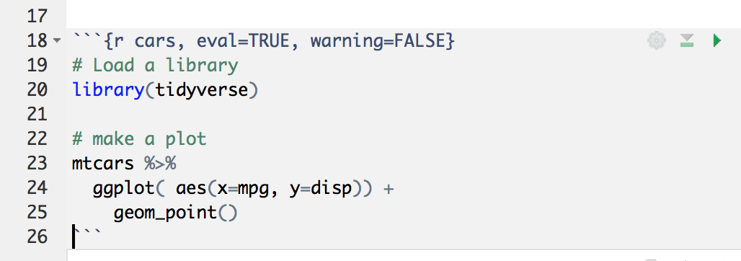
Anatomy of a Code chunk:
Run all previous chunks
Run this chunk
Optional: chunk name
Chunk options
R, bash, python?
Comment your code

Slide 10
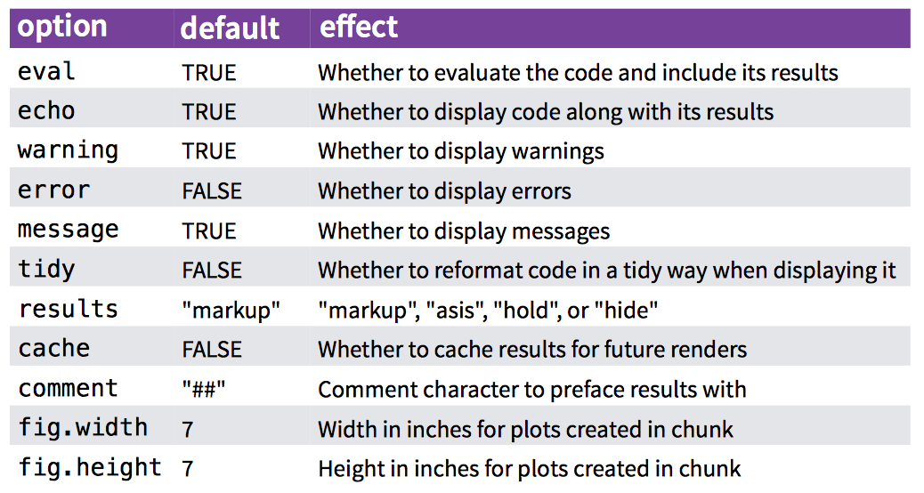
Code chunk options:

Slide 11
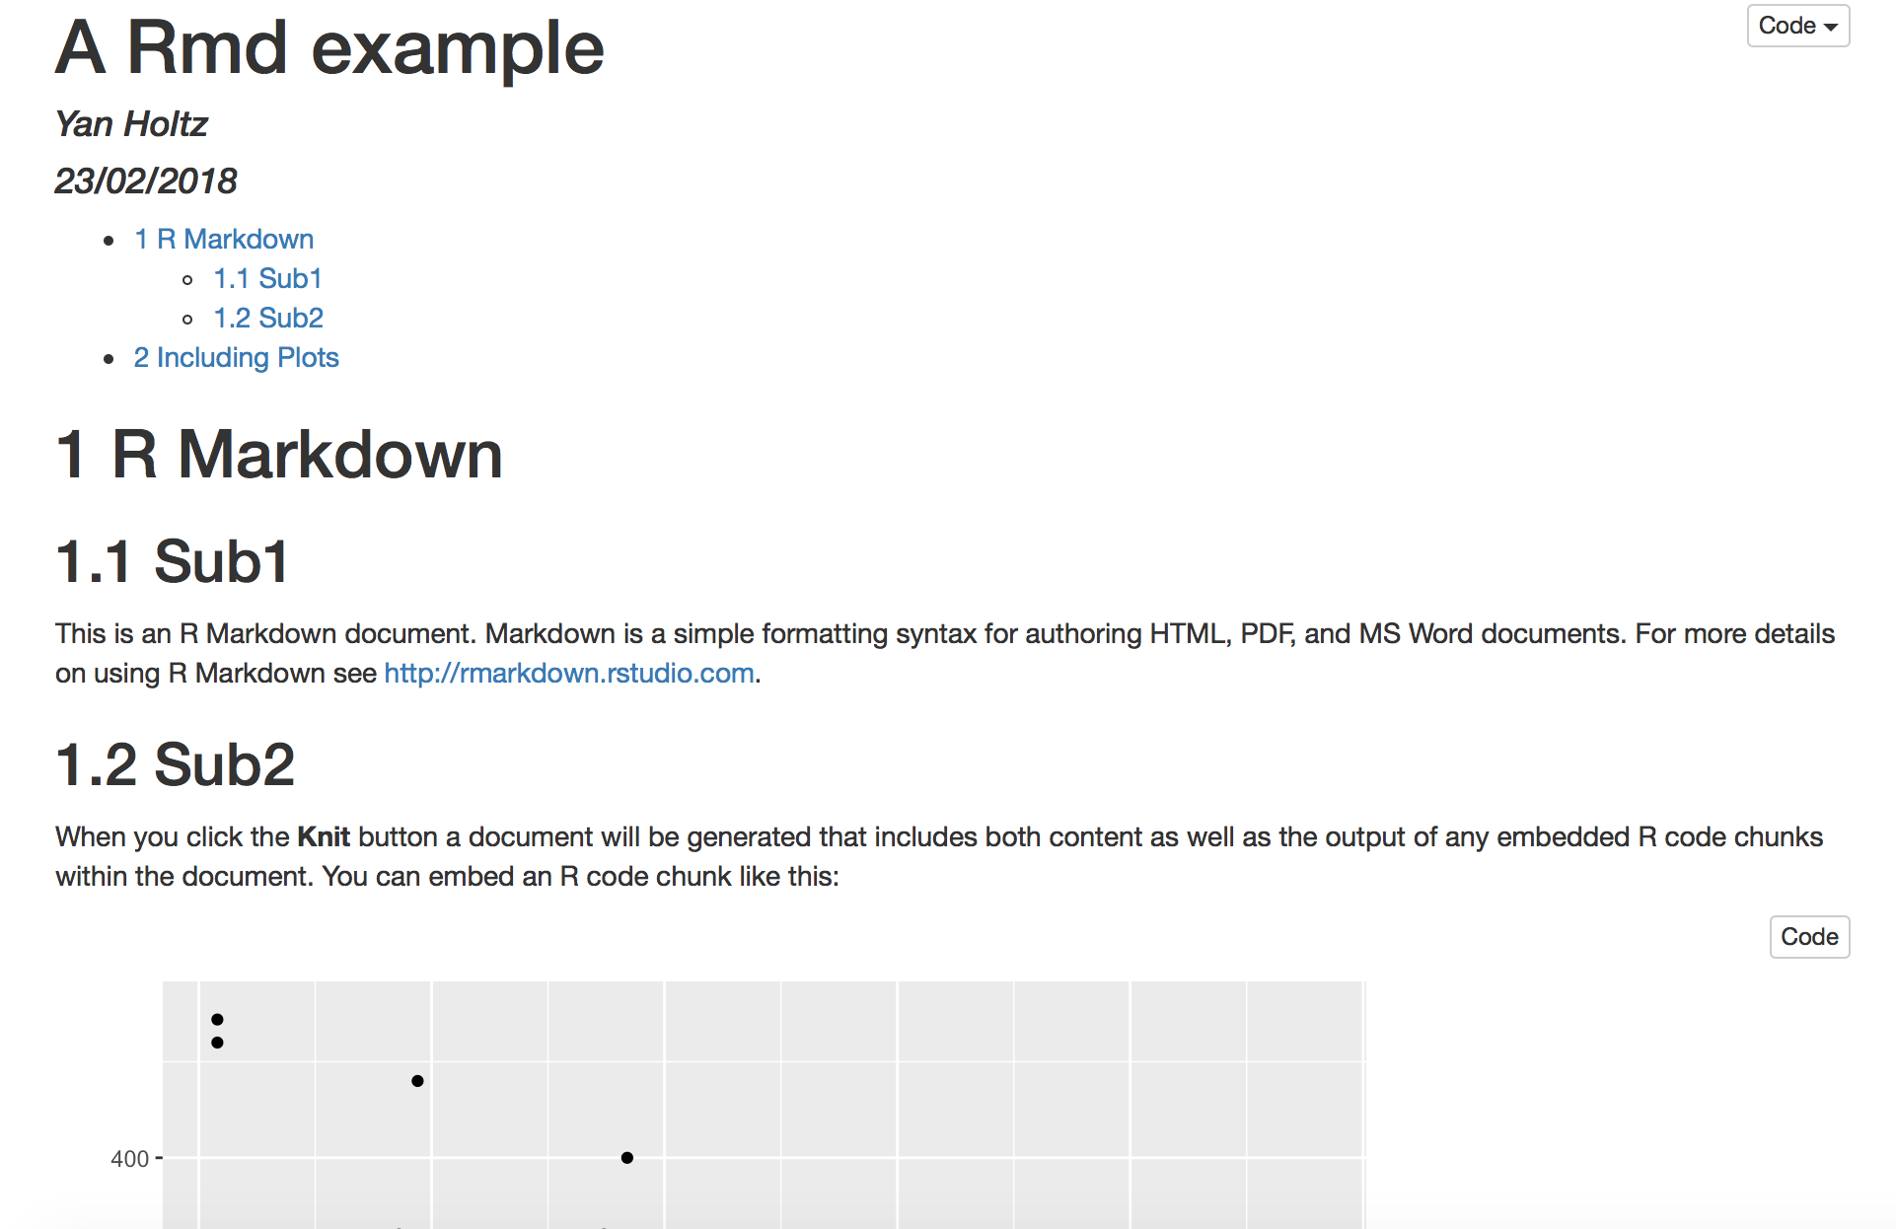
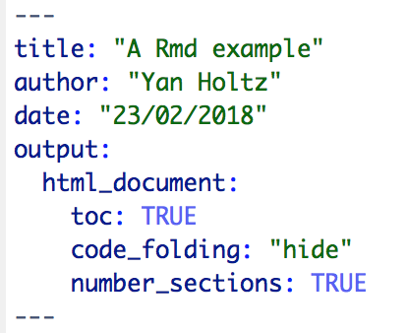
Anatomy of the header:

Slide 12
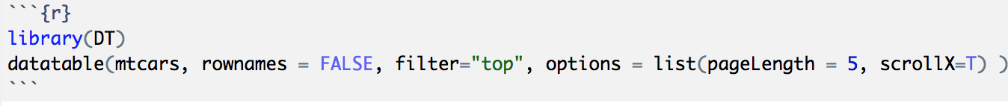
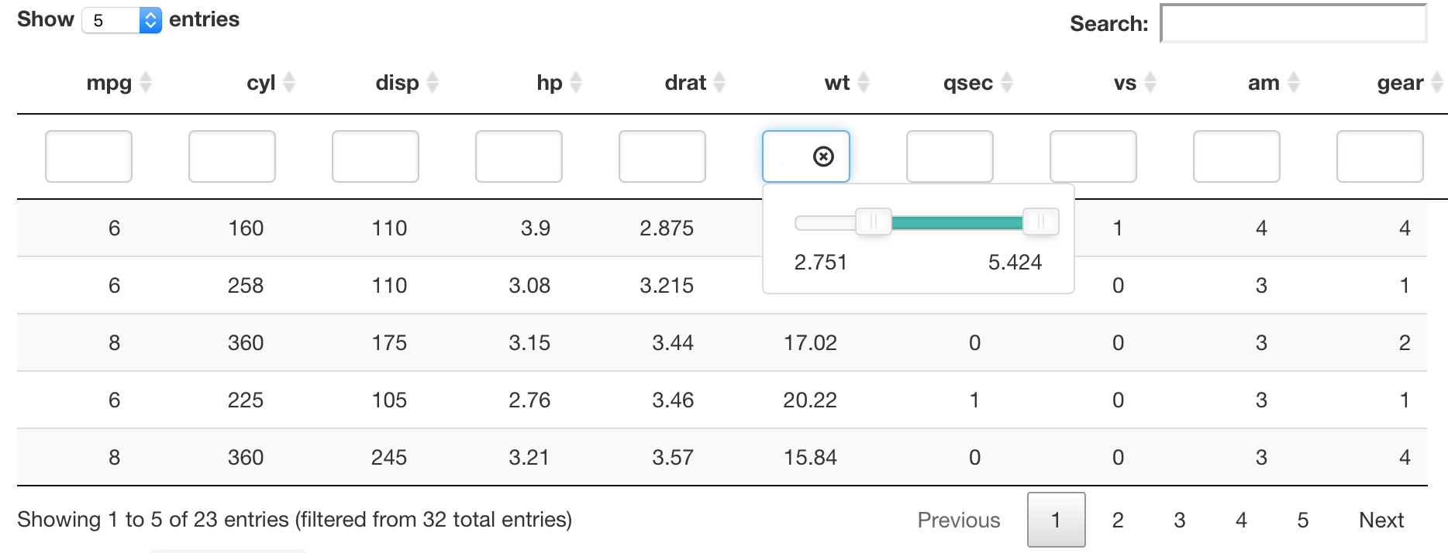
Insert a table: the DT library
Data frame

Slide 13
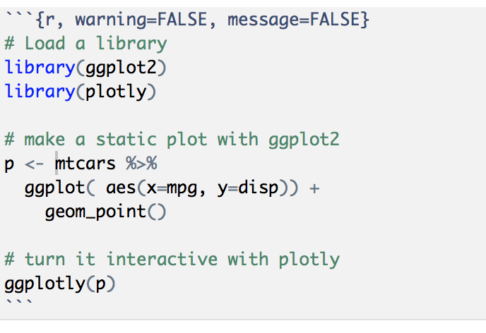
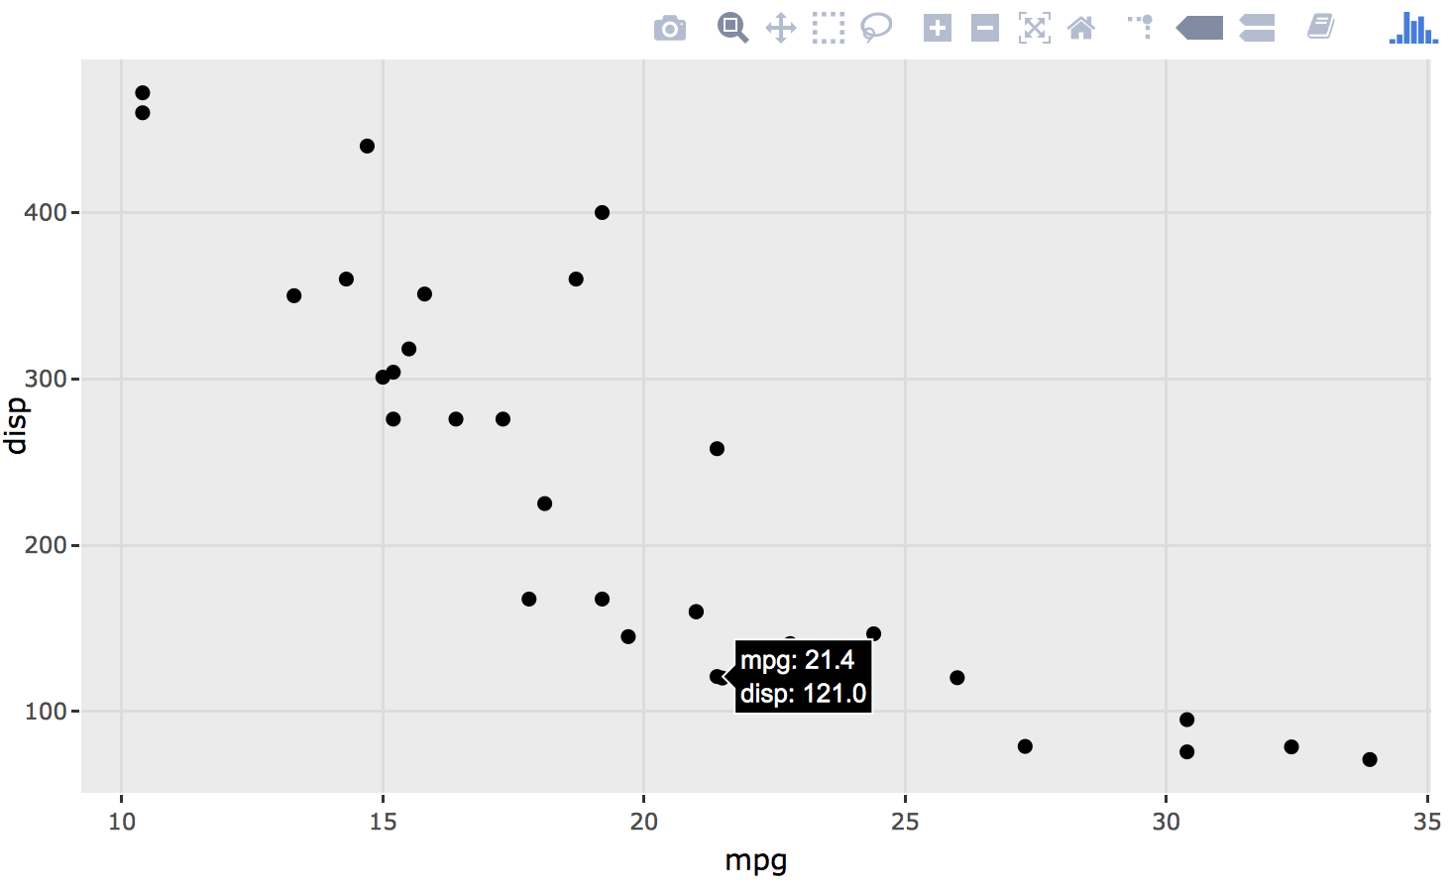
Use Interactive graphics
Result: zoom / hover / export .. And more
Plotly library
Basic ggplot2 graphic
Ggplotly turn the plot interactive

Slide 14
A note on interactivity
Interactivity = javascript
The HTML widgets wrap javascript in R function
See http://www.htmlwidgets.org
Large topic, needs another tutorial (?)

Slide 15
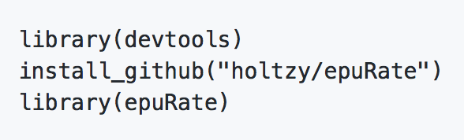

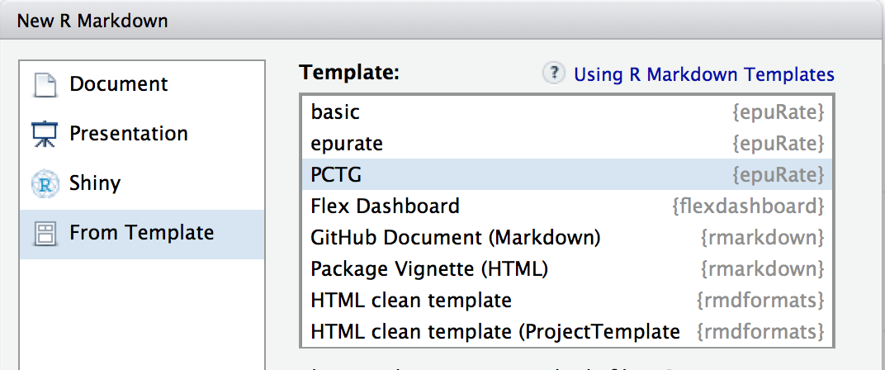
Use a template
The PCTG template: www.github.com/holtzy/epuRate

Slide 16
Pimp my .Rmd
holtzy.github.io/Pimp-my-rmd/
Everything is possible
Use CSS and HTML code
Add header and footer
More

Slide 17
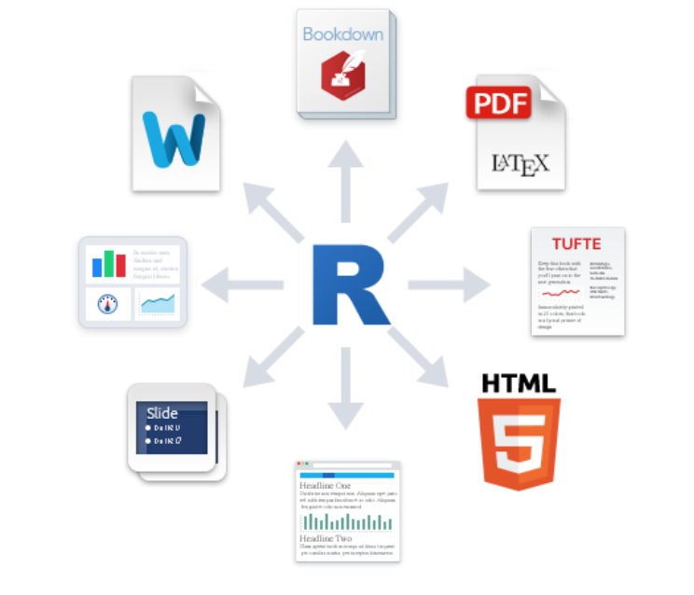
Output format?
Book
.pdf
Word .doc
Dashboard
Template
Slides
Blog

Slide 18

Share your analysis
Mail with colleagues, supervisor
Publication as a suplementary material
Github: www.github.com
Website

Slide 19
An example: my bioinfo pipeline:
Interaction with clusters
One unique folder
Several .rmd wrapped in a website
Shared online

