Slide 1
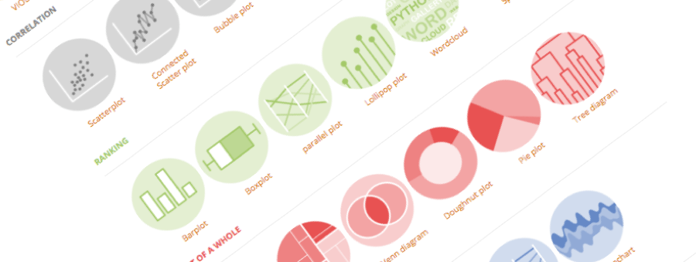
Going further with ggplot2
An overview of the most powerful R library for data visualization
Yan-holtz.com/teaching

Slide 2
What
“ An R Markdown (.Rmd) file is a record of your research. It contains the code that a scientist needs to reproduce your work along with the narration that a reader needs to understand your work. “
Why
Efficiency
Reproducibility
Interactivity
Automation
Notebook
And much more..

Slide 3
Section name

Slide 4




Thanks
Yan.holtz.data@gmail.com
www.yan-holtz.com
Slides:
bit.ly/2SxJFlV
Cheat Sheet:
bit.ly/2AZySd9
@R_Graph_Gallery
github.com/holtzy
Pimp my rmd:
bit.ly/2QDX7Hz

