Slide 1

Introduction to Github
Store code + version control + share it online + collaboration
Yan-holtz.com/teaching

Slide 2

« GitHub is a code hosting platform for version control and collaboration. It lets you and others work together on projects from anywhere »
Github.com

Slide 3
« GitHub is a code hosting platform for version control and collaboration. It lets you and others work together on projects from anywhere »
Host your code
Version control
Share your code
Collaborate
Github.com
Suggest modification

Slide 4
Create an account

Slide 5
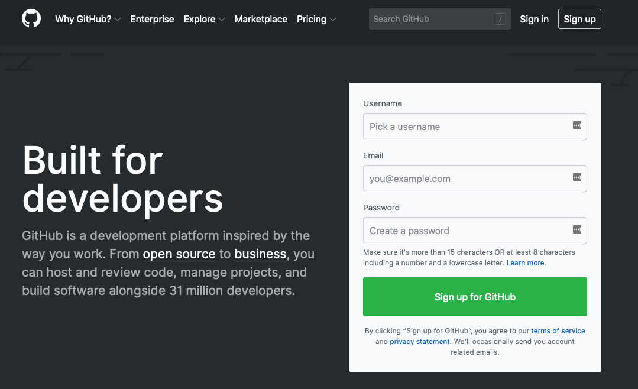
Github.com

Slide 6
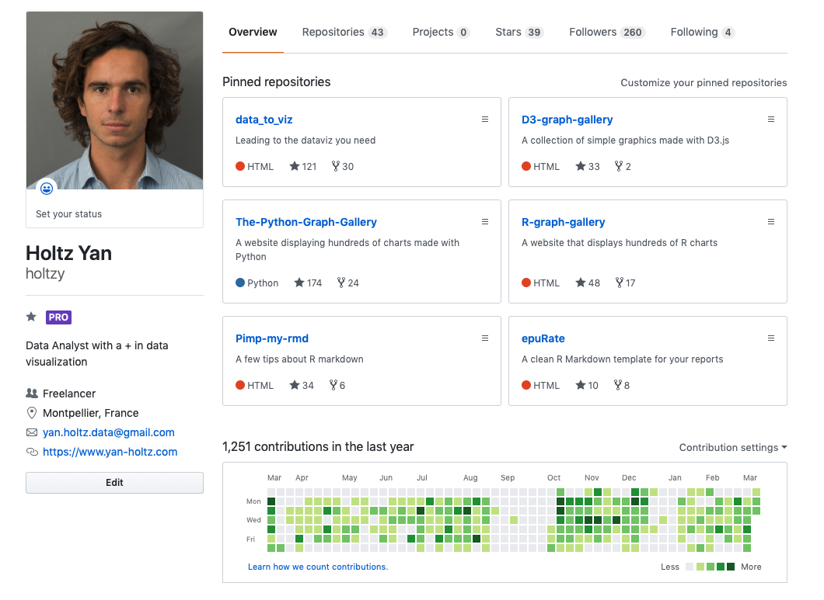
All repo
One repo = one project
ID
Description
Contact
Your Activity

Slide 7
Your Github profile is part of your CV !

Slide 8
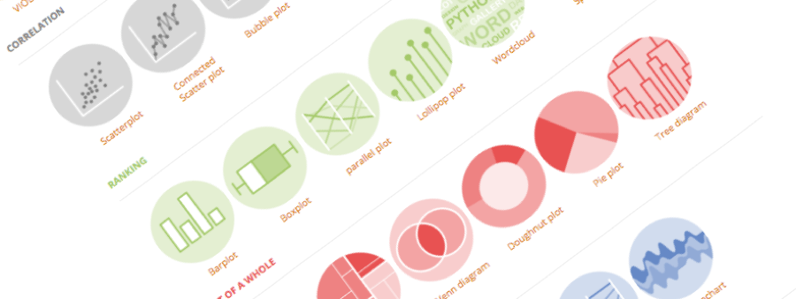
Github Desktop
The link between your laptop and github

Slide 9

Your computer
Github

Slide 10
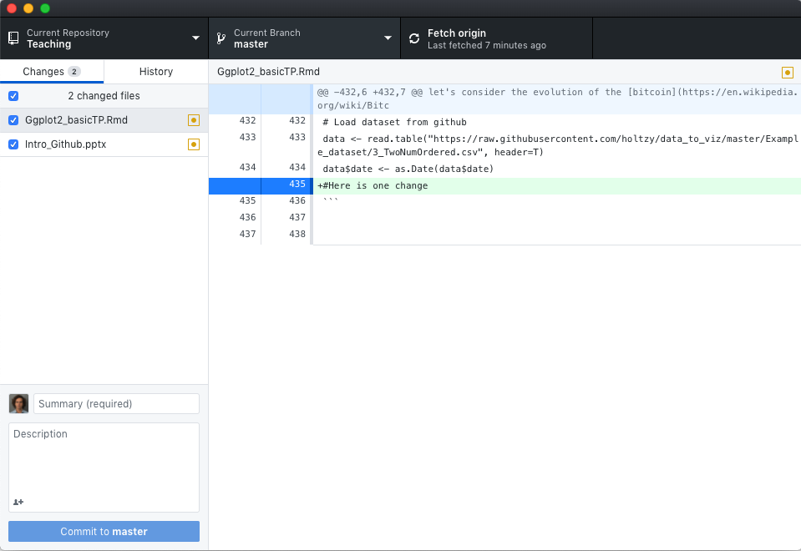
Github Desktop:
- Link computer - github.com.
- Replace the command line
desktop.github.com
Your computer
Github

Slide 11
Your first repo
Hopefully not the last

Slide 12
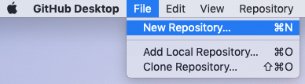


1 – Create a new github repositoy
2 – Put a few files in it
3 – Publish the repo
4– Have a look to it online

Slide 13
Your first ‘commit’

Slide 14
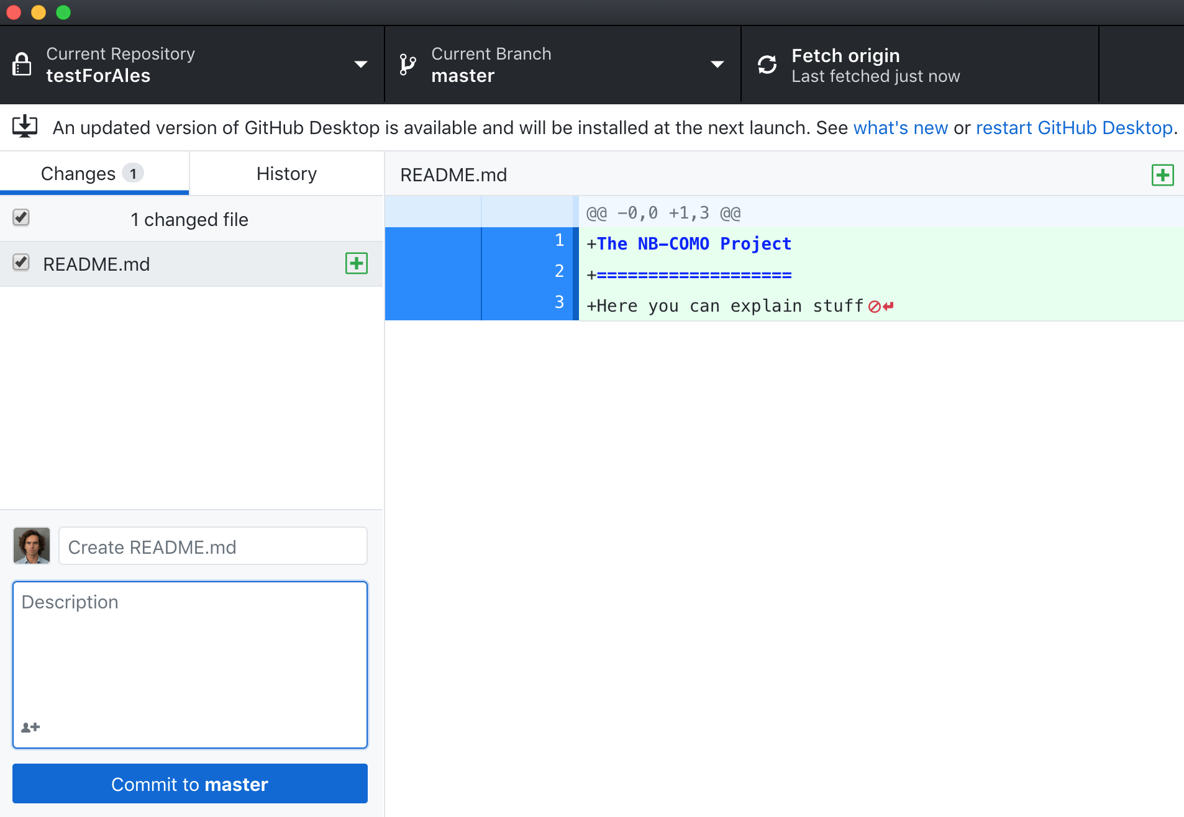
1 – Make a change in the local folder
4 - Push
Differences are shown here
2 – Create commit message
3 - Commit

Slide 15
Always add a readMe

Slide 16
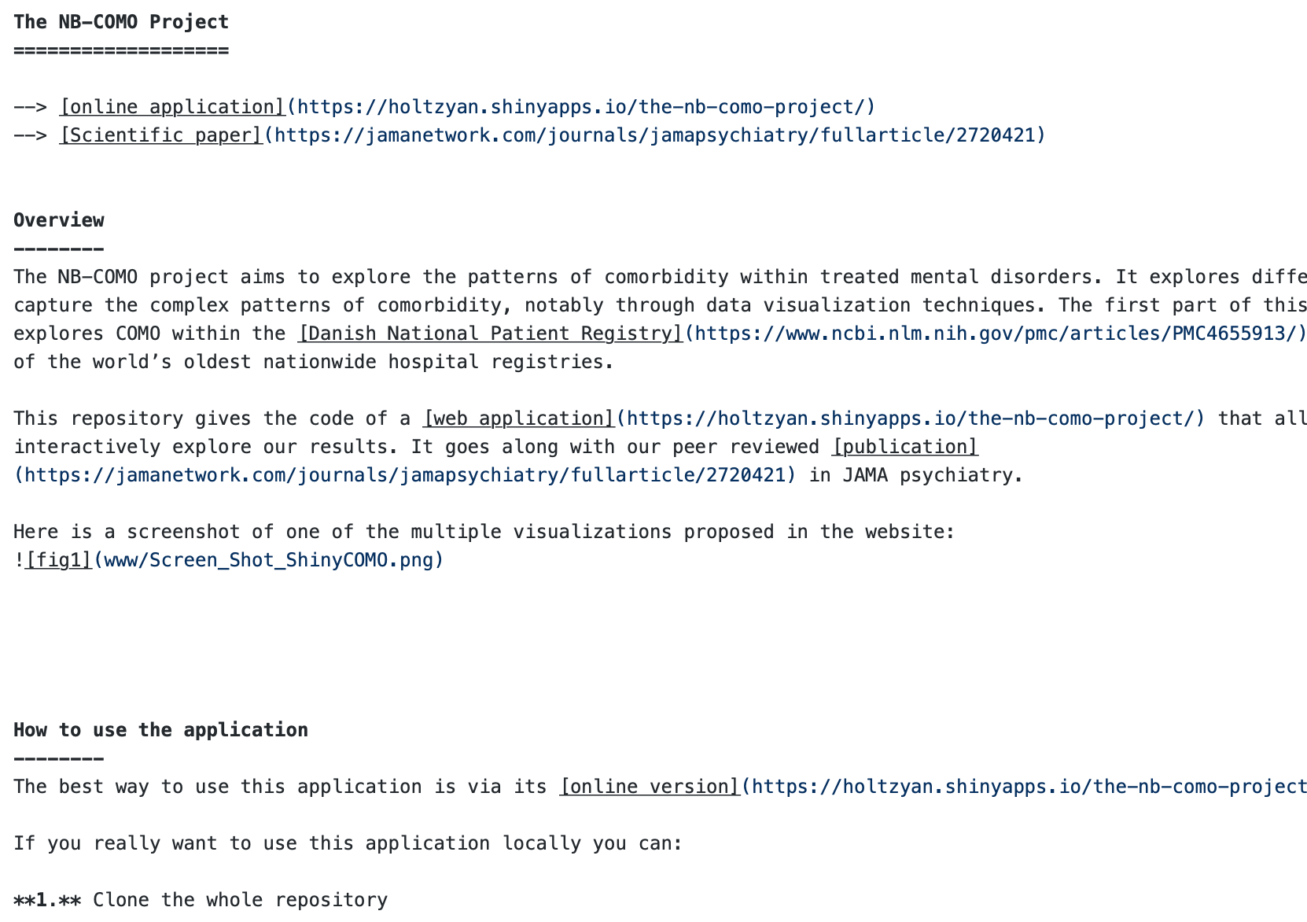
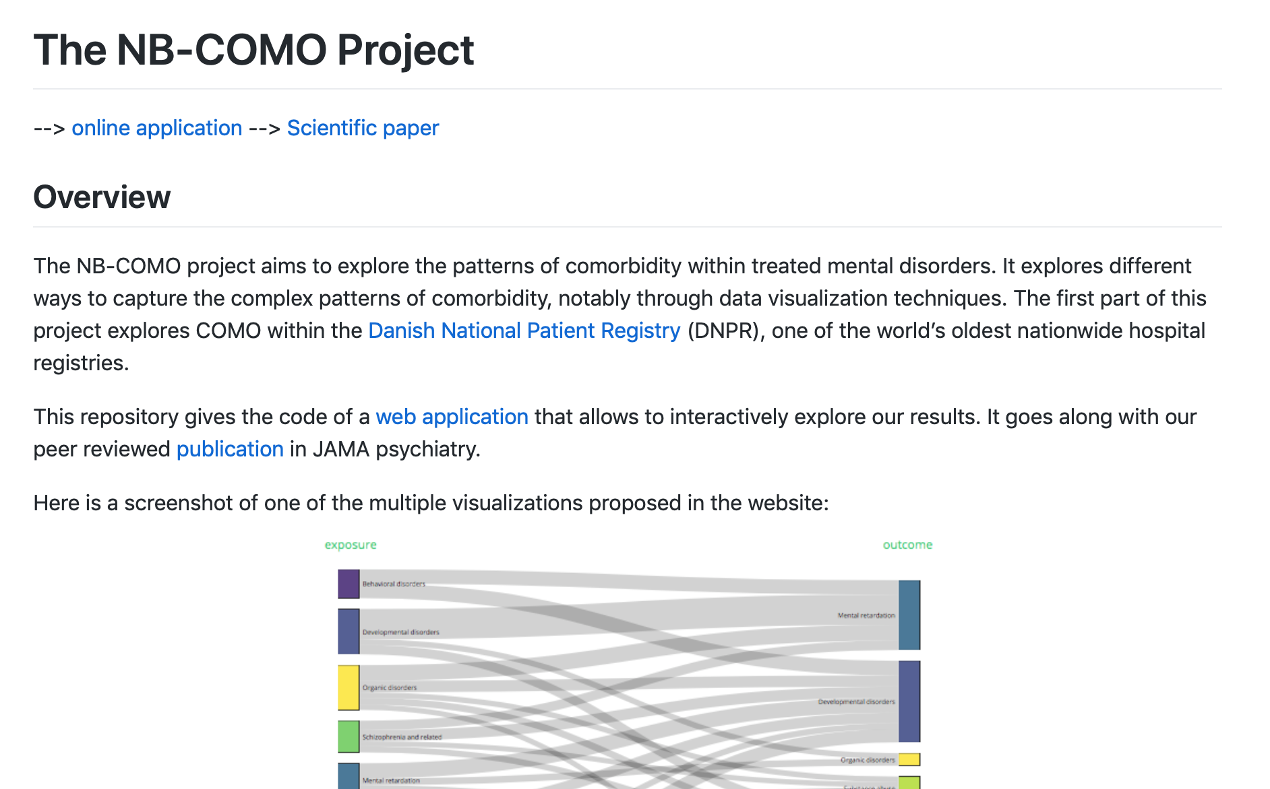
Readme.md in your folder
Readme seen on Github

Slide 17
Submit an issue

Slide 18
Create a website with your analysis

Slide 19
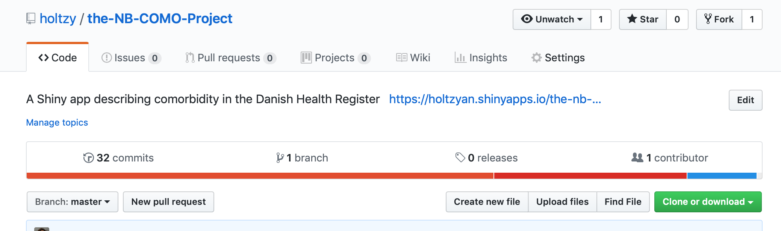
1 – call your Rmd output index.html
2 – Click settings

Slide 20
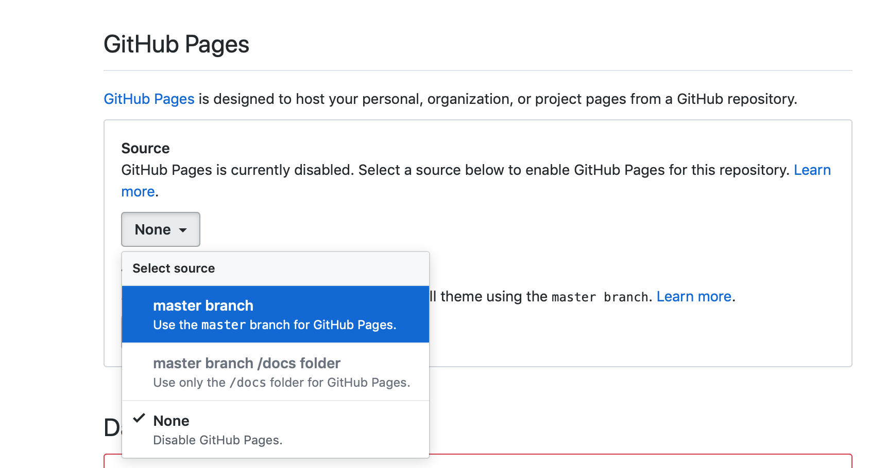
3 – Github Pages: Master branch

Slide 21
4 – Your index.html file is now a website.
url: https://username.github.io/repoName.

Slide 22




Thanks
Yan.holtz.data@gmail.com
www.yan-holtz.com
Slides:
Yan-holtz/teaching
Github:
@R_Graph_Gallery
github.com/holtzy
Github.com

