Slide 1
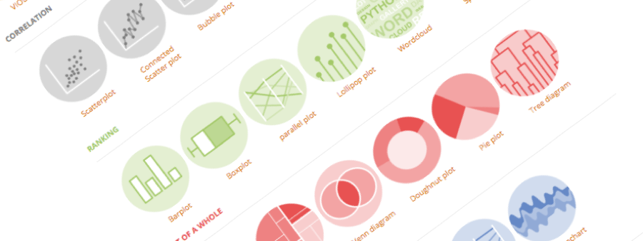
Introduction to Github
Building interactive and reproducible reports in minutes
Yan-holtz.com/teaching

Slide 2

« GitHub is a code hosting platform for version control and collaboration. It lets you and others work together on projects from anywhere »
Github.com

Slide 3
« GitHub is a code hosting platform for version control and collaboration. It lets you and others work together on projects from anywhere »
Host your code
Version control
Share your code
Collaborate
Github.com
Suggest modification

Slide 4
Create an account

Slide 5
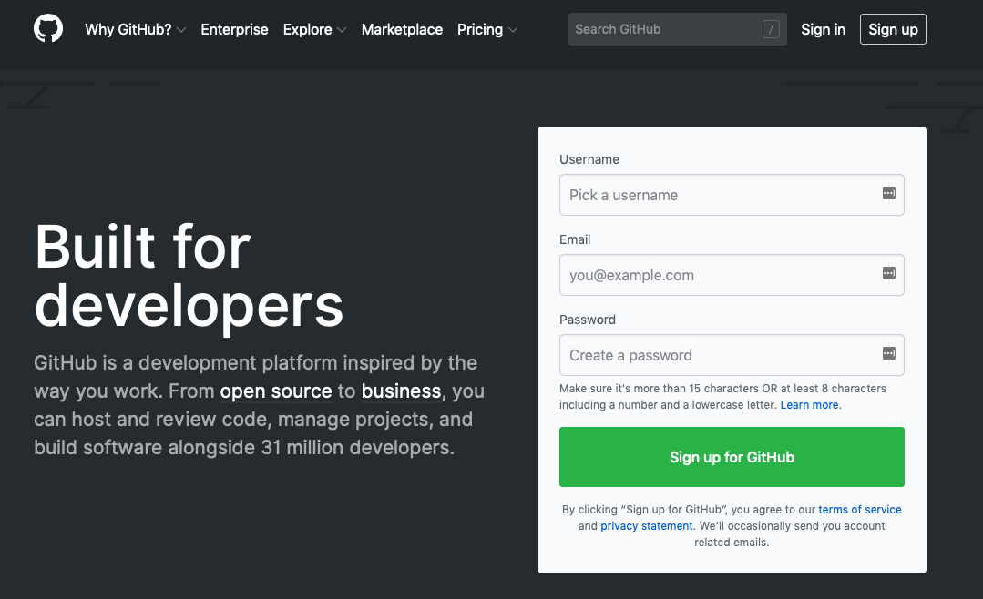
Github.com

Slide 6
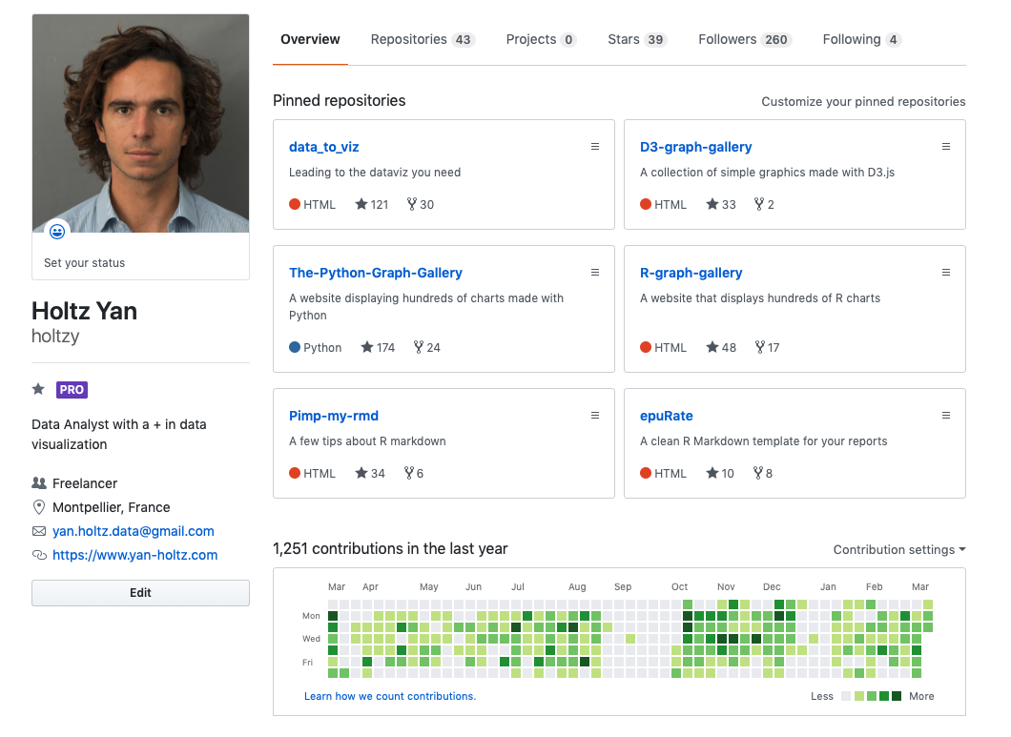
All repo
One repo = one project
ID
Description
Contact
Your Activity

Slide 7
Your Github profile is part of your CV !

Slide 8
Github Desktop
The link between your laptop and github

Slide 9

desktop.github.com
Your computer
Github

Slide 10
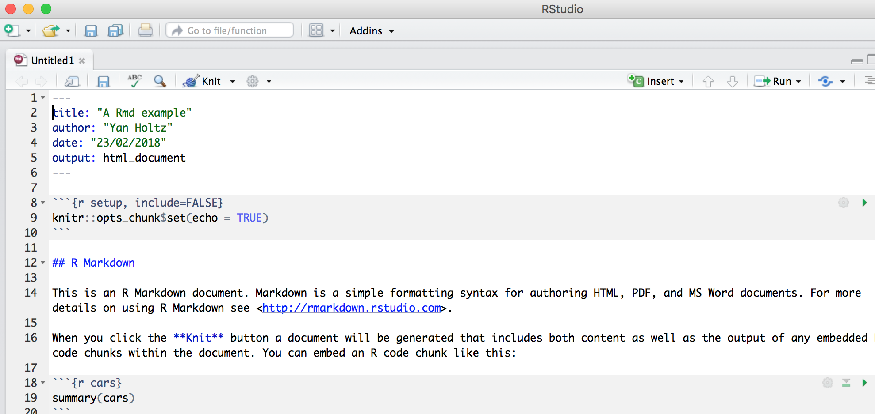
3 - Knit the .Rmd file:

Slide 11
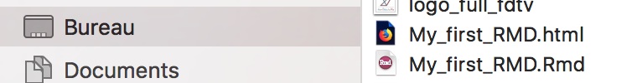
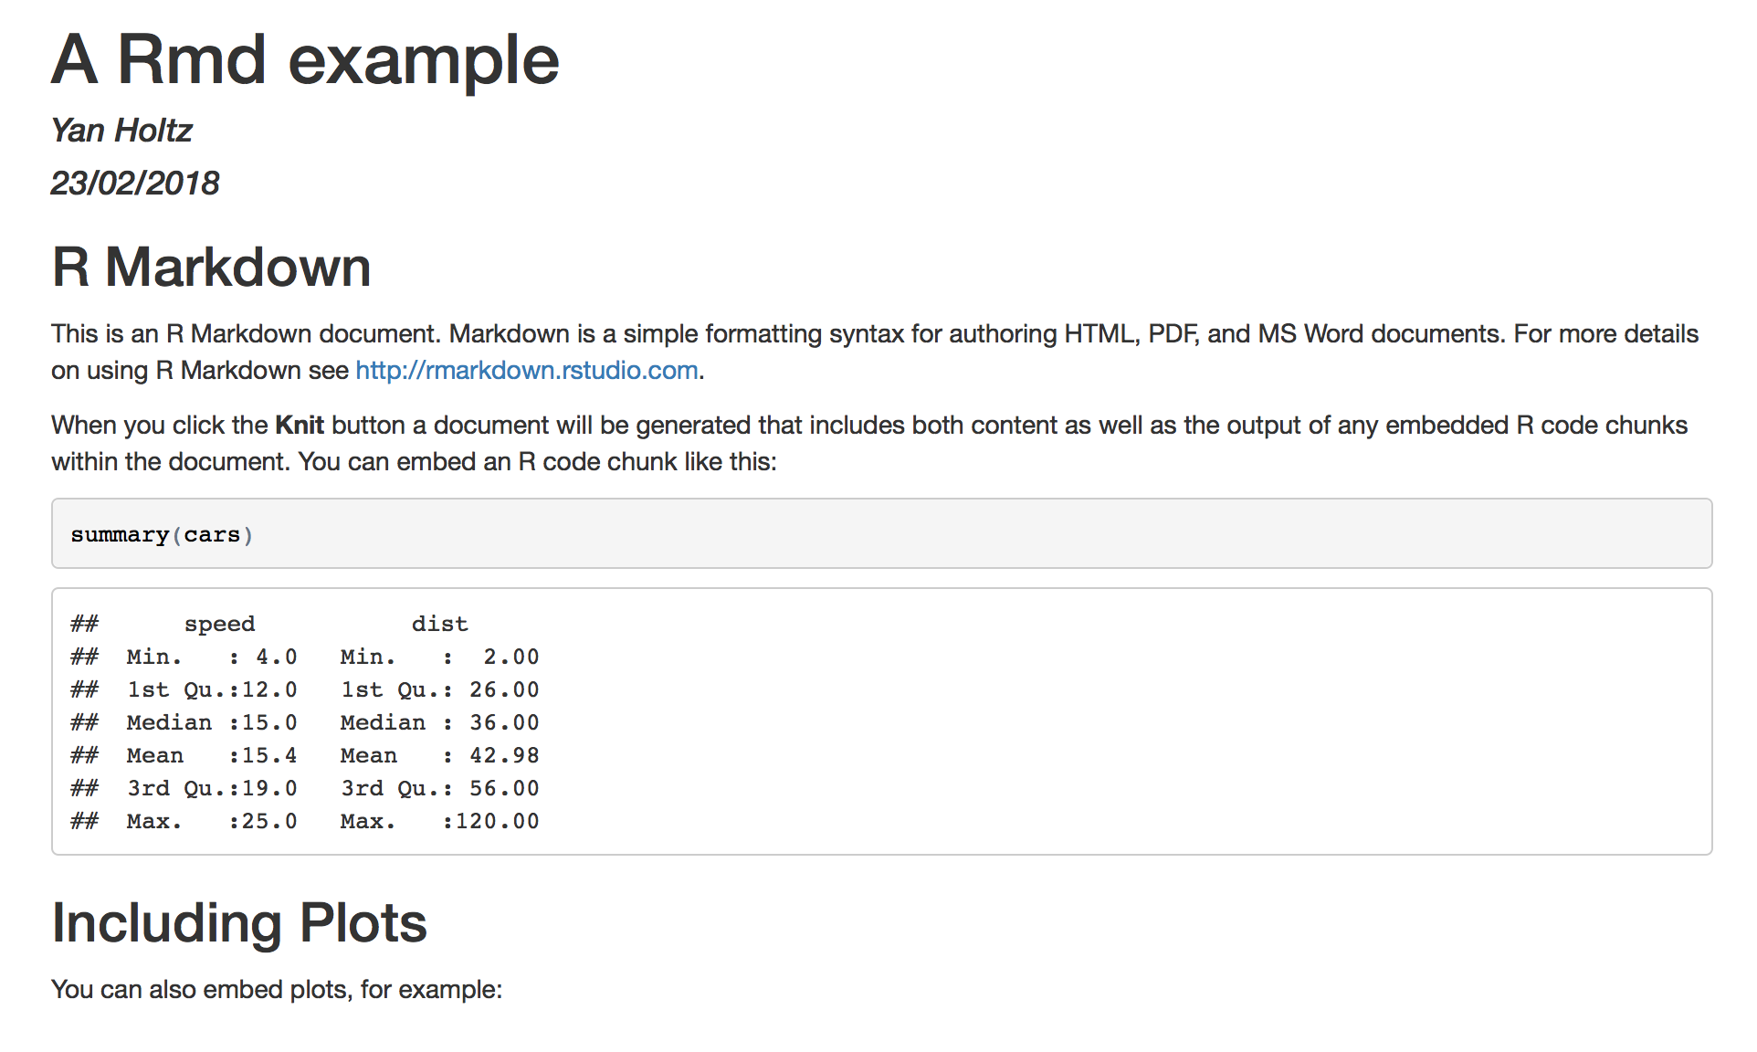
.html
4 - .HTML output is ready
Have a look to your current directory
Open the .html in a browser
.rmd
header
Title
Text
Code
Code result

Slide 12
Customize text

Slide 13
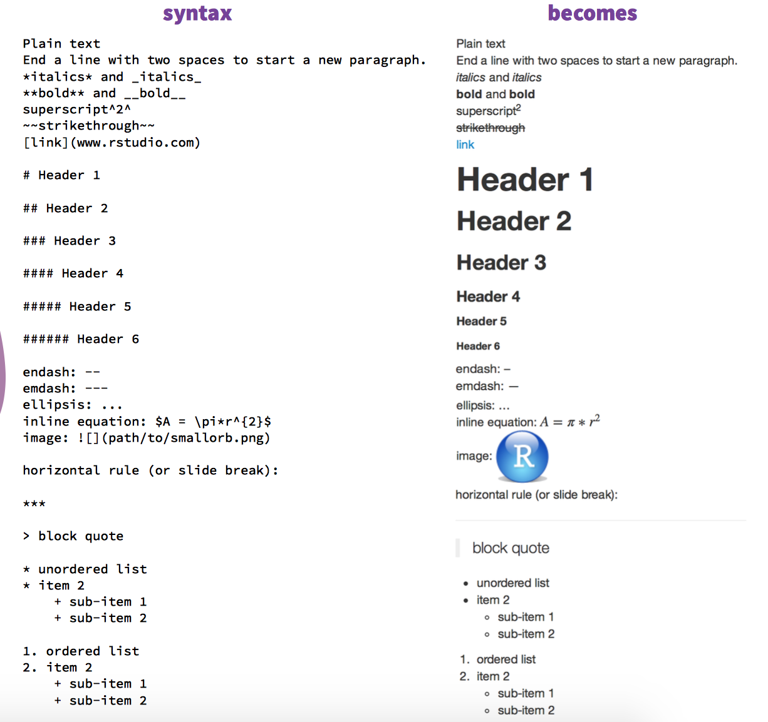
Customize the text
R Markdown cheat sheet
bit.ly/1SuNTo9

Slide 14
Code chunk options

Slide 15
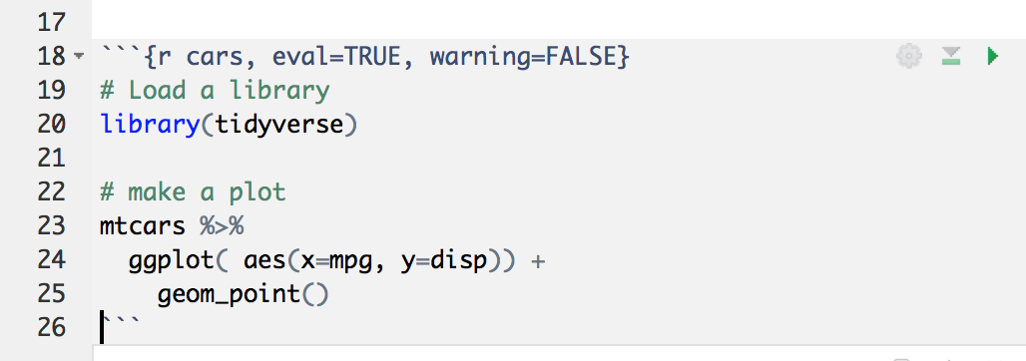
Anatomy of a Code chunk:
Run all previous chunks
Run this chunk
Optional: chunk name
Chunk options
R, bash, python?
Comment your code

Slide 16
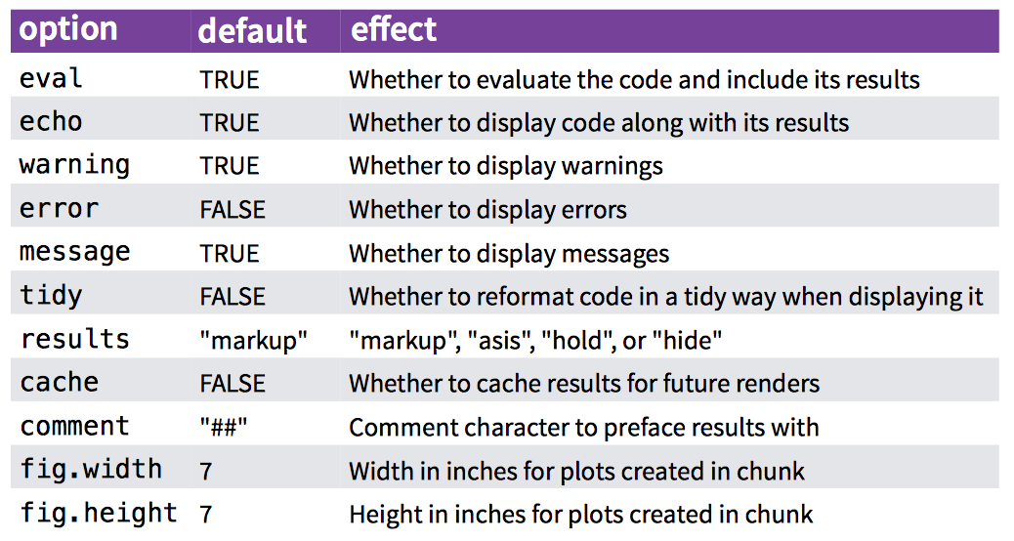
Code chunk options:

Slide 17
Do not always run the whole document
→ R Markdown document is a Notebook !!

Slide 18
Header

Slide 19
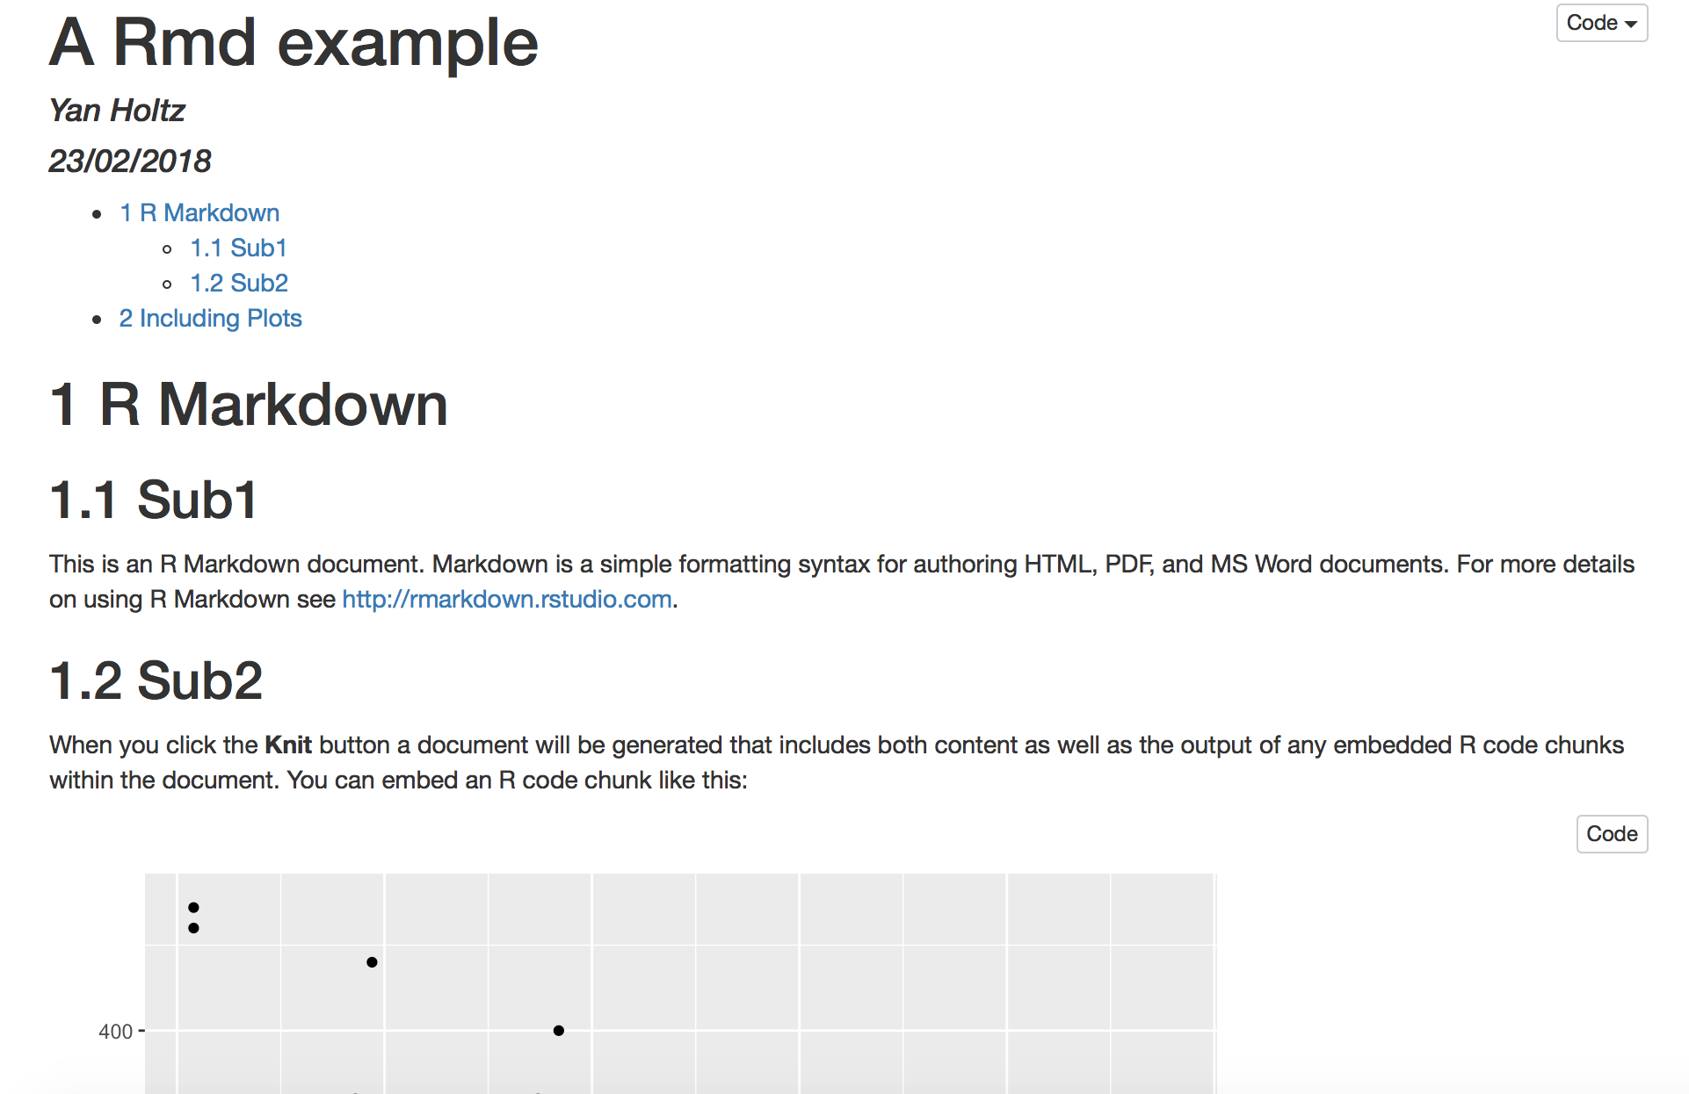
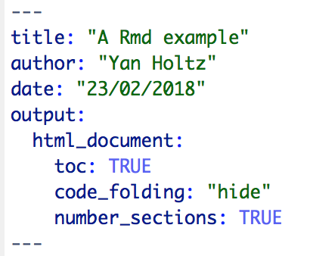
Anatomy of the header:

Slide 20
Going further

Slide 21
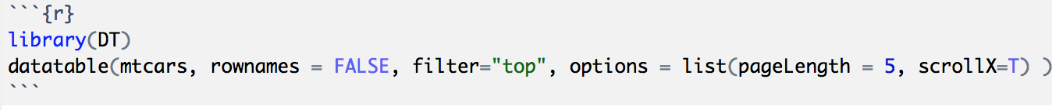
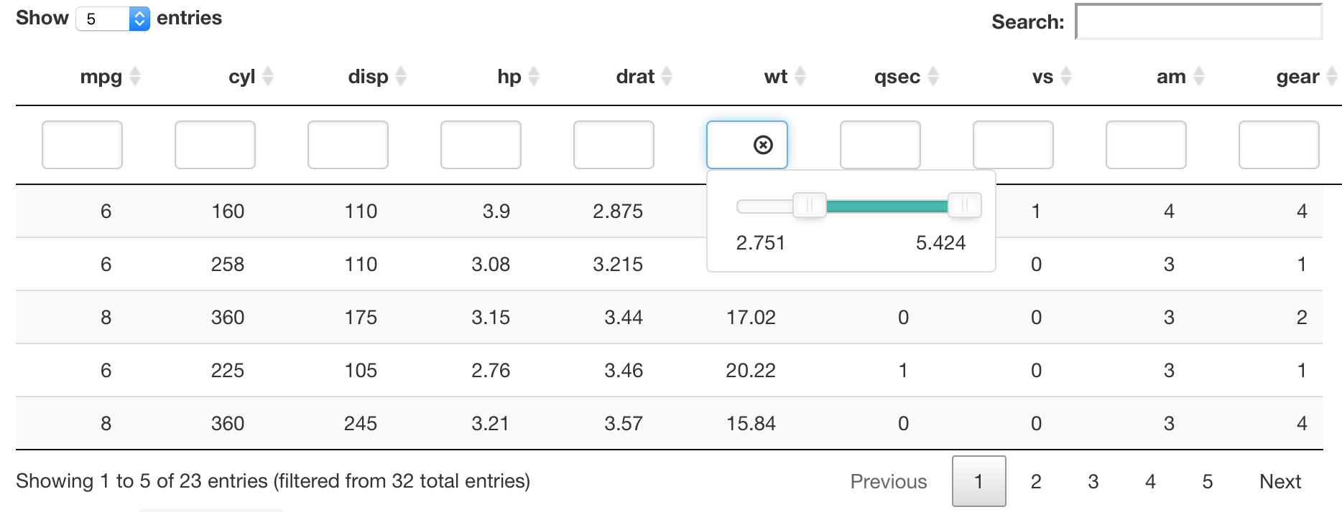
Insert a table: the DT library
Data frame

Slide 22
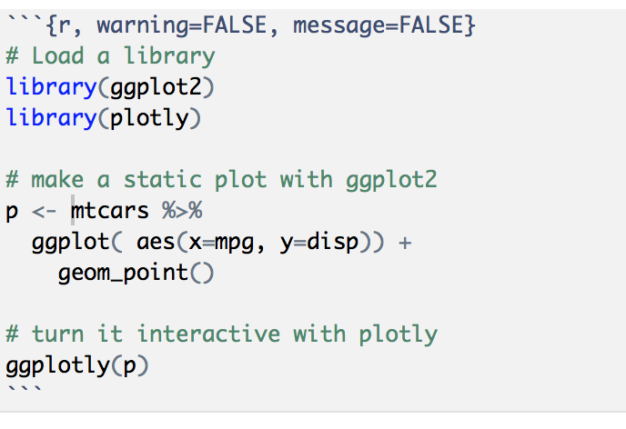
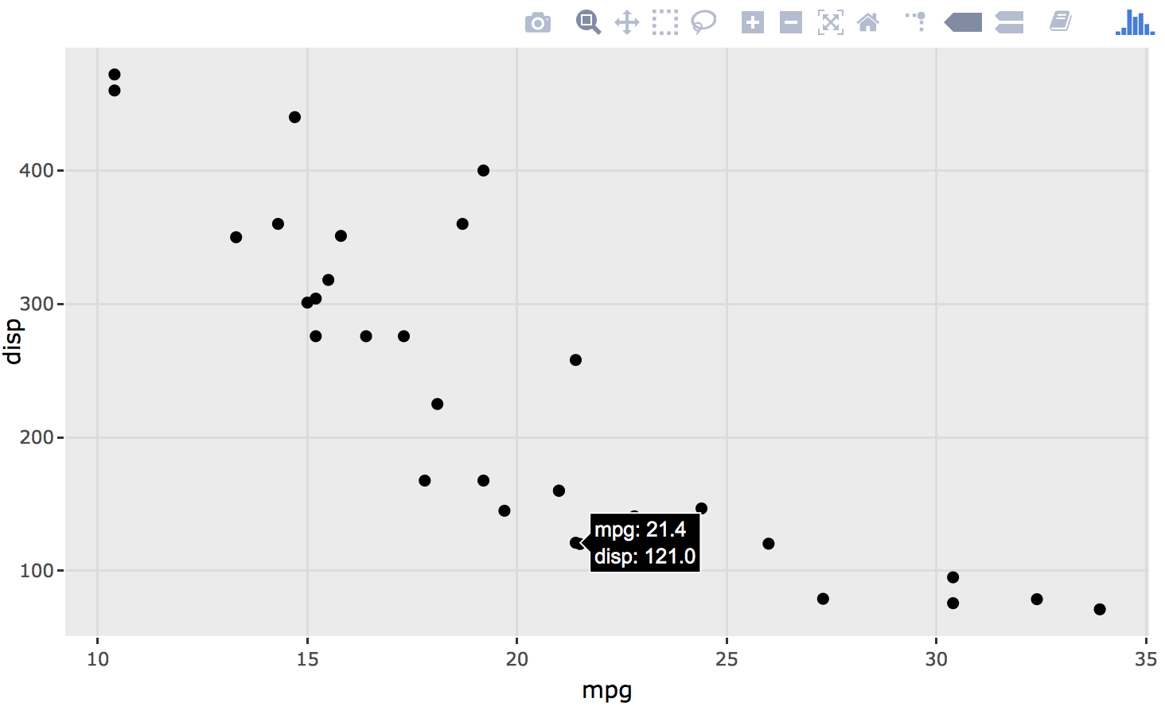
Use Interactive charts
Result: zoom / hover / export .. And more
Plotly library
Basic ggplot2 graphic
Ggplotly turn the plot interactive
http://www.htmlwidgets.org

Slide 23
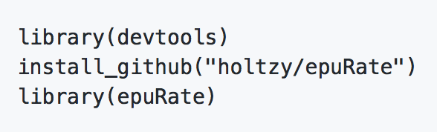

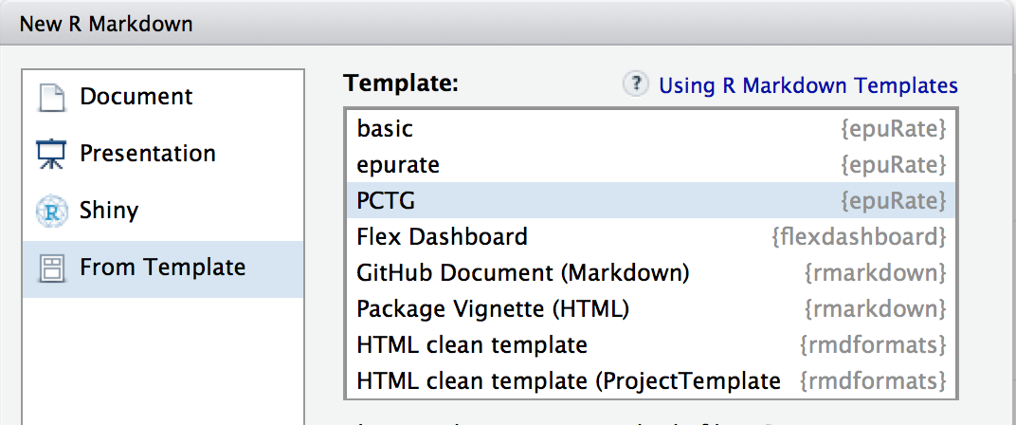
Use a template
The PCTG template: www.github.com/holtzy/epuRate

Slide 24
Pimp my .Rmd
holtzy.github.io/Pimp-my-rmd/
Everything is possible
Use CSS and HTML code
Add header and footer
More

Slide 25
Sharing

Slide 26
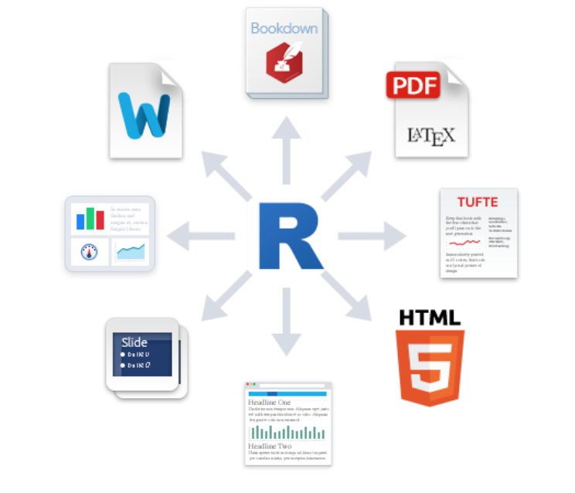
Output format?
Book
.pdf
Word .doc
Dashboard
Template
Slides
Blog

Slide 27

Share your analysis
Mail with colleagues, supervisor
Publication as a supplementary material
Github: www.github.com
Website

Slide 28
Example

Slide 29
An example: my bioinfo pipeline:
Interaction with clusters
One unique folder
Several .rmd wrapped in a website
Shared online

Slide 30




Thanks
Yan.holtz.data@gmail.com
www.yan-holtz.com
Slides:
bit.ly/2SxJFlV
Cheat Sheet:
bit.ly/2AZySd9
@R_Graph_Gallery
github.com/holtzy
Pimp my rmd:
bit.ly/2QDX7Hz

