Slide 1
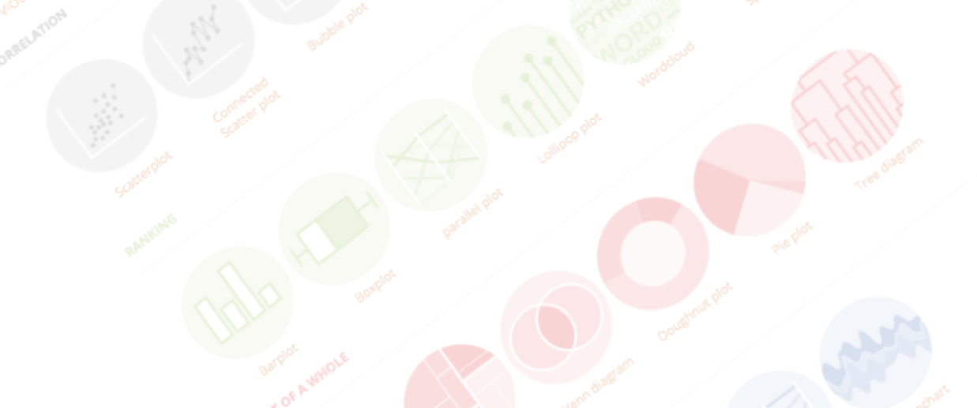
The basics of ggplot2
An overview of the most powerful R library for data visualization
Yan-holtz.com/teaching

Slide 2


Base R

Slide 3
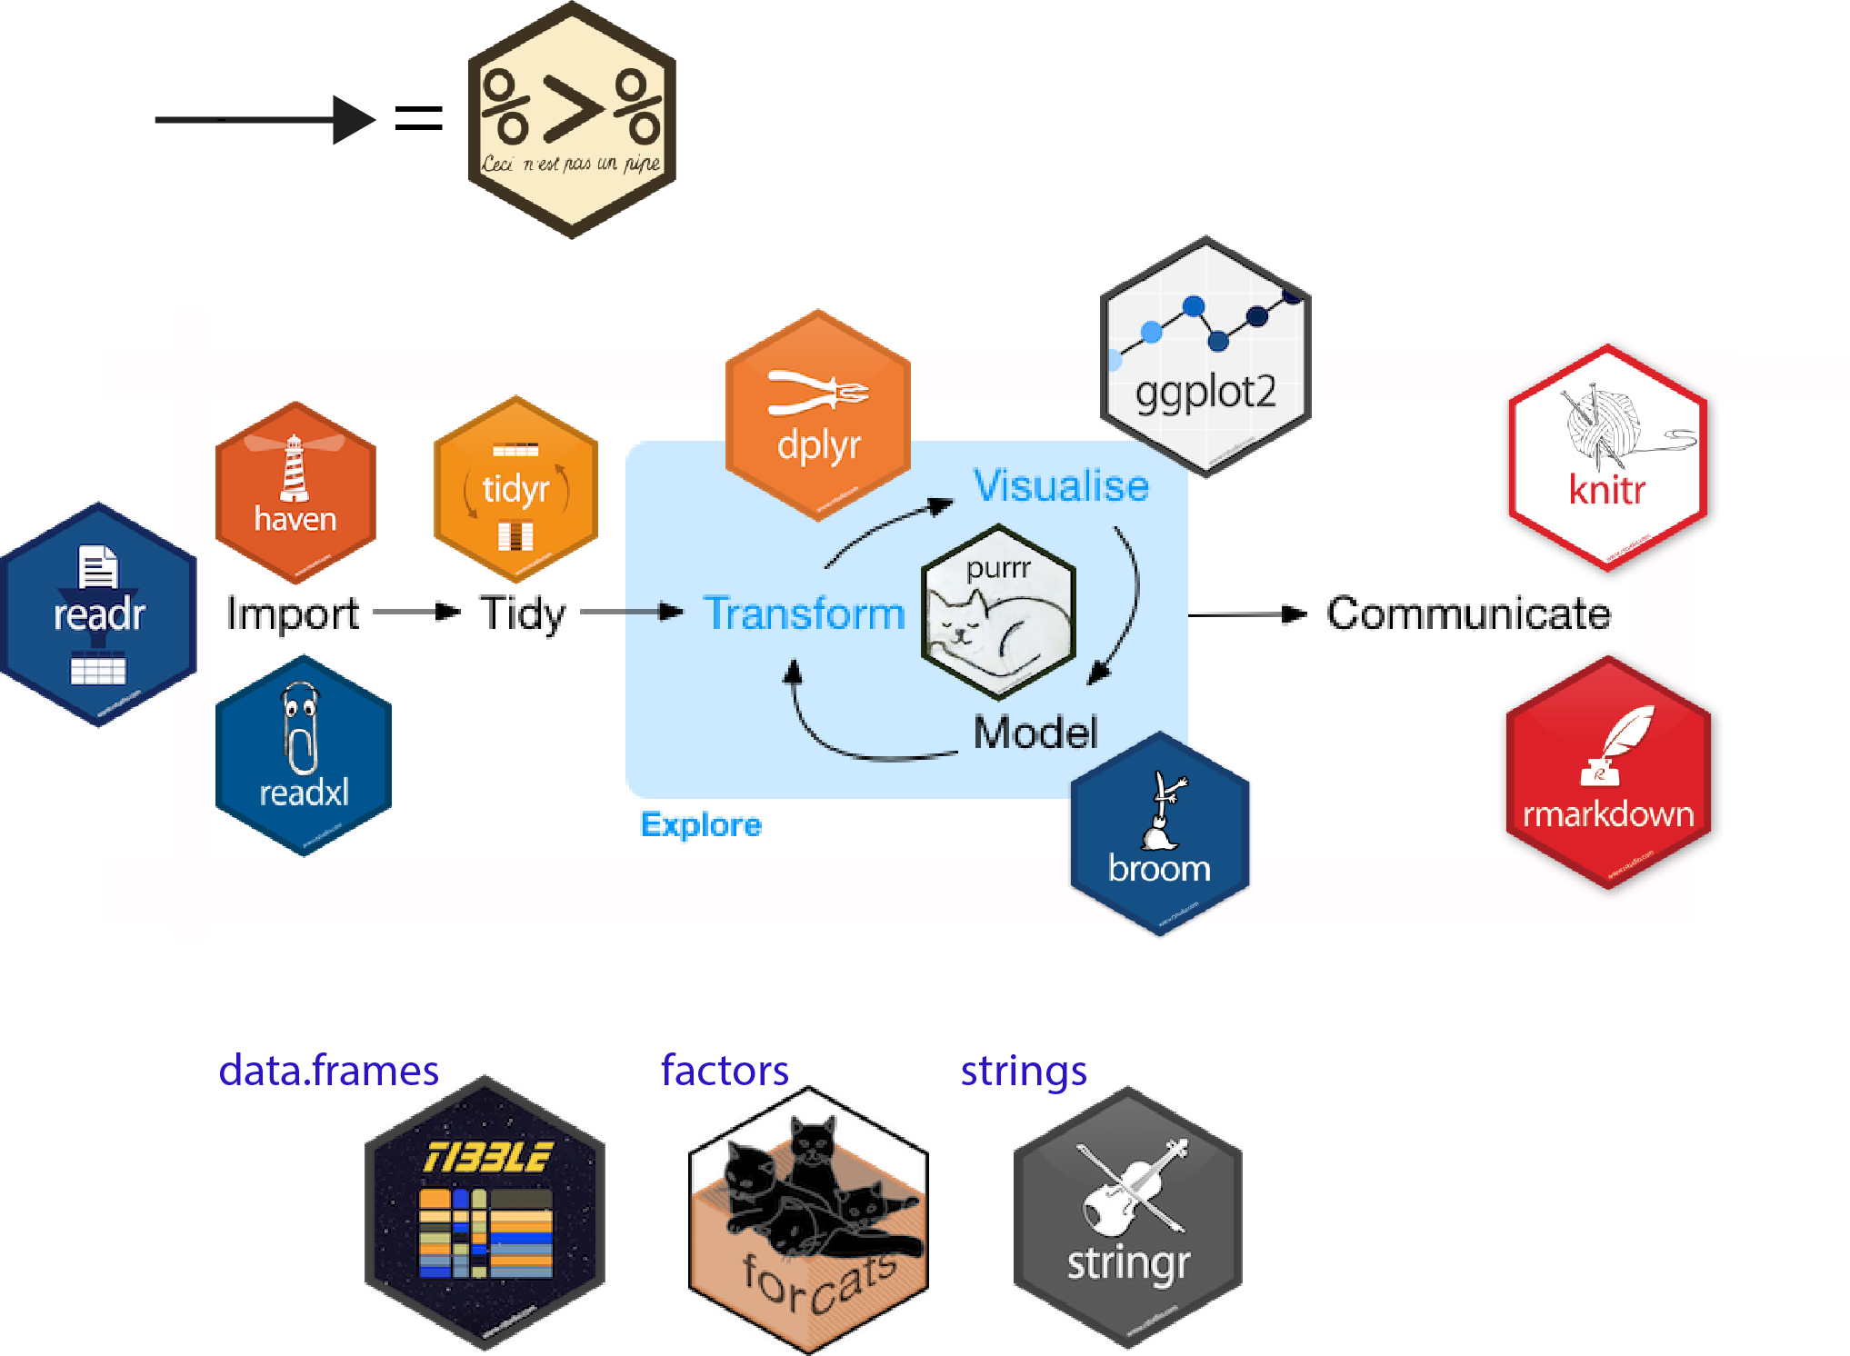
=
A collection of R packages designed for data science
source

Slide 4


Base R

Slide 5

Base R

Slide 6
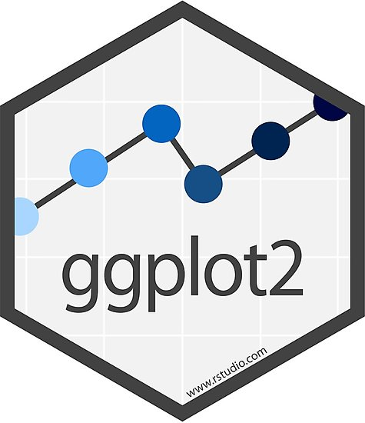
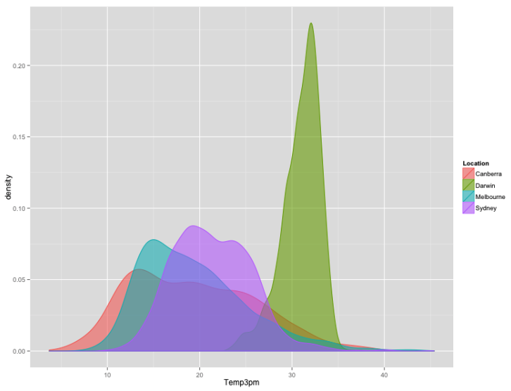

Creator: Hadley Whickam
Based on the Grammar of Graphic

Slide 7


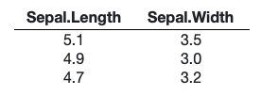
Data

Slide 8

Data

Slide 9
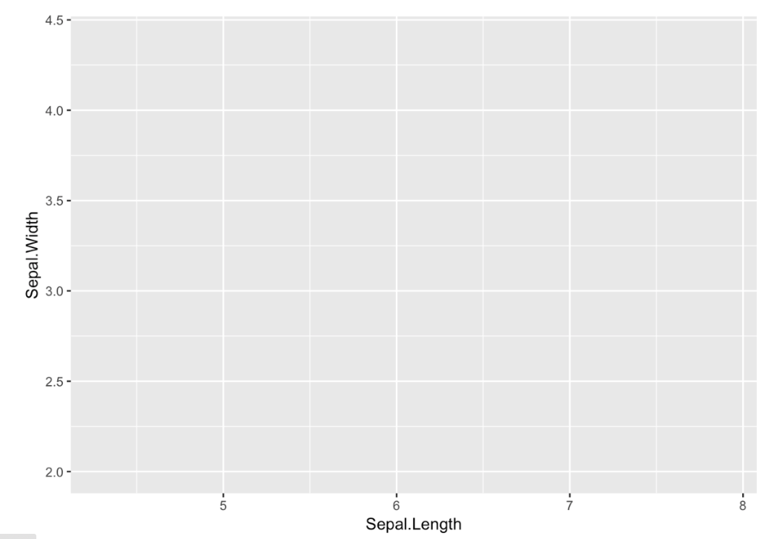
Data

Slide 10

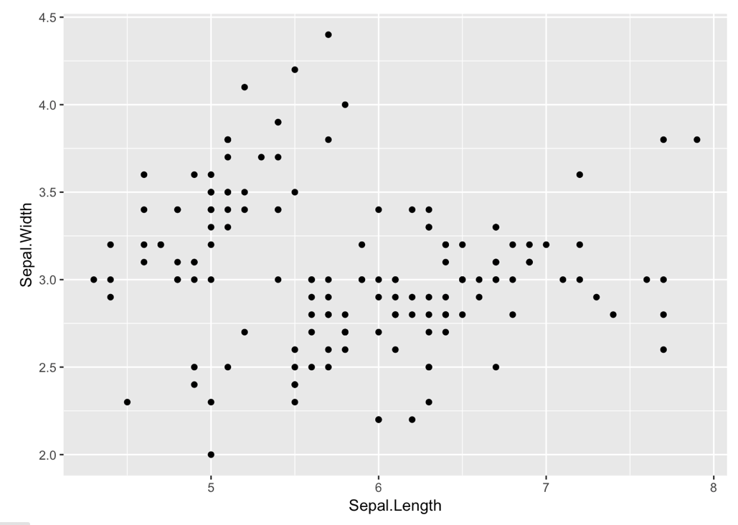
Data

Slide 11

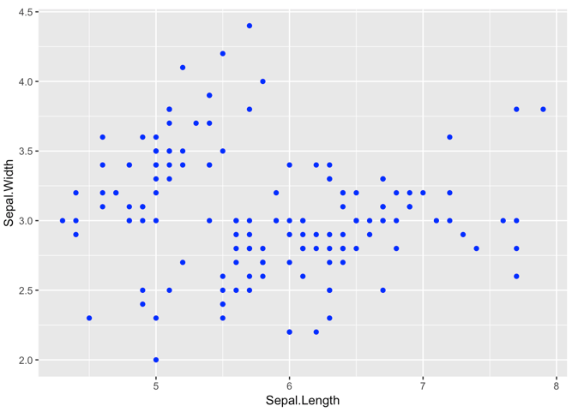
Data

Slide 12
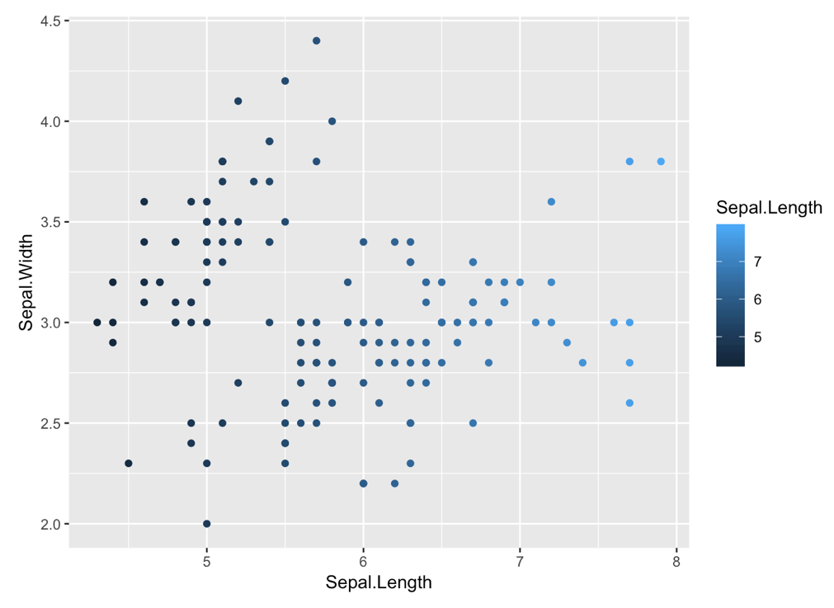
Data

Slide 13
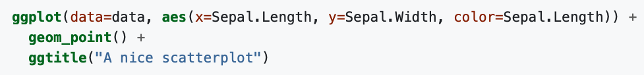
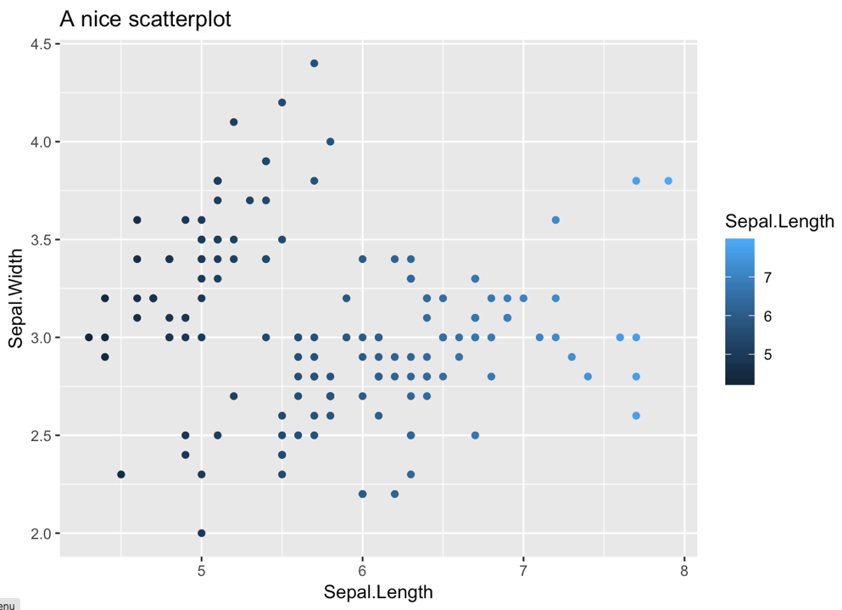
Data

Slide 14
Learn by doing
Useful link
Cheatsheet:
link
Yan-holtz.com/teaching
Home:
link
R Graph Gallery:
R-graph-gallery.com

Slide 15




Thanks
Yan.holtz.data@gmail.com
www.yan-holtz.com
Slides:
Yan-holtz/teaching
@R_Graph_Gallery
github.com/holtzy

