Slide 1
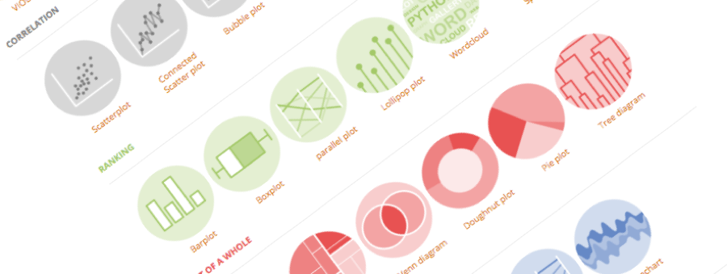
Introduction to Github
Building interactive and reproducible reports in minutes
Yan-holtz.com/teaching

Slide 2

« GitHub is a code hosting platform for version control and collaboration. It lets you and others work together on projects from anywhere »
Github.com

Slide 3
« GitHub is a code hosting platform for version control and collaboration. It lets you and others work together on projects from anywhere »
Host your code
Version control
Share your code
Collaborate
Github.com
Suggest modification

Slide 4
Create an account

Slide 5
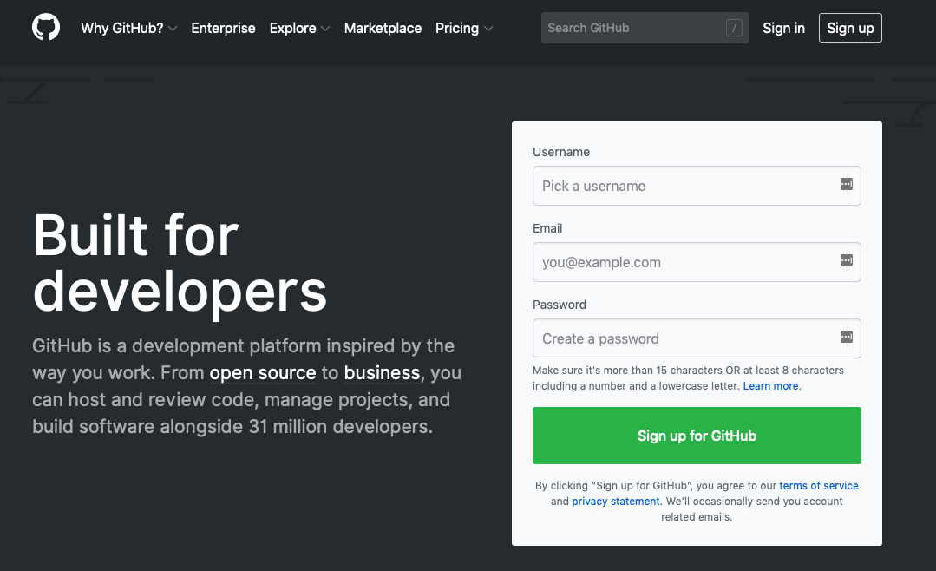
Github.com

Slide 6
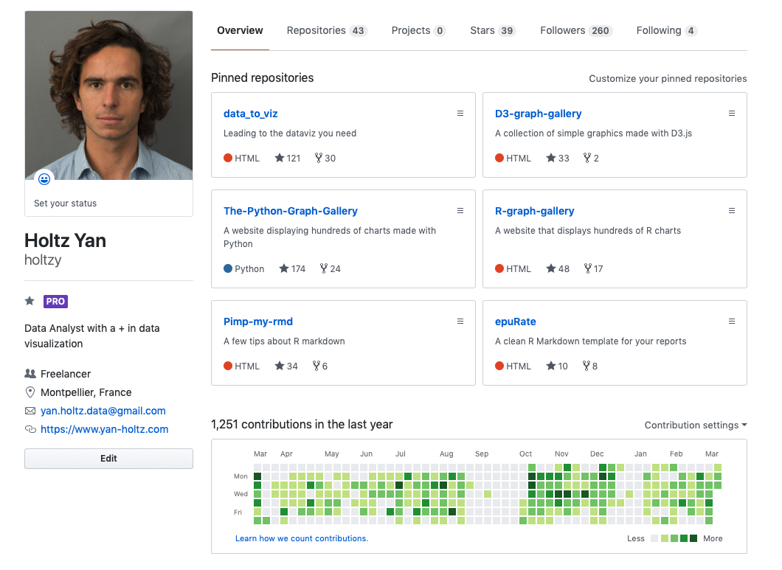
All repo
One repo = one project
ID
Description
Contact
Your Activity

Slide 7
Your Github profile is part of your CV !

Slide 8
Github Desktop
The link between your laptop and github

Slide 9

Your computer
Github

Slide 10
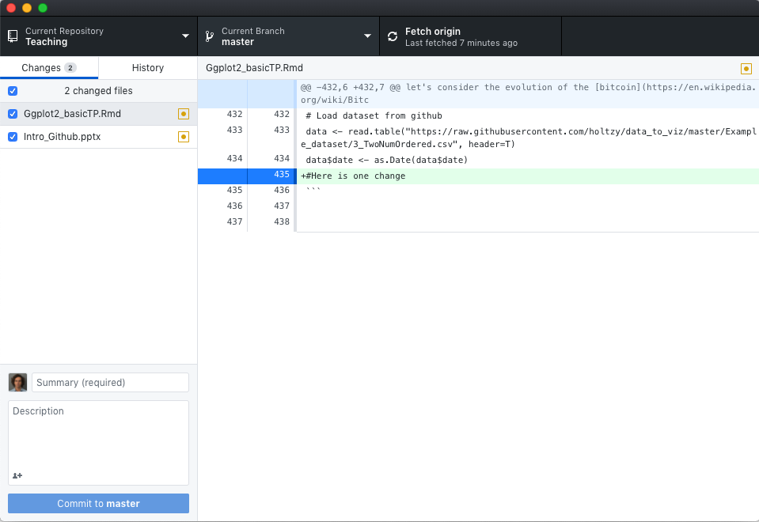
Github Desktop:
- controls the link between your computer and github.com.
- Just replace the the command line
desktop.github.com
Your computer
Github

Slide 11
Your first repo
Hopefully not the last

Slide 12
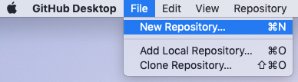


1 – Create a new github repositoy
2 – Put a few files in it
3 – Publish the repo
4– Have a look to it online

Slide 13
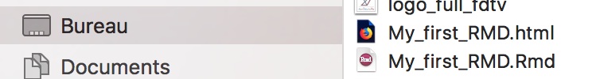
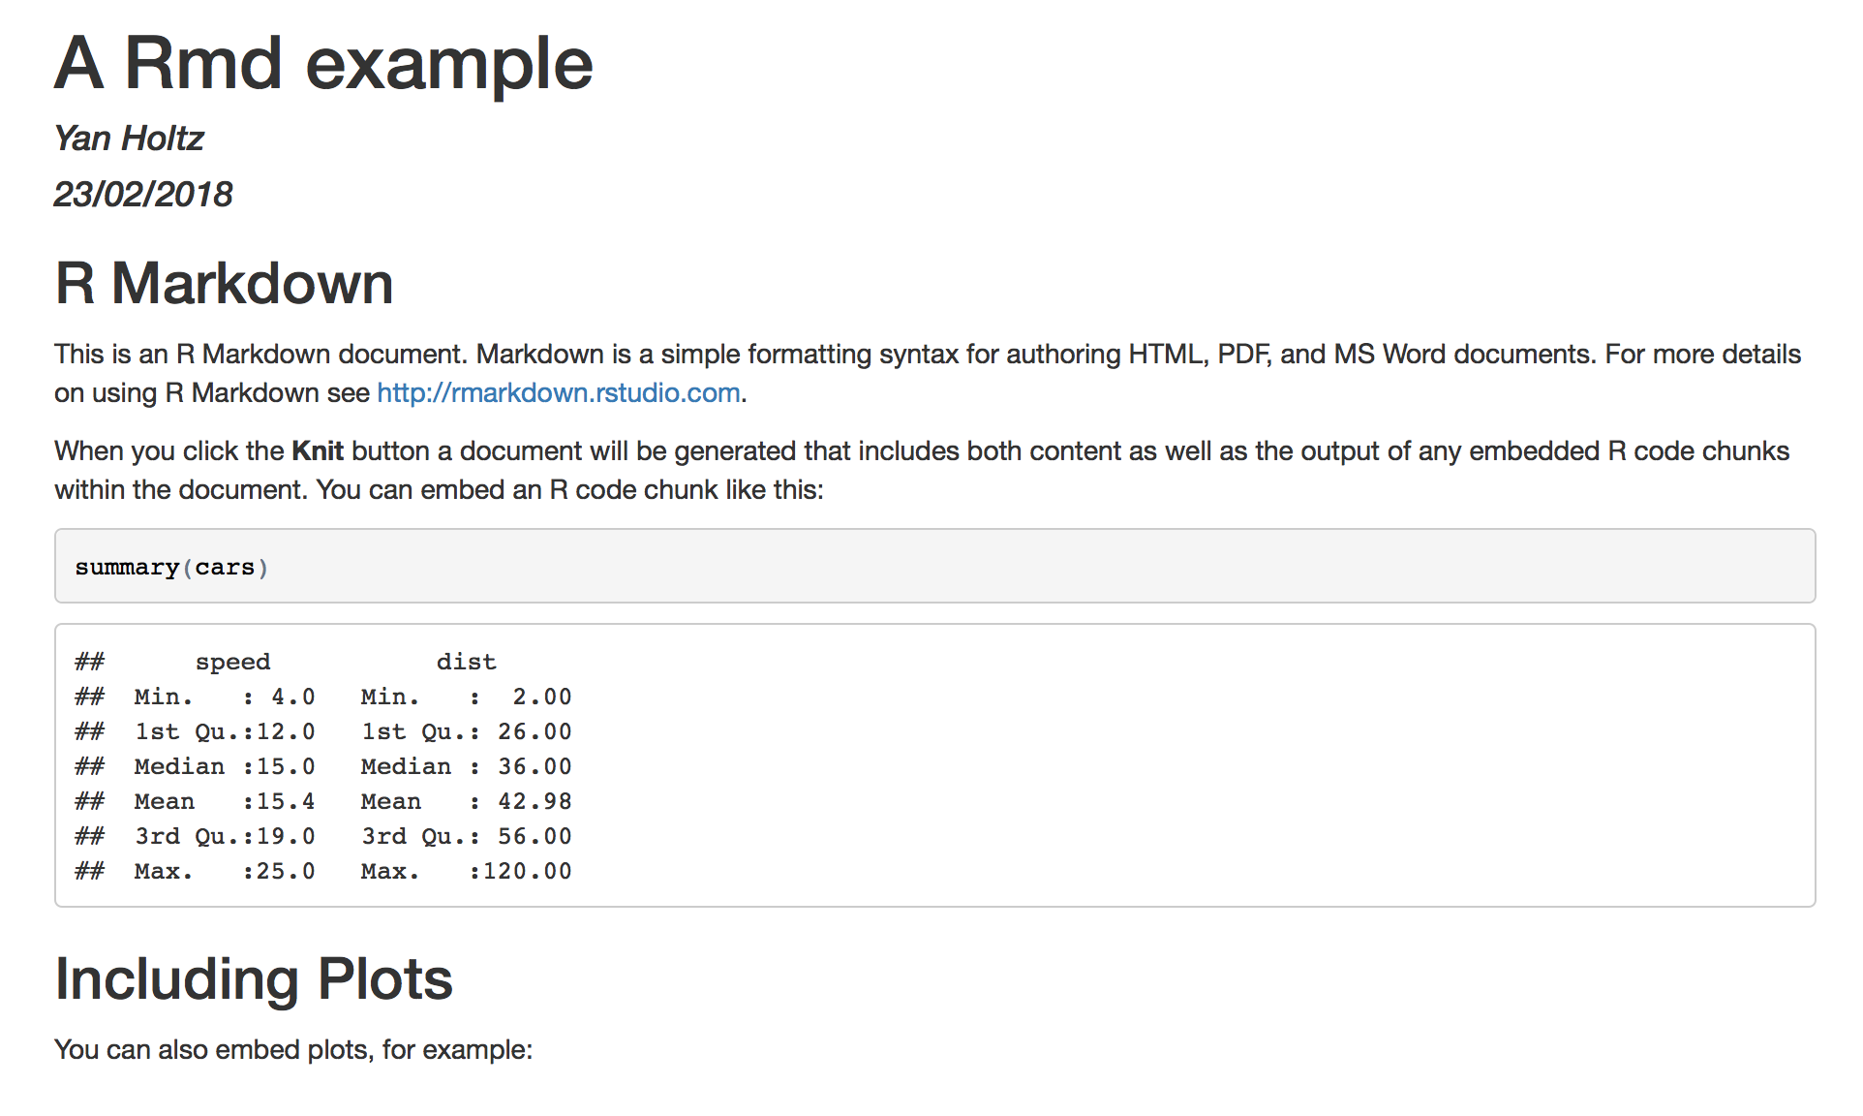
.html
4 - .HTML output is ready
Have a look to your current directory
Open the .html in a browser
.rmd
header
Title
Text
Code
Code result

Slide 14
Your first ‘commit’

Slide 15
Always add a readMe

Slide 16
Your first issue

Slide 17
Store your .html file online

Slide 18




Thanks
Yan.holtz.data@gmail.com
www.yan-holtz.com
Slides:
Yan-holtz/teaching
Github:
@R_Graph_Gallery
github.com/holtzy
Github.com

