Slide 1
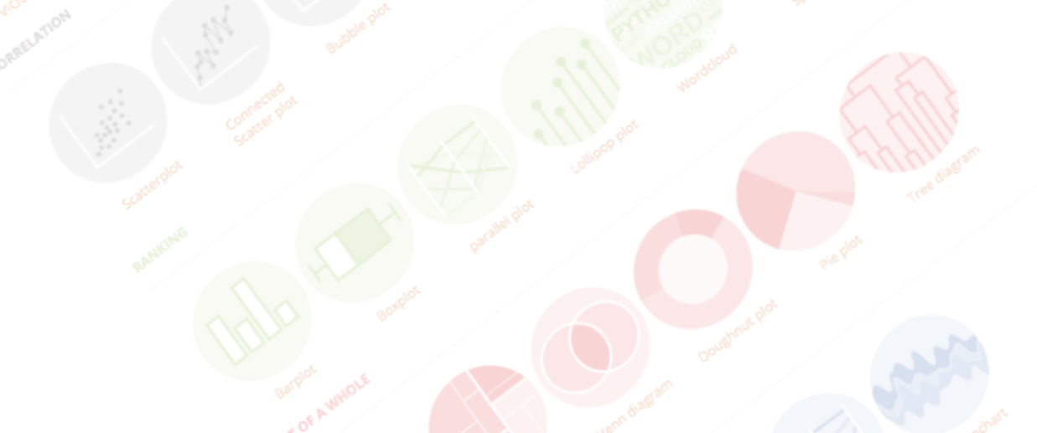
An exploration of dataviz bad practices
An overview of dataviz caveats
Yan-holtz.com/teaching

Slide 2
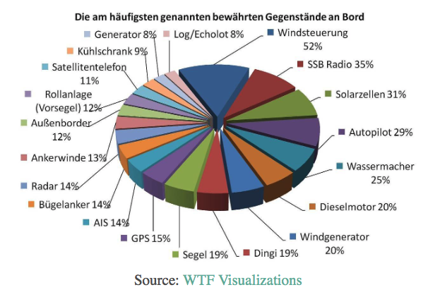
What’s wrong with this chart?

Slide 3
Calculation
+
3D
+
Pie chart

Slide 4
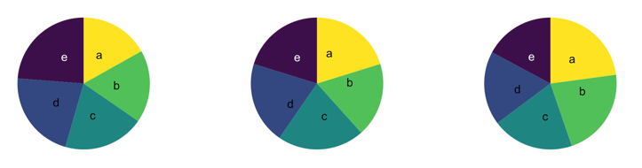
What’s wrong with pie chart?
What can you see?

Slide 5
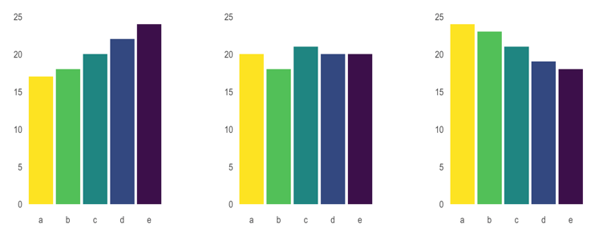
What’s wrong with pie chart?
It is hard to distinguish angles

Slide 6
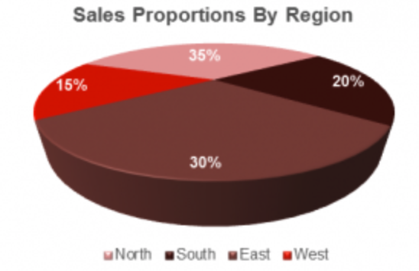
What’s wrong with 3D

Slide 7
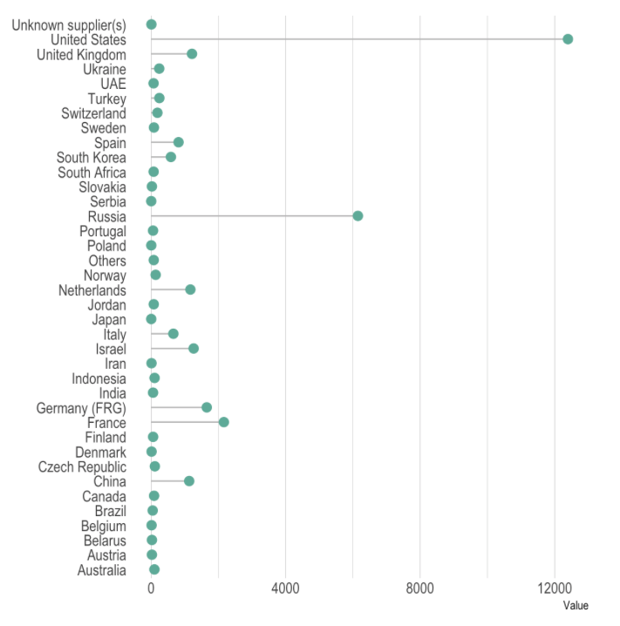
What could be better here?

Slide 8
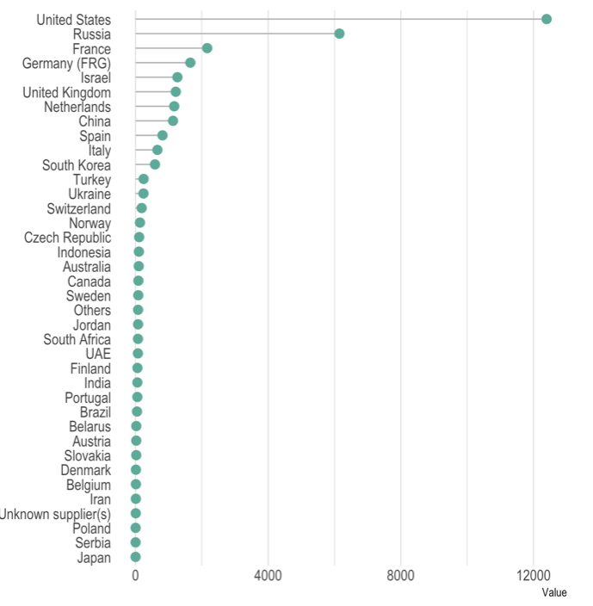
Order your data

Slide 9
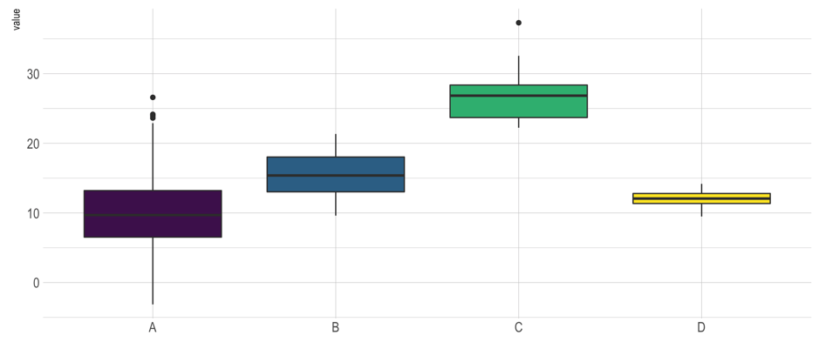
Anything wrong here?

Slide 10
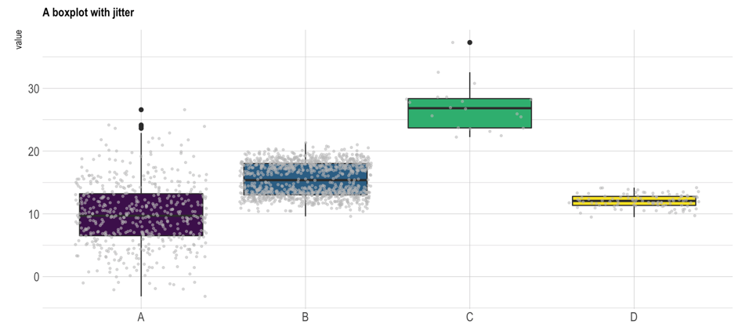
Boxplot = hide information
Almost no data !
Bimodal distribution

Slide 11
Boxplot = hide information
If small sample size, add data points with jitter
Almost no data !
Bimodal distribution

Slide 12
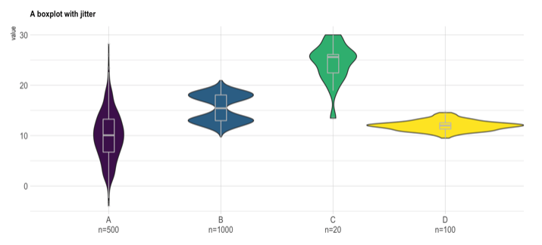
If big sample size, use violin plot
Show distribution
Show sample size

Slide 13
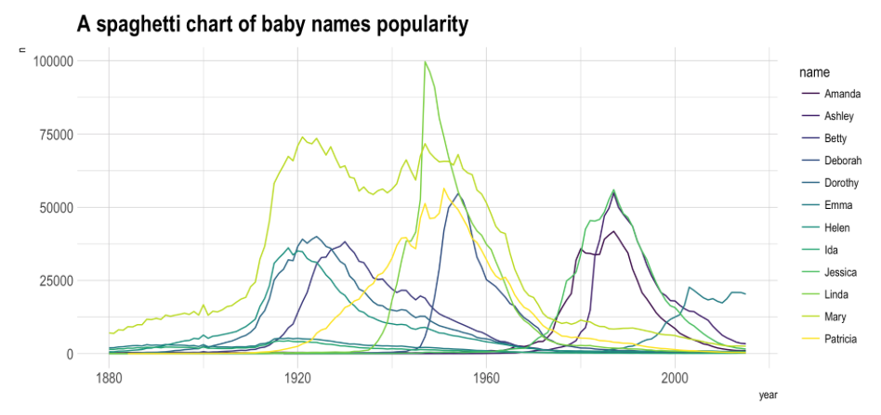
Look at this chart

Slide 14
What do you remember?

Slide 15
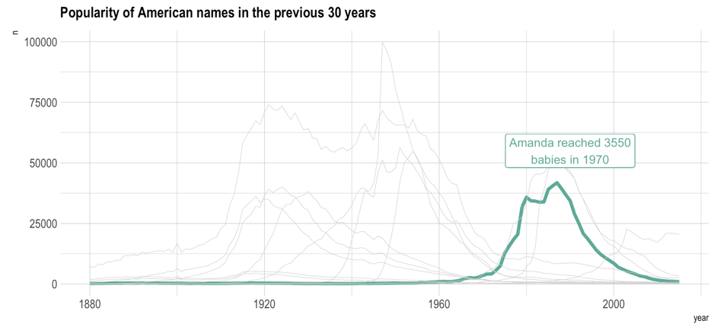
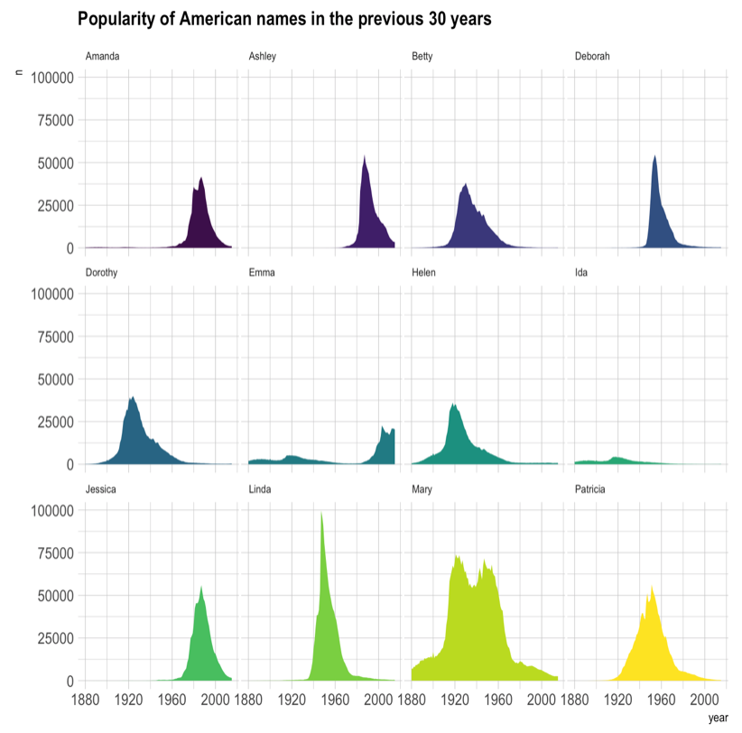
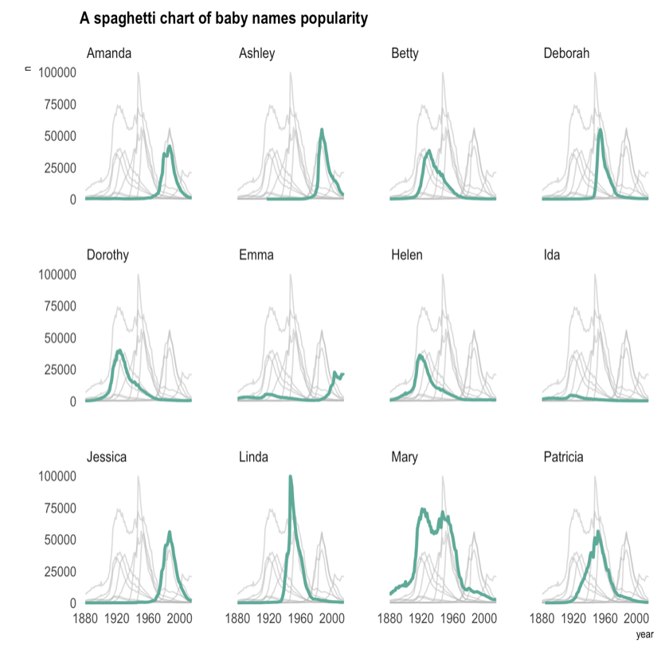
The Spaghetti chart
Read more

Slide 16
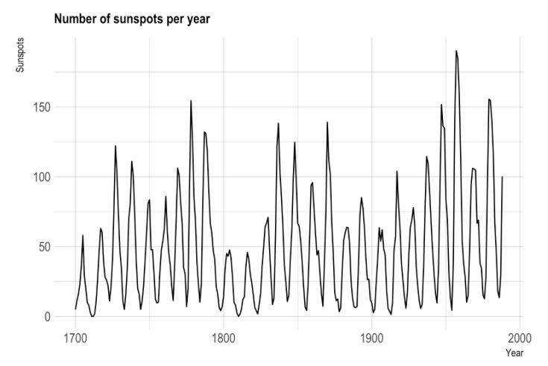

Slide 17
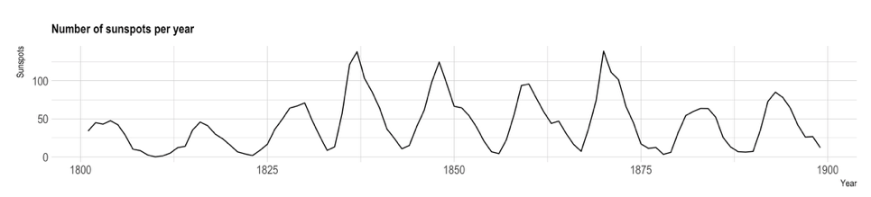
Mind the aspect ratio
Read more

Slide 18
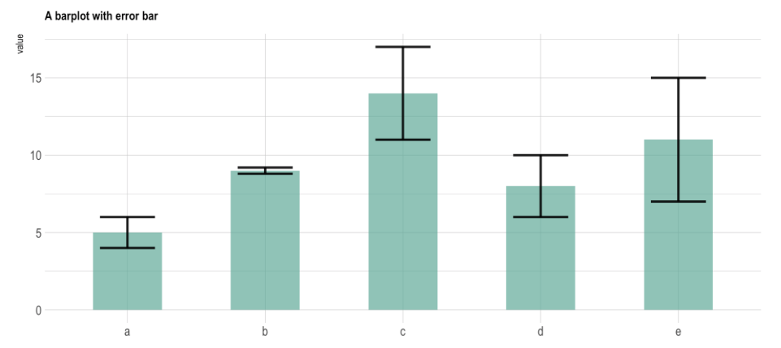

Slide 19
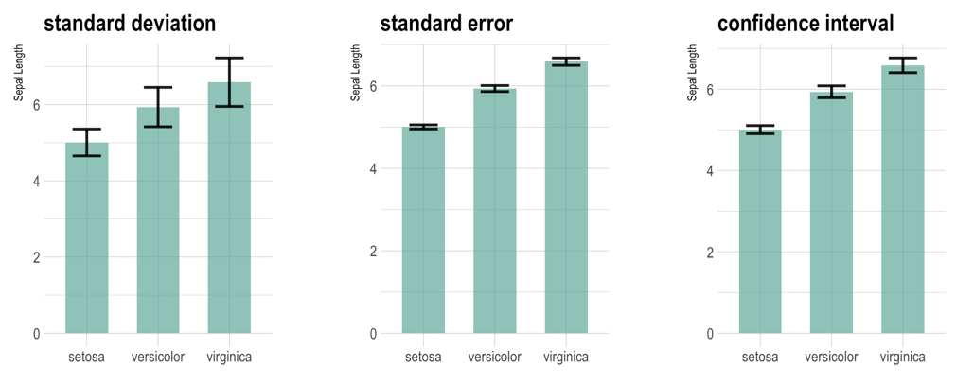
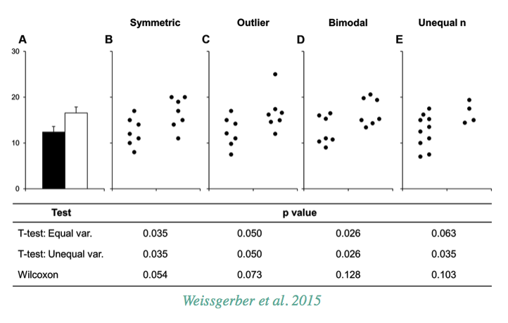
The issue with error bars
Read more

Slide 20
The issue with error bars
Read more

Slide 21
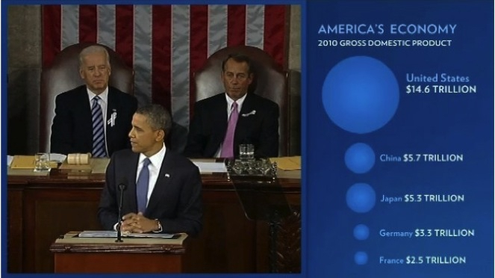

Slide 22
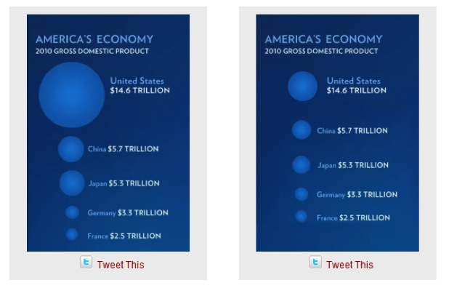
Size = radius
Size = area
Source: Fast Fedora blog

Slide 23
Size = radius
Size = area
Area = poor metaphor
Source: Fast Fedora blog

Slide 24
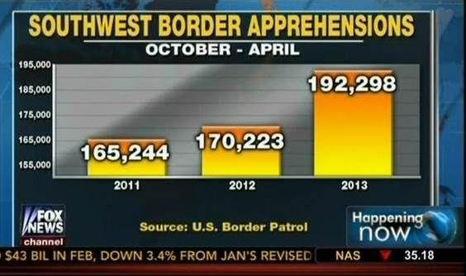
Source: Fox News, via Media Matters for America

Slide 25
Obama adminitration
=
2x more apprehensions?
Source: Fox News, via Media Matters for America

Slide 26
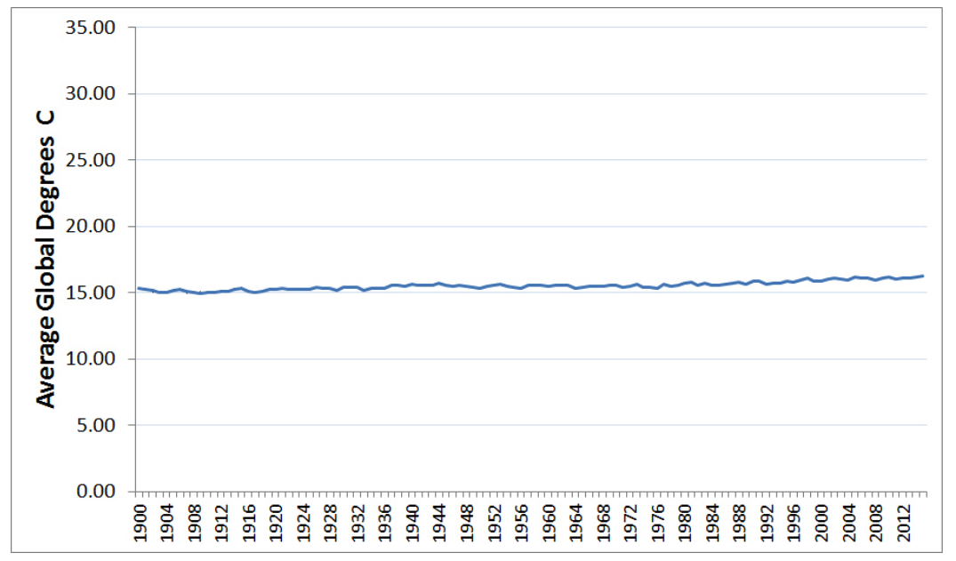

Slide 27
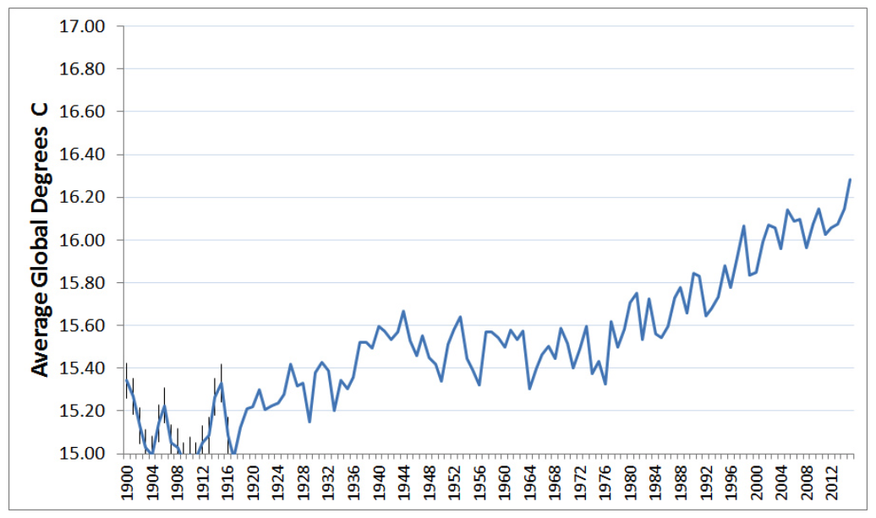
“In general, in a time-series, use a baseline that shows the data not the zero point” - Edward Tufte

Slide 28
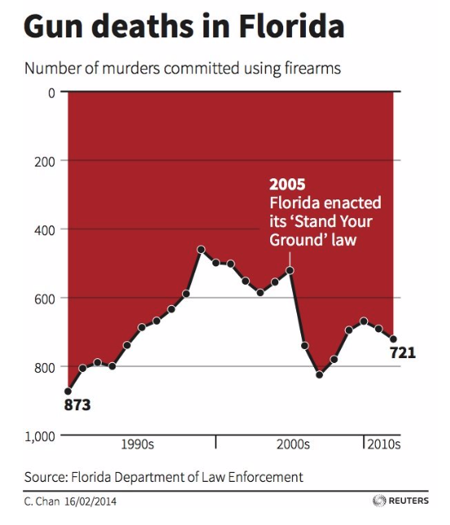
Source: KD Nuggets

Slide 29
Do not be
counter intuitive
Reverse Y Axis
Source: KD Nuggets

Slide 30
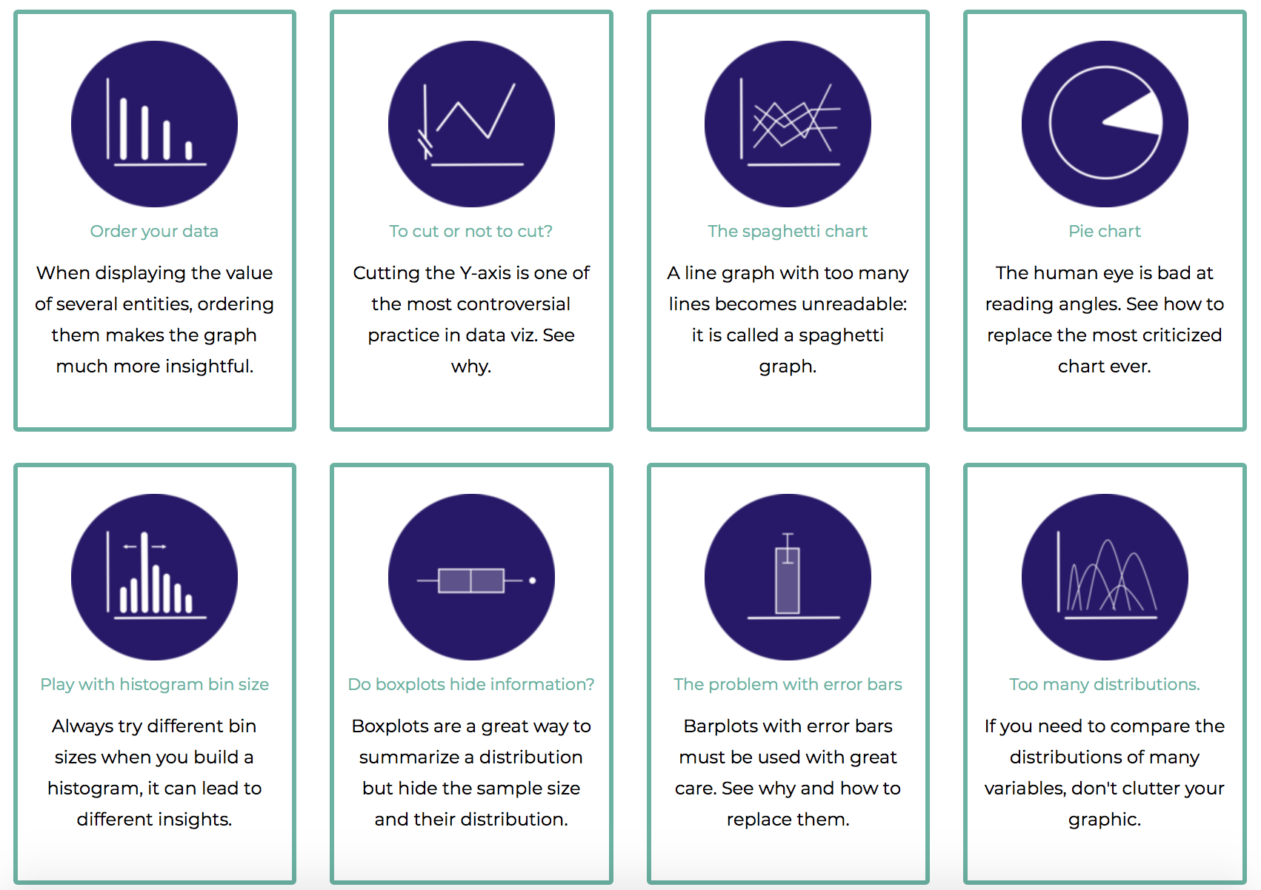
Data-to-viz.com/caveats
Data to Viz
A collection of dataviz caveats

Slide 31




Thanks
Yan.holtz.data@gmail.com
www.yan-holtz.com
Slides:
Yan-holtz/teaching
Data to viz:
Data-to-viz.com
@R_Graph_Gallery
github.com/holtzy

