Slide 1
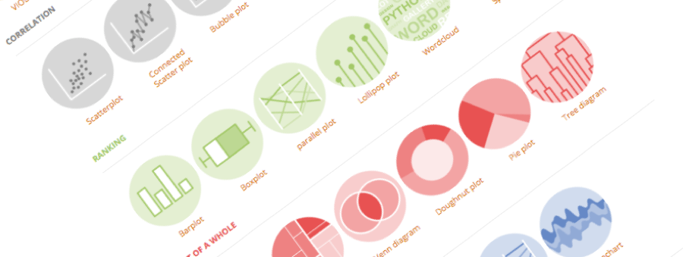
Introduction to Github
Building interactive and reproducible reports in minutes
Yan-holtz.com/teaching

Slide 2

« GitHub is a code hosting platform for version control and collaboration. It lets you and others work together on projects from anywhere »
Github.com

Slide 3
« GitHub is a code hosting platform for version control and collaboration. It lets you and others work together on projects from anywhere »
Host your code
Version control
Share your code
Collaborate
Github.com
Suggest modification

Slide 4
Create an account

Slide 5
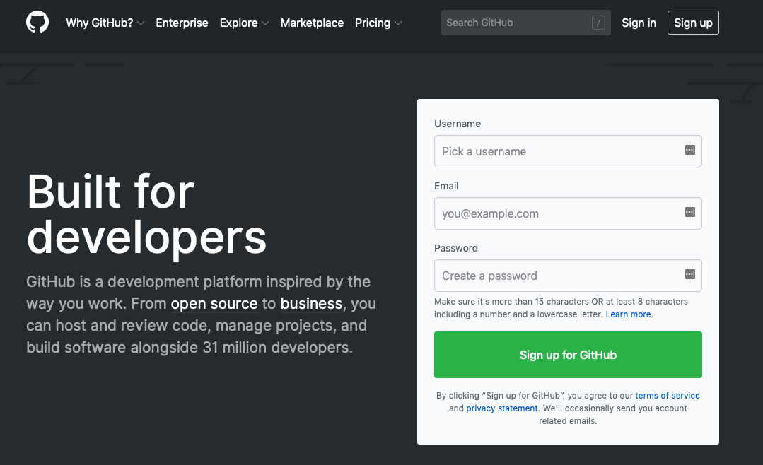
Github.com

Slide 6
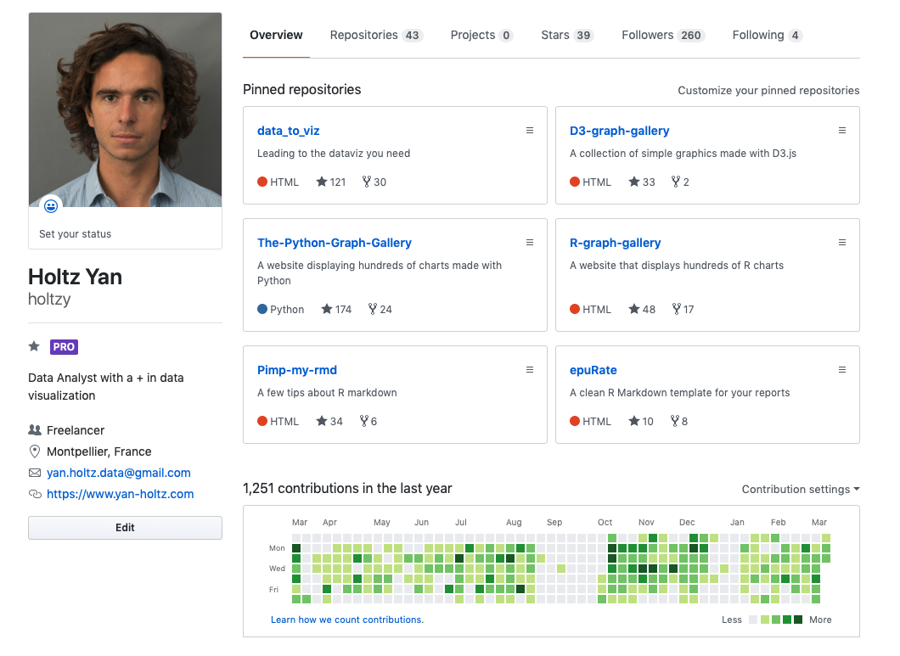
All repo
One repo = one project
ID
Description
Contact
Your Activity

Slide 7
Your Github profile is part of your CV !

Slide 8
Github Desktop
The link between your laptop and github

Slide 9

Your computer
Github

Slide 10
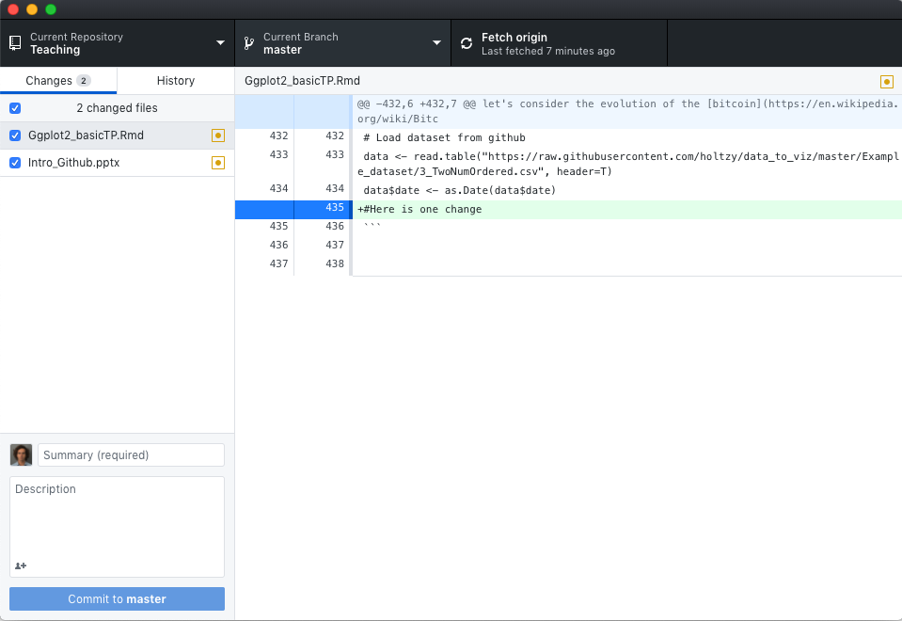
Github Desktop:
- controls the link between your computer and github.com.
- Just replace the the command line
desktop.github.com
Your computer
Github

Slide 11
Your first repo
Hopefully not the last

Slide 12

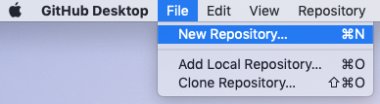

1 – Create local folder
2 – Transform it in a Git repository
3 – Publish the repo
4– Have a look to it online

Slide 13
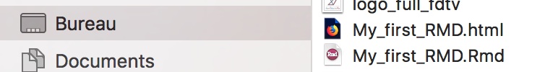
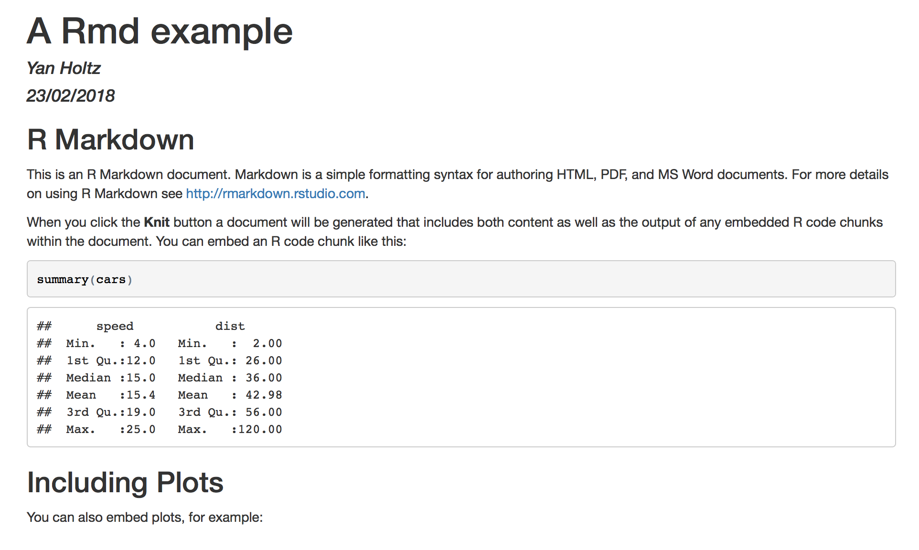
.html
4 - .HTML output is ready
Have a look to your current directory
Open the .html in a browser
.rmd
header
Title
Text
Code
Code result

Slide 14
Customize text

Slide 15
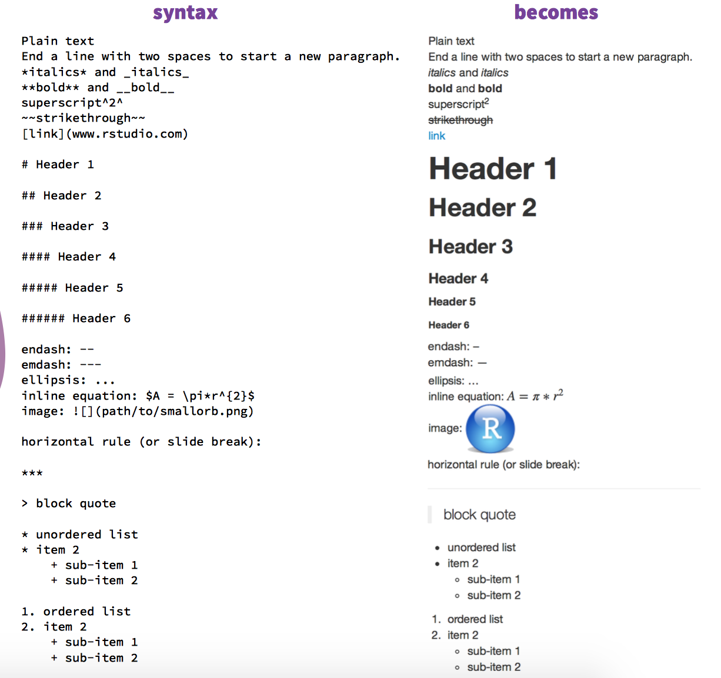
Customize the text
R Markdown cheat sheet
bit.ly/1SuNTo9

Slide 16
Code chunk options

Slide 17
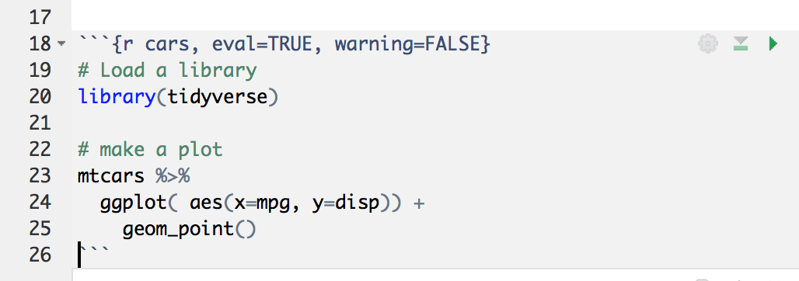
Anatomy of a Code chunk:
Run all previous chunks
Run this chunk
Optional: chunk name
Chunk options
R, bash, python?
Comment your code

Slide 18
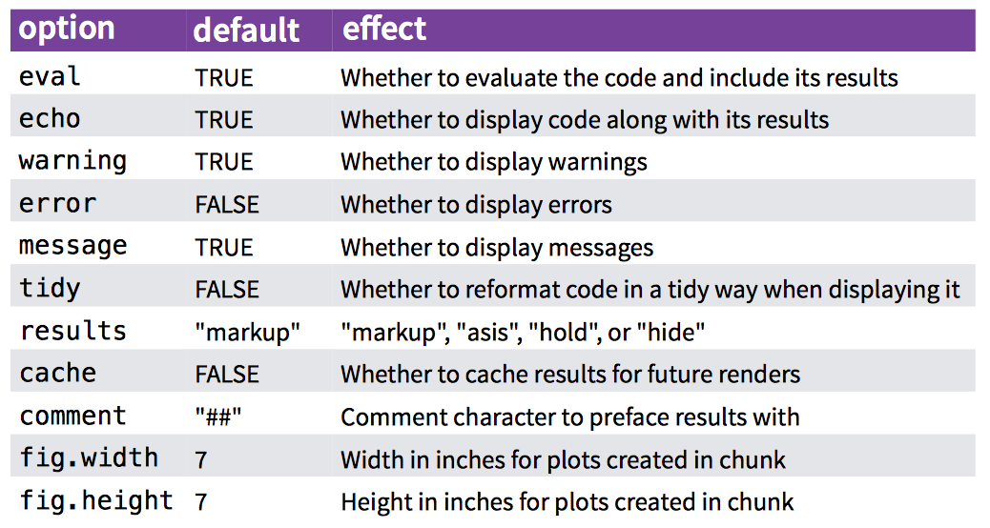
Code chunk options:

Slide 19
Do not always run the whole document
→ R Markdown document is a Notebook !!

Slide 20
Header

Slide 21
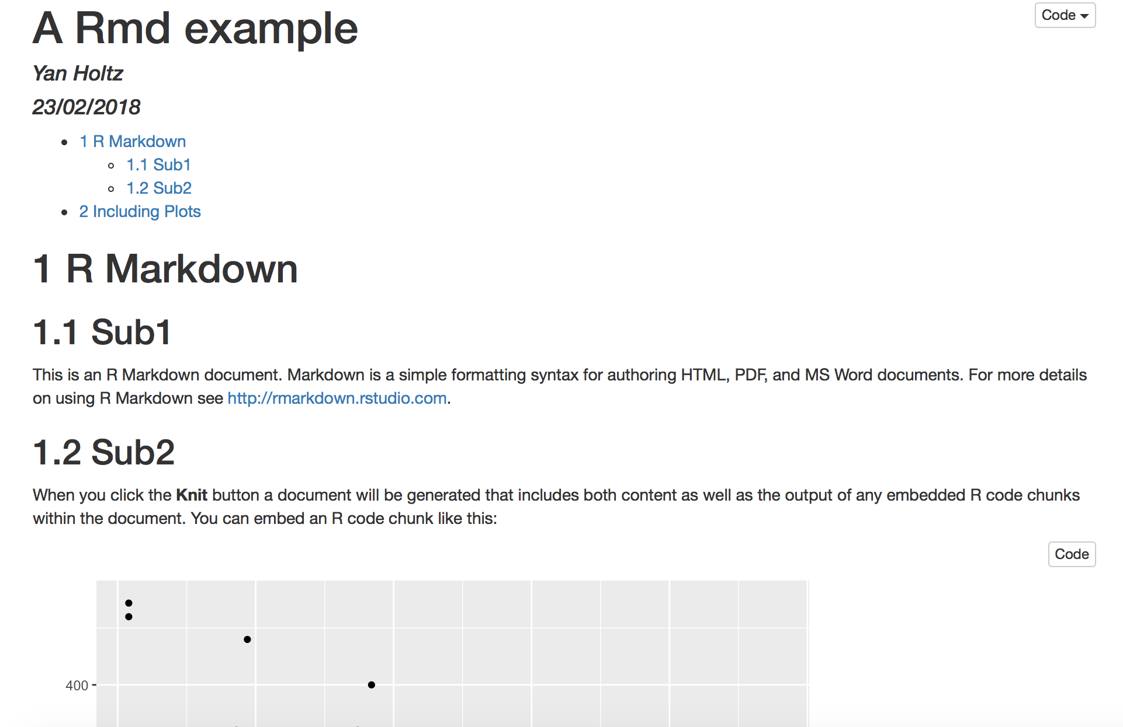
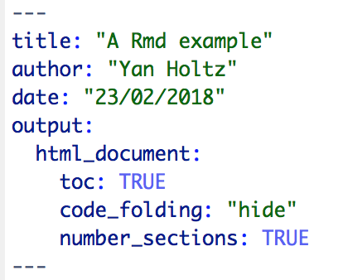
Anatomy of the header:

Slide 22
Going further

Slide 23
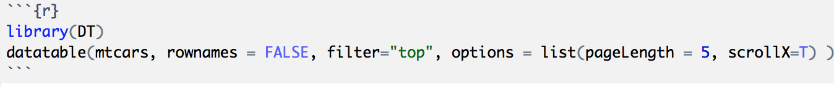
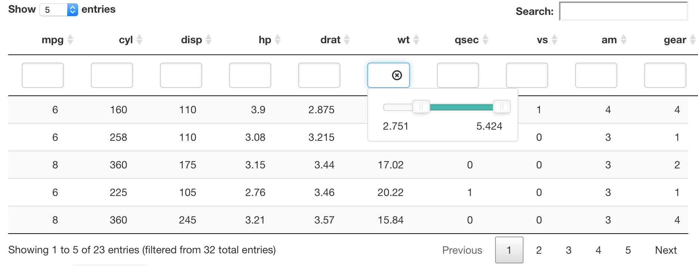
Insert a table: the DT library
Data frame

Slide 24
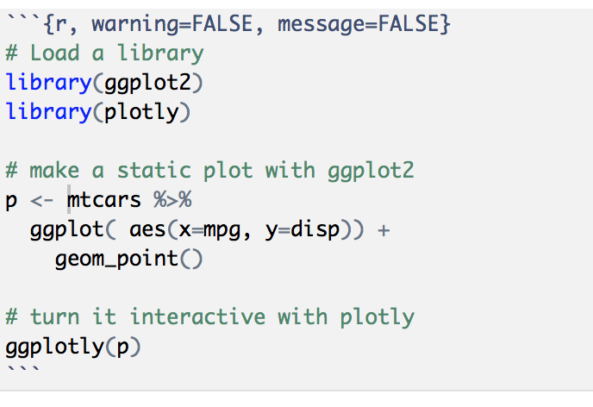
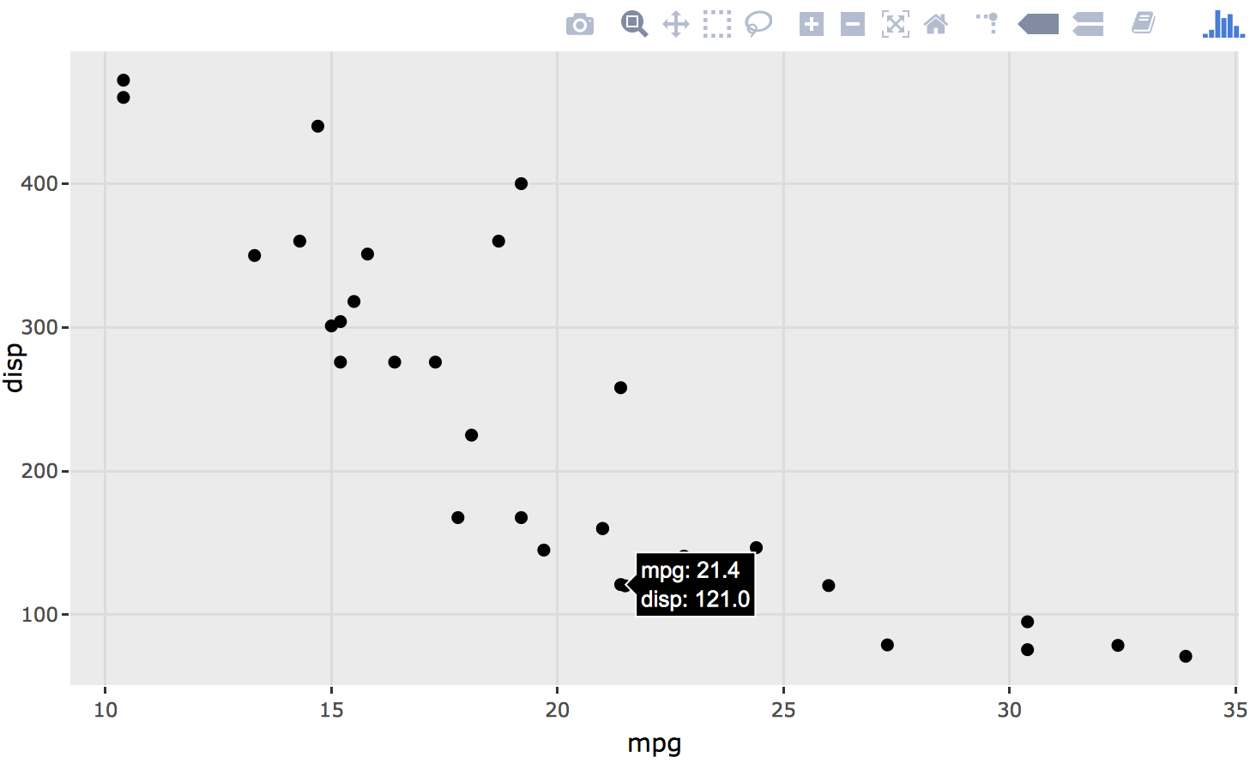
Use Interactive charts
Result: zoom / hover / export .. And more
Plotly library
Basic ggplot2 graphic
Ggplotly turn the plot interactive
http://www.htmlwidgets.org

Slide 25
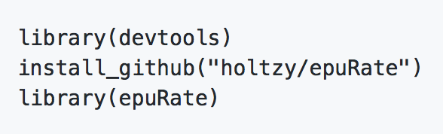

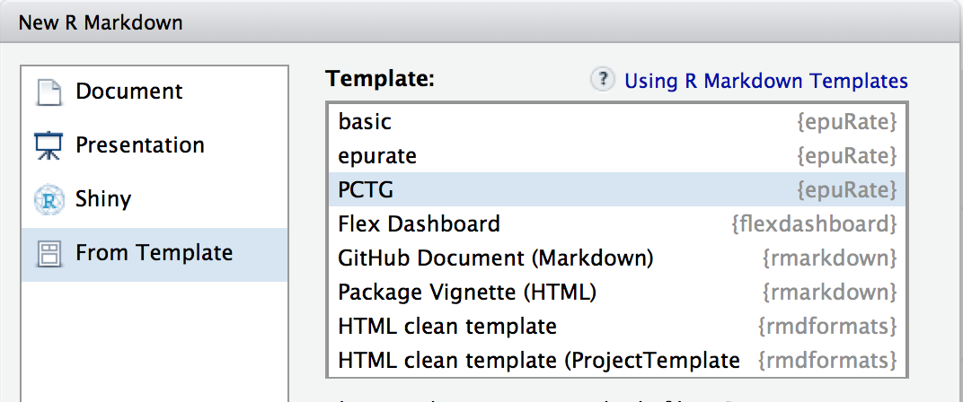
Use a template
The PCTG template: www.github.com/holtzy/epuRate

Slide 26
Pimp my .Rmd
holtzy.github.io/Pimp-my-rmd/
Everything is possible
Use CSS and HTML code
Add header and footer
More

Slide 27
Sharing

Slide 28
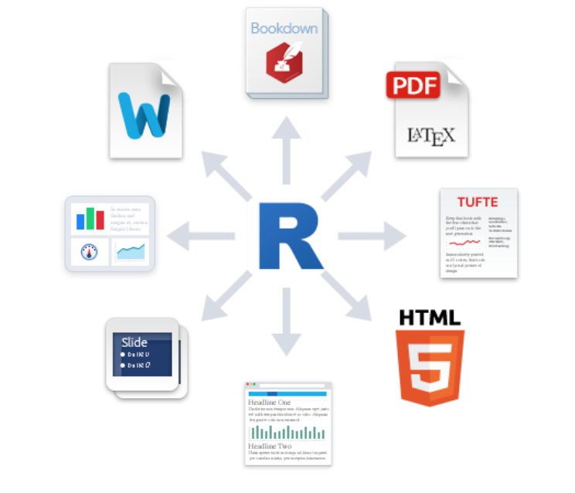
Output format?
Book
.pdf
Word .doc
Dashboard
Template
Slides
Blog

Slide 29

Share your analysis
Mail with colleagues, supervisor
Publication as a supplementary material
Github: www.github.com
Website

Slide 30
Example

Slide 31
An example: my bioinfo pipeline:
Interaction with clusters
One unique folder
Several .rmd wrapped in a website
Shared online

Slide 32




Thanks
Yan.holtz.data@gmail.com
www.yan-holtz.com
Slides:
bit.ly/2SxJFlV
Cheat Sheet:
bit.ly/2AZySd9
@R_Graph_Gallery
github.com/holtzy
Pimp my rmd:
bit.ly/2QDX7Hz

