Slide 1
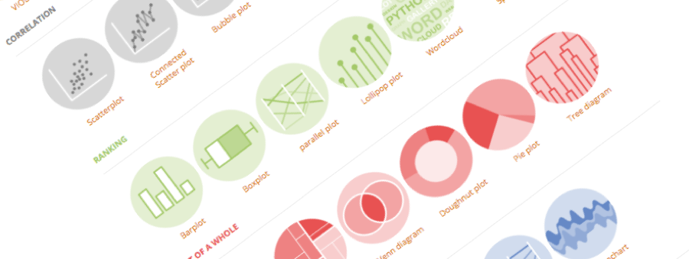
Introduction to Data visualization
The what and the why of dataviz
Yan-holtz.com/teaching

Slide 2
Ideas
- Who I am
brainstorming: what is it for you?
What is it for -> Ascombe quartet, Dynausorus / Show a huge table and a chart that summarize it
Dataviz is in 2 part of the data science process: exploration / explanatory
Different types of chart
How to pick the right chart
What is a bad chart
Different types of medium: static / interactive / storytelling / infographie
Tools

Slide 3
What
“ An R Markdown (.Rmd) file is a record of your research. It contains the code that a scientist needs to reproduce your work along with the narration that a reader needs to understand your work. “
Why
Efficiency
Reproducibility
Interactivity
Automation
Notebook
And much more..

Slide 4
Section name

Slide 5




Thanks
Yan.holtz.data@gmail.com
www.yan-holtz.com
Slides:
bit.ly/2SxJFlV
Cheat Sheet:
bit.ly/2AZySd9
@R_Graph_Gallery
github.com/holtzy
Pimp my rmd:
bit.ly/2QDX7Hz

