Slide 1
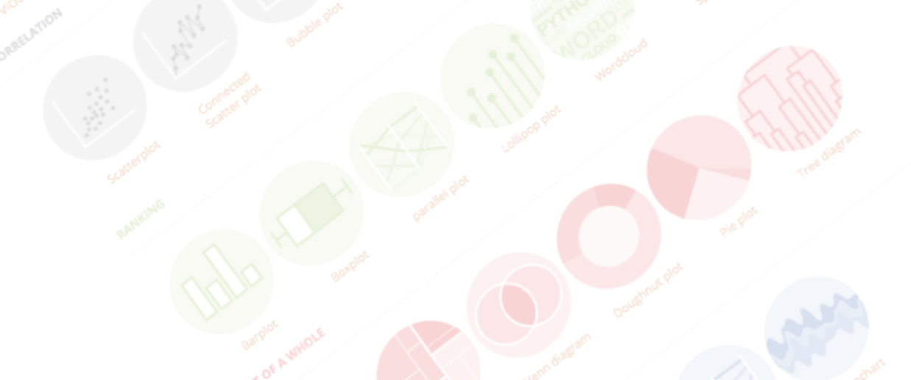
Some slides by Yan-Holtz.com
Make your data analysis report a website
In 10 minutes or less
Montpellier | October 2021

Slide 2
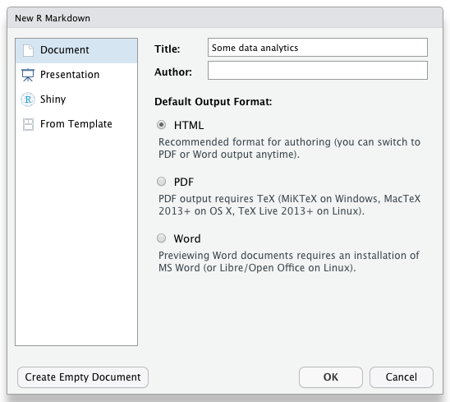
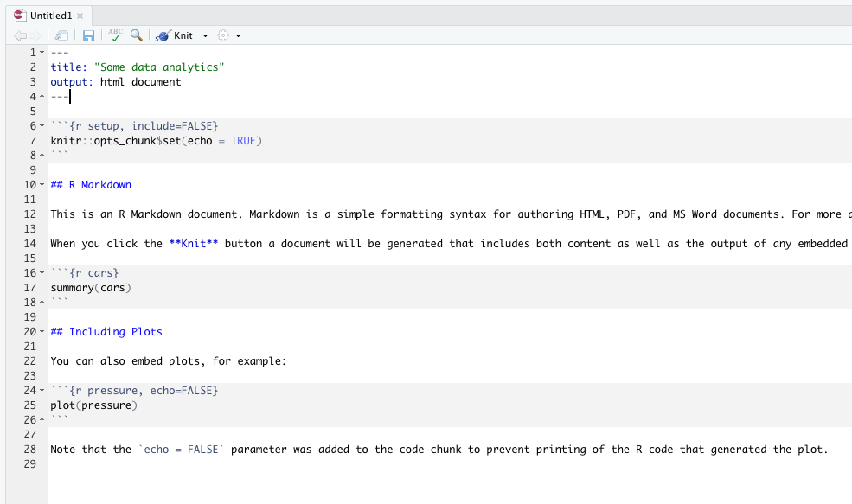

Step 1 – Create a R Markdown file
Create a new folder
Open R studio
File → New File → R Markdown
Add a title, select HTML, click OK
Click Knit
Save in the newly created folder as index
You’ve built a R Markdown document! ☺
Html output
R analysis

Slide 3
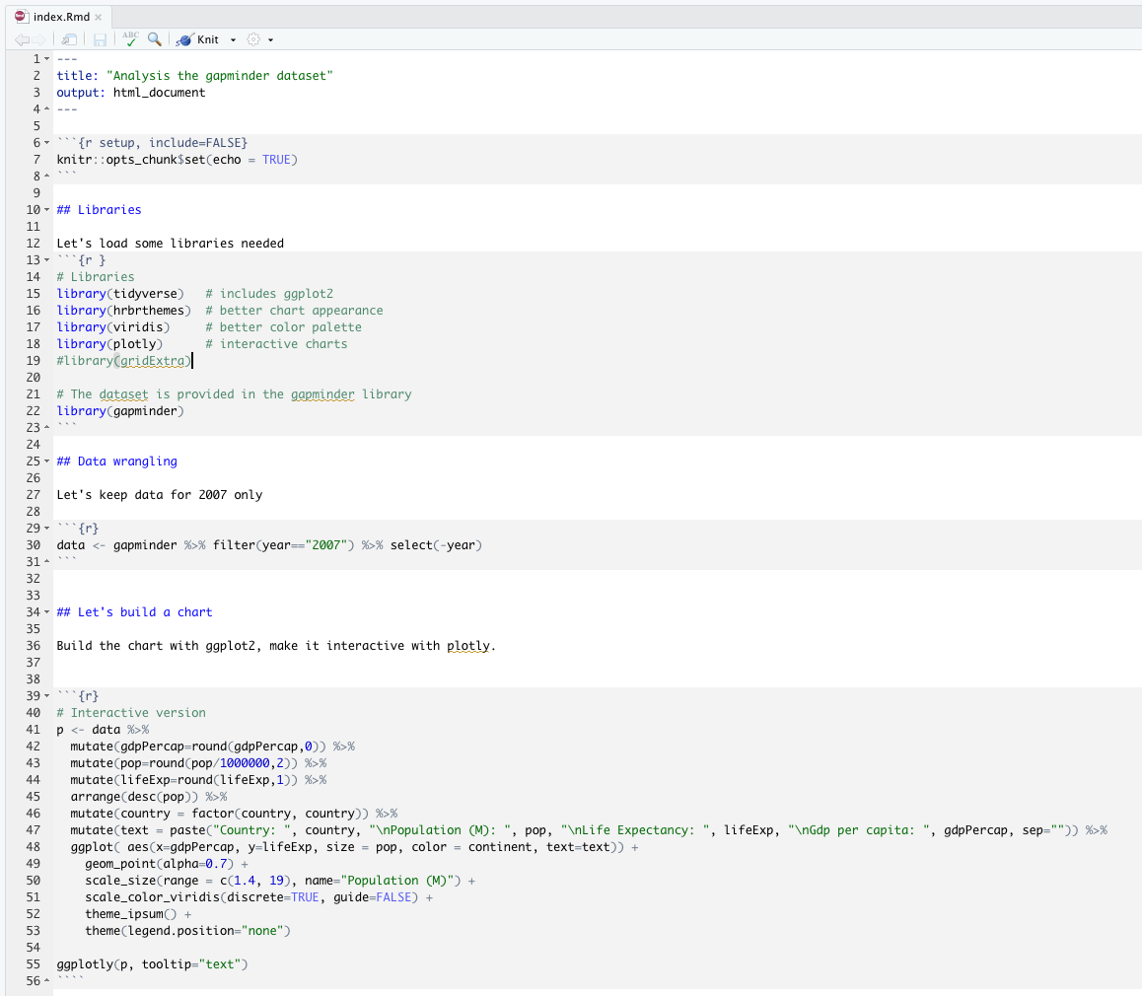
Step 2 – Add your analysis
Document title
Section title
Some text to explain what your doing
R code
Plot with ggplot2 …
Knit again !!
… made interactive with plotly

Slide 4
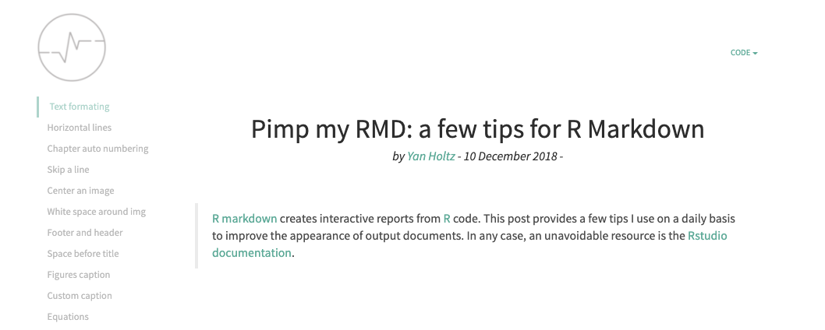
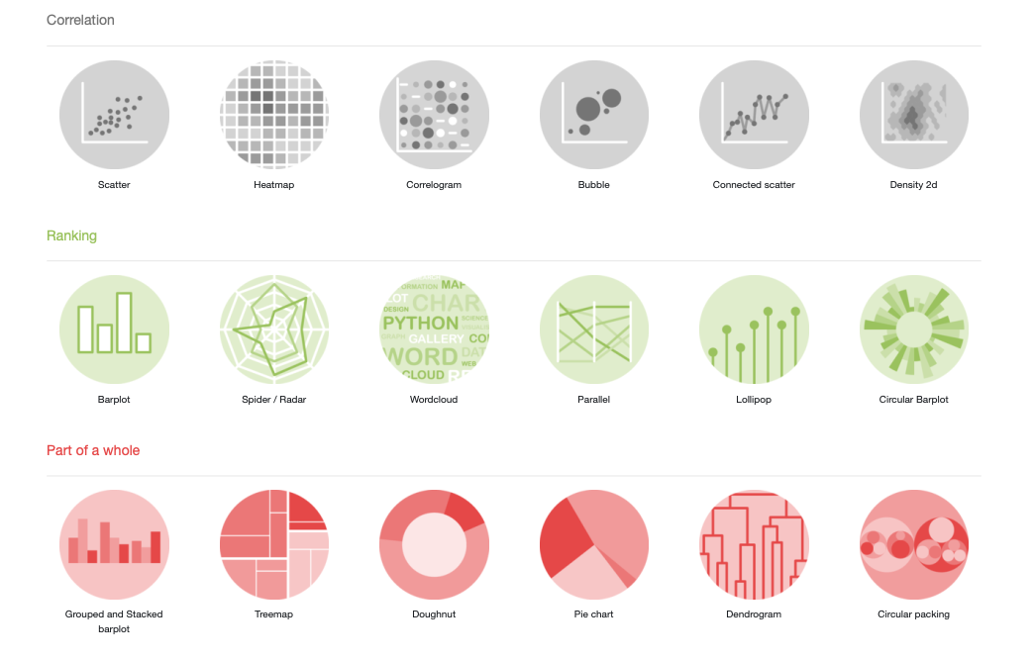
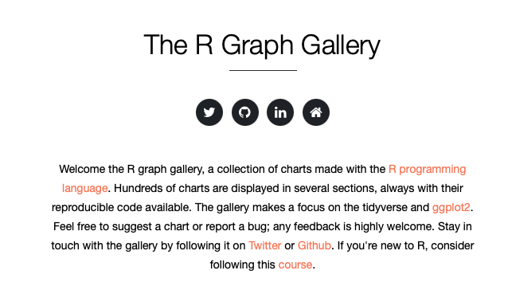
Step 2 – Useful links
holtzy.github.io/Pimp-my-rmd
R-graph-gallery.com

Slide 5
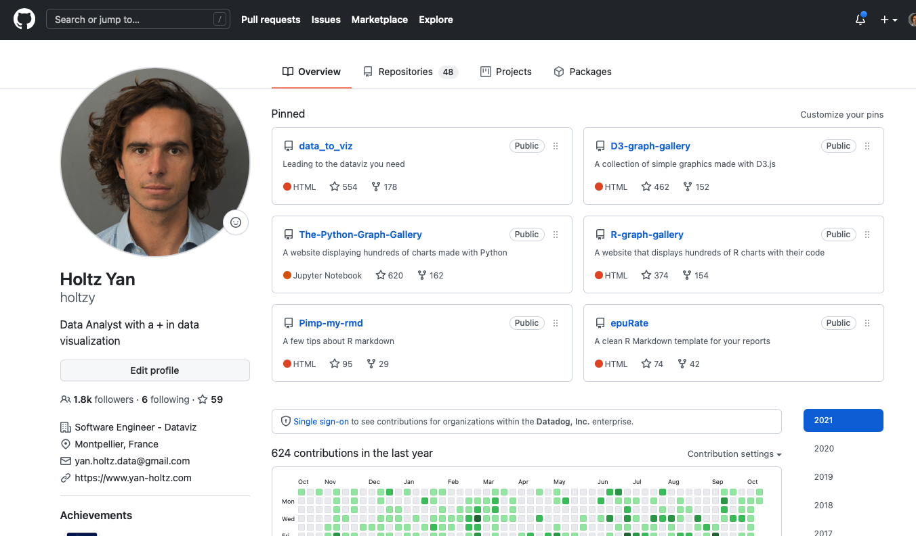
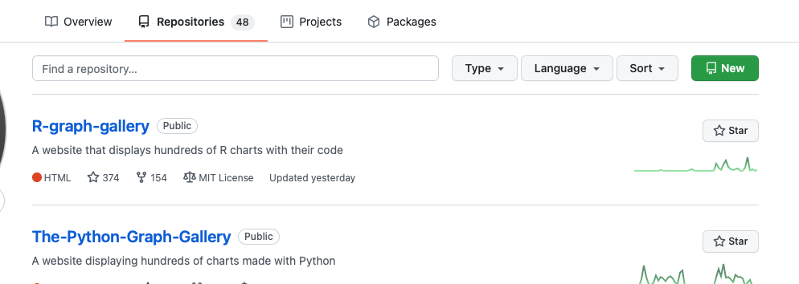
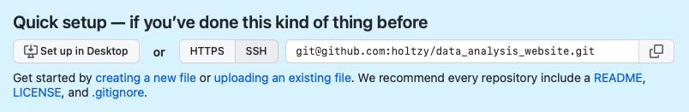

Step 3 – Store your analysis on Github
You need a Github account
Click on Repositories
Click on New
Add a name, make it public, click create repo
Copy the adress in the blue section
Go to your local folder using a terminal

Slide 6
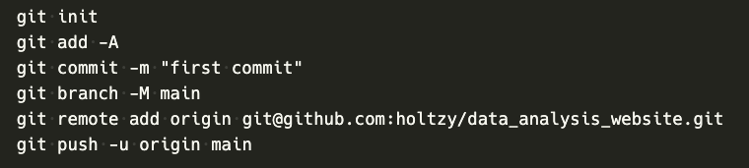
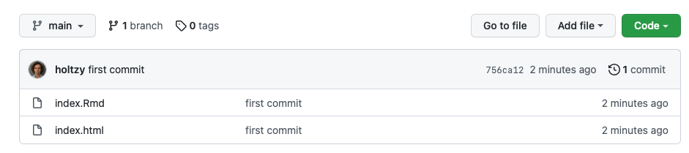
Step 3 – Store your analysis on Github
Update this!!
Copy paste this code
Your github repository now exists!! ☺ (Refresh the browser)

Slide 7
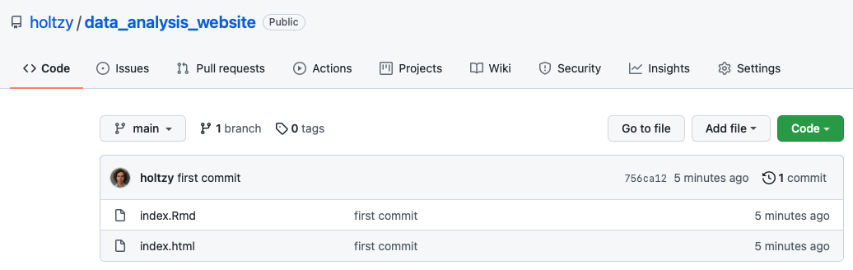
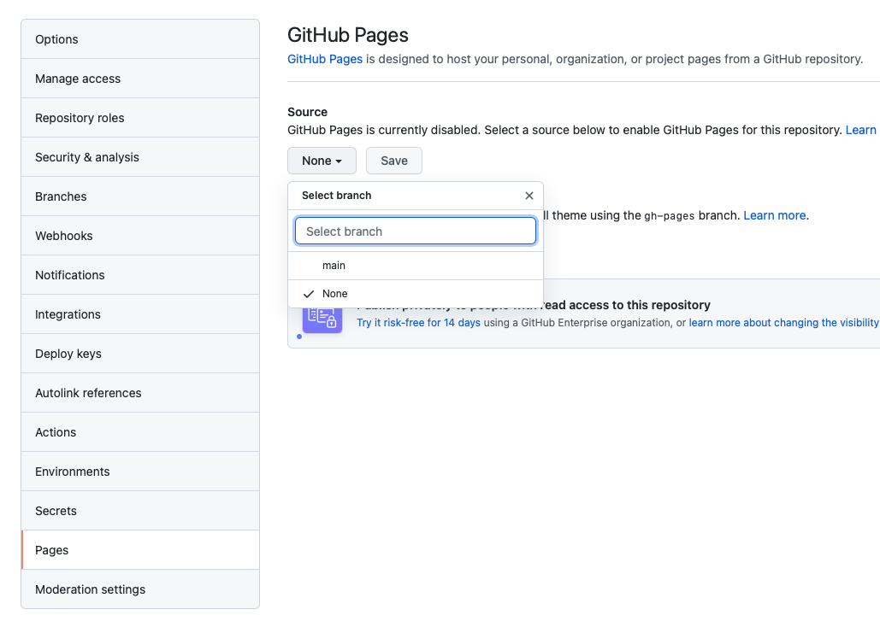
Step 4 – Make it a website
Click on Settings
Go to the Pages tab
Select the main branch
Click Save
Pages tab
Your website is waiting for you! ☺

Slide 8
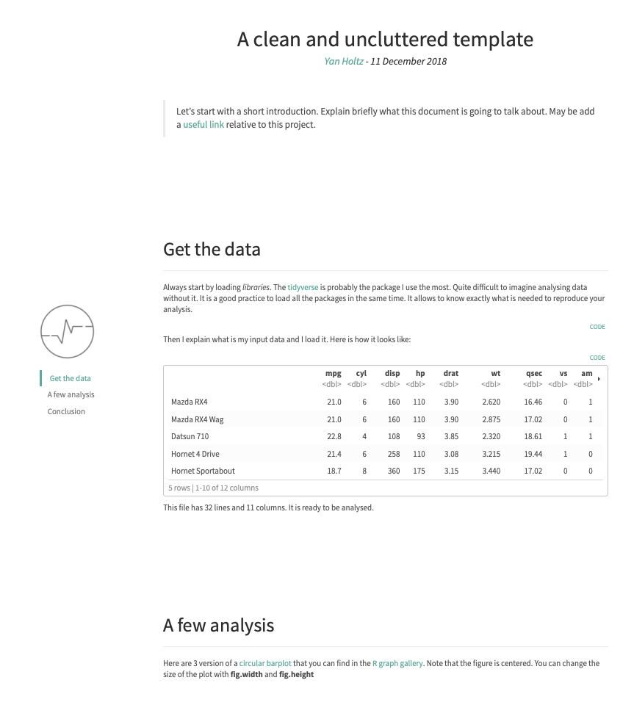
Step 5 – Use a template to make the report look better
Epurate is a R Markdown template:
github.com/holtzy/epuRate
More Templates on the rmarkdown website:
- rmarkdown.rstudio.com/gallery.html

Slide 9




Data-to-viz.com
@R_Graph_Gallery
github.com/holtzy/Talk
Yan.holtz.data@gmail.com
www.yan-holtz.com

