Slide 1

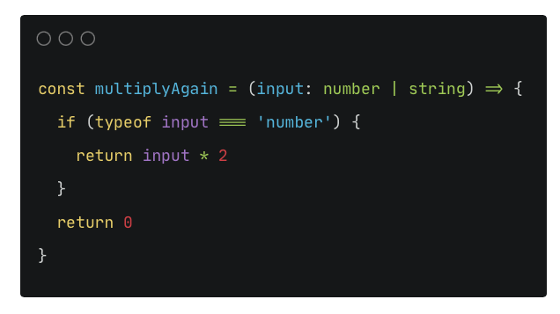
Input can be a number or a string
NARROWING with TYPEOF
1
So we use a typeguard: typeof in a if statement make sure we’re dealing with a number
But we want to perform a specific action if input is a string
3
2
'number’ is a value here, not a type. You can NOT use a type or an interface here.
4
Front-end-flashcard.io | Yan Holtz
Notes:
Playground:
Doc: https://www.typescriptlang.org/docs/handbook/2/narrowing.html

Slide 2
Input can be a number or a string
NARROWING with IN
1
4
Front-end-flashcard.io | Yan Holtz
Notes:
Playground:
Doc: https://www.typescriptlang.org/docs/handbook/2/narrowing.html

Slide 3
Input can be a number or a string
EQUALITY NARROWING
1
Front-end-flashcard.io | Yan Holtz
Notes:
Playground:
Doc: https://www.typescriptlang.org/docs/handbook/2/narrowing.html

Slide 4
Input can be a number or a string
NARROWING with INSTANCE OF
1
Front-end-flashcard.io | Yan Holtz
Notes:
Playground:
Doc: https://www.typescriptlang.org/docs/handbook/2/narrowing.html

Slide 5
Input can be a number or a string
TYPE PREDICATES
1
Notes:
Playground:
Doc: https://www.typescriptlang.org/docs/handbook/2/narrowing.html

Slide 6
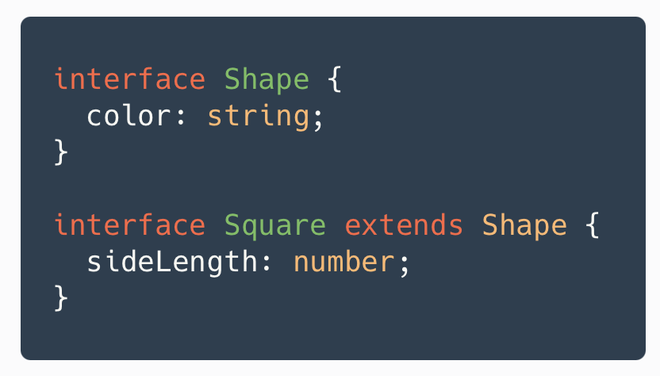
Input can be a number or a string
EXTENDS
1
Notes:
Playground:
Doc: https://www.typescriptlang.org/docs/handbook/2/narrowing.html

Slide 7

A boolean can be true or false.
An expression can be truthy are falsy. We can use it in conditionals.
Truthiness
1
So we use a typeguard: typeof in a if statement make sure we’re dealing with a number
But we want to perform a specific action if input is a string
3
2
'number’ is a value here, not a type. You can NOT use a type or an interface here.
4
Front-end-flashcard.io | Yan Holtz
Notes:
Playground: https://codesandbox.io/s/javascript-truthiness-mh3kg?file=/src/index.js

Slide 8
Operators
??
?.
Optional Chaining Operator
Nullish Coalescing Operator
const output = toto ?? ’hello’
Returns toto if toto is not null nor undefined. Hello otherwise
||
Logical Or Operator
const output = toto || ’hello’
Returns toto if toto is not falsy.
0 or ‘’ are falsy
&&
Logical AND operator
Used for conditions (returns boolean)
Short circuit evaluation
a6 = false && 'Cat' // f && t returns false
?
Conditional Ternary Operator
Const output = toto ? 1 : 2
Notes:
Playground: https://codesandbox.io/s/javascript-truthiness-mh3kg?file=/src/index.js

Slide 9
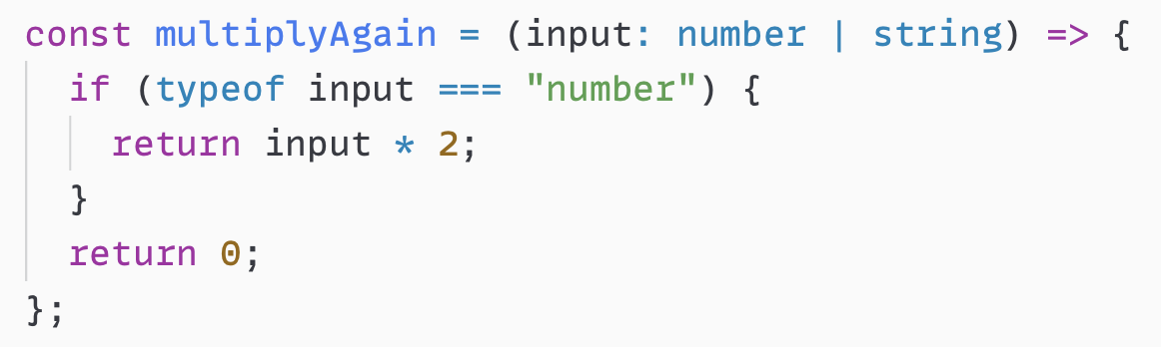
Wtf is multiplyAgain about again?
Some explanation about why number is that way

