Slide 1



















Slide 2


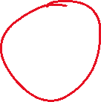


Slide 3
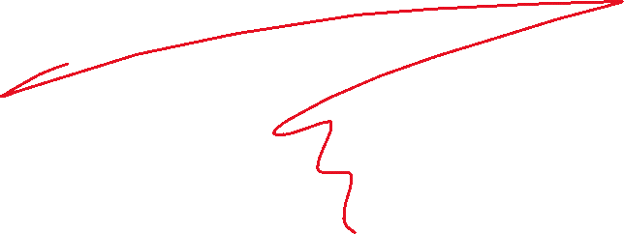







Slide 4
















Slide 5




Hide / Show
Fade
Slide
Animate
Stop()

