Slide 1
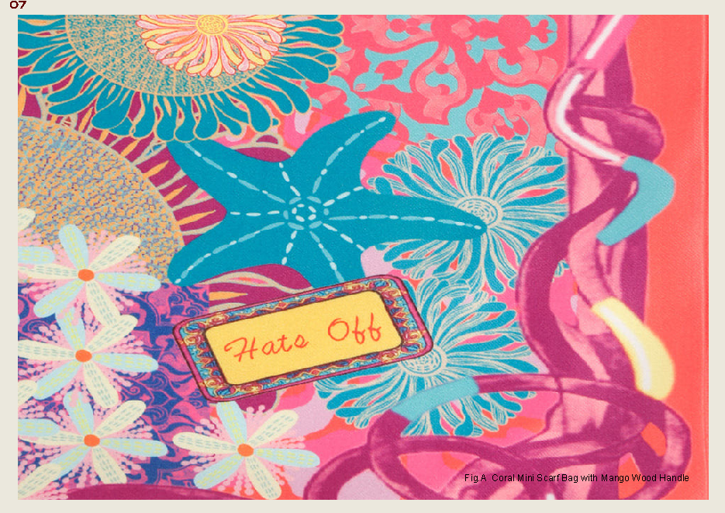
INDUSTRY INTERNSHIP
Hats Off
Accessories
A study in craft, colour and the journey
from material to market.
ADITI ARYA
Leather Design | Batch 2023–2027
NIFT Raebareli | Unique ID BD/23/2936
1 June – 24 July 2026 | Eight weeks
FACULTY MENTOR Dr. Anketa Kumar
INDUSTRY MENTOR Ms. Sunaina Harjai, Founder

Slide 2
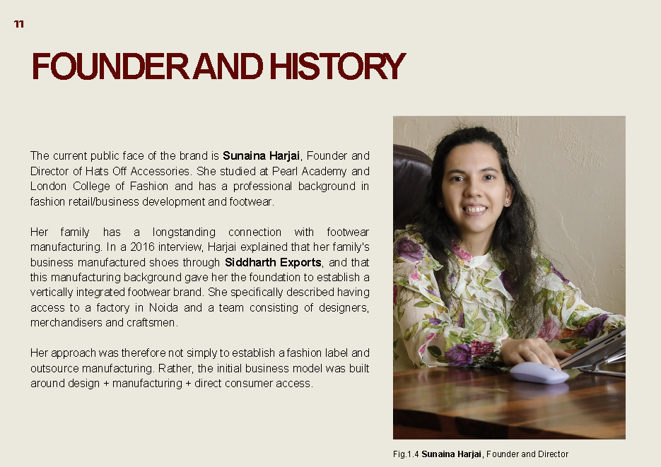
01 / THE BRIEF
Learning the whole object
An eight-week immersion in a founder-led, craft-driven accessories house.
CRAFT
SYSTEM
STORY
THE INTERNSHIP
IN ONE LINE
Patience, accuracy
and material respect.
A product moves
through many hands.
Design travels
through image and channel.
From classroom
knowledge to
professional
practice.
Concept → sample → finish
Design ↔ sourcing ↔ QC
Object → shoot → customer
Design · production · commerce
A founder-led studio where aesthetic decisions are accountable to making.

Slide 3
02 / THE HOUSE
Hats Off Accessories
Indian craftsmanship, contemporary accessories and a direct-to-consumer rhythm.
FOUNDER & HISTORY
NEW DELHI / NOIDA
D2C / SHOPIFY
Sunaina Harjai
WHATSAPP COMMERCE
A founder-led brand rooted in footwear manufacturing, expanded into handcrafted bags and accessories.
A hybrid infrastructure
Factory-linked making
In-house design & merchandising
Domestic + Italian leather streams
Direct digital selling + global shipping
THE BRAND PROMISE
Made with purpose.
Built to last.
accessible luxury · heritage craft · individuality · colour · durability

Slide 4
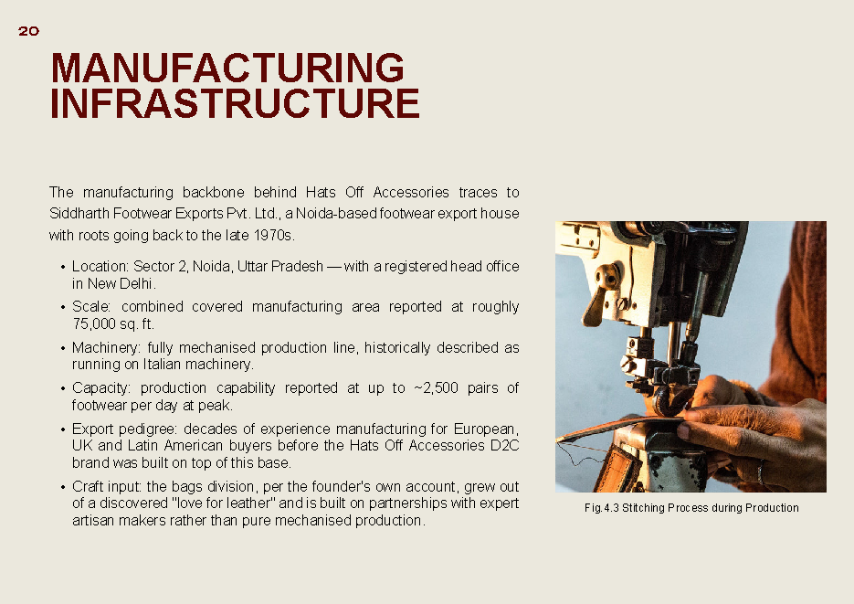
03 / MARKET POSITION
Who is the object speaking to?
A broad accessories universe, held together by a clear bridge between craft and everyday luxury.
A MULTI-SCENE WARDROBE
THE CORE BUYER
01
THE WORKING WOMAN
Urban,
digitally native,
occasion-aware.
totes · laptop bags · structure
02
THE OCCASION SHOPPER
metallics · embellishment · colour
03
THE BESPOKE BUYER
custom Italian leather · WhatsApp
India first · global diaspora
₹1,899–₹6,999 bags
₹2,249–₹4,499 footwear
04
THE MODERN PROFESSIONAL MAN
formal footwear · executive bags

Slide 5
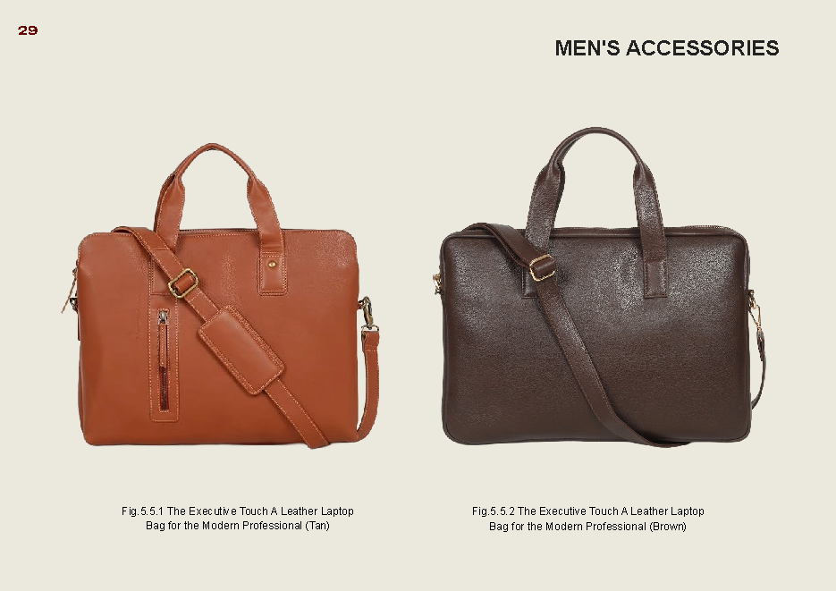
04 / MATERIAL CULTURE
Material is the first design decision
Texture, hardware and sourcing shape both the aesthetic and the commercial proposition.
01
FULL-GRAIN LEATHER
core range · longevity
SOURCING
LOGIC
02
EMBOSSED / EXOTIC TEXTURE
statement surfaces · hardware
Domestic leather
+ factory tie-ups
03
METALLIC FINISH
occasion-led shine
Italian leather
+ made-to-order colourways
04
WOVEN / BRAIDED LEATHER
signature tactile language
05
MANGO WOOD + TEXTILE
contrast · warmth · handle detail
Local trims and hardware keep the small-batch model responsive.

Slide 6
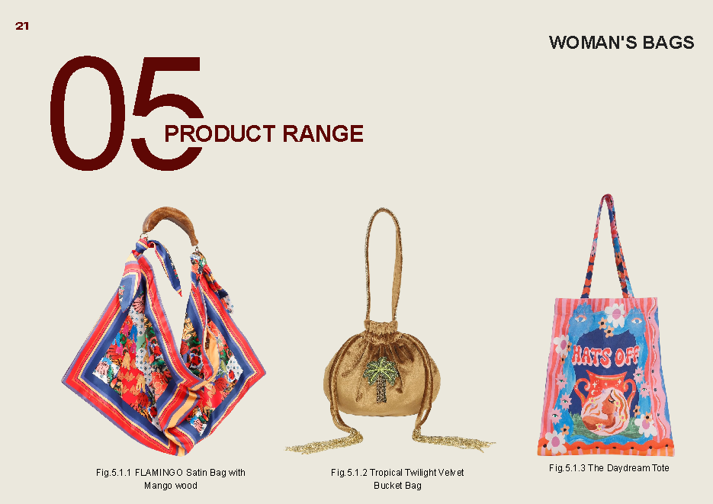
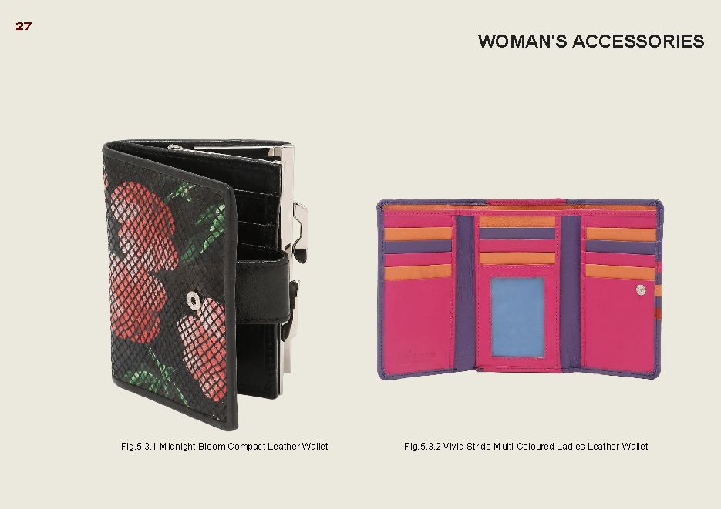
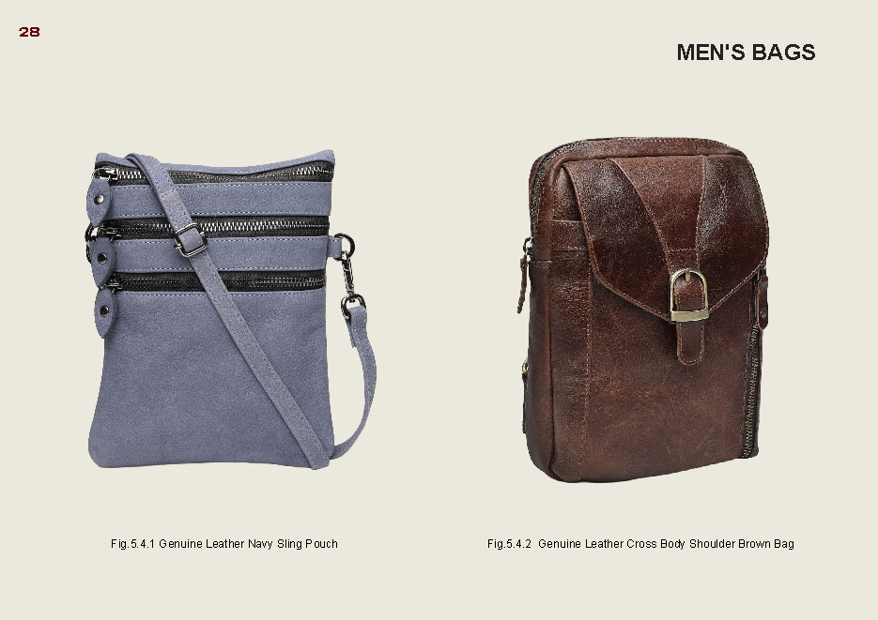
05 / THE PRODUCT UNIVERSE
A vocabulary of objects
The range moves from statement bags to daily companions, footwear and small leather goods.
01
WOMEN’S BAGS
02
WOMEN’S SHOES
03
SMALL LEATHER GOODS
04
MEN’S ACCESSORIES
sling · tote · hobo · clutch
mules · ballerinas · slides
wallets · card holders
sling pouches · executive bags
The design language is not one silhouette; it is a repeatable attitude toward colour, surface and utility.

Slide 7
06 / THE MAKING SYSTEM
From idea to object to image
The internship revealed design as coordination: every aesthetic decision carries a production consequence.
01
RESEARCH
02
DESIGN
03
MATERIAL
inspiration / audience
direction / silhouette
selection / sourcing
04
SAMPLE
05
MAKE
06
SELL
prototype / correction
cut / stitch / finish
shoot / merch / D2C
What changed for me
A material choice is never purely aesthetic; it changes cost, timing, construction and the final image.

Slide 8
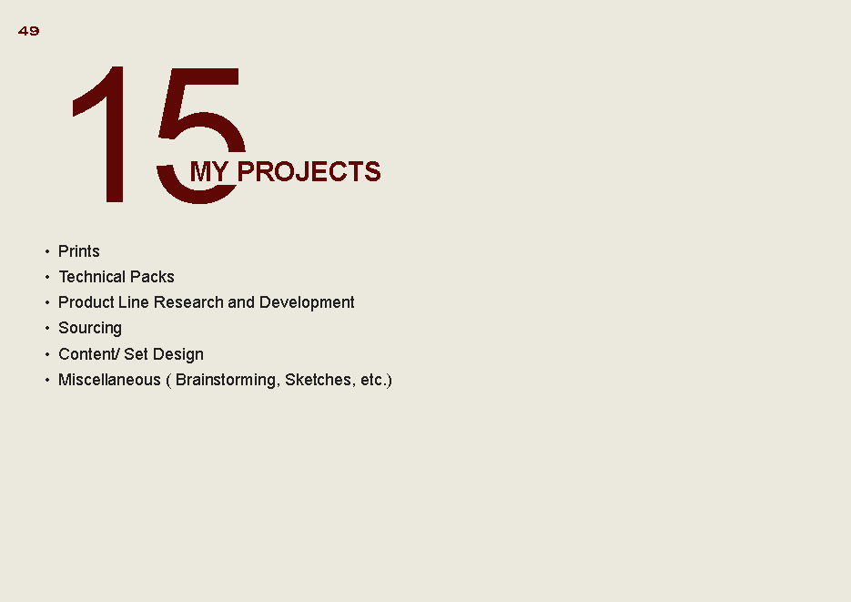
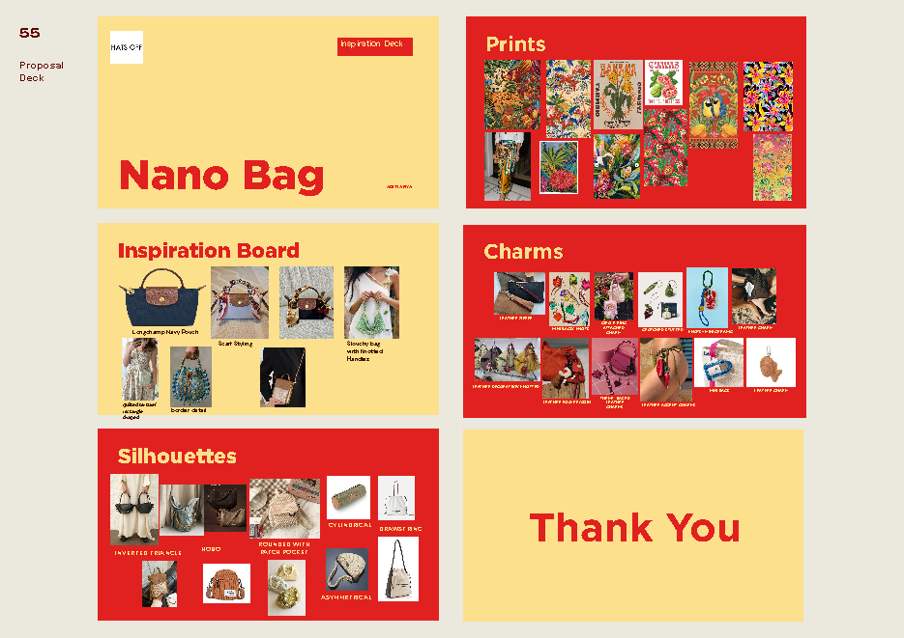
07 / MY CONTRIBUTION
A portfolio of applied practice
Five project strands connected research, visual thinking and production-ready communication.
01
PRINTS
research → motif → repeat → final
02
TECHNICAL PACKS
measurements · materials · trims
03
PRODUCT R&D
line research · silhouettes · direction
04
SOURCING
fabric, leather, hardware, local context
05
CONTENT / SET DESIGN
visual world for the object
research becomes direction; direction becomes a system.

Slide 9
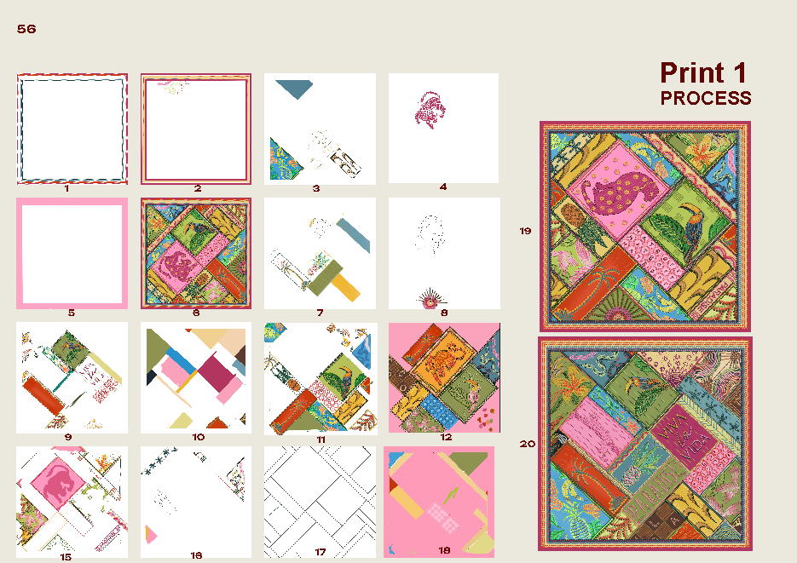
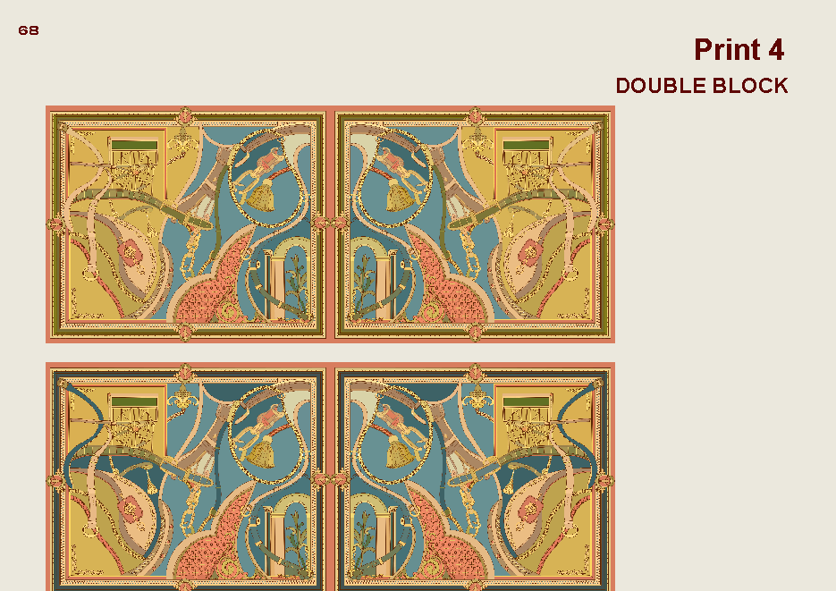
08 / SELECTED OUTCOMES
Making the idea legible
The strongest learning was translation: from visual intuition to repeatable, shareable instructions.
PRINT 01 / PROCESS
PRINT 01 / FINAL
Exploration is not the opposite of precision. It is how precision is found.
A finished print carries a process; a technical pack carries a decision.
TECH PACK / DRAWSTRING BAG

Slide 10
09 / REFLECTION
What I take forward
An internship in making became an education in judgement.
TECHNICAL
PERSONAL
Craftsmanship is
coordination made visible.
Design development
Print-making
Material selection
Costing & sourcing
Product photography
The work sharpened my communication, adaptability and respect for the many hands behind a finished object.
From concept to prototype, production and finishing.
THANK YOU
Aditi Arya · Leather Design · NIFT Raebareli

