Slide 1
Video Games and Programming

Slide 2
Why Video Games?

Slide 3
Frame Rate

Slide 4
Frame Rate
What is frame rate?
What is the fastest frame rate you’ve heard of?
What is the slowest frame rate you can have?

Slide 5
Frame Rate

Slide 6
Frame Rate

Slide 7
Frame Rate

Slide 8
Frame Rate

Slide 9
Frame Rate

Slide 10
Frame Rate

Slide 11
Frame Rate

Slide 12
Frame Rate

Slide 13
Frame Rate

Slide 14
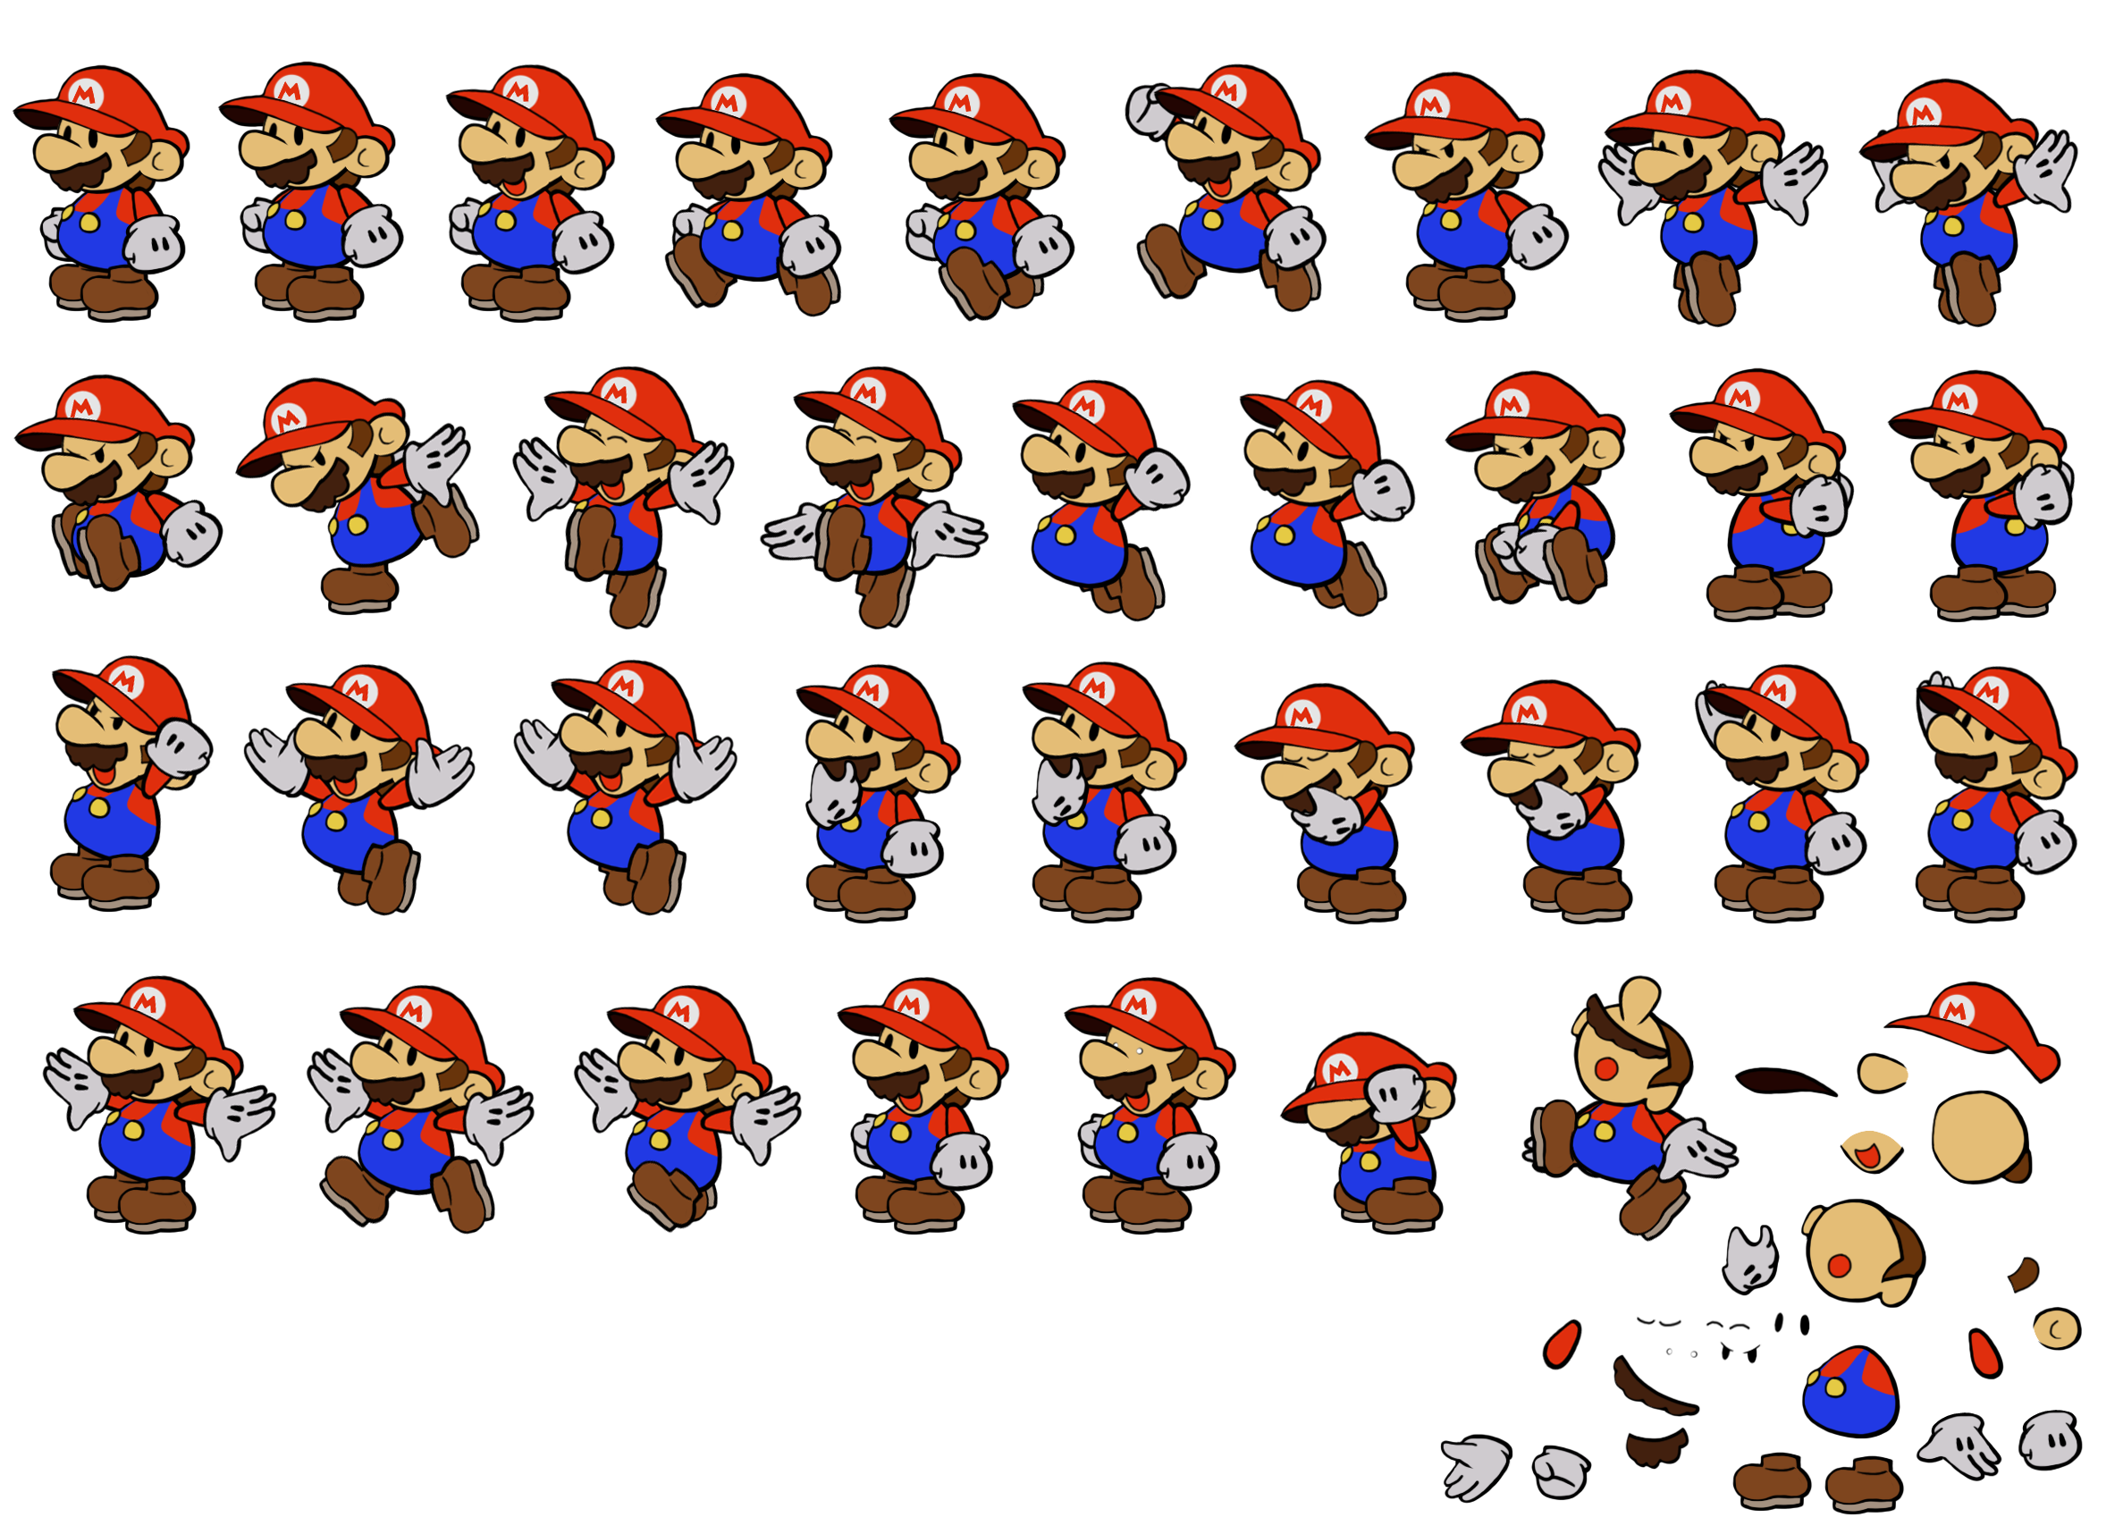

Slide 15
The Game Loop
initialize()
while no_exit():
check_for_user_input()
run_npcs()
move_characters()
resolve_collisions()
draw_graphics()

Slide 16
The Game Loop
> initialize()
while no_exit():
check_for_user_input()
run_npcs()
move_characters()
resolve_collisions()
draw_graphics()

Slide 17
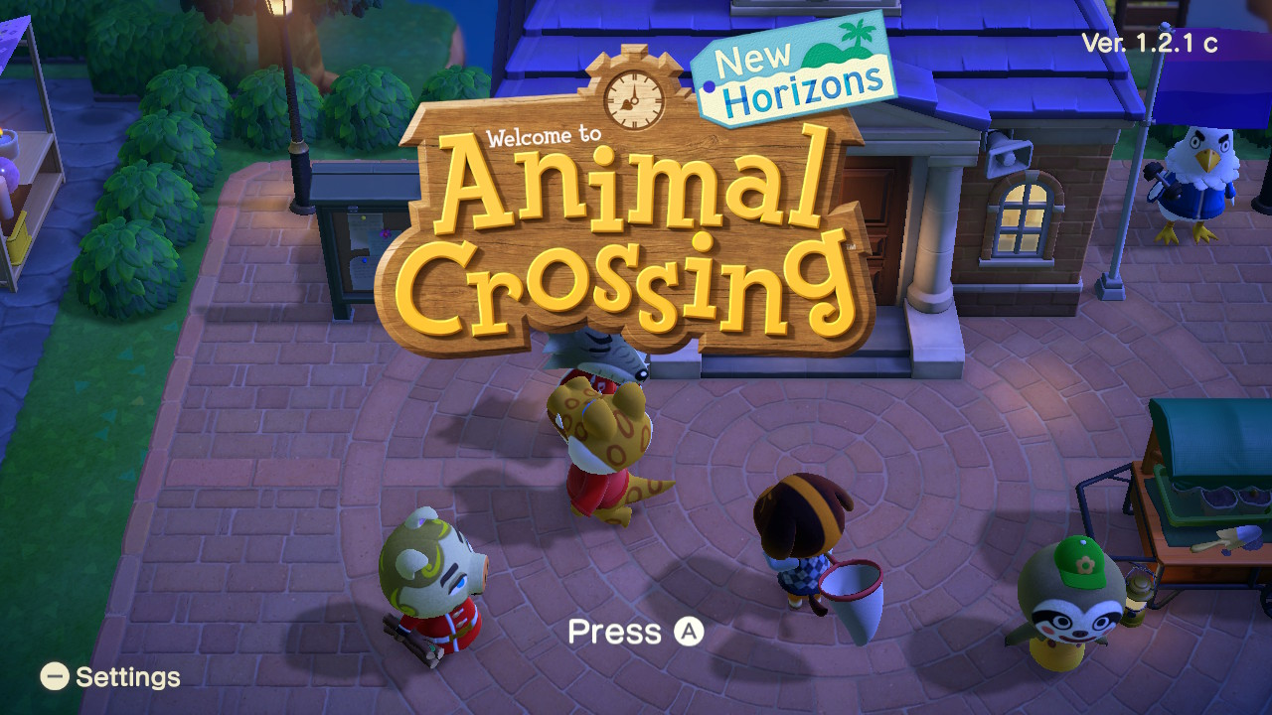
Initialization

Slide 18
The Game Loop
initialize()
while no_exit():
> check_for_user_input()
run_npcs()
move_characters()
resolve_collisions()
draw_graphics()

Slide 19
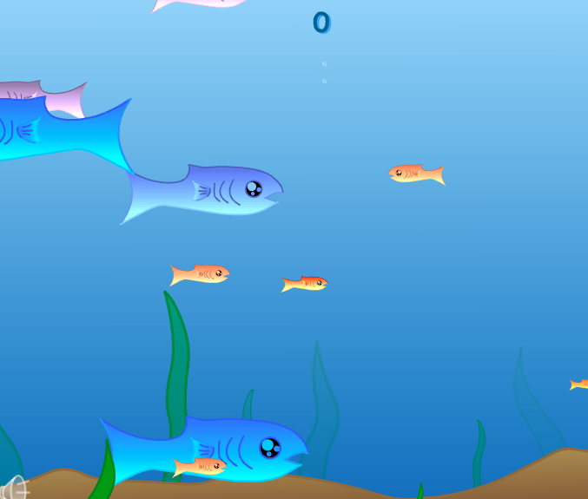
Checking for User Input
https://freefishy.org/

Slide 20
Checking for User Input
How does the keyboard control the fish?
How does the computer “move” things?

Slide 21
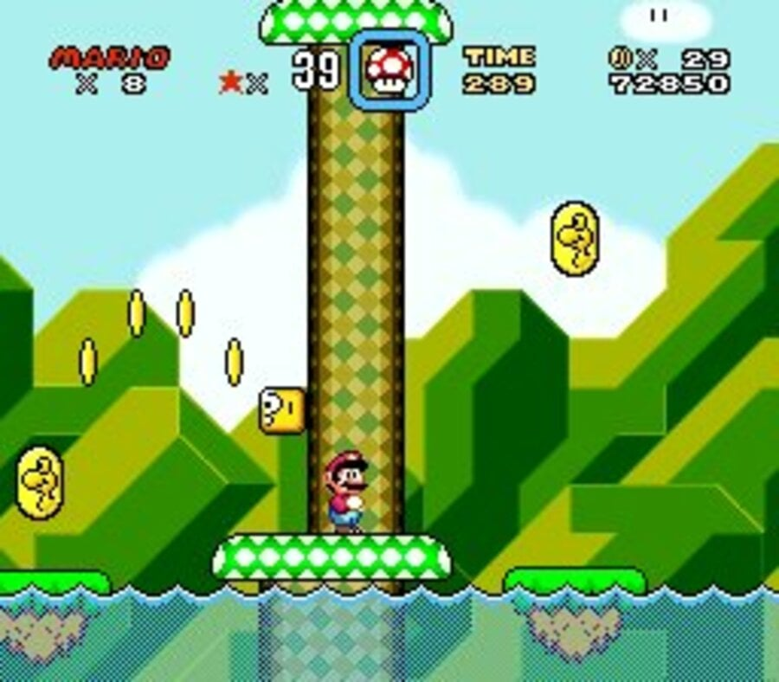
Checking for User Input
if left_arrow_pressed():
move_left()
if right_arrow_pressed():
move_right()
if a_button_pressed():
jump()

Slide 22
The Game Loop
initialize()
while no_exit():
check_for_user_input()
> run_npcs()
move_characters()
resolve_collisions()
draw_graphics()

Slide 23
Run NPCs
2013
https://youtu.be/WnzlbyTZsQY
2023
https://youtu.be/mx7ggnsRwGM?t=272

Slide 24
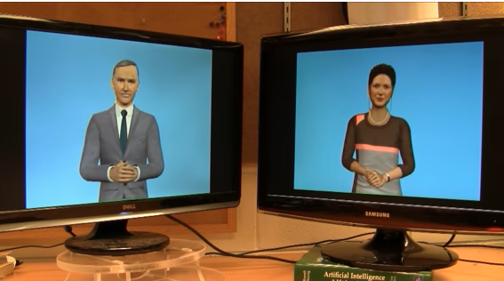
Run NPCs
Wasn’t very good!
Now scary good!
Mini programs that make decisions.

Slide 25
The Game Loop
initialize()
while no_exit():
check_for_user_input()
run_npcs()
> move_characters()
resolve_collisions()
draw_graphics()

Slide 26
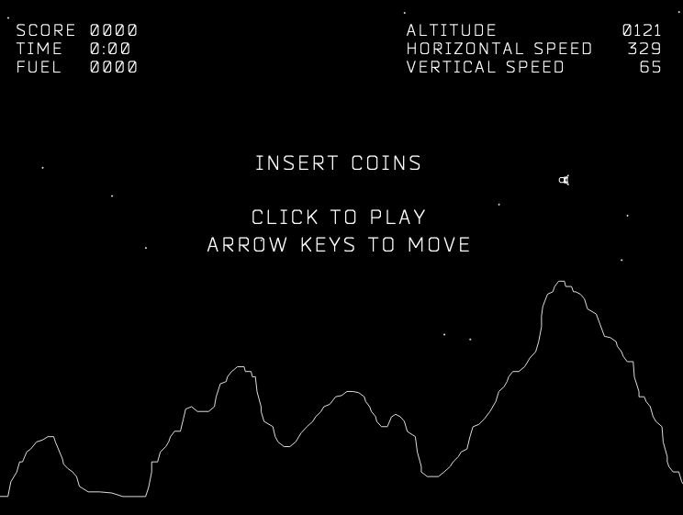
Moving Characters
http://moonlander.seb.ly/

Slide 27
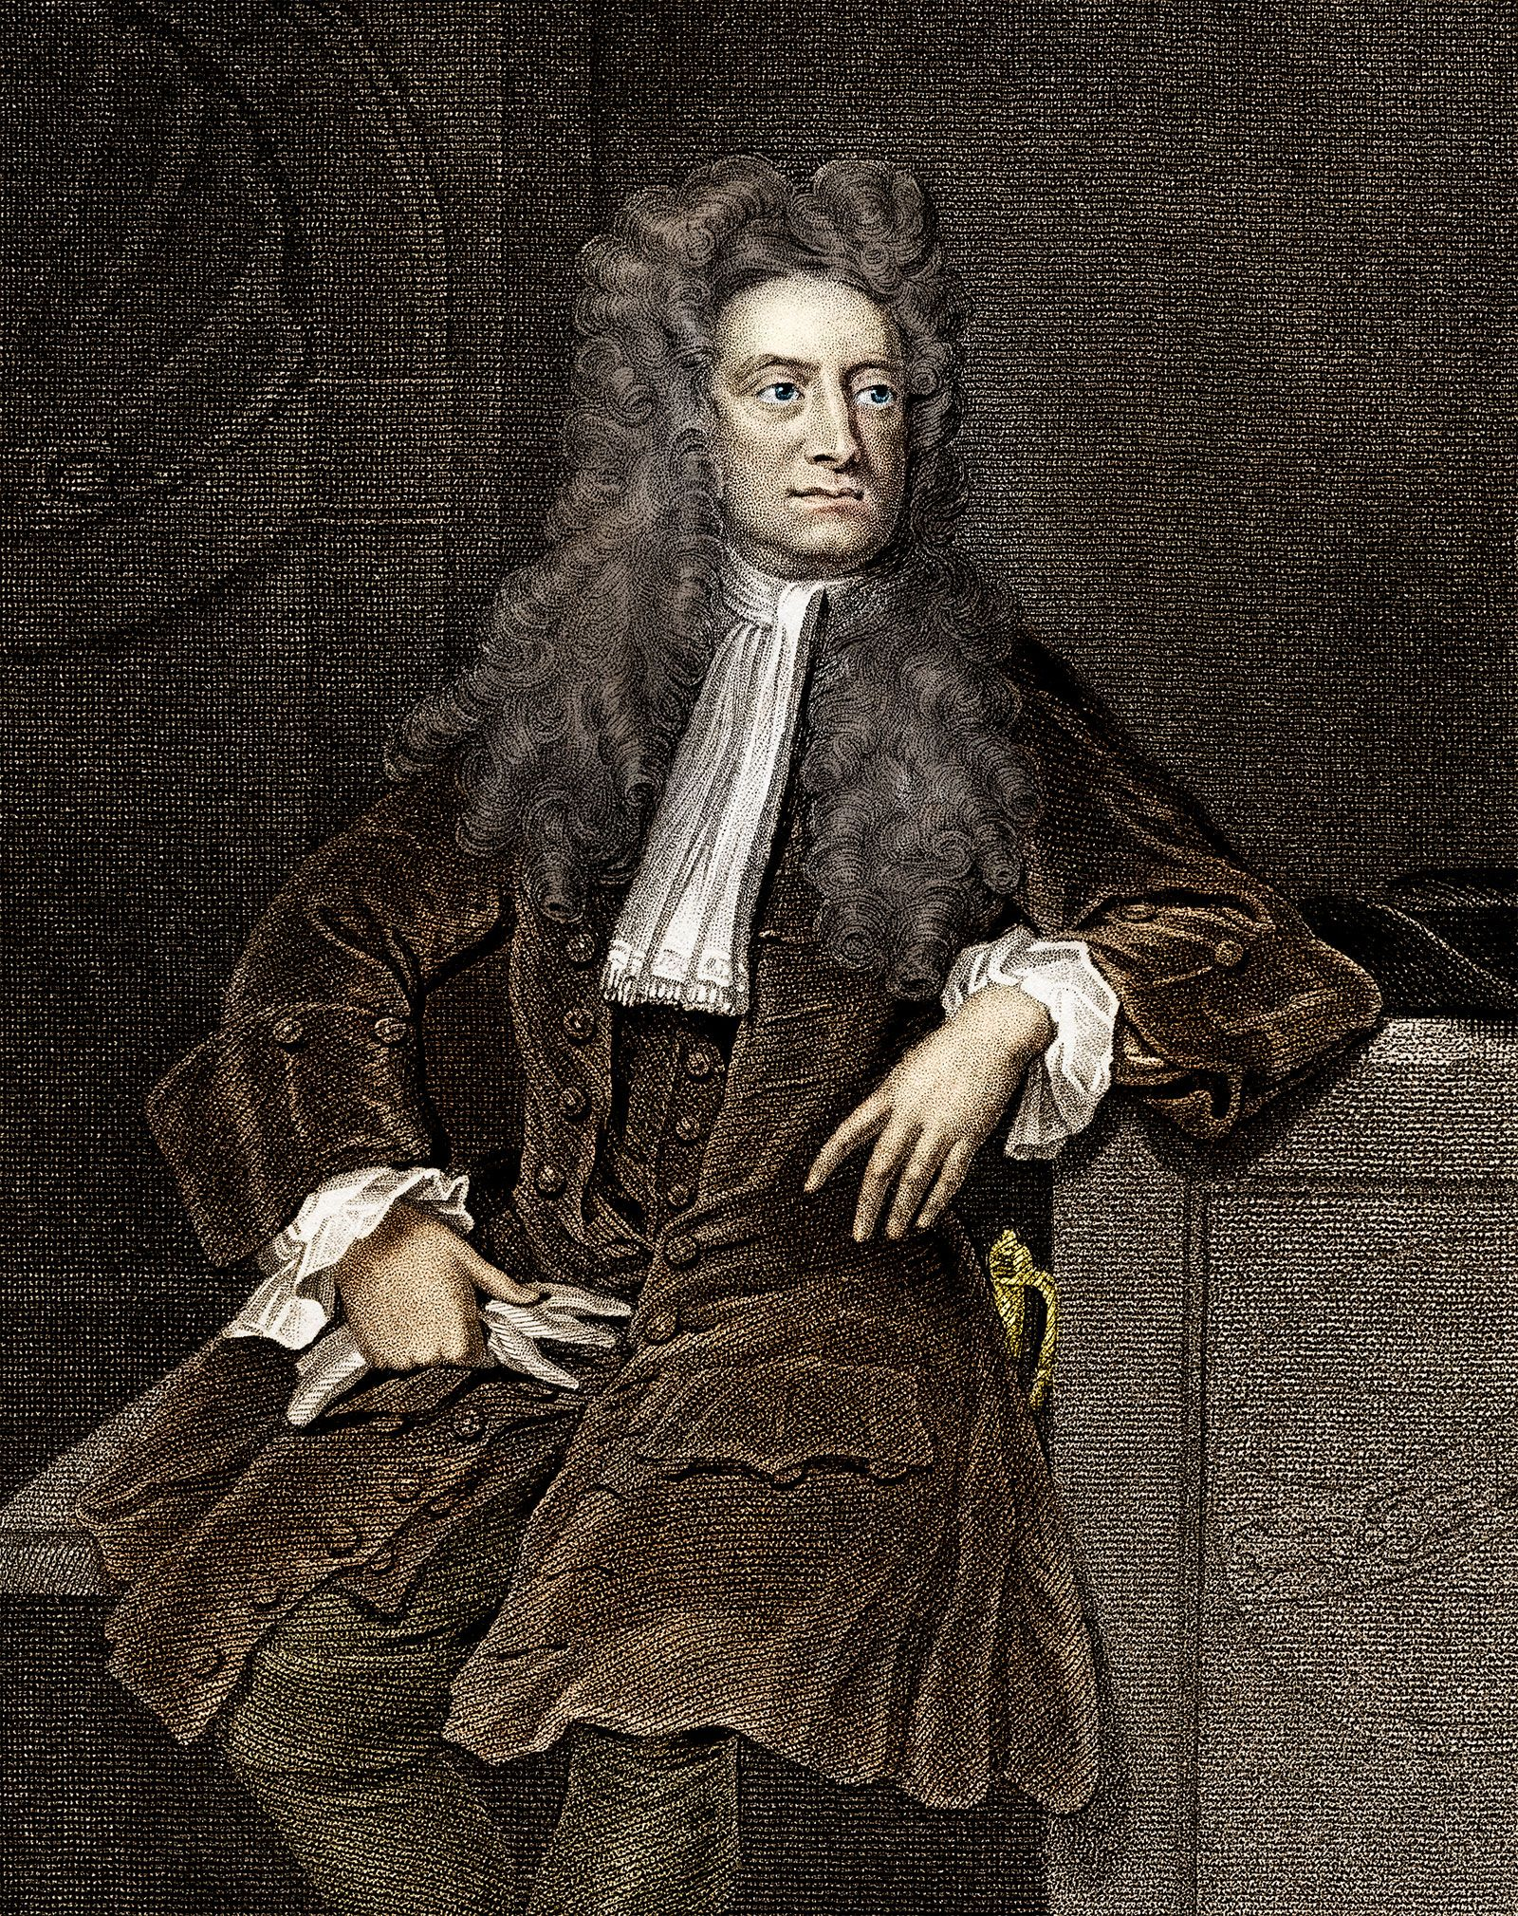
Moving Characters
Simulates physics on objects in the game
Uses properties such as:
Simulated mass
Simulated momentum
Simulated Angle

Slide 28
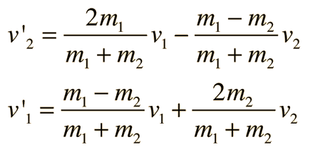
Moving Characters
Simulate Gravity
new_speed = old_speed - 9.8
Simulate collisions

Slide 29
The Game Loop
initialize()
while no_exit():
check_for_user_input()
run_npcs()
move_characters()
> resolve_collisions()
draw_graphics()

Slide 30
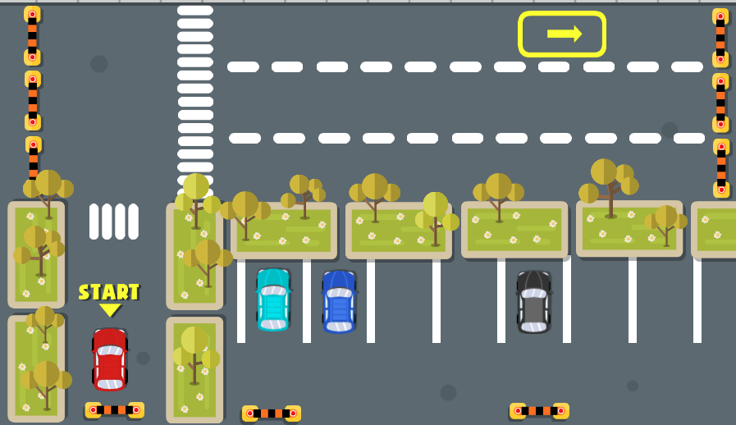
Resolve Collisions
https://lagged.com/en/g/extreme-car-parking

Slide 31
Resolve Collisions
Pixel Detection
Old School
Proximity Detection
New(er) School

Slide 32
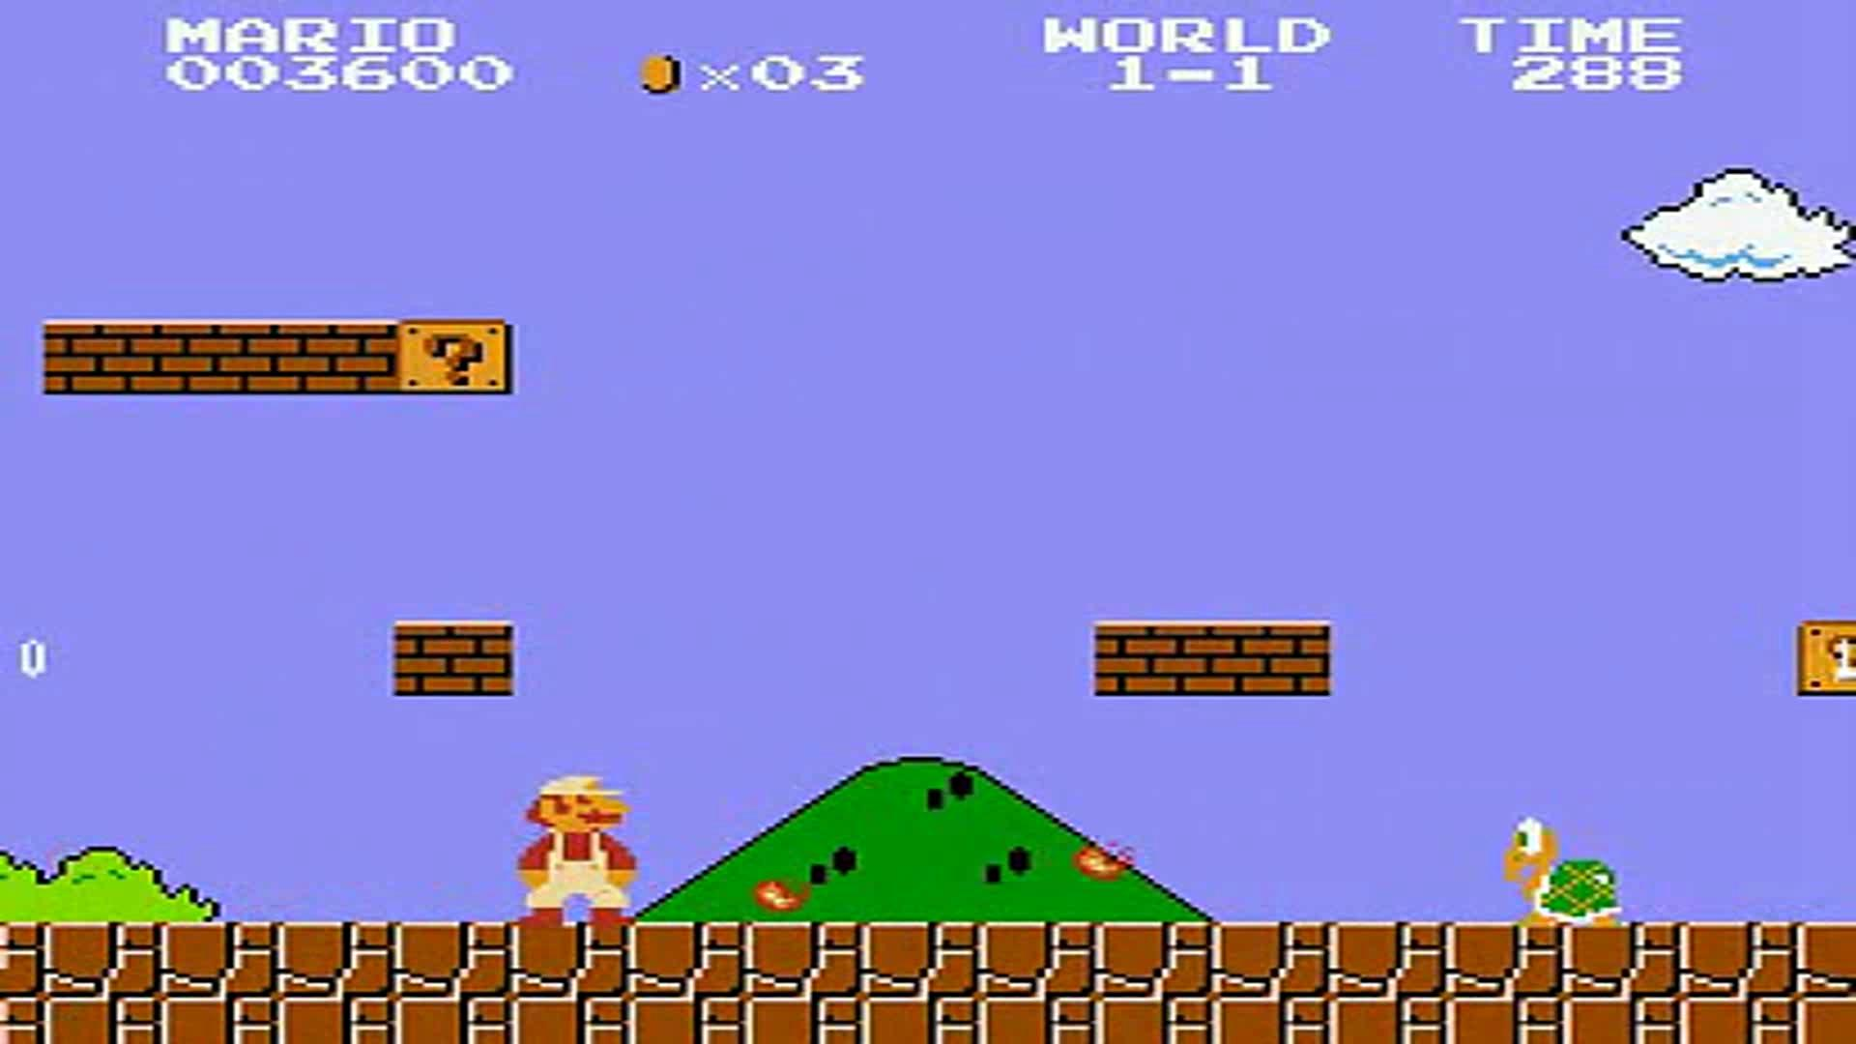
Pixel Collision

Slide 33
Proximity Collisions
Circle on Circle detection
Polygons
More Complicated!

Slide 34
The Game Loop
initialize()
while no_exit():
check_for_user_input()
run_npcs()
move_characters()
resolve_collisions()
> draw_graphics()

Slide 35
Drawing Graphics
Usually done by a Library
Scratch
Handled for you!
Python
pygame.draw.circle(x,y)
Java
Graphics().drawOval(x-radius, y-radius, 2*radius, 2*radius)
C
int gd = DETECT, gm; initgraph(&gd, &gm, ""); circle(x, y, radius);

Slide 36
The Game Loop
initialize()
while no_exit():
check_for_user_input()
run_npcs()
move_characters()
resolve_collisions()
draw_graphics()

Slide 37
Why Scratch
Language designed at MIT
Used at University of Berkely in Introduction to Programming class
All program languages are basically the same
Lots of useful (and fun) “libraries”

