Slide 1

Notes:
Render this deck locally: npx @marp-team/marp-cli docs/presentation.md --preview Export to PDF: npx @marp-team/marp-cli docs/presentation.md --pdf Export to PPTX (editable in Keynote/PowerPoint): npx @marp-team/marp-cli docs/presentation.md --pptx Or: install the Marp for VS Code extension and open this file.

Slide 2


Slide 3
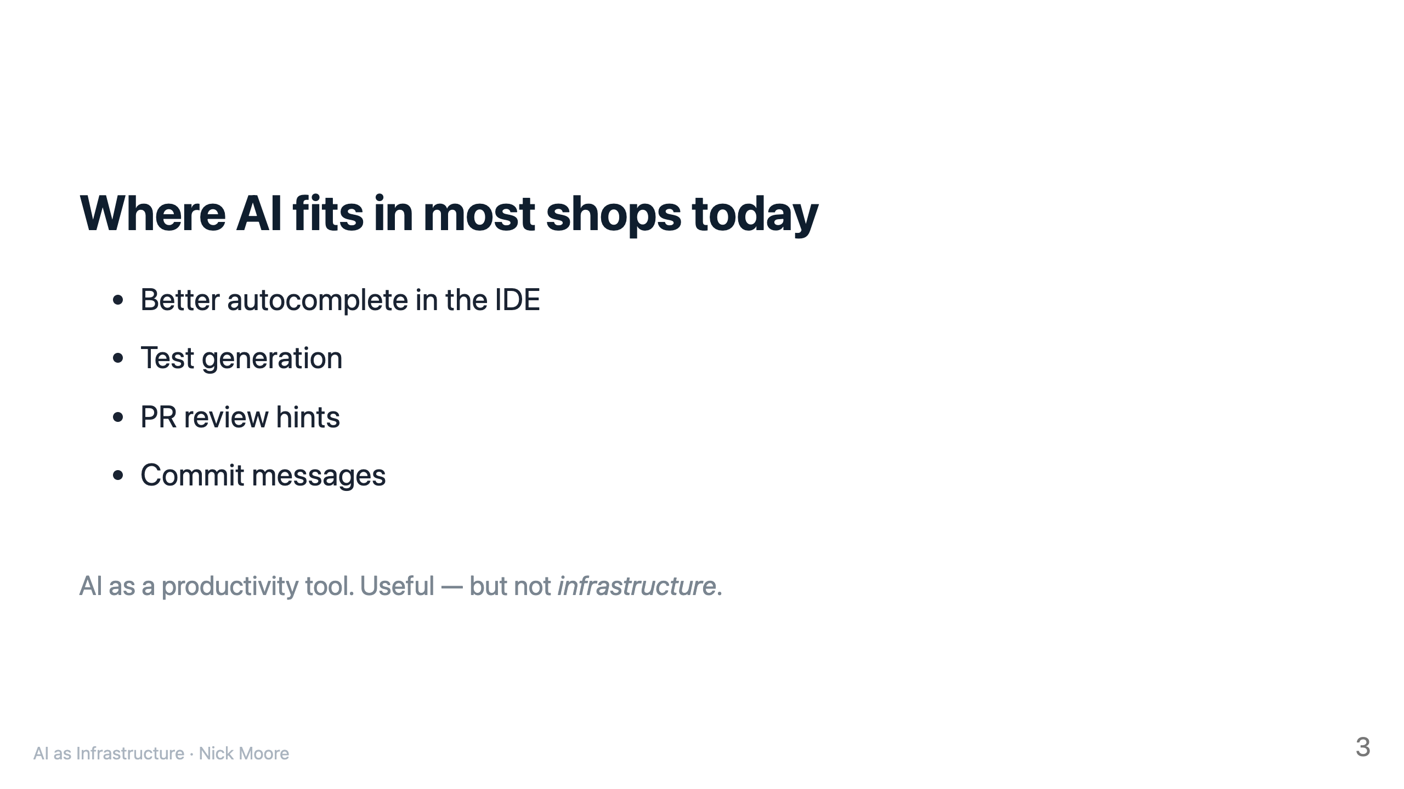

Slide 4
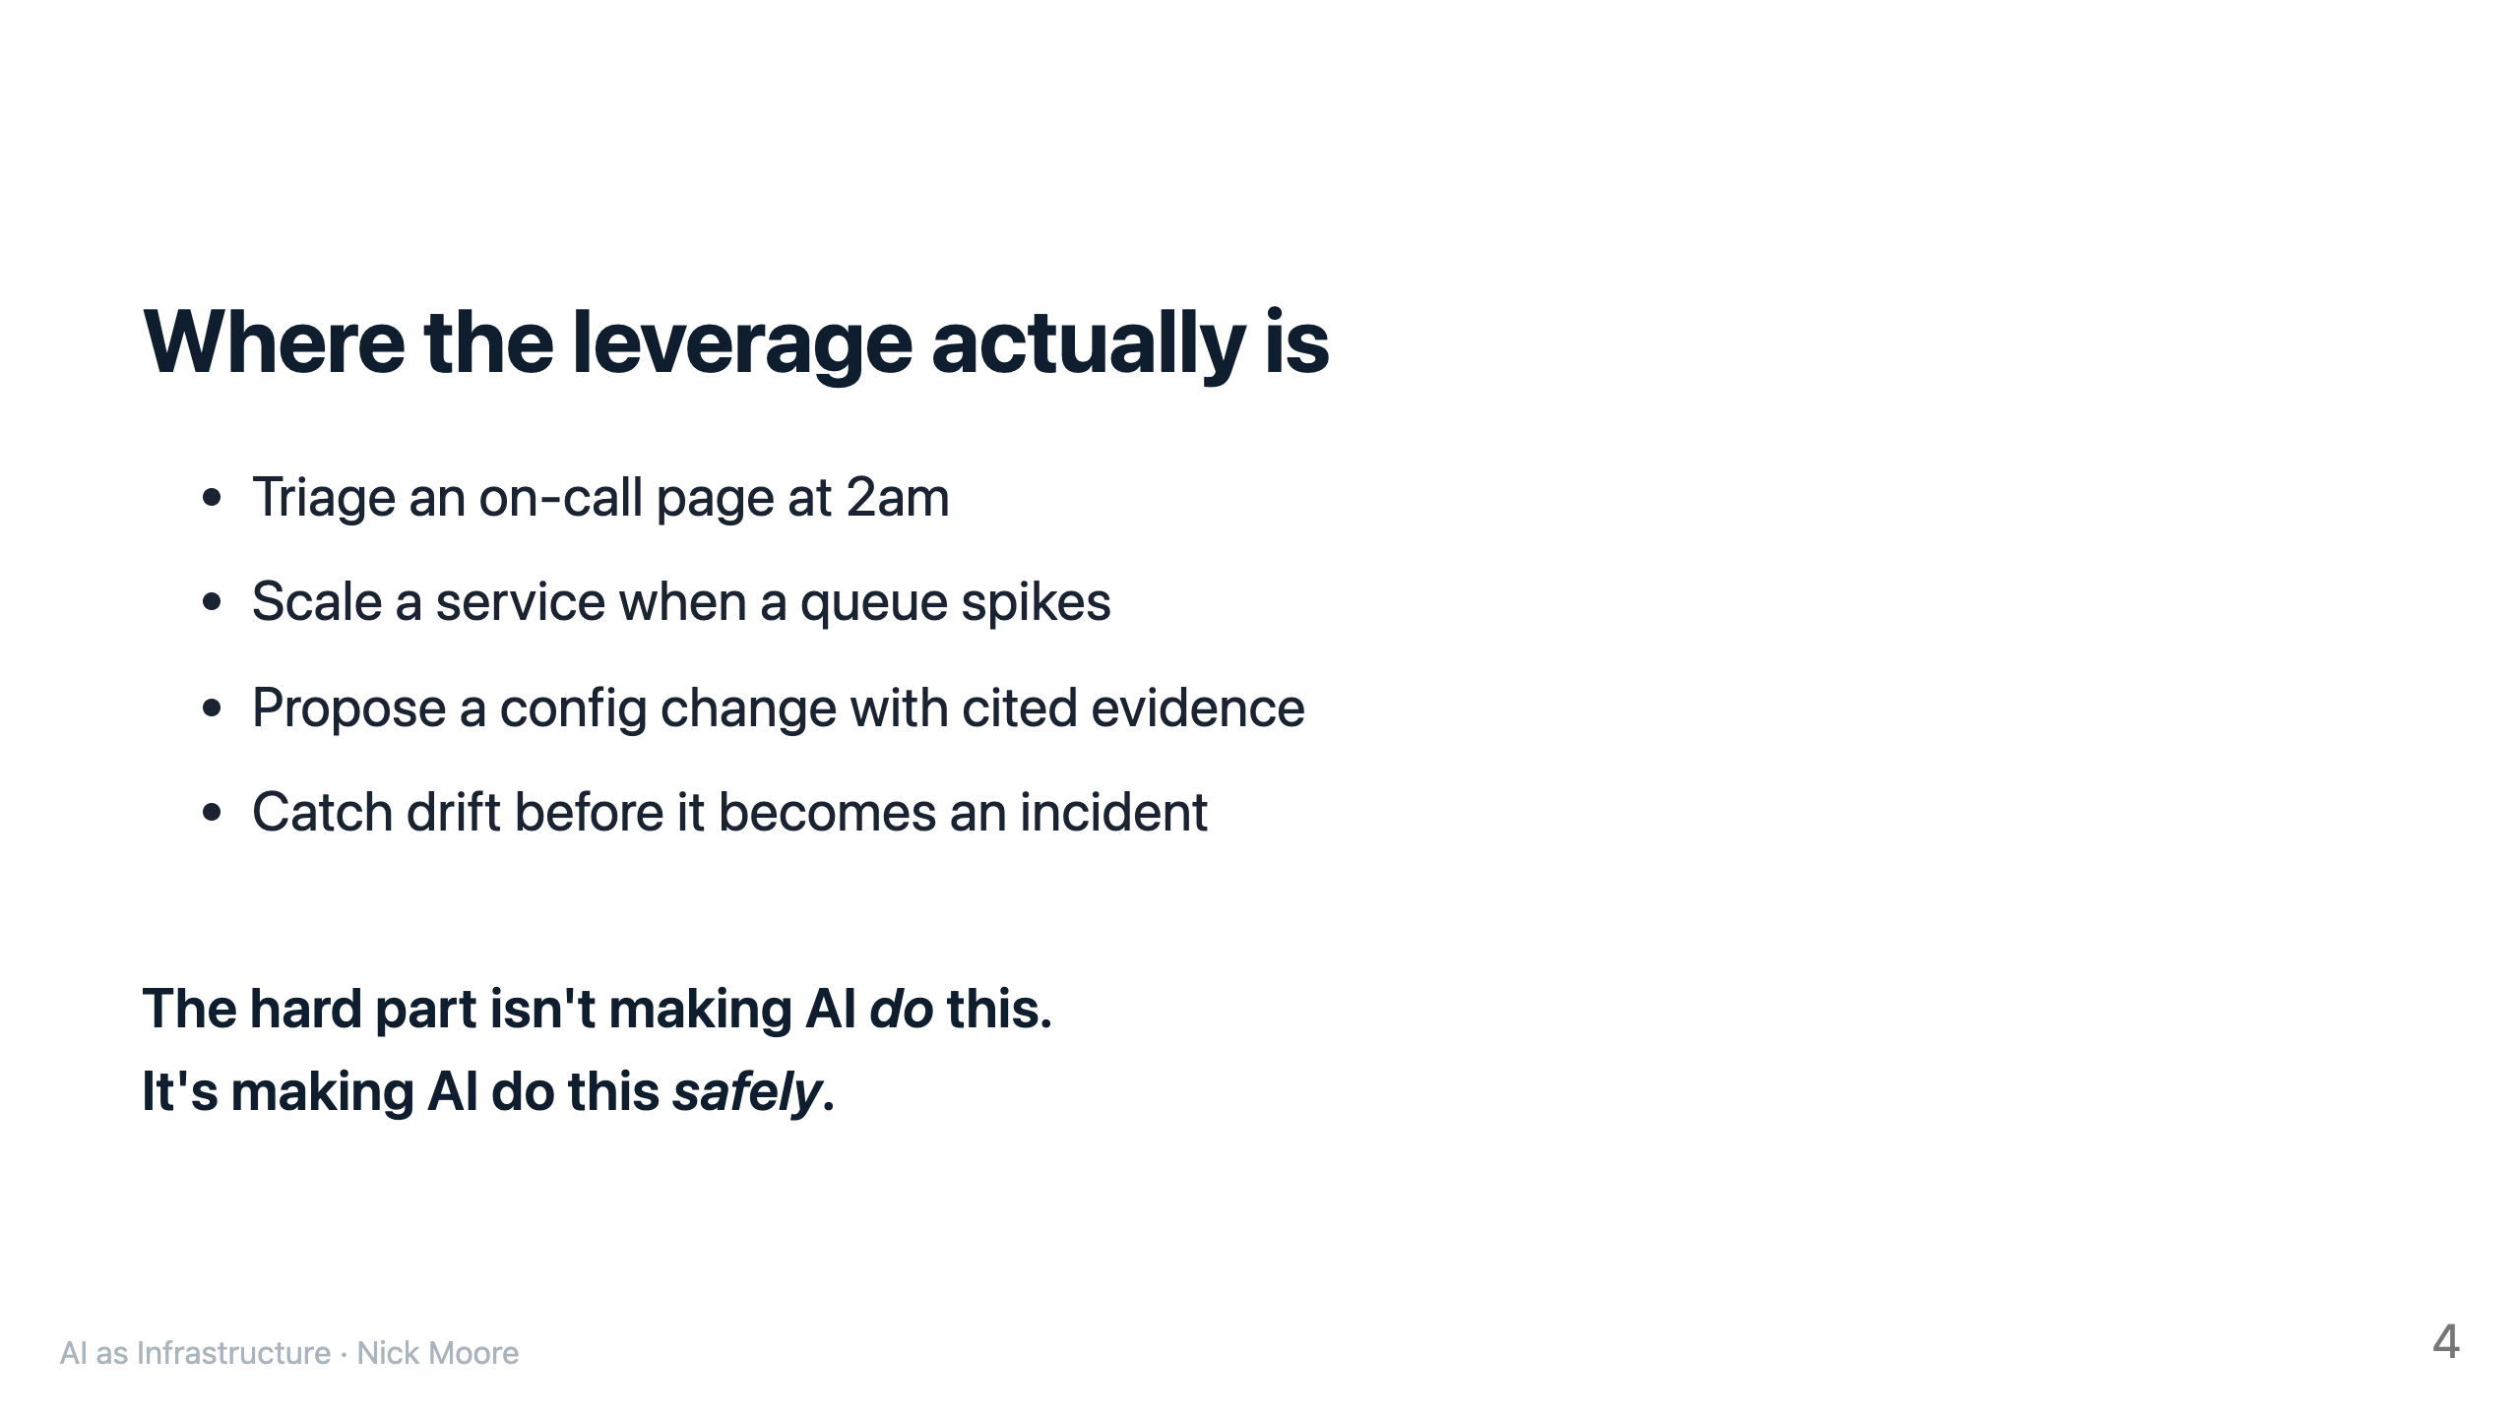

Slide 5
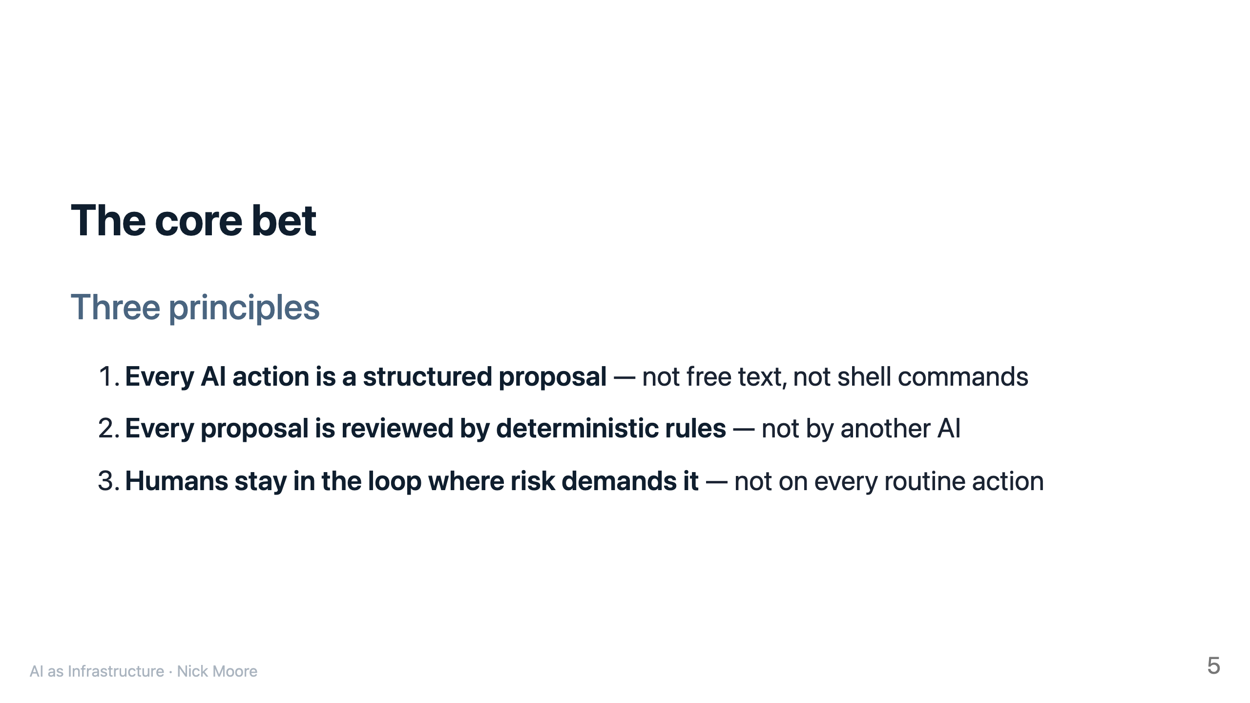

Slide 6
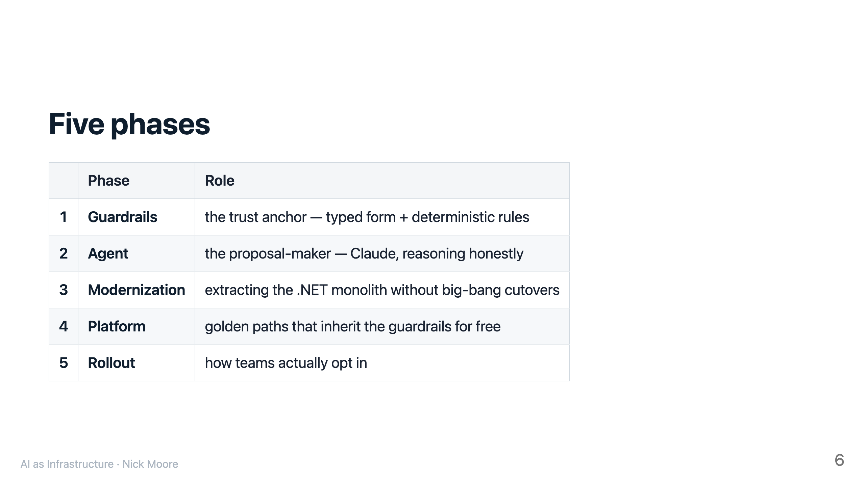

Slide 7
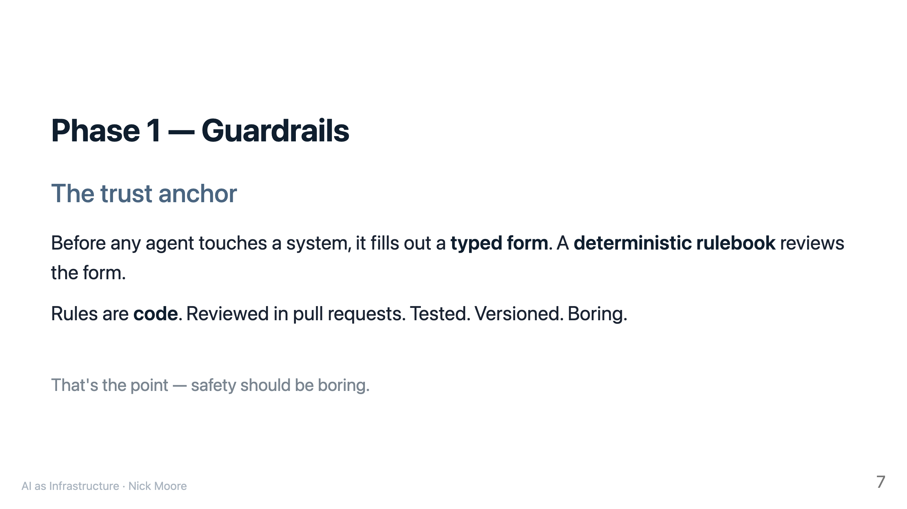

Slide 8
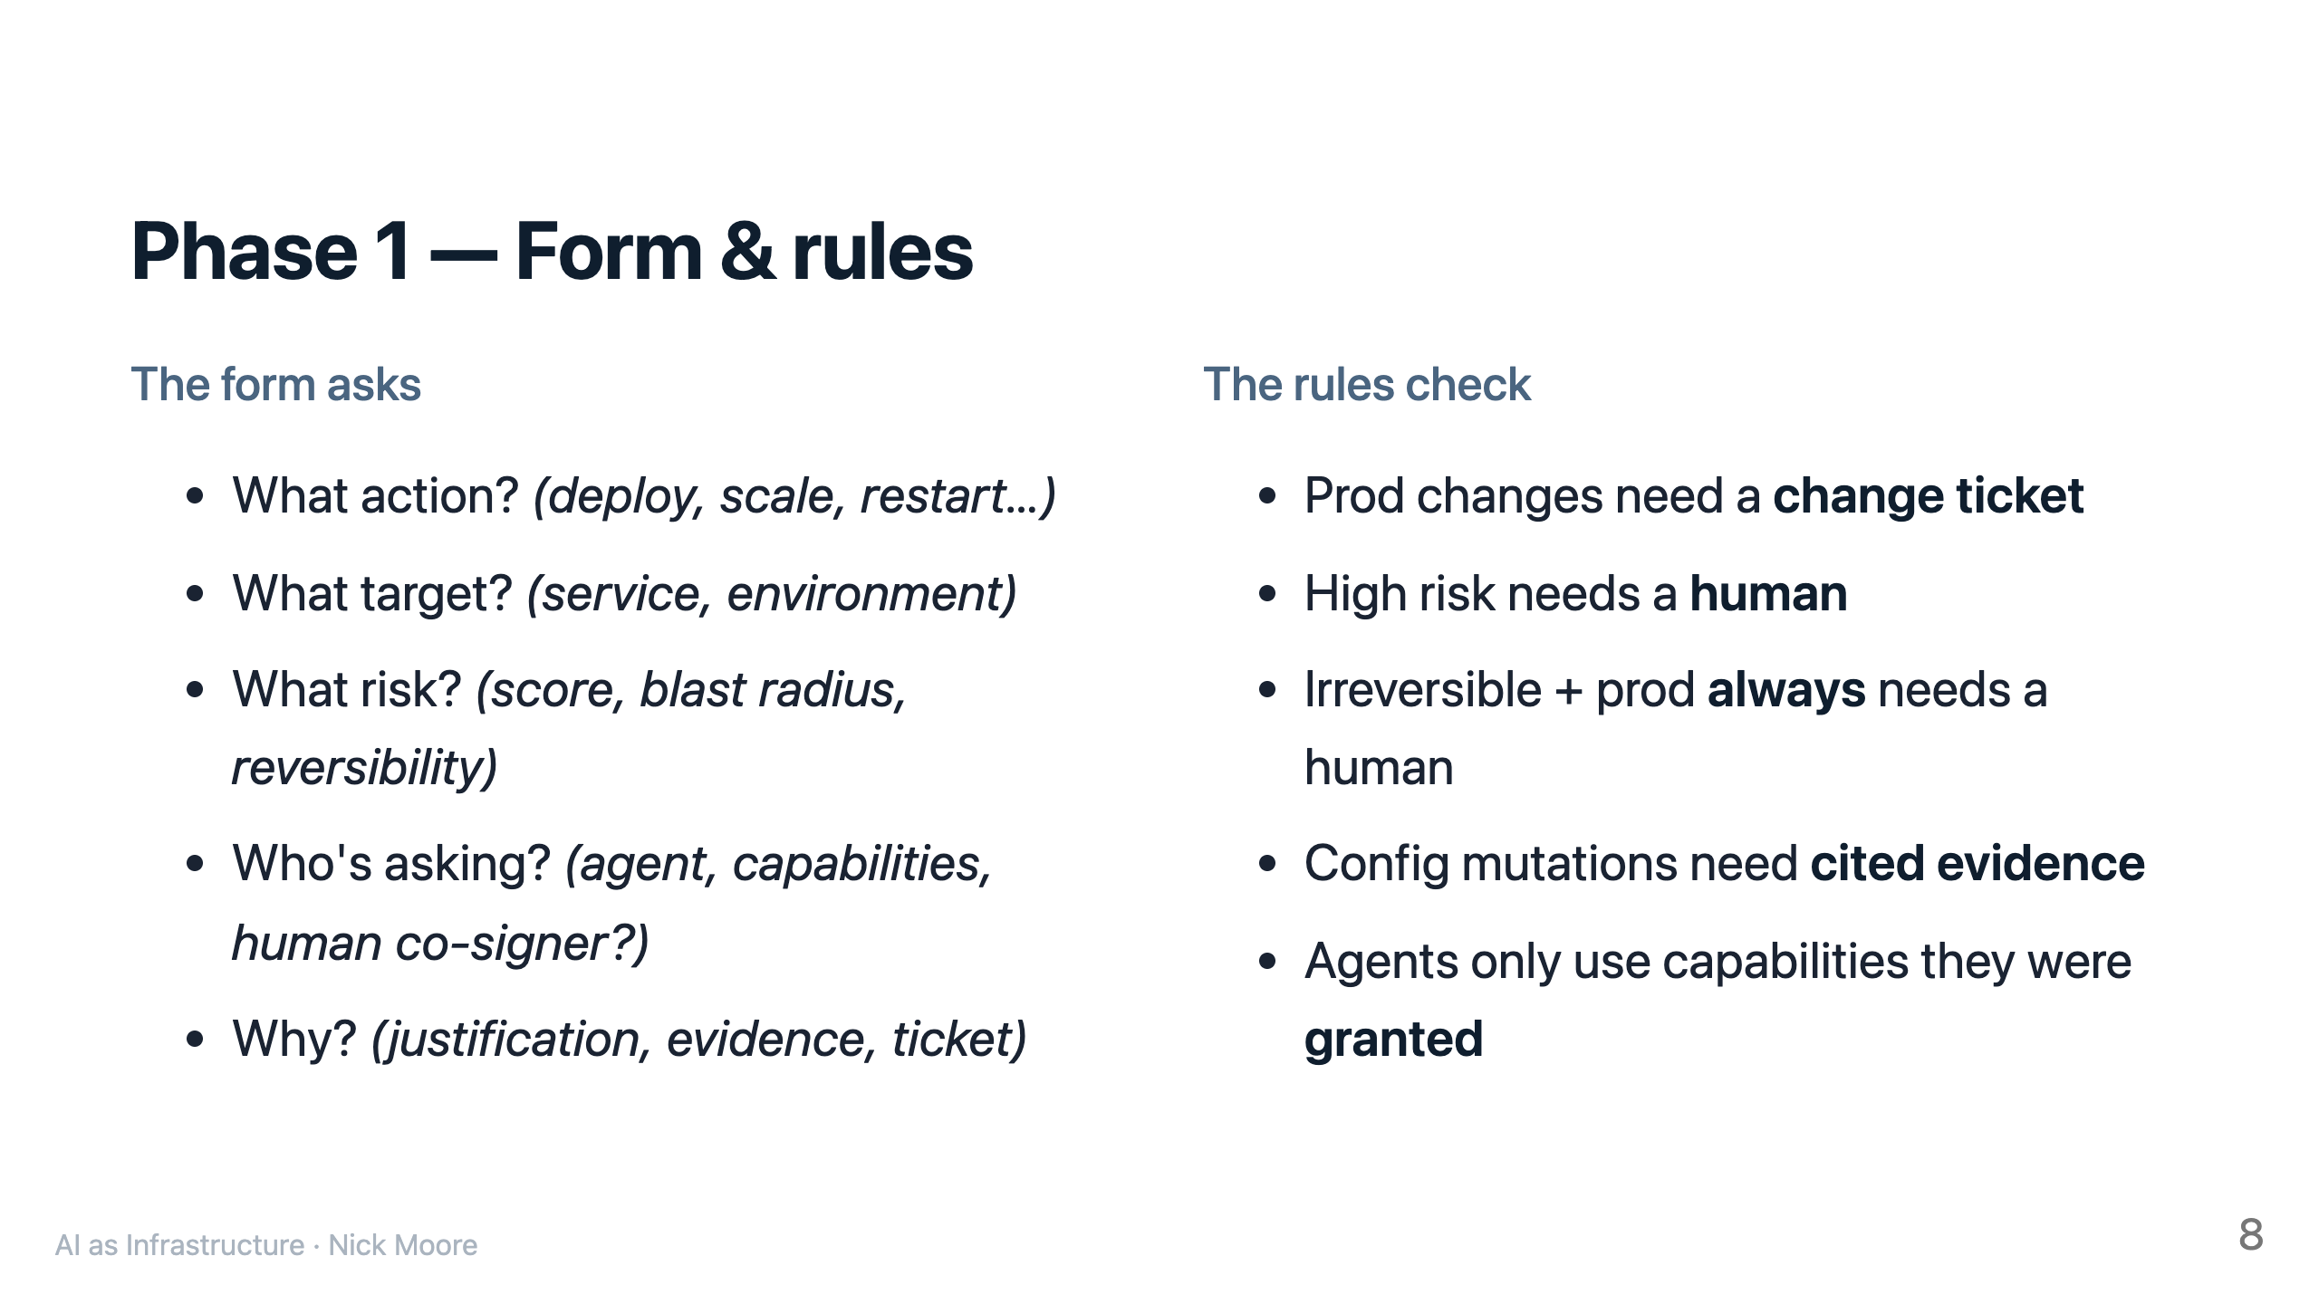

Slide 9
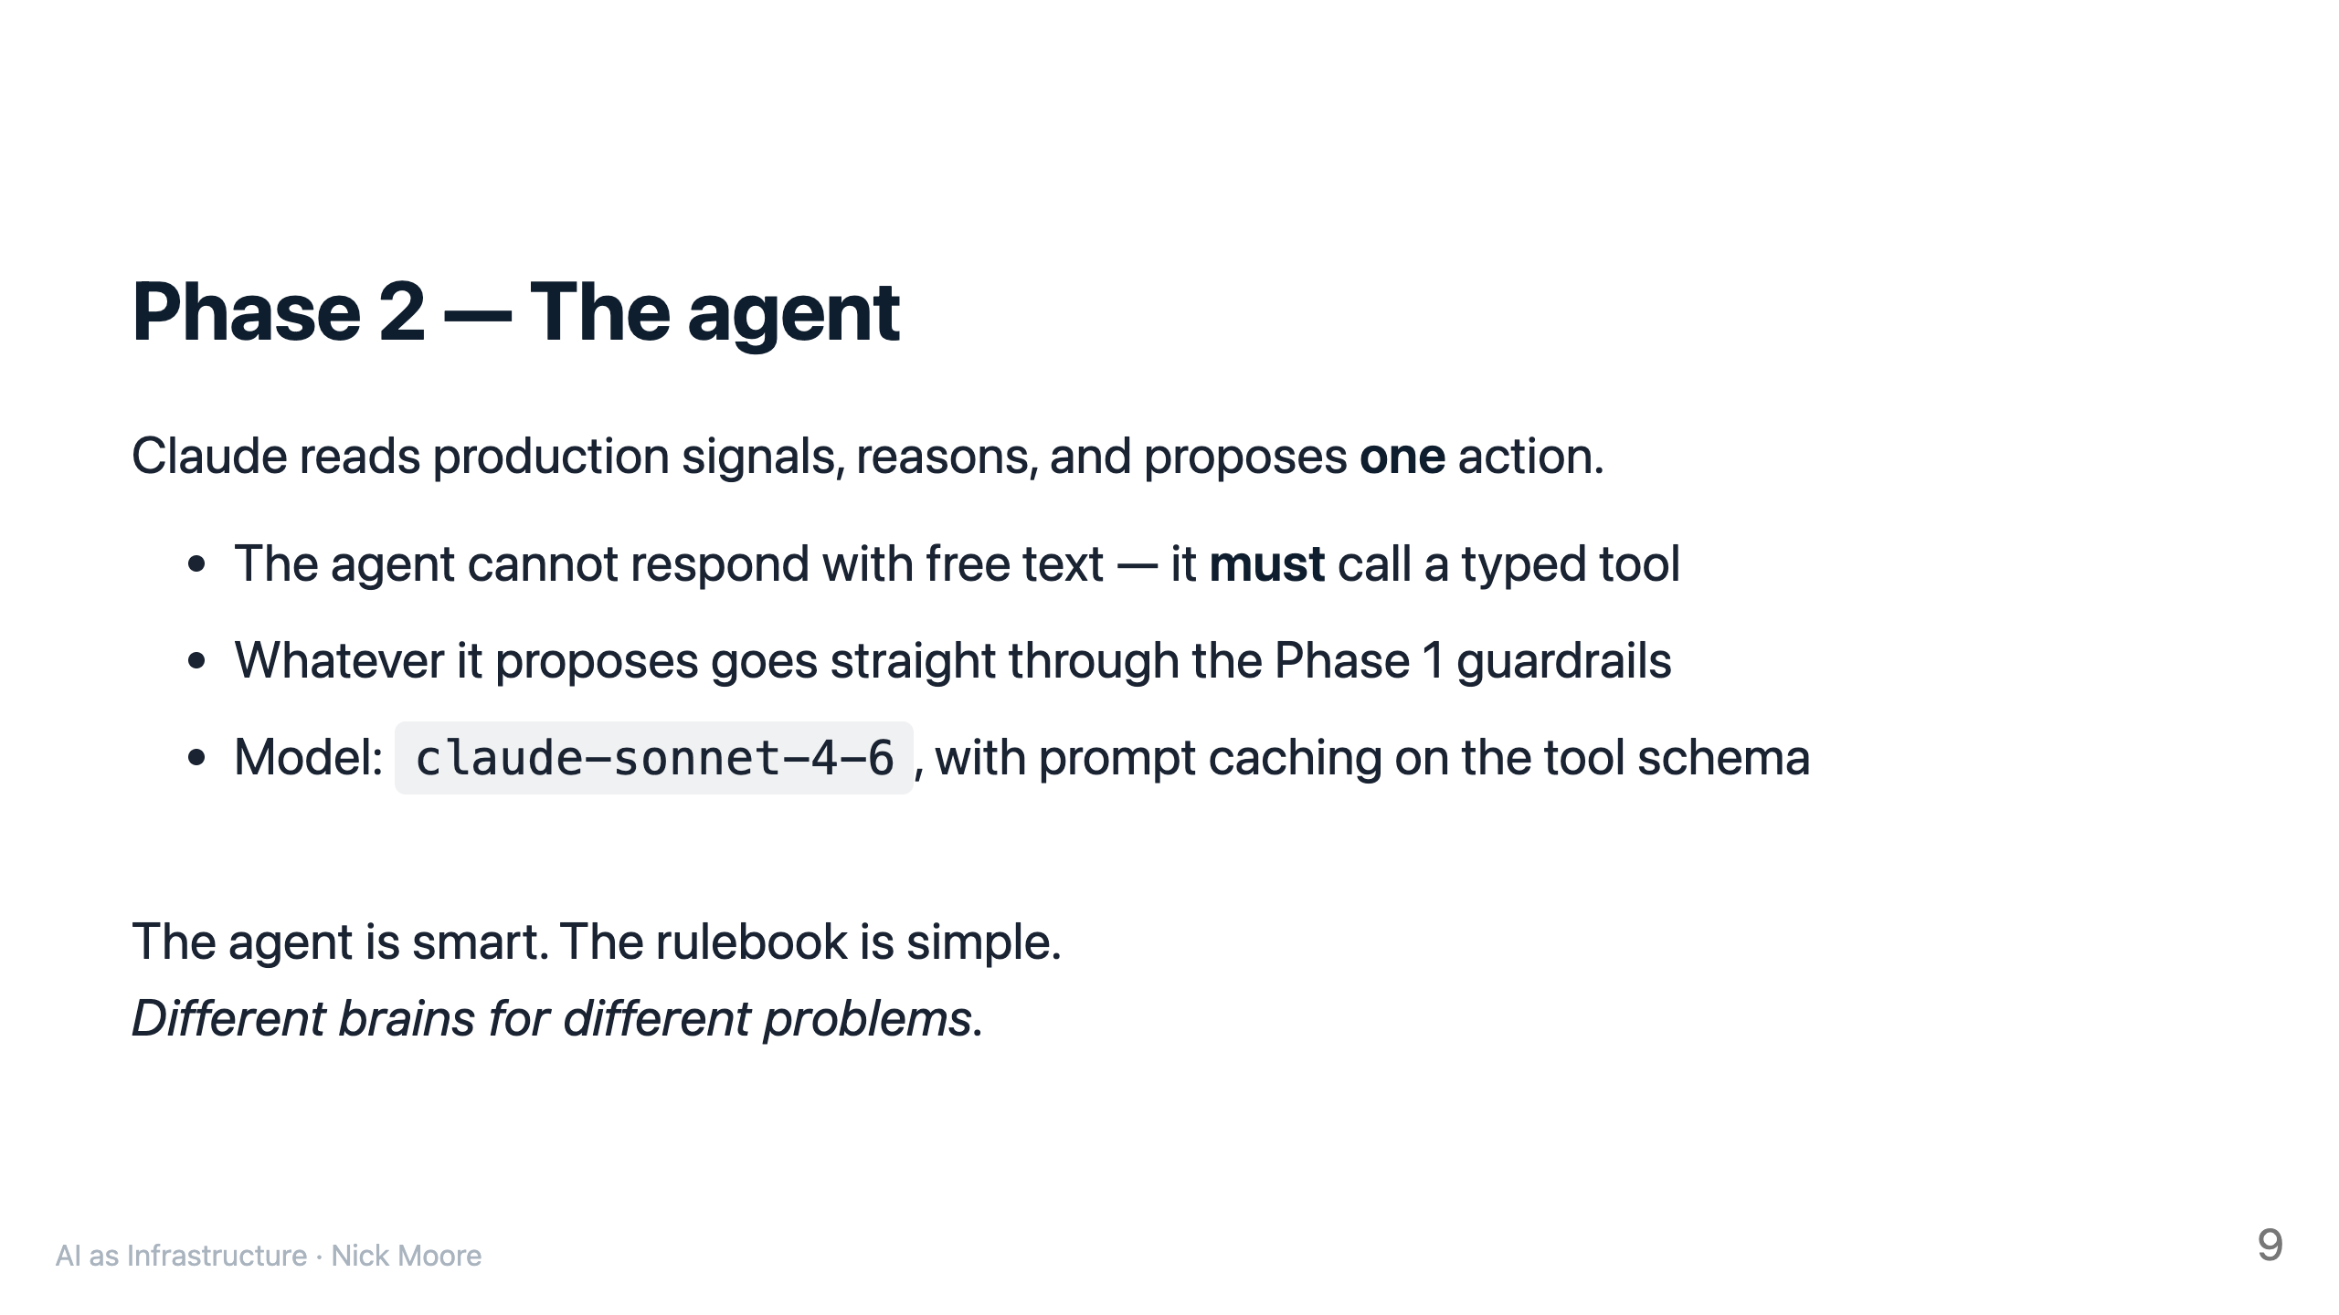

Slide 10
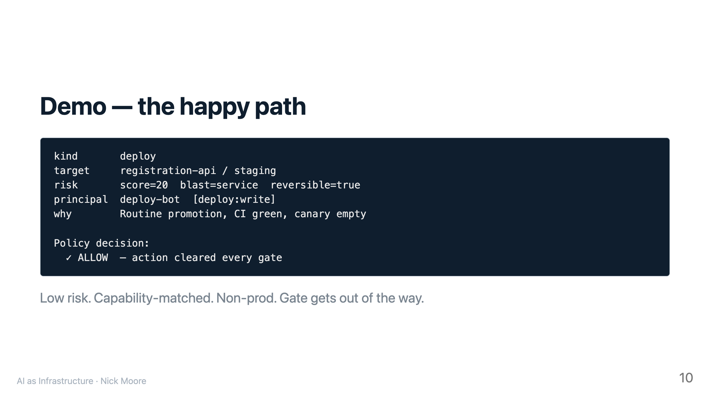

Slide 11
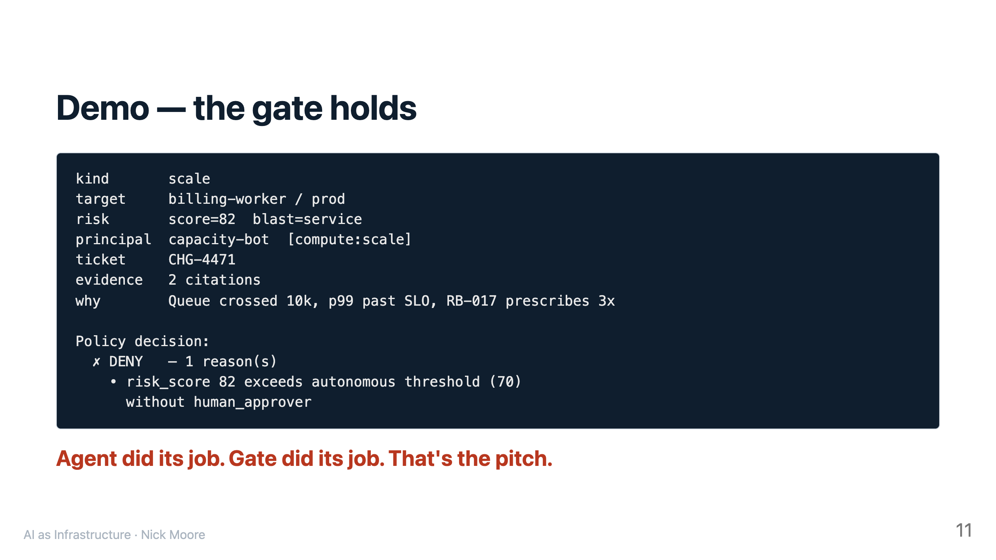

Slide 12
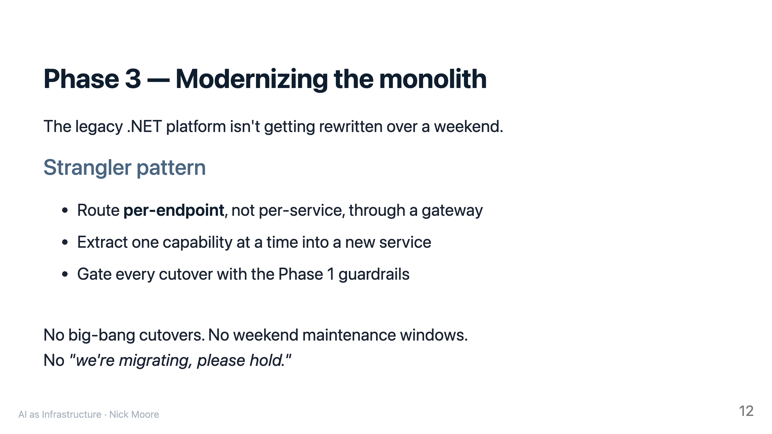

Slide 13
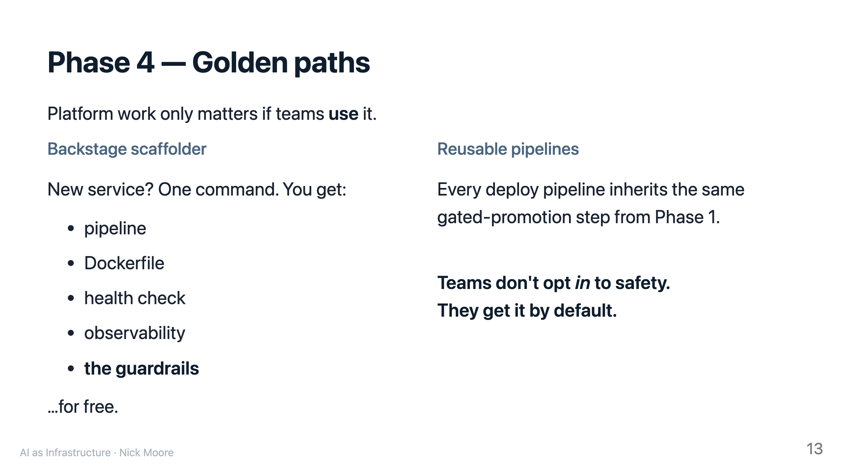

Slide 14
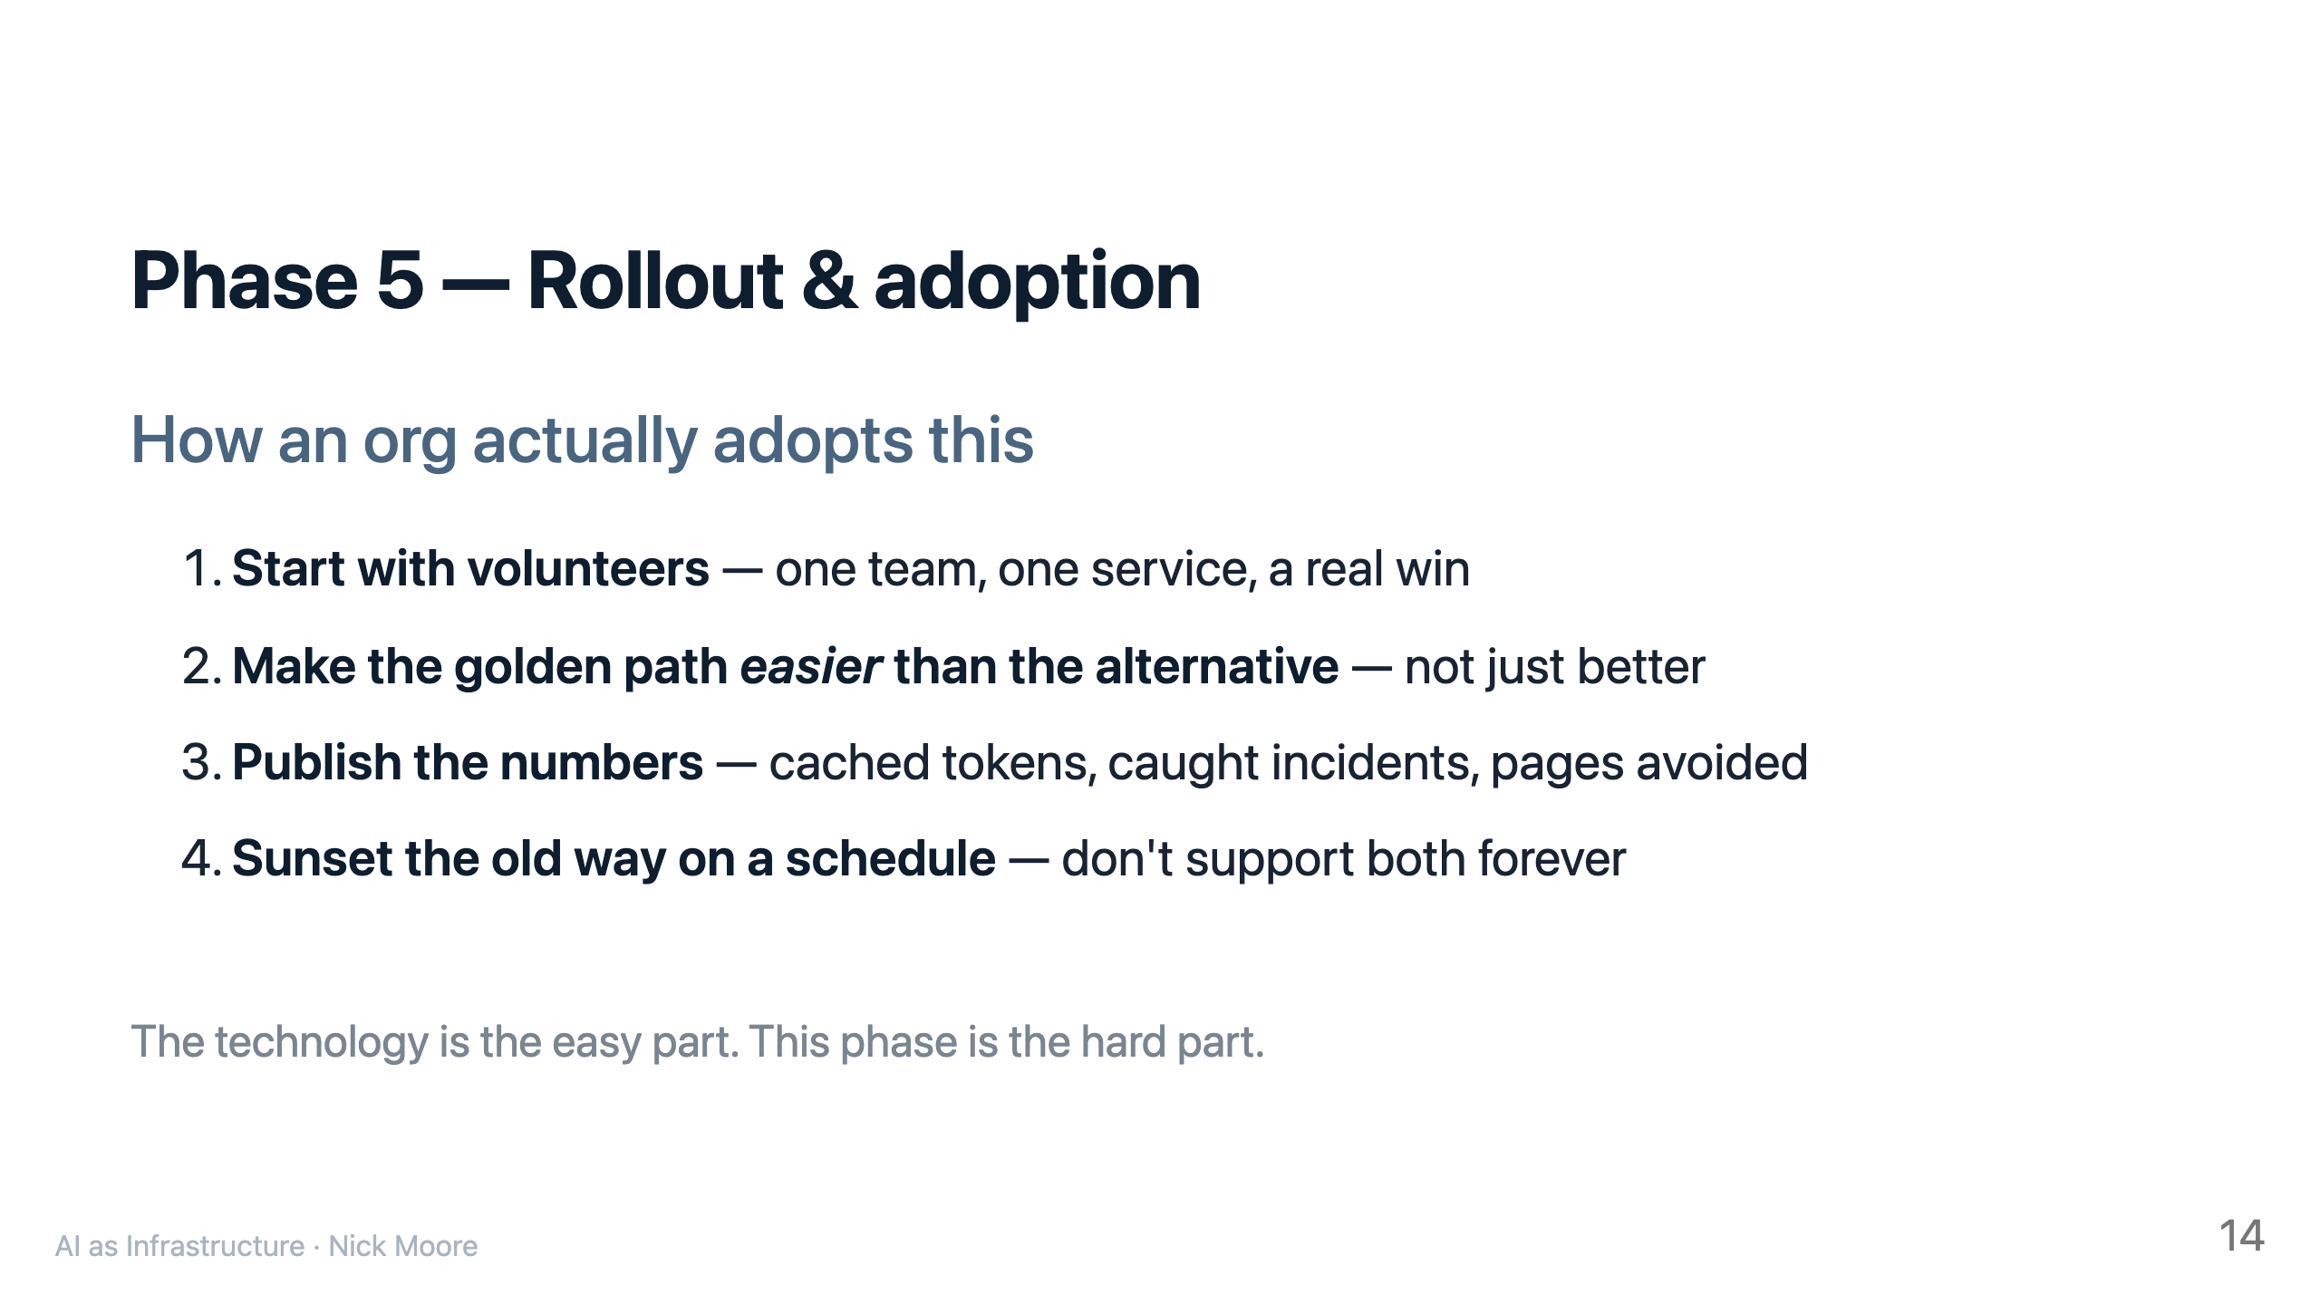

Slide 15
