Slide 1
阅读关键词
by SoftNGR
(陈大慧, 郑飘旦, 郑健衡)

Slide 2
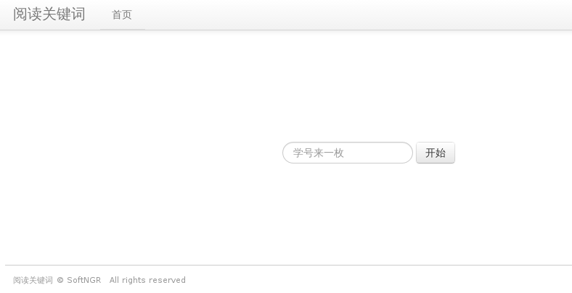
首页

Slide 3
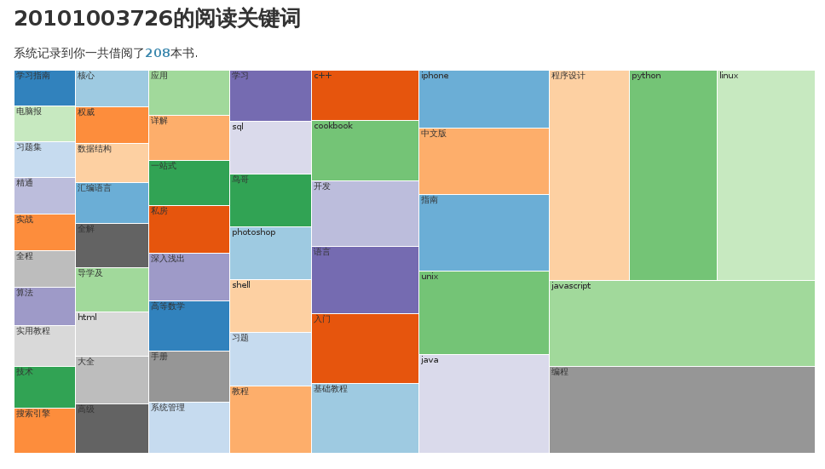
结果展示

Slide 4
流程
输入学号> 获取XML结果> 解析XML>
获取title字符串>分词、取权重（TF-IDF）>
生成JSON API> D3 treemap 绘图 > over

Slide 5
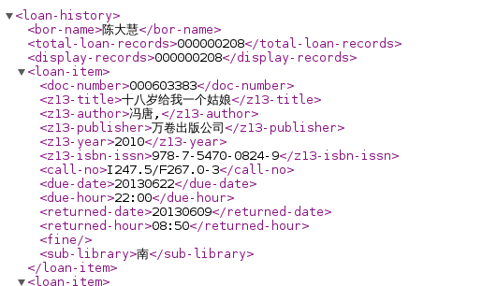
XML 结果

Slide 6
JSON API
{
"name": "kw",
"children": [
{
"name": "\u6307\u5357",
"size": 0.17859379620073054
},
{
"name": "photoshop",
"size": 0.077628360408441566
},
{
"name": "\u7cfb\u7edf\u7ba1\u7406",
"size": 0.074128383131168832
},
{
"name": "\u5165\u95e8",
"size": 0.13339275527206168
}
]
}

Slide 7
Thank you
github:
https://github.com/holys/jieba
https://github.com/holys/Homework/tree/master/NLP/Keyword

