Slide 1
Networking In the Linux Kernel (kerNet)
Lecture 11
TCP Structures In the Kernel, Assortment of Sockets

Slide 2
Announcements
Peer 1 Reviews available
Click “View Grade” by Peer Review Return: Assignment 1
Download your PDFs
Assignment 2 due Thursday night
GFP_USER is not your friend!
Pre-allocate your 2-D array in user-space
Static arrays may also do weird things: char** x; and then manual allocation usually works out better than char x[256][256].

Slide 3
Assignment 2 Discussion
Why does the sleep() cause issues?

Slide 4
Testing Discussion
“Basic arguments” – What does this mean?
“I ran the standard test” - What does this mean?
“When I tried with invalid arguments” – What does this mean?
When you run multiple tests in a row, it’s possible they could be related! But the ordering of tests (and the exact details) were rarely shared
“Multiple clients” / “Ran clients and killed the server” – when? How many clients? Did some/all of them finish writing?
Notes:
TODO: FILL ME IN!

Slide 5
Testing Discussion
Screenshots are not required but can be helpful
Exact commands and the order you run them in are also useful
“I tried with values of x from 0 to 5” … is that
0, 3, 5?
0,1,2,3,4,5?
???
OS, compiler version, etc. can be helpful but I’ll consider “extra”
If you can’t reproduce a bug, it’s still worth providing as much detail as you can – perhaps the original coder will have insight / will be able to run your tests many times and see the bug happen.

Slide 6
Testing Discussion
Very few students had enough description to be sure I was reproducing their tests correctly (especially when there were multiple runs required).
I'll be much pickier in future peer reviews about your explanation of testing!
Communication intensive course – and being able to communicate precisely about testing is important (arguably more so than essay-style writing will be in most of your careers)

Slide 7
Sources for Today
Kurose, James F. and Ross, W. Keith. Computer Networking A Top-Down Approach. Pearson Education Inc., 2006.
Basically just for the TCP header

Slide 8
Quick Teaser About Windows…
/* Update our send window.
*
* Window update algorithm, described in RFC793/RFC1122 (used in linux-2.2
* and in FreeBSD. NetBSD's one is even worse.) is wrong.
*/
static int tcp_ack_update_window(struct sock *sk, const struct sk_buff *skb, u32 ack, u32 ack_seq)
Notes:
Our goal is not to study this function, but it’s clear that at some point (assuming this comment is up to date – it’s been around a while!) the Linux kernel designers felt there was a mistake in how the TCP window update was done, and wrote their own modifications to the algorithm. Whether or not they were correct, this shows that different systems take their own creative license with the RFCs. In a closed source system you never know exactly what’s going on. Then again most of us probably don’t read our OS code even if we have an open system… and these modifications seem to interact with other systems well enough that we don’t say “TCP in Linux/Windows/etc. is broken”

Slide 9
TCP Header

Slide 10
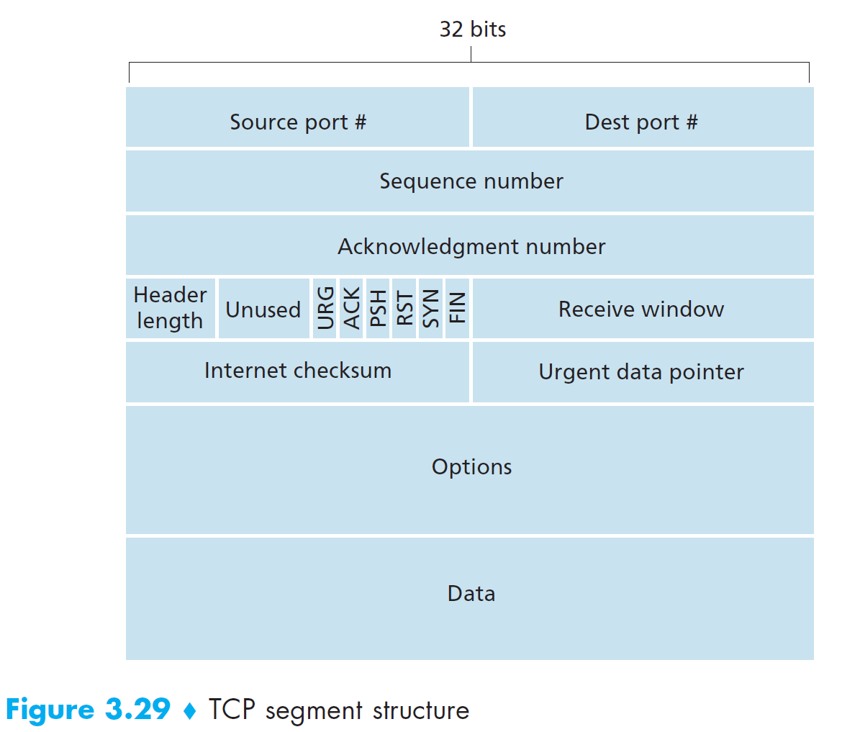
TCP Segment Structure

Slide 11
A Few Header Notes
This gives us the basic header layout
We haven’t discussed options
We might have a variable number of TCP options.
Not all options have the same length
Header length is 4 bits, representing the number of 4-byte words the header-with-options takes
Without options, we’re looking at 20 bytes (5 words), you’ll often see 0x5
Remember this is a half-byte, so it’ll get mashed together with “unused” to yield 0x50. With RFC 3540 you might see 0x51, 9th flag bit!
Notes:
Exciting bonus note – Linux doesn’t like to deal with unaligned options during construction (perhaps parsing incoming segments is okay. Hopefully it is. We might see the code later in the semester.) so if an option doesn’t align to a multiple of 4 bytes, Linux will add padding prior to the next option. Might be a good little tidbit to remember for Project 1.

Slide 12
Header in the Kernel
tcp_hdr(skb) returns a pointer to the transport header data in skb
The return type is struct tcphdr* defined in <linux/uapi/tcp.h>
Let’s pull it up and compare it to the TCP Segment Structure graphic from earlier

Slide 13
tcphdr (1/3)
struct tcphdr {
__be16 source;
__be16 dest;
__be32 seq;
__be32 ack_seq;
Notes:
Source and destination port
Sequence number
Ack number
Easy!

Slide 14
tcphdr (2/3)
#elif defined(__BIG_ENDIAN_BITFIELD)
__u16 doff:4,
res1:4,
cwr:1,
ece:1,
urg:1,
ack:1,
psh:1,
rst:1,
syn:1,
fin:1;
Notes:
Just choosing the big endian arbitrarily, but you can just look at the names. Since we specify WHERE in the u16 each field is, you don’t have to do any annoying math yourself!
You can run lscpu and look for the “Byte Order” field. (Do this on WSL to demonstrate) – probably little endian.
doff = data offset = header length. (If you took the base address of the transport header + 4*doff, you should get to the data no matter how many options there are).
res1 is reserved space (the blank area before the flags)
Then we have each possible flag marked.
You might notice CWR and ECE weren’t in our diagram – these are ECN bits that use some of the reserved space between doff and flags! Exactly the intent of that reserved space!

Slide 15
tcphdr (3/3)
#endif
__be16 window;
__sum16 check;
__be16 urg_ptr;
};
Notes:
Receive window, checksum, and urgent pointer (used for URG, which is for out of band TCP data. Rarely used but we do support it and it can create quite a mess in other code we look at!)

Slide 16
tcphdr enum
enum {
TCP_FLAG_CWR = __constant_cpu_to_be32(0x00800000),
TCP_FLAG_ECE = __constant_cpu_to_be32(0x00400000),
TCP_FLAG_URG = __constant_cpu_to_be32(0x00200000),
TCP_FLAG_ACK = __constant_cpu_to_be32(0x00100000),
TCP_FLAG_PSH = __constant_cpu_to_be32(0x00080000),
TCP_FLAG_RST = __constant_cpu_to_be32(0x00040000),
TCP_FLAG_SYN = __constant_cpu_to_be32(0x00020000),
TCP_FLAG_FIN = __constant_cpu_to_be32(0x00010000),
TCP_RESERVED_BITS = __constant_cpu_to_be32(0x0F000000),
TCP_DATA_OFFSET = __constant_cpu_to_be32(0xF0000000)
}; [source]

Slide 17
What About TCP Options?
A bunch of #defines for option numbers and lengths in <net/tcp.h>
Look for the definition of TCPOPT_SACK_PERM to find the corresponding blocks
net/ipv4/tcp_input.c: tcp_parse_options()
We normally only do this during handshakes (SYN flag set), slowpath parsing
First attempts tcp_fast_parse_options() which only expects a timestamp
You’ll see doff used here, get used to it - this is the data offset.
If you walk further up the call chain, tcp_fast_parse_options() or tcp_conn_request() or tcp_rcv_fastopen_synack() or tcp_synsent_state_process()
Fast path only called through tcp_validate_incoming() which is…
Getting off track (for now), a lot about PAWS/RST here
Called by tcp_rcv_established() and tcp_rcv_state_process()
Notes:
To get to fast path: Validate incoming -> fast_parse -> if we have more than tstamp, parse_options
Notice many specialized functions for different situations such as synsent, conn request, etc. that jump directly to parse_options (can’t use the fastpath)

Slide 18
TCP Socket Structure
Notes:
Going through this in this manner might be a bad plan, but we’ll start by looking at this massive data structure, and as we start to go through functions in the coming weeks, we’ll see how some of these variables get used…

Slide 19
tcp_sock (1/25)
struct tcp_sock {
/* inet_connection_sock has to be the first member of tcp_sock */
struct inet_connection_sock inet_conn;
u16 tcp_header_len; /* Bytes of tcp header to send */
u16 gso_segs; /* Max number of segs per GSO packet */
/*
* Header prediction flags
* 0x5?10 << 16 + snd_wnd in net byte order
*/
__be32 pred_flags;
Notes:
Why does inet_connection_sock have to be the first member of tcp_sock? Let’s take a look!
A TCP sock (often a variable tp will be used for a tcp_sock*) contains an inet_connection sock at the front (so tcp_sock extends icsk)

Slide 20
Detour: inet_connection_sock
struct inet_connection_sock {
/* inet_sock has to be the first member! */
struct inet_sock icsk_inet;
…
}
struct inet_sock {
/* sk and pinet6 has to be the first two members of inet_sock */
struct sock sk;
#if IS_ENABLED(CONFIG_IPV6)
struct ipv6_pinfo *pinet6;
#endif
Notes:
An icsk contains an inet sock (usually we do inet_sk(sk)->member directly and don’t store an inet_sk(sk) variable unlike tp, icsk, sk) at the front (icsk extends inet_sk)
An inet sock contains a network socket (sock) – not network layer specifically just network as opposed to the “struct socket” that is the Berkeley socket, so inet_sock extends sock

Slide 21
Detour: sock
struct sock {
/*
* Now struct inet_timewait_sock also uses sock_common, so please just
* don't add nothing before this first member (__sk_common) --acme
*/
struct sock_common __sk_common;
/**
* struct sock_common - minimal network layer representation of sockets
Notes:
Finally, every sock contains a sock_common at the start – and we even get mention of another inet socket type!

Slide 22
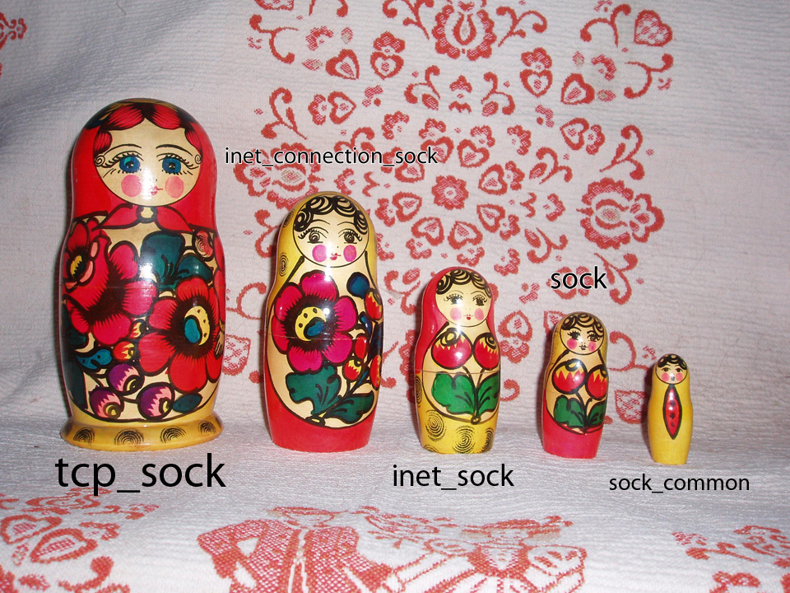
tcp_sock -> sock_common
Modified from https://en.wikipedia.org/wiki/Matryoshka_doll#/media/File:Russian-Matroshka.jpg, CC BY-SA 3.0

Slide 23
tcp_sock (2/25)
/*
* RFC793 variables by their proper names. This means you can
* read the code and the spec side by side (and laugh ...)
* See RFC793 and RFC1122. The RFC writes these in capitals.
*/
u64 bytes_received; /* RFC4898 tcpEStatsAppHCThruOctetsReceived
* sum(delta(rcv_nxt)), or how many bytes
* were acked.
*/
u32 segs_in; /* RFC4898 tcpEStatsPerfSegsIn
* total number of segments in.
*/
u32 data_segs_in; /* RFC4898 tcpEStatsPerfDataSegsIn
* total number of data segments in.
*/
Notes:
RFC 793 is the DARPA TCP spec, 1981. That’s 40 years ago!!! RFC4898 = MIB stuff – used for statistics counting.

Slide 24
tcp_sock (3/25)
u32 rcv_nxt; /* What we want to receive next */
u32 copied_seq; /* Head of yet unread data */
u32 rcv_wup; /* rcv_nxt on last window update sent */
u32 snd_nxt; /* Next sequence we send */
u32 segs_out; /* RFC4898 tcpEStatsPerfSegsOut
* The total number of segments sent.
*/
Notes:
rcv_next -> what we’ll report as our ack number in ACK
snd_next -> next byte we'll use for a seq
rcv_wup -> what was the last advertised rwnd? (Used so that WE know our sending limits based on receiver feedback, i.e. Flow Control)

Slide 25
tcp_sock (4/25)
u32 data_segs_out; /* RFC4898 tcpEStatsPerfDataSegsOut
* total number of data segments sent.
*/
u64 bytes_sent; /* RFC4898 tcpEStatsPerfHCDataOctetsOut
* total number of data bytes sent.
*/
u64 bytes_acked; /* RFC4898 tcpEStatsAppHCThruOctetsAcked
* sum(delta(snd_una)), or how many bytes
* were acked.
*/
u32 dsack_dups; /* RFC4898 tcpEStatsStackDSACKDups
* total number of DSACK blocks received
*/
Notes:
Skip right past, more stats variables!

Slide 26
tcp_sock (5/25)
u32 snd_una; /* First byte we want an ack for */
u32 snd_sml; /* Last byte of the most recently transmitted small packet */
u32 rcv_tstamp; /* timestamp of last received ACK (for keepalives) */
u32 lsndtime; /* timestamp of last sent data packet (for restart window) */
u32 last_oow_ack_time; /* timestamp of last out-of-window ACK */ u32 compressed_ack_rcv_nxt;
Minshall’s modification to Nagle’s algorithm: [here]
TCP SACK Compression added in 4.19.7: [discussion]
Notes:
snd_una is the important one here, but observe there's a lot more going on than what's needed for "Textbook TCP“
A lot of these variables make more sense if we find functions that use them… but not always! “unacked” = “unacked”
“small packet” likely has to do with Nagle’s algorithm. A search gets you a few functions with “Minshall” in the name, a draft was submitted in 1999
It’s not too heavy a read, but we won’t read it together. The draft explains Nagle’s algorithm (wait before sending more data if you can’t make a full packet), Delayed ACKs (wait until you receive 2 packets or until you have data to send so you can piggyback – an ACK with no data is probably inefficient due to overhead of the TCP header), and what Minshall’s modification is (which requires snd.sml)

Slide 27
tcp_sock (6/25)
u32 tsoffset; /* timestamp offset */
struct list_head tsq_node; /* anchor in tsq_tasklet.head list */
struct list_head tsorted_sent_queue; /* time-sorted sent but un-SACKed skbs */
/* Data for direct copy to user */
struct ucopy; <----- no longer exists, see [prequeue discussion]
Notes:
Thank goodness we simplified a bit. There used to be FOUR possible receive queues to read from.

Slide 28
Detour: tsq?
/* TCP SMALL QUEUES (TSQ)
*
* TSQ goal is to keep small amount of skbs per tcp flow in tx queues (qdisc+dev)
* to reduce RTT and bufferbloat.
* We do this using a special skb destructor (tcp_wfree).
*
* Its important tcp_wfree() can be replaced by sock_wfree() in the event skb
* needs to be reallocated in a driver.
* The invariant being skb->truesize subtracted from sk->sk_wmem_alloc
*
* Since transmit from skb destructor is forbidden, we use a tasklet
* to process all sockets that eventually need to send more skbs.
* We use one tasklet per cpu, with its own queue of sockets.
*/
struct tsq_tasklet {
Notes:
Tx = Transmit, Rx= Receive
This is a detour… let's not think on this too hard and keep our pattern of looking at "core TCP" as much as possible.
This is all optimizations you won't find in textbook TCP. Bufferbloat is another neat thing… video about it was linked in last Monday’s lecture.

Slide 29
TSQ Supplemental Reading
https://lwn.net/Articles/507065/
Has a link to the patch proposal, which is at: https://lwn.net/Articles/506237/
Notes:
Eric Dumazet's TCP small queues patch looks like it should be able to fill at least part of that gap [buffer bloat-related management]. It limits the amount of data that can be queued for transmission by any given socket regardless of where the data is queued, so it shouldn't be fooled by buffers lurking in the queueing, traffic control, or netfilter code. -2012
Uses a different skb destructor for accounting reasons.

Slide 30
tcp_sock (7/25)
u32 snd_wl1; /* Sequence for window update */
u32 snd_wnd; /* The window we expect to receive */
u32 max_window; /* Maximal window ever seen from peer */
u32 mss_cache; /* Cached effective mss, not including SACKS */
u32 window_clamp; /* Maximal window to advertise */
u32 rcv_ssthresh; /* Current window clamp */
Notes:
More window variables.
Advertise is what we call sending out a window.

Slide 31
SND.WL2?
From RFC793:
SND.WL1 - segment sequence number used for last window update
SND.WL2 - segment acknowledgment number used for last window update
These plus some other variables should be in a “Transmission Control Block, or TCB” but we have them in tcp_sock
Not to be confused with tcp_skb_cb (discussed next time)
Claim: WL2 is redundant
Reading: https://www.ietf.org/mail-archive/web/tsvwg/current/msg03445.html
Notes:
We’re not going to discuss this, but this is why you won’t see snd_wl2 in the tcp_sock implementation

Slide 32
tcp_sock (8/25)
/* Information of the most recently (s)acked skb */
struct tcp_rack {
struct skb_mstamp mstamp; /* (Re)sent time of the skb */
u8 advanced; /* mstamp advanced since last lost marking */
u8 reord; /* reordering detected */
} rack;
See also, comment above tcp_rack_detect_loss() and draft-ietf-tcpm-rack-01
Lots of work on this – two years ago we were on revision 05, last year revision 11.
Current version is a full RFC: RFC 8985
Notes:
Skipping right past this! There are a couple more members in the rack struct now.
RACK: a time-based fast loss detection algorithm for TCP
draft-ietf-tcpm-rack-01

Slide 33
tcp_sock (9/25)
u16 advmss; /* Advertised MSS */
u8 compressed_ack;
u8 dup_ack_counter:2,
tlp_retrans:1, /* TLP is a retransmission */
unused:5;
u32 chrono_start; /* Start time in jiffies of a TCP chrono */
u32 chrono_stat[3]; /* Time in jiffies for chrono_stat stats */
u8 chrono_type:2, /* current chronograph type */
rate_app_limited:1, /* rate_{delivered,interval_us} limited? */
….
Notes:
advmss is the receive window WE send out when WE are the receiver.
This u8 with dup_ack_counter is NEW
Truncating the rate_app_limited u8 for the interest of space. Go look at the code if you really care, has some fastopen options. Interestingly, last year (2019) this was just “rate_app_limited:1” and “unused:7”

Slide 34
tcp_sock (10/25)
u8 nonagle : 4,/* Disable Nagle algorithm? */
thin_lto : 1,/* Use linear timeouts for thin streams */
thin_dupack : 1,/* Fast retransmit on first dupack */
repair : 1,
frto : 1;/* F-RTO (RFC5682) activated in CA_Loss */
This part actually comes AFTER the next slide, just putting it here for space reasons:
u32 tcp_tx_delay; /* delay (in usec) added to TX packets */
u64 tcp_wstamp_ns; /* departure time for next sent data packet */
u64 tcp_clock_cache; /* cache last tcp_clock_ns() (see tcp_mstamp_refresh()) */
Notes:
Speed through here. Do mention F-RTO is a little dense, not too bad on paper though but has some implications that *really* change behavior of TCP

Slide 35
tcp_sock (11/25)
u8 repair_queue;
u8 do_early_retrans:1,/* Enable RFC5827 early-retransmit */
syn_data:1, /* SYN includes data */
syn_fastopen:1, /* SYN includes Fast Open option */
syn_fastopen_exp:1,/* SYN includes Fast Open exp. option */
syn_data_acked:1,/* data in SYN is acked by SYN-ACK */
save_syn:1, /* Save headers of SYN packet */
is_cwnd_limited:1;/* forward progress limited by snd_cwnd? */
u32 tlp_high_seq; /* snd_nxt at the time of TLP retransmit. */
Notes:
Skip through here as well. Point is we have a lot of flags.

Slide 36
tcp_sock (12/25)
/* RTT measurement */
u32 srtt_us; /* smoothed round trip time << 3 in usecs */
u32 mdev_us; /* medium deviation */
u32 mdev_max_us; /* maximal mdev for the last rtt period */
u32 rttvar_us; /* smoothed mdev_max */
u32 rtt_seq; /* sequence number to update rttvar */
struct minmax rtt_min;
Notes:
Hey, we talked about RTT measurement before, now you can see some of the members…

Slide 37
tcp_sock (13/25)
u32 packets_out; /* Packets which are "in flight" */
u32 retrans_out; /* Retransmitted packets out */
u32 max_packets_out; /* max packets_out in last window */
u32 max_packets_seq; /* right edge of max_packets_out flight */
u16 urg_data; /* Saved octet of OOB data and control flags */
u8 ecn_flags; /* ECN status bits. */
u8 keepalive_probes; /* num of allowed keep alive probes */
u32 reordering; /* Packet reordering metric. */
u32 snd_up; /* Urgent pointer */
Notes:
Speed on through…

Slide 38
tcp_sock (14/25)
/*
* Options received (usually on last packet, some only on SYN packets).
*/
struct tcp_options_received rx_opt;
/*
* Slow start and congestion control (see also Nagle, and Karn & Partridge)
*/
u32 snd_ssthresh; /* Slow start size threshold */
u32 snd_cwnd; /* Sending congestion window */
u32 snd_cwnd_cnt; /* Linear increase counter */
u32 snd_cwnd_clamp; /* Do not allow snd_cwnd to grow above this */
u32 snd_cwnd_used;
u32 snd_cwnd_stamp;
Notes:
All our received options are in rx_opt. Maybe someday we'll take a peek into that struct, for now moving on… here's our send window numbers.
Old Elixir comment: rx_opt will not show up in Elixir, it will in Cscope ~187 times

Slide 39
tcp_sock (15/25)
u32 prior_cwnd; /* Congestion window at start of Recovery. */
u32 prr_delivered; /* Number of newly delivered packets to
* receiver in Recovery. */
u32 prr_out; /* Total number of pkts sent during Recovery. */
u32 delivered; /* Total data packets delivered incl. rexmits */
u32 lost; /* Total data packets lost incl. rexmits */
u32 app_limited; /* limited until "delivered" reaches this val */
u64 first_tx_mstamp; /* start of window send phase */
u64 delivered_mstamp; /* time we reached "delivered" */
u32 rate_delivered; /* saved rate sample: packets delivered */
u32 rate_interval_us; /* saved rate sample: time elapsed */
See [net/ipv4/tcp_rate.c] for more on rate variables
Notes:
Check out net/ipv4/tcp_rate.c for more information on the rate variables. We're gonna speed through.

Slide 40
tcp_sock (16/25)
u32 rcv_wnd; /* Current receiver window */
u32 write_seq; /* Tail(+1) of data held in tcp send buffer */
u32 notsent_lowat; /* TCP_NOTSENT_LOWAT */
u32 pushed_seq; /* Last pushed seq, required to talk to windows */
u32 lost_out; /* Lost packets */
u32 sacked_out; /* SACK'd packets */
u32 fackets_out; /* FACK'd packets */
Notes:
rcv_wnd is important, skip through the rest…
This is OUR receive window. Not the perceived receive window of the other side. (See RFC 793, page 25: A segment is judged to occupy a portion of valid receive sequence space if RCV.NXT =< SEG.SEQ < RCV.NXT+RCV.WND)

Slide 41
tcp_sock (17/25)
struct hrtimer pacing_timer;
struct hrtimer compressed_ack_timer;
/* from STCP, retrans queue hinting */
struct sk_buff* lost_skb_hint;
struct sk_buff *retransmit_skb_hint;
/* OOO segments go in this rbtree. Socket lock must be held. */
struct rb_root out_of_order_queue;
struct sk_buff *ooo_last_skb; /* cache rb_last(out_of_order_queue) */
Notes:
Zoom zoom through. Hints often have to do with SACK.
OOO: Out of Order. Note that the queue uses a red-black tree.

Slide 42
tcp_sock (18/25)
/* SACKs data, these 2 need to be together (see tcp_options_write) */
struct tcp_sack_block duplicate_sack[1]; /* D-SACK block */
struct tcp_sack_block selective_acks[4]; /* The SACKS themselves*/
struct tcp_sack_block recv_sack_cache[4];
struct sk_buff *highest_sack; /* skb just after the highest
* skb with SACKed bit set
* (validity guaranteed only if
* sacked_out > 0)
*/
Notes:
Skip SACK - but point is it REALLY complicates the situation. Suddenly cumulative ACKs don't look like such a bad deal, right?

Slide 43
tcp_sock (19/25)
int lost_cnt_hint;
u32 prior_ssthresh; /* ssthresh saved at recovery start */
u32 high_seq; /* snd_nxt at onset of congestion */
u32 retrans_stamp; /* Timestamp of the last retransmit,
* also used in SYN-SENT to remember stamp of
* the first SYN. */
u32 undo_marker; /* snd_una upon a new recovery episode. */
int undo_retrans; /* number of undoable retransmissions. */
Notes:
Zoom through.
If you followed the link before that led to tcp_recovery.c you might have stumbled upon the term already. Sometime we will be able to UNDO congestion avoidance or retransmissions if we can recover from a false alarm / brief CA event.

Slide 44
tcp_sock (20/25)
u64 bytes_retrans; /* RFC4898 tcpEStatsPerfOctetsRetrans
* Total data bytes retransmitted
*/
u32 total_retrans; /* Total retransmits for entire connection */
u32 urg_seq; /* Seq of received urgent pointer */
unsigned int keepalive_time; /* time before keep alive takes place */
unsigned int keepalive_intvl; /* time interval between keep alive probes */
int linger2;
Notes:
Zoom through.

Slide 45
tcp_sock (21/25)
u16 timeout_rehash; /* Timeout-triggered rehash attempts */
u32 rcv_ooopack; /* Received out-of-order packets, for tcpinfo */
/* Receiver side RTT estimation */
u32 rcv_rtt_last_tsecr;
struct {
u32 rtt;
u32 seq;
u32 time;
} rcv_rtt_est;
Notes:
Zoom through, but hey more RTT stuff

Slide 46
tcp_sock (22/25)
/* Receiver queue space */
struct {
int space;
u32 seq;
u32 time;
} rcvq_space;
Notes:
Zoom through, remember we send AND we receive. Receiver is generally a LOT LESS work though.

Slide 47
tcp_sock (23/25)
/* TCP-specific MTU probe information. */
struct {
u32 probe_seq_start;
u32 probe_seq_end;
} mtu_probe;
u32 mtu_info; /* We received an ICMP_FRAG_NEEDED / ICMPV6_PKT_TOOBIG
* while socket was owned by user.
*/
Notes:
Skip. MTU estimation is cool but hard.

Slide 48
tcp_sock (24/25)
#ifdef CONFIG_TCP_MD5SIG
/* TCP AF-Specific parts; only used by MD5 Signature support so far */
const struct tcp_sock_af_ops *af_specific;
/* TCP MD5 Signature Option information */
struct tcp_md5sig_info __rcu *md5sig_info;
#endif
Notes:
MD5 signatures (option 19) used for BGP (an inter-router protocol that uses TCP)

Slide 49
tcp_sock (25/25)
/* TCP fastopen related information */
struct tcp_fastopen_request *fastopen_req;
/* fastopen_rsk points to request_sock that resulted in this big
* socket. Used to retransmit SYNACKs etc.
*/
struct request_sock *fastopen_rsk;
u32 *saved_syn;
};
See also: RFC 7413
Notes:
Fastopen lets data be in Syn/Synack packets. RFC 7413.

Slide 50
For Next Time
Monday: TCP CBs, Connection and States
Assignment 2 Peer Review will also be assigned
Thursday: TCP Congestion Avoidance
Looking forward:
Monday (10/25): Projects 1 AND 2 will be released
Monday 10/25, Thursday 10/28: In-class time for Project 1
Monday 11/1 – Monday 11/8: Project 1 Presentations (these are in-person) and Project 1 Peer Reviews (presentation feedback)
Notes:
We don’t really expect you to “start” Project 2, but give it a read, and as you watch through other teams’ presentations in early November, keep Project 2 in mind.

