Slide 1
Peer-to-Peer Networking
Network Programming

Slide 2
Interesting Approaches
High-level overview
Only scratch the surface!
Too many to cover any in depth
High level overview
I encourage everyone to dig more deeply if anything intrigues you
Notes:
This should be considered more of a survey than anything

Slide 3
Motivation
Routing resilience
If a node breaks, should be able to route around the damage
Communication still feasible
Formerly, prioritize connectivity
Now prioritize content from endpoints!
Notes:
This last point is a giant change!
Dr. LaPre: “The content providers have become powerful gatekeepers
They hold all the cards and don’t have to allow you access at all”
What he’s saying is that with peer-to-peer we can distribute to each other and the content providers (Youtube, Facebook, CNN, etc.) can’t censor us.

Slide 4
Problems
What if an endpoint goes down?
Gmail? Facebook? Twitter?
What if a state-level agency decides Facebook is bad?
Maybe Bhutan bans depression sites?
What about natural disasters?
I need to find my family/friends
Notes:
We may have too much dependence on the Internet
When it breaks, how does my iPhone route me around traffic?
Break out the Garmin GPS
911 showed that cellphones are far from perfect. You build a DOS (Denial of Service) scenario from your customer usage patterns!
Bhutan has not done so yet https://en.wikipedia.org/wiki/Censorship_in_Bhutan#Censorship_on_the_Internet but Bhutan does measure itself on Gross National Happiness (or some sources say so anyway), so depression might be a politically sensitive topic.

Slide 5
Peer-to-Peer
All peers are equal
Content providers
Routing partners
Pay to play
Each host generates workload
Each host also contributes resources
Conceptually, scales well
Notes:
Dr. LaPre: Note this [Pay to Play] is how old-school BBS used to work. Your Upload/Download ratio was based on how much you contributed to your community

Slide 6
Examples
Napster
P2P w/ a centralized server
Single point of failure!
Gnutella
Creates an overlay network
Floods content requests
No single point of failure, more resilient than Napster but scalability issues
Both have limitations!
Notes:
Napster: Not the first or last fileshare, but 2000 Napster vs. Metallica was very public. "Christian Hard Rock" 2006 South Park episode
Old networks didn't do hashing, were subject to pollution. Search by name! Songs with (rare) often just mislabeled. Could be filled with static instead of the right audio (RIAA/MPAA or trolls) but could just be misattribution. Wrong movies, you think you’re going to watch Harry Potter 2 and instead you end up with The Texas Chainsaw Massacre.
Gnutella: Fully distributed architecture but only returns content in nearby peers due to limited scope query flooding

Slide 7
Distributed Hash Tables
Properties:
Decentralized
Fault Tolerant
Scalable
Generally use keyspace partitioning scheme
Each node maintains a (partial) routing table for the overlay network
Notes:
Chord is one such example
Decentralized: Nodes can operate autonomously – there’s not a server you can disconnect/seize and suddenly the whole system goes down.
Fault tolerant: system must not fail when a node joins, leaves, crashes, etc.
Scalable: system should be able to support thousands or millions of nodes
Minimize number of hosts needed to coordinate with
Minimize state updates when node joins or leaves network
Often take advantage of content addressable memory

Slide 8
Routing in Overlay Network
Notes:
This example might be Chord, classic diagram for something like it where every node has a “finger table” with an algorithm to store some keys that are at different parts of the “ring”.
Though actually since it’s prefix-routing it’s probably Pastry.
The ring is just the keyspace visualized in 2D space.
This is called an overlay because it is a network/graph but has nothing to do with physical location or routing network (a node that is 1 hop away in the overlay network may be 50 hops away using routers to deliver a packet).
We are 65a1fc but we are trying to locate d46a1c
We have nothing in common, but know of a node starting with prefix d
Just follow longer and longer prefixes to forward request to
Ultimately, will arrive at node with no closer nodes to route to, and this should host the target object

Slide 9
Chord
ids are length m (so entire space is 0… 2^{m}-1)
Common value is 16-bits (64k keys/nodes)
Node a wants to try to find key k
Who is successor(k), the node responsible for k?
If a node j has ID k, then successor(k) = j
o.w. node j’ (the first node going clockwise from where k would be, i.e. closest node with ID>k) is the successor
If successor(k) ≠ a and ≠ a+1, ask a+1 to find the next node.
O(N) search, not great!
Notes:
Chord is one of the oldest DHT algorithms

Slide 10
Chord – Finger Tables
Every node keeps a “finger table” with up to m entries
Entry i for node n is
successor( (n + 2^{i-1}) mod 2^{m})
Now we can “jump” further along the circle as needed, instead of having to ask n+1, n+2, n+3, … successor(k)
O(log N) search time, much better!
Should feel a lot like a binary search
See Wikipedia for more details
Notes:
Wiki’s explanation is a little rough, but they have a proof sketch and some pseudo code. It’s good for a light read.
Also goes into some of the tricky bits for when nodes join. But we’re keeping this high level, no need to get into those details.

Slide 11
Gnutella
Nodes are called servants
Connect, then send descriptors (Gnutella protocol concept, not C file descriptor)
Ping to discover
Reply with one or more pongs to describe availability
Query to ask for data
QueryHit to reply that you have the data

Slide 12
Gnutella Routing
Pongs can only travel back along the path the Ping came from
QueryHit similarly can only follow Query's path
Forward Ping/Query to all direct connections except the one you received it on
Decrement TTL field and increment Hops before forwarding. Do not forward if TTL = 0
Don't forward if payload descriptor and descriptor ID already seen - prevents replication of messages!

Slide 13
Gnutella Downloads
Remember that Gnutella is an overlay
For downloads we do a direct client-to-client connection
Don't route through other servants in the overlay network
This is still P2P, no dedicated server
But if we could stop the initial distributor before copies were shared, we could prevent a file from spreading
Easier said than done!
Notes:
To initially block a file we'd have to either know in advance which computer it was on, or block everyone. Hard to do!

Slide 14
BitTorrent
Break files up into pieces
Upon downloading a piece, able to then serve it to another consumer
Popularity increases number of hosts for that piece / content
Cryptographic hashing used to ensure no changes to piece made
Notes:
Thus more popular files are downloaded and then hosted more frequently, scaling with popularity of file
Reduces burden on content distributors
Companies such as Blizzard regularly use torrents to distribute large data files
Provide redundancy, original host can even stop hosting and the swam will persist
More on this in a bit. (But not an exciting amount, remember this is a survey lecture).

Slide 15


Chapter 2 Application Layer
A note on the use of these Powerpoint slides:
We’re making these slides freely available to all (faculty, students, readers). They’re in PowerPoint form so you see the animations; and can add, modify, and delete slides (including this one) and slide content to suit your needs. They obviously represent a lot of work on our part. In return for use, we only ask the following:
Computer Networking: A Top Down Approach
If you use these slides (e.g., in a class) that you mention their source (after all, we’d like people to use our book!)
If you post any slides on a www site, that you note that they are adapted from (or perhaps identical to) our slides, and note our copyright of this material.
Thanks and enjoy! JFK/KWR
All material copyright 1996-2016
J.F Kurose and K.W. Ross, All Rights Reserved
7th edition Jim Kurose, Keith Ross Pearson/Addison Wesley April 2016

Slide 16
Chapter 2: outline
2.1 principles of network applications
2.2 Web and HTTP
2.3 electronic mail
SMTP, POP3, IMAP
2.4 DNS
2.5 P2P applications
2.6 video streaming and content distribution networks
2.7 socket programming with UDP and TCP

Slide 17

















Pure P2P architecture
no always-on server
arbitrary end systems directly communicate
peers are intermittently connected and change IP addresses
examples:
file distribution (BitTorrent)
Streaming (KanKan)
VoIP (Skype)
Notes:
We'll consider this extreme - in truth many solutions require at least a "bootstrap node" to contact initially. Or they may use a web service to find other peers, think about every time The Pirate Bay (for torrents of mainly illegal content) goes down - hard to start new downloads but if you already have the torrent file and start it up, it still needs a way to find other people. Many clients run their own DHT (Distributed Hash Table) as a secondary way of finding people. Discovery is a hard problem!

Slide 18

File distribution: client-server vs P2P
Question: how much time to distribute file (size F) from one server to N peers?
peer upload/download capacity is limited resource
u_{s}: server upload capacity
u₁
d_{i}: peer i download capacity
file, size F
u_{s}
d₁
u₂
d₂
server
d_{i}
u_{N}
network (with abundant
bandwidth)
u_{i}
d_{N}
u_{i}: peer i upload capacity
Notes:
u_s is server upload capacity
u_1, u_2, … u_n are upload capacities of node 1, node 2, … node n
d_1, d_2, … d_n are download capacities
We will assume the network core is never the bottleneck.

Slide 19
Side Question
If a tracker is required, is the tracker legally responsible?
What if we killed/blocked the tracker?
What effect does killing the tracker have?
Does it kill the P2P network?
Can we somehow still access content?
Notes:
It becomes harder to find information about a torrent. We could use a DHT to find more users.
But in fact, we could even use a DHT to store the torrents themselves!
Anyone could host a DHT. You would have to literally block every IP address…
But you could also try and pollute the network.

Slide 20
File distribution time: client-server
server transmission: must sequentially send (upload) N file copies:
time to send one copy: F/u_{s}
time to send N copies: NF/u_{s}
F
u_{s}
d_{i}
network
u_{i}
client: each client must download file copy
d_{min} = min client download rate
min client download time: F/d_{min}
time to distribute F
to N clients using
client-server approach
D_{c-s} > max{NF/u_{s,},F/d_{min}}
increases linearly in N
Notes:
Don't sweat the math, but the point is that the server must sequentially send files. If you want multi-thread, just multiply N by T threads and same problem.
Each client must download at least 1 full copy by definition.
The server sends N copies of file with size F, so that's NF bits. The fastest it can send them is NF/u_s, this is basically the L/R calculation.
But perhaps the server can send files very fast, but each of the nodes is connected via 3G tethering to their phones. So the limiting factor might be the download speed.
If d_min is the slowest download rate out of the n nodes, then F/d_min could be our limiting factor.
D_cs thus has a lower bound of the expression on the slide.

Slide 21
File distribution time: P2P
server transmission: must upload at least one copy
time to send one copy: F/u_{s}
F
u_{s}
d_{i}
client: each client must download file copy
min client download time: F/d_{min}
network
u_{i}
clients: as aggregate must download NF bits
max upload rate (limiting max download rate) is u_{s} + Σu_{i}
time to distribute F
to N clients using
P2P approach
D_{P2P} > max{F/u_{s,},F/d_{min,},NF/(u_{s} + Σu_{i})}
increases linearly in N …
… but so does this, as each peer brings service capacity
Notes:
Don't sweat the math here either.
P2P is a little more complicated.
Server has to send at least one full copy of the file (though it may not send the entire file to one peer, it could send half to node 1, and the other half to node 2). If the server sent less than F bits, there would not be a complete copy in the P2P network no matter how much nodes shared with each other.
Each node will ultimately download all F bits if we want to consider the transfer a success, so F/d_min could be the limiting factor
Or it could be server is fast, no node is particularly slow, but it takes some time to spread the data around. Keep in mind each node is both a client AND a server, in that they can download AND upload parts of the file. So we can approximate by using NF/(u_s + sum of node capacity). Then P2P looks like it scales a lot better, since as the number of nodes increases, our NF term also has an increasing denominator. This does require some planning on the algorithm's part to get scheduling right.

Slide 22
Client-server vs. P2P: example
client upload rate = u, F/u = 1 hour, u_{s} = 10u, d_{min} ≥ u_{s}
Notes:
The min distribution time does increase as we add clients in either scheme. But in P2P the growth is much slower, scaling looks promising.
Just making some assumptions here with 10 clients, each with upload capacity u.
u_s = 10u so that the server is not the bottleneck in this example.
P2P distribution time grows but it grows slowly!
Pure client-to-server time increase as N increases (but doesn't blow up exponentially).

Slide 23


P2P file distribution: BitTorrent
file divided into 256Kb chunks
peers in torrent send/receive file chunks
tracker: tracks peers
participating in torrent
torrent: group of peers exchanging chunks of a file
Alice arrives …
… obtains list
of peers from tracker
… and begins exchanging
file chunks with peers in torrent
Notes:
We can change the chunk size, but a Torrent will mandate the chunk size for its files. Chunks can be broken into pieces.
The peers serving the torrent are called the swarm. A peer with a complete copy is called a seed.

Slide 24


P2P file distribution: BitTorrent
peer joining torrent:
has no chunks, but will accumulate them over time from other peers
registers with tracker to get list of peers, connects to subset of peers (“neighbors”)
while downloading, peer uploads chunks to other peers
peer may change peers with whom it exchanges chunks
churn: peers may come and go
once peer has entire file, it may (selfishly) leave or (altruistically) remain in torrent

Slide 25
BitTorrent: requesting, sending file chunks
requesting chunks:
at any given time, different peers have different subsets of file chunks
periodically, Alice asks each peer for list of chunks that they have
Alice requests missing chunks from peers, rarest first
sending chunks: tit-for-tat
Alice sends chunks to those four peers currently sending her chunks at highest rate
other peers are choked by Alice (do not receive chunks from her)
re-evaluate top 4 every10 secs
every 30 secs: randomly select another peer, starts sending chunks
“optimistically unchoke” this peer
newly chosen peer may join top 4
Notes:
Rarest first
tit-for-tat, re-evaluate, also pick some random peers so that peers with no history or changes in upload speed/piece availability can send
"rarest first" algorithm - tracker tells Alice about some number of peers in the swarm, her client goes and checks which chunks they have. The most uncommon chunks should be downloaded first, why? A: Due to churn, these are the most likely chunks to 'disappear' if she doesn't download them now. Also she can help other peers that are missing these chunks if she has them, putting less burden on the nodes that do have them, which could be the seeds or even initial seed (someone has to provide the files in the first place!)
We will have an animation of tit-for-tat on the next slide. Alice sends to peers who are sending the fastest to her - this encourages everyone to share and not throttle (artificially limit) their upload bandwidth. Periodically Alice will choose a random peer and upload to them as though they were in the top 4 uploaders - this might result in the "unchoked" peer also uploading faster to Alice. tit-for-tat tries to match users of similar bandwidth capability.

Slide 26

BitTorrent: tit-for-tat
(1) Alice “optimistically unchokes” Bob
(2) Alice becomes one of Bob’s top-four providers; Bob reciprocates
(3) Bob becomes one of Alice’s top-four providers
higher upload rate: find better trading partners, get file faster !

Slide 27
Blockchain
String of records, or blocks
Each block contains a hash of the previous block in the chain
Distributed across many nodes, fairly difficult to modify
Nodes are incentivized to reach consensus

Slide 28
Blockchain continued
Inherently decentralized
All nodes have a copy of the blockchain
Makes tampering more difficult, must use distributed consensus
Proof of Work
Mining! Finding blocks is hard, verification is easy!
Difficulty in mining increases over time
Notes:
These blocks have rare cryptographic properties
Malicious users must compete with compute power of the remainder of the network!
To change a block that would change all the other hashes down the chain (because remember, each block contains a hash of the previous block in the chain).

Slide 29
Blockchain illustrated

Slide 30
Bitcoin
First widely-adopted cryptocurrency
See https://bitcoin.org/en/developer-guide
Built on blockchain transaction ledger
Contents within distributed database
Bitcoins are awarded for updating/verifying ledger
Bitcoin are mined
Essentially, rewards for perpetuating the network
Notes:
Bitcoin mining is NP-hard
They take a long time to find the answer but a suggested answer can be verified quickly

Slide 31
InterPlanetary File System
Sum of many previous technologies
P2P, DHT, CAM, blockchain, etc.
Permanent, decentralized file storage & retrieval
Uses Merkle DAG, nodes access by name
“Tim's NeXT cube is now a museum piece. The first of millions of future dead web servers.”
Notes:
Have a web page? You’ve made an implicit contract with your viewers

Slide 32
Video
https://www.youtube.com/watch?v=_qzPUlNoC0E

Slide 33
Kademlia
Network Programming

Slide 34
DHT?
Why is Kademlia called a Distributed Hash Table?
Partition the key space by using node IDs
Each ID stores a subset of the table (hence distributed)
How do we partition? We use XOR of ID and key as a hash
So do nodes store <key,value> pairs as a hash table?
They can, but don't need to. Often use linked lists.
Notes:
For HW3, just use linked lists to keep it easy. Usually the lists are not huge so a linked list (easier to implement/manage) is nicer than a hash table.
You can think of each NODE as a row in a hash table of HASH <-> NODE, and every NODE can store one or more pieces of data with its own internal data structure (which could be anything, not necessarily a hash table) as long as it can retrieve the data associated with HASH.

Slide 35
Understanding Kademlia
For HW3 we're not making an exact implementation but…
[details in next week’s HW3 handout]
Will use Python / gRPC to do our RPCs
Real Kad
UDP
Viewed as RPCs
Notes:
We’ll

Slide 36
Understanding Kademlia
For HW3 we're not making an exact implementation but…
Every node generates an ID of length N
Fun fact - the behavior for ID collisions is undefined!
To compute distance between IDs, simply use the bitwise XOR.
In Python/C/C++ that's operator^
Keys are also length N. So we can compute node ID vs key distance the same way.

Slide 37
Node ID Generation
In real Kad, just pick from 2^160 randomly
If there is a collision, nodes are probably too far to see each other (unless k is large)
Notes:
Explain our steps

Slide 38
OpenSSL SHA-1 Code (C, 1/2)
#include <openssl/evp.h>
EVP_MD_CTX *mdctx;
const EVP_MD *md;
char input[] = "12345";
unsigned char id[EVP_MAX_MD_SIZE];
int md_len;
//Create a context
mdctx = EVP_MD_CTX_new();
Notes:
Example of SHA-1 code using the OpenSSL library

Slide 39
OpenSSL SHA-1 Code (C 2/2)
/*Initialize our digest to use the md TYPE object given by EVP_sha1 */
/*Need to do this every time we want to hash something */
EVP_DigestInit_ex(mdctx, EVP_sha1(), NULL);
//Add to the hash
EVP_DigestUpdate(mdctx, input, strlen(input));
//Finalize the hash, store in md_value
EVP_DigestFinal_ex(mdctx, id, &md_len);
//Free the context
EVP_MD_CTX_free(mdctx);
Notes:
Example of SHA-1 code using the OpenSSL library

Slide 40
OpenSSL SHA-1 Code (Python 3)
#!/usr/bin/env python3
import hashlib
m = hashlib.sha1()
m.update(b"This is a str")
m.update(b"ring in two parts")
m.digest() #Gives the actual hash
Notes:
And now, a Python 3 version! General idea is the same, but a little simpler since we don’t have to worry about pointers and whatnot.

Slide 41
k and k-buckets
Routing is split up into k-buckets. There are N of them.
Each bucket 0≤i<N holds nodes with 2^{i} ≤ distance < 2^{i+1}
If a node is in bucket i, then bit i is the first bit that was different (lowest bit on the left)
For small i, there are very few possible values, probably an empty bucket.
For large i, there are many possible values. Don't want to store them all.
Only store up to k values
Notes:
Remember N was the number of bits in our Node IDs / hashes. (They have the same length!)
We will have N buckets (so for 160-bit hashes we have 160 buckets, for 3 bit hashes we’d only have 3 buckets) per node.
There is only one possible node ID that is distance 1 away (LSB is different, all others are the same), so if that node isn’t in the network, then the 0th bucket is empty.
By contrast, there are about 1000 nodes that could have a distance of 1024 <= ID < 2047 (i=10 k-bucket), or 10^45 nodes that could fit into (i=150 k-bucket).
Obviously we don’t have 2^160 bytes of RAM, so we can’t even store 1 byte per node ID for all possible IDs, need a way to cut down. This is where k comes in!

Slide 42
k and k-buckets
How do we pick which ones to kick out?
Least Recently Used (LRU) list
If we follow the Kad paper the most recently used is the tail and the least recently used is the head
Head or tail is fine, as long as it’s an LRU list
If you receive a message from a node, send it to the "most recent" end of the list
We don't want to update LRU when we send to a node, because it might turn out that node is dead. UDP means we won't get a "connection refused"

Slide 43
k and k-buckets
Replacement Cache
We won't do this in HW3
In real Kad, can keep a number of nodes as "backup" - if a spot opens up in k-bucket, use a backup node
Instead, only kick out if node fails to respond to a PING
We won't even implement PING, real systems do though it may be very infrequent, e.g. once per 24 hours

Slide 44
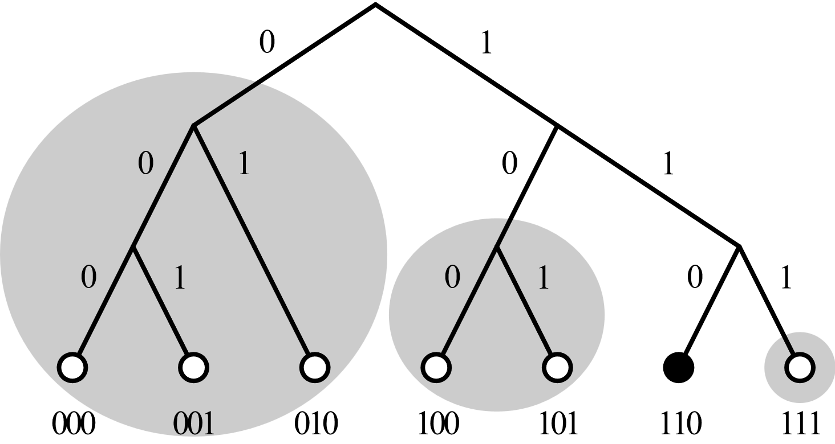
Visualizing k-buckets
Source: https://commons.wikimedia.org/wiki/File:Dht_example_SVG.svg
Notes:
Maybe do this out on the iPad / text editor, see Lecture08_xor.txt
Here we have node 110's tree in a 3 bit case
Bucket i=1: 111
Bucket i=2: 10X (101, 100)
Bucket i=3: 0XX (000, 001, 010, [011])
Note that the buckets get increasingly large. These are not ALL the nodes that could be in the largest bucket, 011 is not in this figure. But it would go in bucket i=2.
Let’s write out the valid distances for buckets i=1, i=2, i=3. (bucket i=0 is trivial and never exists, the only thing that is 0<= dist <1 is the current node itself)
Let’s do the XORs by hand in Notepad, and then figure out the distances.
IMPORTANT: The distances are relative to each node, if we picked node 001 and drew what its buckets looked like, they would be very different!

Slide 45
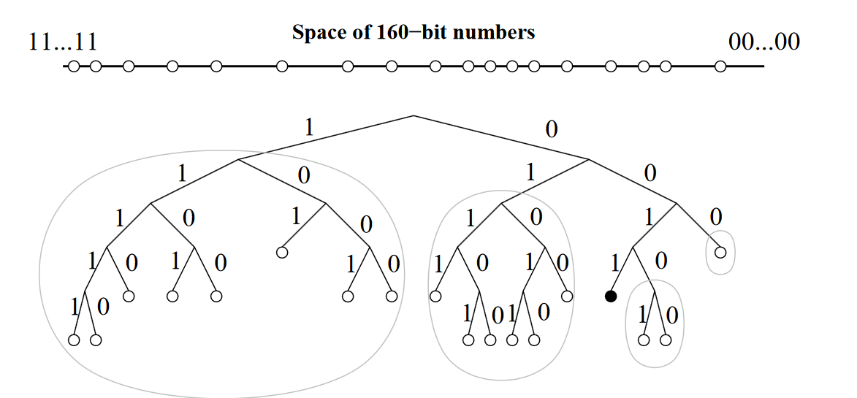
Visualizing k-buckets
Source: https://pdos.csail.mit.edu/~petar/papers/maymounkov-kademlia-lncs.pdf
Notes:
Picture is complicated, because some things are longer bit strings than us. But if you pick the first bit as 1, that's half the tree!

Slide 46
Kademlia Protocol
Four RPCs
FIND_NODE(id)
Returns (IP, UDP Port, Node ID) for k closest nodes to id that are known by the remote node
FIND_VALUE(key)
Same thing as FIND_NODE but if the node is storing a value for that key already, then it just returns the value
PING()
Check if a node is responding
STORE(key,value)
Store the key,value pair. Initiator asks k closest nodes to key.

Slide 47
Doing Lookups
“Concurrency” parameter α
Pick up to α nodes from closest non-empty k-bucket (we may only know fewer than α)
In parallel, make the same RPC (FIND_NODE or FIND_VALUE) to each of those nodes
RPCs will return nodes, update our buckets and repeat the search with another α nodes (but do not ask nodes we already asked)
Stop when all k closest nodes have been asked

Slide 48
Kademlia Performance
Hopefully we can do a search in O(log N) time, proving this is a little tricky
α=1 behaves similar to Chord for searching performance
If node IDs are very far away, number of nodes is low, and N and k are not chosen well, it is possible not all nodes can reach each other.

Slide 49
Question
For N=5, k=8, and a network with 32 nodes connected, which node IDs could be in bucket i=3 for the node with ID = 10110? You can put your answers in binary, hex, or decimal. (Hint: there will be 8 IDs)

