Slide 1


+-+-+-+-+-+-+-+-+-+-+-+-+-+-+-+-+-+-+-+-+-+-+-+-+-+-+-+-+-+-+-+-+
| 6 | Traffic Class | Flow Label |
+-+-+-+-+-+-+-+-+-+-+-+-+-+-+-+-+-+-+-+-+-+-+-+-+-+-+-+-+-+-+-+-+
| 14 Minutes | 58 | 64 |
+-+-+-+-+-+-+-+-+-+-+-+-+-+-+-+-+-+-+-+-+-+-+-+-+-+-+-+-+-+-+-+-+
| Florian::Holzbauer, Markus::Maier, Johanna::Ullrich | | |
+-+-+-+-+-+-+-+-+-+-+-+-+-+-+-+-+-+-+-+-+-+-+-+-+-+-+-+-+-+-+-+-+
| ff05::IMC24 |
+-+-+-+-+-+-+-+-+-+-+-+-+-+-+-+-+-+-+-+-+-+-+-+-+-+-+-+-+-+-+-+-+
| 128 | 0 | Checksum |
+-+-+-+-+-+-+-+-+-+-+-+-+-+-+-+-+-+-+-+-+-+-+-+-+-+-+-+-+-+-+-+-+
| Identifier | Sequence Number |
+-+-+-+-+-+-+-+-+-+-+-+-+-+-+-+-+-+-+-+-+-+-+-+-+-+-+-+-+-+-+-+-+
| Destination Reachable: | What ICMPv6 Error Messages Reveal
| About Their Sources
+-+-+-+-+-

Slide 2



+-+-+-+-+-+-+-+-+-+-+-+-+-+-+-+-+-+-+-+-+-+-+-+-+-+-+-+-+-+-+-+-+
| 6 | Traffic Class | Flow Label |
+-+-+-+-+-+-+-+-+-+-+-+-+-+-+-+-+-+-+-+-+-+-+-+-+-+-+-+-+-+-+-+-+
| Payload Length | 58 | 64 |
+-+-+-+-+-+-+-+-+-+-+-+-+-+-+-+-+-+-+-+-+-+-+-+-+-+-+-+-+-+-+-+-+
| 2001:db8:5ba::1 |
+-+-+-+-+-+-+-+-+-+-+-+-+-+-+-+-+-+-+-+-+-+-+-+-+-+-+-+-+-+-+-+-+
| 2001:db8:200::random IID |
+-+-+-+-+-+-+-+-+-+-+-+-+-+-+-+-+-+-+-+-+-+-+-+-+-+-+-+-+-+-+-+-+
| 128 | 0 | Checksum |
+-+-+-+-+-+-+-+-+-+-+-+-+-+-+-+-+-+-+-+-+-+-+-+-+-+-+-+-+-+-+-+-+
| Identifier | Sequence Number |
+-+-+-+-+-+-+-+-+-+-+-+-+-+-+-+-+-+-+-+-+-+-+-+-+-+-+-+-+-+-+-+-+
| Echo Request
+-+-+-+-+-
Sending a request to every IPv4 address takes less than an hour
Scanning every address not feasible in IPv6
ICMPv6 error messages are still returned, even when targeting a random address inside a network
1
Notes:
ICMPv6 error messages are part of the ICMPv6 protocol, which is an integral part of IPv6 and MUST be implemented by every IPv6 node
It is responsible for reporting errors in processing packets and diagnostics.
Everyone of you is probably familiar with PING,
- it is the process of sending an echo request and in case of a successful connection we will receive an echo reply, however in case of an error we can receive one of the following errors:

Slide 3
Code 0 infers?
+-+-+-+-+-+-+-+-+-+-+-+-+-+-+-+-+-+-+-+-+-+-+-+-+-+-+-+-+-+-+-+-+
| 6 | Traffic Class | Flow Label |
+-+-+-+-+-+-+-+-+-+-+-+-+-+-+-+-+-+-+-+-+-+-+-+-+-+-+-+-+-+-+-+-+
| Payload Length | 58 | 56 |
+-+-+-+-+-+-+-+-+-+-+-+-+-+-+-+-+-+-+-+-+-+-+-+-+-+-+-+-+-+-+-+-+
| 2001:db8:200:1000::ab |
+-+-+-+-+-+-+-+-+-+-+-+-+-+-+-+-+-+-+-+-+-+-+-+-+-+-+-+-+-+-+-+-+
| 2001:db8:5ba::1 |
+-+-+-+-+-+-+-+-+-+-+-+-+-+-+-+-+-+-+-+-+-+-+-+-+-+-+-+-+-+-+-+-+
| 1 | 0 | Checksum |
+-+-+-+-+-+-+-+-+-+-+-+-+-+-+-+-+-+-+-+-+-+-+-+-+-+-+-+-+-+-+-+-+
| Identifier | Sequence Number |
+-+-+-+-+-+-+-+-+-+-+-+-+-+-+-+-+-+-+-+-+-+-+-+-+-+-+-+-+-+-+-+-+
| Destination Unreachable
+-+-+-+-+-
🧐
Typ | Error Message | Codes | Level
1 | Destination Unreachable | 7 | SHOULD
2 | Packet Too Big | 1 | MUST
3 | Time Exceeded | 2 | MUST
4 | Parameter Problem | 3 | SHOULD
2
Notes:
ICMPv6 currently defines 4 different error message types.
In this work the scope lays on Destination Unreachable and Time Exceeded that are returned in response to packets with valid headers and do not exceed the MTU
They have different requirement levels. Destination Reachable should be returned to the sender

Slide 4
Code 0 infers?
+-+-+-+-+-+-+-+-+-+-+-+-+-+-+-+-+-+-+-+-+-+-+-+-+-+-+-+-+-+-+-+-+
| 6 | Traffic Class | Flow Label |
+-+-+-+-+-+-+-+-+-+-+-+-+-+-+-+-+-+-+-+-+-+-+-+-+-+-+-+-+-+-+-+-+
| Payload Length | 58 | 56 |
+-+-+-+-+-+-+-+-+-+-+-+-+-+-+-+-+-+-+-+-+-+-+-+-+-+-+-+-+-+-+-+-+
| 2001:db8:200:1000::ab |
+-+-+-+-+-+-+-+-+-+-+-+-+-+-+-+-+-+-+-+-+-+-+-+-+-+-+-+-+-+-+-+-+
| 2001:db8:5ba::1 |
+-+-+-+-+-+-+-+-+-+-+-+-+-+-+-+-+-+-+-+-+-+-+-+-+-+-+-+-+-+-+-+-+
| 1 | 0 | Checksum |
+-+-+-+-+-+-+-+-+-+-+-+-+-+-+-+-+-+-+-+-+-+-+-+-+-+-+-+-+-+-+-+-+
| Identifier | Sequence Number |
+-+-+-+-+-+-+-+-+-+-+-+-+-+-+-+-+-+-+-+-+-+-+-+-+-+-+-+-+-+-+-+-+
| Destination Unreachable
+-+-+-+-+-
🧐
Code | Description
0 | No route to destination
1 | Communication with destination administratively prohibited
2 | Beyond scope of source address
3 | Address unreachable
4 | Port unreachable
5 | Source address failed ingress/egress policy
6 | Reject route to destination
3
Notes:
0) No entry in routing table for dest. ip
Firewalling
2) Beyond scope =
3) Address Unreachable, no other code matches and mainly if link-local address cannot be resolved
4) Dest. Host has no listener
5) Source based filtering
6) Router has been configured to reject all the traffic for a specific destination prefix (Null Routing)

Slide 5
Routing Loop!!
+-+-+-+-+-+-+-+-+-+-+-+-+-+-+-+-+-+-+-+-+-+-+-+-+-+-+-+-+-+-+-+-+
| 6 | Traffic Class | Flow Label |
+-+-+-+-+-+-+-+-+-+-+-+-+-+-+-+-+-+-+-+-+-+-+-+-+-+-+-+-+-+-+-+-+
| Payload Length | 58 | 56 |
+-+-+-+-+-+-+-+-+-+-+-+-+-+-+-+-+-+-+-+-+-+-+-+-+-+-+-+-+-+-+-+-+
| 2001:db8:200:1000::ab |
+-+-+-+-+-+-+-+-+-+-+-+-+-+-+-+-+-+-+-+-+-+-+-+-+-+-+-+-+-+-+-+-+
| 2001:db8:5ba::1 |
+-+-+-+-+-+-+-+-+-+-+-+-+-+-+-+-+-+-+-+-+-+-+-+-+-+-+-+-+-+-+-+-+
| 3 | 0 | Checksum |
+-+-+-+-+-+-+-+-+-+-+-+-+-+-+-+-+-+-+-+-+-+-+-+-+-+-+-+-+-+-+-+-+
| Identifier | Sequence Number |
+-+-+-+-+-+-+-+-+-+-+-+-+-+-+-+-+-+-+-+-+-+-+-+-+-+-+-+-+-+-+-+-+
| Time Exceeded
+-+-+-+-+-
🧐
Typ | Error Message | Codes | Level
1 | Destination Unreachable | 7 | SHOULD
2 | Packet Too Big | 1 | MUST
3 | Time Exceeded | 2 | MUST
4 | Parameter Problem | 3 | SHOULD
4

Slide 6
Periphery Addresses
+-+-+-+-+-+-+-+-+-+-+-+-+-+-+-+-+-+-+-+-+-+-+-+-+-+-+-+-+-+-+-+-+
| 6 | Traffic Class | Flow Label |
+-+-+-+-+-+-+-+-+-+-+-+-+-+-+-+-+-+-+-+-+-+-+-+-+-+-+-+-+-+-+-+-+
| Payload Length | 58 | 56 |
+-+-+-+-+-+-+-+-+-+-+-+-+-+-+-+-+-+-+-+-+-+-+-+-+-+-+-+-+-+-+-+-+
| 2001:db8:200:1000::ab |
+-+-+-+-+-+-+-+-+-+-+-+-+-+-+-+-+-+-+-+-+-+-+-+-+-+-+-+-+-+-+-+-+
| 2001:db8:5ba::1 |
+-+-+-+-+-+-+-+-+-+-+-+-+-+-+-+-+-+-+-+-+-+-+-+-+-+-+-+-+-+-+-+-+
| 1,3 | Code | Checksum |
+-+-+-+-+-+-+-+-+-+-+-+-+-+-+-+-+-+-+-+-+-+-+-+-+-+-+-+-+-+-+-+-+
| Identifier | Sequence Number |
+-+-+-+-+-+-+-+-+-+-+-+-+-+-+-+-+-+-+-+-+-+-+-+-+-+-+-+-+-+-+-+-+
| ICMPv6 Error Message
+-+-+-+-+-
🧐
Error Messages in Measurements
Edgy (Rye, 2020)
64.8M Last-Hop Routers
XMap (Li, 2021)
52M Routers + User Equipment (15 ISP ranges)
Periphery can include your:
Home Router
Smartphone
5

Slide 7



Our Goal:
Analyze ICMPv6 error messages beyond their source addresses
Our Contribution:
1. Verification of error message type & code usage and classification of error messages for 11 Billion IPv6 prefixes
2. ICMPv6 error message rate-limiting measurements of 1.4M routers show vendor defaults & kernel versions
Active network behind router
Device Information
6

Slide 8
What Do ICMPv6 Error Messages Reveal About Their Sources?
Networks
2. Routers
7
Notes:
Slides in the layout KAPITEL/TRENNfolie (main part of the presentation, in contrast to the blue COVER slide) are generally in BLUE colour. Special slides, such as the quote or message slide are held in dark red, dark green or dark grey.

Slide 9
Methods Overview
Controlled Environment
2. Verification in the IPv6 Internet
3. IPv6-wide Measurements
Collect error messages under six different routing scenarios
Find error messages that are returned only for active/inactive networks
8

Slide 10
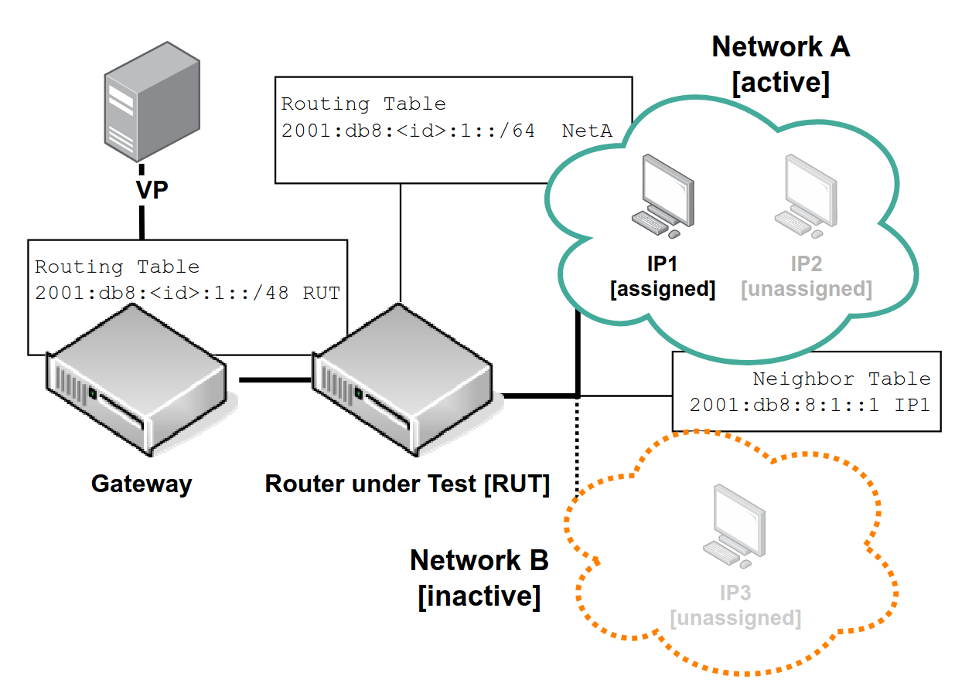

Router Lab
Valuable for further reconnaissance
Typ | Router / Router OS
1 | Cisco XRv, IOS-XE, IOS
2 | Juniper Junos
3 | Huawei NetEngine
4 | HPE VSR
5 | Arista
6 | VyOs
7 | Mikrotik (2 Versions)
8 | OpenWRT (2 Versions)
9 | Aruba
Routed
11 Vendors, 15 Appliances, 6 routing scenarios derived from RFC 4443
Typ | Firewall
1 | PfSense
2 | Fortigate
sbaresearch/router-lab
9

Slide 11
Result I: Router Lab
Mikrotik
Scenario | 1 | 2 | 3 | 4 | 5 | 6
Description | Active Network | Inactive Network | Active Netw. ACL | Inactive Netw. ACL | Null Route | Routing Loop | Classification
No Route (S2) | ○ 0 | ● 14 | ● 1 | ● 2 | ● 2 | ○ 0 | Ambiguous
Admin. Prohib. (S3,S4) | ○ 0 | ○ 0 | ● 4 | ● 5 | ● 3 | ○ 0 | Ambiguous
Addr. Unreach. (S1) | ● 14 | ○ 0 | ○ 0 | ○ 0 | ● 1 | ○ 0 | Ambiguous
Port Unreach. () | ○ 0 | ○ 0 | ● 3 | ● 2 | ○ 0 | ○ 0 | Ambiguous
Failed Policy (S3,S4) | ○ 0 | ● 1 | ● 1 | ● 2 | ○ 0 | ○ 0 | Ambiguous
Reject Route (S5) | ○ 0 | ○ 0 | ○ 0 | ○ 0 | ● 2 | ○ 0 | Inactive
Time Exceeded (S6) | ○ 0 | ○ 0 | ○ 0 | ○ 0 | ○ 0 | ● 15 | Inactive
∅ | ● 1 | ○ 0 | ● 4 | ● 3 | ● 9 | ○ 0
10
Notes:
Controlled environment, limited number vendors but full control of the routers.
Klassifizierung: Active, inactive, ambiguous + Timing Unterschied

Slide 12
Result I: Router Lab
Juniper
Scenario | 1 | 2 | 3 | 4 | 5 | 6
Description | Active Network | Inactive Network | Active Netw. ACL | Inactive Netw. ACL | Null Route | Routing Loop | Classification
No Route (S2) | ○ 0 | ● 14 | ● 1 | ● 2 | ● 2 | ○ 0 | Ambiguous
Admin. Prohib. (S3,S4) | ○ 0 | ○ 0 | ● 4 | ● 5 | ● 3 | ○ 0 | Ambiguous
Addr. Unreach. (S1) | ● 14 | ○ 0 | ○ 0 | ○ 0 | ● 1 | ○ 0 | Ambiguous
Port Unreach. () | ○ 0 | ○ 0 | ● 3 | ● 2 | ○ 0 | ○ 0 | Ambiguous
Failed Policy (S3,S4) | ○ 0 | ● 1 | ● 1 | ● 2 | ○ 0 | ○ 0 | Ambiguous
Reject Route (S5) | ○ 0 | ○ 0 | ○ 0 | ○ 0 | ● 2 | ○ 0 | Inactive
Time Exceeded (S6) | ○ 0 | ○ 0 | ○ 0 | ○ 0 | ○ 0 | ● 15 | Inactive
∅ | ● 1 | ○ 0 | ● 4 | ● 3 | ● 9 | ○ 0
Solution: RTTs! AU in S1 shows delays of 2, 3 and 18 seconds, in S5 it is returned immediately
11
Notes:
Controlled environment, limited number vendors but full control of the routers.
Klassifizierung: Active, inactive, ambiguous + Timing Unterschied

Slide 13
Result I: Router Lab
Scenario | 1 | 2 | 3 | 4 | 5 | 6
Description | Active Network | Inactive Network | Active Netw. ACL | Inactive Netw. ACL | Null Route | Routing Loop | Classification
No Route (S2) | ○ 0 | ● 14 | ● 1 | ● 2 | ● 2 | ○ 0 | Ambiguous
Admin. Prohib. (S3,S4) | ○ 0 | ○ 0 | ● 4 | ● 5 | ● 3 | ○ 0 | Ambiguous
Addr. Unreach._{RTT≥1sec} | ● 14 | ○ 0 | ○ 0 | ○ 0 | ○ 0 | ○ 0 | Active
Addr. Unreach._{RTT<1sec} | ○ 0 | ○ 0 | ○ 0 | ○ 0 | ● 1 | ○ 0 | Inactive
Port Unreach. () | ○ 0 | ○ 0 | ● 3 | ● 2 | ○ 0 | ○ 0 | Ambiguous
Failed Policy (S3,S4) | ○ 0 | ● 1 | ● 1 | ● 2 | ○ 0 | ○ 0 | Ambiguous
Reject Route (S5) | ○ 0 | ○ 0 | ○ 0 | ○ 0 | ● 2 | ○ 0 | Inactive
Time Exceeded (S6) | ○ 0 | ○ 0 | ○ 0 | ○ 0 | ○ 0 | ● 15 | Inactive
∅ | ● 1 | ○ 0 | ● 4 | ● 3 | ● 9 | ○ 0
12
Notes:
Controlled environment, limited number vendors but full control of the routers.
Klassifizierung: Active, inactive, ambiguous + Timing Unterschied

Slide 14
Result I: Classification
Scenario | 1 | 2 | 3 | 4 | 5 | 6
Description | Active Network | Inactive Network | Active Netw. ACL | Inactive Netw. ACL | Null Route | Routing Loop | Classification
No Route (S2) | ○ 0 | ● 14 | ● 1 | ● 2 | ● 2 | ○ 0 | Ambiguous
Admin. Prohib. (S3,S4) | ○ 0 | ○ 0 | ● 4 | ● 5 | ● 3 | ○ 0 | Ambiguous
Addr. Unreach._{RTT≥1sec} | ● 14 | ○ 0 | ○ 0 | ○ 0 | ○ 0 | ○ 0 | Active
Addr. Unreach._{RTT<1sec} | ○ 0 | ○ 0 | ○ 0 | ○ 0 | ● 1 | ○ 0 | Inactive
Port Unreach. () | ○ 0 | ○ 0 | ● 3 | ● 2 | ○ 0 | ○ 0 | Ambiguous
Failed Policy (S3,S4) | ○ 0 | ● 1 | ● 1 | ● 2 | ○ 0 | ○ 0 | Ambiguous
Reject Route (S5) | ○ 0 | ○ 0 | ○ 0 | ○ 0 | ● 2 | ○ 0 | Inactive
Time Exceeded (S6) | ○ 0 | ○ 0 | ○ 0 | ○ 0 | ○ 0 | ● 15 | Inactive
∅ | ● 1 | ○ 0 | ● 4 | ● 3 | ● 9 | ○ 0
13
Notes:
Controlled environment, limited number vendors but full control of the routers.
Klassifizierung: Active, inactive, ambiguous + Timing Unterschied

Slide 15
Methods Overview
Controlled Environment
2. Verification in the IPv6 Internet
3. IPv6-wide Measurements
Goal: Collect error messages for IPv6 networks known to be active and inactive
Problem: There is no such dataset
Scanning random subnets?
Target network might not be suballocated
BValue Steps = Border Values to the rescue
14

Slide 16
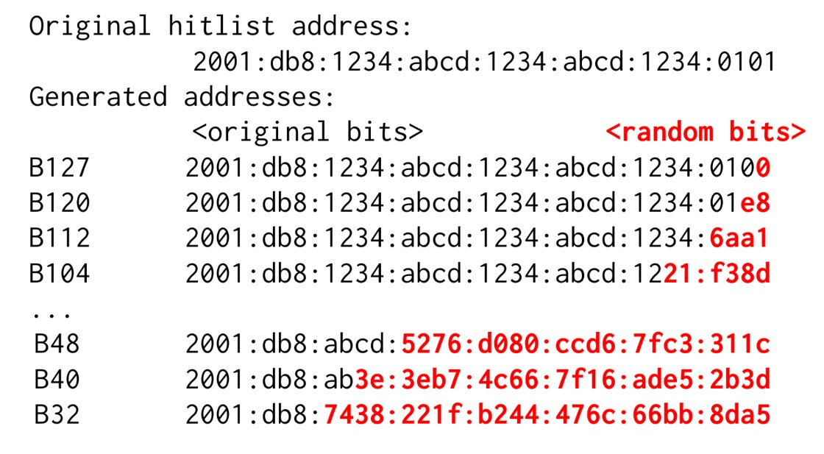



BValue Steps
Input: Responsive IPv6 addresses in active network (Hitlist Service; Gasser, 2018)
Randomize more and more of the target address (steps of 8 bits) up to the routed network border
Detect changes in response behavior
Active = before change
Inactive = after change
Hitlist IP
Active
Applied to one hitlist address/subnet per routed BGP prefix
47,923 pass ICMPv6 responsiveness check
We are able separate active from inactive in 44% (17% are not suballocated, 38% unresponsive)
B127​
B120​
...
.
Unassigned IPs
B32
Inactive
15

Slide 17
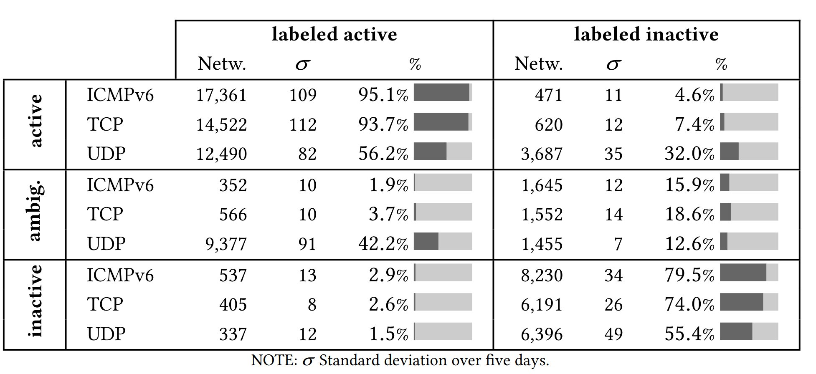
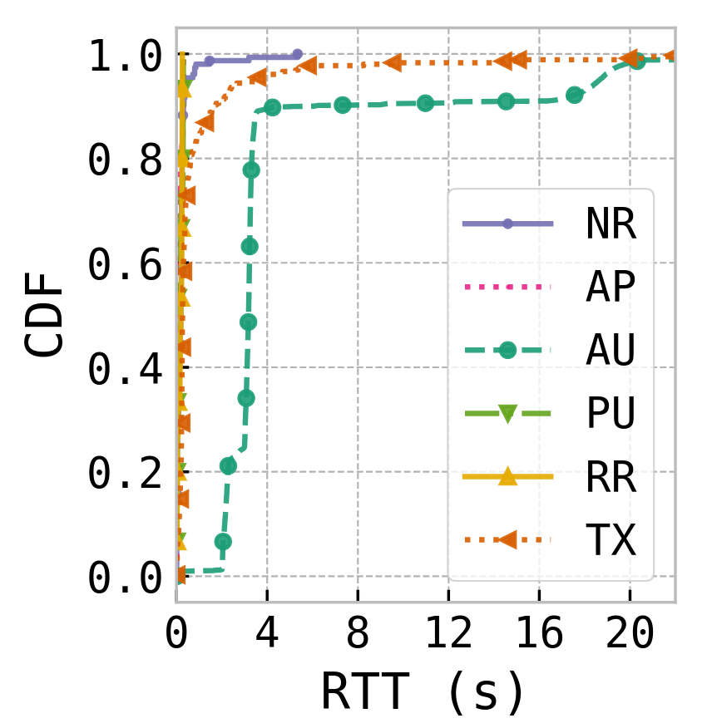
Result II: BValue Steps
True Positives
BValues
Error Messages
18,250/21,070 Responsive
10,346/21,070 Responsive
Five days, Three protocols
95% labeled active networks returned AU_{RTT≥1sec}
80% labeled inactive networks returned AU_{RTT<1sec}, Reject Route, Time Exceeded; 16% Ambiguous (Higher share of No Route)
True Negatives
Of error messages for active networks
16
Notes:
False Negatives: Publicly available loopback-interfaces

Slide 18
Methods Overview
Controlled Environment
2. Verification in the IPv6 Internet
3. IPv6-wide Measurements
17

Slide 19

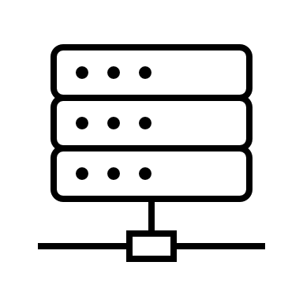

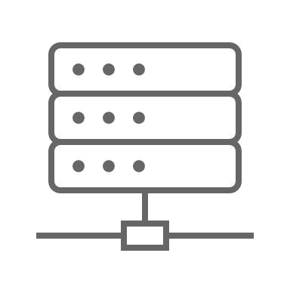
IPv6-wide measurements
YARRP (Beverly, 2016): Traceroutes to 5 Billion /48s:
ZMap (Gasser, 2016) Scans to 6 Billion /64s:
HL: 1
Router Addr, Hop Count & Destination IP = Input for Contribution 2
Time Exceeded
HL: 4
Time Exceeded
HL: 2
HL: 3
Dest. Unreach. Time Exceeded
Time Exceeded
HL: 255
Dest. Unreach.
Time Exceeded
Random IID
18

Slide 20
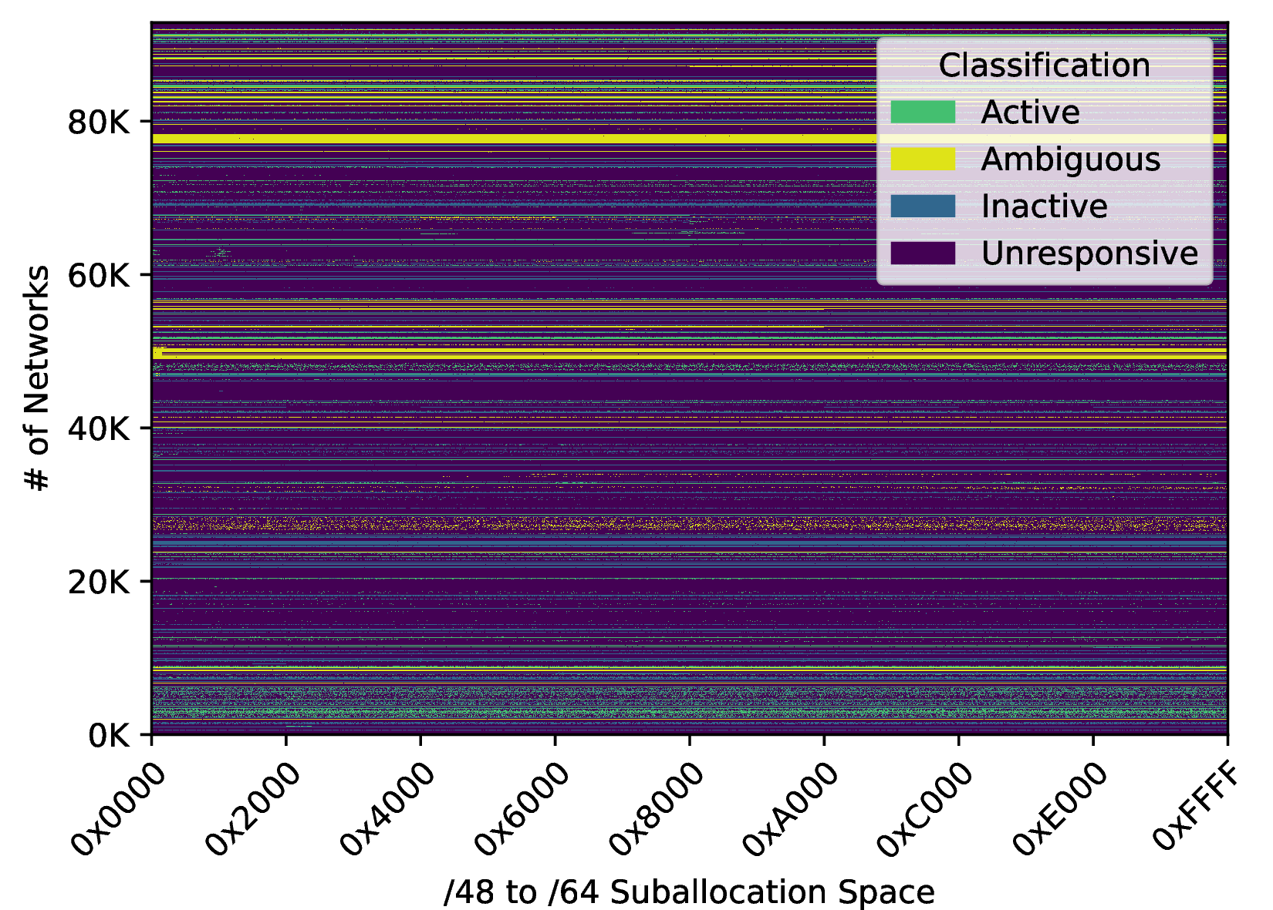
Result III: /64s Measurement
38% of measured networks remain silent
Measured /64s | 6,085,410,816 (100%)
Responsive | 1,368,371,825 (22.5%)
Unresponsive | 4,717,038,991 (77.5%)
Responsive | /64s
Active | 355,616,627 = 26%
Ambiguous | 209,970,342 = 15%
Inactive | 802,784,856 = 59%
At least 1 active /64 in 61% of responsive networks
Only 15% of responsive /64s remain ambiguous
19

Slide 21
What Do ICMPv6 Error Messages Reveal About Their Sources?
Networks
2. Routers
20
Notes:
Slides in the layout KAPITEL/TRENNfolie (main part of the presentation, in contrast to the blue COVER slide) are generally in BLUE colour. Special slides, such as the quote or message slide are held in dark red, dark green or dark grey.

Slide 22

Methods Overview
Origination of ICMPv6 error messages must be rate limited
Measure & detect rate limits that are unique to vendors
Refill Interval (ms)
Refill Size
Controlled Environment
X
… Token
1 Token removed per error message
Bucket Size
21

Slide 23

Methods Overview
Origination of ICMPv6 error messages must be rate limited
Measure & detect rate limits that are unique to vendors
Refill Interval (ms)
Refill Size
Controlled Environment
X
… Token
1 Token removed per error message
Bucket Size
1
...
x
Requests
IP behind router
10 sec
Target Router
21

Slide 24
Methods Overview
Origination of ICMPv6 error messages must be rate limited
Measure & detect rate limits that are unique to vendors
Refill Interval (ms)
Refill Size
Controlled Environment
X
… Token
1 Token removed per error message
NR(10) … Total error messages over timespan of 10 seconds
T1, T2, T10 Number of error messages during 1st, 2nd, .. 10th second
Bucket Size
1
...
x
Requests
IP behind router
10 sec
NR, AU, TX
Target Router
T1 | T2 | T3 | … | T10
21

Slide 25
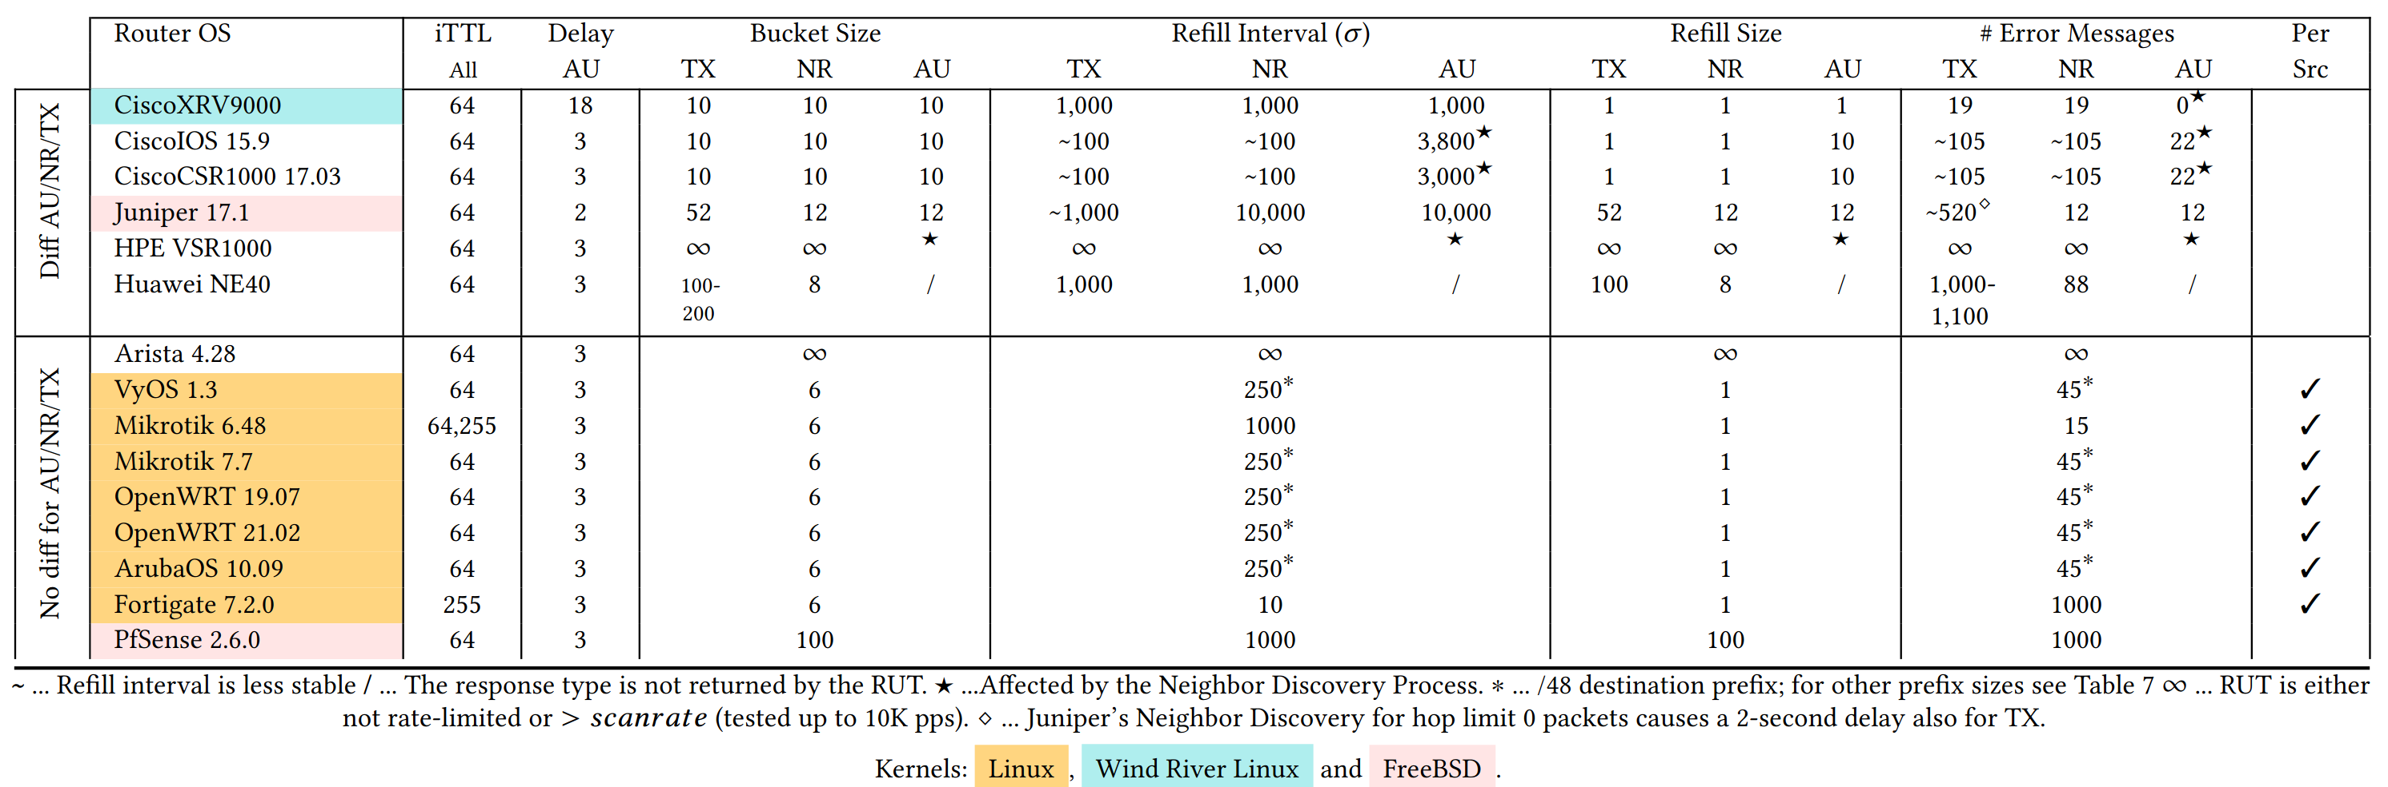
Result I: Router Lab
Vendor Defaults
Kernel Defaults
22

Slide 26
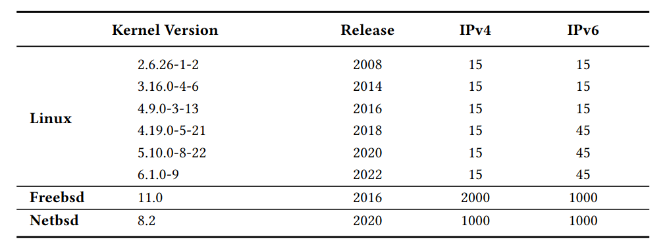
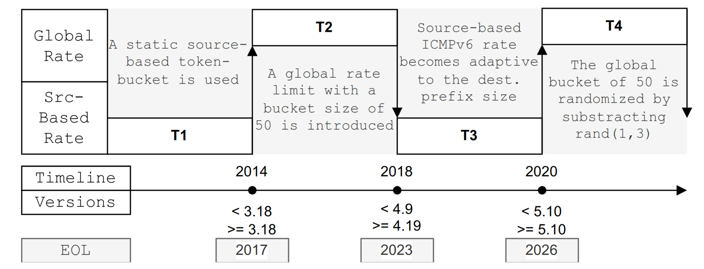
Result I: Changes in the Kernel
Number of error messages over 10 seconds
Static and dynamic testing of the Linux kernel shows a change for IPv6 in kernel version 4.
Three rate-limiting changes over time:
Introduction of global rate
Peer-based becomes adaptive to dest. prefix
Global bucket is randomized
23

Slide 27
Methods Overview
Our Goal:
1) Validate collected defaults in the Internet
2) Extend defaults with new rate-limits for which the vendor is known (see Paper)
Data Source:
Extract SNMPv3 vendor labels for 476K IPv6 routers (Albakour, 2021)
50,952 match our tracerouting data, for which we can collect rate limit parameters
requires:
2. Verification in the IPv6 Internet
destination behind router, hop limit
24

Slide 28
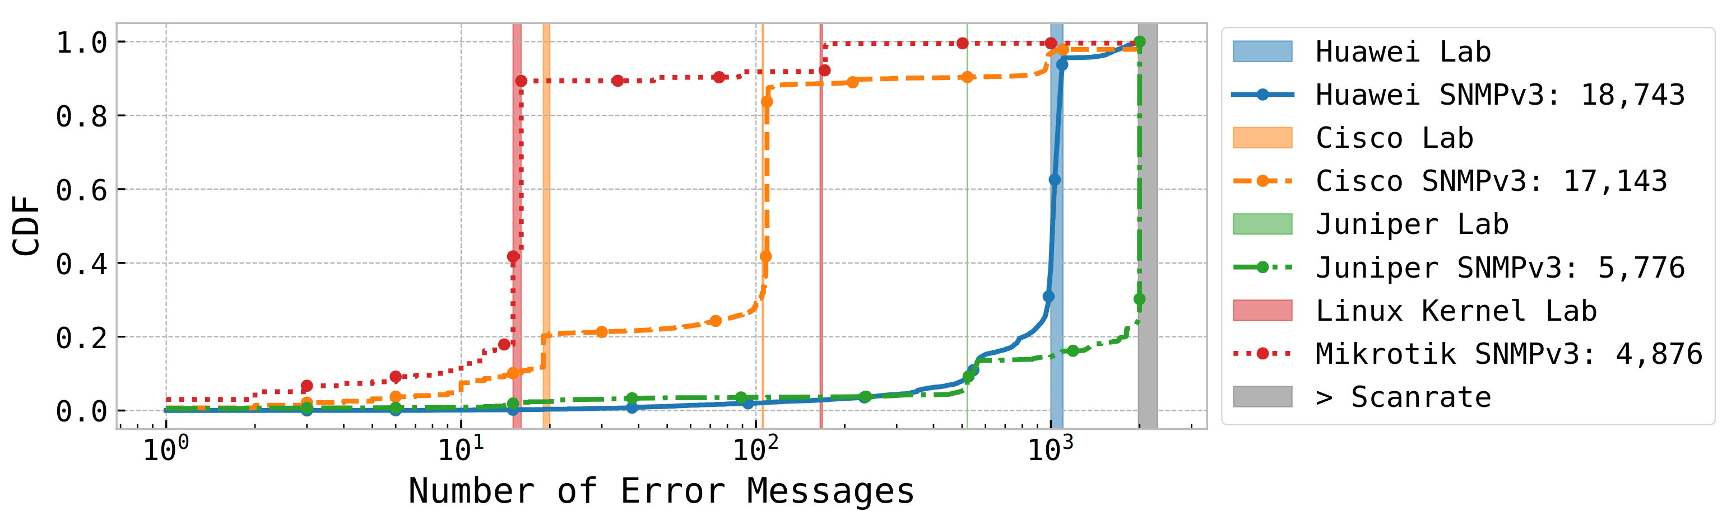
Result II: SNMPv3 Label Comparison
Huawei labeled match lab default
Cisco labeled match XRv and IOS lab defaults
Majority of Juniper labeled is limited above measurement scanrate of 200pps
Mikrotik matches Linux kernel defaults
25

Slide 29
Methods Overview
We collected rate-limits for 1.4M of the IPv6 routers
Split Routers based on Centrality Score:
Number of paths to a /48 destination a router is seen on
Distance-based matching to known rate limiting paramters
Bin the number of responses for each second (T1,T2,..T10) and compute distance
Match rate limiting parameters (Bucket Size, Refill Interval, Refill Size) for rates within adaptive threshold (10 to 100 based on NR(10))
Measurement Parameters: 200 PPS, 10 seconds, Time Exceeded
3. IPv6-wide Measurements
26

Slide 30
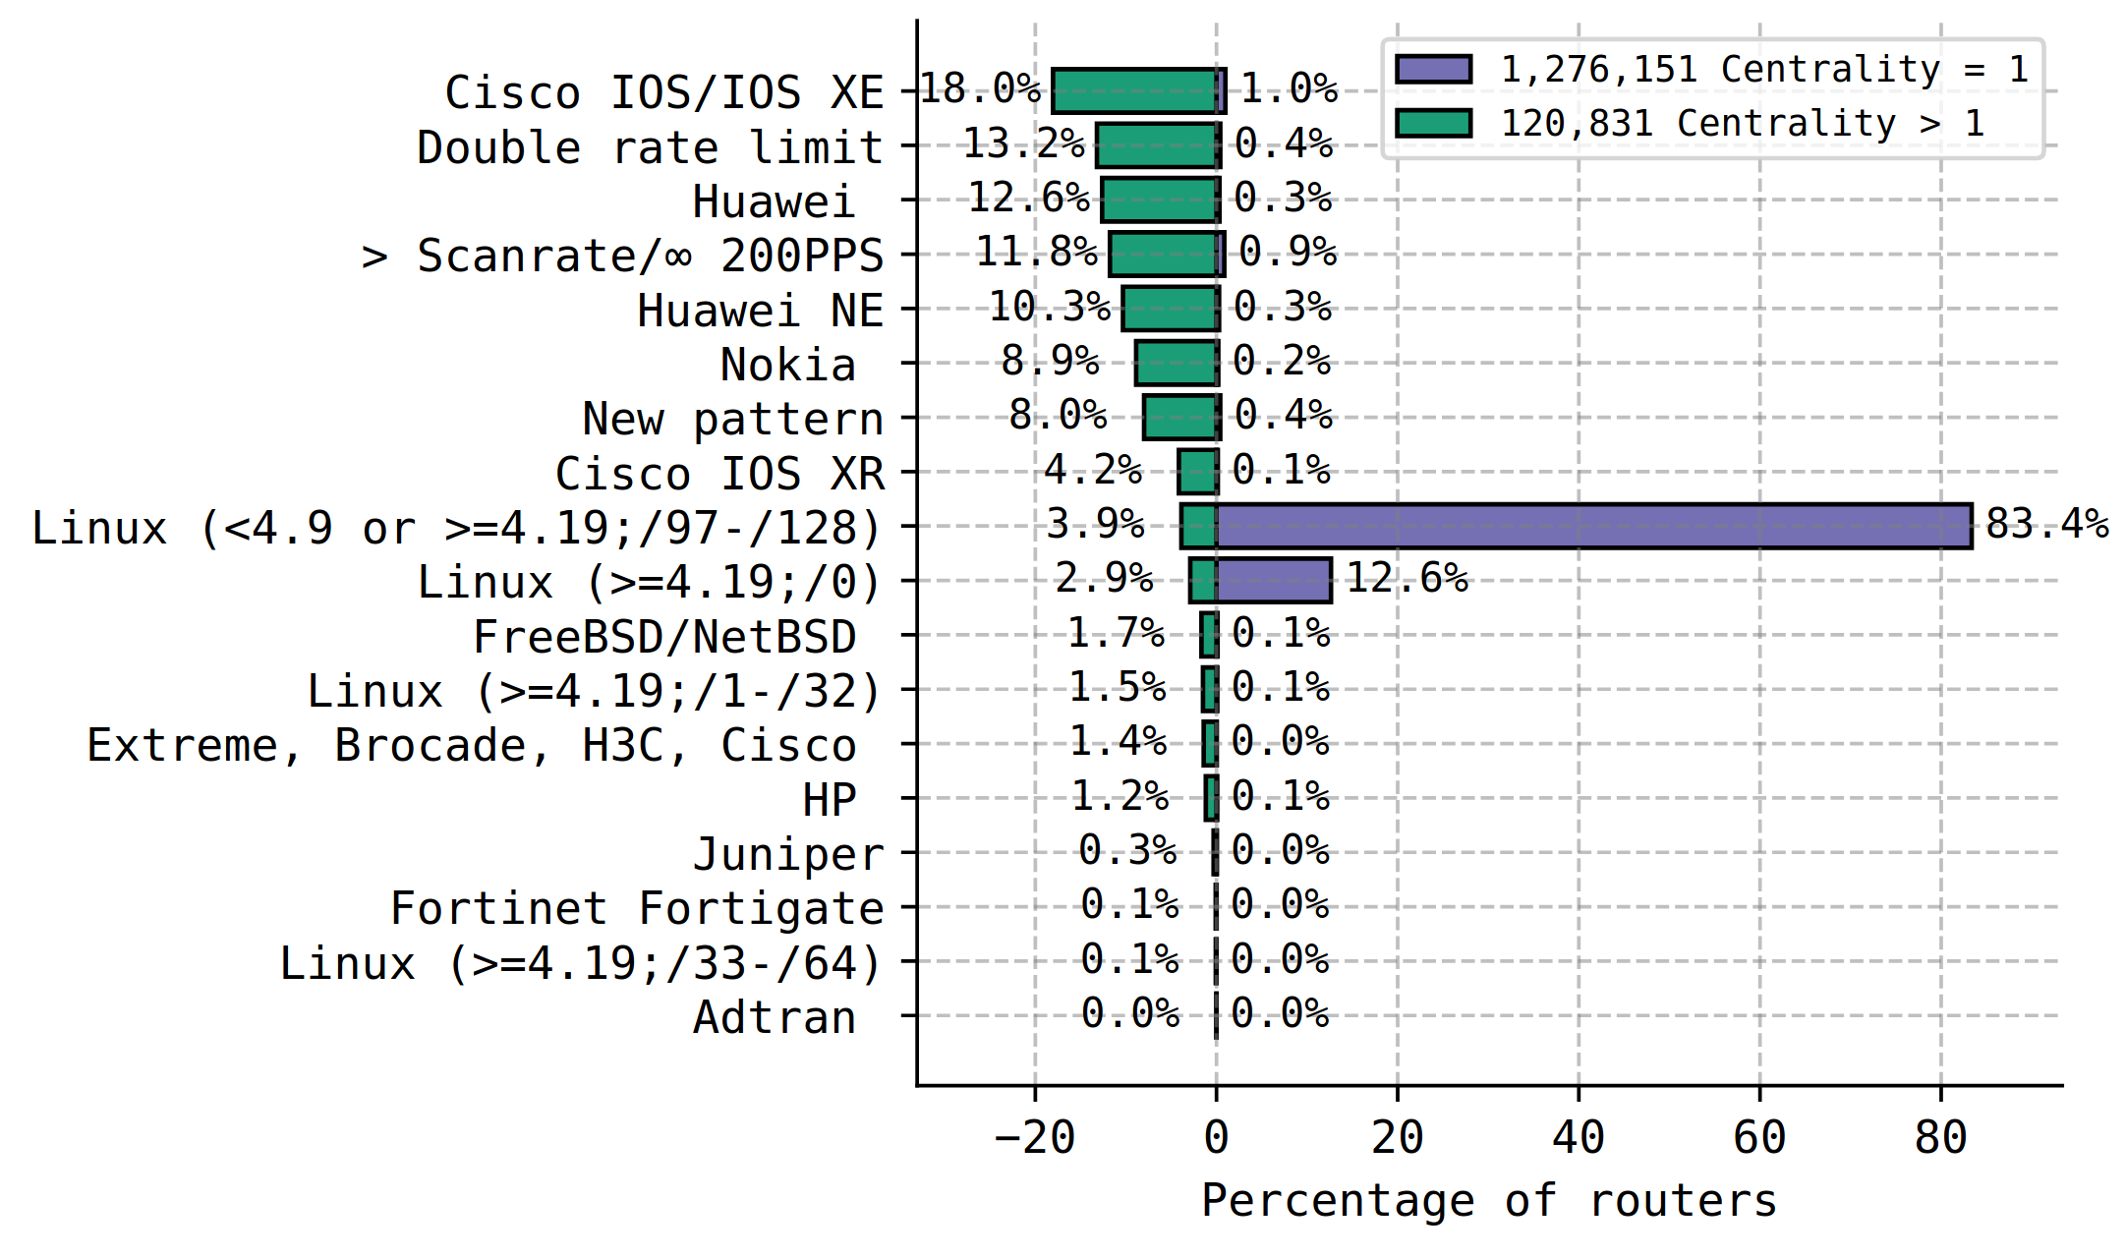
Result III: Rate Limit Matching
Routers on multiple paths (green), more distinguishable rate limits
E.g. Cisco (18% IOS, 4.2% XRv)
Periphery (purple)
83.4% Linux <4.9 or newer version with small dest. prefix sizes (less likely)
12.6% ≥4.19 with default route
27

Slide 31
Conclusion: What Do ICMPv6 Error Messages Reveal About Their Sources?
Networks
2. Routers
+ Active
AU_{RTT≥ 1 sec}
+ Inactive
RR, TX & AU_{RTT<1sec}
+ Centrality > 1:
Vendors
+ Centrality = 1:
Kernel Version
28
Notes:
Slides in the layout KAPITEL/TRENNfolie (main part of the presentation, in contrast to the blue COVER slide) are generally in BLUE colour. Special slides, such as the quote or message slide are held in dark red, dark green or dark grey.

Slide 32
+-+-+-+-+-+-+-+-+-+-+-+-+-+-+-+-+-+-+-+-+-+-+-+-+-+-+-+-+-+-+-+-+
| 6 | Traffic Class | Flow Label |
+-+-+-+-+-+-+-+-+-+-+-+-+-+-+-+-+-+-+-+-+-+-+-+-+-+-+-+-+-+-+-+-+
| Payload Length | 58 | 56 |
+-+-+-+-+-+-+-+-+-+-+-+-+-+-+-+-+-+-+-+-+-+-+-+-+-+-+-+-+-+-+-+-+
| 2001:db8:200:1000::ab |
+-+-+-+-+-+-+-+-+-+-+-+-+-+-+-+-+-+-+-+-+-+-+-+-+-+-+-+-+-+-+-+-+
| 2001:db8:5ba::1 |
+-+-+-+-+-+-+-+-+-+-+-+-+-+-+-+-+-+-+-+-+-+-+-+-+-+-+-+-+-+-+-+-+
| 129,1,3 | Code | Checksum |
+-+-+-+-+-+-+-+-+-+-+-+-+-+-+-+-+-+-+-+-+-+-+-+-+-+-+-+-+-+-+-+-+
| Identifier | Sequence Number |
+-+-+-+-+-+-+-+-+-+-+-+-+-+-+-+-+-+-+-+-+-+-+-+-+-+-+-+-+-+-+-+-+
| Questions?
| … Please set Typ and Code accordingly :)
+-+-+-+-+-
Dipl.-Ing. Florian Holzbauer
PhD Candidate @University of Vienna
florian.holzbauer@univie.ac.at
Artifacts available:
sbaresearch/icmpv6-destination-reachable
sbaresearch/router-lab

