Slide 1
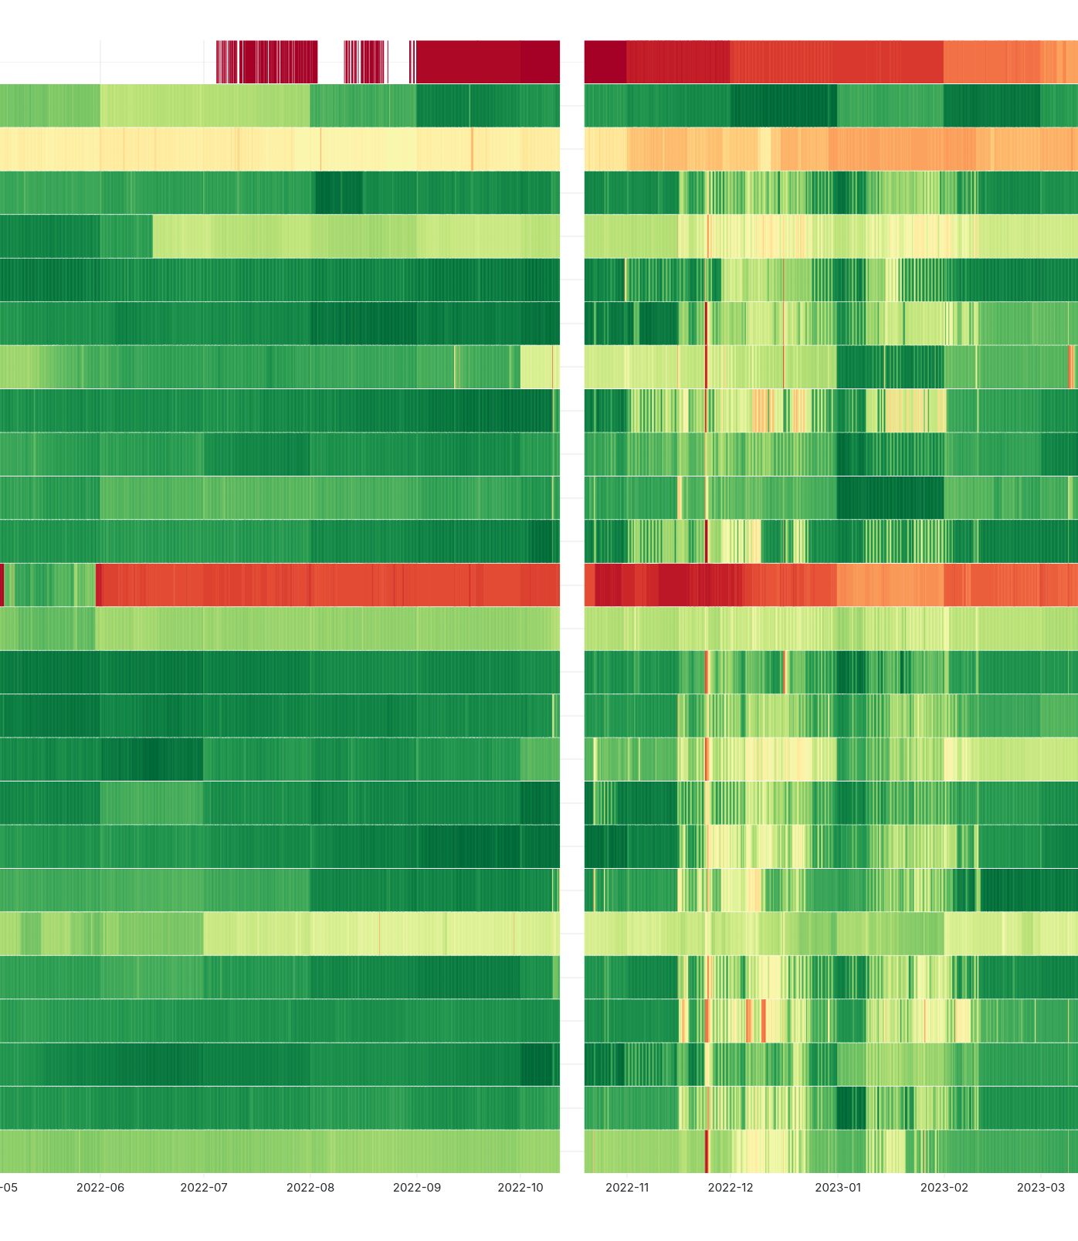


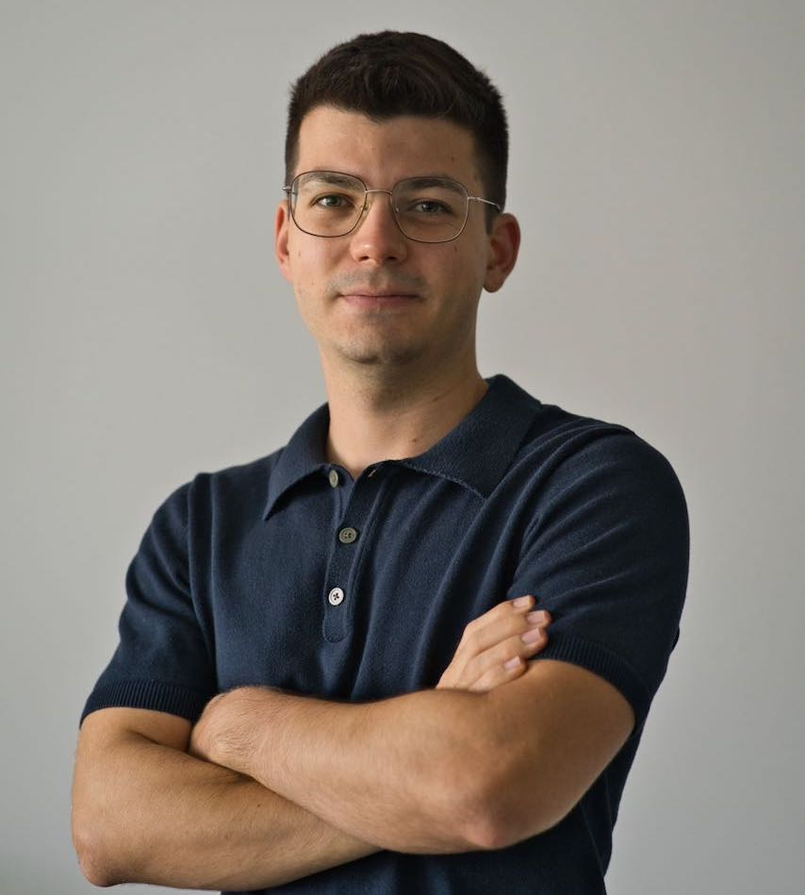

Tracking Internet Disruptions in Ukraine: Insights from Three Years of Active Full Block Scans
Florian Holzbauer, Sebastian Strobl & Johanna Ullrich

Slide 2
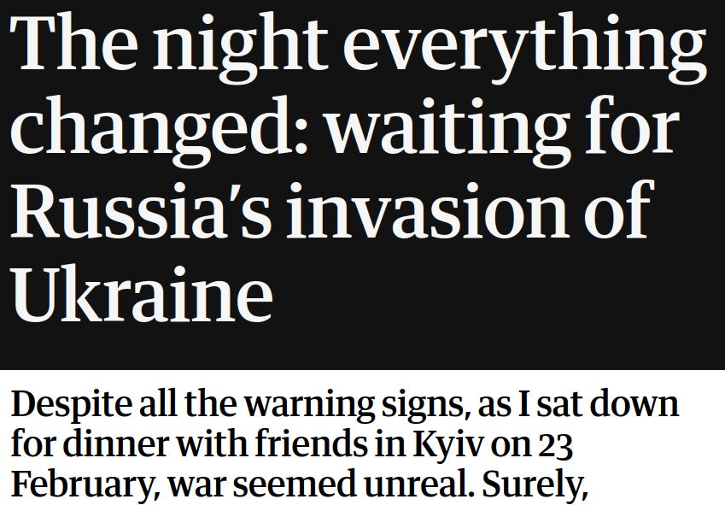
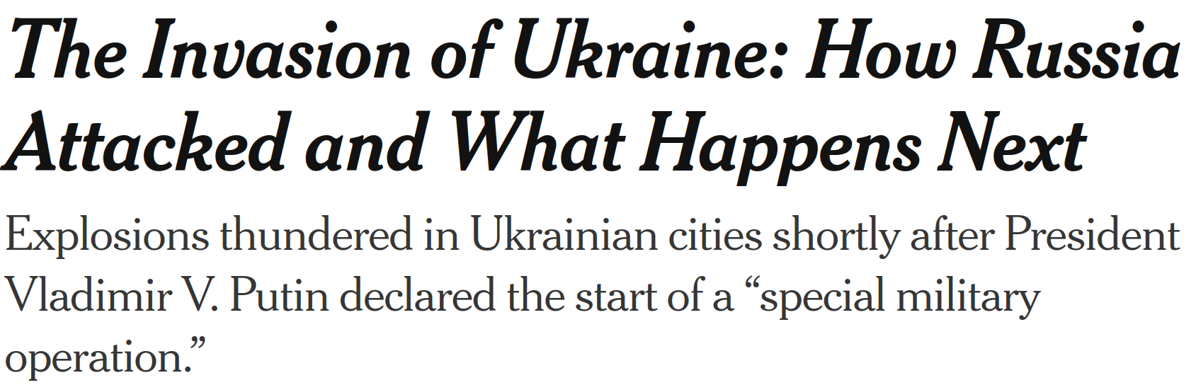
Motivation
Assumption: Internet-connected devices serve as sensors
$ countrymonitor/scan.sh UA 8000
02-24
FEBRUARY2022
FEBRUARY
2025
[Guardian]
Since then every 2h
02-23
02-03 10:00
[New York Times]

Slide 3
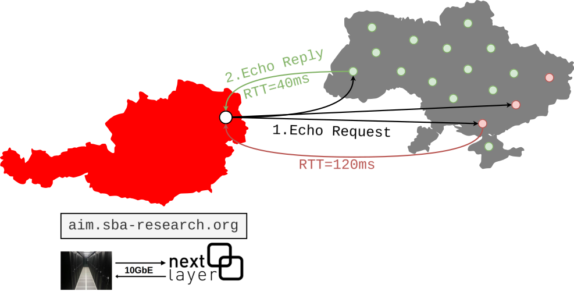
From Austria to Ukraine and back
🖥️ ⌀ 1.5 Mio Responses every 2h
🗣️ 1 Opt-Out Notification
🖥️ 10.5 Million Requests
📦 8,000 Packets per Second
⏰ 22 Minutes Scan Duration

Slide 4



From Ping to Outage Signal
1. IPs to /24 blocks
2. Block attribution with external datasets
Timestamp | IP | /24
2022-03-02 10:00 | 193.151.240.1 | 193.151.240
2022-03-02 10:00 | 193.151.240.112 | 193.151.240
2022-03-02 10:00 | 193.151.240.13 | 193.151.240
2022-03-02 10:00 | 193.151.240.15 | 193.151.240
2022-03-02 14:00 | 193.151.240.1 | 193.151.240
2022-03-02 14:00 | 193.151.240.112 | 193.151.240
2022-03-02 14:00 | 193.151.240.15 | 193.151.240
Timestamp | /24
2022-03-02 10:00 | 193.151.240 | ✅
2022-03-02 12:00 | 193.151.240 | ❌
2022-03-02 14:00 | 193.151.240 | ✅
Region
Org.

Slide 5



From Ping to Outage Signal
UPDATE 193.151.240/24 AS1
193.151.240​
.240.101
...
.240.201
/24 Block
2. ❌ Link Fehler
AS1
AS2
.241.1
3. UPDATE WITHDRAW
/24 Block
193.151.241
BGP Feeds
🔴 Responsive IPs
🟢 Active /24s
🔵 Routed /24s
⚠️ Outage = current Value < X% of moving average of previous week

Slide 6
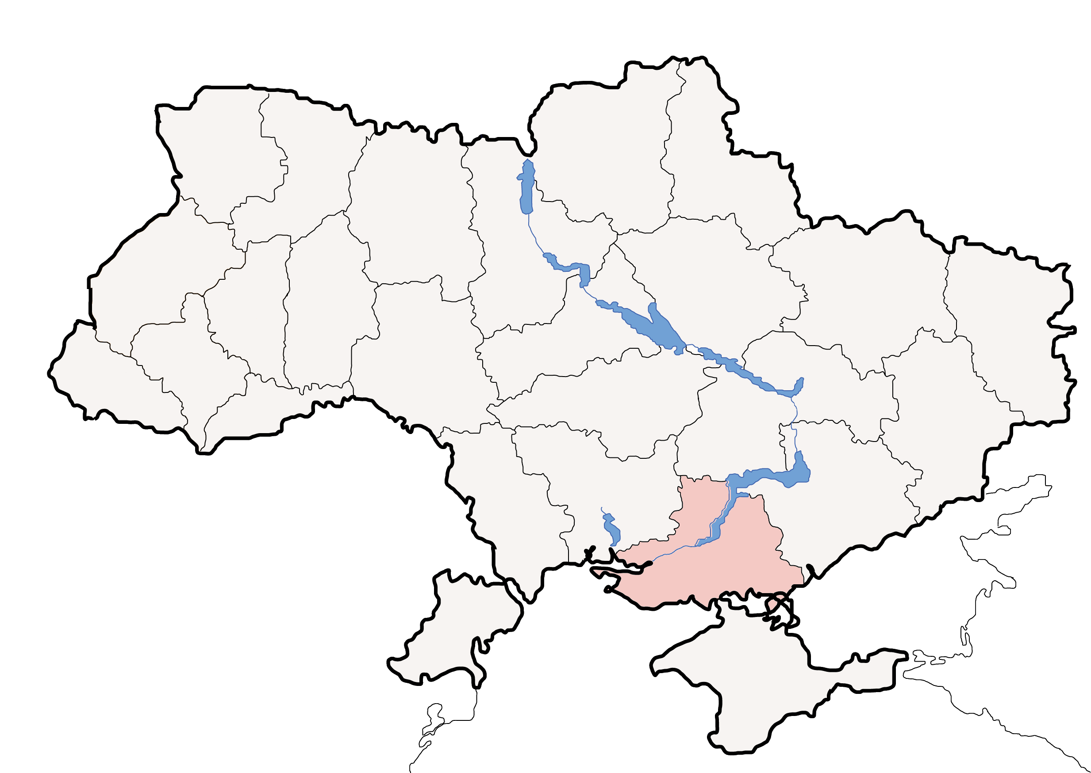



8 Insights from Tracking Internet Disruptions in Ukraine
Lviv
Kyiv
Kherson

Slide 7
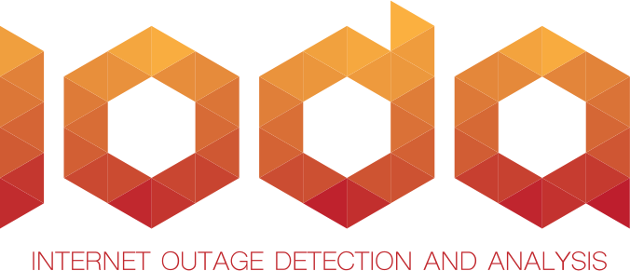

#1 Existing measurements fail to comprehensively track disruptions in Ukraine.
 | Singla et al. | Klick et al. | IODA
Protocols | Modbus, DNP3 | 60+ | ICMP
Signal | IP based | IP based | Block based (Sampling)
Interval | 24 Hours | 4 Hours | 10 Minutes
War Coverage | 6 Months 2022 | Until March 2023 | Since 2022
Outage Location | IP Geolocation | Static IPs | IP Geolocation
Trinocular
Signal differences?
Short-lived outages?
Limited war coverage
Static IPs only?
Sampling?
Geolocation Precision?

Slide 8
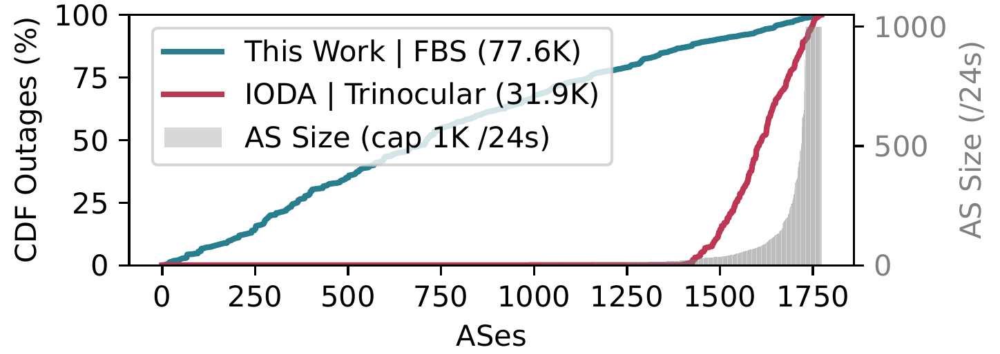
#2 We report outages for many smaller ASes in Ukraine while IODA does not.
IODA returns raw data for 90% of ASes (1,597 out of 1,773) but only reports outages for 19% (333) of ASes.
Figure 2: Outages reported for 1,773 ASes with regional /24s in Ukraine.

Slide 9
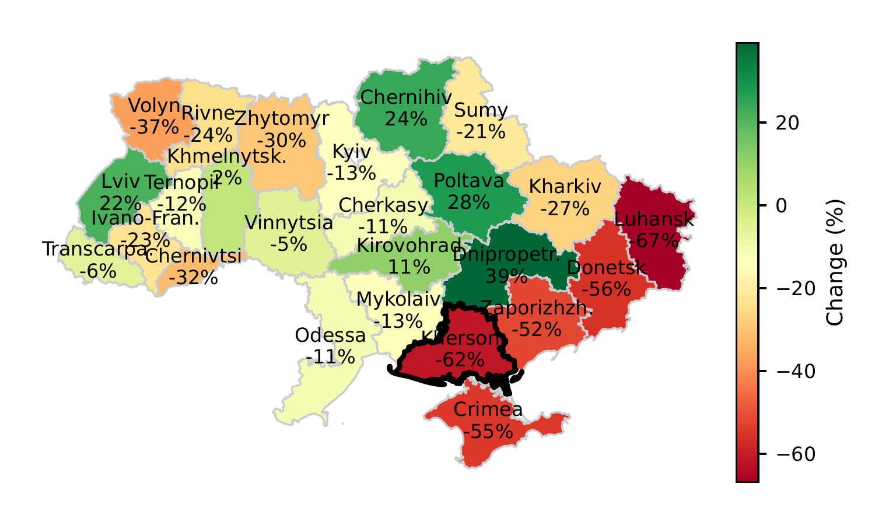

#3 Significant IP churn visible in Ukraine, especially in frontline regions.
60% between oblasts
Ukrtelecom, Kyivstar, Vodafone, Vega
40% to other countries (1.5M IPs)
33%
Figure 3: IP Churn - Comparing 2022 with 2025
3.7M IPs affected
Notes:
Wie sieht die Umfrage genau aus?
Ziele: keinesfalls die Infrastruktur in einem Land mit Krieg belasten (Ziel erreicht: eine einzige Opt-Out Meldung und
Wir messen die Zeit die ein Paket von Österreich in die Ukraine braucht und zurück
Wir messen ob das Ziel antwortet oder nicht
X Anfragen pro Tag
~ X Antworten pro Tag
Aus ethischen Gründen keine Zielnetzwerke überlasten
-> ICMP -> kleinen Fußabdruck bewahren
-> Alle 2h
-> 8000 Pakete pro Sekunde (480 KB/s)

Slide 10
#4 Regional classification detects long-term trends in geolocation.
Challenge:
Assign outages to a region in Ukraine
Lviv
Kyiv
Regional Classification: Only consider /24s that have more than M addresses in the target region for more than T_perc of routed months.
Kherson
Timestamp | /24
2022-03-02 10:00 | 193.151.240 | ✅
2022-03-02 12:00 | 193.151.240 | ❌
2022-03-02 14:00 | 193.151.240 | ✅
In the paper: M = T_perc = 70%

Slide 11
#4 Regional classification detects long-term trends in geolocation.
Kherson
Identifies 32% of blocks for which outages are representative of the Kherson region
Target set serves as input to outage detection.
Class | Kherson
 | ASNs | IPs | /24s
Total | 118 | 73.8K | 512
Regional | 13 | 8.3K | 33
Non-Regional | 40 | 65K | 465
Target Set | 34 | 41.7K | 168

Slide 12
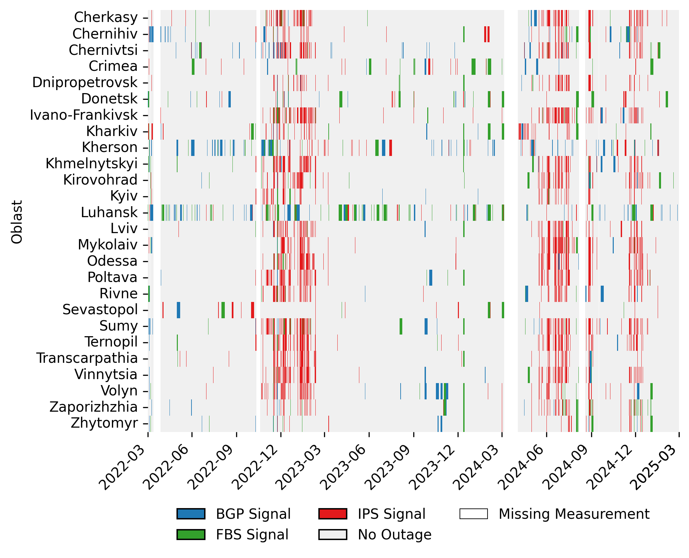
#5 Internet disruptions in Ukraine peaked during winter 2022/23 and throughout 2024.
Intense attacks on the power grid -> partial outages through IPS signal
Infrastructure types (core vs edge)
Full block outages (FBS) more frequent in frontline regions
Only part of the outages are passively visible in BGP
Figure 5: Outages detected by each signal type across oblasts.
Notes:
26 Verwaltungseinheiten = Oblaste
Cherkasy 66720.0
Chernihiv 16094.0
Chernivtsi 25836.0
Crimea 21274.0
Dnipropetrovsk 110736.0
Donetsk 58501.0
Ivano-Frankivsk 31113.0
Kharkiv 125910.0
Kherson 19649.0
Khmelnytskyi 54904.0
Kirovohrad 19542.0
Kyiv 622087.0
Luhansk 24089.0
Lviv 89439.0
Mykolaiv 37307.0
Odessa 115518.0
Poltava 61278.0
Rivne 29108.0
Sumy 25549.0
Ternopil 42407.0
Transcarpathia 16639.0
Vinnytsia 49883.0
Volyn 19089.0
Zaporizhzhia 56995.0
Zhytomyr 21131.0

Slide 13
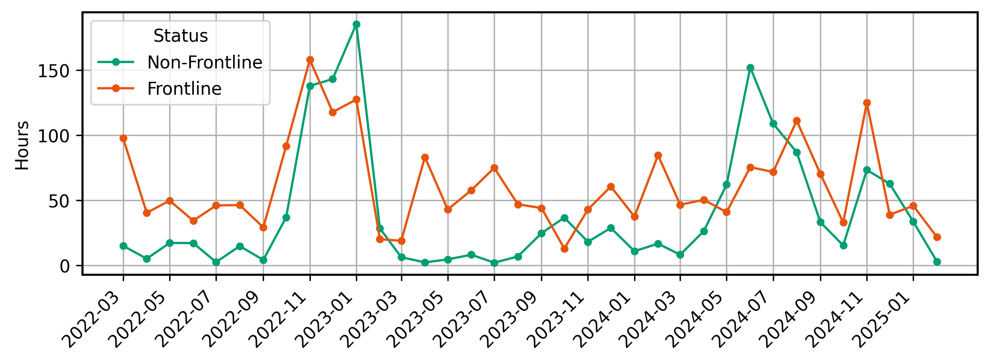
#6 Difference between frontline and non-frontline unique to our dataset.
Figure 7: Average number of 2h intervals with outages.
Notes:
26 Verwaltungseinheiten = Oblaste
Cherkasy 66720.0
Chernihiv 16094.0
Chernivtsi 25836.0
Crimea 21274.0
Dnipropetrovsk 110736.0
Donetsk 58501.0
Ivano-Frankivsk 31113.0
Kharkiv 125910.0
Kherson 19649.0
Khmelnytskyi 54904.0
Kirovohrad 19542.0
Kyiv 622087.0
Luhansk 24089.0
Lviv 89439.0
Mykolaiv 37307.0
Odessa 115518.0
Poltava 61278.0
Rivne 29108.0
Sumy 25549.0
Ternopil 42407.0
Transcarpathia 16639.0
Vinnytsia 49883.0
Volyn 19089.0
Zaporizhzhia 56995.0
Zhytomyr 21131.0

Slide 14
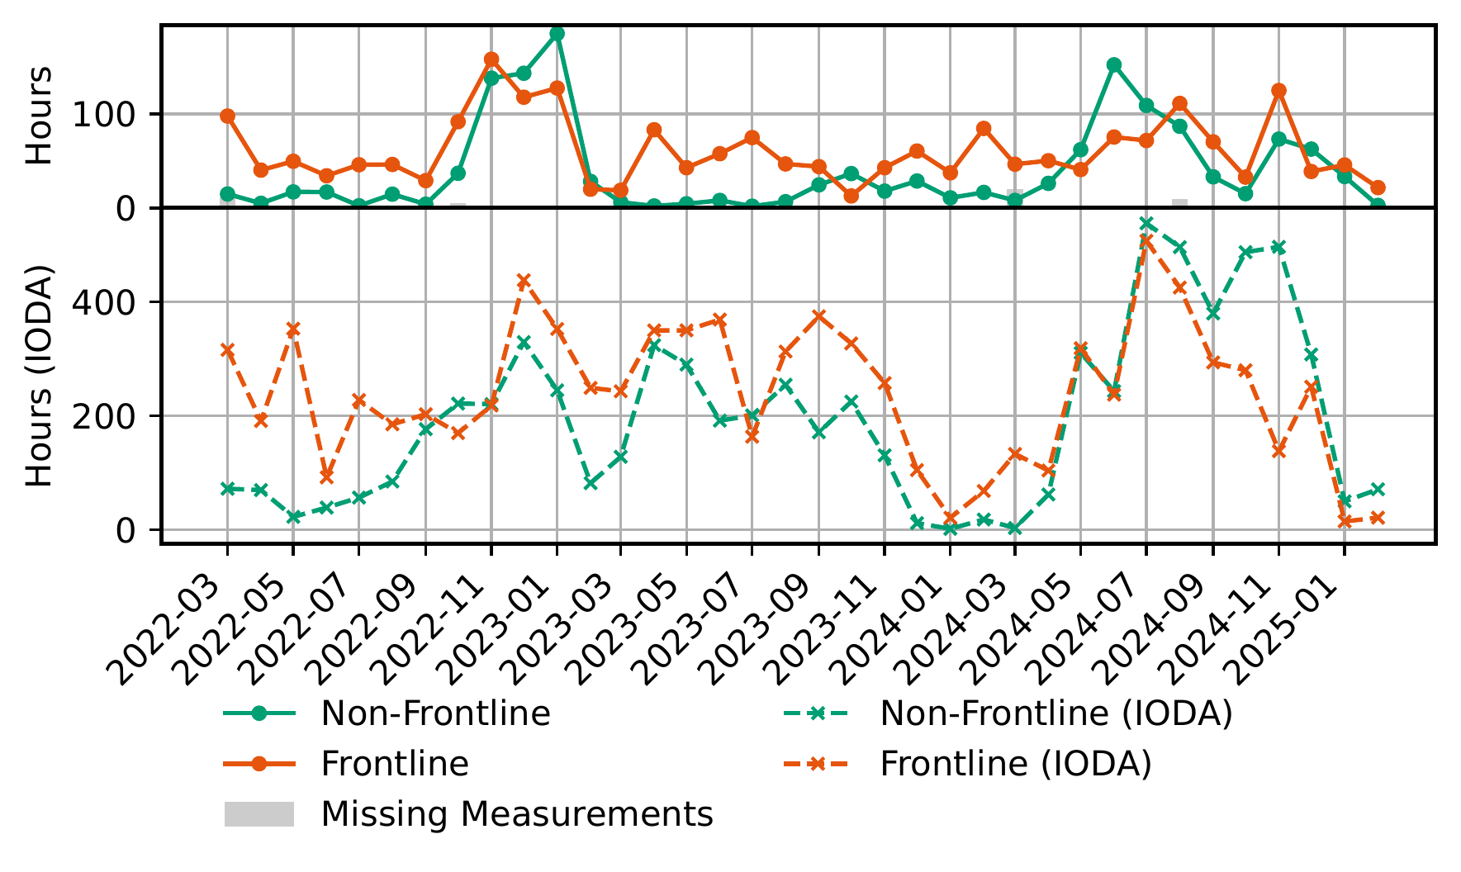
#6 Difference between frontline and non-frontline unique to our dataset.
IODA: Frontline and Non-Frontline regions show similar behavior
Figure 7: Average number of 2h intervals with outages.
Notes:
26 Verwaltungseinheiten = Oblaste
Cherkasy 66720.0
Chernihiv 16094.0
Chernivtsi 25836.0
Crimea 21274.0
Dnipropetrovsk 110736.0
Donetsk 58501.0
Ivano-Frankivsk 31113.0
Kharkiv 125910.0
Kherson 19649.0
Khmelnytskyi 54904.0
Kirovohrad 19542.0
Kyiv 622087.0
Luhansk 24089.0
Lviv 89439.0
Mykolaiv 37307.0
Odessa 115518.0
Poltava 61278.0
Rivne 29108.0
Sumy 25549.0
Ternopil 42407.0
Transcarpathia 16639.0
Vinnytsia 49883.0
Volyn 19089.0
Zaporizhzhia 56995.0
Zhytomyr 21131.0

Slide 15
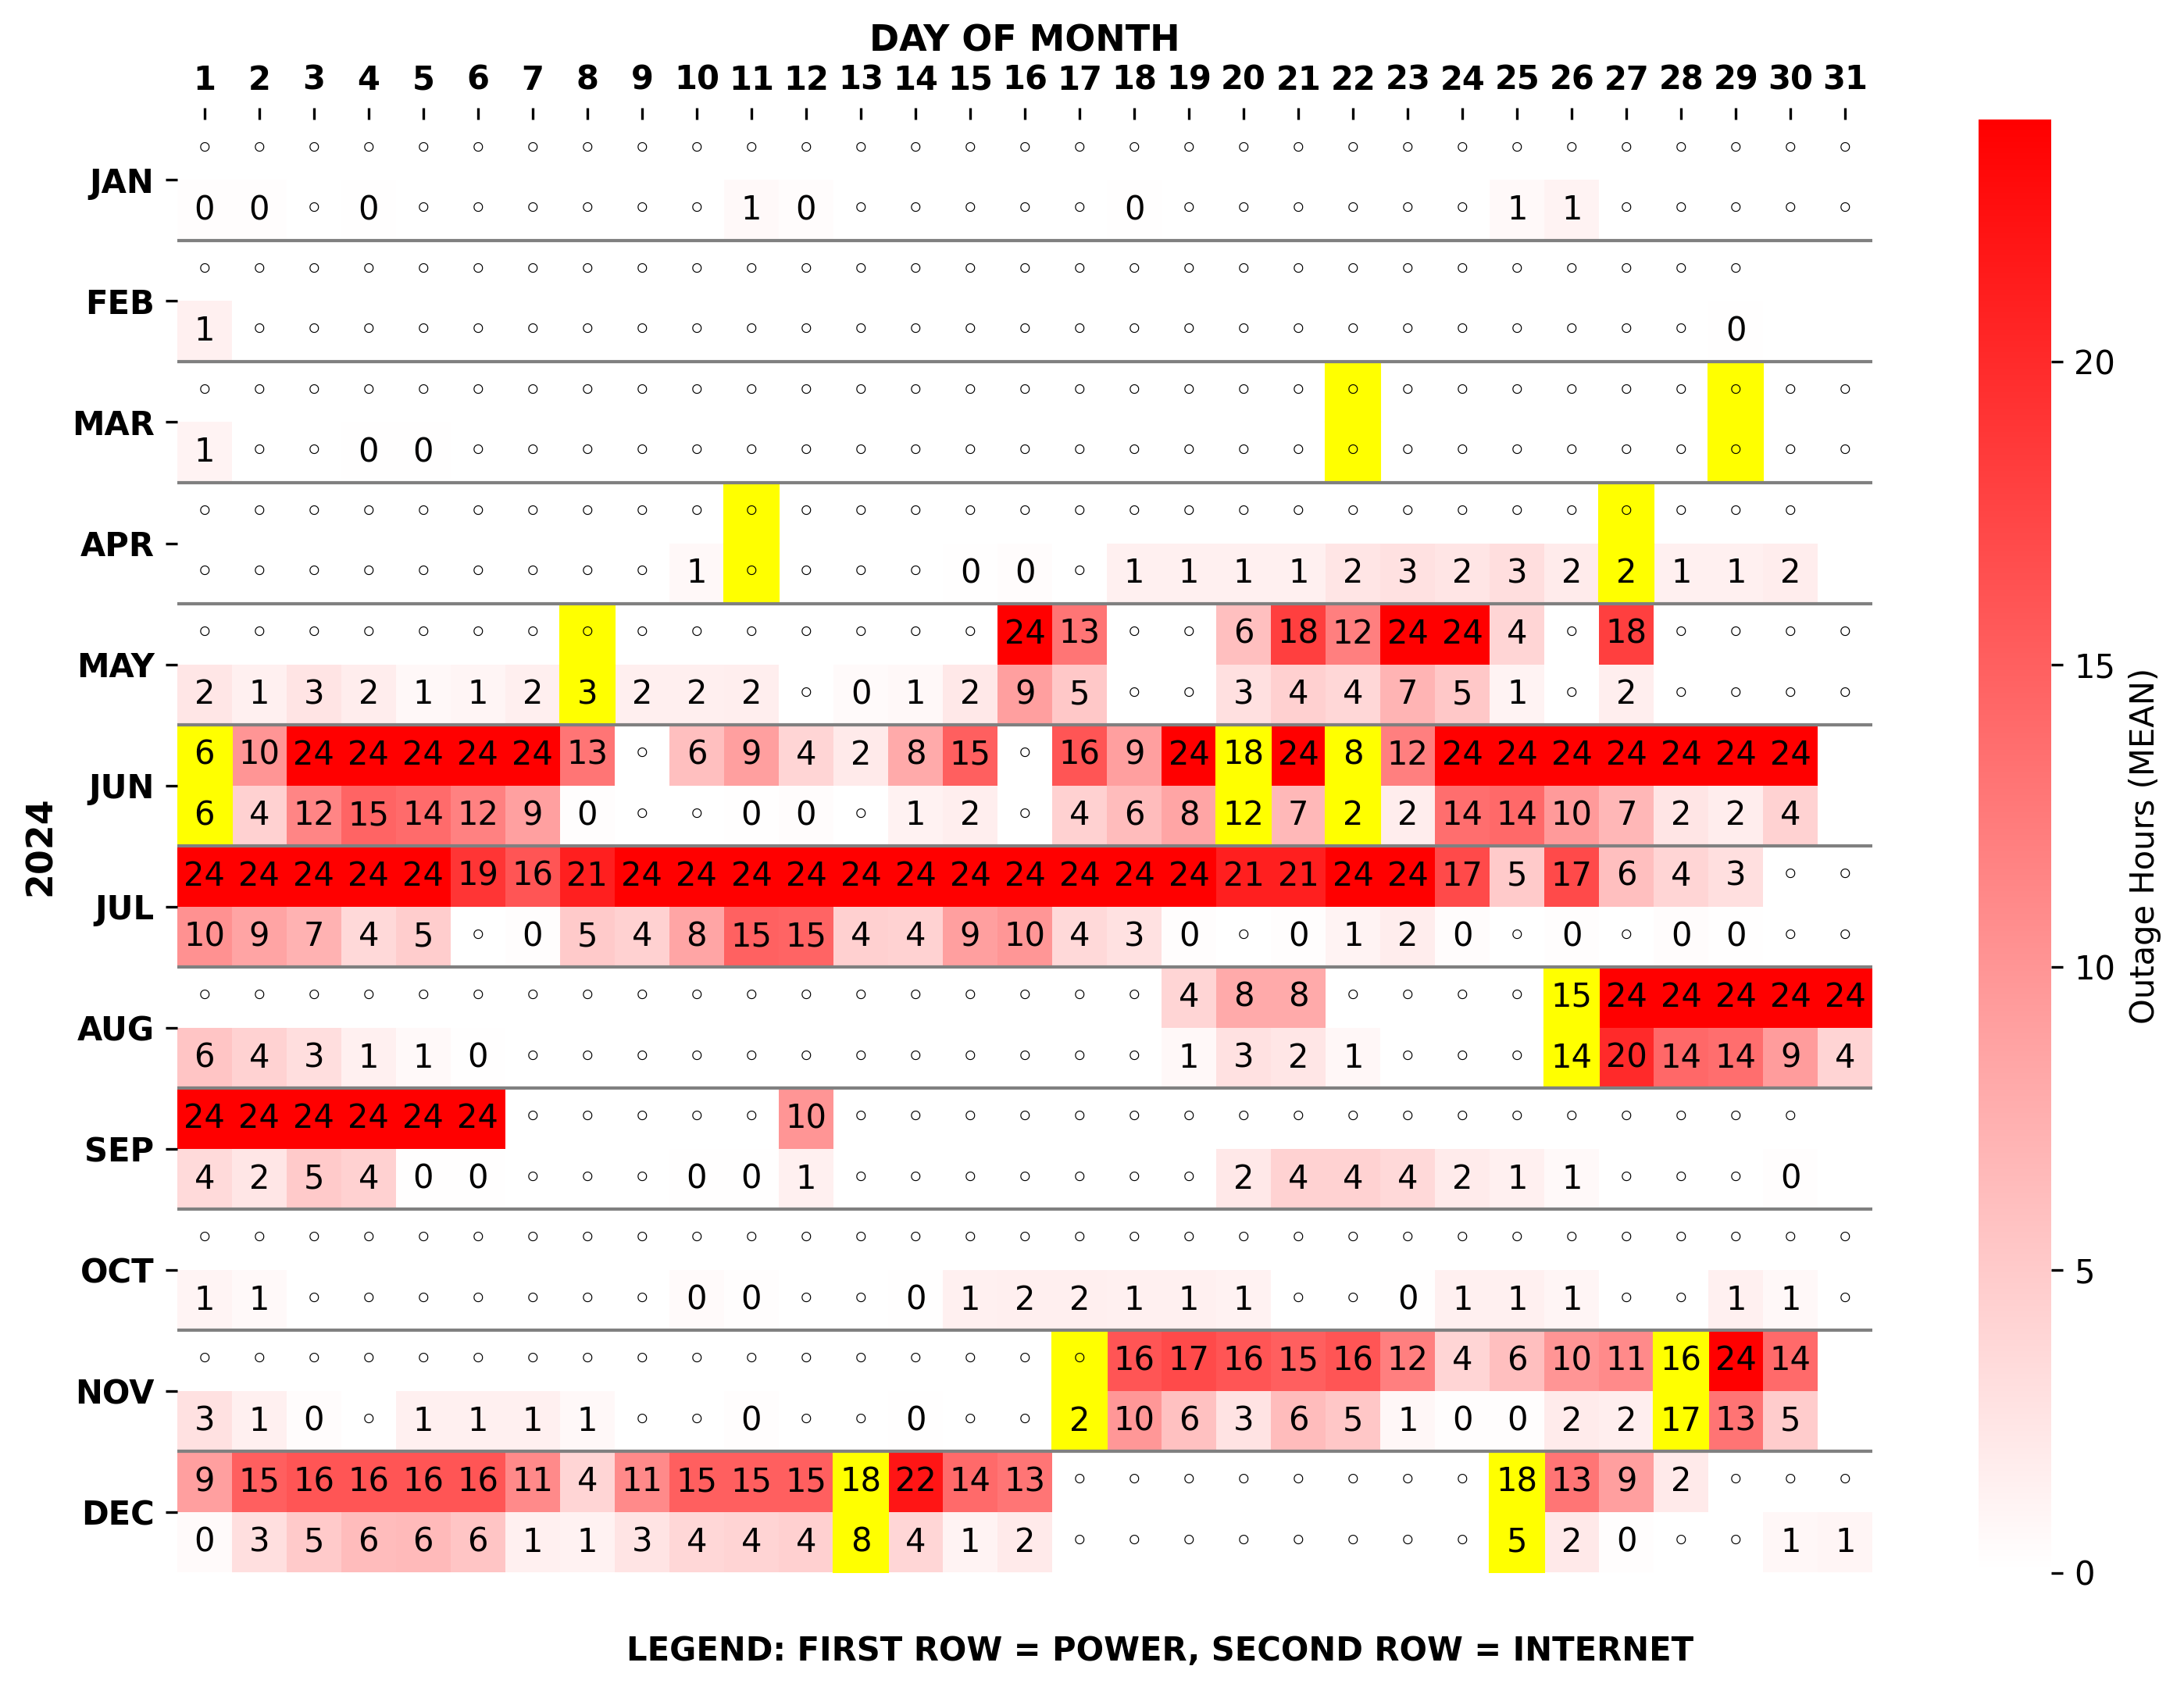
#7 Strong correlation of days with outages & power cuts in non-frontline regions.
1951 HOURS with electricity outages in 2024
Avg. 686 HOURS Max. 2822 HOURS with Internet outages in 2024
Pearson r=0.725 overlap of days
Figure 8: Hours affected by power and Internet outages in 2024.

Slide 16
Kherson – 3 Years on the Frontline
Kherson
Notes:
Siedlungen städtischen Typs: 31
Dörfer: 656
Siedlungen: 88

Slide 17
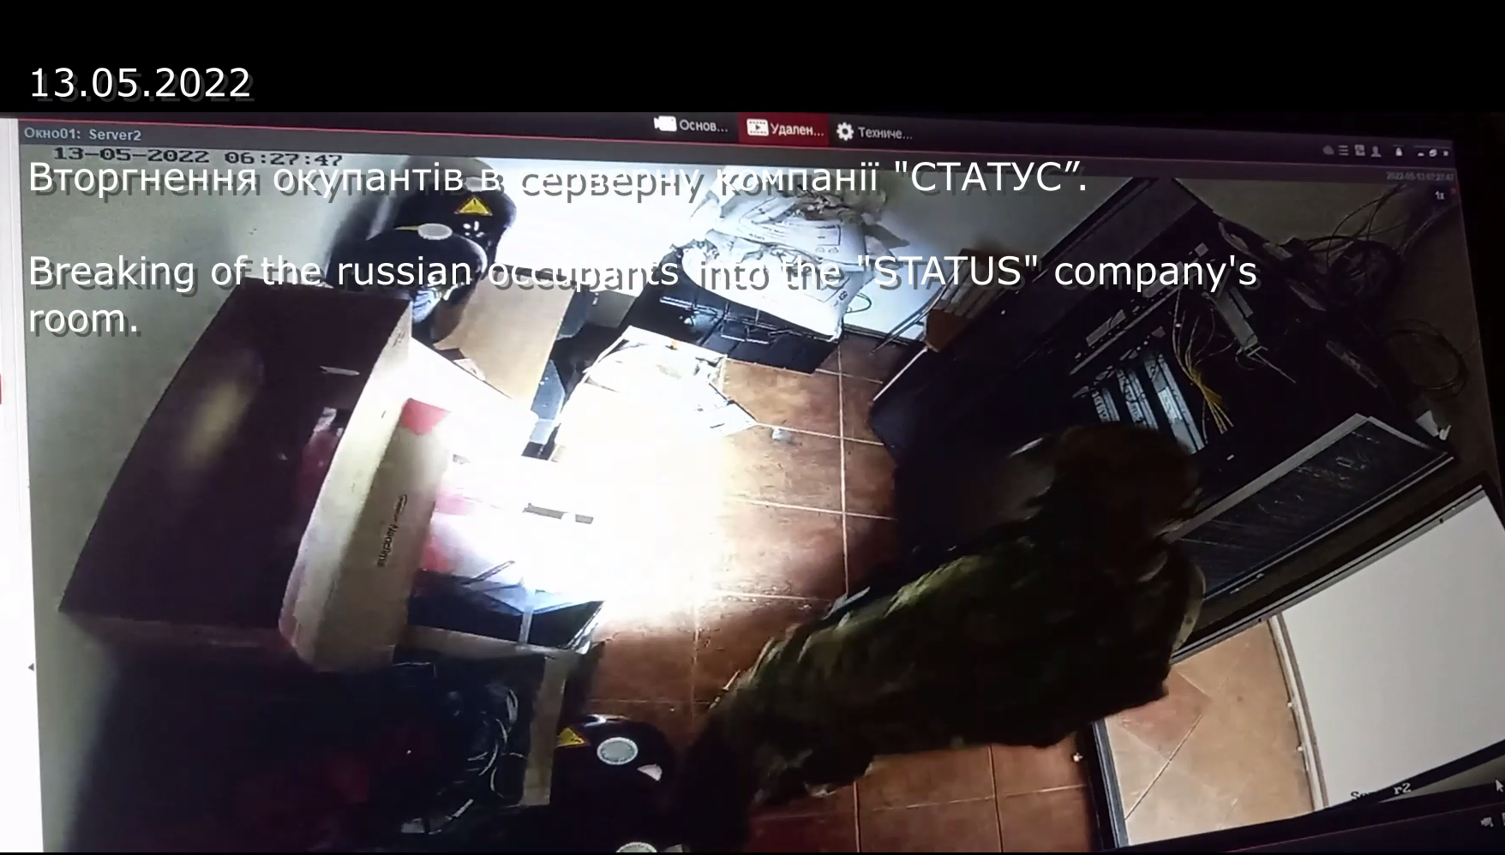
#8 Dataset provides insights into smaller regional providers in Kherson.

Slide 18
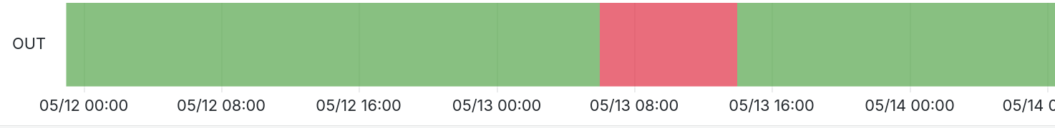
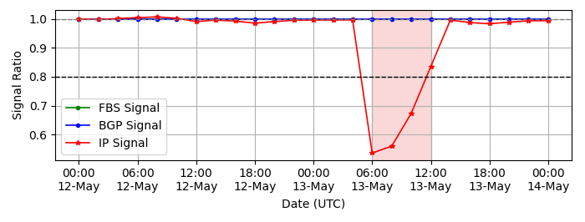
#8 Dataset provides insights into smaller regional providers in Kherson.
CountryMonitor: Decline in responsive IPs for ASN 25482 (STATUS ISP) at the same time as the incident
Incident: Russian soldiers search
STATUS Office

Slide 19
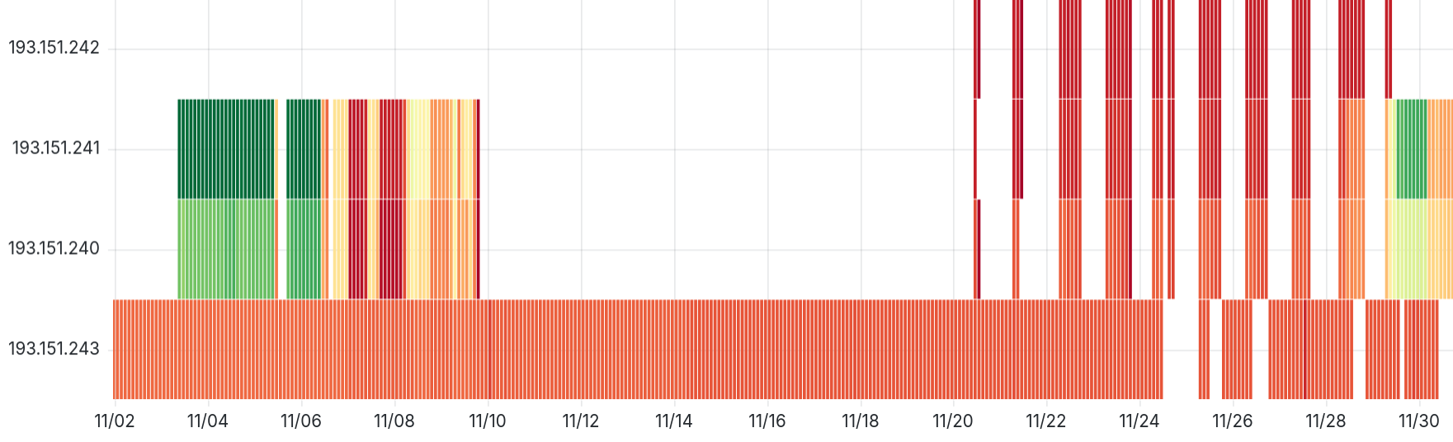
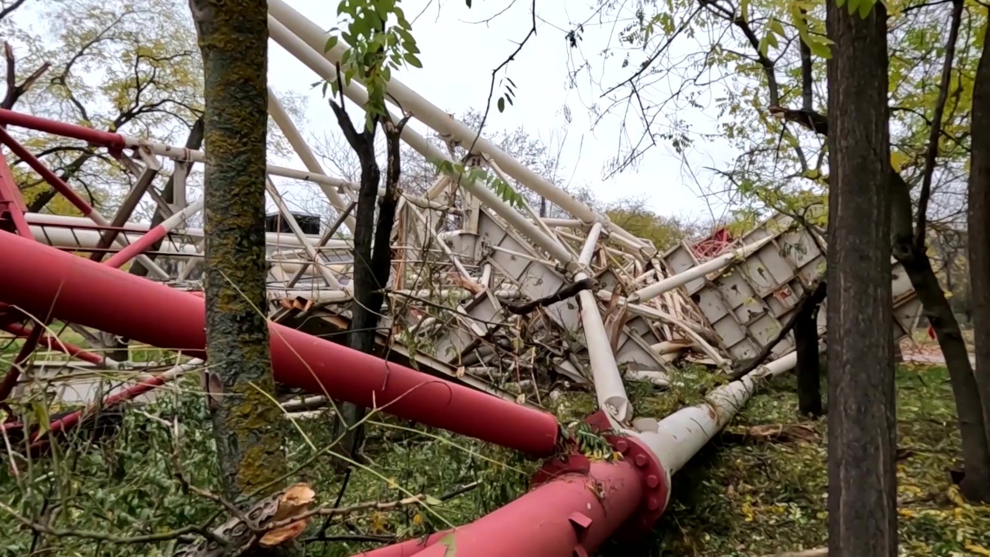
Nov 2022: Kherson city powered through generators
#8 Dataset provides insights into smaller regional providers in Kherson.
Kherson
ISP "STATUS"
Kyiv
⚡ Daily Cycles
START: 08:00
END: 18:00
Russian Troops destroy critical infrastructure (TV Tower, Heat/Power Plant during retreat )

Slide 20
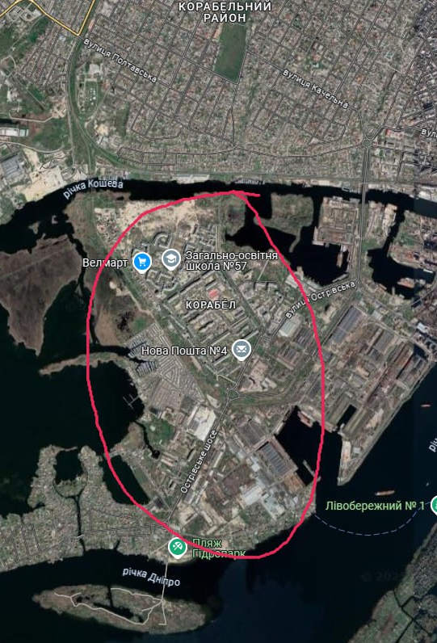
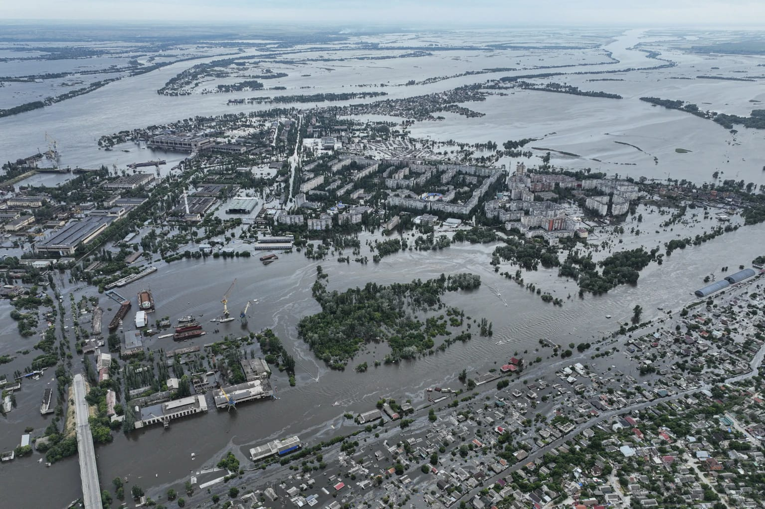
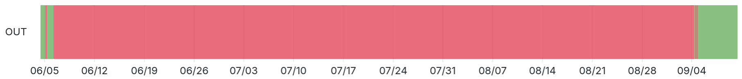
Jun/2023 Kakhovka Dam
#8 Dataset provides insights into smaller regional providers in Kherson.
Ostrov Net AS6446

Slide 21

CountryMonitor - Takeaways
 | Singla et al. | Klick et al. | IODA | CountryMonitor
Protocols | Modbus, DNP3 | 60+ | ICMP | ICMP
Signal | IP based | IP based | Block based (Sampling) | Block based (no Sampling)
Interval | 24 Hours | 4 Hours | 10 Minutes | 2 Hours
War Coverage | 6 Months 2022 | Until March 2023 | Since 2022 | Since 2022
Outage Location | IP Geolocation | Static IPs | IP Geolocation | Regional Classification
Short-lived outages >= 2h
Static IPs only? ✅
Sampling? Small Providers✅
Geolocation Precision ✅

Slide 22
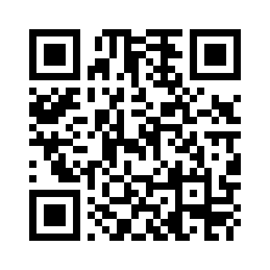
Acknowledgements:
Alexander Kovalenko – Status ISP
Dipl.-Ing. Florian Holzbauer
Researcher & PhD Candidate
University of Vienna
florian.holzbauer@univie.ac.at
countrymonitor.github.io Research Access -> Oct 28th​ 2025

