Slide 1
Context Matters: Repository-Aware Security Analysis of the Agent Skill Ecosystem
Florian Holzbauer, David Schmidt, Gabriel Gegenhuber, Sebastian Schrittwieser and Johanna Ullrich

Slide 2
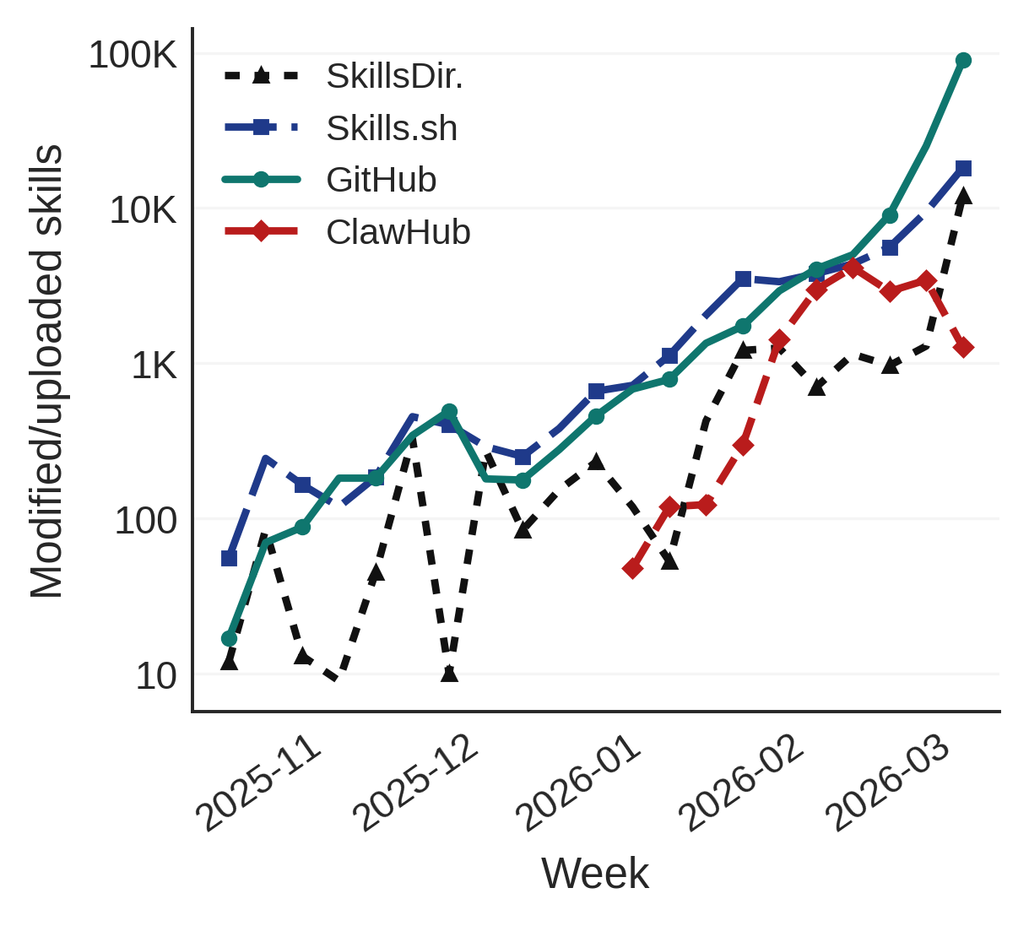

Motivation
Agent skill sharing is rapidly gaining momentum.

Slide 3

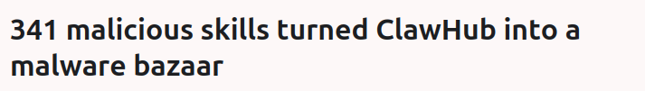

Motivation
Agent skill sharing is rapidly gaining momentum.
Abuse by malicious actors. High malicious rates of skill scanners. Trust in shared skills?

Slide 4



The Agent Skill Ecosystem March 9, 2026
Skills Directory.com
Clawhub.ai
Skills.sh
18K Skills
46.8% flagged suspicious
87K Skills
23% flagged
36K Skills
6% flagged

Slide 5

Motivation
Agent skill sharing is rapidly gaining momentum.
Abuse by malicious actors. High malicious rates of skill scanners. Trust in shared skills?
Analyze repository context to improve classification and provide additional trust metric.

Slide 6
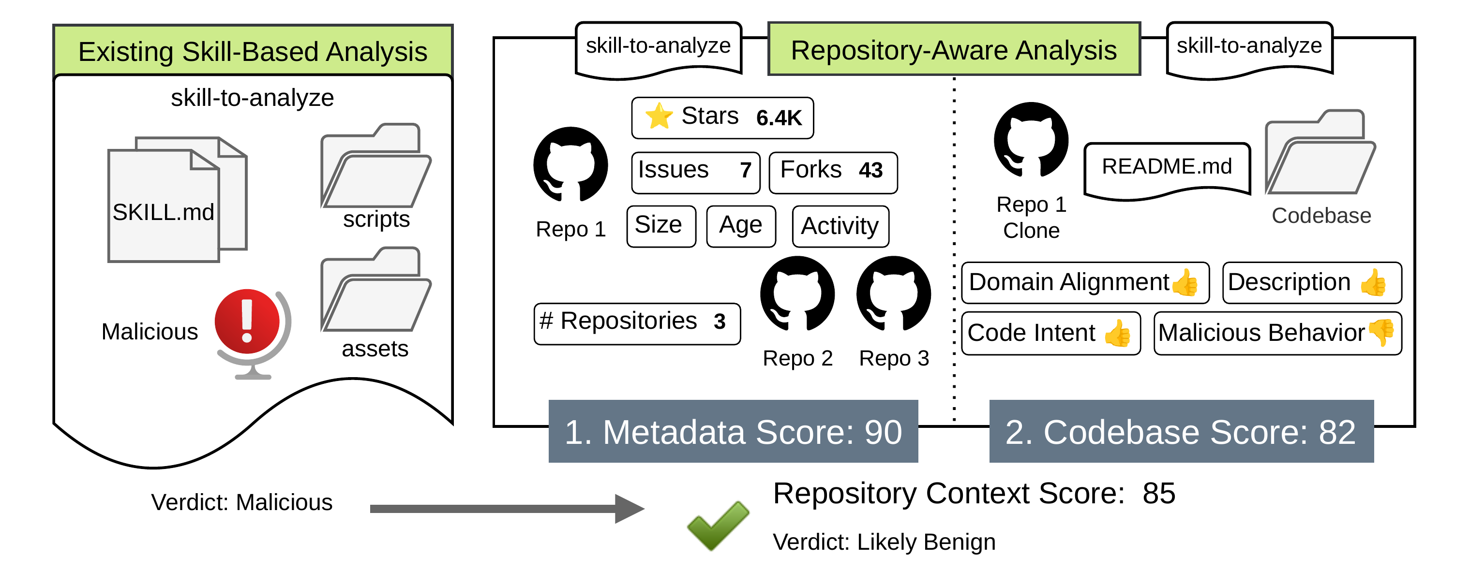
Methodology
1. Cross Plattform Skill Dataset
2. Skill-scanner Classification
3. Repository-Aware Analysis

Slide 7
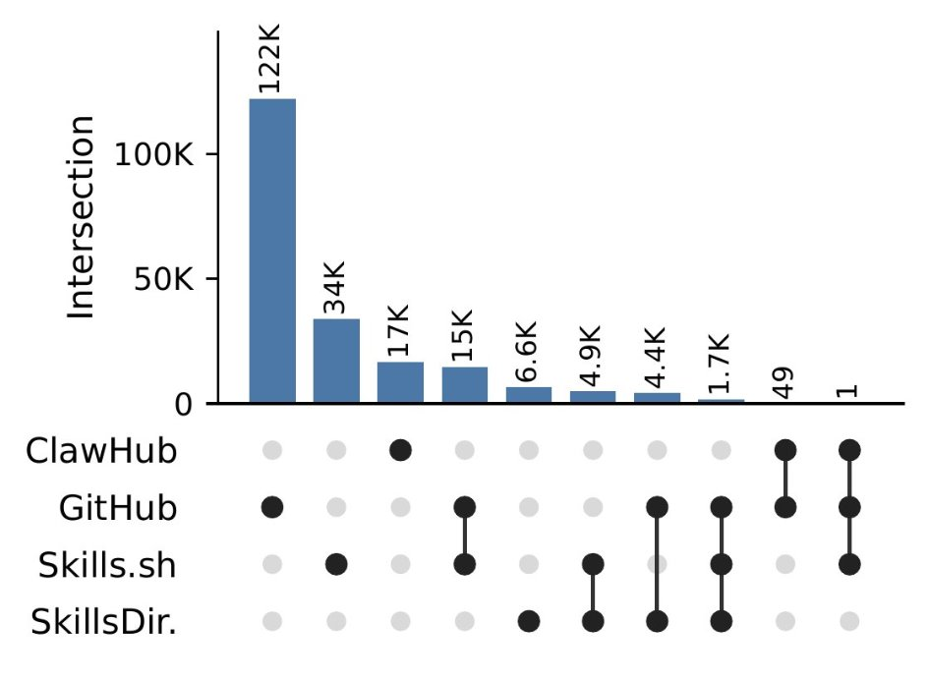

Results: Cross-Plattform Skill Dataset
238,180K collected skills
 | Clawhub.ai | SkillDirectory.com | Skills.sh | Github
Skills | 16,755 | 32,896 | 79,735 | 142,824
Repos | n/a | 709 | 7,950 | 14,197
Context | n/a | ✅ | ✅ | ✅

Slide 8



Results: Cross-Plattform Skill Dataset
44.1% of ClawHub skills contain scripts vs. 11.8-15.7% elsewhere;
Repository Context: available for 93% of collected skills
Skill Provisioning: Clawhub direct Others through Github
Supply Chain Attack: Skills with 1K+ installs hijacked

Slide 9
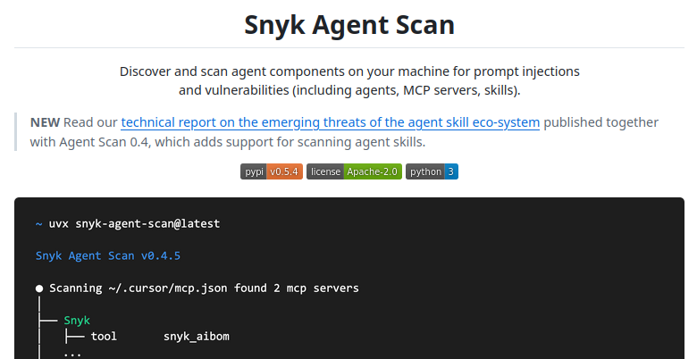
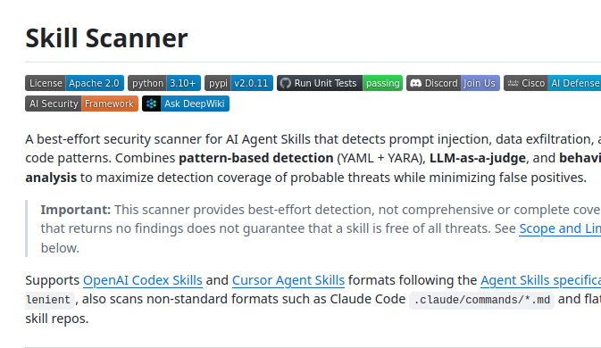
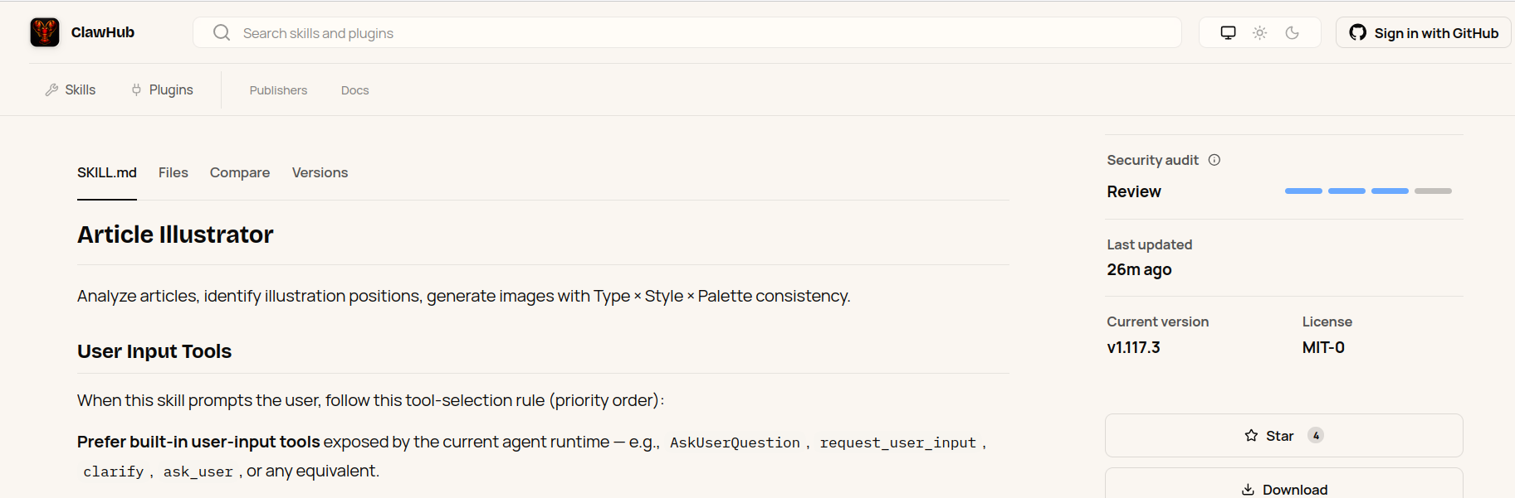
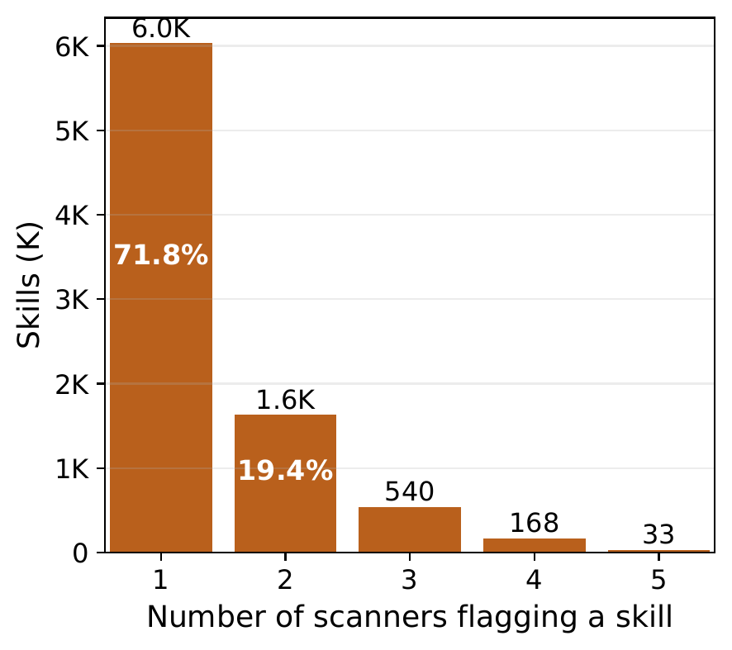
Results: Skill Scanner Classification
Effect of scanner on flagging rate: 3.8% Snyk 14-16% Cisco 42% OpenClaw
Scanner consensus limited: only 33 out of 8,402 skills (0.4%) are flagged by all five indexed scanners.
(Static + Behavior)
(LLM-Judge)

Slide 10
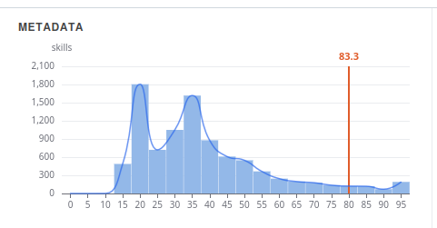
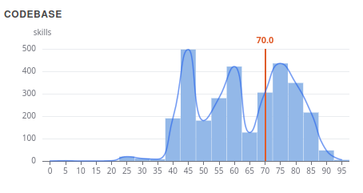
Results: Repository Context
alibaba/higress
Metadata Score: Static
⭐ 43% of new skill repos have 0 stars
⏳ 73% are 1 month to 1 year old
Codebase Score: LLM-Judge
🔄 Domain alignment (72%), README (69%), and codebase (39%).
😈 only 2% show repository-level maliciousness signs.
0.52% not related to security tooling.

Slide 11
Conclusion
📍 Skill marketplaces inherit supply-chain risks
🔍 Skill scanners currently overstate risk
📁 Repository context: Codebase alignment and metadata score can assist security analysis
⚠️ Repository-aware scanning is not ground truth

Slide 12

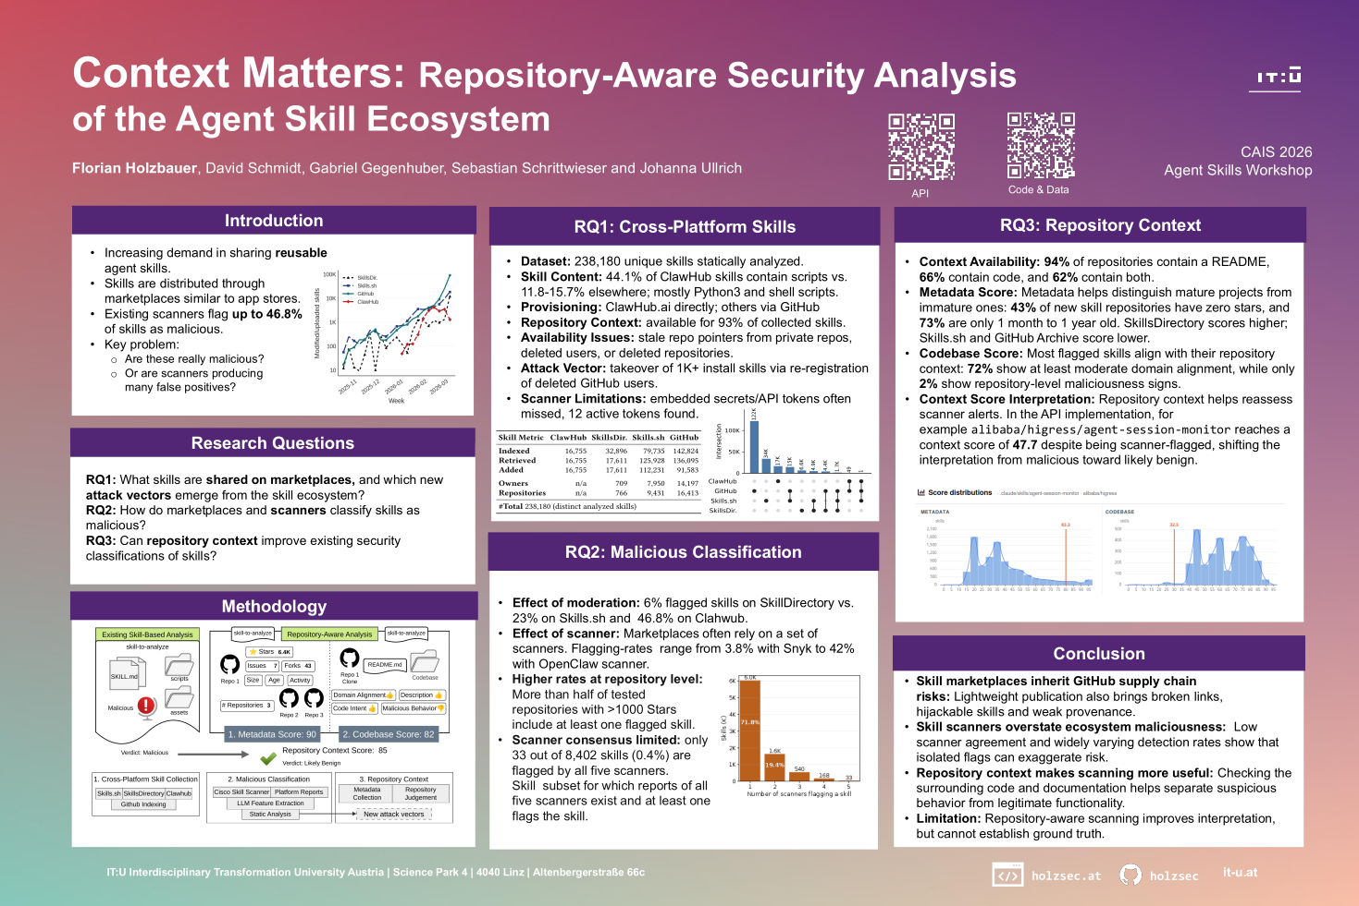


Poster
Code & Data
repository-context-agentskills
Contact
Frontend
agentskills.internetwarte.eu
holzsec
holzsec.at

