Slide 1
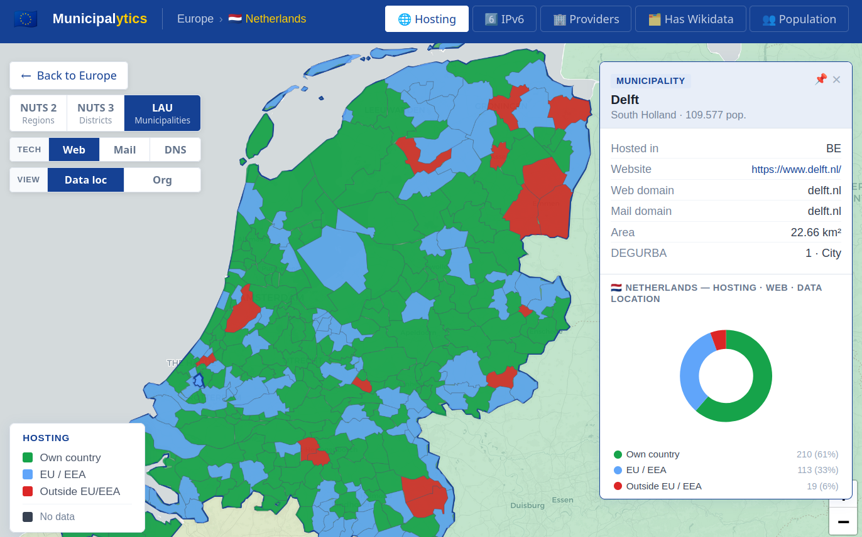

Municipalytics: Mapping the Digital Infrastructure of Municipalities Across GDPR Countries
Florian Holzbauer, Gabriel Gegenhuber and Johanna Ullrich

Slide 2
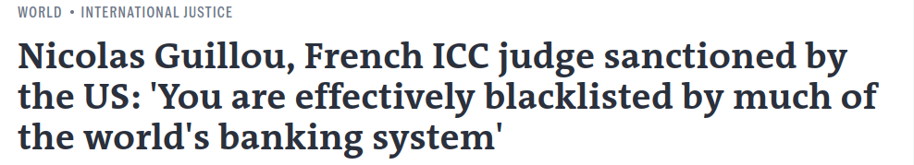

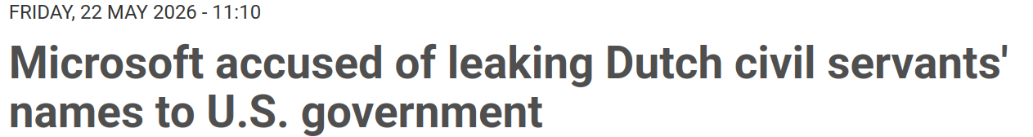


Digital Sovereignty
Availability
Access restriction: SWIFT, ICC
Confidentiality
+ email content

Slide 3
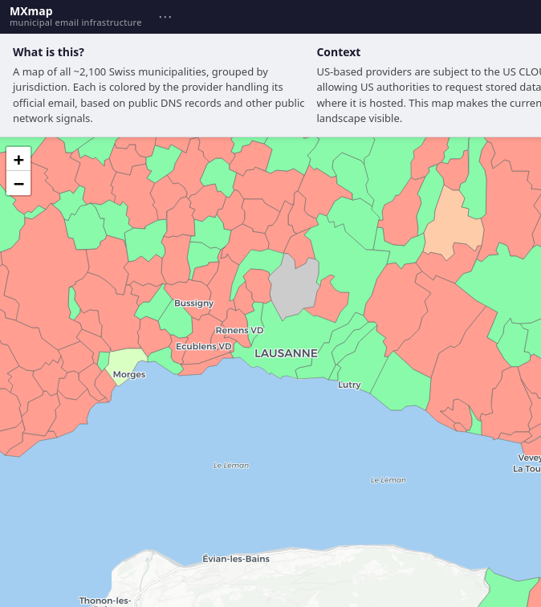
Introduction
MXMap shows dependency of Swiss municipalities (credits David Huser)
Red = emails end up in US cloud

Slide 4
Introduction
RQ: What is the current state of municipal hosting across GDPR countries?

Slide 5
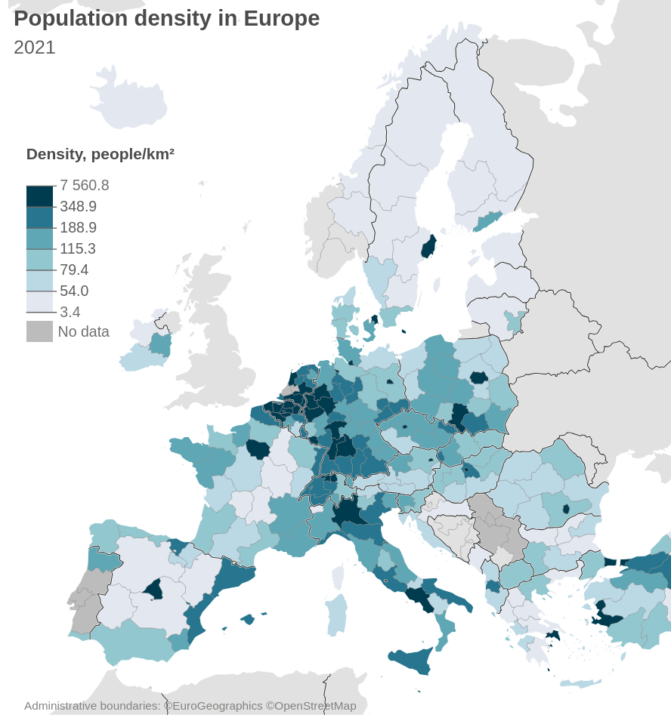
Introduction
Eurostat provides data ​on the local administrative layer across Europe.
There is no such data collected for digital infrastructure. We miss a comprehensive domain list.
Link Eurostat administrative units with municipal wikidata entries.

Slide 6




Methodology Overview
2. Wikidata Linking
3. Active DNS resolution
4. IP Attribution
1. Geojsons
Goal 1: Retrieve website entry for Eurostat data
Goal 2: Resolve Web, Mail and NS to IPs
Goal 3: IP to physical and jurisdictional hosting location

Slide 7
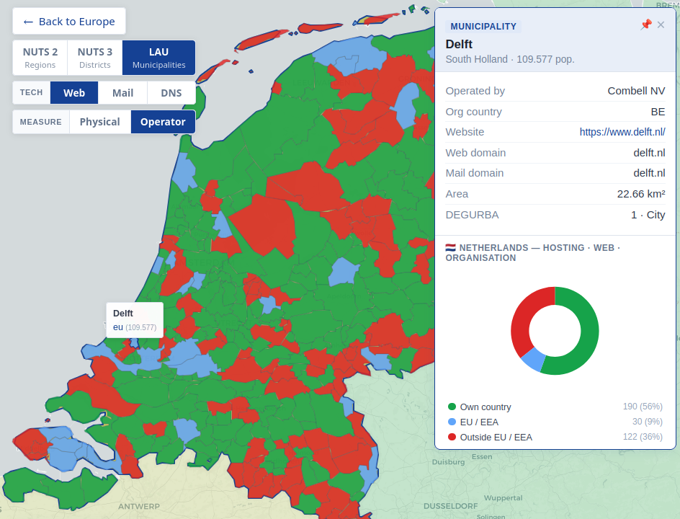
Data Overview: Delft
Overall Goal: Reproducible and automated pipeline for all countries

Slide 8
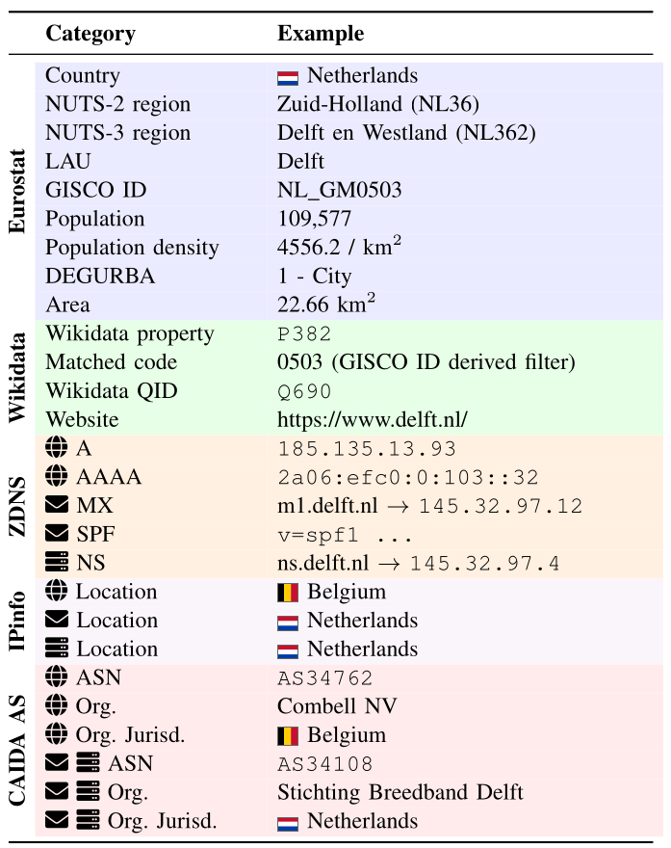
Data Overview: Delft
-
Two Geojson Inputs:
NUTS regions
LAU's

Slide 9
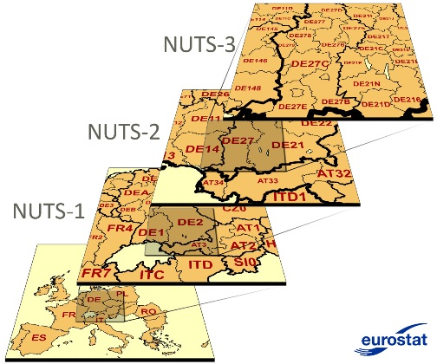
Data Overview: Delft
-
NUTS = Nomenclature of territorial units for statistics
4/5 (=LAU's) … municipality/commune
3... district
2... province
1... state
Bavaria

Slide 10
Data Overview: Delft
-
NUTS = Nomenclature of territorial units for statistics
"type": "Feature",
"properties": {"NUTS_NAME": ".." },
"geometry": { },
# either 4326 unprojected lon,lat
# or 3035 projected x,y

Slide 11
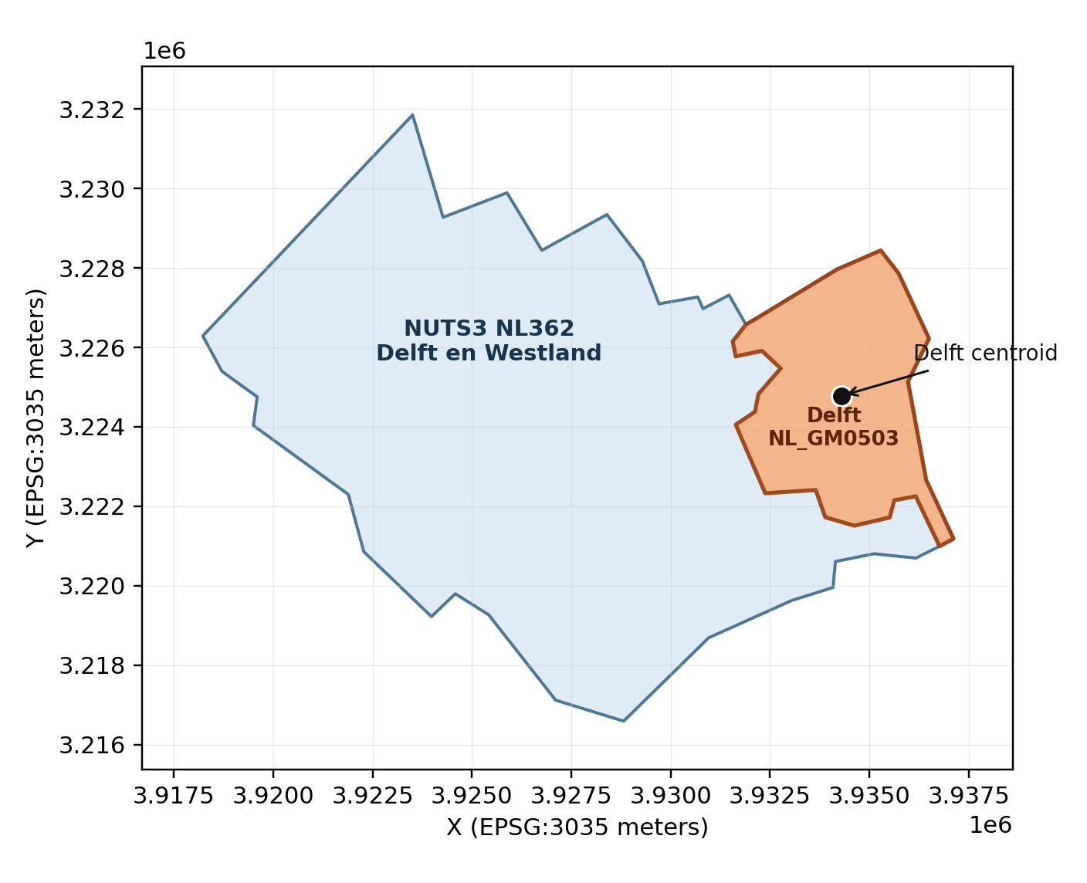
Data Overview: Delft
-
NUTS = Nomenclature of territorial units for statistics
"type": "Feature",
"properties": {"NUTS_NAME": ".." },
"geometry": { },
# either 4326 unprojected lon,lat
# or 3035 projected x,y

Slide 12
Data Overview: Delft
-
Wikidata Linking
Goal: List of Website/Email entries
Eurostat ✅ What domain is Delft using for web/email?

Slide 13
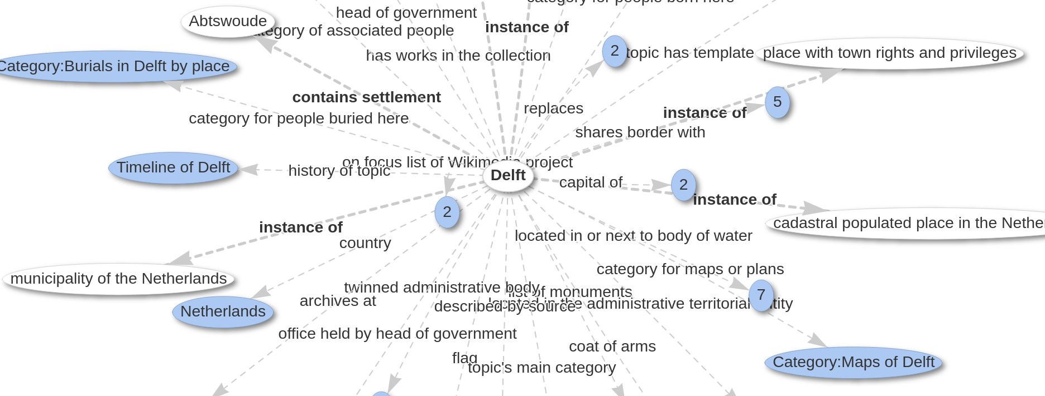
Wikidata Data Model
Subject → predicate → object
Delft → country → Netherlands

Slide 14
Data Overview: Delft
-
Wikidata Linking
Method 1: Property match based on GISCO ID
Method 2: Spatial Lookup
For countries without matching GISCO ID
Delft (Q690) > instance of (P31) > municipality of the Netherlands(Q2039348)
Retrieve all the entries of a country
Match LAU names, use spatial lookup for multiple results based on Wikidata coordinates.

Slide 15
Data Overview: Delft
-
Wikidata Linking
Goal: find Website/Email entries
Bridge: P382 … CBS municipality code
Full property list in paper

Slide 16
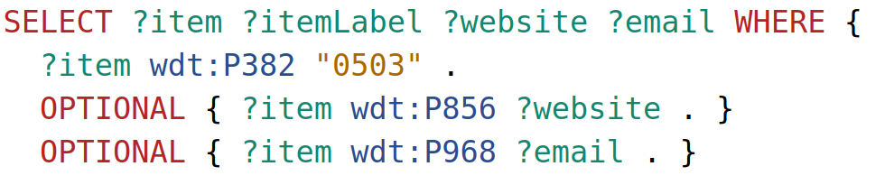
Data Overview: Delft
-
Wikidata Linking
Website/Email entries
P382 … CBS municipality code
Wikidata Query Service (SPARQL)

Slide 17
Data Overview: Delft
-
Wikidata Properties
Website/Email entries
DNS resolution

Slide 18
Data Overview: Delft
-
Wikidata Linking
Website/Email entries
DNS resolution
Physical Hosting Loc.
IP to country-level geolocation

Slide 19
Data Overview: Delft
-
Wikidata Properties
Website/Email entries
DNS resolution
Physical Hosting Loc.
HQ Jurisdiction

Slide 20
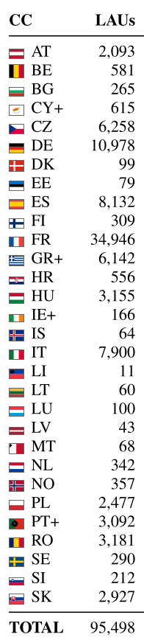
Municipal Coverage
Category | #
Countries | 30 (EU27 + EEA)
Eurostat LAU's | 95,498
Wikidata coverage | 88,948 (93%)
With website entry | 69,220 (73%)
% Resolvable | 97% NS – 81% SPF
30 Countries: EU 27 + EEA GDPR applies also to EEA countries

Slide 21
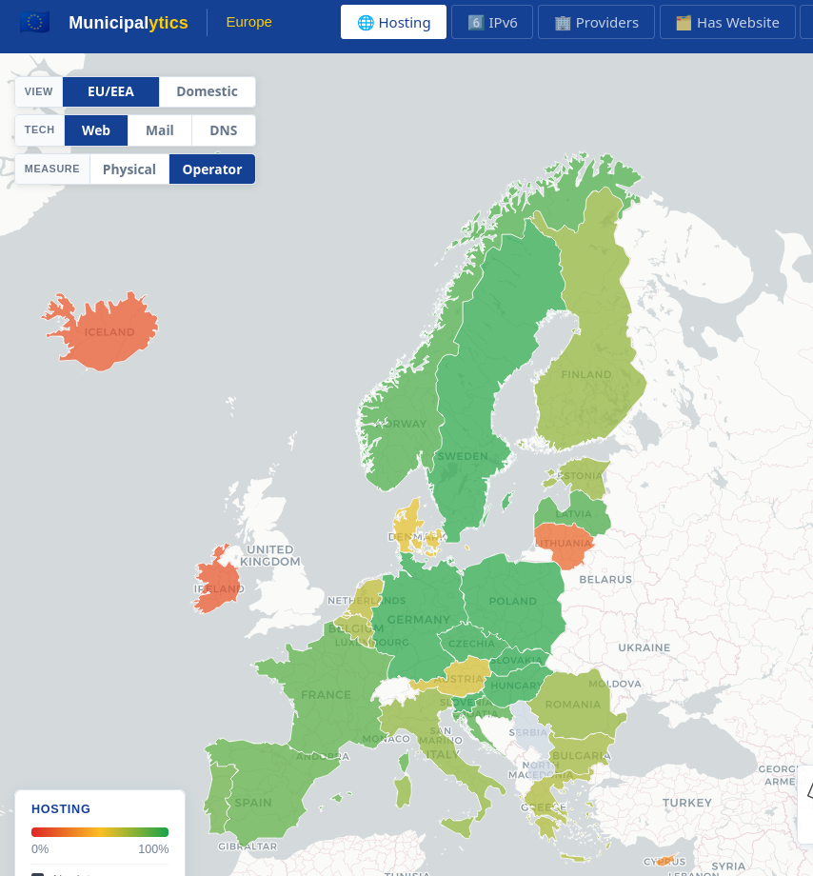
Evaluation and Results

Slide 22
Digital Sovereignty
Good: Domestic infrastructure or in EU/EEA and resilient through a competitive market. Allows more policy control by the state. (IPv6 strategy: NL; NIS 2:
Bad: Large parts of the infrastructure outside the country. Single points of failure; centralized around single operators.
RQ: What is the current state of municipal hosting across EU countries?

Slide 23
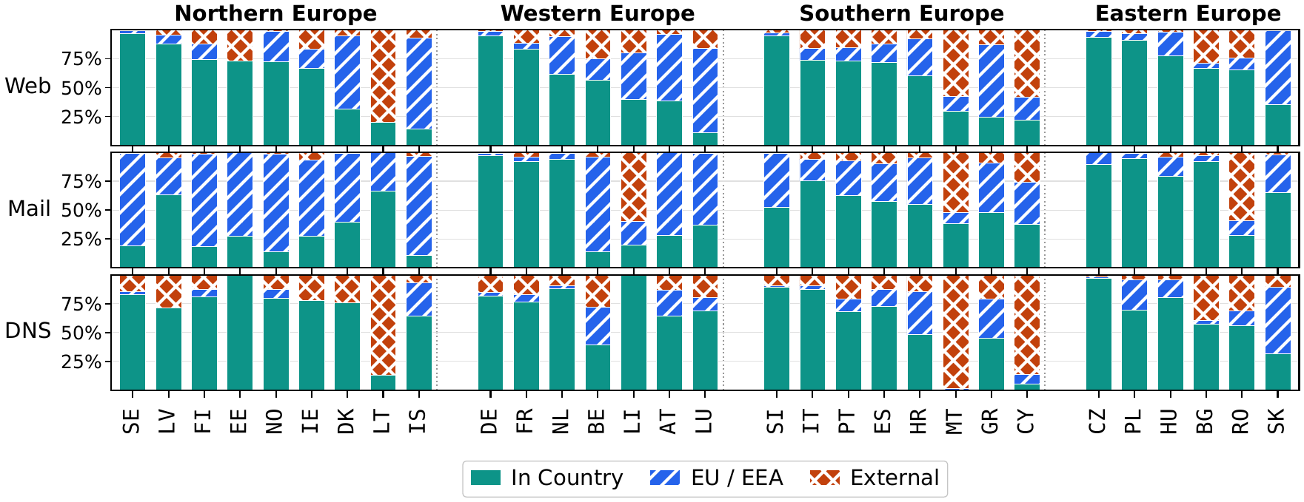
Results 1: Physical Hosting Locations

Slide 24
Results 1: Physical Hosting Locations

Slide 25
Results: Physical Hosting Locations

Slide 26
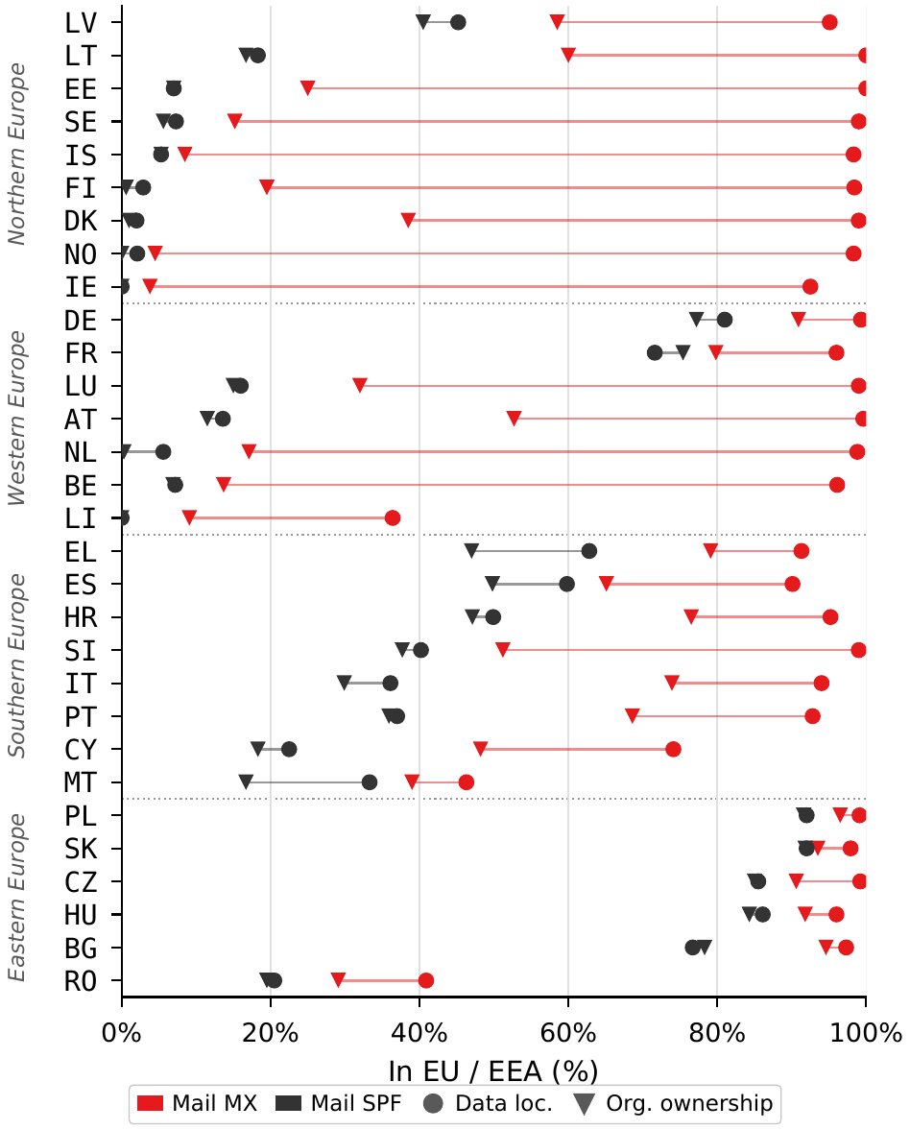
Results: Jurisdictional Dependencies
Wide gap = strong influence by Jurisdiction; Microsoft operates infrastructure in EU, but is still headquartered in the US
Outbound mail trust is often granted outside EU
Eastern Europe: In EU inbound and outbound mail (RO exception with strong influence of Yahoo)

Slide 27
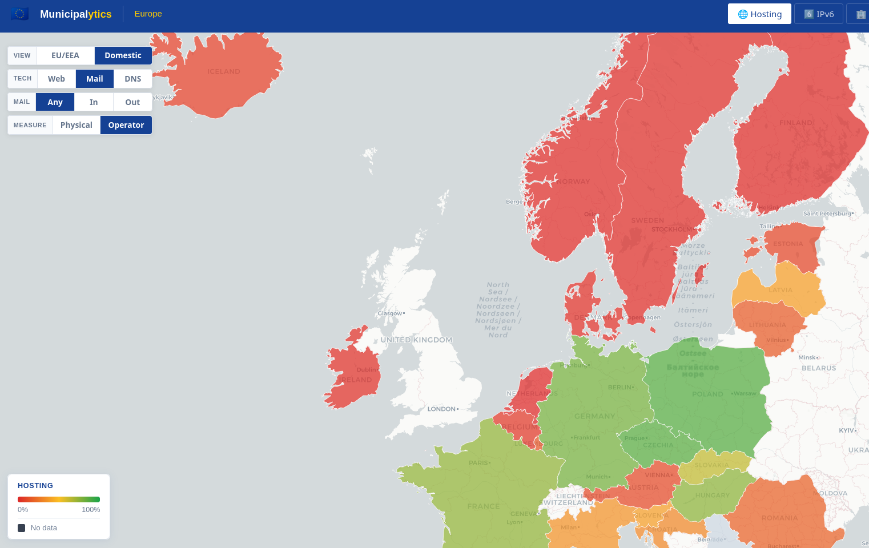
Results: ​Northern European Mail in the US cloud

Slide 28
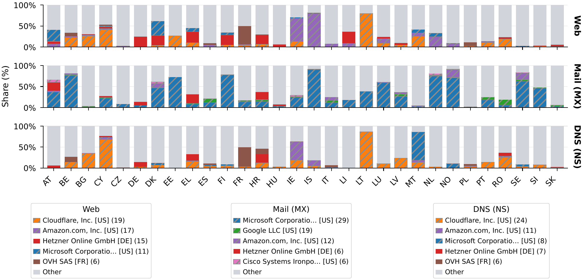
Results: Top Providers

Slide 29
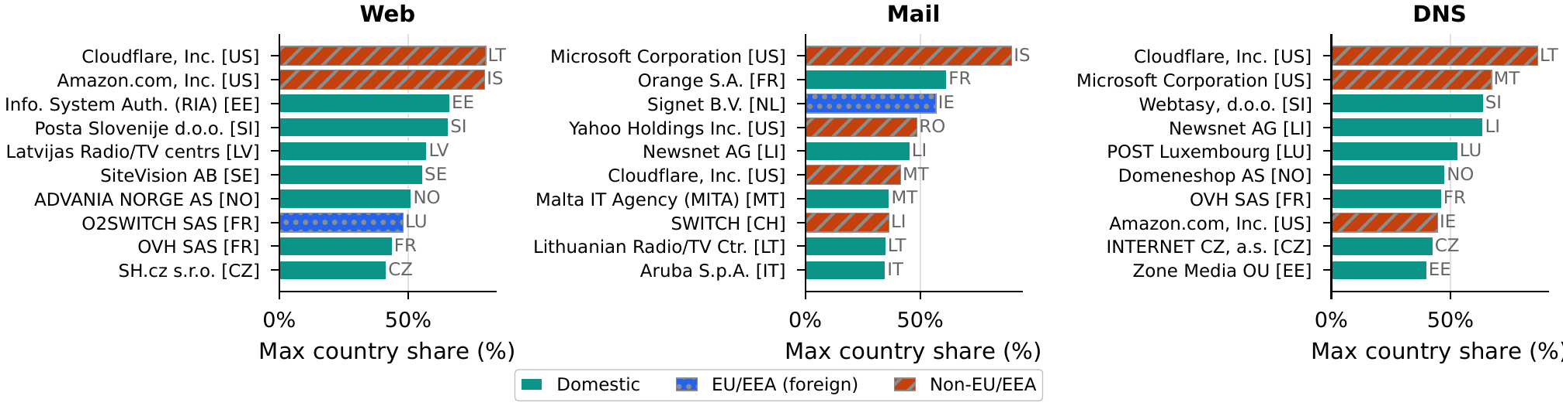
Results: Top Providers

Slide 30
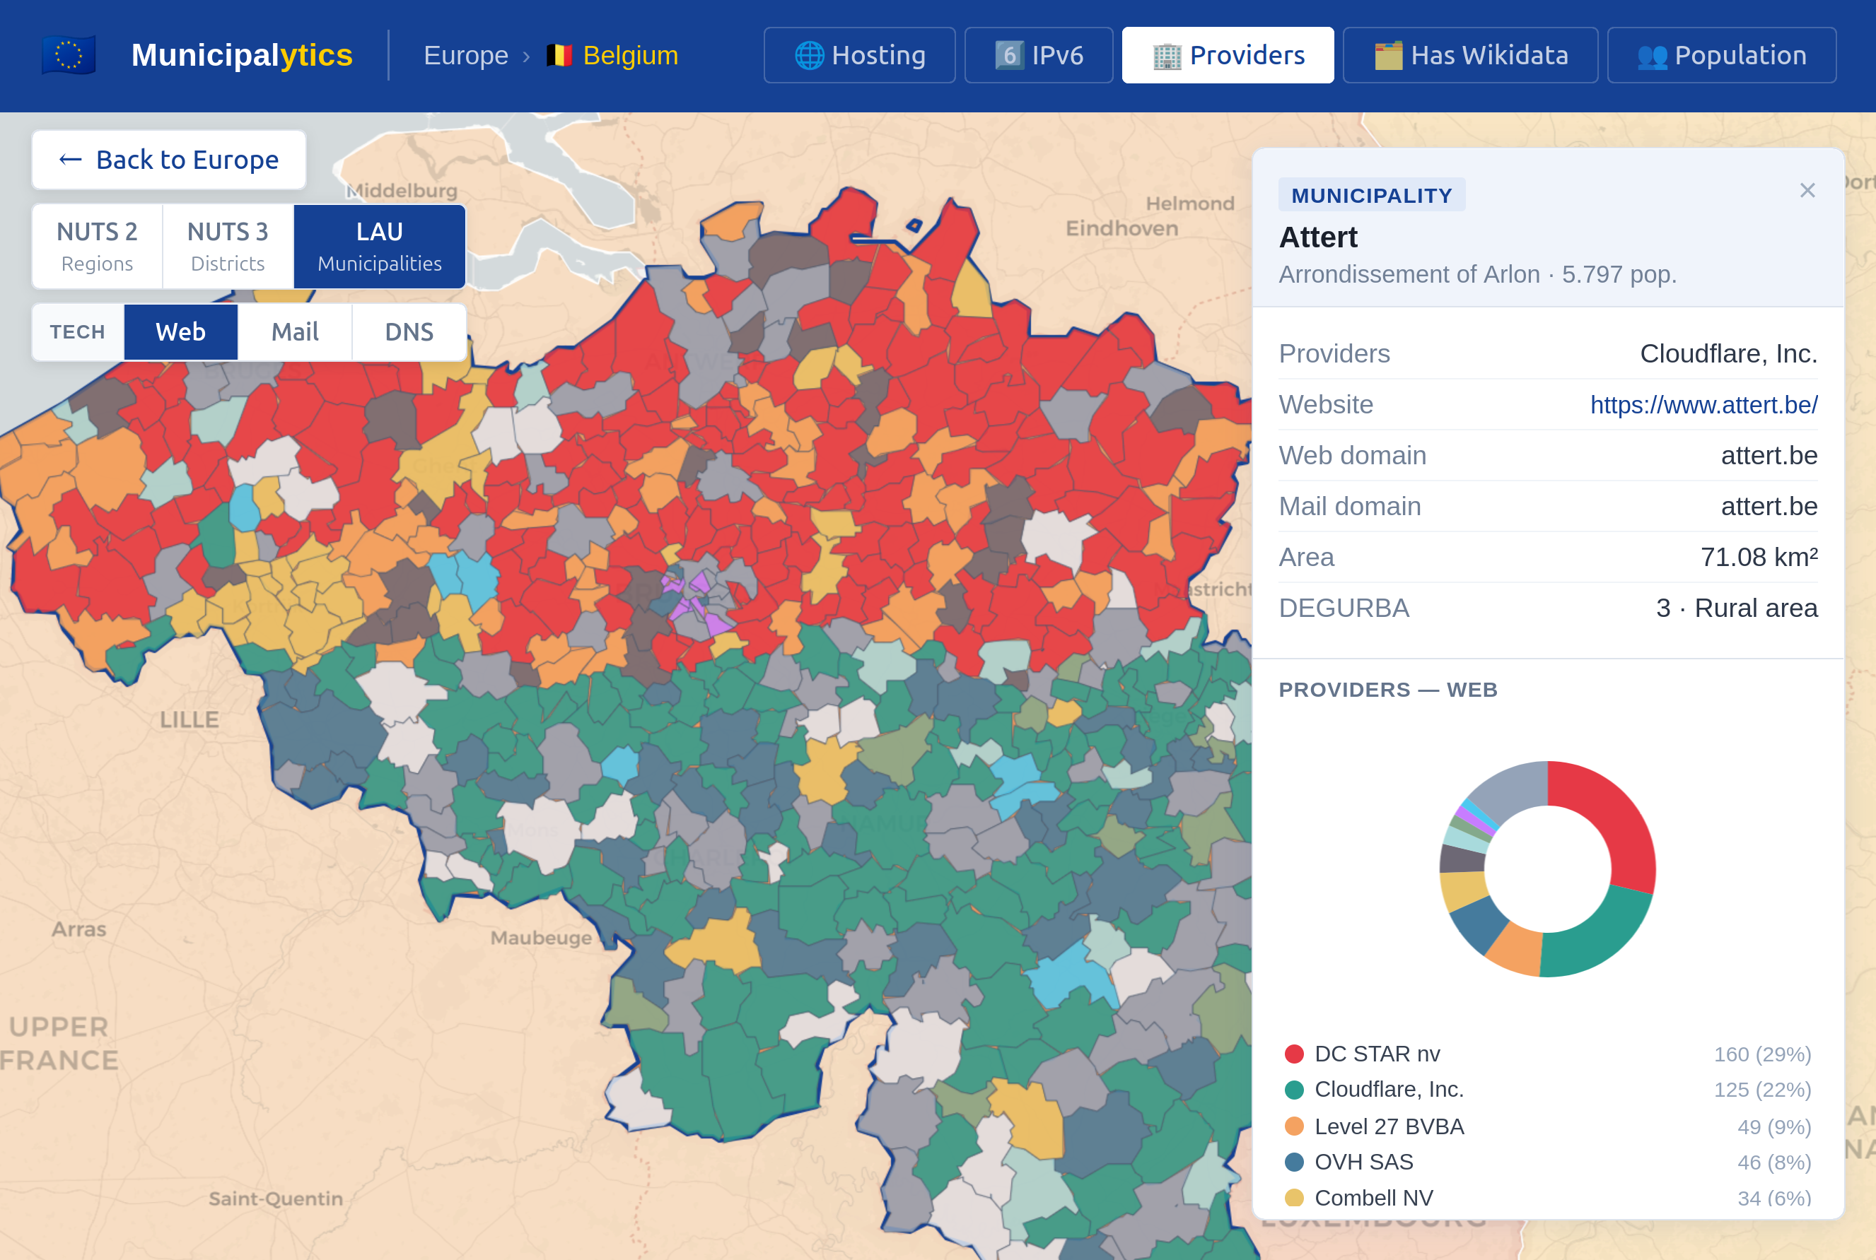
Results: Flanders vs. Wallonia

Slide 31
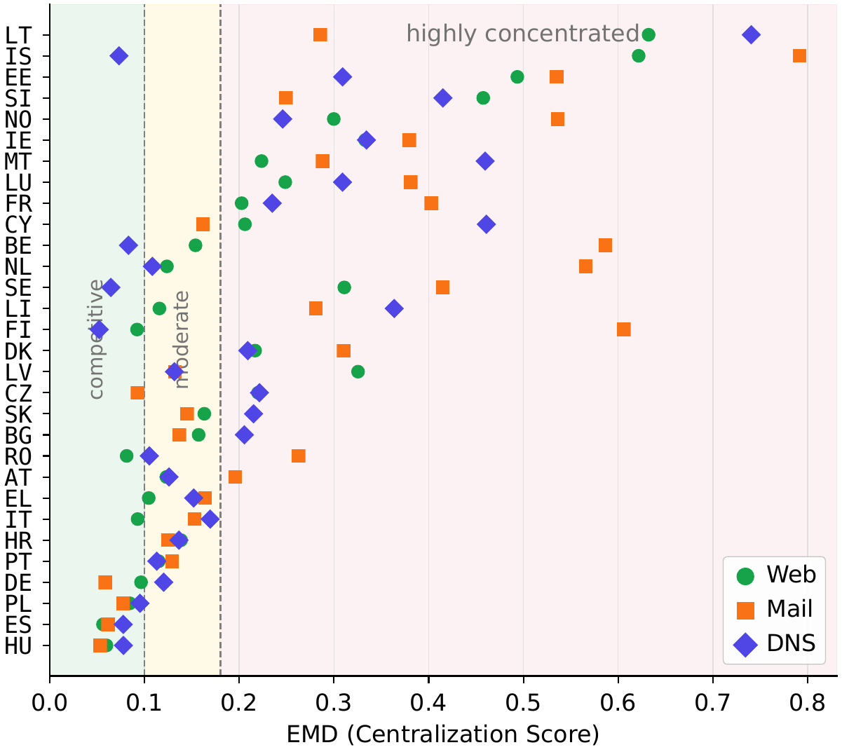
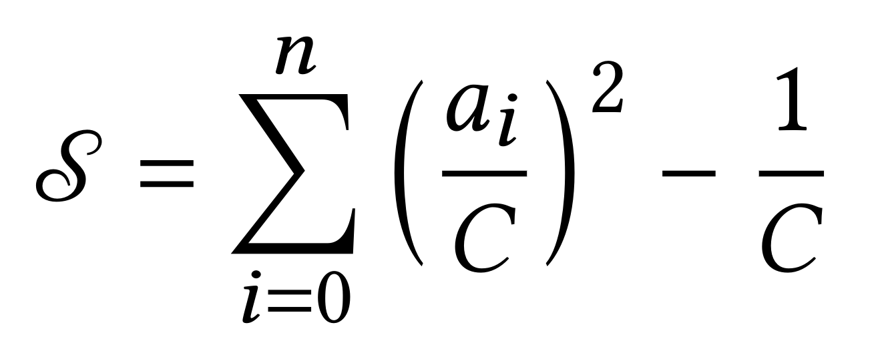
Results: Centralization
Earth Mover's Distance (EMD) from IMC'25 Formalizing Dependence of Web Infrastructure
a_{i} … # of munici. hosted by provider i
C … # of munici. in country
Interpretation (IMC'25):
competitive (<0.10),
moderately concentrated (0.10-0.18)
highly concentrated (>0.18)

Slide 32
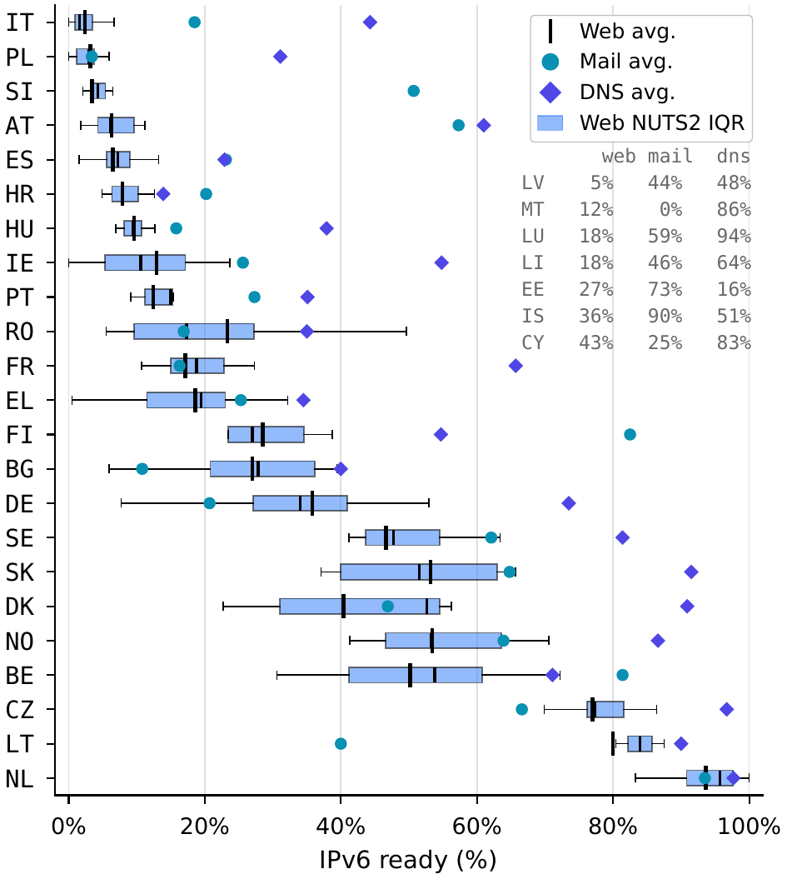
Results: IPv6 Reachability
IPv6 reachability shows largest gap between countries
Often DNS > Mail > Web
Web is more often hosted domestically
Mail and DNS influenced by centralization
Effect of national strategies visibile(CZ, NL)

Slide 33
Takeaways
30 Countries - different digital strategies visible
US cloud dependency (Northern Europe)
Domestic strategies (DE, ES, PL and Eastern europe)
IPv6 adoption (NL, CZ)
Municipal operators rarely cover Web, Mail and DNS
Digital sovereignty yes, but also market concentration important to resilience
Status: May 2025

Slide 34

Check your Country
municipalytics.internetwarte.eu

