Slide 1
Kotlin Coroutines
Android Team
Notes:
<number>

Slide 2
Agenda
1
INTRODUCTION
2
THE DIFFERENCES
3
NEW CONCEPTS
4
EXCEPTIONS HANDLING
5
EXCELLENT THINGS
6
Q&A

Slide 3
INTRODUCTION

Slide 4

Introduction
Threads vs Cores
Website
Notes:
<number>

Slide 5
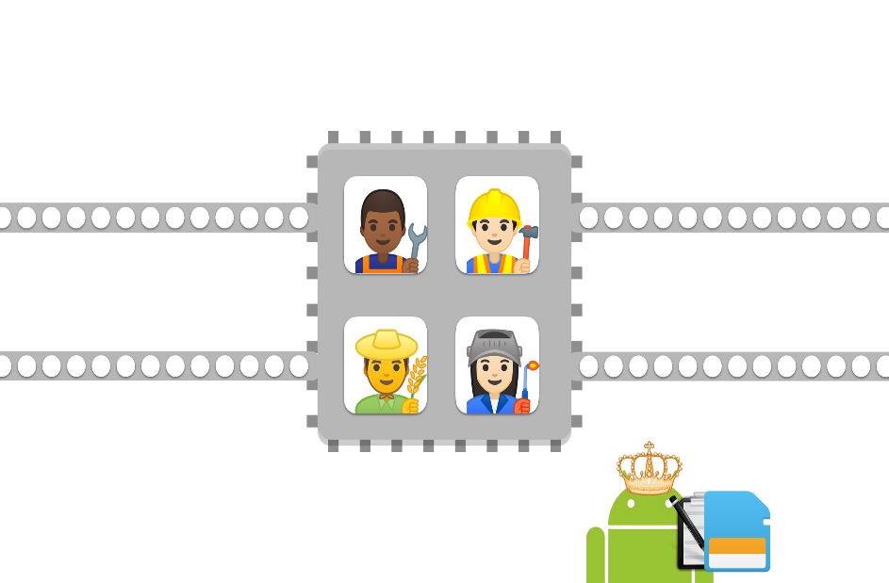

Introduction
Physical vs Logical cores
Notes:
<number>

Slide 6
Introduction
Physical vs Logical cores
Notes:
<number>

Slide 7
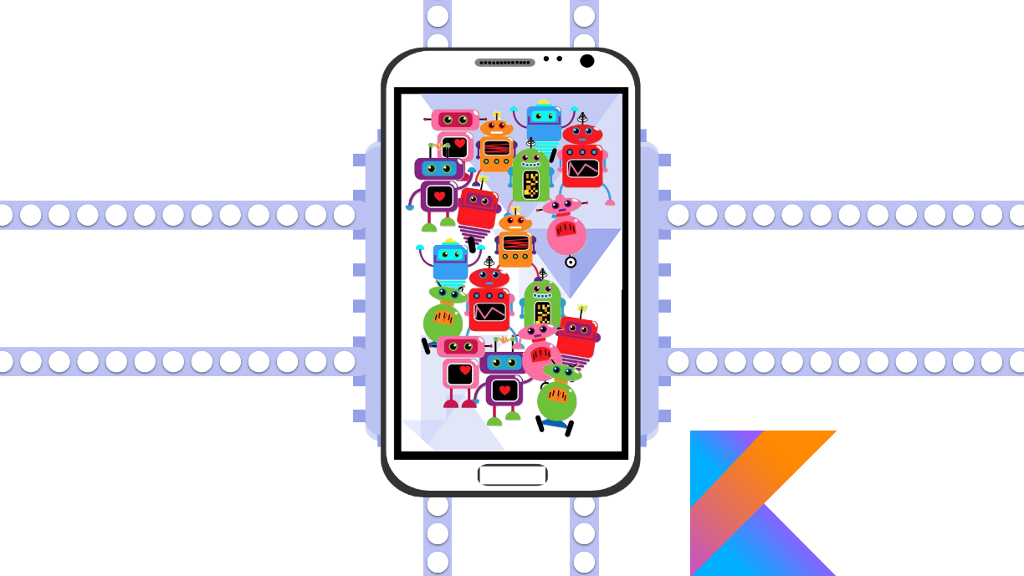
Introduction
Coroutines
Notes:
<number>

Slide 8
THE DIFFERENCES

Slide 9
The differences
Coroutines vs Thread
Thread
Coroutines
Thread has a limit
1 MB per Thread
Cost a lot of resources and resources
Seems free
Few bytes per coroutine
Extremely cheap
Notes:
<number>

Slide 10
The differences
Blocking vs. Non-blocking
Blocking
Non-blocking
The code is executed sequentially
Can become blocker if handled too long
Not necessarily sequential execution
Cannot become a blocker despite handling a lot of time
Notes:
Thêm code ví dụ delay và thread.sleep
<number>

Slide 11
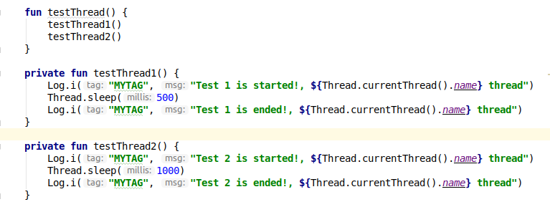

The differences
Thread in code
Notes:
Code ví dụ lại
<number>

Slide 12
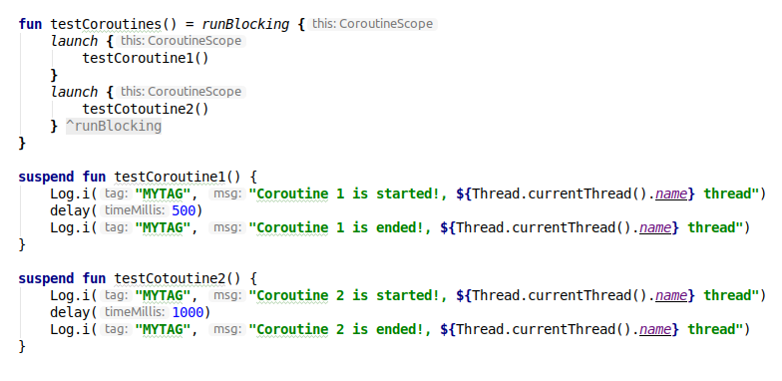

The differences
Coroutines in code
Notes:
Code ví dụ lại
<number>

Slide 13
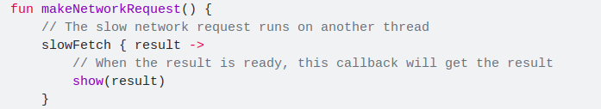
The differences
Coroutines vs. Callbacks
Callback is used for long-running tasks
Avoid blocking UI thread
Notes:
Code ví dụ lại
<number>

Slide 14
The differences
Coroutines vs. Callbacks
Callbacks disadvantages
Coroutines
The code is hard to read and debug
Difficult exception handling
The code is written sequentially
Easy to read and debug
Easy exception handling
Notes:
<number>

Slide 15
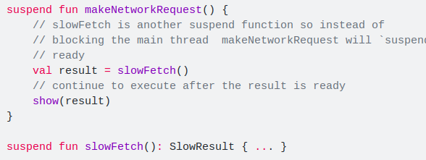
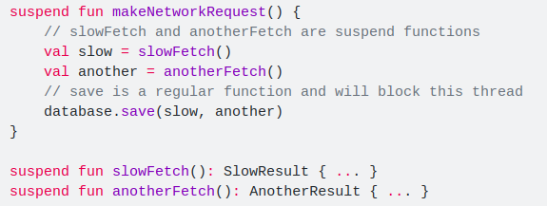
The differences
Coroutines vs. Callbacks
Coroutines
Notes:
Code lại ví dụ
<number>

Slide 16
The differences
Coroutines vs. AsyncTask - Handler
AsyncTask - Handler
Coroutines
Complex writing, difficult for newbies
The code looks difficult to read
Easy-to-read sequential code
Easily switch another thread
Notes:
Code ví dụ
<number>

Slide 17
NEW CONCEPTS
Notes:
<number>

Slide 18
New concepts
CoroutineScope - GlobalScope
Interfaces that provide scope for coroutines
Reference for coroutine context
GlobalScope use for top-level coroutines
GlobalScope is rarely used in Android development
Notes:
<number>

Slide 19
New concepts
Context – Dispatchers
Describe the type of thread that the coroutines will run
Dispatchers | Thread - In case of used
Main | Main thread - Lightweight task and UI updates
IO | Background thread – Database, networking, files
Default | Background thread – Large list, huge JSON
Unconfined | Current thread - Often used with GlobalScope
Notes:
<number>

Slide 20
New concepts
Builders
Builder
launch
async
produce
runBlocking
Notes:
<number>

Slide 21
New concepts
Job
Job hold coroutines information and active status
Provides functions for managing coroutines
cancel()
join()
Notes:
<number>

Slide 22
New concepts
Deferred
Non-blocking cancellable future - a Job with a result
The result of the deferred is available when it is completed and can be retrieved by await()
A cancelled deferred is also considered as completed
getCompletionExceptionOrNull from a completed instance of deferred
Notes:
<number>

Slide 23
New concepts
Suspending functions
The center of coroutines
A function that can be paused and resumed at a later time
Execute a long-running task without blocking
Can only be called in a suspending function
Notes:
<number>

Slide 24
EXCEPTIONS HANDLING

Slide 25
Exceptions Handling
Basic catch
Run the finally block
Example code
Notes:
<number>

Slide 26
Exceptions Handling
100 coroutines
How can we catch all exceptions?
Notes:
<number>

Slide 27
Exceptions Handling
CoroutineExceptionHandler
Generic catch block
Catch and return to a callback function
Example code
Notes:
<number>

Slide 28
EXCELLENT THINGS

Slide 29
Excellent things
SupervisorJob - supervisorScope
SupervisorJob
Another version of Job
Similar usage
Coroutine is not stopped if no exception is encountered
supervisorScope
Usage is similar to coroutineScope
The same effect with SupervisorJob
Notes:
<number>

Slide 30
Excellent things
viewModelScope
Automatically cancel when ViewModel is cleared
Use for coroutines only work when ViewModel is active
Notes:
<number>

Slide 31
Excellent things
lifecycleScope
Defined for each Lifecycle object (Activity – Fragment)
Automatically cancel when lifecycle is destroyed
Use for coroutines only work when Activity or Fragment is active
launchWhenCreated
launchWhenStarted
launchWhenResumed
Notes:
<number>

Slide 32
Excellent things
liveData Builder
Automatically execute when live data is active
Automatically decides when to stop and cancel based on the lifecycle owner
Use emit () to assign values to LiveData
Notes:
<number>

Slide 33
Q&A
Thank you for listening
Notes:
<number>

