Slide 1
What I learned in the English training course
26/09/2022
Takahide Nagase

Slide 2
The Survey from Progrid Co.
About 70% of Japanese business people fail to achieve their English goals

Slide 3
Outline
What I have learned in this course
How I will make use of the experience in the future
Important points to improve our English skills as businesspeople

Slide 4
(1) What I have learned in this course
AM
Self-study at home
“Study Supplement”
“Sankei Online”
PM
Lessons in person with teachers
Business conversation
Practical presentation
Supplementary Lessons
Going out for dinner
Playing board games
Taking trips
EX

Slide 5
(2) How I will make use of the experience in the future
1st
2nd
Lead and facilitate meetings with business partners overseas
Participate in overseas academic conferences
To play a more active part in global society

Slide 6
(3) Important points to improve our English skills as business people
Learn English as a communication skill
Practice a lot !!
Learn expressions for business
Create an good environment for learning
Use convenient apps
Combine learning with having fun

Slide 8
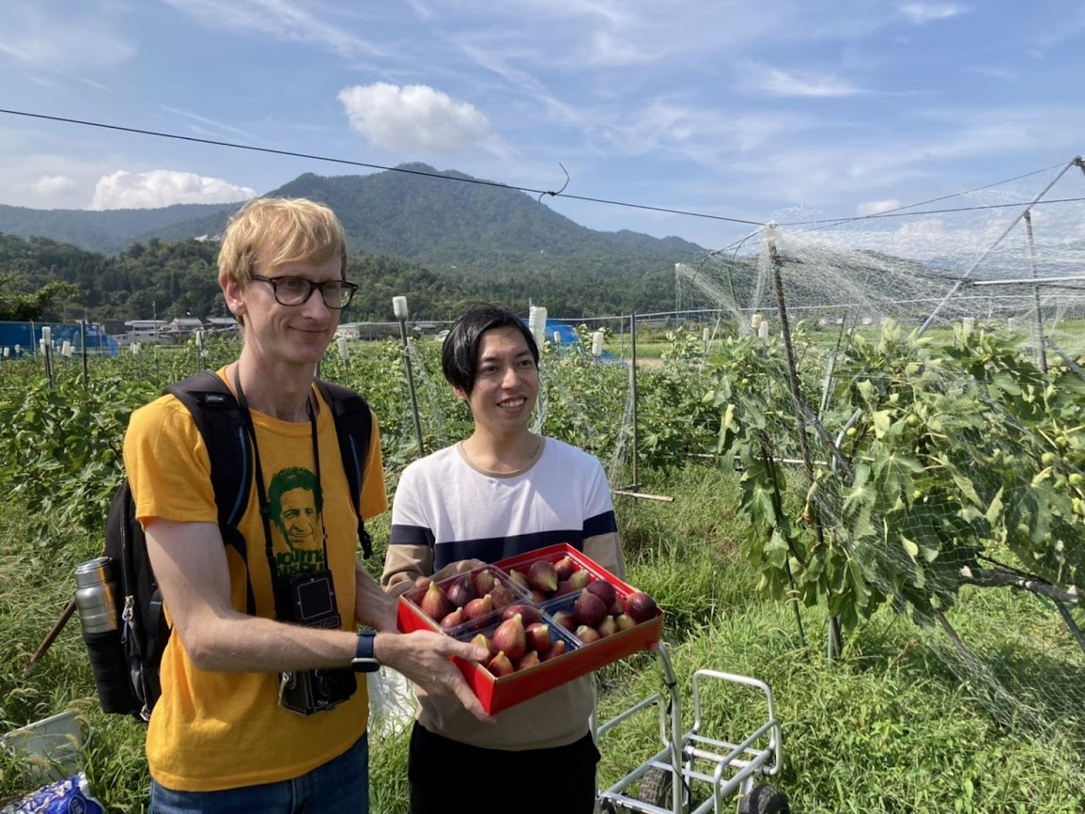
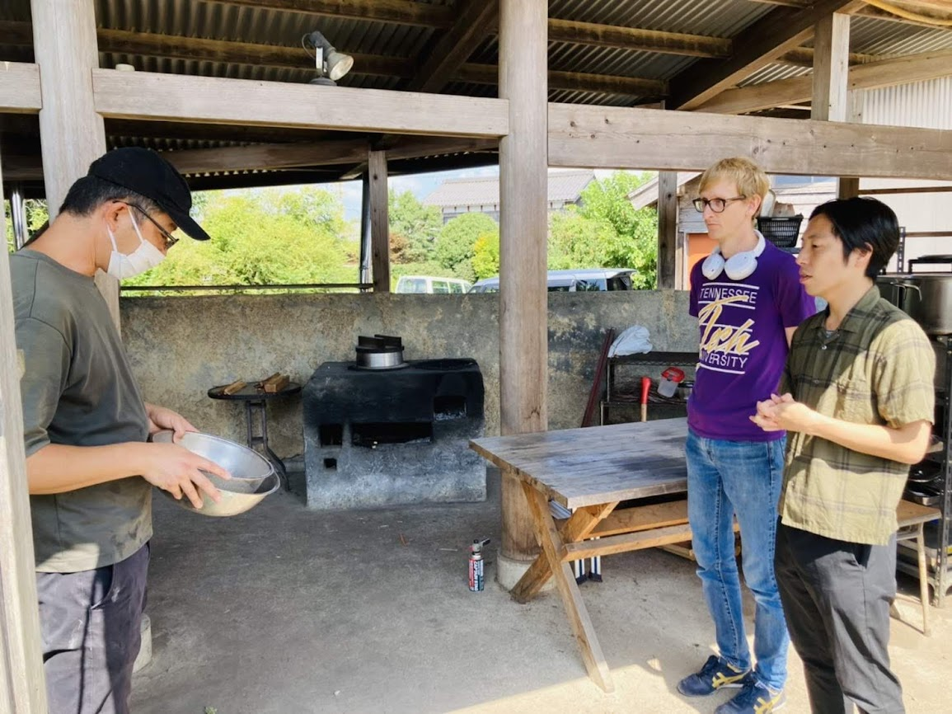
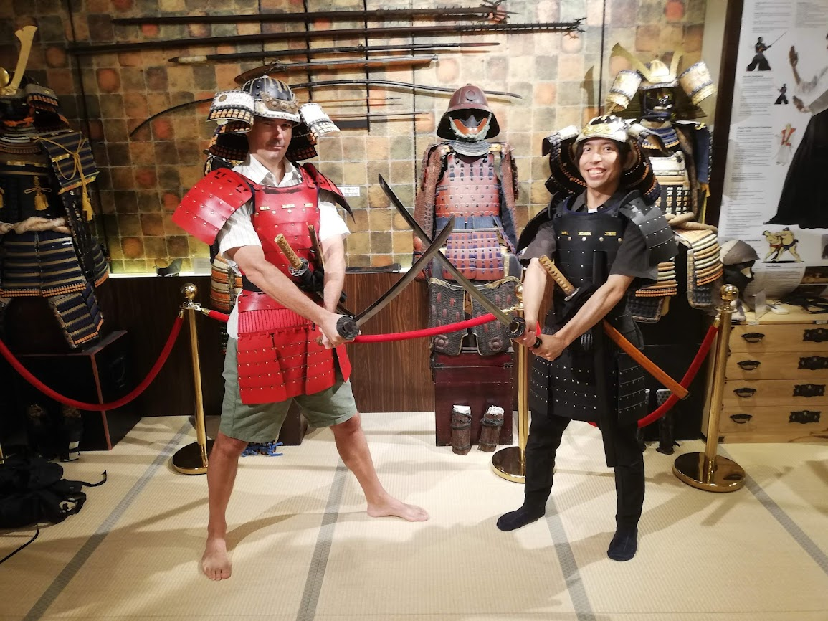
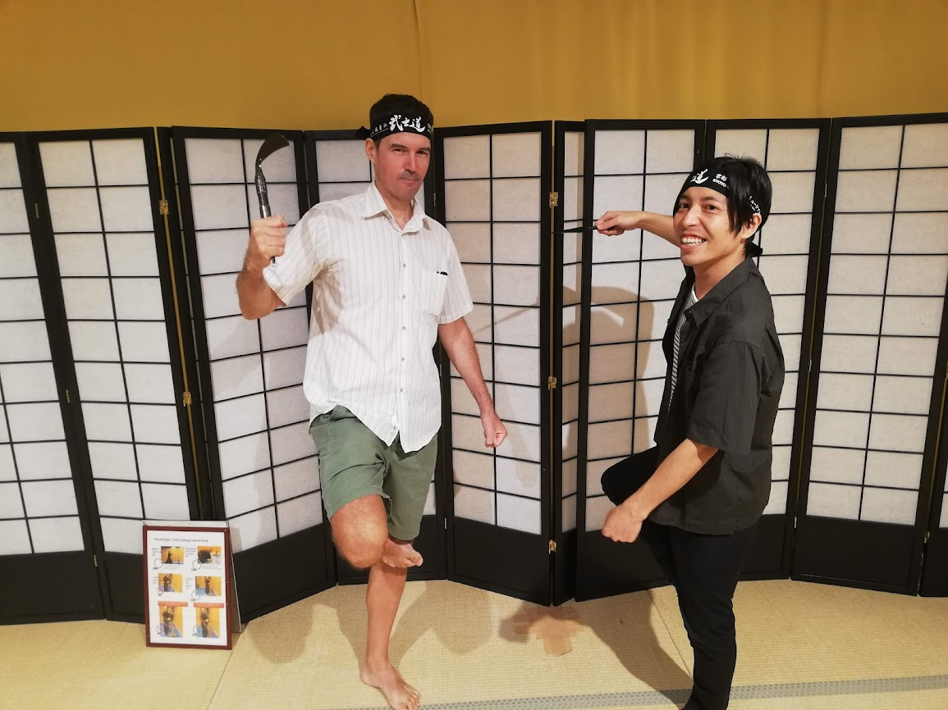
3 days trip for Shiga
A day trip for Kyoto

Slide 9

