Slide 1

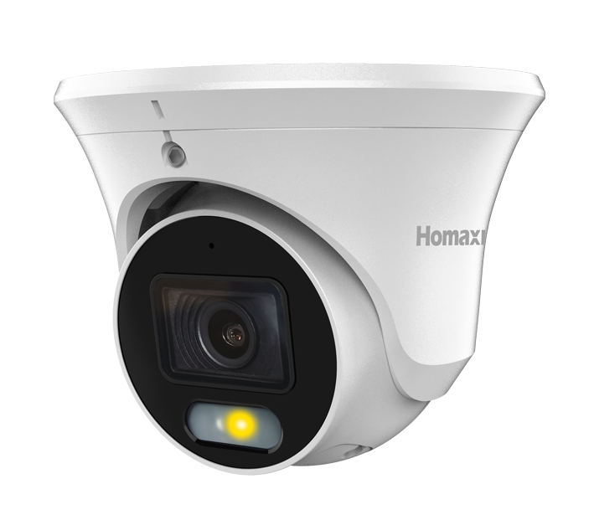
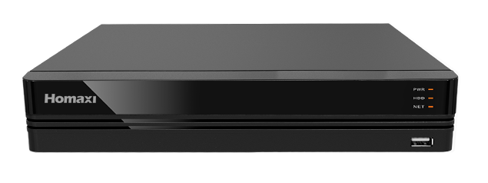
GW-K104-4DL6
Notes:
[Sources]
- User-approved GuardWatch brand language in the current conversation, 2026-08-30.
- Homaxi logo cropped from the Homaxi IPC6TF4R4-AD-TPMSCR datasheet render.

Slide 2
GW-K108-6DL6
Notes:
[Sources]
- User-approved GuardWatch brand language in the current conversation, 2026-08-30.
- Homaxi logo cropped from the Homaxi IPC6TF4R4-AD-TPMSCR datasheet render.

Slide 3
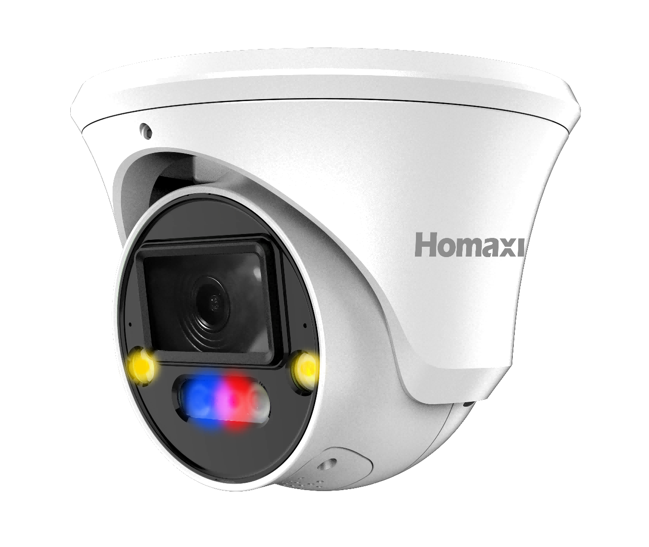
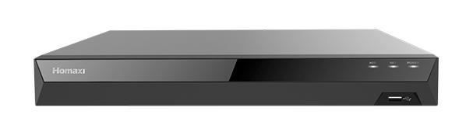
GW-K208-6AD4
Notes:
[Sources]
- User-approved GuardWatch brand language in the current conversation, 2026-08-30.
- Homaxi logo cropped from the Homaxi IPC6TF4R4-AD-TPMSCR datasheet render.

Slide 4
GW-K216-10AD4
Notes:
[Sources]
- User-approved GuardWatch brand language in the current conversation, 2026-08-30.
- Homaxi logo cropped from the Homaxi IPC6TF4R4-AD-TPMSCR datasheet render.

