Slide 1
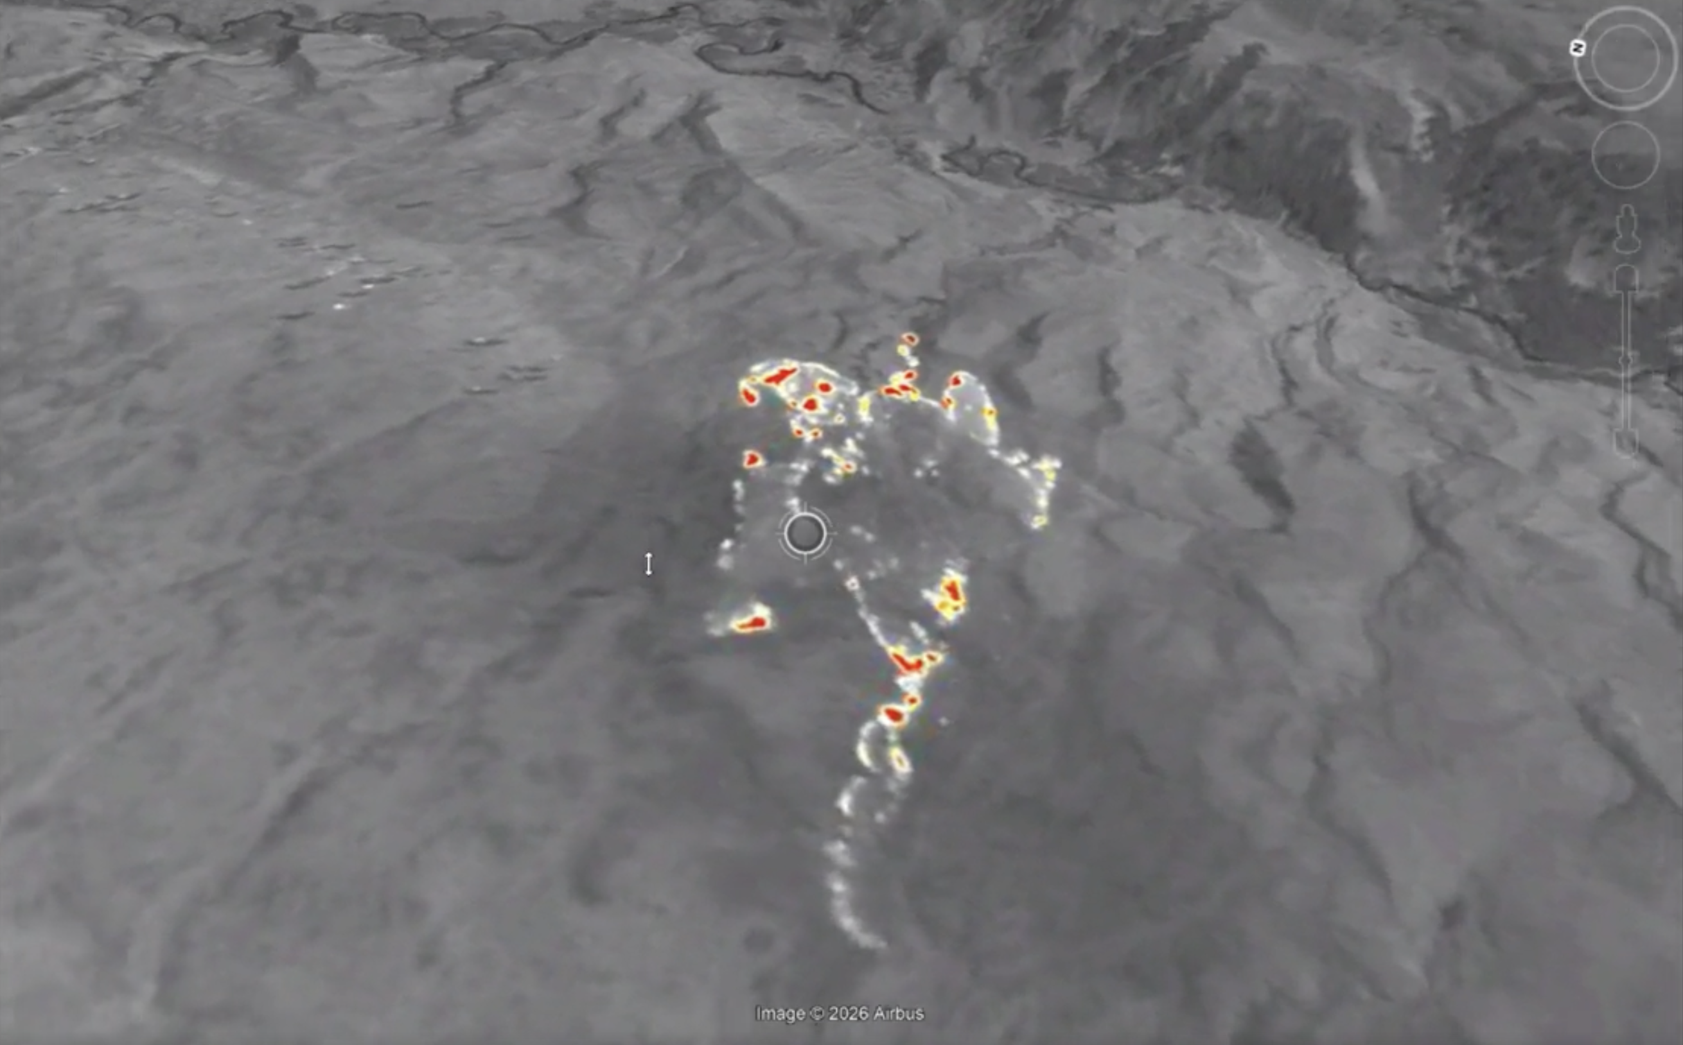
Do you see the same false detections in night-time acquisitions?

