Slide 1
Word Dictionary

Slide 2
Features
English Word Search
Dari Word Search
Real Time Search
Modern UI
Reliable Source
Modularized

Slide 3
Challenges
Reformat Source Data
Optimizing Real Time Search

Slide 4

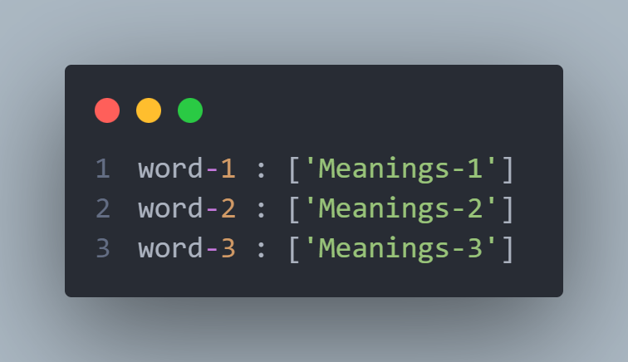
Reformat Source Data
JSON
CSV
TXT
Programmer

Slide 5
Source Data Reformatted

Slide 6


Optimizing Real Time Search
Search
100 Years Later
User

Slide 7

Optimizing Real Time Search
Too Many Words To Process
(70,000)
Creating Suggested Frame For
Every Single Word
Word
Button
Python Interpreter

Slide 8
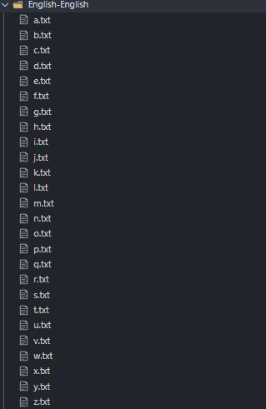

Optimizing Real Time Search
Organize
Words
Programmer
70,000 Records to Process
171-7000 Records to Process

Slide 9


Optimizing Real Time Search
Too Many Words To Process
(70,000)
Creating Suggested Frame For
Every Single Word
Word
Button
Python Interpreter

Slide 10

Optimizing Real Time Search
CustomTkinter

Slide 11

Optimizing Real Time Search
Ok, You Slow Snail,
I Can Make The
Search Process
Even Faster…
How??
CustomTkinter
Programmer

Slide 12

Optimizing Real Time Search
Fast Lookup O(L)
Efficient Memory Usage
Easy Alphabetical Sort
Trie (Retrieve)

Slide 13
Real Time Search Optimized

Slide 14
Demo

Slide 15
Conclusion

Slide 16
Question?

