Slide 1
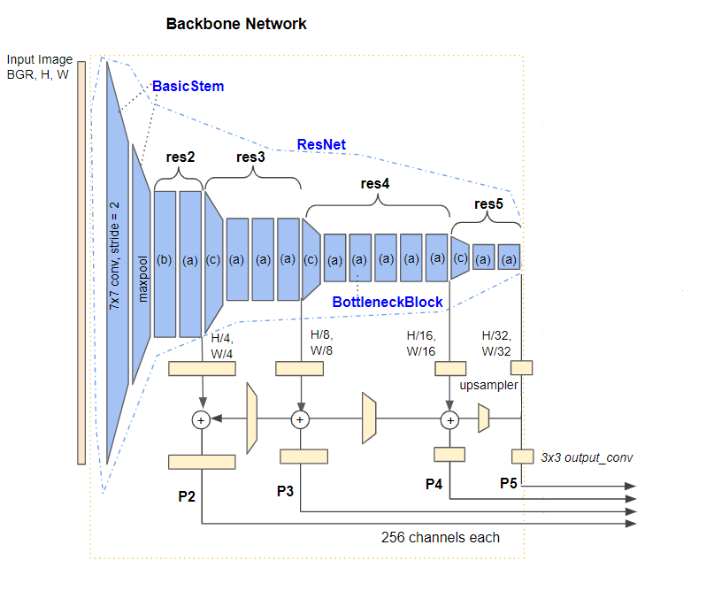
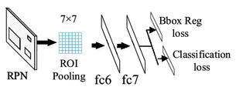

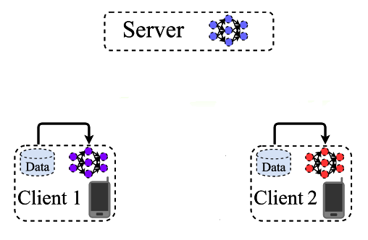
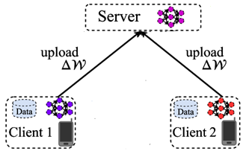
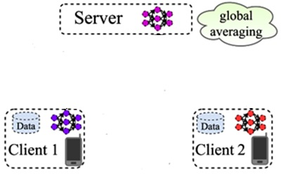
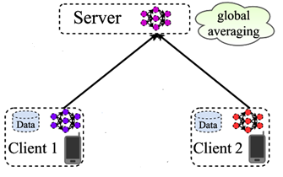
Feature Compression for Split Inference
Client
Cloud Server
Intermediate features to be compressed consisting of 4 tensors
DNN Part 2 (Task Head)
Feature Compression Block
DNN Part 1
Model/Model Update Compression for Federated Learning
Update

