Slide 1


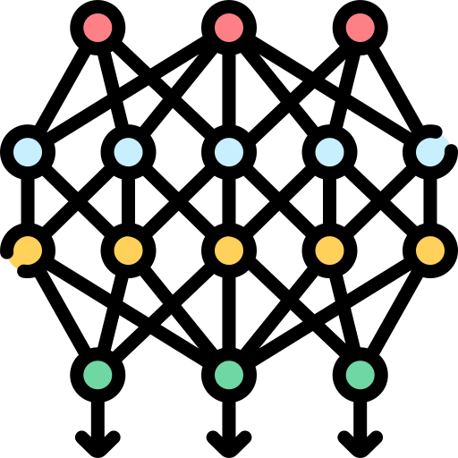
Query Selection
Label
Unlabelled Data
Annotated Data
Model Inference
Model Training

