Slide 1



Manufacturing Defect Analysis Presentation
By Hom Dahal
Date: 08/14/2022
Root Cause Analysis
&
Manufacturing Troubleshooting
Notes:
Manufacturing defect analysis.

Slide 2








Any Business may encounter defects in products during manufacturing process
Project Managers are working hard to keep manufacturing process free from defects.
Background
It is important to find the root cause of defects and implement a strategy to reduce or eliminate defects in manufacturing process.
We will use Manufacturing data to perform an analysis to find the cause of defects.
Notes:
In this presentation, we are presenting a case of manufacturing defects faced by a company in Tijuana, Mexico. The demand for the company's manufactured goods has recently increased. In the meantime, the company saw a rise in various types of faults in welding electronic circuit boards and Thru-Hole components. The solder bridge, missing components, damaged components, elevated components, insufficient solder, and excessive solder are just a few of the flaws they discovered. As a result, all electronic boards offered as finished goods have electronic tests and assembly difficulties. Fixing all flaws becomes more difficult and expensive if electronic boards are complete with more final product components. In addition, the business cannot repair, modify, or alter the finished product unless it complies with the IPC-A-610E standard for electronic components. In order to achieve the goal of this research, we will conduct an appropriate situational analysis as well as other problem-solving strategies including the Pareto chart and root cause analysis. We will finally perform a hypothesis test to see the statistical significance of the models and provide recommendations for a possible solution to the problem. ( Project Case Study)

Slide 3





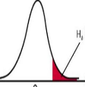



Pareto Chart Analysis
Root Cause Analysis using fishbone diagram
Methods and techniques
Hypothesis Testing
Data Visualization using Tableau
Conclusions and Recommendations
Notes:
This slide shows a clear picture of how our problem of manufacturing defects is addressed in different steps.

Slide 4
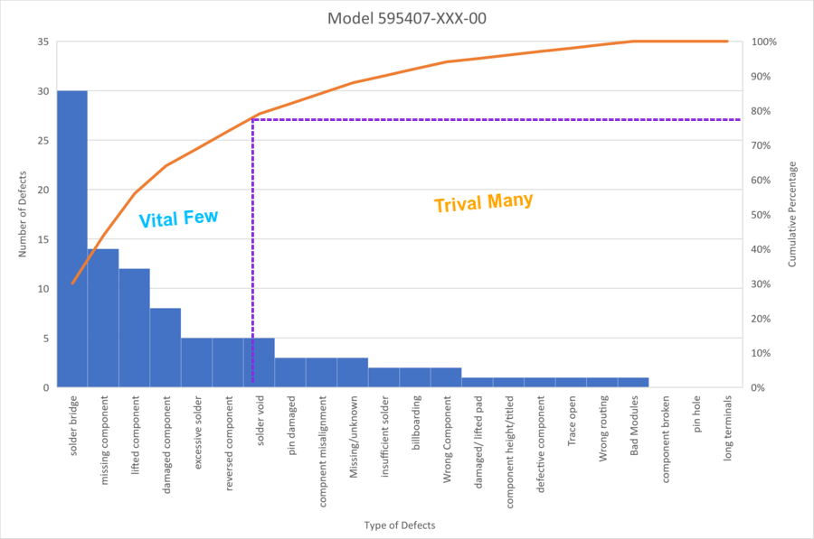
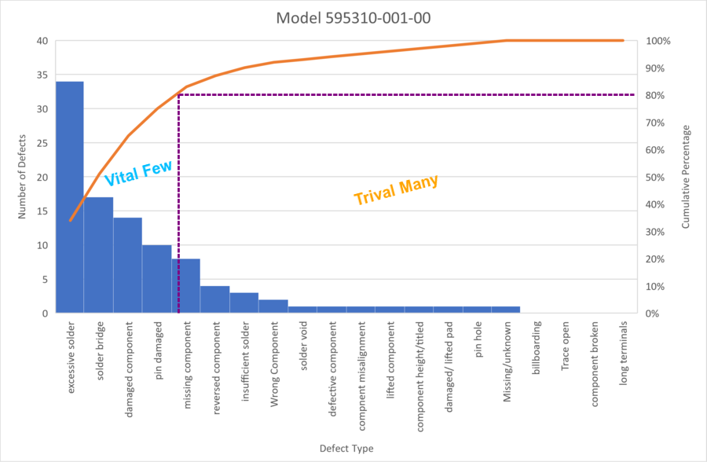
Pareto Chart Analysis
Model 1
Model 2
Notes:
The Pareto chart for Model 595407-XXX-00 or Model 1 clearly shows that most of the defects come from the Solder bridge, missing component, lifted component, damaged component, excessive solder, and reversed component. Here the maximum defects are seen on solder bridge and least on excessive solder and reversed components. The company can dedicate its time, effort, and money to these major defect areas to decrease the defects in the entire facility.
Model 2 represents the Pareto chart for model 595481-00X-00. The chart clearly shows that most of the defects come from the Solder Bridge, Lifted Component, Wrong Component, Pin Damaged, Missing Component, and Excessive Solder. Here the maximum defects are seen on solder bridge and least on excessive solder. The company can dedicate its time, effort, and money to these major defect areas to decrease the defects in the entire facility.

Slide 5
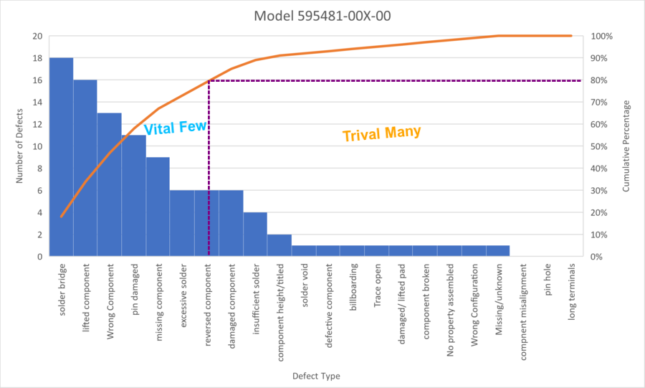
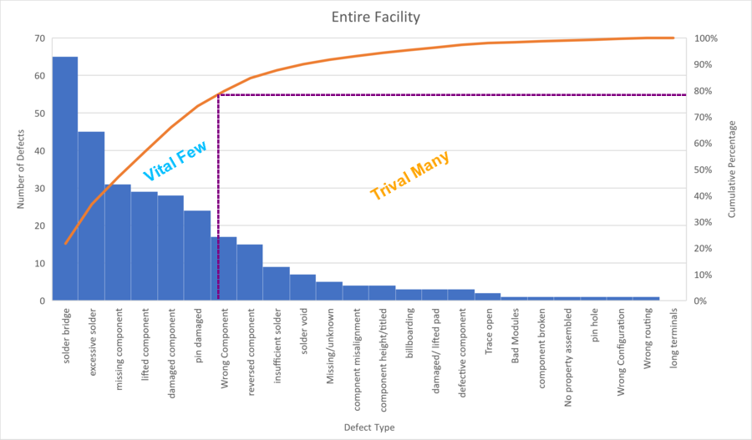
Pareto Chart Analysis
Model 3
Entire Facility
Notes:
Now, let us look at our third model. The Pareto chart for this model is presented in this slide. Looking at the chart we can say the top 20% of the defects are contributed by excessive Solder, Solder Bridge, Damaged Component, and, Pin Damaged. Here the maximum defects are seen on solder bridge and least on excessive solder and reversed components. Here the maximum defects are seen on excessive solder and least on pin damage. The company can dedicate its time, effort, and money to these major defect areas to decrease the defects in the entire facility.
Finally, let us look at the Pareto chart for our entire facility. The above is the Pareto chart for the whole facility. When we compare the entire facility with the individual models above, we see that all three models contribute to the entire facility. Most of the typical top defects in each model are also the common top defects in the entire facility. The next step in the process is to perform a hypothesis test to find the statistical difference in the number of defects between the production line to help find out which line has the highest number of defects so we can have those defects corrected.

Slide 6

Fishbone Diagram
Notes:
The above diagram shows the different causes that are likely to produce the effect of manufacturing welding defects. We have identified the different possible causes of the problem. All the categories of causes of the problem are listed by their functions. Next, all the subcategories are listed under each category by brainstorming. The questions were asked regarding each category and subcategory to identify the root causes: Was there any wrong alignment, missed process steps, or wrong documentation in the manufacturing process? After asking questions about each category, we found that the root cause originates from the machine itself and not from any other categories. In the next step, we will perform the 5 “why” analysis to identify the root cause.

Slide 7


Five Why Analysis
Notes:
The root cause was found to be originated from the Machine.
5 Why Analysis
Now let us ask “why” five times to find the root cause.
Why are there defects in welding? →Because of the failed capability of machines to perform welding functions properly.
Why is that? →Because the specified calibration failed during machine operation.
Why does that happen →Because there was a feed issue?
Why does that happen? → Because the alignment control of the electronic board and thru holes failed.
Why does that happen? → Because the welding fixture was malfunctioning.
Thus, we conclude that ‘the root cause of the manufacturing welding defect was a malfunctioning fixture.

Slide 8

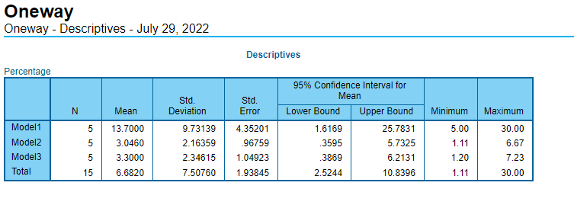
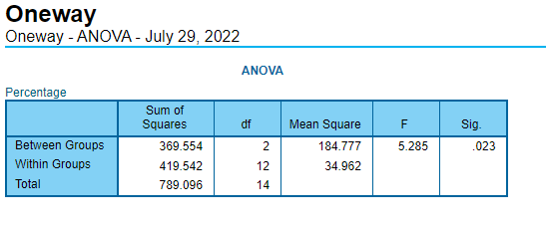
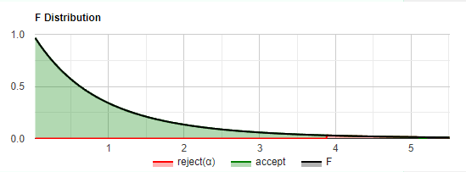
Hypothesis
Testing
Using
One-Way
ANOVA
Notes:
We already found out that there are defects in the process. Now we will perform a hypothesis test to test different models. If μ1, μ2, and μ3 represent the means of model1, model2, and model3 respectively:
The null hypothesis is no difference in the three model defects. And the alternative hypothesis is, that there is a difference in the three model defects.
Mathematically,
Ho: μ1 = μ2 = μ3
Ha: μ1 ≠ μ2 ≠ μ3.
The second screenshot in this slide shows the degree of freedom between and within groups which is 2 and 12 respectively. Using these two values we find the F-critical value of 3.89 from the chart.
Also, from the above output screenshot from the SPSS report we see that the F-statistic value is 5.28. This F-statistic value is not in the 95% region of acceptance: [-∞, F-Critical Value]
For our test, an F-statistic value greater than the F-critical value provides evidence to reject the null hypothesis in favor of the research hypothesis at the level of significance we chose (0.05). We can conclude that the means of at least one of the three models deviate significantly. We must do a post hoc test to pinpoint which models differ.

Slide 9
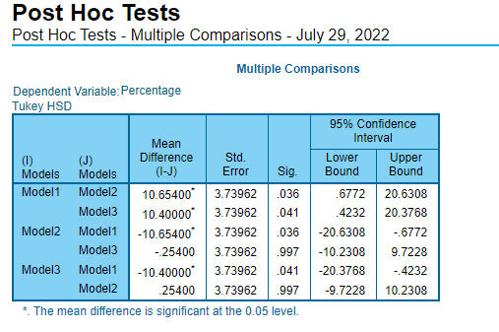
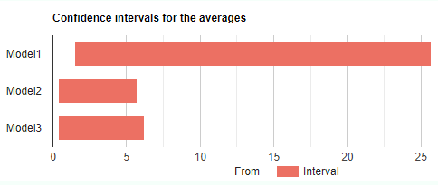
Hypothesis
Testing
Using
One-Way
ANOVA
Multiple
Comparison
Notes:
From the above table, we can see the following information:
Model1 Vs Model2 → Null hypothesis is rejected with a significance of 0.036
Model1 Vs Model3 →Null hypothesis is rejected with a significance of 0.041
Model2 Vs Model3 → Failed to reject the null hypothesis with a significance of 0.997
The means of the following pairs are significantly different: Model1 – Model2 and Model1- Model3.
From the table above, we see that there is no significant difference between the mean of Model2 and Model3,
so, the mean of Model1 is significantly different.

Slide 10

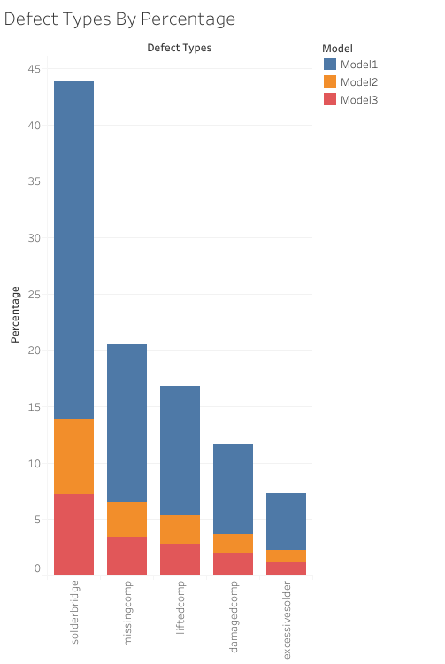
Tableau Dashboard showing defect types by percentage
Notes:
The screenshot on the current slide represents the Tableau dashboard showing defect types by percentage.
For each model, the defect types are shown in which model1 has the highest number of defects. Similarly,
model2 has fewer defects percentage than model1 and model3 has fewer defects than model2.
in the next steps, we will perform a Pareto chart analysis followed by root cause analysis and then hypothesis testing.

Slide 11
Conclusions and Recommendations
Conclusions | Recommendations
From the Pareto chart analysis, we found defects in the manufacturing process. We found defects in each model and the entire facility. The major defects seen in each model are also the major ones in the facility. From the Fishbone diagram we found that the root cause of the defects originates from the Machine. From the Five why analysis, we found the root cause to be a malfunctioning welding fixture. Hypothesis test shows that there is a significant difference between the mean of the three models. Multiple comparison test from ANOVA indicates that model1 is significant and has the highest number of defects. Our tableau dashboard clearly shows problems of defects in different models. | To reduce the number of defects throughout the facility, the company can focus its time, energy, and resources on top defects in each model. Carefully inspect welding machine for defects origin. Replace welding Fixtures and collect data to perform analysis again to see if the problem has been fixed. Correct the defects on model1 which is found to be the line with the highest number of defects.
Notes:
Conclusions and recommendations

Slide 12
References
To complete this project and prepare this presentation, we have used the first and second project materials. We have also included the link for the project’s case study provided to us. All other references used are provided in the speaker note section of this slide.
Notes:
First and second projects – 22EW6 Applied Data Analysis Retrieved August 12, 2022,
From https://learn.snhu.edu/d2l/home/1119486
Project three Guidelines and Rubric, Project Case Study(n.d.). Retrieved August 12, 2022,
From https://learn.snhu.edu/content/enforced/1119486-DAT-475-T6752-OL-TRAD-UG.22EW6/course_documents/DAT%20475%20Project%20Case%20Study.pdf?_&d2lSessionVal=JpZTECrTP8Zyjqse1zhwEggpo&ou=1119486

