Slide 1
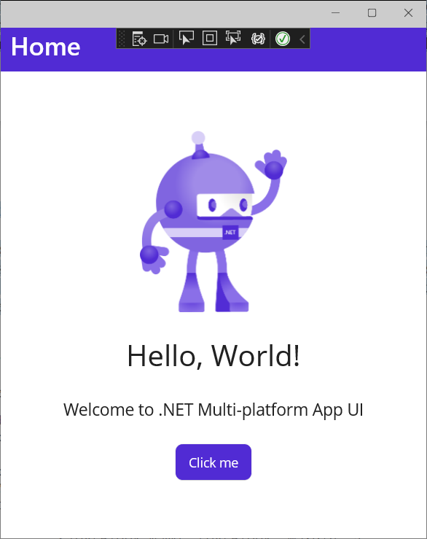
<?xml version="1.0" encoding="utf-8" ?>
<ContentPage xmlns="http://schemas.microsoft.com/dotnet/2021/maui"
xmlns:x="http://schemas.microsoft.com/winfx/2009/xaml"
x:Class="ActiveGraphic.MainPage">
<ScrollView>
<VerticalStackLayout
Spacing="25"
Padding="30,0"
VerticalOptions="Center">
<Image
Source="dotnet_bot.png"
SemanticProperties.Description="Cute dot net bot waving hi to you!"
HeightRequest="200"
HorizontalOptions="Center" />
<Label
Text="Hello, World!"
SemanticProperties.HeadingLevel="Level1"
FontSize="32"
HorizontalOptions="Start" />
<Label
Text="Welcome to .NET Multi-platform App UI"
SemanticProperties.HeadingLevel="Level2"
SemanticProperties.Description="Welcome to dot net Multi platform App U I"
FontSize="18"
HorizontalOptions="Center" />
<Button
x:Name="CounterBtn"
Text="Click me"
SemanticProperties.Hint="Counts the number of times you click"
Clicked="OnCounterClicked"
HorizontalOptions="Center" />
</VerticalStackLayout>
</ScrollView>
</ContentPage>
①
①
②
②
③
③
④
④
⑤
⑤

Slide 2
<?xml version="1.0" encoding="utf-8" ?>
<ContentPage xmlns="http://schemas.microsoft.com/dotnet/2021/maui"
xmlns:x="http://schemas.microsoft.com/winfx/2009/xaml"
x:Class="ActiveGraphic.MainPage">
<ScrollView>
<VerticalStackLayout
Spacing="25"
Padding="30,0"
VerticalOptions="Center">
<Image
Source="dotnet_bot.png"
SemanticProperties.Description="Cute dot net bot waving hi to you!"
HeightRequest="200"
HorizontalOptions="Center" />
<Label
Text="Hello, World!"
SemanticProperties.HeadingLevel="Level1"
FontSize="32"
HorizontalOptions="Start" />
<Label
Text="Welcome to .NET Multi-platform App UI"
SemanticProperties.HeadingLevel="Level2"
SemanticProperties.Description="Welcome to dot net Multi platform App U I"
FontSize="18"
HorizontalOptions="Center" />
<Button
x:Name="CounterBtn"
Text="Click me"
SemanticProperties.Hint="Counts the number of times you click"
Clicked="OnCounterClicked"
HorizontalOptions="Center" />
</VerticalStackLayout>
</ScrollView>
</ContentPage>
namespace ActiveGraphic
{
public partial class MainPage : ContentPage
{
int count = 0;
public MainPage()
{
InitializeComponent();
}
private void OnCounterClicked(object sender, EventArgs e)
{
count++;
if (count == 1)
CounterBtn.Text = $"Clicked {count} time";
else
CounterBtn.Text = $"Clicked {count} times";
SemanticScreenReader.Announce(CounterBtn.Text);
}
}
}
①
①
②
②

Slide 3
<?xml version="1.0" encoding="utf-8" ?>
<ContentPage xmlns="http://schemas.microsoft.com/dotnet/2021/maui"
xmlns:x="http://schemas.microsoft.com/winfx/2009/xaml"
x:Class="ActiveGraphic.MainPage">
<ScrollView>
<VerticalStackLayout
Spacing="25"
Padding="30,0"
VerticalOptions="Center">
<Image
Source="dotnet_bot.png"
SemanticProperties.Description="Cute dot net bot waving hi to you!"
HeightRequest="200"
HorizontalOptions="Center" />
<Label
Text="Hello, World!"
SemanticProperties.HeadingLevel="Level1"
FontSize="32"
HorizontalOptions="Start" />
<Label
Text="Welcome to .NET Multi-platform App UI"
SemanticProperties.HeadingLevel="Level2"
SemanticProperties.Description="Welcome to dot net Multi platform App U I"
FontSize="18"
HorizontalOptions="Center" />
<Button
x:Name="CounterBtn"
Text="Click me"
SemanticProperties.Hint="Counts the number of times you click"
Clicked="OnCounterClicked"
HorizontalOptions="Center" />
</VerticalStackLayout>
</ScrollView>
</ContentPage>
namespace ActiveGraphic
{
internal class CodebaseMainPage : ContentPage
{
readonly ScrollView scrollView = new();
readonly VerticalStackLayout verticalStackLayout = new()
{
Spacing = 25,
Padding = new Thickness(30, 0),
VerticalOptions = LayoutOptions.Center,
};
readonly Image image = new()
{
Source = "dotnet_bot.png",
HeightRequest = 200,
HorizontalOptions = LayoutOptions.Center,
};
readonly Label label = new()
{
Text = "Hello, World!",
FontSize = 32,
HorizontalOptions = LayoutOptions.Center,
};
readonly Label label2 = new()
{
Text = "Welcome to .NET Multi-platform App UI",
FontSize = 18,
HorizontalOptions = LayoutOptions.Center,
};
readonly Button CounterBtn = new()
{
Text = "Click me",
HorizontalOptions = LayoutOptions.Center,
};
int count = 0;
public CodebaseMainPage()
{
Content = scrollView;
scrollView.Content = verticalStackLayout;
verticalStackLayout.Children.Add(image);
verticalStackLayout.Children.Add(label);
verticalStackLayout.Children.Add(label2);
verticalStackLayout.Children.Add(CounterBtn);
CounterBtn.Clicked += OnCounterClicked;
}
private void OnCounterClicked(object sender, EventArgs e)
{
count++;
if (count == 1)
CounterBtn.Text = $"Clicked {count} time";
else
CounterBtn.Text = $"Clicked {count} times";
SemanticScreenReader.Announce(CounterBtn.Text);
}
}
}
①
①
②
②
③
③
④
④
⑤
⑤
⑥
⑥
⑦
⑦

Slide 4
Y
(0,0)
원점
X1
X
(X1,Y1)
Y1
Y1
(X1,Y1)
(0,0)
원점
X1
X
Y

