Slide 1
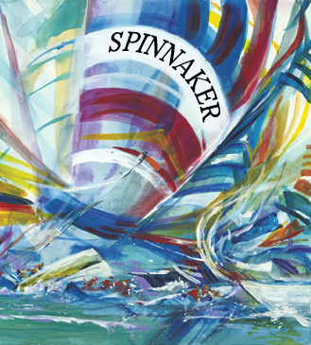
Spinnaker
Using Paxos to Build a Scalable, Consistent, and Highly Available Datastore
Jun Rao
Eugene Shekita
Sandeep Tata (IBM Almaden Research Center)

Slide 2
Outline
Motivation and Background
Spinnaker
Existing Data Stores
Experiments
Summary

Slide 3
Motivation
Growing interest in “scale-out structured storage”
  Examples: BigTable, Dynamo, PNUTS
  Many open-source examples: HBase, Hypertable, Voldemort, Cassandra
The sharded-replicated-MySQL approach is messy
Start with a fairly simple node architecture that scales:
Focus on | Give up
Commodity components Fault-tolerance and high availability Easy elasticity and scalability | Relational data model SQL APIs Complex queries (joins, secondary indexes, ACID transactions)

Slide 4
Outline
Motivation and Background
Spinnaker
Existing Data Stores
Experiments
Summary

Slide 5
Data Model
Familiar tables, rows, and columns, but more flexible
  No upfront schema – new columns can be added any time
  Columns can vary from row to row
row
key
col
name
col
value
row 1
k127
type: capacitor
farads: 12mf
cost: $1.05
row 2
k187
type: resistor
ohms: 8k
label: banded
cost: $.25
…
…
row 3
k217
Notes:
Column Families – “physical grouping”

Slide 6
Basic API
insert (key, colName, colValue)
delete(key, colName)
get(key, colName)
test_and_set(key, colName, colValue, timestamp)
Notes:
string key
byte[] colName
byte[] colValue
int64 timestamp
No multi-action ACID transactions : “begin transaction” …. “end transaction”

Slide 7
Spinnaker: Overview
Data is partitioned into key-ranges
Chained declustering
The replicas of every partition form a cohort
Multi-Paxos executed within each cohort
Timeline consistency
Zookeeper
Node A
key ranges
[0,199]
[800,999]
[600,799]
Node B
key ranges
[200,399]
[0,199]
[800,999]
Node C
key ranges
[400,599]
[200,399]
[0,199]
Node D
key ranges
[600,799]
[400,599]
[200,399]
Node E
key ranges
[800,999]
[600,799]
[400,599]

Slide 8
Single Node Architecture
Memtables
Commit Queue
Replication and
Remote Recovery
Local Logging
and Recovery
SSTables

Slide 9
Replication Protocol
Phase 1: Leader election
Phase 2: In steady state, updates accepted using Multi-Paxos

Slide 10
Multi-Paxos Replication Protocol
CohortLeader
Cohort
Followers
Client
insert X
Log, propose X
Log, ACK
time
ACK client (commit)
Clients can read latest version at
leader and older versions at followers
async commit
All nodes have latest version

Slide 11
Details
Client
Leader
Followers
Write
Acquire LSN = X
Propose X to Followers
Write log record to WAL & Commit Queue
Write X to WAL & Commit Queue Send Ack to Master
Don’t apply to Memtables yet
Ack X
Time
Update Commit Queue
Apply X to Membtables
Send Ack to Client
Client can read the latest value at the Leader
X is not in the Memtable yet.
Reads at Followers see an older value now
Asynchronous Commit Message for LSN = Y (Y>=X)
Process everything in the Commit Queue until Y and apply to Memtables.
Reads now see every update up to LSN = Y

Slide 12
Recovery
Each node maintains a shared log for all the partitions it manages
If a follower fails and rejoins
  Leader ships log records to catch up follower
  Once up to date, follower joins the cohort
If a leader fails
  Election to choose a new leader
  Leader re-proposes all uncommitted messages
  If there’s a quorum, open up for new updates

Slide 13
Guarantees
Timeline consistency
Available for reads and writes as long as 2 out of 3 nodes in a cohort are alive
Write: 1 disk force and 2 message latencies
Performance is close to eventual consistency (Cassandra)

Slide 14
Outline
Motivation and Background
Spinnaker
Existing Data Stores
Experiments
Summary

Slide 15
BigTable (Google)
Table partitioned into “tablets” and assigned to TabletServers
Logs and SSTables written to GFS – no update in place
GFS manages replication
Chubby
Chubby
Master
Chubby
TabletServer
TabletServer
TabletServer
TabletServer
TabletServer
Memtable
Memtable
Memtable
Memtable
Memtable
GFS
Contains Logs and SSTables for each TabletServer

Slide 16
Advantages vs BigTable/HBase
Logging to a DFS
  Forcing a page to disk may require a trip to the GFS master.
  Contention from multiple write requests on the DFS can cause poor performance
DFS-level replication is less network efficient
  Shipping log records and SSTables
DFS consistency does not allow tradeoff for performance and availability
  Not warm standby in case of failure – large amount of state needs to be recovered
  All reads/writes at same consistency and need to be handled by the TabletServer.

Slide 17
Dynamo (Amazon)
BDB/
MySQL
Always available, eventually consistent
Does not use a DFS
Database-level replication on local storage, with no single point of failure
Anti-entropy measures: Hinted Handoff, Read Repair, Merkle Trees
BDB/
MySQL
BDB/
MySQL
Gossip Protocol
Hinted Handoff,
Read Repair,
Merkle Trees
BDB/
MySQL
BDB/
MySQL
BDB/
MySQL

Slide 18
Advantages vs Dynamo/Cassandra
Spinnaker can support ACID operations
  Dynamo requires conflict detection and resolution; does not support transactions
Timeline consistency: easier to reason about
Almost the same performance
Notes:
10% slower writes
Faster consistent reads (1.5X to 3X)
“Good” availability
Simpler design
No hinted handoff, read-repair, or Merkle trees

Slide 19
PNUTS (Yahoo)
Chubby
Chubby
Chubby
Chubby
Tablet Controller
Router
Yahoo!
Message Broker
Files/
MySQL
Files/
MySQL
Files/
MySQL
Files/
MySQL
Files/
MySQL
Data partitioned and replicated in files/MySQL
Notion of a primary and secondary replicas
Timeline consistency, support for multi-datacenter replication
Primary writes to local storage and YMB; YMB delivers updates to secondaries

Slide 20
Advantages vs PNUTS
Spinnaker does not depend on a reliable messaging system
  The Yahoo Message Broker needs to solve replication, fault-tolerance, and scaling
  Hedwig, a new open-source project from Yahoo and others could solve this
More efficient replication
  Messages need to be sent over the network to the message broker, and then resent from there to the secondary nodes

Slide 21
Spinnaker Downsides
Research prototype
Complexity
  BigTable and PNUTS offload the complexity of replication to DFS and YMB respectively
  Spinnaker’s code is complicated by the replication protocol
  Zookeeper helps
Single datacenter
Failure models
  Block/file corruptions – DFS handles this better
  Need to add checksums, additional recovery options

Slide 22
Outline
Motivation and Background
Spinnaker
Existing Data Stores
Experiments
Summary

Slide 23
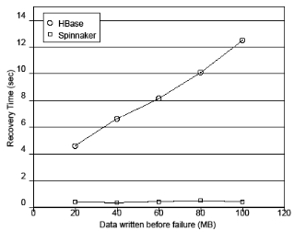
Unavailability Window on Failure: Spinnaker vs HBase
HBase recovery takes much longer: depends on amount of data in the logs
Spinnaker recovers quickly: unavailability only depends on asynchronous commit period

Slide 24
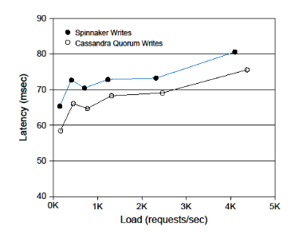
Write Performance: Spinnaker vs. Cassandra
Quorum writes used in Cassandra (R=2, W=2)
For similar level of consistency and availability,
  Spinnaker write performance similar (within 10% ~ 15%)

Slide 25
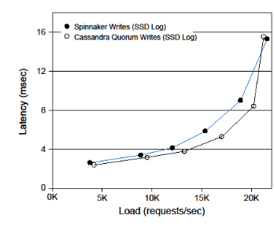
Write Performance with SSD Logs: Spinnaker vs. Cassandra
Notes:
TODO: Fix this to use the latest graphs.

Slide 26
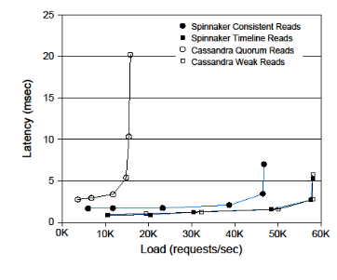
Read Performance: Spinnaker vs. Cassandra
Quorum reads used in Cassandra (R=2, W=2)
For similar level of consistency and availability,
  Spinnaker read performance is 1.5X to 3X better

Slide 27
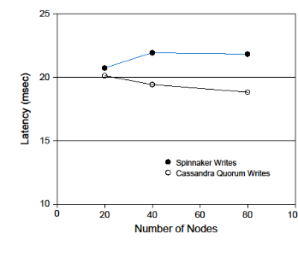
Scaling Reads to 80 nodes on Amazon EC2

Slide 28
Outline
Motivation and Background
Spinnaker
Existing Data Stores
Experiments
Summary

Slide 29
Summary
It is possible to build a scalable and consistent datastore in a single datacenter without relying on a DFS or a pub-sub system with good availability and performance characteristics
A consensus protocol can be used for replication with good performance
  10% slower writes, faster reads compared to Cassandra
Services like Zookeeper make implementing a system that uses many instances of consensus much simpler than previously possible

Slide 30
Related Work
Database Replication
  Sharding + 2PC
  Middleware-based replication (Postgres-R, Ganymed, etc.)
Bill Bolosky et. al., “Paxos Replicated State Machines as the Basis of a High-Performance Data Store”, NSDI 2011
John Ousterhout et al. “The Case for RAMCloud” CACM 2011
Curino et. al, “Relational Cloud: The Case for a Database Service”, CIDR 2011
SQL Azure, Microsoft

Slide 31
Backup Slides

Slide 32
Eventual Consistency Example
Apps can see inconsistent data if they are not careful about
choice of R and W
  Might not see its own writes or successive reads might see a row’s state jump back and forth in time
update to cols x,y on different nodes
x=1
y=1
[x=0, y=0]
[x=1, y=0]
[x=1, y=1]
[x=0, y=0]
[x=0, y=1]
[x=1, y=1]
initial state
inconsistent state
time
consistent state
To ensure durability and strong consistency
  Use quorum reads and writes (N=3, R=2, W=2)
For higher read performance and timeline consistency
  Stick to the same replicas within a session and use (N=3, R=1, W=1)

