Slide 1
Ultimately Interesting Tool Kit
Taking sample ux into the next generation

Slide 2
Similarities between UITK & SampleGUI
Both are "retained mode" UI systems (controls are persistent across frames and maintain state)
Both can communicate to sample code through callback binding (call a lambda when something I care about happens)
Both are extensible through sample code (sample code can augment the UI scene graph)
Both depend on the DirectXTK as their low-level render interface

Slide 3
Differences between UITK & SampleGUI
SampleGUI
UITK
Is quite compact (just 1 CSV & 2 source files needed)
Emphasizes simplicity over feature richness
Layout is ordered lines of CSV values
Absolute pixels, resolution dependent
No grouping of UI elements
Minimal styling options
Can stand up simple UIs quickly, difficult to scale to more complex UIs
Supports hierarchical, composable elements (any element can contain other elements)
Supports prefabs (reusable snippets of elements)
Supports ref units*, UI scaling
Supports inheritable, reusable styles
Has a flexible JSON data schema
Has a unit & render test framework
Leverages C++17 features

Slide 4
What are “ref units” … ?
They are the individual UI pixels for a “reference resolution.”
All of the UI positional and sizing data for a sample is consistent within this same resolution.
1 texel equals 1 ref unit.
They are ultimately scaled to the current device resolution at render time accordingly.
If the aspect ratio matches, then it is a straight scale.
If the aspect ratio does not match, then a scaling policy is applied… … either the smallest dimension expands to fit, or the largest dimension shrinks to fit.
Do we need the reference resolution (and scaling policy) to be optionally configurable per sample?

Slide 5
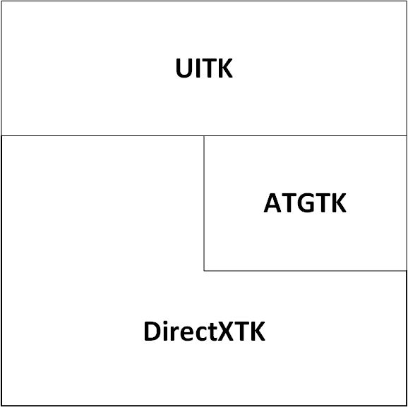
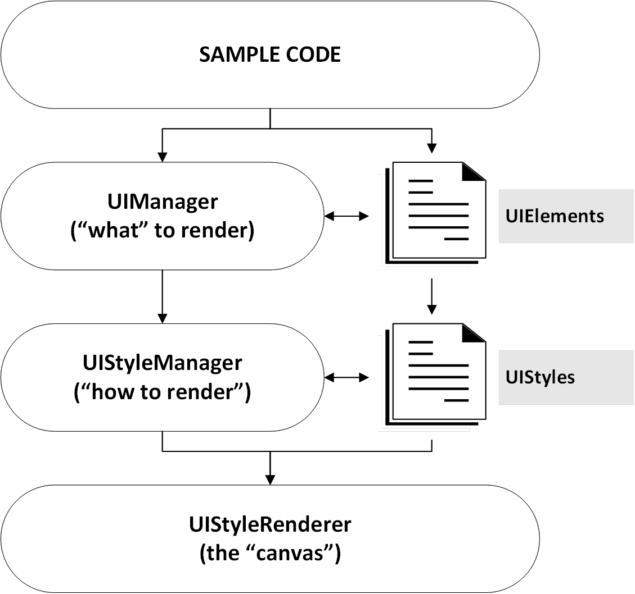
Architecture
Dependencies
Layers
DirectX
Windows/Xbox OS

Slide 6
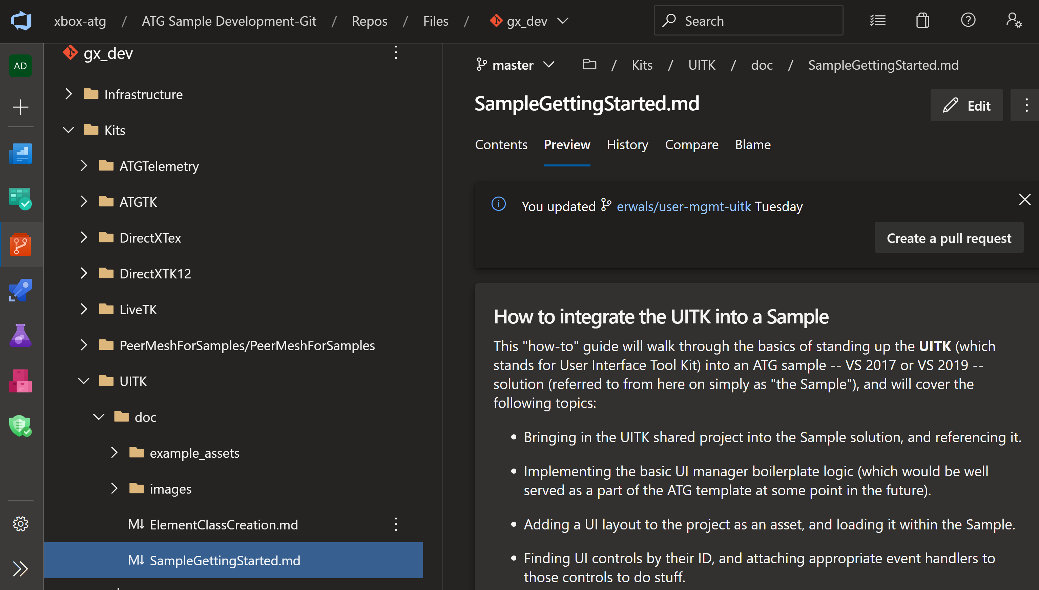




Where is it?
Look ma, it's not vaporware...

Slide 7
Documentation
Sample writers' integration ("Getting Started") guide (Has extraneous documentation due to ATG sample template integration not being complete yet. Taken from the point of view of a new sample created from the template.) https://xbox-atg.visualstudio.com/ATG%20Sample%20Development-Git/_git/gx_dev?path=%2FKits%2FUITK%2Fdoc%2FSampleGettingStarted.md&version=GBmaster&_a=preview
Widget author's step-by-step guide (General-purpose widgets can be integrated back into the UITK. Custom sample widgets follow pretty much the same steps.) https://xbox-atg.visualstudio.com/ATG%20Sample%20Development-Git/_git/gx_dev?path=%2FKits%2FUITK%2Fdoc%2FElementClassCreation.md&version=GBmaster&_a=preview
More to come … what do you need?

Slide 8
Porting a Sample to UITK
Highlights, Differences, and results (SOCIAL_DESKTOP)

Slide 9
1. Setting up the Sample’s UI
Give the sample a UIManager & UIStyleRenderer, and update/render it…
in Social_Desktop.h...
...
// UITK
ATG::UITK::UIManager m_uiManager;
ATG::UITK::UIInputState m_uiInputState;
in Social_Desktop.cpp... Sample::Update() {
...
m_uiInputState.Update(elapsedTime);
m_uiManager.Update(elapsedTime, m_uiInputState); Sample::Render() {
...
m_uiManager.Render();
Sample::CreateDeviceDependentResources() {
...
auto renderer = std::make_unique<UIStyleRendererD3D>(m_myDeviceResourcesProvider);
m_uiManager.GetStyleManager().InitializeStyleRenderer(std::move(renderer));

Slide 10
2. Finding and using elements
Get references to the UI elements you need, call APIs on them, and bind event handlers to them…
in Social_Desktop.h...
...
ATG::UITK::UIConsoleWindow m_console;
ATG::UITK::UIStackPanel m_friendsList;
ATG::UITK::UITwistMenu m_twistMenu;
in Social_Desktop.cpp... auto sampleLayout = m_uiManager.LoadLayoutFromFile("Assets/Layouts/sample-layout.json");
m_uiManager.AttachTo(sampleLayout, m_uiManager.GetRootElement());
m_console = m_uiManager.FindTypedById<UIConsoleWindow>(ID("Console_Window"));
m_friendsList = m_uiManager.FindTypedById<UIStackPanel>(ID("Friends_Button_List"));
m_twistMenu = m_uiManager.FindTypedById<UITwistMenu>(ID("Twist_Menu"));
m_twistMenu->SelectedItemState().AddListener([this](UITwistMenu* twistMenu) {
this->m_selectedFriendList = (FriendListType)twistMenu->GetCurrentItemIndex();
this->Refresh();
});

Slide 11
3. Dynamically adding buttons
Instantiate a prefab, access its sub elements, modify their text, and execute code on button presses…
in Social_Desktop.cpp... auto friendButton = CastPtr<UIButton>(
m_uiManager.InstantiatePrefab("#friend_button_prefab"));
m_uiManager.AttachTo(friendButton, m_friendsList);
auto tagText = friendButton->GetTypedSubElementById<UIStaticText>(ID("Gamer_Tag"));
tagText->SetDisplayText(gamerTag);
auto statusText = friendButton->GetTypedSubElementById<UIStaticText>(ID("Status"));
statusText->SetDisplayText(userStatus);
m_friendButtonToXuid[friendButton->GetID()] = xuid;
friendButton->ButtonState().AddListenerWhen(
UIbuttonButton::State::Pressed, [this](UIButton* button) {
auto friendXuid = this->m_friendButtonToXuid[button->GetID()];
this->ShowUserProfileCard(friendXuid);
});

Slide 12
Vital Statistics (Social_Desktop)
3 source files removed (a total of 6,805 bytes) Custom ItemRepeater and UserRepeater classes were no longer needed in favor of using a prefab & a map.
25,717 bytes of modified code (before) became 24,987 bytes of modified code (after) Social_Desktop.cpp was reduced by about 2K bytes
~23% reduction in total code bytes (not including unchanged sample boilerplate)
10,172 bytes of UI data added

Slide 13

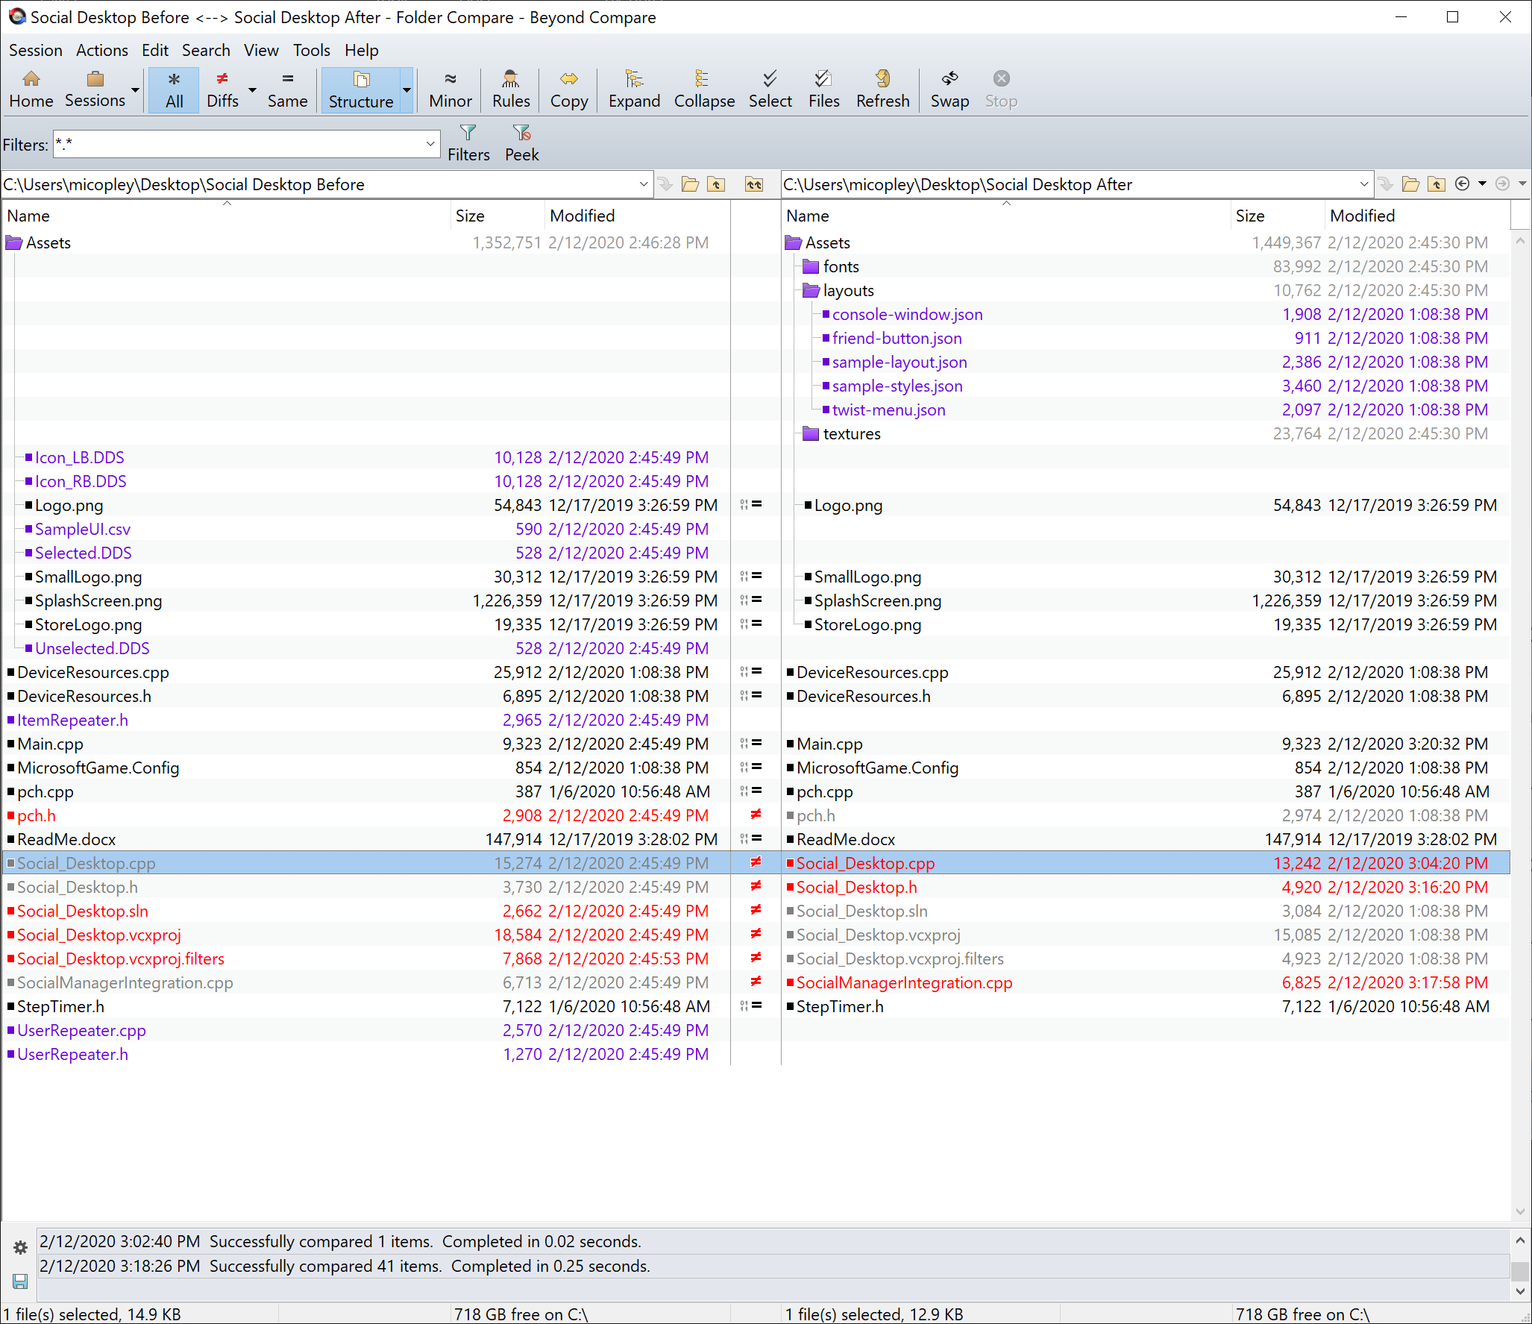
Social_Desktop BeyondCompare

Slide 14
Principal Classes
classes that make the UItk tick

Slide 15
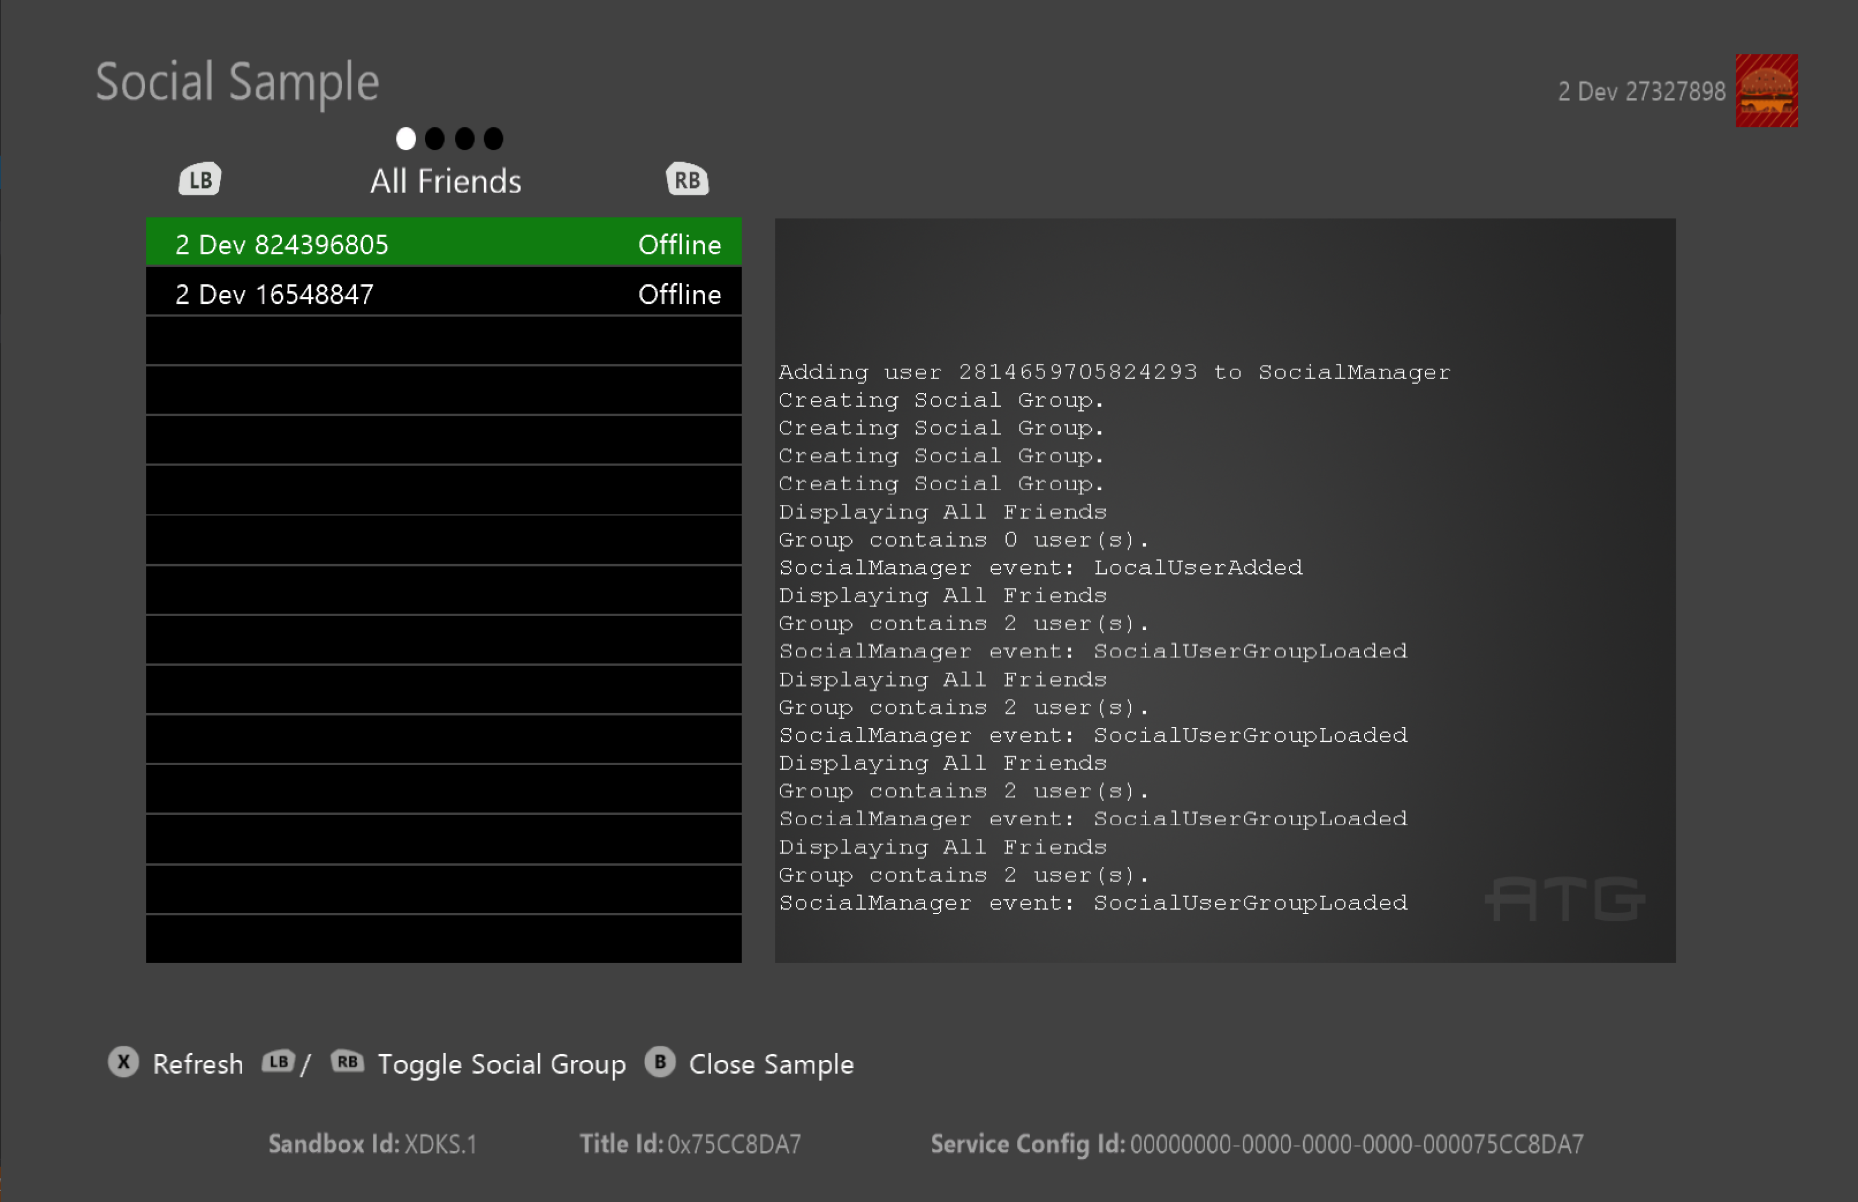
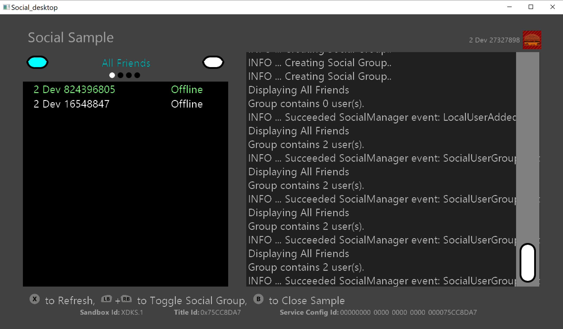
Before & After (straight port)…

Slide 16
UISerializedObjects & IDs …THE BASICS: HOW DATA & CODE BIND TO EACH OTHER
An ATG::UITK::ID is:
A strongly typed identifier used for naming, references, and enumerated values.
It is essentially a case-insensitive string “under the hood.”
Is expected to be immutable.
A UISerializedObject (shortened to UIDataPtr in the code) is:
The interface for parsing and retrieving data values from UI data.
Data values are keyed, and the keys are case-sensitive.
It is essentially UTF8 encoded JSON formatted text “under the hood.”
It supports strong type and default handling.

Slide 17
UIManager (singleton owned by Sample) … in <UIManager.h>
Responsibilities include:
Load UI layout & prefab data LoadLayoutFromFile(const std::string& layoutFilePath);
Register UI element factories RegisterElementFactory(const ID& elementClassId);
Attach/Detach UI elements AttachTo(UIElementPtr child, UIElementPtr parent);
Find UI elements by ID std::shared_ptr<T> FindTypedById(ID id) const;
Hit testing of UI elements GetElementUnderPixel(UIElementPtr root, int x, int y);
UI scene graph updating/rendering Update(float elapsedTimeInS, const UIInputState& inputState);
UI scene related input handling HandleMouseInput(const UIInputState& inputState);
Focused UI element management UIElementPtr FindFocusElement(UIElementPtr root);
Ref units to pixels scaling float GetRefUnitsToPixelsScale() const;

Slide 18
UIStyleManager (singleton owned by UIManager) … in <UIStyleManager.h>
Responsibilities include:
Load UI style data LoadStyleFromData(const ID& context, UIDataPtr data);
Register UI style factories RegisterStyleFactory(ID styleClassId)
Flatten UI style chains FlattenAllStyles();
Find UI styles by ID std::shared_ptr<T> GetTypedById(const ID& id) const;
Possesses the style renderer StyleRenderer& GetStyleRenderer();

Slide 19
UIStyleRenderer (singleton owned by UIStyleManager) … in <UIStyleRenderer.h>
Responsibilities include:
Cache texture assets CacheTexture(const std::string& textureFilePath);
Cache font assets CacheFont(const std::string& fontFilePath);
Get font metrics GetFontTextSize(FontHandle, const std::string& text);
Draw textured/untextured quads DrawTexturedQuads(TexHandle, const std::vector<TexturedQuad>& quads);
Draw UTF8 text strings DrawTextString(FontHandle, const TextString& string);
Manage the scissor rectangle stack PushScissorRectangle(const Rectangle& rectInPixels);
Manage the color stack PushTintColor(const Color& tintColor);

Slide 20
UIElement (base instances owned by UIManager) … in <UIElement.h>
Responsibilities include:
Exposes basic props (vis/enab/etc.) bool IsVisible() const; ... void SetEnabled(bool isEnabled);
Relative rect positioning and sizing virtual Rectangle GetScreenRectInPixels();
Parent and descendents access UIElementPtr GetChildById(ID id) const;
Virt PostLoad [all loading done] virtual void PostLoad();
Virt HandleInputEvent virtual void HandleInputEvent(const InputEvent&);
Virt Update [after input] virtual void Update(float elapsedTimeInS);
Virt Render/PostRender (hier order) virtual void Render(); ... virtual void PostRender();
Has factory (create/deserialize) virtual T* UIElementFactory::Create();

Slide 21
Widgets (derived instances owned by UIManager) … in <UIWidgets.h>
Example classes include:
Data Class | Description | Header
Button | Rect with press/release/hover states | <UIButton.h>
CheckBox | Rect with toggle states (on/off) | <UICheckBox.h>
ConsoleWindow | Rect with scrollable, stacked lines of history text | <UIConsoleWindow.h
Image | Rect with a static/dynamic sprite | <UIImage.h>
Panel | Rect of elements that optionally clips | <UIPanel.h>
PipStrip | Rect with H/V pips with one always selected | <UIPipStrip.h>
ProgressBar | Rect with a percentage sprite fill | <UIProgressBar.h>
Slider | Rect with a discrete/continuous thumb value | <UISliderElement.h>
StackPanel | Rect with dynamic placed H/V stacked elements | <UIStackPanel.h>
StaticText | Rect with h/v aligned text within it | <UIStaticText.h>
TwistMenu | Rect with text choice and L/R option buttons | <UITwistMenu.h>

Slide 22
UIStyle (base instances owned by UIStyleManager) … in <UIStyle.h>
Responsibilities include:
Exposes basic props (pad/mar/etc.) Rectangle AddMarginToRect(const Rectangle& rect) const;
Data inheritance with prop override ID InheritsFromID() const; ... virtual void Flatten();
Orchestrates render state virtual void BeforeRender(); ... virtual void AfterRender();
Provides higher level render API void RenderLegendText(const Rectangle&, const UIDisplayStr&);
Has factory (create/deserialize) virtual T* UIStyleFactory::Create();

Slide 23
Styles (derived instances owned by UIStyleManager) … in <UIStyleImpl.h>
Example classes include:
Data Class | Description | Header
NullStyle | Style that does no rendering | <UIStyleImpl.h>
SpriteStyle | Style that renders sliced tex/untex quads | <UIStyleImpl.h>
TextStyle | Style that renders UTF8 text strings | <UIStyleImpl.h

Slide 24
UIStateEvents …HOW DOES SAMPLE CODE GET NOTIFIED BY UI CHANGES?
They are publicly declared by the deriving widget class:
E.g. UIStateEvent<UIButton, UIButton::State>& UIButton::ButtonState();
They are privately dispatched by the deriving widget class through the class setting its state value:
void Set(StateValT value, ElementT* setter, bool notify = true) { ... if (notify) Dispatch(setter); }
They are publicly “listened to” by whomever wants to:
E.g. ListenerHandle AddListenerWhen(StateValT value, Listener listener);

Slide 25
Performance Profile
Will integrating the UITK keep my sample performant?

Slide 26
Perf Poop

