Slide 1
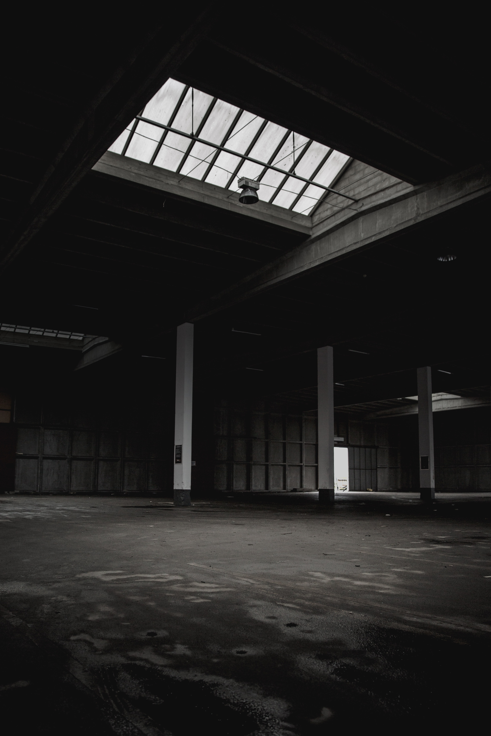
too
small
to
fail
Securing Small and Medium Businesses
@HomeBrewedSec
#SecuringSMB

Slide 2
Audience Participation
I won’t be having a Q&A time (use the hashtag)
Q&A usually isn’t inclusive for speaker or participant
If I use an acronym or mention a concept you don’t understand:
Tweet me (# or @ me)
Heckle. Yell out “ELABORATE” or “EXPLAIN YOURSELF”
# SecuringSMB

Slide 3
Goals
If you’re at an SMB
Give you a starting point
Give you tools to convince management
Everyone else
Convince you that SMBs are important, and securable
# SecuringSMB

Slide 4
Why? Why are SMBs Important?
How? How do we secure SMBs?
#SecuringSMB

Slide 5
Why? Why are SMBs important?
#SecuringSMB

Slide 6
Too Small to Fail
28.8 Million SMBs in the US
SMBs represent 55% of all jobs in the US
65% of spear-phishing attempts are aimed at SMBs
Target breach was result of a breach of a small HVAC vendor
# SecuringSMB
Then why do we dismiss SMBs when it comes to InfoSec?

Slide 7
How to Get Buy-In
Regulatory Compliance and a prior breach are the major factors for security spending no matter the business size
Appeal to owners’ self-pride in their business, and risk to that pride from a breach
Introduce Information Security as a sales / marketing tactic
# SecuringSMB

Slide 8
Easier Ship to Turn
SMBs often have less bureaucracy
We often have direct access to decision makers, and personal buy-in from management
Easier experimentation / piloting
Smaller environment increases the ability to know where everything is and what it does
# SecuringSMB

Slide 9
How? How do we secure SMBs?
#SecuringSMB

Slide 10
Risk Management
Risk Assessment and Threat Modeling is even more important in SMBs
Understand the type of attacks and threats to expect
Don’t attempt to secure the same way a large enterprise would
# SecuringSMB

Slide 11
Threat Modelling
Know what you’re protecting and know what you’re protecting against
Risk Assessment + Business Impact Assessment
Estimate what happens to the business if X happens, and the likelihood of X happening
Defender’s Dilemma (traditionally): An attacker only needs to exploit one weakness, a defender needs to protect all weaknesses
Attacker’s Dilemma (homebrewedsec): A defender needs to make it too expensive for an attacker to exploit a target given the value of that target
# SecuringSMB

Slide 12
Hardening
Principal of Least Privilege: An account shouldn’t be able to access anything that account shouldn’t have access to
Principal of Least Functionality: A machine shouldn’t be able to do anything that machine shouldn’t be able to do
Encrypt all the things & Patch all the things
# SecuringSMB

Slide 13
Open Source Everything
(please don’t)
Consider your resources
Do you really have time to manage Open Source software?
You might not need a multimillion $ SIEM
Consider what resources and scenarios need to be monitored
# SecuringSMB

Slide 14
Transition Plan
“Outgoing-sider threat”
Maintain lists of passwords, accounts, keys, certificates, etc. distributed to who (especially IT and InfoSec)
Higher priority in SMBs, as insider knowledge is consolidated
Ensure CFAA warning is in exit interview / termination process
# SecuringSMB

Slide 15
Backups!!!!!!!
Backup your data
Check your backup
Test your backup
Alert on your backup
Check your alerts
Resolve your alerts
# SecuringSMB

Slide 16
tl;dr
SMBs are important
SMBs are targeted
SMBs are similar in a lot of ways to enterprises
Backup. Backup. Backup.
Need to apply resource and risk assessment techniques even moreso than in enterprise environments
# SecuringSMB

Slide 17
Appendix: Resources
Background Image
https://unsplash.com/photos/Z2EgLCJob40
Verizon 2018 DBIR
https://enterprise.verizon.com/resources/reports/2018/DBIR_2018_Report_execsummary.pdf
# SecuringSMB

Slide 18
too
small
to
fail
Securing Small and Medium Businesses
Slides
homebrewedsec.com/talks/
Questions
@HomeBrewedSec
#SecuringSMB
Notes:
Image https://unsplash.com/photos/Z2EgLCJob40

