Slide 1
AUS Pharma Website Designs

Slide 2
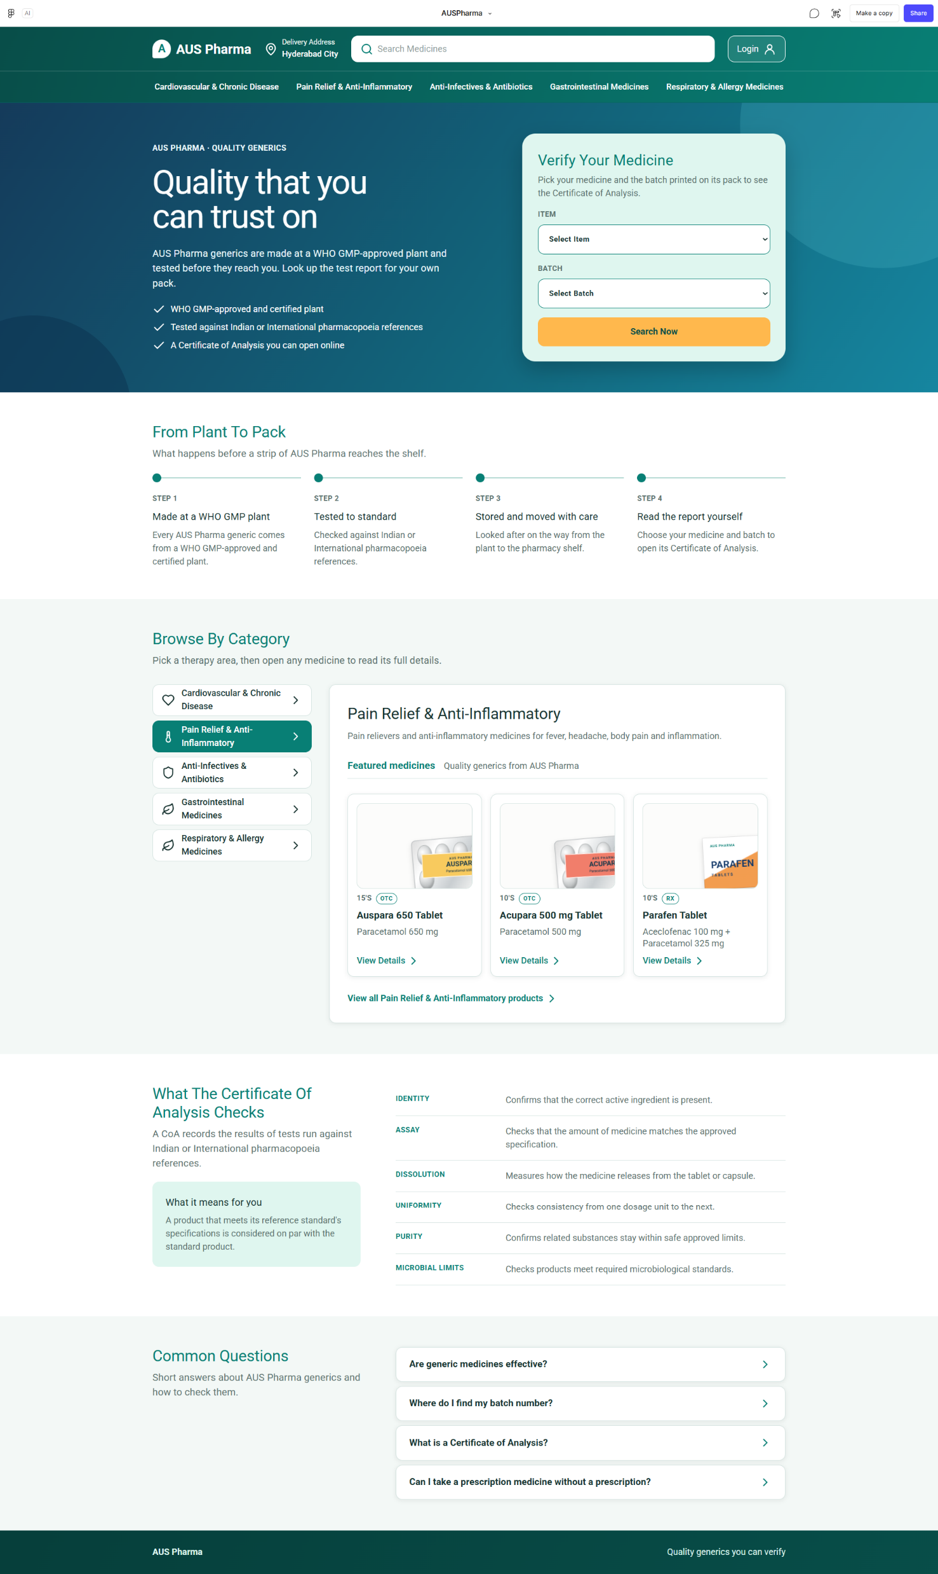
Home Page

Slide 3
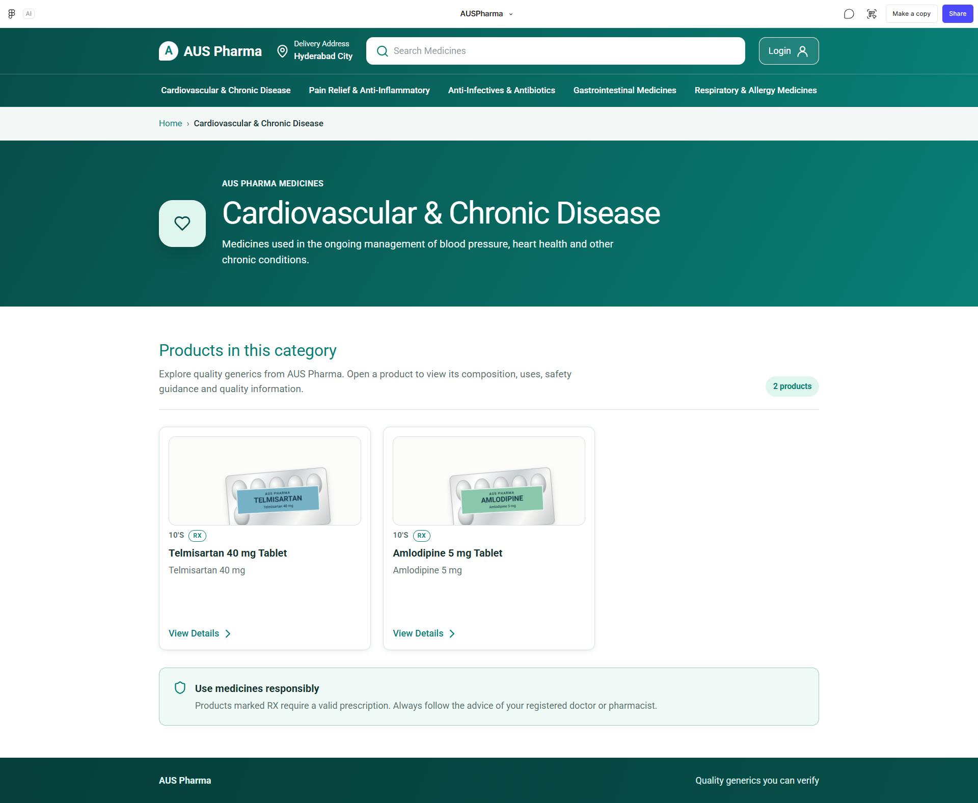
Category Page

Slide 4
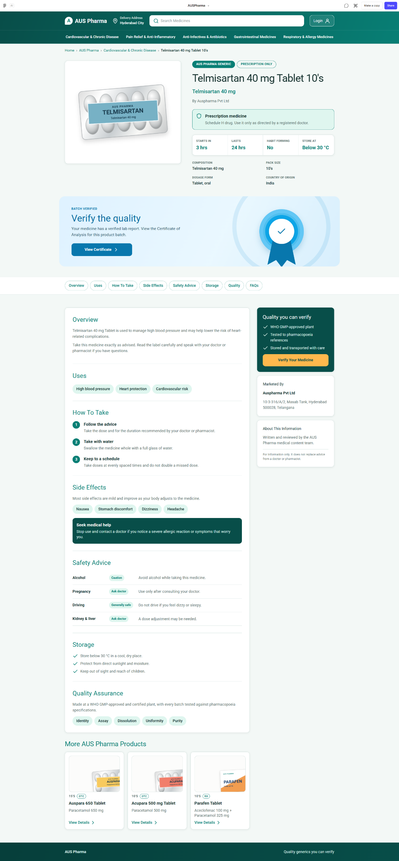
Product Detail Page

Slide 5
Thank You

