Slide 1
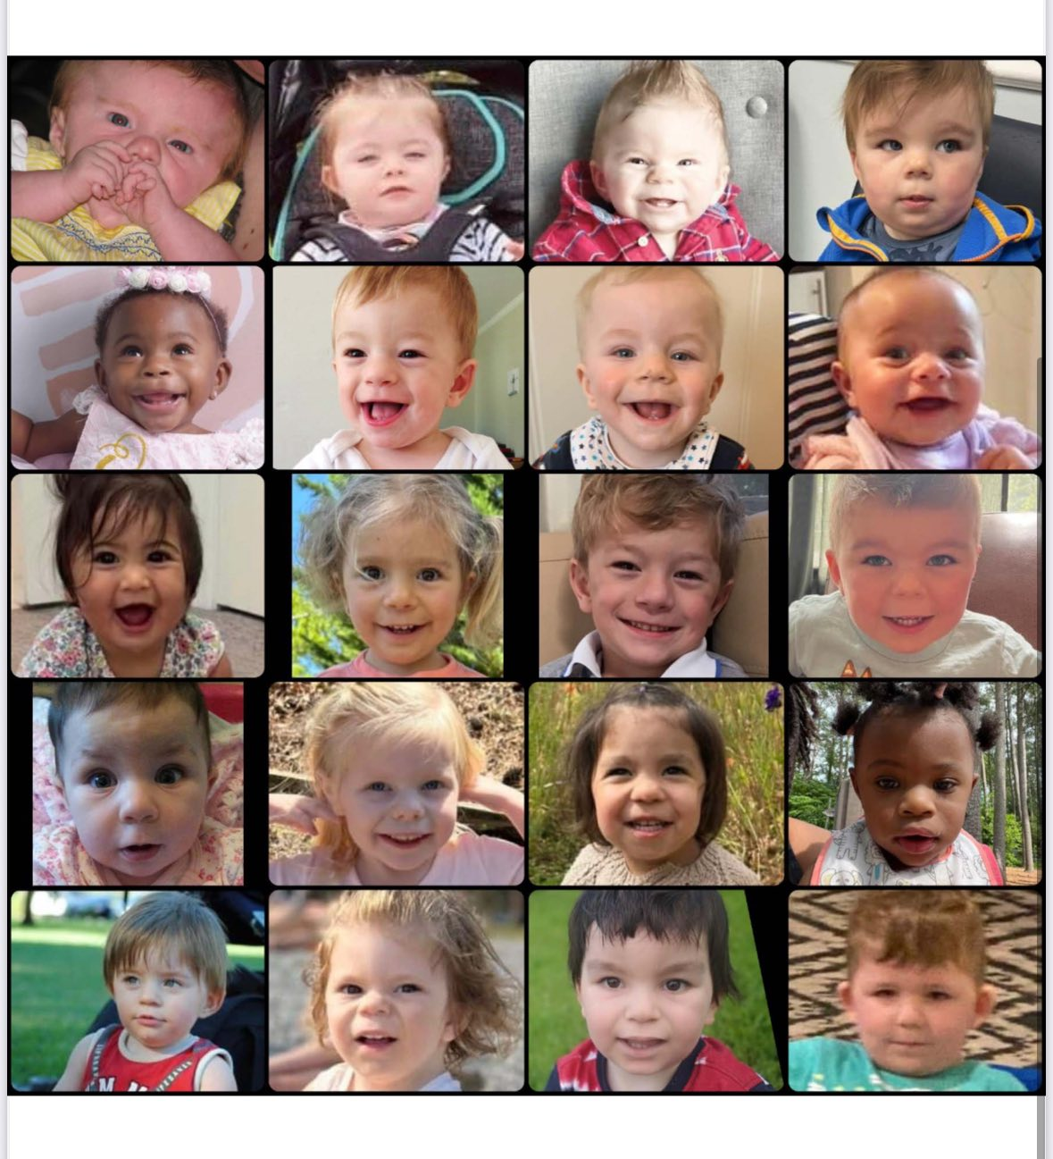
SETD5 SYNDROME FOUNDATION
Founding Meeting
Building Something Real — Together
Wednesday, 2/25/2026 830PM ET · Zoom · 90 Minutes
Laura Biazon laura.biazon19@gmail.com
Mandy Wittenberg
Intros & Vision
Landscape Review
Formation Basics
Working Groups
Action Items
Notes:
Intros - Laura Biazon, NP/DNP, Raina 2.5 – Her name means queen in tagolog and Spanish and her personality matches,
Kate Carr
Notes will be shared after the meeting
Decisions today are directional — nothing is final until bylaws are adopted

Slide 2
SETD5 SYNDROME FOUNDATION
Why We're Here
🔬
🤝
📢
Research
& Science
Family Support
& Community
Awareness
& Advocacy
Fund studies, build a patient registry, attract researchers who will find answers for our children
101 publications, 53 in past 5 years
Connect families globally, reduce isolation, provide expert resources, build a support network
Grow recognition, build clinical relationships, influence policy, make SETD5 known worldwide
SETD5 Syndrome Foundation · Founding Meeting
Notes:
101 publications in literature mention SETD5
53 of which were published in the past 5 years
Mandy has a great resource list we will have to put out

Slide 3
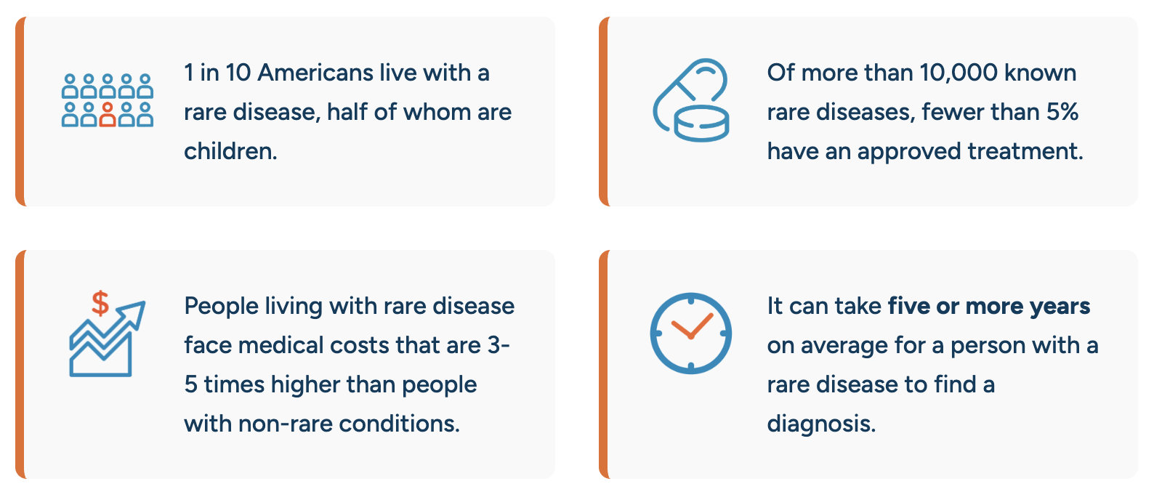

Slide 4
SETD5 SYNDROME FOUNDATION
What Is SETD5?
SETD5 (SET Domain Containing 5) is a gene involved in regulating how other genes are expressed. Pathogenic variants cause a neurodevelopmental syndrome characterized by:
~1% of patients with ID and/or ASD
Relatively frequent cause
(likely underdiagnosed)
Intellectual disability –Borderline-Moderate (None – Severe)
1,100+
Speech & language delays
People in our global
Facebook community
350 (2022), 8 new members in last week alone
Autism spectrum features (~30%)
Variety of medical complexity
De novo and Inherited
Facial feature differences
Most pathogenic variants are new and not found in either parent, but a growing number of cases are inherited from a mildly or unaffected parent
SETD5 Syndrome Foundation · Founding Meeting
Notes:
Mandy makes the point ~ 350 members when I joined in 2022
+8 members in the last week alone

Slide 5
SETD5 SYNDROME FOUNDATION
Landscape: Gaps & Opportunities
✅ What Exists
🎯 What We'll Build
NORD — rare disease umbrella org
Official patient registry – Simons Searchlight
Global Genes — advocacy network
Centralized family resource hub
1,000+ member Facebook community
Scientific Advisory Board
Growing published case literature
Coordinated researcher relationships
Dedicated parent advocates (YOU)
Formal 501(c)(3) nonprofit structure
SETD5 Syndrome Foundation · Founding Meeting

Slide 6
SETD5 SYNDROME FOUNDATION
Becoming Official: Formation Steps
1
2
3
4
5
Incorporate
Draft Bylaws
Elect Board
Get EIN
File 501(c)(3)
Choose state (Delaware or CA recommended). File Articles of Incorporation. NORD
Governance rules, board structure, officer roles, meeting requirements, Conflict of Interest (NORD templates)
Inaugural board meeting, Minimum 3 directors. Typically 5–7 for a founding board. Elect officers.
Federal Employer Identification Number. Free, fast from IRS.gov.
IRS Form 1023-EZ (faster) or 1023. Tax-exempt status unlocks donations. Obtain state licenses for fundraising?
2–4 weeks
2–4 weeks
At first meeting
Same day
3–6 months
SETD5 Syndrome Foundation · Founding Meeting
Notes:
Where do we want to incorporate?
Founding team
Incorporate state entity – NORD template available
Draft bylaws – NORD template available
Conflict of interest policy – NORD template available
Draft governance policies
Hold inaugural board meeting
Get an EIN
1023-EZ vs. 1023 form
Apply for Federal 501[c](3)
Obtain state licenses & tax exemptions

Slide 7
SETD5 SYNDROME FOUNDATION
Working Groups — Sign Up Today!
Each group needs a Lead + 2–4 members. Report back in 30 days.
⚖️
🧬
💙
💰
📣
Governance
& Legal
Medical &
Scientific
Community
Support
Fundraising
& Finance
Comms
& Brand
Incorporation, bylaws, 501(c)(3), attorney
Recruit SAB, researcher relationships, registry
Family resources, peer support, online community
Fundraising strategy, grants, donor database
Website, social, logo, foundation name vote
Lead: ___________
Lead: ___________
Lead: ___________
Lead: ___________
Lead: ___________
SETD5 Syndrome Foundation · Founding Meeting

Slide 8

M I S S I O N
The SETD5 Foundation exists to drive research from discovery to clinical trials, unite and strengthen the global SETD5 community, and champion awareness and advocacy worldwide. Through strategic research investment, family support, data and registry development, and cross-sector collaboration, we are committed to improving lives today while accelerating the path toward transformative treatments and a cure
Research · Community · Advocacy

Slide 9
N A M E
SETD5 Syndrome Foundation
SETD5 Foundation
???
Research · Community · Advocacy

Slide 10

https://youtu.be/FuvhmiPsXbo
Notes:
As we discussed, Simons Searchlight collects online parent and participant reported survey data in over 184 rare genetic neurodevelopmental disorders (including SETD5), as well as blood samples for potential creation of biospecimens. We make all phenotypic, genetic, and biospecimens data available for qualified researchers to access and analyze via SFARI Base, our data distribution platform managed by the Simons Foundation, our program funder. As mentioned, we also have the Simons Searchlight Research Match program that gives investigators the opportunity to recruit Simons Searchlight participants for external studies or surveys.

Slide 11

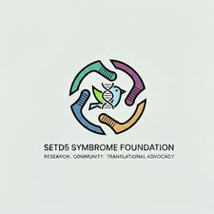
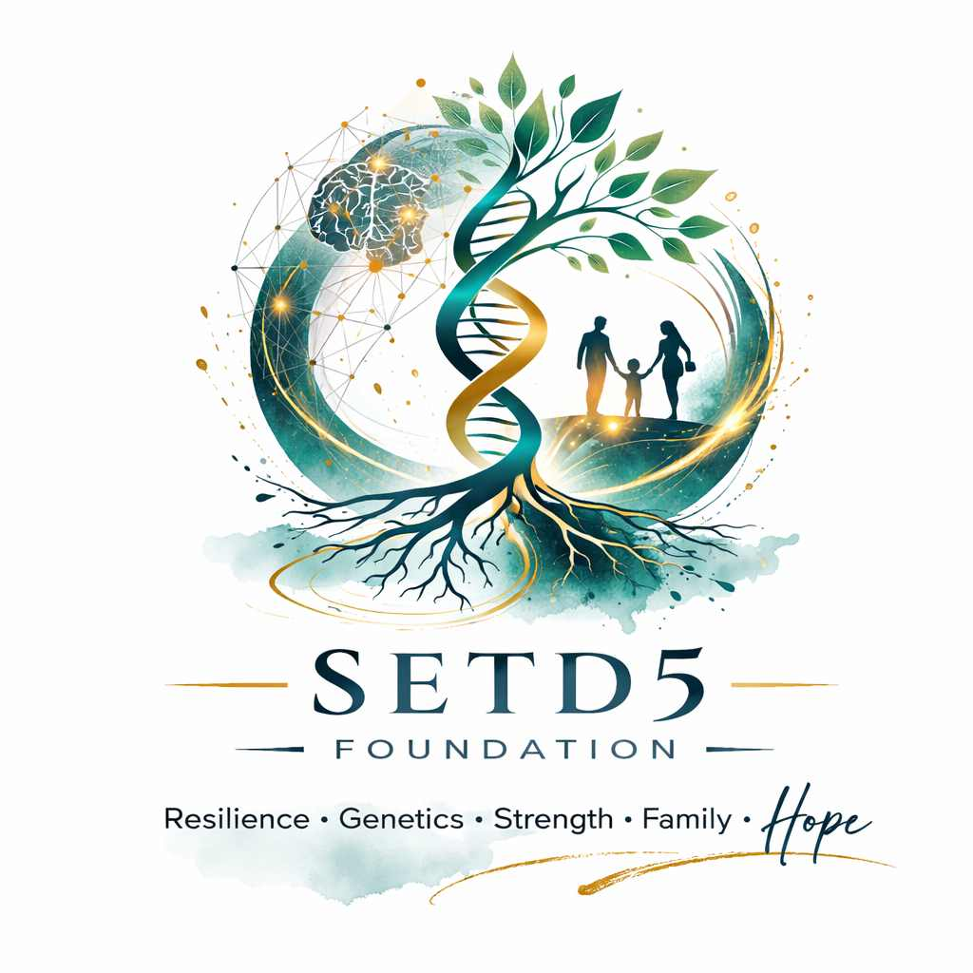

Notes:
Hummingbird – me, AI, of all the rare disease logos, I think CTNNB1s stands out the most and love the dragonfly with gene symbol in it. 1. Strength Despite Size
Hummingbirds are tiny but incredibly strong and resilient. They can travel long distances and survive demanding conditions. This mirrors many individuals with SETD5 mutations who face significant developmental challenges yet show remarkable strength and perseverance.
2. Uniqueness and Rarity
Just as hummingbirds are rare and extraordinary birds, SETD5-related disorder is a rare genetic condition. The hummingbird highlights the uniqueness of each individual and the importance of recognizing and supporting rare disease communities.
3. Energy and Determination
Hummingbirds must constantly move to survive. Their rapid wingbeats symbolize determination, endurance, and the continuous effort families put into therapies, advocacy, and care.
4. Hope and Joy
Across many cultures, hummingbirds symbolize hope, resilience, and joy. The foundation uses this symbol to represent optimism, progress in research, and a brighter future for those affected.
Liv Thornton
Samantha Cotter I’m drawn to imagery that reflects neurology and long-term resilience — like an owl (learning, seeing the world differently) or even a sea turtle (endurance and long journeys). I think either could feel very timeless and meaningful for a foundation.
Taryn Mildenhall- made a good point that an animal does not necessarily need to be our symbol. Chat gpt made this one.

Slide 12
Initial Board Members
Laura Biazon
Mandy Wittenberg
Jesiree Mendez
Amelia Marie (last name?)
Research · Community · Advocacy
Notes:
Any objections or comments to this initial group who will act as the founding members for incorporation? , if not then we will have to hold a more formal vote after drafting bylaws

Slide 13
SETD5 SYNDROME FOUNDATION
Working Groups — Sign Up Today!
Each group needs a Lead + 2–4 members. Report back in 30 days.
⚖️
🧬
💙
💰
📣
Governance
& Legal
Medical &
Scientific
Community
Support
Fundraising
& Finance
Comms
& Brand
Incorporation, bylaws, 501(c)(3), attorney
Recruit SAB, researcher relationships, registry
Family resources, peer support, online community
Fundraising strategy, grants, donor database
Website, social, logo, foundation name vote
Lead: Laura Biazon ?
Lead: Laura Biazon ?
Lead: ___________
Lead: ___________
Lead: ___________
SETD5 Syndrome Foundation · Founding Meeting

Slide 14
SETD5 SYNDROME FOUNDATION
Action Items — Next 60 Days
Confirm all working group leads and members
All attendees
Select state of incorporation
Governance group
Identify nonprofit legal help
Governance group
Website Under Construction
Comms group
Conceptualize foundation logo
Comms group
Draft bylaws for board review
Governance group
Schedule next meeting (60 days)
[Chair]
SETD5 Syndrome Foundation · Founding Meeting

Slide 15
PAG-specific support resources
Patient Advocacy Partnerships: Empowering Communities in Research Webpage
Participation Progress Dashboard Webpage (see current metrics on your community)
PAG Outreach Toolkit Webpage (IRB-approved messaging, videos, and graphics)
SETD5 Gene Webpage
Video: Simons Searchlight & Jordan’s Guardian Angels: Partners in Accelerating Science
A Family Guide: Navigating Life After a Rare Genetic Diagnosis Webpage
A Family Guide: Understanding Genetic and Clinical Diagnoses Webpage
How to Add CRID Webpage
You may find these established resources helpful in navigating the process of setting up a PAG (you most likely have already seen these but sharing again just in case)
NCATS Toolkit: Starting a Patient Group
NORD RareLaunch: Support for New Organizations
Rare Village Foundation

Slide 16

SETD5 Syndrome Foundation
"Every family who learns about SETD5 in the future
will have something real to turn to
because of what we build together today."
Research · Community · Advocacy

