Slide 1
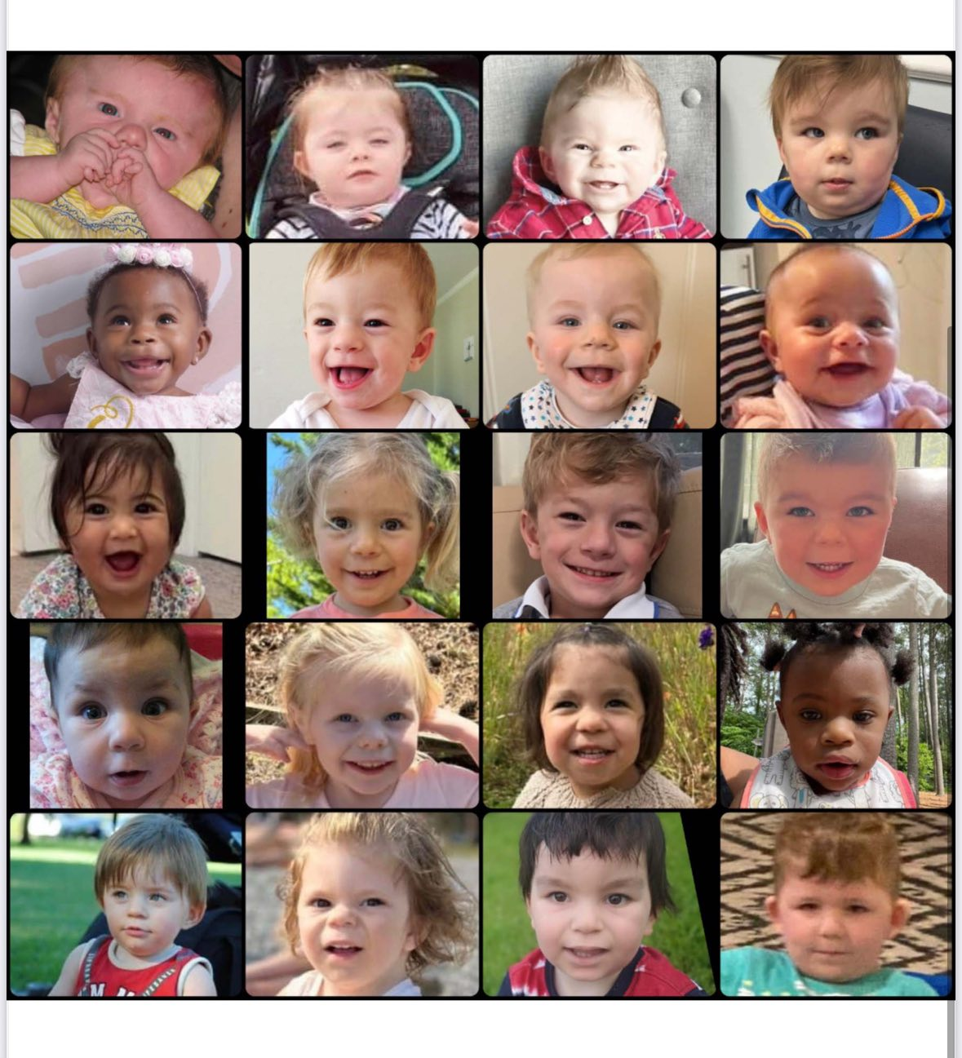
FOUNDING MEETING · FEBRUARY 25, 2026
SETD5 Syndrome Foundation
Building Something Real, Together
Wednesday, 2/25/2026 · 8:30 PM ET · Zoom · 90 Minutes
Laura Biazon, NP/DNP
Mandy Wittenberg
Tonight's Agenda
Intros & Vision
Landscape Review
Formation Basics
Working Groups · Action Items
Research · Community · Advocacy

Slide 2
OUR PURPOSE
Why We're Here
R
S
A
Research & Science
Family Support & Community
Awareness & Advocacy
Fund studies, build a patient registry, attract researchers who will find answers for our children.
101 publications, 53 in the past 5 years.
Connect families globally, reduce isolation, provide expert resources, and build a powerful support network.
Grow recognition, build clinical relationships, influence policy, and make SETD5 Syndrome known worldwide.
SETD5 Syndrome Foundation · Founding Meeting

Slide 3
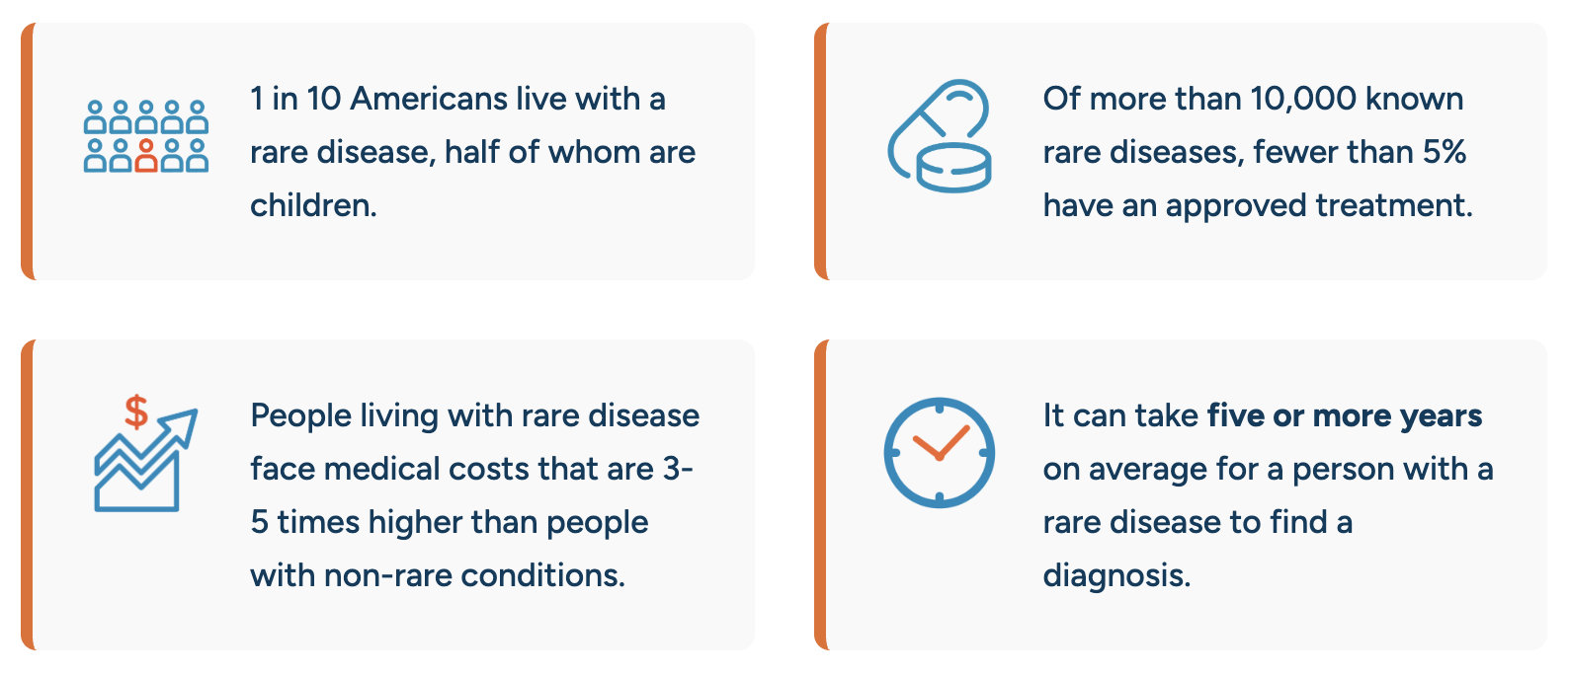
The Rare Disease Landscape
SETD5 Syndrome is rare, but families like ours are why this work matters.
Research · Community · Advocacy

Slide 4
THE SCIENCE
What Is SETD5 Syndrome?
~1%
1,100+
SETD5 (SET Domain Containing 5) is a gene involved in regulating how other genes are expressed. Pathogenic variants cause a neurodevelopmental syndrome characterized by:
of patients with ID and/or ASD (likely underdiagnosed)
people in our global Facebook community
Intellectual disability (borderline to moderate; range: none to severe)
Speech and language delays
Autism spectrum features (~30%)
Facial feature differences
Variety of medical complexity
Most variants are de novo; growing number are inherited
101
53
published research paper references
publications in the past 5 years
Most pathogenic variants are new (de novo) and not found in either parent, but a growing number of cases are inherited from a mildly or unaffected parent.
SETD5 Syndrome Foundation · Founding Meeting

Slide 5
WHERE WE STAND
Landscape: Gaps & Opportunities
What Exists
What We'll Build
NORD: rare disease umbrella org
Global Genes: advocacy network
1,000+ member Facebook community
Growing published case literature
Dedicated parent advocates (YOU)
Official patient registry, Simons Searchlight
Centralized family resource hub
Scientific Advisory Board
Coordinated researcher relationships
Formal 501(c)(3) nonprofit structure
=>
SETD5 Syndrome Foundation · Founding Meeting

Slide 6
GETTING OFFICIAL
Becoming Official: Formation Steps
1
2
3
4
5
Incorporate
Draft Bylaws
Elect Board
Get EIN
File 501(c)(3)
Choose state (Delaware or CA recommended). File Articles of Incorporation. NORD template available.
Governance rules, board structure, officer roles, meeting requirements, Conflict of Interest policy.
Inaugural board meeting. Minimum 3 directors; typically 5-7 for a founding board. Elect officers.
Federal Employer Identification Number. Free and fast from IRS.gov.
IRS Form 1023-EZ (faster) or full Form 1023. Tax-exempt status unlocks charitable donations.
2-4 weeks
2-4 weeks
At first meeting
Same day
3-6 months
SETD5 Syndrome Foundation · Founding Meeting

Slide 7
Working Groups
Each group needs a Lead + 2-4 members · Report back in 30 days
G
Sci
C
F
PR
Governance
& Legal
Medical &
Scientific
Community
Support
Fundraising
& Finance
Comms
& Brand
Incorporation, bylaws, 501(c)(3), attorney
Recruit SAB, researcher relationships, registry
Family resources, peer support, online community
Fundraising strategy, grants, donor database
Website, social, logo, foundation name vote
Lead: ___________
Lead: ___________
Lead: ___________
Lead: ___________
Lead: ___________

Slide 8
M I S S I O N
The SETD5 Syndrome Foundation exists to drive research from discovery to clinical trials, unite and strengthen the global SETD5 community, and champion awareness and advocacy worldwide. Through strategic research investment, family support, data and registry development, and cross-sector collaboration, we are committed to improving lives today while accelerating the path toward transformative treatments and a cure.
Research · Community · Advocacy

Slide 9
DISCUSSION
What Should We Call Ourselves?
SETD5 Syndrome Foundation
Most descriptive; directly links the name to the diagnosis
SETD5 Foundation
Shorter and simpler, still clearly gene-focused
???
Open for your ideas; share in chat!
SETD5 Syndrome Foundation · Founding Meeting

Slide 10

PARTNER RESOURCE
Simons Searchlight:
A Key Registry Partner
Simons Searchlight collects online parent and participant-reported survey data in 184+ rare genetic neurodevelopmental disorders (including SETD5 Syndrome), plus blood samples for potential biospecimen creation.
All phenotypic, genetic, and biospecimen data are available for qualified researchers via SFARI Base. Their Research Match program helps investigators recruit participants for external studies.
youtu.be/FuvhmiPsXbo
SETD5 Syndrome Foundation · Founding Meeting

Slide 11

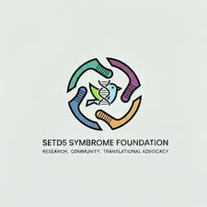

BRAND IDENTITY
Logo & Identity Options
Our visual identity should feel hopeful, scientific, and community-driven. Here are concepts to discuss:
Hummingbird
Strength + Hope
Circular DNA
Community + Science
SETD5 Teal Crest
Recognition + Identity
SETD5 Syndrome Foundation · Founding Meeting

Slide 12
Initial Board Members
Founding team acting as directors for incorporation, pending formal vote after bylaws are adopted.
LB
MW
JM
AM
Laura Biazon
Mandy Wittenberg
Jesiree Mendez
Amelia Marie
Research · Community · Advocacy

Slide 13
Working Groups: Sign Up Today!
Each group needs a Lead + 2-4 members · Report back in 30 days
G
Sci
C
F
PR
Governance
& Legal
Medical &
Scientific
Community
Support
Fundraising
& Finance
Comms
& Brand
Incorporation, bylaws, 501(c)(3), attorney
Recruit SAB, researcher relationships, registry
Family resources, peer support, online community
Fundraising strategy, grants, donor database
Website, social, logo, foundation name vote
Lead: Laura Biazon?
Lead: Laura Biazon?
Lead: ___________
Lead: ___________
Lead: ___________

Slide 14
NEXT STEPS
Action Items: Next 60 Days
Confirm all working group leads and members
All attendees
Select state of incorporation
Governance group
Identify nonprofit legal help
Governance group
Website Under Construction
Comms group
Conceptualize foundation logo
Comms group
Draft bylaws for board review
Governance group
Schedule next meeting (60 days)
Chair
SETD5 Syndrome Foundation · Founding Meeting

Slide 15
FROM SIMONS SEARCHLIGHT
Helpful Resources
PAG-specific support resources
Patient Advocacy Partnerships: Empowering Communities in Research
Participation Progress Dashboard (current metrics on your community)
PAG Outreach Toolkit: IRB-approved messaging, videos, and graphics
SETD5 Gene Webpage
Video: Simons Searchlight & Jordan's Guardian Angels
A Family Guide: Navigating Life After a Rare Genetic Diagnosis
A Family Guide: Understanding Genetic and Clinical Diagnoses
How to Add CRID
Additional Resources
NCATS Toolkit: Starting a Patient Group
NORD RareLaunch: Support for New Organizations
Rare Village Foundation
SETD5 Syndrome Foundation · Founding Meeting

Slide 16
SETD5 Syndrome Foundation
"Every family who learns about SETD5 Syndrome in the future will have something real to turn to because of what we build together today."
Research · Community · Advocacy

